Slide 1
Molecular biology (1)
(Foundation Block)

Slide 2
Objectives
By the end of this lecture, the students should be able to:
Know the central dogma of molecular biology.
Understand the composition, types and structure of DNA and
RNA.
Describe the organization of DNA in the chromosome and the role of histone proteins.

Slide 3
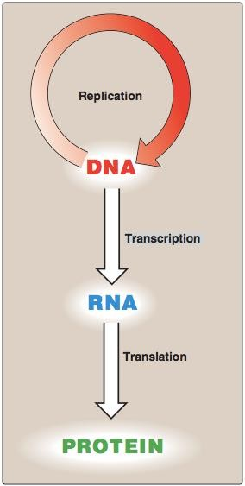
The central dogma of Molecular Biology
A portion of DNA, called a
gene, is transcribed into RNA.
RNA is translated into proteins.
Human genome contains about 35,000 genes

Slide 4
Nucleic acids
Required for the storage and expression of genetic information.
Two types:
  DNA (Deoxyribonucleic acid).
  RNA (Ribonucleic acid).
Building blocks of nucleic acids are nuclueoside triphosphates (nucleotides).

Slide 5
Nucleotides
Nucleotides are composed of:
  Nitrogenous base:
    Purines: Adenine (A) and Guanine (G)
    Pyrimidines: Cytosine (C), Thymine (T)
and Uracil (U).

Slide 6
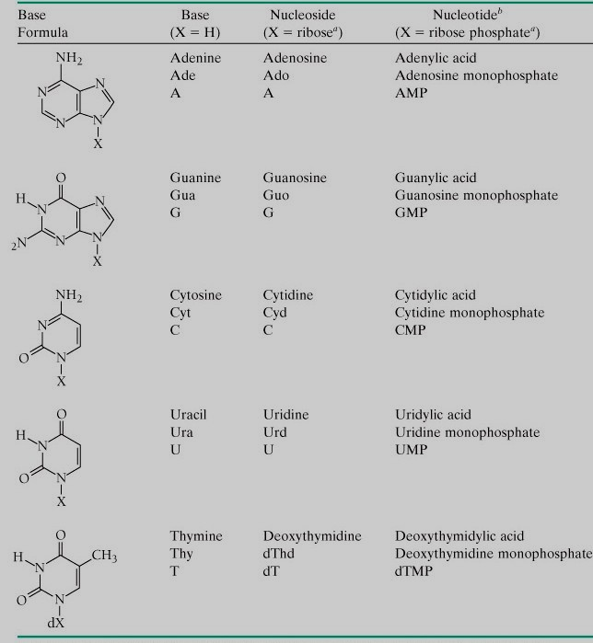

Slide 7
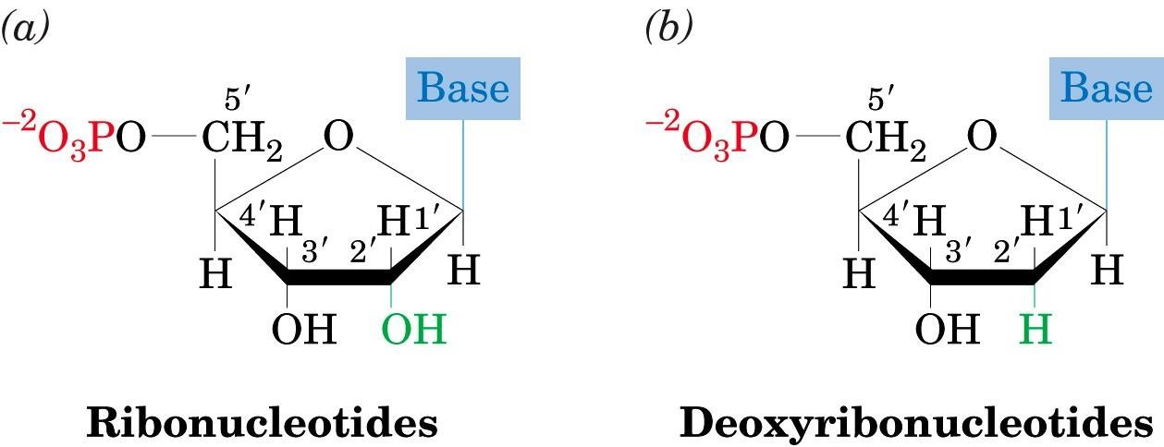
Sugar: pentose with 5 carbon ring:
  Ribose (with –OH at C₂).
  Deoxyribose.
3. Phosphate groups.

Slide 8
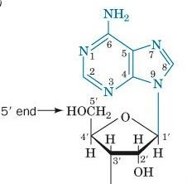
The sugar carbon
numbers are
primed (1’ 2’ 3’ etc.), while the nitrogenous base atoms are unprimed.
The nitrogenous base is bonded to
C₁’ of sugar.
The PO₄ group is bonded to C₃’ or
C₅’ of sugar.

Slide 9
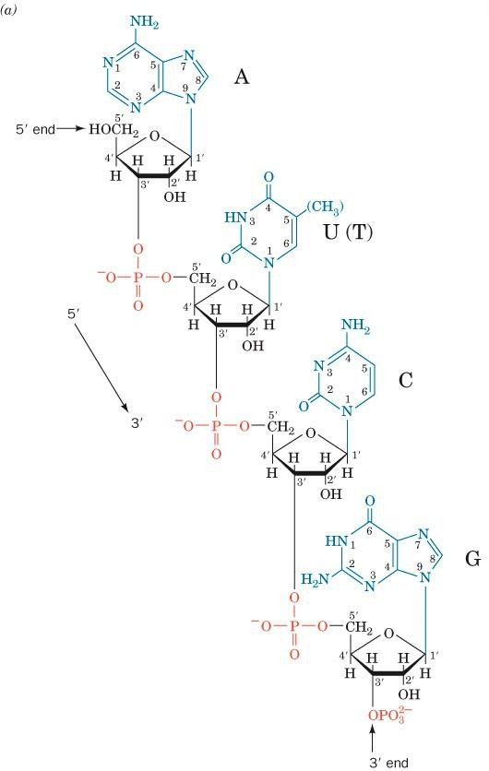
Chemical structure of DNA & RNA
The PO₄ bridges the 3’ and 5’
positions of ribose sugar.
The PO₄ and sugar bonding is the backbone of DNA structure.
The linkage between the nucleotides is called phosphodiester bond

Slide 10
Function of nucleotides
Polymers of nucleotides (as DNA or RNA) store and transfer
genetic information.
Free nucleotides and their derivatives perform various metabolic functions not related to genetic information.
Other nucleotides: FAD, NAD, CoA.

Slide 11
The double helix DNA
The structure of DNA was first determined by James Watson
and Francis Crick in 1953.
Commonly known as Watson-Crick structure.

Slide 12
Features of Watson-Crick DNA structure
① Two polynucleotide chains wind around a common axis to
form a double helix.
① The two strands are anti-parallel (run in opposite direction).
① Each strand is a right-handed helix.
② The nitrogenous bases are in the center of the double helix and the sugar-phosphate chains are on the sides.

Slide 13
⑤ The surface of the double helix contains 2 grooves: the major
and minor grooves.
⑤ Each base is hydrogen bonded to a base in the opposite strand to form a base pair (A-T and G-C), known as complementary base pairing.
⑤ The helix has 10 base pairs (bp) per turn.

Slide 14
Watson-Crick base pairs
Adenine (A) Guanine (G)
Thymine (T) Cytosine (C)
In RNA, Thymine is replaced by Uracil (U)

Slide 15
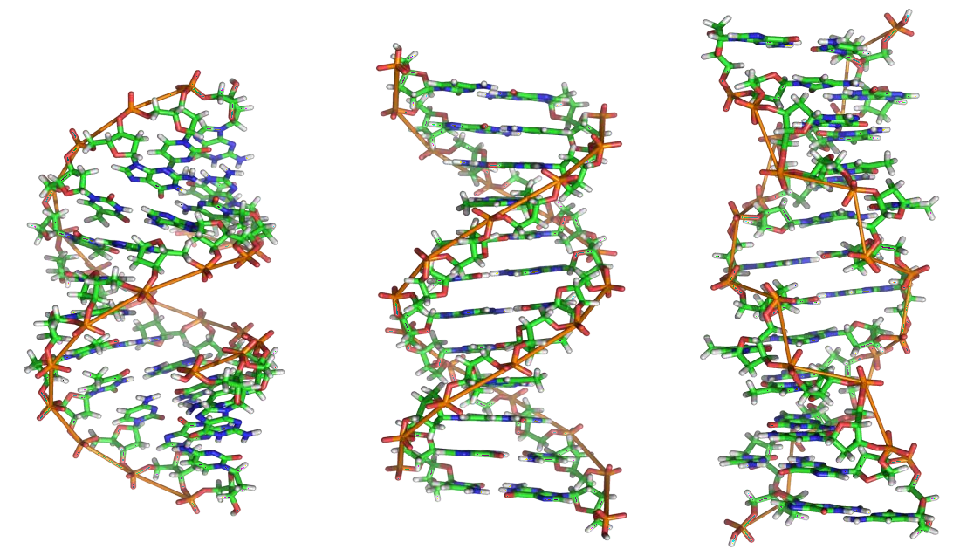
Types of DNA structure
 | A-DNA | B-DNA* | Z-DNA
Direction | Right-handed | Right-handed | Left-handed
Helix length | Short | Elongated | More elongated
Major groove | Deep and narrow | Wide | Not real groove
Minor groove | Wide | Narrow | Narrow
Placement of bp | Displaced away from the helical axis | Centred over the helical axis | Zig-zag pattern (nearly perpendicular to the helical axis)
bp per turn | 11 | 10 | 12
Conformation of deoxyribose | C₃ | C₂ | G (C₂) ; C (C₃)
* Watson-Crick model (B-DNA)

Slide 16
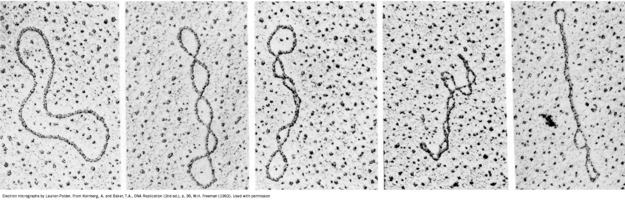
DNA supercoiling
The chromosomes of many bacteria and viruses contain
circular DNA which is supercoiled.

Slide 17
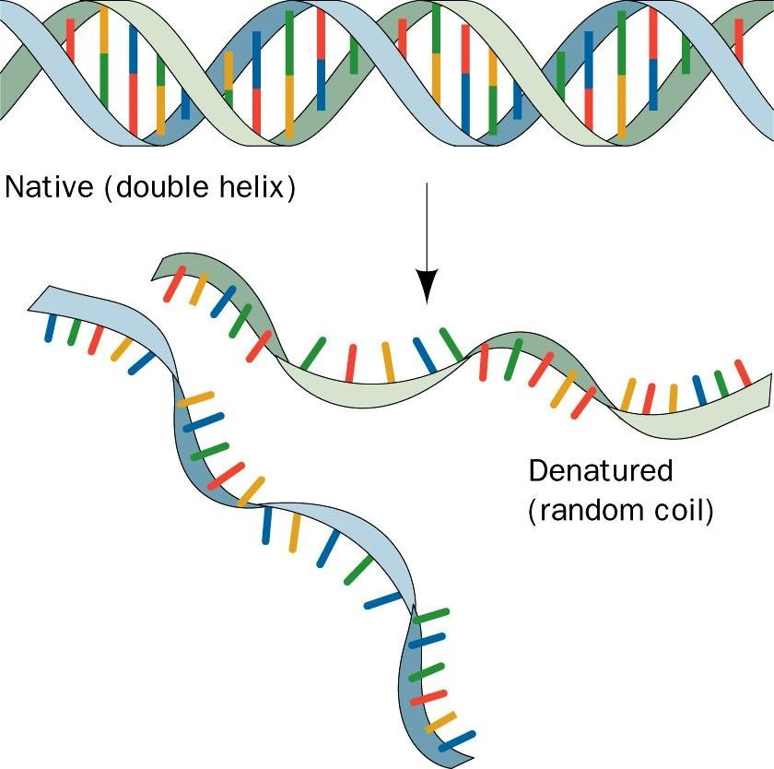
Melting temperature (MT)
The temperature at which the double-stranded DNA is separated
into two single strands.
MT of DNA depends on nitrogenous base content (A-T and G-C). G-C has 3 hydrogen bonds ➔ stronger than A-T.

Slide 18
RNA (Types and function)
RNA is a single-stranded polymer of ribonucleotides.
Types of RNA:
  mRNA (messenger RNA) ➔ Function: process (from DNA to mRNA).
Transcription
tRNA (transfer RNA) ➔ Function: Recognition and transferring. It recognizes amino acids’ codons and transfers the selected amino acids to the growing protein chain.
rRNA (ribosomal RNA) ➔ Function: Site of protein synthesis (factory).

Slide 19
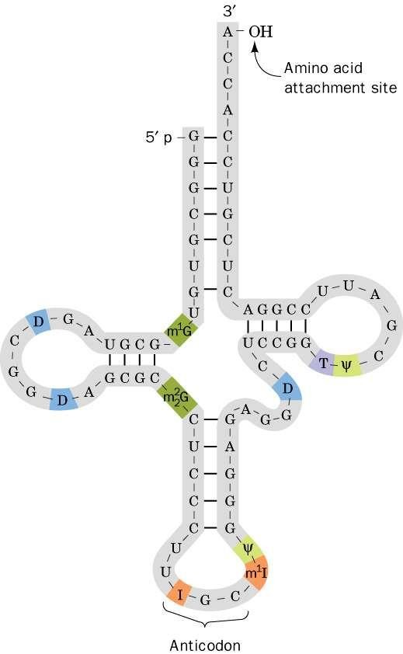
Structure of a tRNA

Slide 20
How DNA is organized in a chromosome?
The human genome contains 3.5 billion base pairs and more
than 95% is non-coding or “junk” DNA.
The DNA from single 23 human chromosomes have a length of 1 meter.
How such large quantities of DNA are packed into a single cell?
Each chromosome is a complex of a single linear DNA
molecule and protein called chromatin.
50% of chromatin consists of proteins called histones.

Slide 21
Histones
Five major types of histones:
H1 H2A H2B H3 H4
Histones have positively charged amino acids (arginine and lysine).
These proteins bind to negatively charged PO₄ groups of DNA to stabilize the chromatin structure.

Slide 22
Nucleosomes
Nucleosomes are particles consisting of DNA and histones connected by thin strands of naked DNA (like beads on a string; Sibhah in Arabic).
Nucleosomes consist of the histone octamer (eight) and DNA
(H2A)₂(H2B)₂(H3)₂(H4)₂
H1 binds to 2 complete helical turns of DNA.

Slide 23
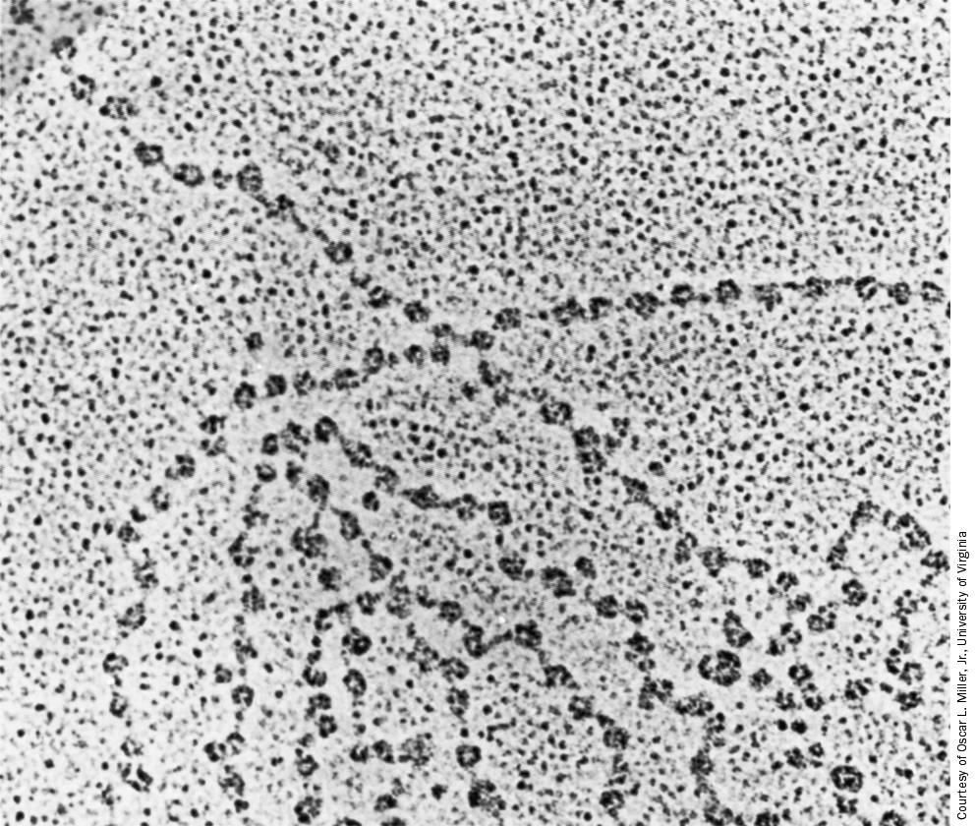
Electron micrograph of chromatin showing nucleosomes

Slide 24
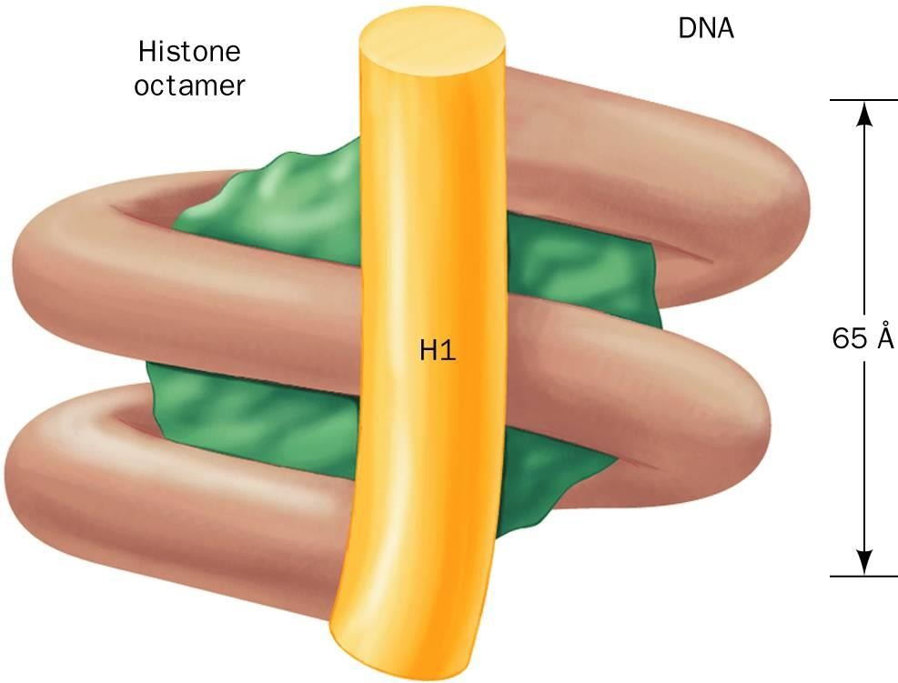
A nucleosome showing interaction of histones with the DNA

Slide 25
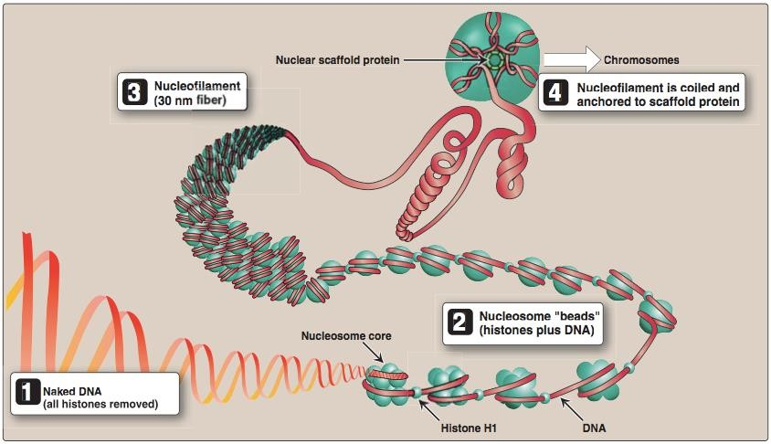
Chromatin filament with nucleosomes and naked DNA

Slide 26
Take home messages
The central dogma of molecular biology involves three components:
DNA, RNA and protein.
There are two chemically distinct types of nucleic acids: DNA and RNA, which perform several crucial functions.
To package the long sequence of the genomic DNA, it is highly organized into chromosomes.

Slide 27
Reference
Lippincott’s Illustrated reviews: Biochemistry 4th edition, Unit 6, Chapter 29 and 30, Pages 395-430.
Biochemistry by Voet and Voet 3rd edition.
http://www.tulane.edu/~biochem/nolan/lectures/rna/bzcomp2.htm
http://biowiki.ucdavis.edu/Genetics/Unit_I%3A_Genes,_Nucleic_Acids,_Genomes_ and_Chromosomes/Chapter_2._Structures_of_nucleic_acids/B-Form,_A-Form,_Z- Form_of_DNA

