Slide 1
Lipids of Physiological Significance
Dr. Sumbul Fatma

Slide 2
Objectives
By the end of this lecture the first year students will be able to:
Define and classify lipids
Understand the physiological importance of lipids
List the examples of simple and complex lipids
Correlate implications of lipids in clinical conditions

Slide 3
Overview
What are lipids?
Classification of lipids
Functions of lipids
Simple lipids: Fatty acids, triacylglycerols, steroids
Complex lipids: Phospholipids, sphingolipids, glycolipids
Plasma lipid transport: types and functions of lipoproteins

Slide 4
What are lipids?
A heterogeneous group of hydrophobic (water-insoluble) organic molecules that are soluble only in organic solvents
Body lipids are compartmentalized (packed) in cell membranes, tissue and plasma

Slide 5
Functions of Lipids
Lipids are essential components of biological membranes
Lipids with hydrocarbon chains serve as major energy stores
Cell signaling involves lipid molecules
e.g. Inositol tri-phosphate
Fat-soluble vitamins, steroid hormones and prostaglandins are formed of lipids

Slide 6
Lipids and disease
Diseases that are strongly associated with abnormality in lipid metabolism:
Atherosclerosis
Coronary artery disease
Obesity
Metabolic syndrome
Hypertension

Slide 7
Classification of Lipids
Simple lipids:
Fatty acids
Triacylglycerols
Steroids (cholesterol)
Complex lipids
Phospholipids
Sphingolipids
Glycolipids

Slide 8
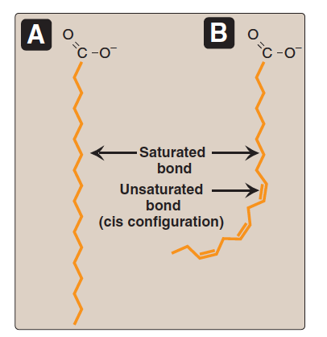
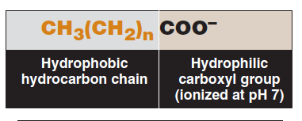
Fatty Acids (FAs)
FAs are carboxylic acids with long-chain hydrocarbon side groups
They are amphipathic in nature (both hydrophilic and hydrophobic)
The carboxylic group (COOH) is hydrophilic
The hydrocarbon chain is hydrophobic

Slide 9
Fatty Acids (FAs)
FAs are highly insoluble in water
Must be transported in plasma with proteins
Majority of plasma FAs are esters of:
Triacylglycerol
Cholesterol
Phospholipids
Chain length
In mammals it varies from C₁₆–C₁₈
Examples: palmitic, oleic, linoleic, stearic acids

Slide 10
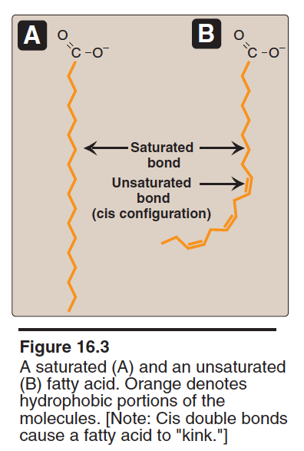
Fatty Acids (FA)
Degree of saturation
FAs may contain:
No double bonds (Saturated / trans form)
One or more double bonds (Mono or Polyunsaturated / cis form)

Slide 11
Saturated FAs | Unsaturated FAs
12:0 Lauric acid | 18:1 Oleic acid
16:0 Palmitic acid | 18:2 Linoleic acid
18:0 Stearic acid | 20:4 Arachidonic acid
16:0
20:4
No. of
carbon
atoms
Zero
double
bonds
No. of
carbon
atoms
Four
double
bonds

Slide 12
Essential Fatty Acids (FA)
Linoleic acid (precursor of arachidonic acid)
α-Linolenic acid
Body cannot synthesize
Must be supplied in the diet
Deficiency can cause dermatitis, membrane function loss
Arachidonic acid is essential when linoleic acid is deficient in the diet

Slide 13
ω-3 and ω-6 fatty acids
ω = Omega
Long-chain polyunsaturated FAs with first double bond starting with 3rd carbon from the methyl end
They reduce serum triglycerides, blood pressure and risk for heart disease
Major source: Fish
Examples: α-linolenic acid, EPA (eicosapentaenoic acid), DHA (Docosahexaenoic acid)

Slide 14
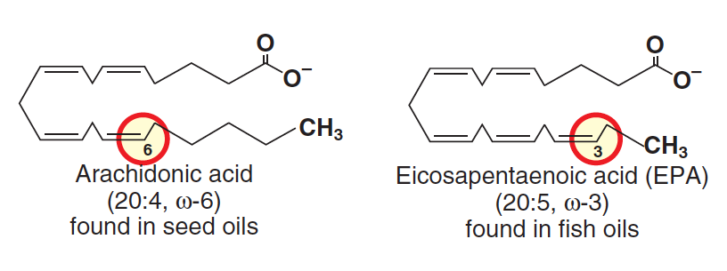
ω-3 and ω-6 fatty acids

Slide 15
ω-3 and ω-6 fatty acids
Long-chain polyunsaturated FAs with first double bond starting with 6th carbon from the methyl end
They reduce serum cholesterol
Major source: Vegetable oils, nuts
Examples:
Linoleic acid 18:2

Slide 16
Triacylglycerols (TGs)
TGs are tri-esters of fatty acids also called fats
Three fatty acids are bonded to a glycerol molecule
Constitutes majority of dietary lipids
Stored in adipocytes (fat cells) as energy reservoir
Not a component of cell membranes
Subcutaneous layer of fats provides thermal insulation

Slide 17
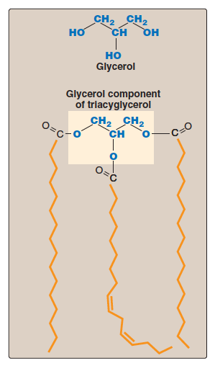
Structure of a triacylglycerol

Slide 18
Steroids
Derivatives of cyclopentanoperhydrophenanthrene ring
Consists of four fused rings called steroid nucleus with an 8-carbon chain
Steroids with a hydroxyl group are called sterols
Cholesterol is a major sterol in humans and animals
Cholesterol in plasma is bound to fatty acids called cholesteryl esters

Slide 19
Functions of cholesterol
Component of cell membranes
Precursor for:
Bile acids / Bile salts
Vitamin D
Steroid hormones (Aldosterone, cortisol, testosterone, estrogen, progesterone)
High levels of plasma cholesterol is strongly associated with coronary artery disease and atherosclerosis

Slide 20
Phospholipids
Two classes of phospholipids:
Glycerophospholipids (contain glycerol backbone)
Sphingophospholipids (contain sphingosine)
Glycerophospholipids
Glycerol-3-PO₄ is bonded to two fatty acid chains
The PO₄ group is linked to a hydrophilic group
Amphiphilic in nature
Hydrophobic tail
Hydrophilic phosphoryl heads

Slide 21
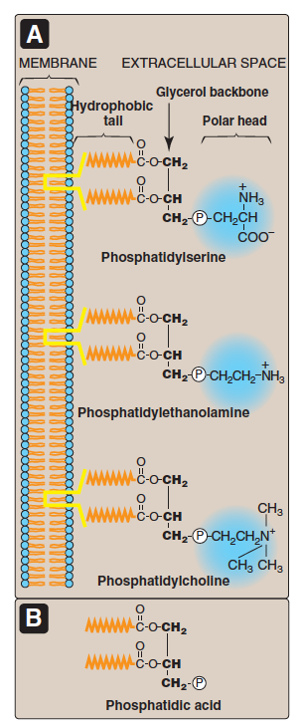
Glycero-
phospholipids

Slide 22
Phospholipids
Major components of biological membranes
Examples: phosphatidic acid, phosphatidyl –choline and serine
Sphinogophospholipids
Long-chain fatty acids attached to sphingosine
Example: Sphingomyelin
An important component of myelin that protects and insulates nerve fibers

Slide 23
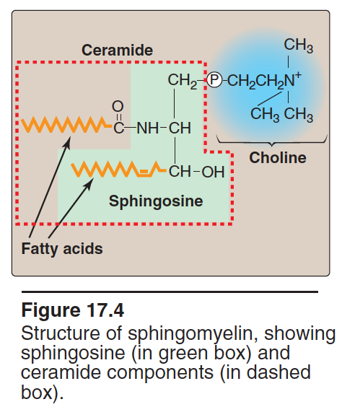

Slide 24
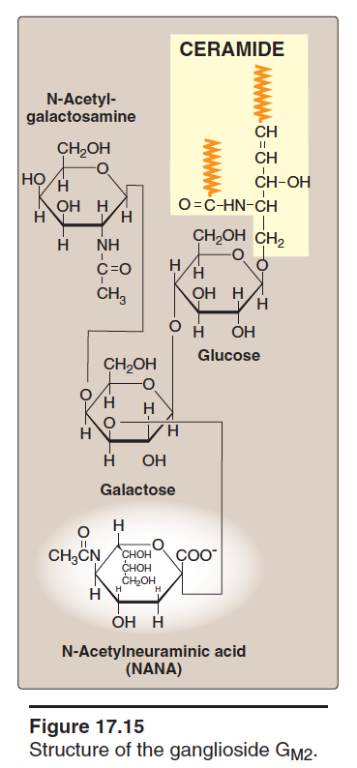
Glycolipids
Contain both carbohydrate and lipid components
Derivatives of ceramide
A long chain fatty acid is attached to sphingosine
Also called glycoshpingolipids
Examples: Ganglioside, glactocerebroside
Act as: Blood group antigens, cell surface receptors for bacteria/viruses

Slide 25
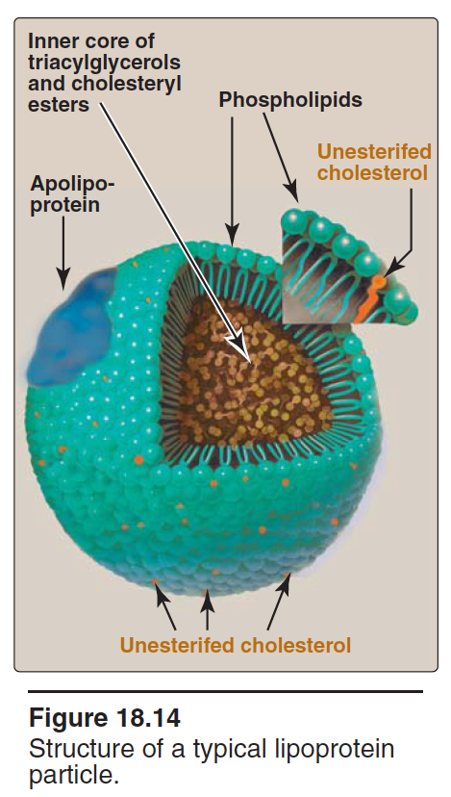
Transport of plasma lipids
Plasma lipids are transported as lipoprotein particles (lipids + protein)
Protein part: Apoproteins or apolipoproteins
Examples: Apolipoproteins A, B, C
Functions: lipid transport, enzymatic functions, ligands for receptors
Lipid part: Contains lipids of various types

Slide 26
Types and functions of lipoproteins
Lipoprotein | Transports
Chylomicrons | Dietary TGs
Very low density lipoprotein (VLDL) | Endogenous TGs
Low density lipoprotein (LDL) | Free cholesterol
High density lipoprotein (HDL) | Cholesteryl esters

Slide 27
Take home message
Lipids are a group of hydrophobic molecules
Perform essential physiological functions in the body
Simple lipids include: fatty acids, TGs and steroids
Complex lipids include: phospholipids, sphingolipids and glycolipids
A number of diseases are associated with abnormal lipid metabolism

Slide 28
References
Lippincott’s Illustrated Reviews, Biochemistry, 6th edition, Denise R. Ferrier, Lippincott Williams & Wilkins, USA.
Chapter 16: pages 181-182, 195-198
Chapter 17, page 201-202, 205-206
Chapter 18, page: 219-220, 226-232

