Slide 1
بسم الله الرحمن الرحيم
Introduction to medical virology
( Foundation Block , Microbiology : 2018)
By: Dr.Malak El-Hazmi
Associate professor
Consultant Virologist
College of Medicine &
King Saud University Medical City
Notes:
‹#›

Slide 2
OBJECTIVES
Distinguish the viruses from other microorganisms
General characteristics of viruses.
Structure & symmetry of viruses.
Classification of viruses.
Steps of virus replication .
laboratory diagnosis of viral infections.

Slide 3
Properties of Microorganisms
characteristic | Parasites | Fungi | Bacteria | Viruses
Cell | Yes | Yes | Yes | No
Type of nucleus | Eukaryotic | Eukaryotic | Prokaryotic | -----
Nucleic acid | Both DNA & RNA | Both DNA & RNA | Both DNA & RNA | DNA or RNA
Ribosomes | Present | Present | Present | Absent
Mitochondria | Present | Present | Absent | Absent
Replication | Mitosis | Budding or mitosis | Binary fission | special

Slide 4
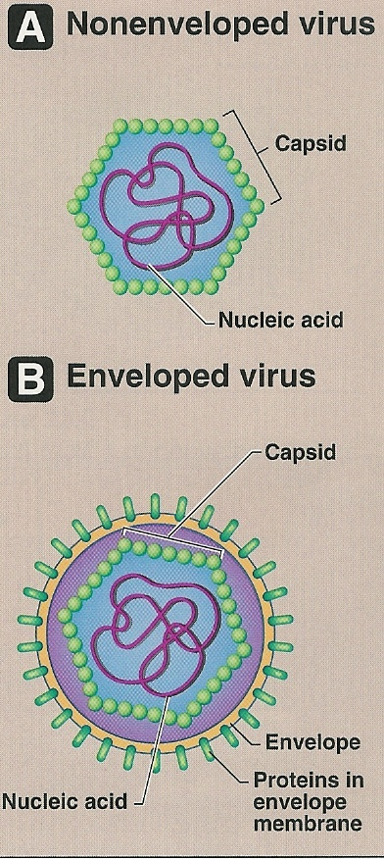
Characteristics of viruses
Acellular organisms
Tiny particles
Internal core
Protein coat
Some Vs have lipoprotein mb
Obligate intracellular organisms
Replicate in a manner diff from cells
( 1V many Vs )

Slide 5
Size ; 20-300 nm

Slide 6
Viral Structure
1-Viral genome
2-Capsid
3-Envelope

Slide 7
Viral Structure 1-Viral genome
DNA
(Deoxyribonucleic acid)
All DNA Vs have ds
except Parvoviruses
Single molecule
RNA
(Ribonucleic acid)
All RNA Vs have ss
except Reoviruses
single / multiple
(+) polarity
(-) polarity
or
All Vs are haploid ,except retroviruses are diploid

Slide 8
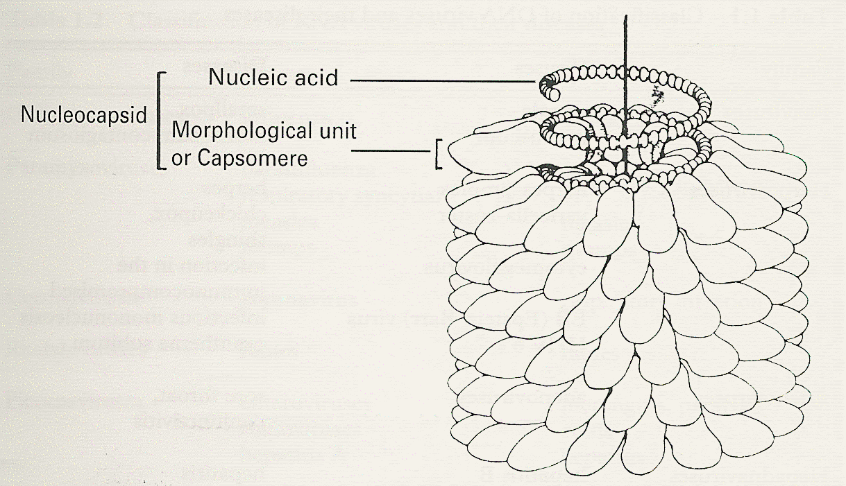
Viral structure
2-Capsid
a protein coat
Subunits (capsomeres)
Genome (NA) + capsid
= nucleocapsid
Function;
Protects NA
Facilitates its entry into cell

Slide 9
Symmetry based on arrangement of capsomeres
Cubic symmetry
( Icosahederal )
Helical symmetry
Complex symmetry

Slide 10
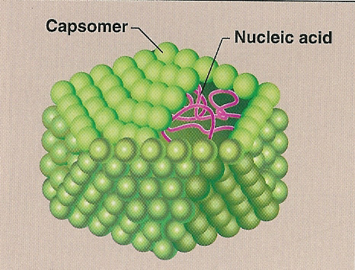
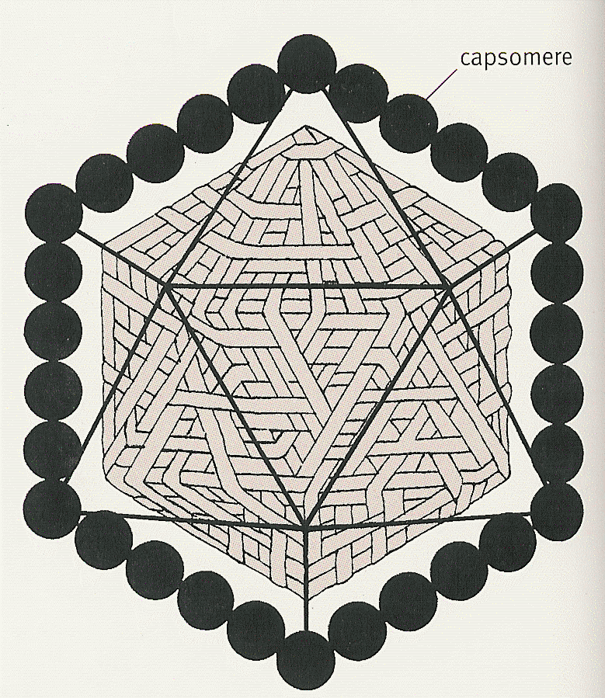
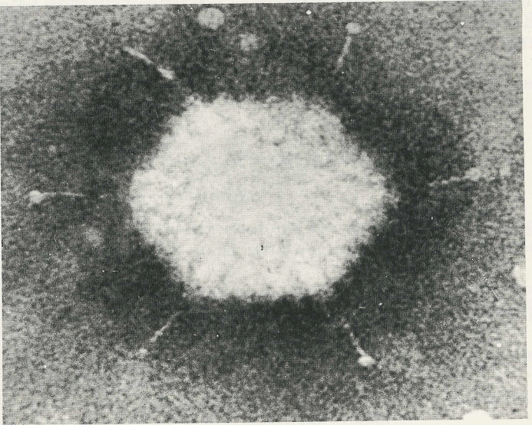
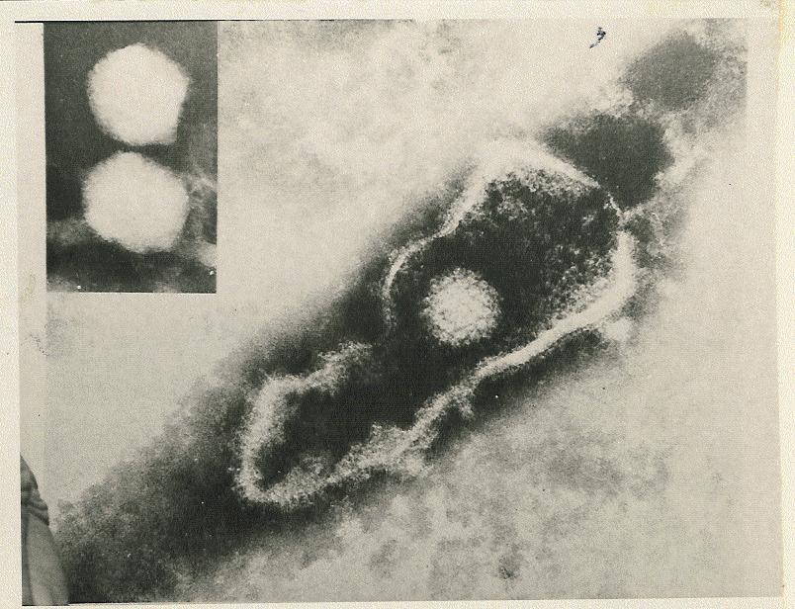
Symmetry based on arrangement of capsomeres
1-Cubic symmetry
( Icosahedral )
Adenovirus Herpesvirus

Slide 11
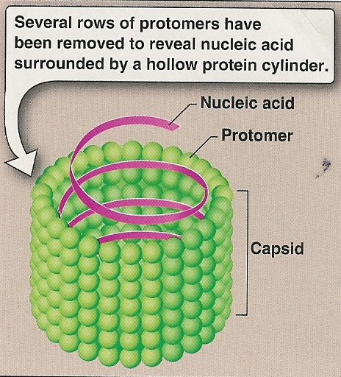
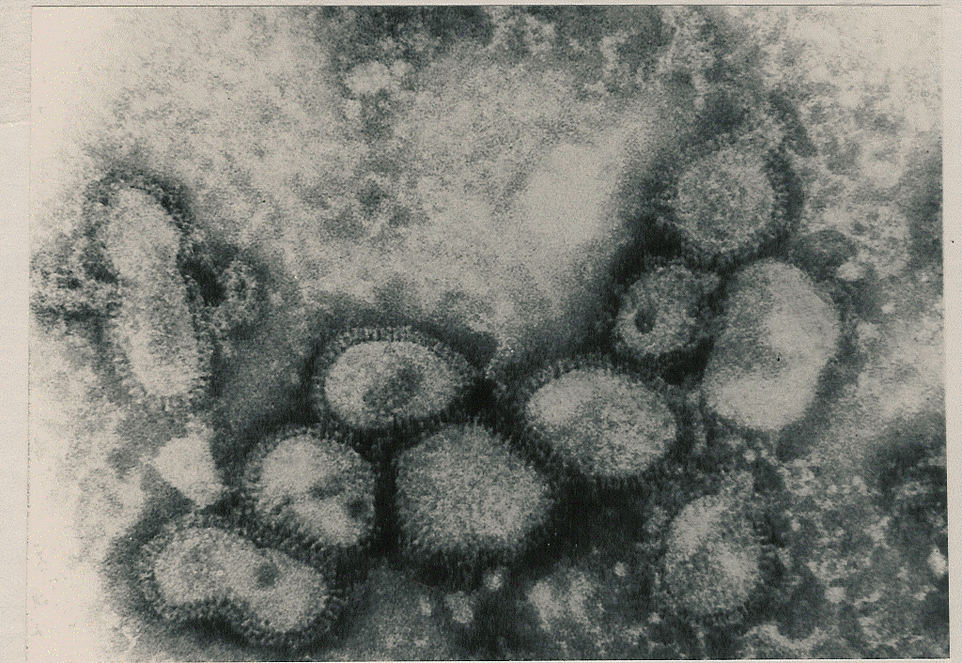
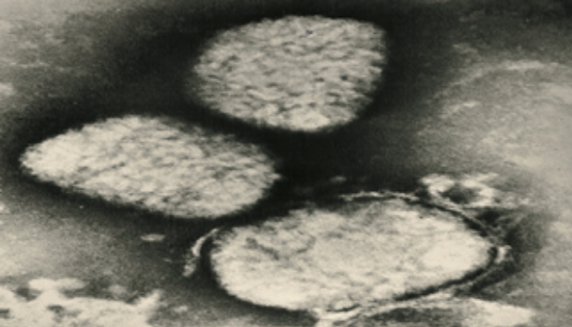
Symmetry based on arrangement of capsomeres
2- Helical symmetry
Elongated
(filoviruses)
Pleomorphic
( influenza v.)
3- Complex symmetry
poxviruses

Slide 12
Viral structure
3-Envelope
Lipoprotein mb
(host lipid ,virus specific protein )
Budding
Envelope is derived from cell mb
except herpesviruses from nuclear mb
Enveloped Vs are more sensitive to
heat ,dry & ether than nonenveloped Vs
Glycoprotein attaches to host cell receptor

Slide 13
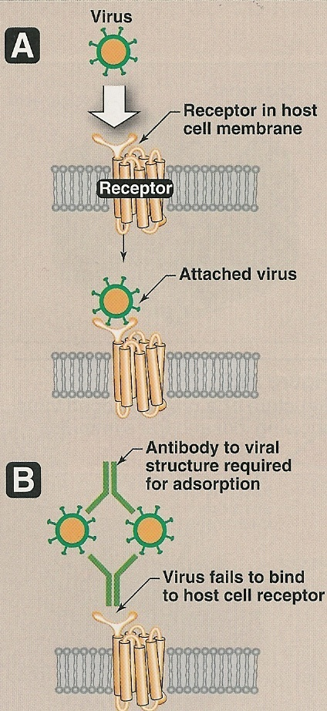
Viral proteins
The outer viral ps
Mediate attachment to specific Rs
Induce neutralizing Abs
Target of Abs
The internal viral ps
Structural ps ( capsid ps of enveloped Vs )
Nonstructural ps ( enzymes)
All ssRNA Vs (-) polarity have transcriptase
( RNA dependent RNA polymerase) inside virions
RetroVs & HBV contain reverse transcriptase

Slide 14
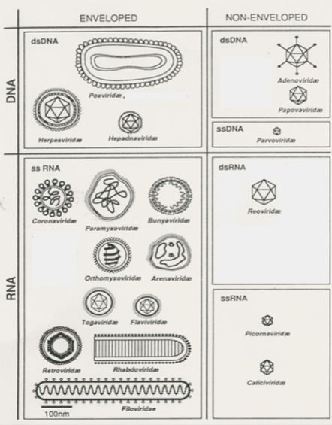
Classification of viruses
Type of NA*
The no. of strand
The polarity
of viral genome
The presence or
absence of envelope
Type of symmetry

Slide 15
Medically Important Viruses
DNA
RNA
Single-stranded
double-stranded
Enveloped
Nonenveloped
Nonenveloped
Icosahedral
Herpesviridae
Hepadnaviridae
Icosahedral
Adenoviridae
Papillomaviridae
Polyomaviridae
Icosahedral
Parvoviridae
Complex
Poxviridae

Slide 16
Medically Important Viruses
DNA
RNA
Single-stranded
double-stranded
Neg - strand
Pos- strand
Nonenveloped
Enveloped
Enveloped
Nonenveloped
Icosahedral
Reoviridae
Helical
Orthomyxoviridae
Paramyxoviridae
Rhabdoviridae
Filoviridae
Bunyaviridae
Arenaviridae
Helical
Coronaviridae
Icosahedral
Togaviridae
Flaviviridae
Retroviridae
Icosahedral
Picornaviridae
Hepeviridae
Caliciviridae
Astroviridae

Slide 17
Replication
Adsorption (Attachment)
Penetration
Uncoating
Synthesis of viral components
mRNA
Viral proteins
NA
Assembly
Release
Viral growth cycle

Slide 18
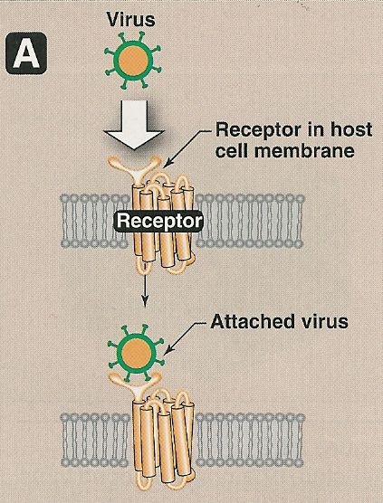
Adsorption
Attachment site ;
ex- glycoprotein
fiber

Slide 19
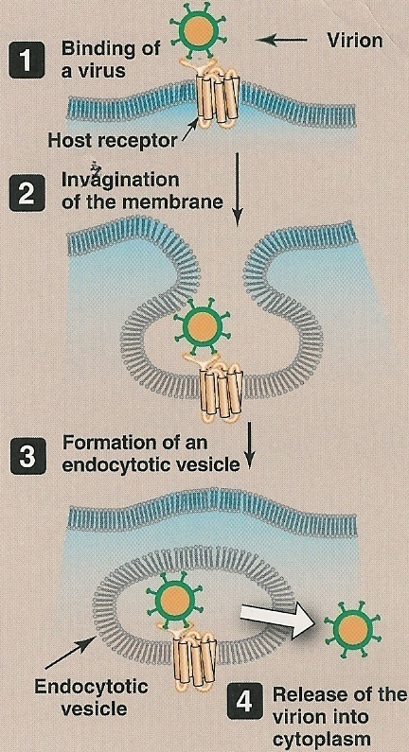
Penetration
1-Fusion
(enveloped Vs )
2-Endocytosis
Viral envelope
fuses with endosome mb
Nonenveloped V. lysis ,pore
Notes:
‹#›

Slide 20
Replication
Adsorption (Attachment)
Penetration
Uncoating
Release of viral genome - cytoplasm
- nucleus

Slide 21
Synthesis of viral components
mRNA
Viral genome transcription mRNA
+ssRNA acts directly
Viral proteins
mRNA translation viral proteins
cell ribosome - enzymes
- structural ps
replication of viral genome

Slide 22
Replication
Adsorption (Attachement)
Penetration
Uncoating
Synthesis of viral components
mRNA
Viral proteins
NA
Assembly
NA + V. proteins = Virions
Release

Slide 23
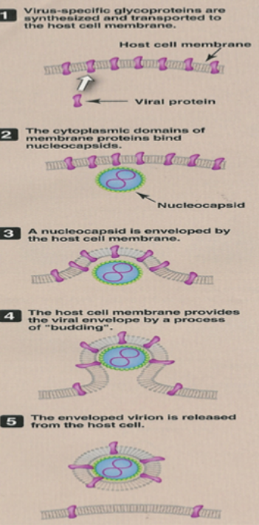
Release
1-Budding
(enveloped Vs)
-cell mb*
-nuclear mb
(herpesVs)
2- Cell lysis
or rupture
(nonenveloped)

Slide 24
laboratory diagnosis of viral infections
Microscopic examination.
Cell culture.
Serological tests .
Detection of viral Ag.
Molecular method .

Slide 25
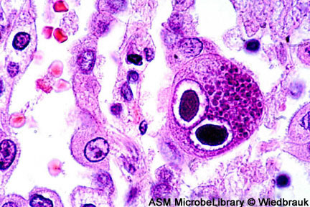
Microscopic examination
Light microscopy;
Histological appearance
Ex. Inclusion bodies
Owl’s eye (CMV)
Electron microscopy;
Morphology& size of virions
Ex.
Dx of skin lesion caused by herpesv, poxv.
It is replaced by Ag detection & molecular tests
Notes:
‹#›

Slide 26
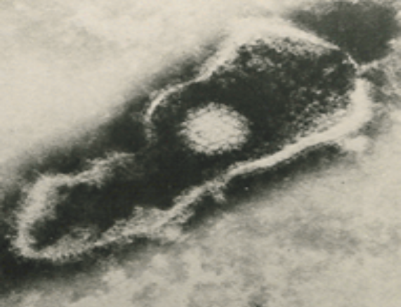
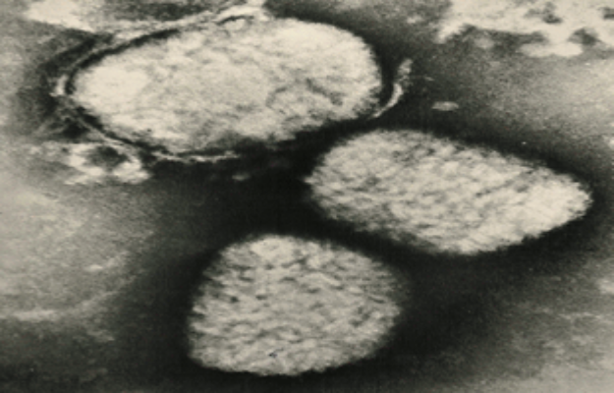
Electron micrographs
Herpesvirus
Poxvirus

Slide 27
Virus cultivation
Laboratory animal
Embryonated egg
Cell culture

Slide 28
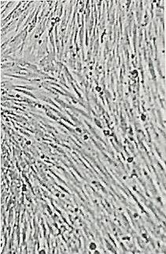
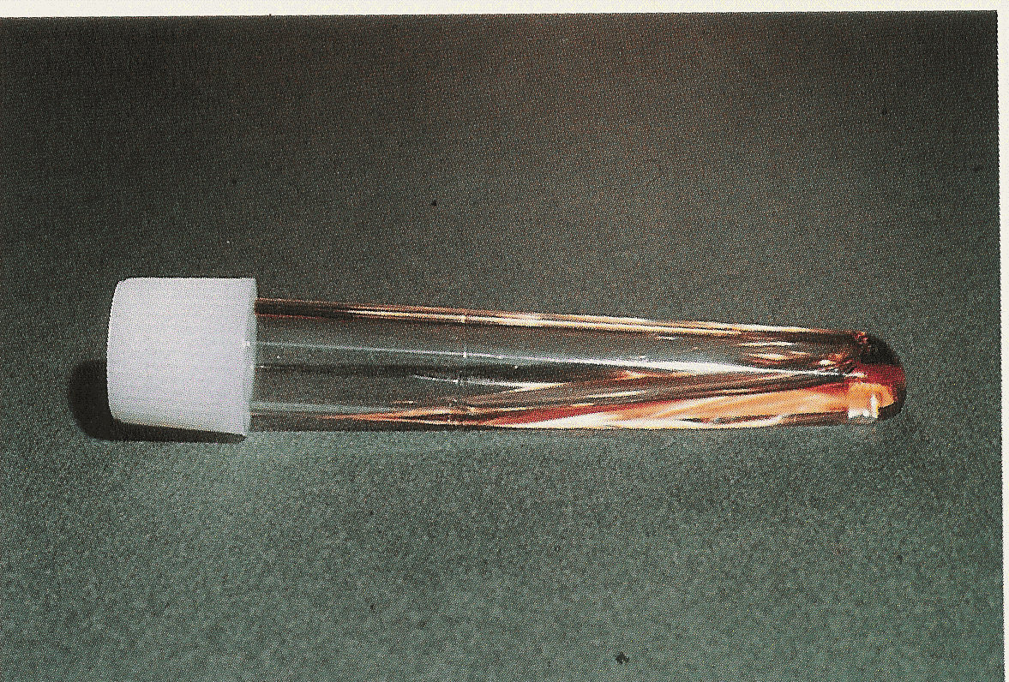
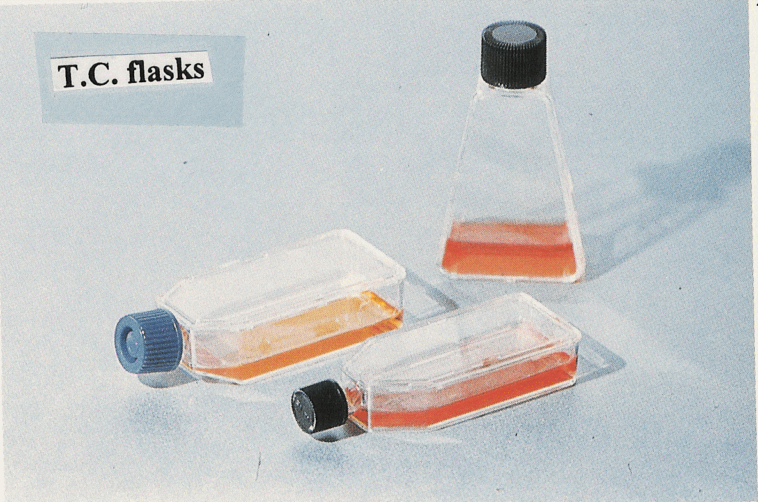
Cell culture

Slide 29
Cell culture C/C)
1-Primary C/C
2-Diploid C/C
[semi continuous]
3-Continuous cell line

Slide 30
Variation in Sensitivity of cell cultures to infection by viruses commonly isolated in clinical virology laboratories
Cell cultureª
Virus
PMK HDF HEp-2
RNA virus
Enterovirus Rhinovirus Influenza virus RSV
+++
++
+/-
+
+++
+
+++
+
-
++
+
+++
DNA virus
Adenovirus HSV VZV CMV
+
++
+++
+
++
++
+
+++
-
-
+++
-
PMK, primary MK. Degree of sensitivity: +++, highly sensitive;++, moderately sensitive; +, low sensitivity; +/-, variable; -, not sensitive

Slide 31
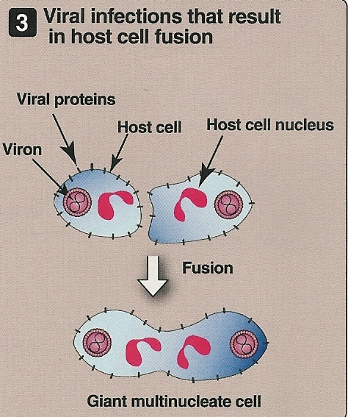
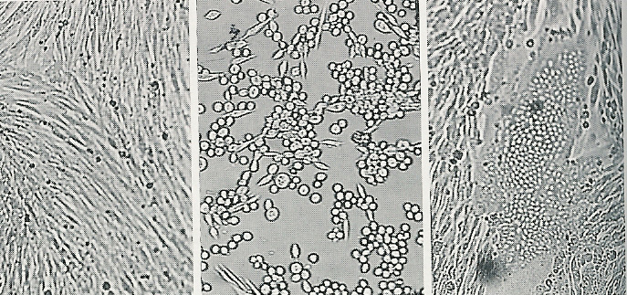
Detection of viral growth
Cytopathic effects
Others
Uninfected cc
Cell rounding
Syncytium

Slide 32
Problems with cell culture ;
Long incubation
Sensitivity is variable
Susceptible to bacterial contamination
Some Vs do not grow in c/c ex. HCV

Slide 33
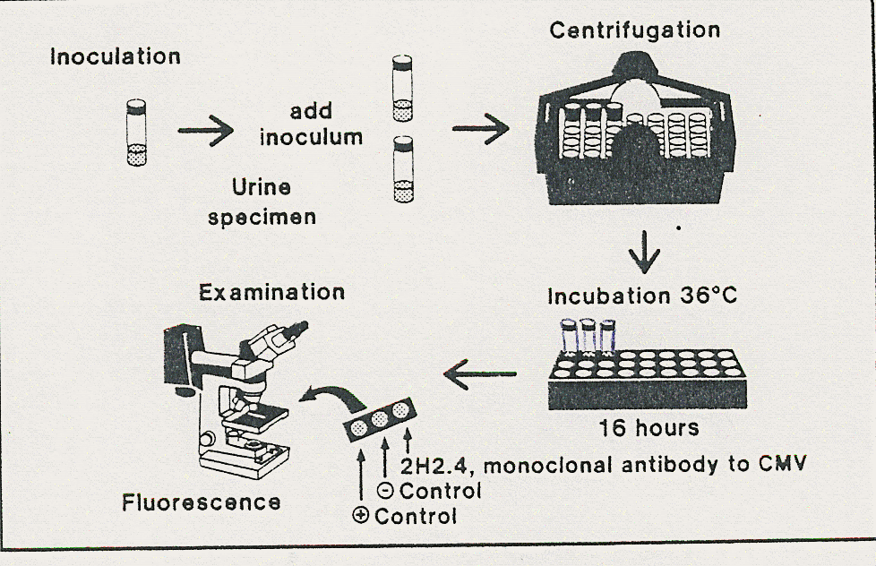
Rapid culture technique
Shell Vial Assay
Detect viral antigens
1-3 days

Slide 34
Serological test; Antigen detection;
sample virus test
Skin scrapings HSV IF
Blood HBV(HBsAg) ELISA

Slide 35
Serological test;
Antibody detection;
Ex of techniques
Immunofluorescence (IF)
Enzyme- linked immunosorbent assay (ELISA)

Slide 36
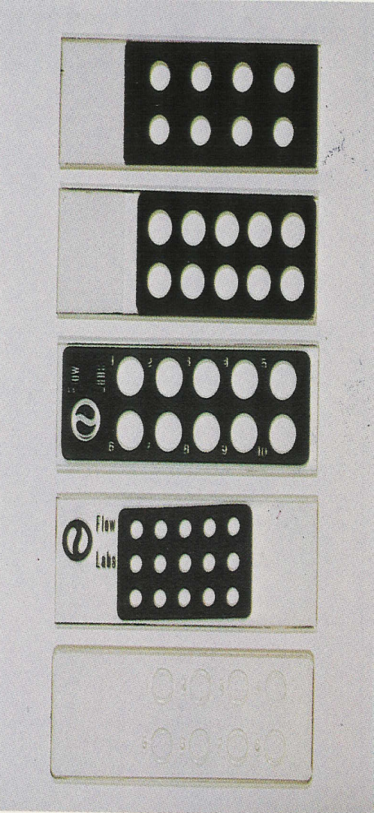
Immunofluorescence ; IF
A- Direct
Ag detection;
Sample (Ag)
B- Indirect
Ab detection;
Sample (Ab)

Slide 37
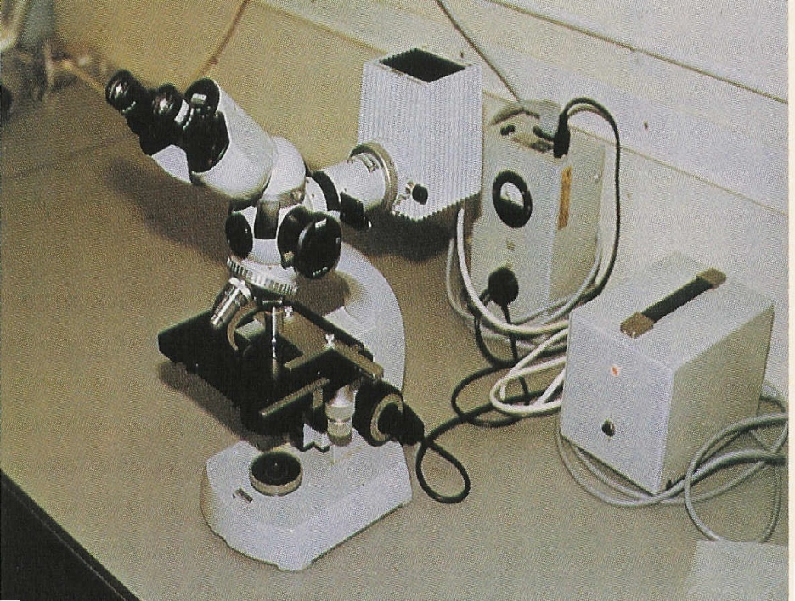
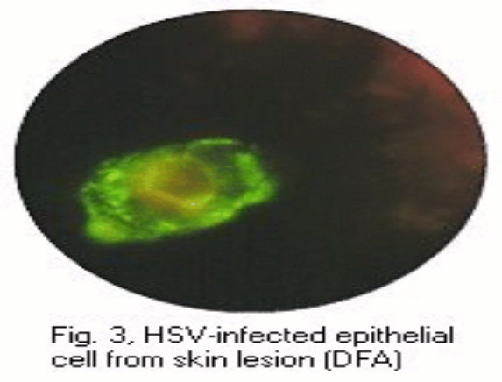

Slide 38
ELISA Ab detection Ag detection
Indirect ELISA for Ab detection ;
coloured wells indicate reactivity

Slide 39
Molecular test;
Polymerase chain reaction (PCR)
Amplification tech.
Viral genome
Uses;
Dx
Monitoring response to Rx

Slide 41
Reference books

Slide 42
Thank you

