Slide 1
Foundation Block
Pathology
Oct 2019
INFLAMMATION AND REPAIR
Lecture 1
Definition of inflammation
Acute Inflammation
Vascular Events in Inflammation
Lecturer: Dr. Maha Arafah

Slide 2
Learning Objectives:
Define inflammation
List cells & molecules that play important roles in inflammation
Types of inflammation: acute and chronic inflammation
Recognize the cardinal signs of inflammation
Describe the sequence of vascular changes in acute inflammation (vasodilation, increased permeability) and their purpose
Compare normal capillary exchanges with exchange during inflammatory response
Define the terms edema, transudate, and exudate.

Slide 3

Reference book and the relevant page numbers..
Robbins Basic Pathology 10th edition
Page: 57 - 60

Slide 4
What is Inflammation?
Define inflammation.
  Inflammation is a local response of the vascularized living tissue to infection and damaged tissue that brings cells and molecules of host defense from the circulation to the sites where they are needed
Therefore, Inflammation is part of immunity: This is a broad protective response
  (innate immunity)
  The aim: to localize and eliminate the causative agents, limit tissue injury and restore tissue to normal

Slide 5
Define inflammation: its causes and steps
Causes of Inflammation
Infection.
Trauma.
Physical injury (burns).
Chemical injury (CCl4).
Immunological injury (e.g. Auto-immune disorder).
Tissue death (e.g.
Myocardial infarction).
Injury
Tissue damage
Tissue response
Eliminates the effect of injury (pathogen and necrotic tissue)
Repair

Slide 6
Define inflammation.
Steps of inflammation
The offending agent is recognized by host cells and molecules.
Leukocytes and plasma proteins are recruited from the circulation to the site where the offending agent
The leukocytes and proteins are activated to destroy and eliminate the offending substance.
The reaction is controlled and terminated.
The damaged tissue is repaired.

Slide 7
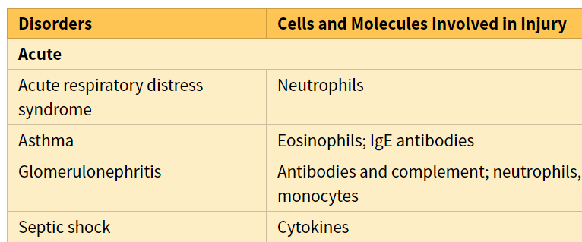
Can inflammation be harmful ! ?
Define inflammation.

Slide 8
Inflammation
Define inflammation.
Inflammation is terminated when the offending agent is eliminated and the secreted mediators are broken down or dissipated.
  There are active anti-inflammatory mechanisms that serve to control the response and prevent it from causing excessive damage to the host.

Slide 9
Learning Objectives:
Upon completion of these lectures, the student should:
Define inflammation.
List cells & molecules that play important roles in inflammation
Types of inflammation: acute and chronic inflammation
Recognize the cardinal signs of inflammation.
Describe the sequence of vascular changes in acute inflammation (vasodilation, increased permeability) and their purpose.
Compare normal capillary exchanges with exchange during inflammatory response.
Define the terms edema, transudate, and exudate.

Slide 10
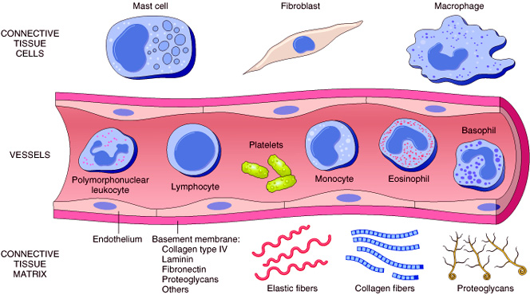
2. List cells & molecules that play important roles in inflammation
Cells of surrounding C.T.
    The circulating cells:
Blood leukocytes
Plasma proteins
Extracellularmatrix of surrounding C.T.
Cells of vascular wall
The extracellular matrix

Slide 11
Chemical Mediators
2. List cells & molecules that play important roles in inflammation
Inflammation is mediated by chemical substances called
What is the source of these chemical mediators?
1. Phagocytes and other host cells
  Leukocyte
  Endothelium
  Mast cell
2. Plasma proteins

Slide 12
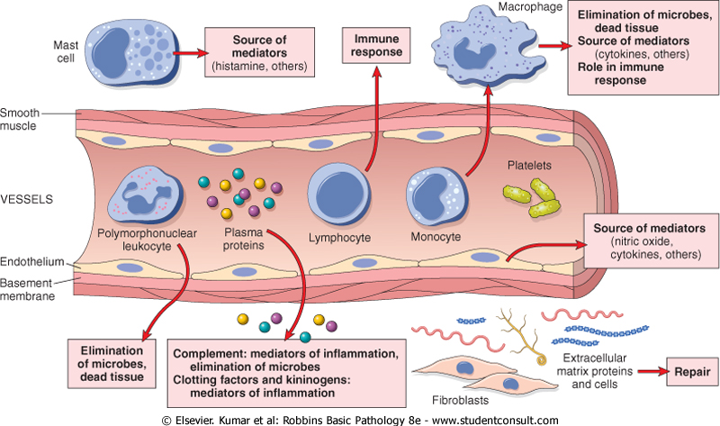
2. List cells & molecules that play important roles in inflammation

Slide 13
Learning Objectives:
Upon completion of these lectures, the student should:
Define inflammation.
List cells & molecules that play important roles in inflammation
Types of inflammation: acute and chronic inflammation
Recognize the cardinal signs of inflammation.
Describe the sequence of vascular changes in acute inflammation (vasodilation, increased permeability) and their purpose.
Compare normal capillary exchanges with exchange during inflammatory response.
Define the terms edema, transudate, and exudate.

Slide 14
TYPES OF Inflammation
3. Acute and chronic inflammation
Acute inflammation
Chronic Inflammation

Slide 15
Features of acute and chronic inflammation
3. Compare between acute and chronic inflammation
Chronic | Acute | Feature
Slow : days, weeks | Fast : minutes or hours | Onset
lymphocytes and macrophages | neutrophils | Cellular infiltrate
Often sever & progressive | Mild, self limited | Tissue injury, fibrosis
Less prominent, may be subtle | Prominent | Local & systemic signs

Slide 16
Acute inflammation
A rapid response to an injurious agent that serves to deliver mediators of host defense-leukocytes and plasma proteins-to the site of injury

Slide 17
The outcome of acute inflammation
is either
elimination of the noxious stimulus, followed by decline of the reaction and repair of the damaged tissue
or
persistent injury resulting in chronic inflammation

Slide 18
Learning Objectives:
Upon completion of these lectures, the student should:
Define inflammation.
List cells & molecules that play important roles in inflammation
Compare between acute and chronic inflammation
Recognize the cardinal signs of inflammation.
Describe the sequence of vascular changes in acute inflammation (vasodilation, increased permeability) and their purpose.
Compare normal capillary exchanges with exchange during inflammatory response.
Define the terms edema, transudate, and exudate.

Slide 19
Clinical Features
4. Recognize the cardinal signs of inflammation
The 5 ancient cardinal signs of inflammation are
Tumor:-swelling
Due to a histamine-mediated increase in permeability of venules
Rubor :– redness
Rubor and calor are due to histamine-mediated vasodilation of arterioles
Calor: – warmth
Dolor :– pain
mediated by PGE2 and bradykinin
Functio Laesa :–loss of function
The suffix “its” is added to the base word to state the condition as in appendix/appendicitis

Slide 20
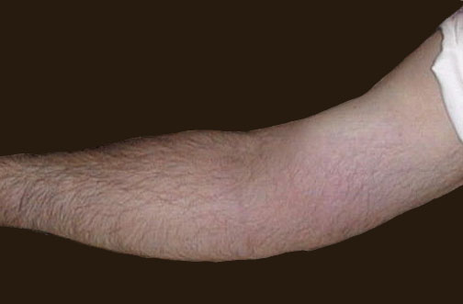
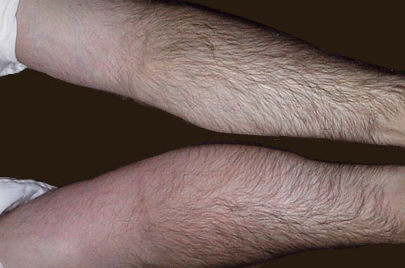
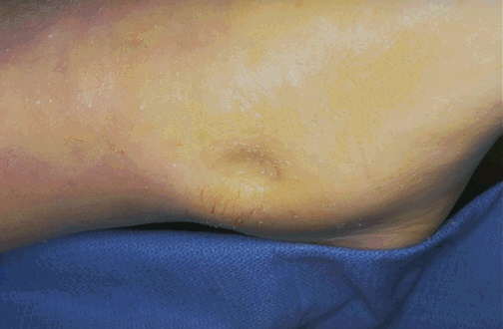
4. Recognize the cardinal signs of inflammation
Redness
Notes:
The cardinal signs of inflammation are rubor (redness), calor (heat), tumor (swelling), dolor (pain), and loss of function. Seen here is skin with erythema, compared to the more normal skin at the far right.

Slide 21
Learning Objectives:
Upon completion of these lectures, the student should:
Define inflammation.
List cells & molecules that play important roles in inflammation
Compare between acute and chronic inflammation
Recognize the cardinal signs of inflammation.
Describe the sequence of vascular changes in acute inflammation (vasodilation, increased permeability) and their purpose.
Compare normal capillary exchanges with exchange during inflammatory response.
Define the terms edema, transudate, and exudate.

Slide 22
Events of acute Inflammation
5. Describe the sequence of vascular changes in acute inflammation
Acute inflammation has three main events:
  (1) Hemodynamic changes
  (alterations in vascular caliber that lead to an increase in blood flow)
  (2) Increased vascular permeability
  (structural changes in the microvasculature that permit plasma proteins and leukocytes to leave the circulation)
  (3) Emigration of the leukocytes from the microcirculation
  (their accumulation in the focus of injury, and their activation to eliminate the offending agent)
vascular
cellular
Notes:
9

Slide 23
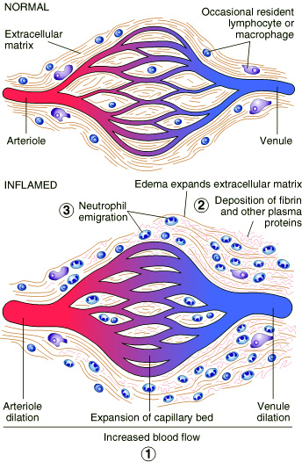
5. Describe the sequence of vascular changes in acute inflammation
Vascular Events
1. Hemodynamic changes
Vasodilatation

Slide 24
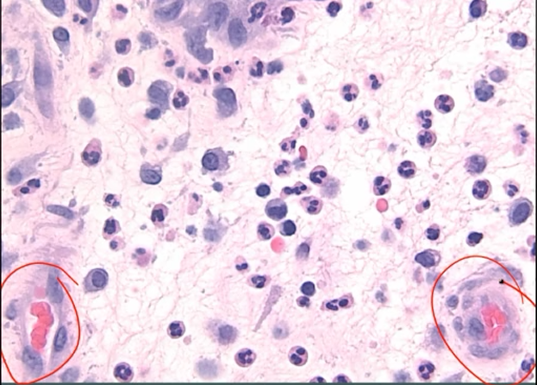
  1. Hemodynamic changes
5. Describe the sequence of vascular changes in acute inflammation

Slide 25
1. Hemodynamic changes
Phases of changes in Vascular Caliber and Flow
5. Describe the sequence of vascular changes in acute inflammation
1. Transient vasoconstriction of arterioles
2. Vasodilatation
3. Slowing of the circulation
4. Stasis

Slide 26
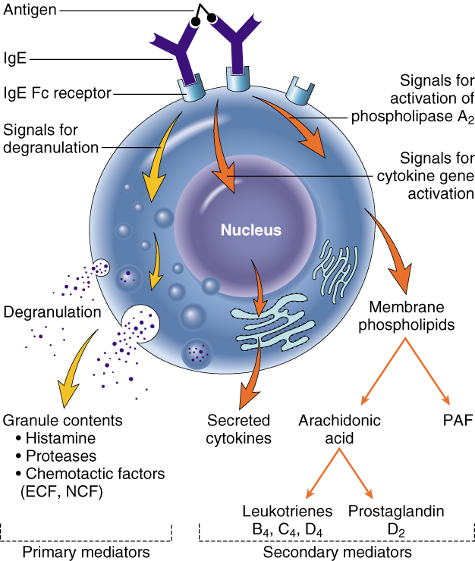
5. Describe the sequence of vascular changes in acute inflammation
1. Hemodynamic changes
Phases of changes in Vascular Caliber and Flow
1. Transient vasoconstriction of arterioles
It disappears within 3-5 seconds in mild injuries
(Due to a neurogenic reflex that lasts only a few seconds)
2. Vasodilatation: It involves the arterioles results in opening of new microvasculature beds in the area leading to increasing blood flow and cause of redness and hotness in acute inflammation
(Due to Histamine effect released from mast cells located in interstitial tissue around the small vessels)

Slide 27
1. Hemodynamic changes
Phases of changes in Vascular Caliber and Flow
5. Describe the sequence of vascular changes in acute inflammation
3. Slowing of the circulation
due to increased permeability of the microvasculature, this leads to outpouring of protein-rich fluid in the extravascular tissues.
4. Stasis: slow circulation due to dilated small vessels packed with red cells

Slide 28
2. Increased Vascular Permeability
5. Describe the sequence of vascular changes in acute inflammation
Vascular Events
A hallmark of acute inflammation (escape of a protein-rich fluid).
  induced by histamine, kinins, and other mediators
It affects small & medium size venules, through gaps between endothelial cells
It result in swelling (tumor) which occurs as a cardinal sign of inflammation

Slide 29
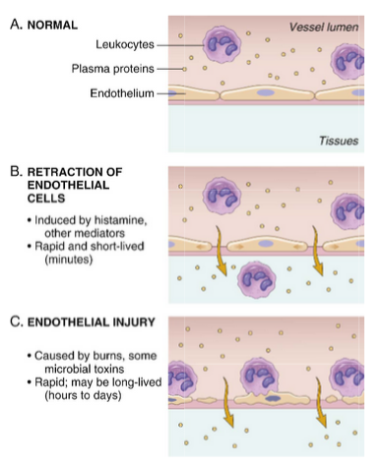
5. Describe the sequence of vascular changes in acute inflammation
Principal mechanisms of increased vascular permeability in inflammation and their features and underlying causes
venules
Arteriols, capillaries and venules

Slide 30
Learning Objectives:
Upon completion of these lectures, the student should:
Define inflammation.
List cells & molecules that play important roles in inflammation
Compare between acute and chronic inflammation
Recognize the cardinal signs of inflammation.
Describe the sequence of vascular changes in acute inflammation (vasodilation, increased permeability) and their purpose. increased vascular permeability.
Compare normal capillary exchanges with exchange during inflammatory response.
Define the terms edema, transudate, and exudate.

Slide 31
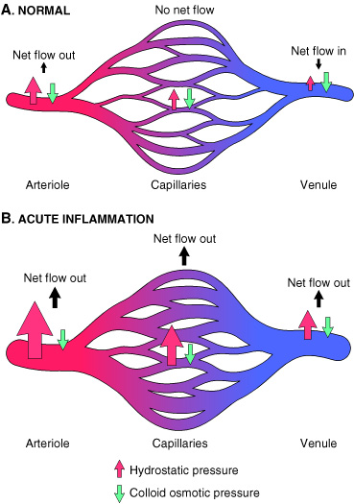
7. Compare normal capillary exchanges with exchange during inflammatory response
Increased blood volume lead to increased local hydrostatic pressure leading to transudation of protein-poor fluid into the extravascular space.
What is the edema?
denotes an excess of fluid in the interstitial or serous cavities
It can be either an exudate or a transudate

Slide 32
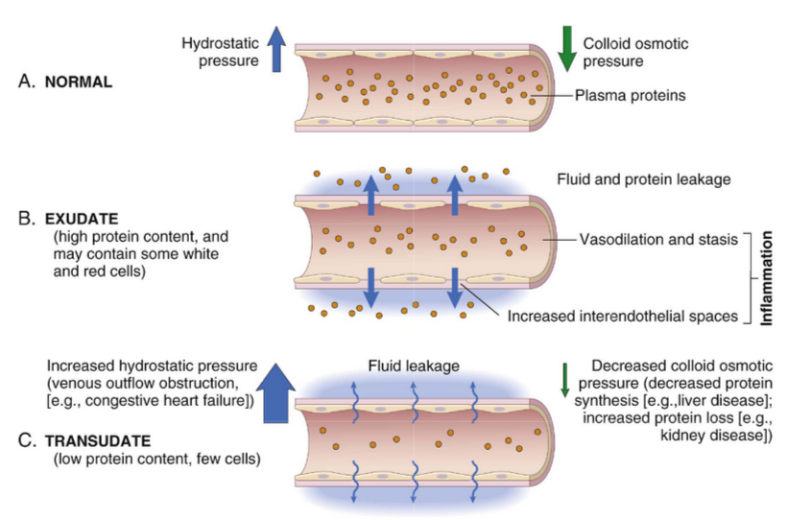
6. Compare normal capillary exchanges with exchange during inflammatory response

Slide 33
Learning Objectives:
Upon completion of these lectures, the student should:
Define inflammation.
List cells & molecules that play important roles in inflammation
Compare between acute and chronic inflammation
Recognize the cardinal signs of inflammation.
Describe the sequence of vascular changes in acute inflammation (vasodilation, increased permeability) and their purpose.
Compare normal capillary exchanges with exchange during inflammatory response.
Define the terms edema, transudate, and exudate.

Slide 34
Edema is defined as an excess of fluid in the interstitial space.
What is the difference between transudates and exudates?
7. Define the terms edema, transudate, and exudate
is a fluid with low protein content and a specific gravity of less than 1.012
It is essentially an ultrafiltrate of blood plasma that results from osmotic or hydrostatic imbalance across the vessel wall
without an increase in vascular permeability
An inflammatory extravascular fluid that has a high protein concentration, cellular debris, and a specific gravity above 1.020
It implies significant alteration in the normal permeability of small blood vessels in the area of injury
Transudate
Exudate

Slide 35
TAKE HOME MESSAGES
Inflammation, the local response of the vascularised living tissue to injury.
Could be acute or chronic.
Several cells & molecules that play important roles in inflammation.
Inflammation has vascular and cellular events to eliminate the cause.
Vascular events include vasodilation and increased permeability to deliver a protein rich fluid to the site of inflammation.

Slide 36
