Slide 1
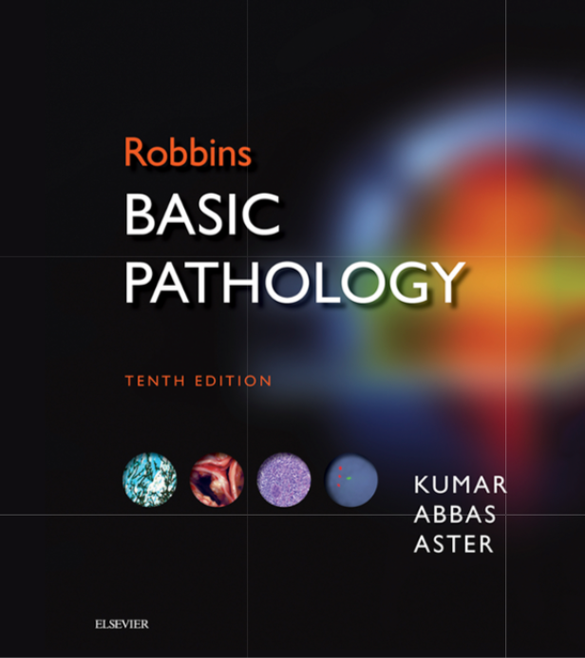
Foundation Block
Pathology
Oct 2019
INFLAMMATION AND REPAIR
Lecture 3
Chemical mediator of inflammation
Different patterns of inflammation
Outcomes of acute inflammation
Page 70- 80
Lecturer: Dr. Maha Arafah

Slide 2
Objectives
Chemical mediators of inflammation:
Definition
Know the general principles for chemical mediators.
Know the cellular sources and major effects of the mediators.
List the most likely mediators of each of the steps of inflammation.
Recognize the different patterns of inflammation.
List and describe the outcome of acute inflammation.

Slide 3
Chemical mediators of inflammation
What are mediators?
Chemical mediators of inflammation are substances produced during inflammation inducing a specific events in acute inflammation.

Slide 4
General principles for chemical mediators
Chemical mediators of inflammation
The production of active mediators is triggered by:
microbial products
host proteins, such as the proteins of the complement, kinin and coagulation systems
(these are themselves activated by microbes and damaged tissues)

Slide 5
General principles for chemical mediators
Chemical mediators of inflammation
Most mediators have the potential to cause harmful effects.
Therefore, there should be a mechanism to checks and balances their action.
Mediator function is tightly regulated by:
decay (e.g. AA metabolites)
inactivated by enzymes (e.g. kininase inactivates bradykinin)
eliminated (e.g. antioxidants scavenge toxic oxygen metabolites)

Slide 6
Source of Chemical mediators
Chemical mediators of inflammation
Cell-derived:
Synthesized as needed (prostaglandin)
Preformed, sequestered and released (mast cell histamine)
against offending agents in tissues
Plasma-derived:
Complement
kinins
coagulation factors
Many in “pro-form” requiring activation (enzymatic cleavage)
against circulating microbes

Slide 7
Chemical mediators of inflammation
Notes:
.

Slide 8
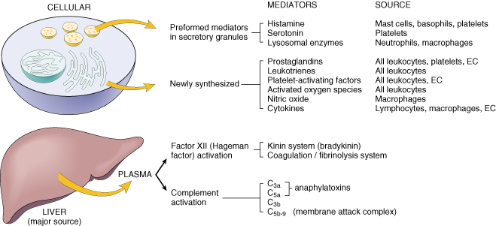
Cell-Derived Mediators
Chemical mediators of inflammation: cell derived
Producing cells:
Tissue macrophages
Mast cells
Endothelial cells
Leukocytes
Notes:
Endothelial cells at the site of inflammation
Leukocytes recruited to the site form the blood

Slide 9
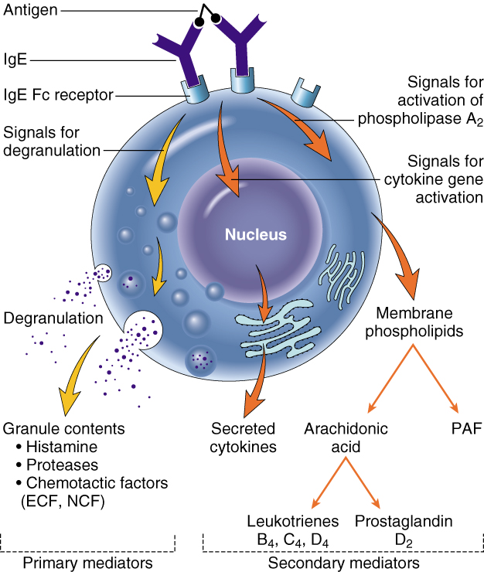
Vasoactive Amines Histamine & Serotonin
3. Chemical mediators of inflammation
Chemical mediators of inflammation: cell derived
Among first mediators in acute inflammatory reactions
Preformed mediators in secretory granules

Slide 10
Histamine
Chemical mediators of inflammation: cell derived- preformed
plays a major role in the early phase of acute inflammation and increases vascular permeability
Source:
many cell types, esp. mast cells, circulating basophils, and platelets
Stimuli of Release:
- Physical injury
- Immune reactions (cross-linking
of cell-surface IgE by antigen)
- C3a and C5a fragments
- Cytokines (e.g. IL-1 and IL-8)
- Neuropeptides
Actions:
ARTERIOLAR DILATION
INCREASED VASCULAR PERMEABILITY (venular gaps)
ENDOTHELIAL ACTIVATION
Inactivated by:
Histaminase
Notes:
Histamine is the principal mediator of the immediate phase of increased vascular permeability, inducing venular endothelial contraction and interendothelial gaps.

Slide 11
Serotonin (5-HT)
Chemical mediators of inflammation: cell derived- preformed
Source:
Platelets
Action:
Neurotransmitter in the gastrointestinal tract
A vasoconstrictor (the importance of this action in inflammation is unclear)
Stimulus:
Platelet aggregation

Slide 12
Chemical mediators of inflammation
Notes:
.

Slide 13
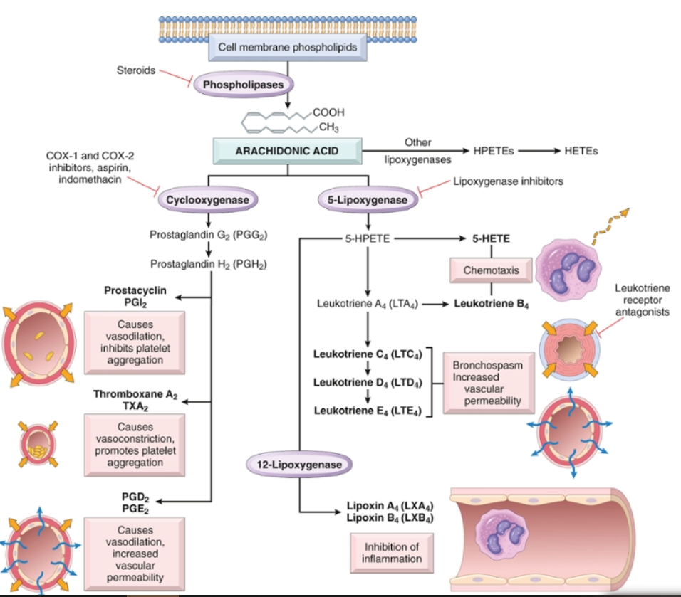
Chemical mediators of inflammation: cell derived- newly synthesized
Source:
Leukocytes
Mast cells
Endothelial cells
Platelets
Arachidonic Acid Metabolites (eicosanoids)
Notes:
.

Slide 14
Arachidonic Acid Metabolites (eicosanoids)
Chemical mediators of inflammation: cell derived- newly synthesized

Slide 15
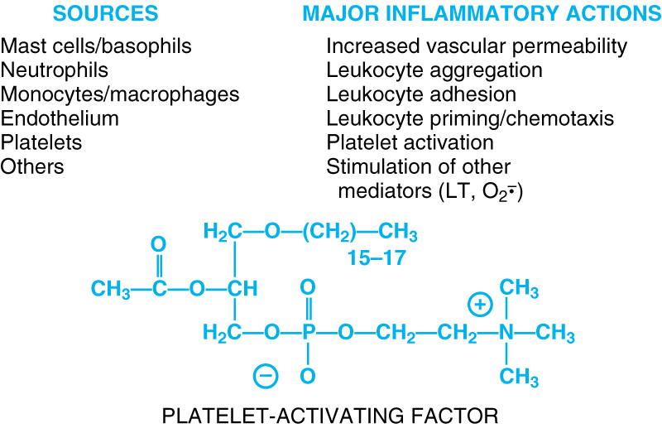
Chemical mediators of inflammation: cell derived- newly synthesized
Notes:
.

Slide 16
Chemical mediators of inflammation: cell derived- newly synthesized
Source:
Lymphocytes
Macrophages
Dendritic cells
Endothelial cells
Epithelial cells
Cytokines
Polypeptides
Actions:
Involved in early immune and inflammatory reactions
Some stimulate bone marrow precursors to produce more leukocytes
Have roles in acute and chronic inflammation
Notes:
.

Slide 17
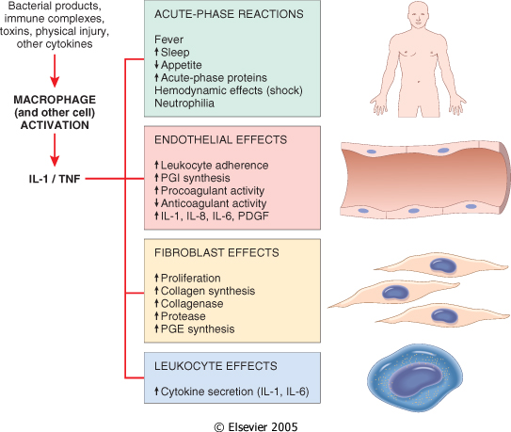
Chemical mediators of inflammation: cell derived- newly synthesized
Cytokine of
Acute inflammation:
Interleukin (IL-1) & TNF
:Action
Stimulates expression of endothelial adhesion molecules and secretion of other cytokines; systemic effects

Slide 18
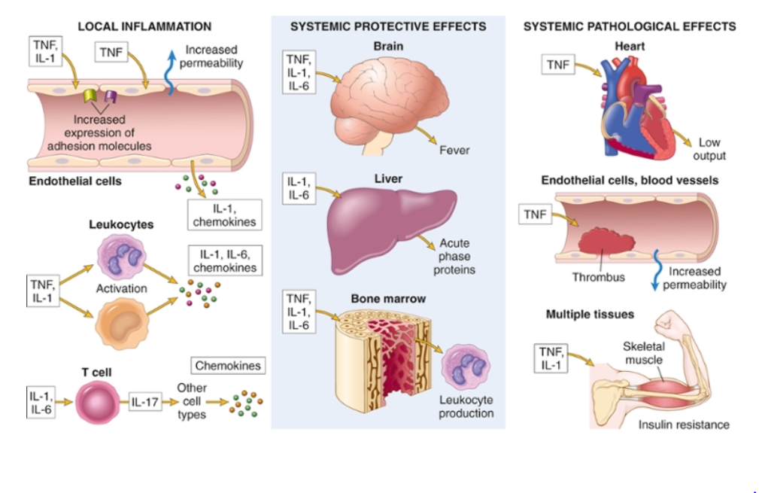
Major roles of cytokines in acute inflammation
TNF antagonists is effective in the treatment of rheumatoid arthritis

Slide 19
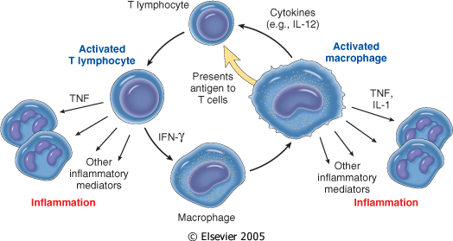
Chemical mediators of inflammation: cell derived- newly synthesized
Chronic Inflammation: Cytokines of
Interferon-γ (INF- γ) & Interleukin ( IL-12)
Activated lymphocytes and macrophages influence each other and also release inflammatory mediators that affect other cells.

Slide 20
Chemical mediators of inflammation: cell derived- newly synthesized
Chemokines
Small proteins
They are chemoattractants for leukocytes
Main functions:
Leukocyte recruitment & activation in inflammation
Normal anatomic organization of cells in lymphoid and other tissues
Notes:
.

Slide 21
Chemical mediators of inflammation: cell derived
Reactive Oxygen Species
Synthesized via
NADPH oxidase pathway
Source:
Neutrophils and Macrophages
Stimuli of release:
Microbes
Immune complexes
Cytokines
Action:
Microbicidial (cytotoxic) agent
Notes:
.

Slide 22
Chemical mediators of inflammation: cell derived- newly synthesized
Nitric Oxide ( NO)
Short-lived
Soluble free-radical gas
Functions:
Vasodilation
Antagonism of platelet activation (adhesion, aggregation, & degranulation)
Reduction of leukocyte recruitment
Microbicidial (cytotoxic) agent (with or without ROS) in activated macrophages
Notes:
.

Slide 23
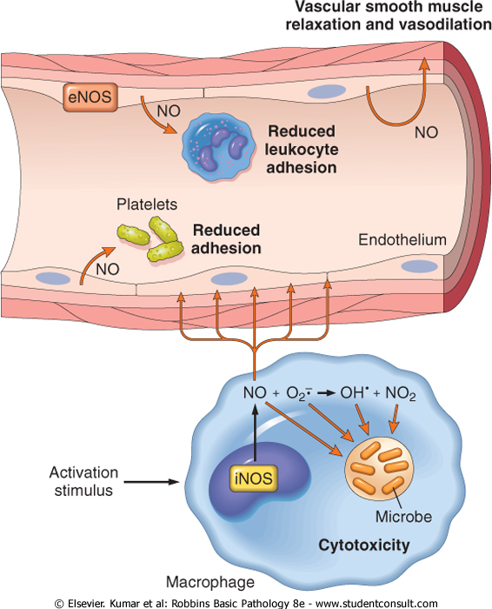
Chemical mediators of inflammation: cell derived- newly synthesized
1
2
Actions of Nitric Oxide
3
4

Slide 24
Chemical mediators of inflammation: cell derived- newly synthesized
Lysosomal Enzymes of Leukocytes
Neutrophils & Monocytes
Enzymes:
Acid proteases
Neutral proteases (e.g. elastase, collagenase, & cathepsin)
Their action is checked by:
Serum antiproteases (e.g. α1-antitrypsin)
Notes:
.

Slide 25
Chemical mediators of inflammation: cell derived- newly synthesized
Neuropeptides
Small proteins
Secreted by nerve fibers mainly in lung & GIT
Initiate inflammatory response
e.g. Substance P :
Transmits pain signals
Regulates vessel tone
Modulates vascular permeability
Notes:
.

Slide 26
Chemical mediators of inflammation

Slide 27
Chemical mediators of inflammation: Plasma protein derived
Clotting systems
Kinin
Complement

Slide 28
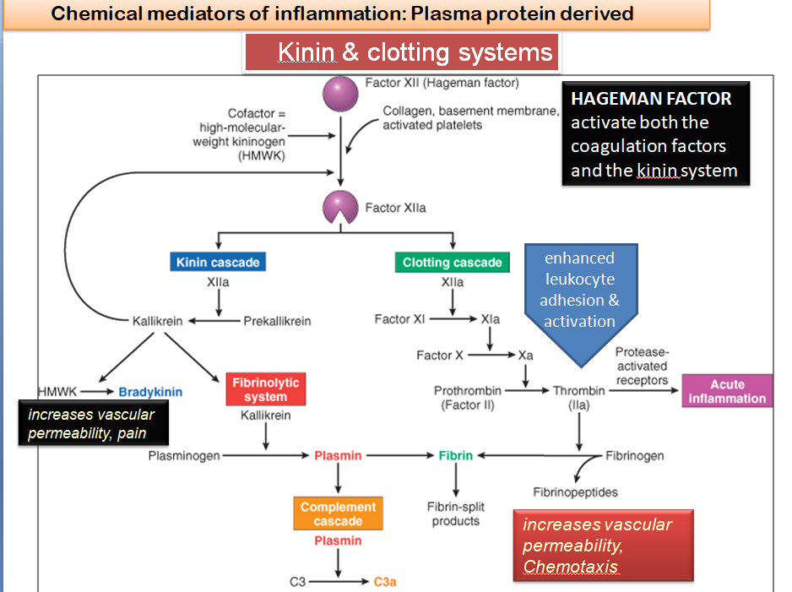

Slide 29
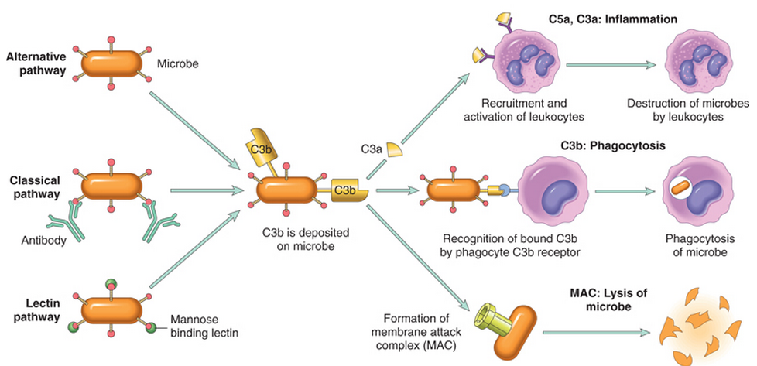
Chemical mediators of inflammation: Plasma protein derived
Complement System
C3a+C5a: anaphylatoxins
C5a: Chemotaxis
Opsonization
MAC: membrane attack complex

Slide 30
Complement protein: action
Chemical mediators of inflammation: Plasma protein derived
C3a & C5a ➔ Increase vascular permeability
( anaphylatoxins)
C5a ➔ Chemotaxis
C3b ➔ Opsonization
C5-9 ➔ membrane attack complex, lead to bacterial lysis

Slide 31
Vasodilation | Prostaglandins Histamine Nitric oxide
Increased vascular permeability | Vasoactive amines Bradykinin Leukotrienes C4, D4, E4 PAF Substance P
Chemotaxis, leukocyte recruitment and activation | C3a, C5a Leukotriene B4 Chemokines IL-1, TNF
Fever | IL-1, TNF Prostaglandins
Pain | Prostaglandins Bradykinin
Tissue damage | Neutrophil and macrophage lysosomal enzymes Oxygen metabolites Nitric oxide
Role of Mediators in Different Reactions of Inflammation

Slide 32
Objectives
Chemical mediators of inflammation:
Definition
Know the general principles for chemical mediators.
Know the cellular sources and major effects of the mediators.
List the most likely mediators of each of the steps of inflammation.
Recognize the different patterns of inflammation.
List and describe the outcome of acute inflammation.

Slide 33
Clinical Features
Recognize the different patterns of inflammation
The 5 ancient cardinal signs of inflammation are
Tumor:-swelling
Due to a histamine-mediated increase in permeability of venules
Rubor :– redness
Rubor and calor are due to histamine-mediated vasodilation of arterioles
Calor: – warmth
Dolor :– pain
mediated by PGE2 and bradykinin
Functio Laesa :–loss of function
The suffix “its” is added to the base word to state the condition as in appendix/appendicitis

Slide 34
Morphologic Patterns of Acute Inflammation
Recognize the different patterns of inflammation.
Several types of inflammation vary in their morphology and clinical correlates. Why?
The severity of the reaction
specific cause
the particular tissue
site involved

Slide 35
Morphologic Patterns of Acute Inflammation
Recognize the different patterns of inflammation.
SEROUS INFLAMMATION
FIBRINOUS INFLAMMATION
CATARRHAL INFLAMMATION
SUPPURATIVE OR PURULENT INFLAMMATION
ULCERS
Others

Slide 36
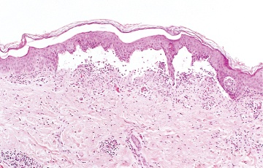
Recognize the different patterns of inflammation.
SEROUS INFLAMMATION:
marked by the outpouring of a thin fluid

Slide 37
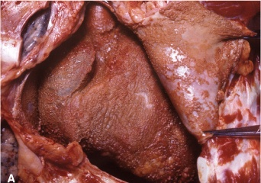
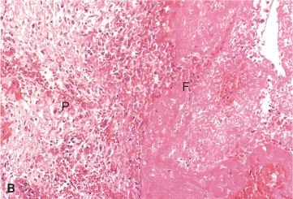
FIBRINOUS INFLAMMATION
Recognize the different patterns of inflammation.
A fibrinous exudate is characteristic of inflammation in the lining of body cavities, such as the meninges, pericardium and pleura (larger molecules such as fibrinogen pass the vascular barrier)
Fibrinous exudates may be removed by fibrinolysis,
if not: it may stimulate the ingrowth of granulation tissue (organization)

Slide 38
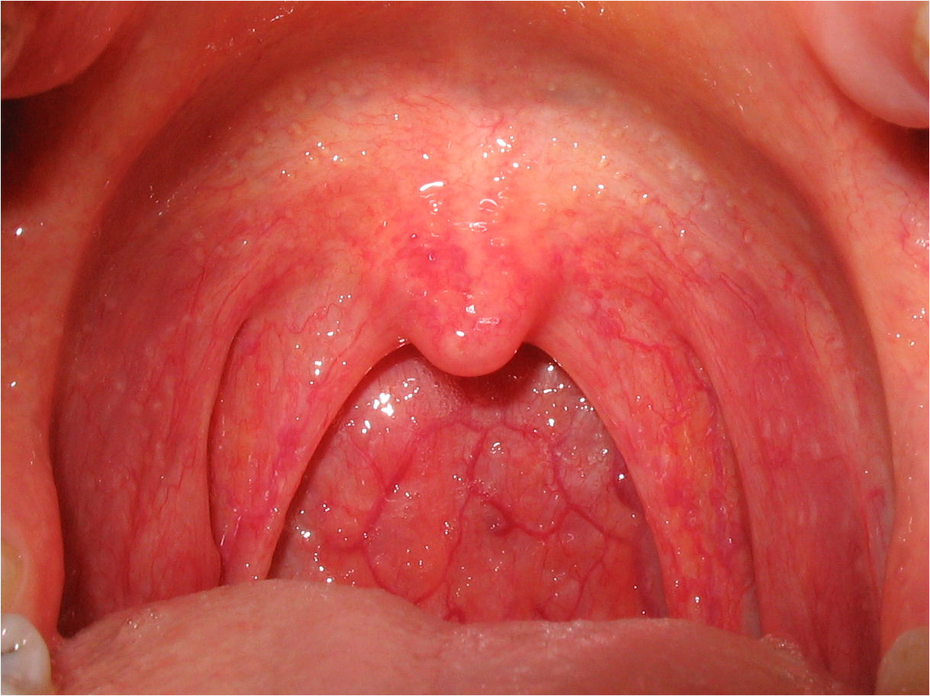
Catarrhal inflammation
Recognize the different patterns of inflammation.
Inflammation affects mucosa-lined surfaces with the outpouring of watery mucus

Slide 39
SUPPURATIVE OR PURULENT INFLAMMATION
Recognize the different patterns of inflammation.
characterized by the production of large amounts of pus or purulent exudate consisting of neutrophils, necrotic cells, and edema fluid caused by pyogenic (pus-producing) bacteria

Slide 40
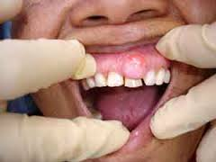
Suppurative abscess
Recognize the different patterns of inflammation.
An abscess is a cavity lined by granulation tissue and containing neutrophils, necrotic cells, bacteria and fibrinous material
An enclosed collection of pus consists of a mixture of neutrophils and necrotic debris

Slide 41
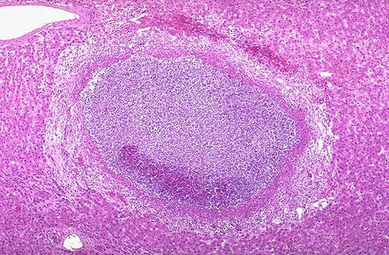
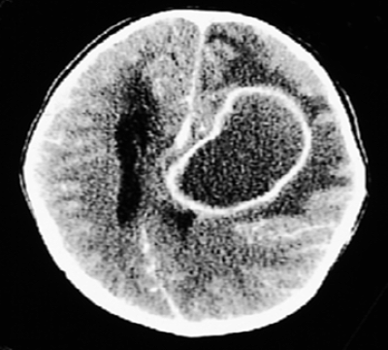
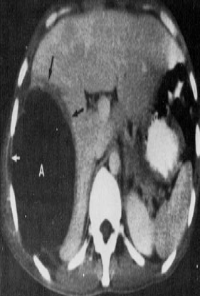
Morphologic Patterns of Acute Inflammation SUPPURATIVE OR PURULENT INFLAMMATION
Recognize the different patterns of inflammation.
Abscesses : A localized collections of purulent inflammatory tissue caused by suppuration buried in a tissue, an organ, or a confined space

Slide 42
Recognize the different patterns of inflammation.
ULCERS
An ulcer is a local defect of the surface of an organ or tissue that is produced by the sloughing (shedding) of inflammatory necrotic tissue
Epithelial Defect
Necrotic base
Fibrinopurulent exudates
Granulation tissue
Fibrosis

Slide 43
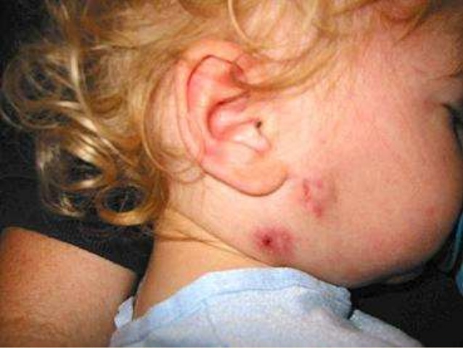
Sinus
Recognize the different patterns of inflammation.
A tract between the abscess and a surface.

Slide 44
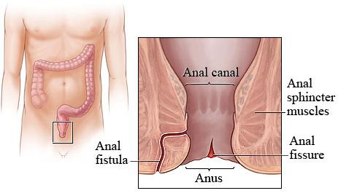
Fistula
Recognize the different patterns of inflammation.
A tract between two surfaces.

Slide 45
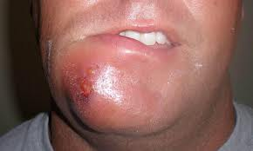
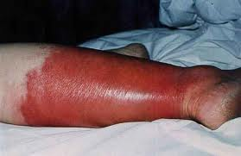
Cellulitis
Recognize the different patterns of inflammation.
denotes a spreading of acute inflammation through interstitial tissues.

Slide 46
Objectives
Chemical mediators of inflammation:
Definition
Know the general principles for chemical mediators.
Know the cellular sources and major effects of the mediators.
List the most likely mediators of each of the steps of inflammation.
Recognize the different patterns of inflammation.
List and describe the outcome of acute inflammation.

Slide 47
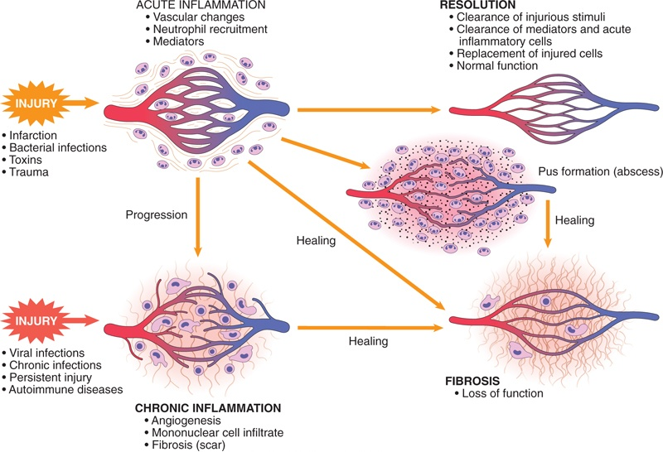
List and describe the outcome of acute inflammation.

Slide 48
Outcomes of Acute Inflammation
List and describe the outcome of acute inflammation.
Acute inflammation may have one of the four outcomes:
Complete resolution
Healing by connective tissue replacement (fibrosis)
Progression of the tissue response to chronic inflammation
Abscess formation

Slide 49
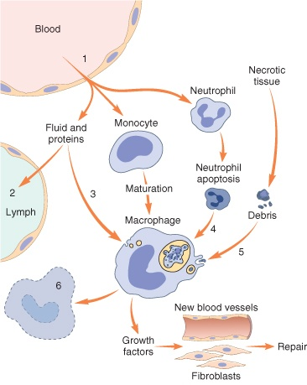
List and describe the outcome of acute inflammation.
Events in the resolution of inflammation
This involves neutralization, decay, or enzymatic degradation of the various chemical mediators; normalization of vascular permeability; and cessation of leukocyte emigration and apoptosis
The necrotic debris, edema fluid, and inflammatory cells are cleared by phagocytes and lymphatic drainage
Lymph node become enlarged and inflamed

Slide 50
Chemical mediators of inflammation:
Definition
Know the general principles for chemical mediators.
Know the cellular sources and major effects of the mediators.
List the most likely mediators of each of the steps of inflammation.
Recognize the different patterns of inflammation.
List and describe the outcome of acute inflammation.

