Slide 1
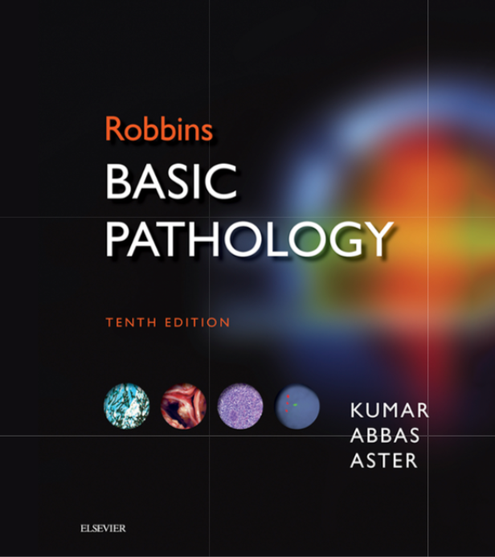
Foundation Block
Pathology
Oct 2019
INFLAMMATION AND REPAIR
Lecture 4
Chronic inflammation
Systemic effect of inflammation
Page 81-87
Lecturer: Dr. Maha Arafah

Slide 2
Objectives
Define chronic inflammation with emphasis on causes, nature of the inflammatory response, cells involved and tissue changes.
Describe the systemic manifestations of inflammation and their general physiology, including fever, leukocyte left shift, and acute phase reactants.

Slide 3
CHRONIC INFLAMMATION
Define chronic inflammation, its causes, effects and patterns
It is slow evolving (weeks to months) resulting into fibrosis
The essential changes are:
Absence of polymorphs (natural life span of 1–3 days); replaced by macrophages, lymphocytes and often plasma cells
Continuous tissue injury and necrosis
Angiogenesis: Proliferation of vascular endothelium by ‘budding’ (formation of new capillaries)
Proliferation of fibroblasts with collagen production leading to Fibrosis.

Slide 4
Chronic inflammation may arise in the following settings:
Causes of chronic inflammation
Persistent infections by microbes that are difficult to eradicate.
e.g.
Mycobacterium tuberculosis
Treponema pallidum (the causative organism of syphilis)
certain viruses and fungi
Persistent infections elicit a T lymphocyte-mediated immune response called delayed-type hypersensitivity.

Slide 5
Causes of chronic inflammation
2. Immune-mediated inflammatory diseases (hypersensitivity diseases- Autoimmune diseases)
e.g.
Rheumatoid arthritis
Inflammatory bowel disease
Psoriasis
or
Immune responses against common environmental substances that cause allergic diseases, such as bronchial asthma.

Slide 6
Causes of chronic inflammation
3. Prolonged exposure to potentially toxic agents.
Examples are nondegradable exogenous materials such as inhaled particulate silica, which can induce a chronic inflammatory response in the lungs (silicosis)
Endogenous agents such as cholesterol crystals, which may contribute to atherosclerosis
Other examples:
neurodegenerative disorders such as Alzheimer disease
some forms of cancer in which inflammatory reactions promote tumor development

Slide 7
Features of chronic inflammation
Chronic inflammation is characterized by a 3 different set of reactions:
Infiltration with mononuclear cells, including:
Macrophages
Lymphocytes
Plasma cells
Tissue destruction, largely induced by the products of the inflammatory cells
Repair, involving new vessel proliferation (angiogenesis) and fibrosis
Acute inflammation is distinguished by vascular changes, edema, and a predominantly neutrophilic infiltrate

Slide 8
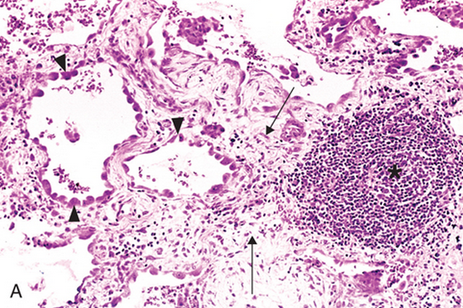
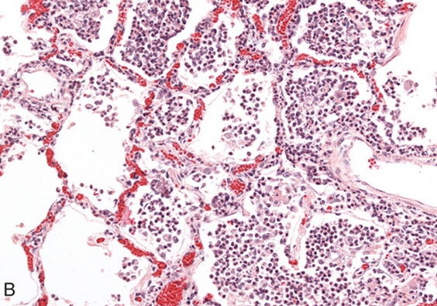
Features of chronic inflammation
Lung chronic inflammation:
Infiltration by lymphocytes
Angiogenesis
fibrosis
Lung acute inflammation

Slide 9
Cells in Chronic inflammation
1. Define chronic inflammation, its causes, effects and patterns
Different types of inflammatory cells accumulate in chronic inflammation
Complex interactions between several cell populations and their secreted mediators.
Mediated by the interaction of monocyte/macrophages with T and B lymphocyte, plasma cells and others

Slide 10
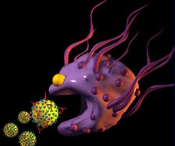
Macrophages
Different types of inflammatory cells accumulate in chronic inflammation
In tissue:
the liver (Kupffer cells)
spleen and lymph nodes (sinus histiocytes)
central nervous system (microglial cells)
and lungs (alveolar macrophages)
In blood: monocytes
Under the influence of adhesion molecules and chemokines, they migrate to a site of injury within 24 to 48 hours after the onset of acute inflammation
(macrophages)
Monocytes are likely to be seen in an inflammatory response to salmonella typhi infection

Slide 11
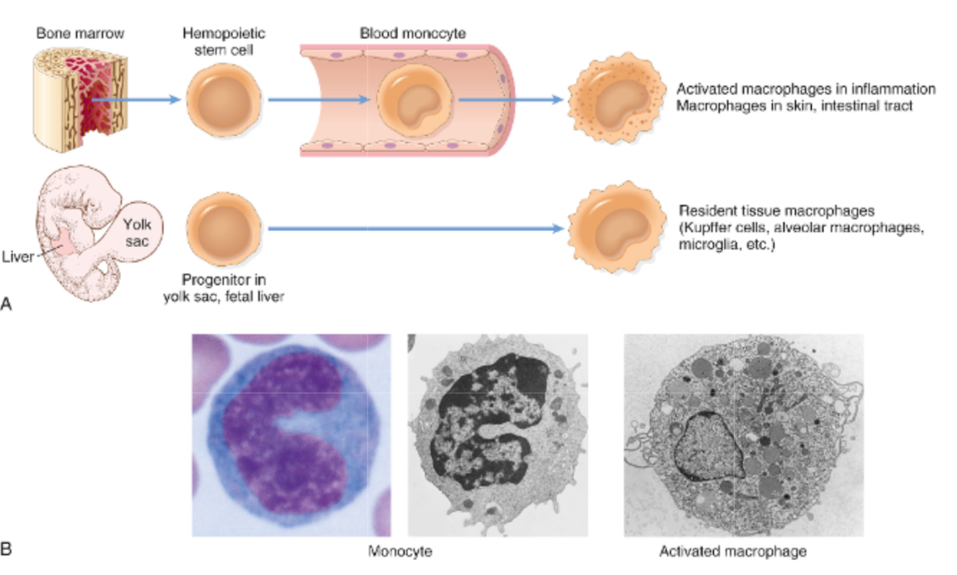
Different types of inflammatory cells accumulate in chronic inflammation
mononuclear phagocyte system
monocytes begin to emigrate into extravascular tissues quite early in acute inflammation and within 48 hours they may constitute the predominant cell type

Slide 12
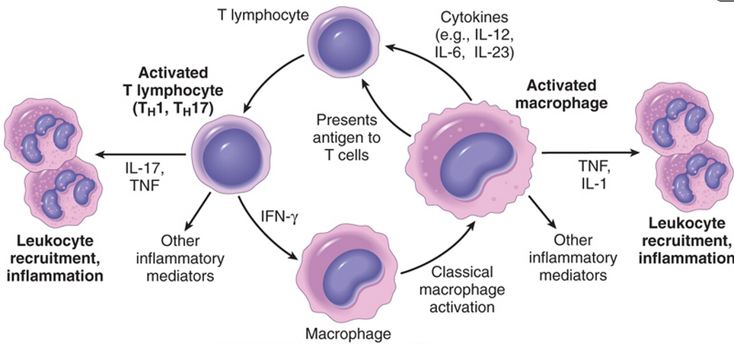
MONONUCLEAR CELL INFILTRATION Macrophages
Different types of inflammatory cells accumulate in chronic inflammation
Macrophages may be activated by a variety of stimuli, including:
cytokines (e.g., IFN-γ) secreted by sensitized T lymphocytes and by NK cells
bacterial endotoxins

Slide 13
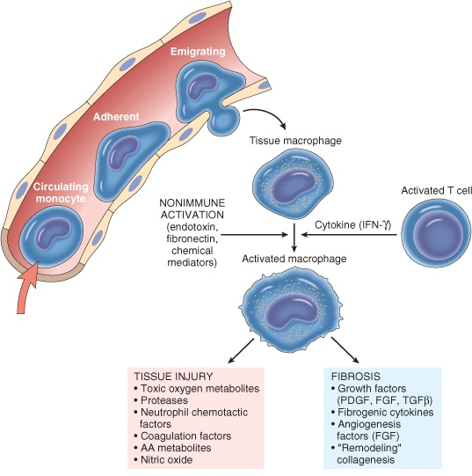
Different types of inflammatory cells accumulate in chronic inflammation
The roles of activated macrophages in chronic inflammation
to eliminate injurious agents such as microbes
to initiate the process of repair
secrete mediators of inflammation, such as cytokines (TNF, IL-1, chemokines, and eicosanoids).
display antigens to T lymphocytes and respond to signals from T cells, thus setting up a feedback loop
It is responsible for much of the tissue injury in chronic inflammation

Slide 14
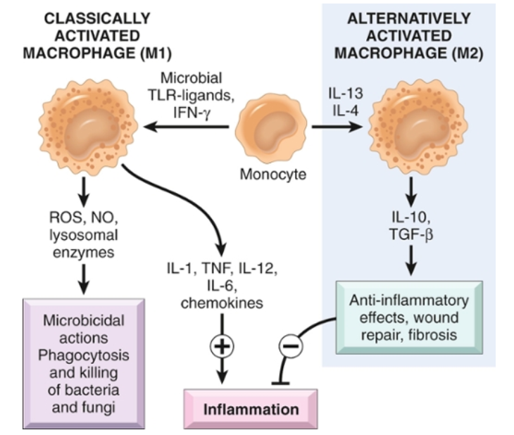
Different types of inflammatory cells accumulate in chronic inflammation

Slide 15
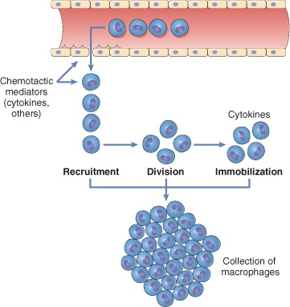
Macrophages/Monocytes
Different types of inflammatory cells accumulate in chronic inflammation
In chronic inflammation, macrophage accumulation persists, this is mediated by different mechanisms:
Recruitment of monocytes from the circulation
Local proliferation of macrophages
Immobilization of macrophages
Collection of activated macrophages :
GRANULOMA

Slide 16
CELLS IN CHRONIC INFLAMMATION
Different types of inflammatory cells accumulate in chronic inflammation
Lymphocytes
Both T & B Lymphocytes migrates into inflammation site, most commonly seen in tissue affected by chronic inflammation
Role: mediators of adaptive immunity, which provides defense against infectious pathogens

Slide 17
Lymphocytes
Different types of inflammatory cells accumulate in chronic inflammation
T lymphocytes are activated to secrete cytokines:
CD4+ T lymphocytes promote inflammation and influence the nature of the inflammatory reaction

Slide 18
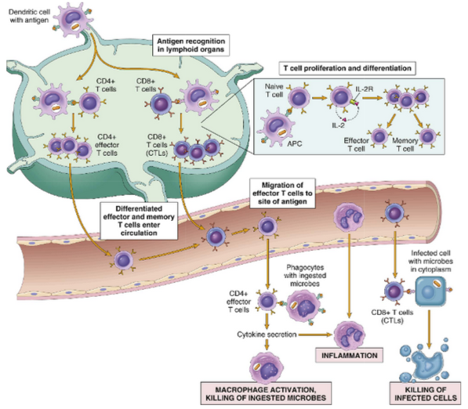
Different types of inflammatory cells accumulate in chronic inflammation
Cell-mediated immunity

Slide 19
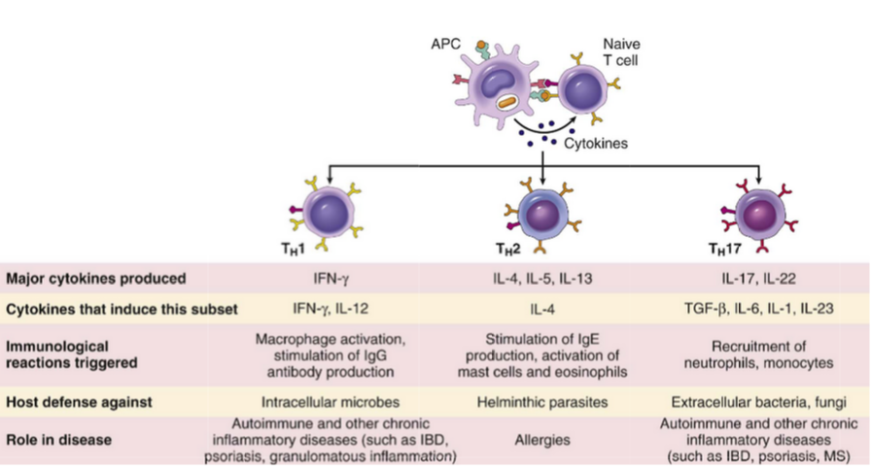
Different types of inflammatory cells accumulate in chronic inflammation
Subsets of helper T (TH) cells
In response to stimuli (mainly cytokines) present at the time of antigen recognition, naive CD4+ T cells may differentiate into populations of effector cells that produce distinct sets of cytokines and perform different functions.
There are three subsets of CD4+ helper T cells
IBD, inflammatory bowel disease
MS, multiple sclerosis

Slide 20
Different types of inflammatory cells accumulate in chronic inflammation
B lymphocytes
B lymphocytes may develop into plasma cells, which secrete antibodies (Humoral immunity)
Naive B lymphocytes recognize antigens, and under the influence of TH cells and other stimuli, the B cells are activated to proliferate and to differentiate into antibody-secreting plasma cells.

Slide 21
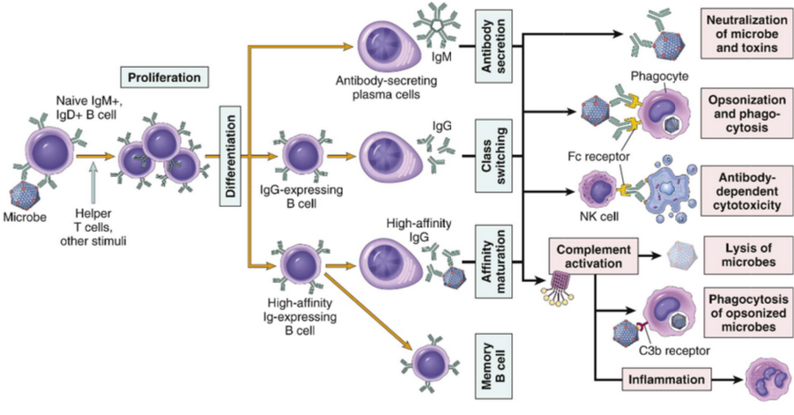
Different types of inflammatory cells accumulate in chronic inflammation
Humoral immunity

Slide 22
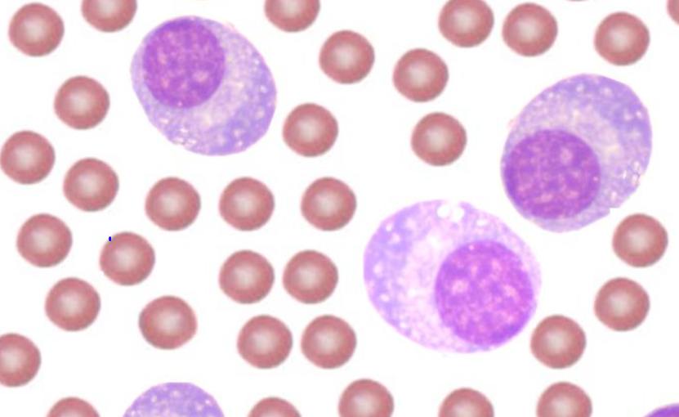
OTHER CELLS IN CHRONIC INFLAMMATION
Different types of inflammatory cells accumulate in chronic inflammation
Plasma cells
Lymphoid cell (Mature B cells)
Common cell in chronic inflammation
Primary source of antibodies
Antibodies are important in inflammation e.g. neutralize antigen and clearance of foreign antigen

Slide 23
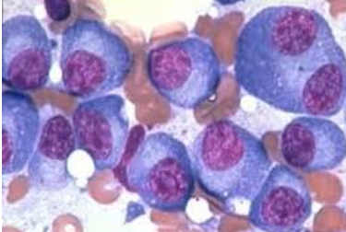
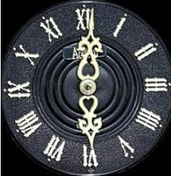
Plasma cells
Different types of inflammatory cells accumulate in chronic inflammation
Morphology of plasma cells:
Cells has an eccentric nucleus shows a cartwheel or clock face pattern of nuclear chromatin with a perinuclear halo

Slide 24
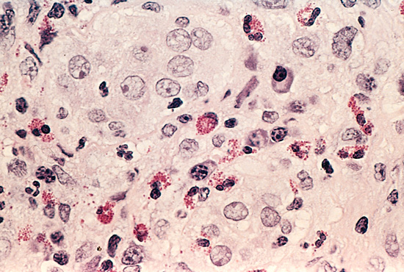
Different types of inflammatory cells accumulate in chronic inflammation
Eosinophils
are abundant in immune reactions mediated by IgE in allergic reaction and in parasitic infections
respond to chemotactic agents derived largely from mast cells
Granules contain major basic protein: toxic to parasites and lead to lysis of mammalian epithelial cells

Slide 25
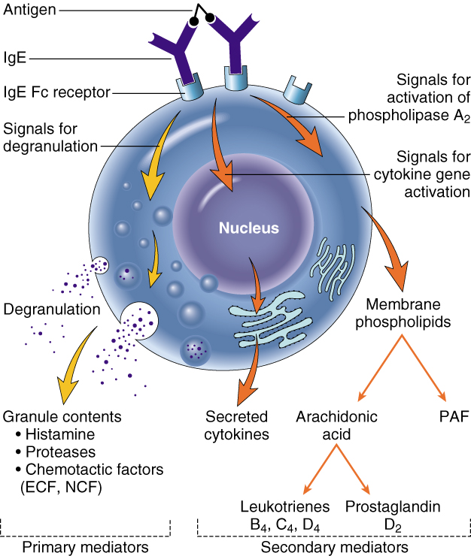
Different types of inflammatory cells accumulate in chronic inflammation
Mast cells
are widely distributed in connective tissues
express on their surface the receptor that binds the Fc portion of IgE antibody
the cells degranulate and release mediators, such as histamine and products of AA oxidation

Slide 26
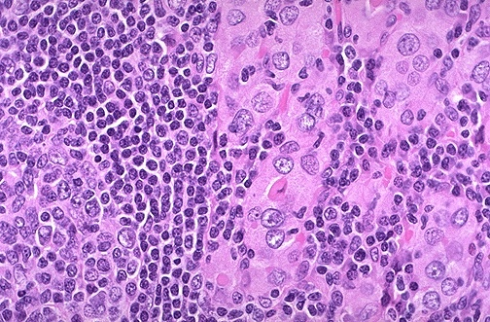
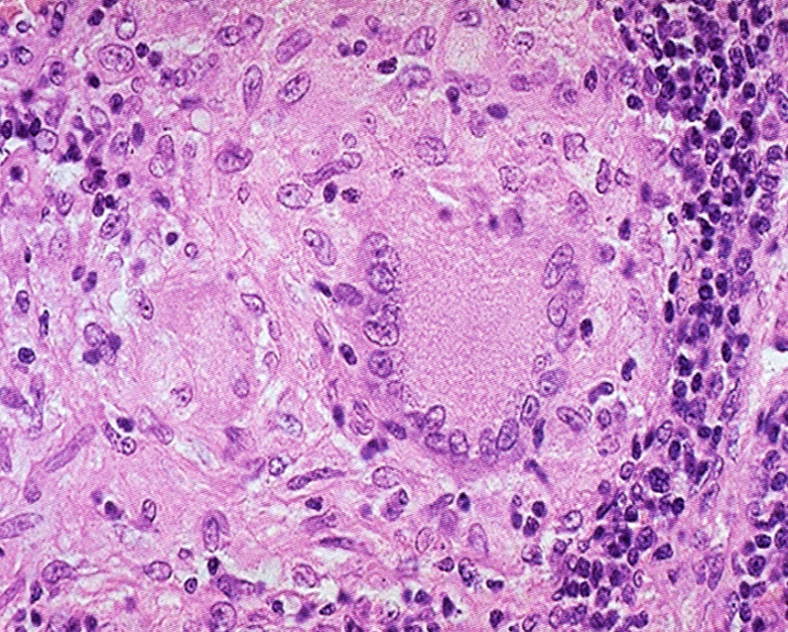
Chronic inflammation patterns
Patterns of chronic inflammation
Chronic non specific inflammation
Chronic granulomatous inflammation
Features of chronic inflammation e.g.:
Foreign material, e.g. silicates, including asbestos.
Auto-immune diseases, e.g. auto-immune thyroiditis
Chronic inflammation in which modified macrophages (epithelioid cells) accumulate in small clusters surrounded by lymphocytes. The small clusters are called: (GRANULOMAS)
Example: TUBERCULOSIS

Slide 27
Objectives
Define chronic inflammation with emphasis on causes, nature of the inflammatory response, cells involved and tissue changes.
Describe the systemic manifestations of inflammation and their general physiology, including fever, leukocyte left shift, and acute phase reactants.

Slide 28
Systemic effects of Inflammation
Systemic manifestations of inflammation
Acute phase reaction/response
- IL-1 and TNF
Fever
Malaise
Anorexia
Bone marrow
- IL-1 + TNF
Leukocytosis
Lymphoid organs
Liver
- IL-6, IL-1, TNF
Acute phase proteins
C-reactive protein
Lipopolysaccharide binding protein
Serum amyloid A
a-2 macroglobulin
Haptoglobin
Ceruloplasmin
fibrinogen

Slide 29
Fever Produced in response to Pyrogens
Systemic manifestations of inflammation
Types of Pyrogens:
Exogenous pyrogens: Bacterial products
Endogenous pyrogens:
Interleukin 1 (IL1) and Tumour necrosis factor (TNF)
Bacterial products stimulate leukocytes to release cytokines such as IL-1 and TNF that increase the enzymes (cyclooxygenases) that convert AA into prostaglandins.
Chemical mediators which are the inducing cause of fever are:
IL-1
TNF
Prostaglandins

Slide 30
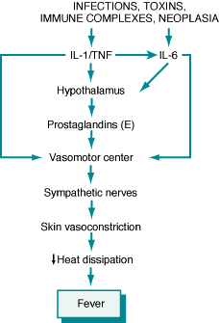
Systemic manifestations of inflammation
Fever
In the hypothalamus, the prostaglandins, especially PGE₂, stimulate the production of neurotransmitters such as cyclic AMP, which function to reset the temperature set-point at a higher level.
NSAIDs, including aspirin , reduce fever by inhibiting cyclooxygenase and thus blocking prostaglandin synthesis.

Slide 31
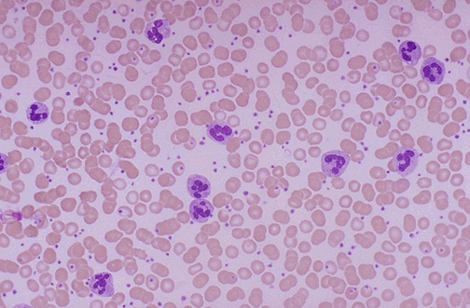
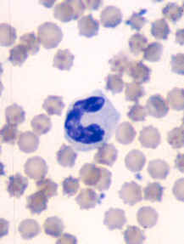
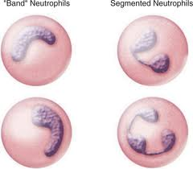
Systemic manifestations of inflammation
Leukocytosis
Shift to left
Notes:
Acute inflammation is marked by an increase in inflammatory cells. Perhaps the simplest indicator of acute inflammation is an increase in the white blood cell count in the peripheal blood, here marked by an increase in segmented neutrophils (PMN's).

Slide 32
Systemic manifestations of inflammation
Inflammation Systemic Manifestations
Leukocytosis:
WBC count climbs to 15,000 or 20,000 cells/μl
most bacterial infection (Neutrophil)
Lymphocytosis:
Viral infections: Infectious mononucleosis, mumps,
German measles ( Lymphocytes)
Eosinophilia: bronchial asthma,
hay fever, parasitic infestations
Leukopenia: typhoid fever,
infection with rickettsiae/protozoa

Slide 33
Systemic manifestations of inflammation
C-reactive protein (CRP)
Lipopolysaccharide binding protein
Serum amyloid A (SAA)
a-2 macroglobulin
Haptoglobin
Ceruloplasmin
fibrinogen
CRP and SAA, bind to microbial cell walls, and they may act as opsonins and fix complement

Slide 34
Acute phase proteins
Systemic manifestations of inflammation
Elevated serum levels of CRP serve as a marker for acute inflammation and increased risk of myocardial infarction in patients with coronary artery disease.
Prolonged production of these proteins (especially SAA) in states of chronic inflammation can cause:
secondary amyloidosis

Slide 35
Systemic manifestations of inflammation
Increased erythrocyte sedimentation rate (ESR)
The rise in fibrinogen causes erythrocytes to form stacks (rouleaux) that sediment more rapidly at unit gravity than do individual erythrocytes.

Slide 36
Systemic manifestations of inflammation

Slide 37
Erythrocyte sedimentation rate (ESR)
Systemic manifestations of inflammation
This is a simple test for an inflammatory response caused by any stimulus.
Fibrinogen binds to red cells and causes them to form stacks (rouleaux) that sediment more rapidly at unit gravity than do individual red cell

Slide 38
Define chronic inflammation with emphasis on causes, nature of the inflammatory response, cells involved and tissue changes.
Describe the systemic manifestations of inflammation and their general physiology, including fever, leukocyte left shift, and acute phase reactants.

