Slide 1

GRANULOMATOUS INFLAMMATION
Foundation Block, Pathology
Oct, 2019
Page 85-86
Dr. Maha Arafah
Associate Professor
Department of Pathology
King Saud University
Email: marafah@ksu.edu.sa
marafah@hotmail.com

Slide 2
OBJECTIVES AND KEY PRINCIPLES TO BE TAUGHT:
Upon completion of this lecture, the student should:
Define Granulomatous inflammation.
Recognize the morphology of granulomas (tubercles) and list the cells found in granuloma along with their appearance.
Understands the pathogenesis of granuloma formation.
Identify the two types of granulomas, which differ in their pathogenesis.
  Foreign body granulomas
  Immune granulomas
List the common causes of Granulomatous Inflammation.

Slide 3
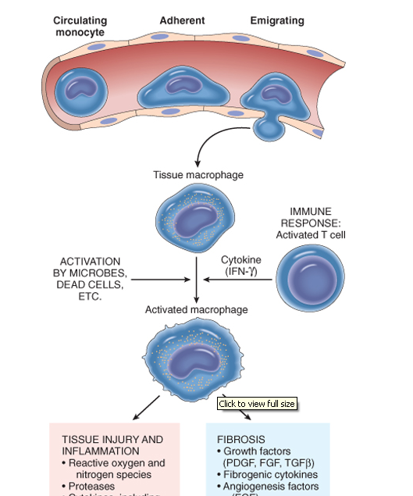
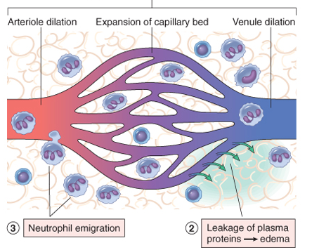
Define Granulomatous inflammation
Inflammation
Acute inflammation
Chronic inflammation
Neutrophils
Macrophage, Lymphocytes & Plasma cells

Slide 4
Granulomatous inflammation
Define Granulomatous inflammation.
A form of chronic inflammation characterized by the formation of granulomas
collections of activated macrophages, often with T lymphocytes, and sometimes associated with central necrosis

Slide 5
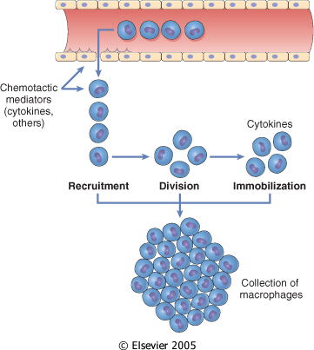
Define Granulomatous inflammation
The activated macro­phages may develop abundant cytoplasm and begin to resemble epithelial cells, and are called epithelioid cells.
Epithelioid histiocytic cells are the principle cellular components in granuloma
= Granuloma

Slide 6
Why is it important?
Define Granulomatous inflammation.
Granulomas are encountered in certain specific pathologic states.
Recognition of the granulomatous pattern is important because of the limited number of conditions (some life-threatening) that cause it

Slide 7
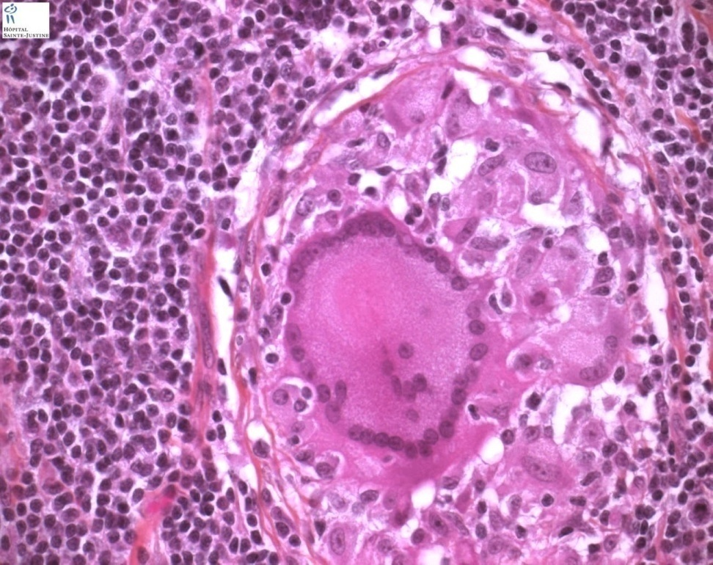
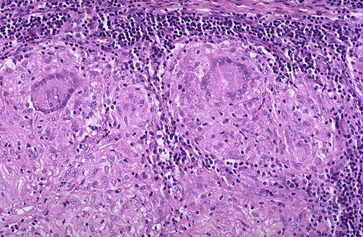
Recognize the morphology of granulomas (tubercles) and list the cells found in granuloma along with their appearance
Granuloma = Nodular collection of epithelioid macrophages surrounded by a rim of lymphocytes
Epithelioid macrophages: squamous cell-like appearance
Some activated macrophages may fuse, forming multinu­cleate giant cells

Slide 8
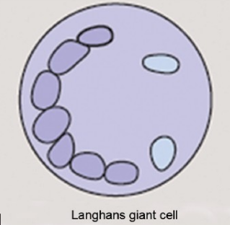
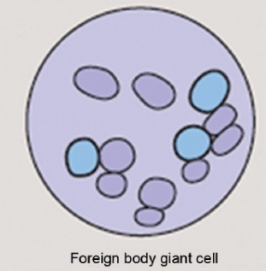
Recognize the morphology of granulomas (tubercles) and list the cells found in granuloma along with their appearance
The nuclei arranged either peripherally (Langhans-type giant cell) or haphazardly (foreign body-type giant cell).

Slide 9
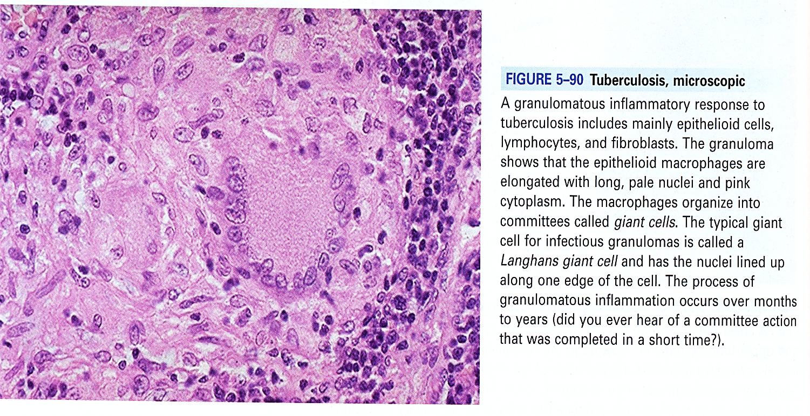
Recognize the morphology of granulomas (tubercles) and list the cells found in granuloma along with their appearance
Granuloma
2. Langhans-type giant cell
1. microscopic aggregation of activated macrophages
3. Lymphocytes

Slide 10
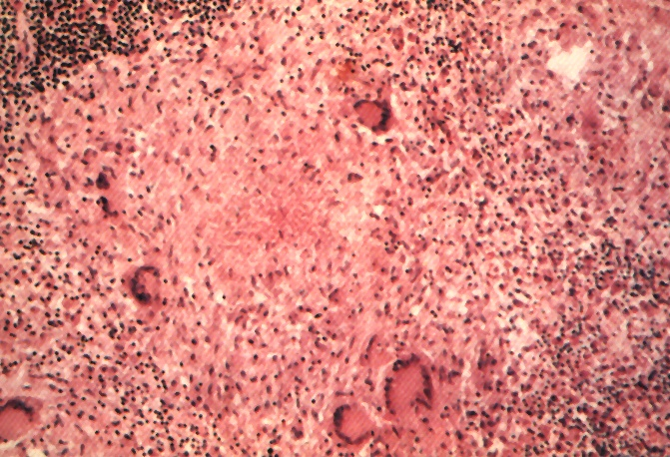
Granuloma
Recognize the morphology of granulomas (tubercles) and list the cells found in granuloma along with their appearance
Langhans Giant Cell
Lymphocytic Rim
Caseous Necrosis
Epithelioid Macrophage

Slide 11
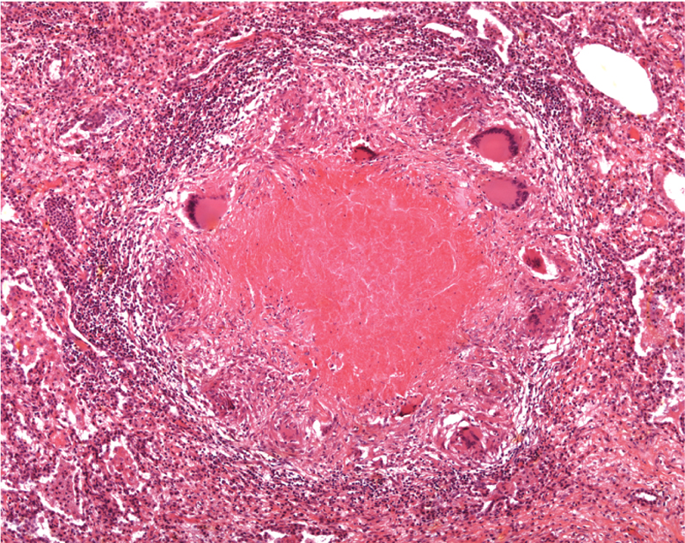
Epithelioid histiocytes
Lymphocytes
Multinucleated cell
Necrosis

Slide 12
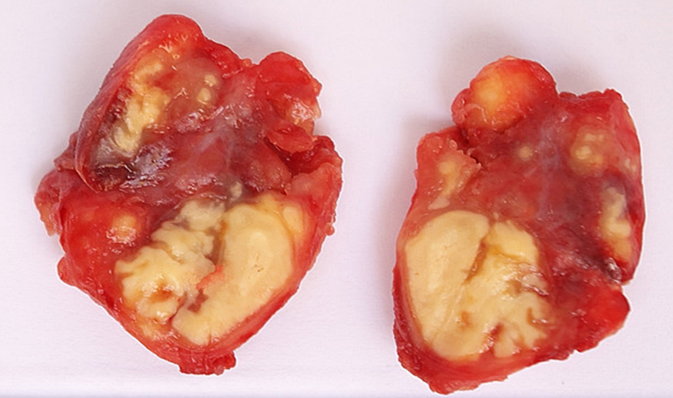
Recognize the morphology of granulomas
Section of a lymph node with caseation necrosis

Slide 13
Granulomatous Inflammation
Understands the pathogenesis of granuloma formation
Pathogenesis
Neutrophils ordinarily remove agents that incite an acute inflammatory response. However, there are circumstances in which reactive neutrophils cannot digest the substances that provoke acute inflammation.

Slide 14
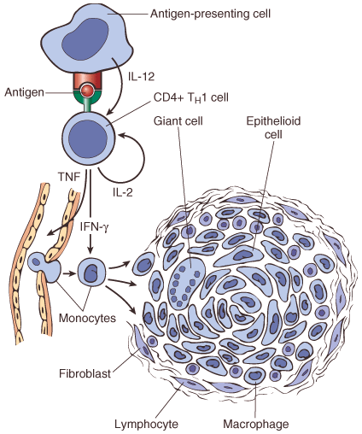
Granulomatous Inflammation Mechanism
Understands the pathogenesis of granuloma formation
What is the initiating event in granuloma formation?
deposition of a indigestible antigenic material
IFN-γ released by the CD4+ T cells of the T_{H}1 subset.
IFN-γ helps to activate and convert macrophages into epithelioid cells during the process of granuloma formation
Type IV hypersensitvity

Slide 15
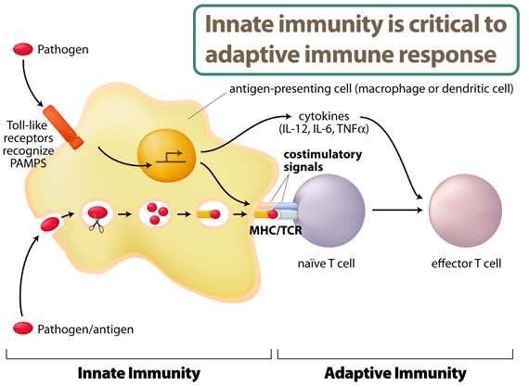
Understands the pathogenesis of granuloma formation
IL-2, and IFN-γ,

Slide 16
There are two types of granulomas
Identify the two types of granulomas, which differ in their pathogenesis
Foreign body granuloma
Immune granuloma
are incited by relatively inert foreign bodies e.g. talc (associated with intravenous drug abuse) or sutures
Typically, foreign body granulomas form when material are large enough to preclude phagocytosis by a single macrophage
These material do not incite any specific inflammatory immune response.
The foreign material can usually be identified in the center of the granuloma, by polarized light (appears refractile).
are caused by a variety of agents that are capable of inducing a persistent T cell–mediated immune response, typically persistent microbes, that are capable of inducing a cell-mediated immune response.

Slide 17
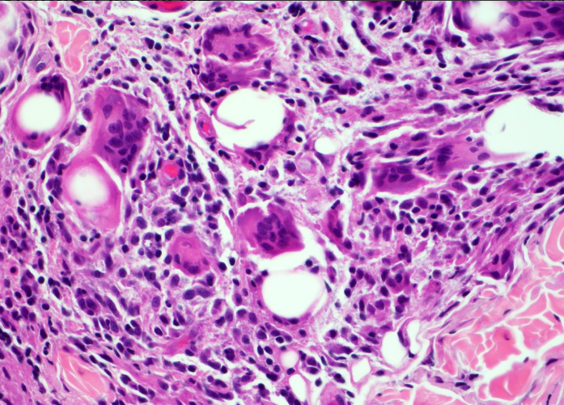
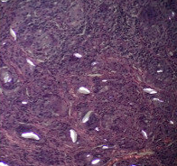
Foreign body granuloma
Identify the two types of granulomas, which differ in their pathogenesis
polarized light

Slide 18
Granulomatous Inflammation
Causes
List the common causes of Granulomatous Inflammation
Non-immune granuloma
Immune granuloma:
Foreign body
  Suture
  Graft material
  talc (associated with intravenous drug abuse)
Bacteria
  Tuberculosis
  Leprosy
  Actinomycosis
  Cat-scratch disease
Parasites
  Schistosomiasis
  Leishmaniasis
Fungi
  Histoplasmosis
  Blastomycosis
Metal/Dust
  Berylliosis
unknown
Sarcoidosis
Crohn’s disease

Slide 19
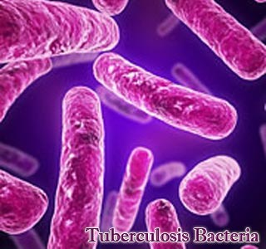
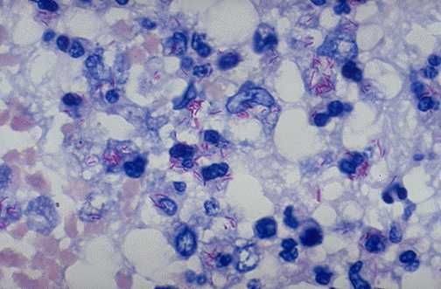
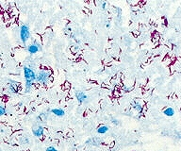
Tuberculosis: Mycobacterum tuberculosis
List the common causes of Granulomatous Inflammation
Mycobacteria – ‘fungus like..
slender rods
acid fast bacilli [AFB] (i.e., they have a high content of complex lipids that readily bind the Ziehl-Neelsen [carbol fuchsin] stain and subsequently resist decolorization).
acid fast bacilli

Slide 20
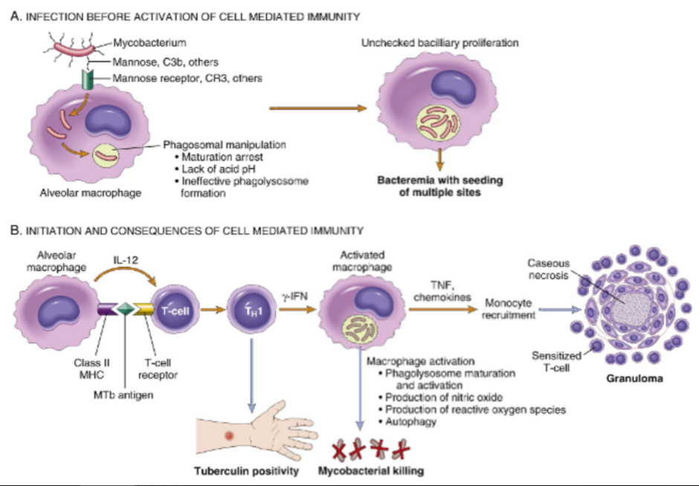
List the common causes of Granulomatous Inflammation
Pathogenesis of TB
Cord factor is a glycolipid molecule found in the cell wall of TB bacilli. It prevents phagosomal function

Slide 21
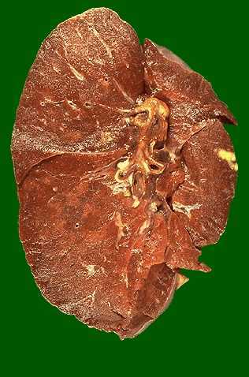
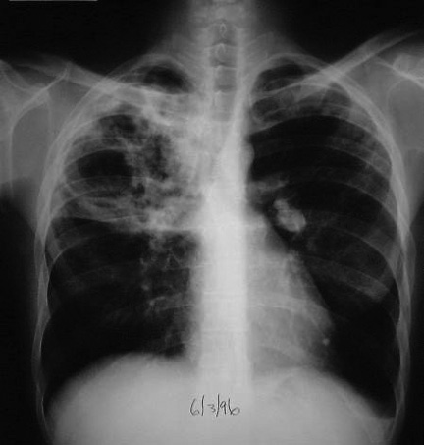
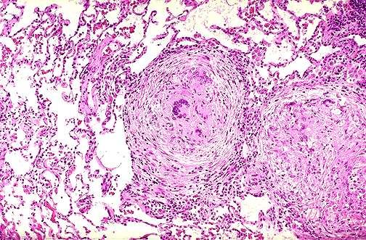
Tuberculosis
List the common causes of Granulomatous Inflammation

Slide 22
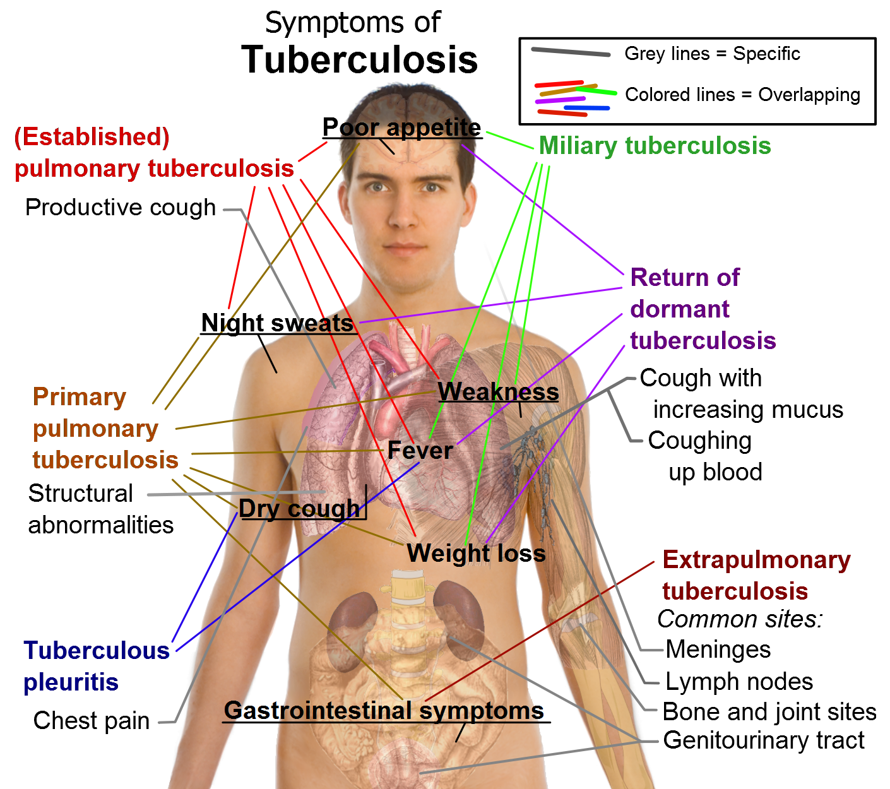

Slide 23
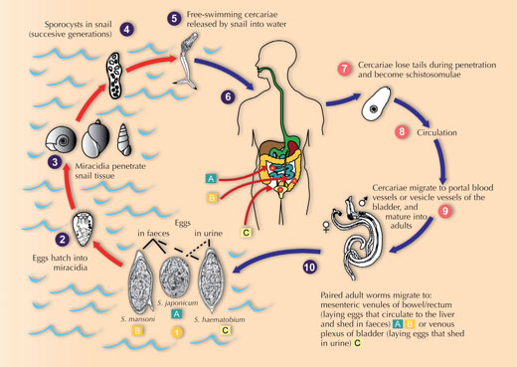
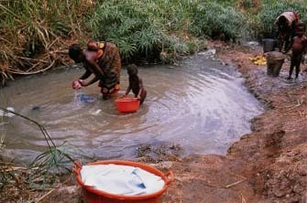
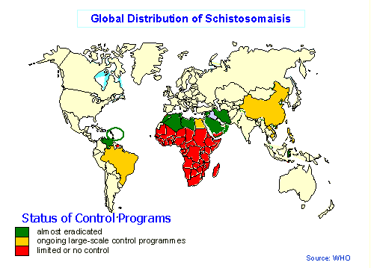
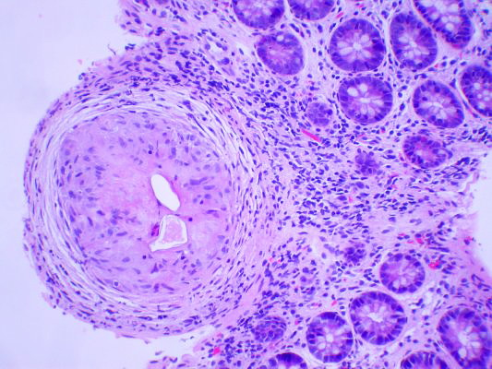
Schistosomiasis
In parasitic infection, the granuloma is associated with eosinophils

Slide 24
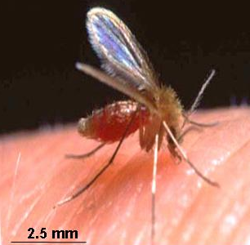
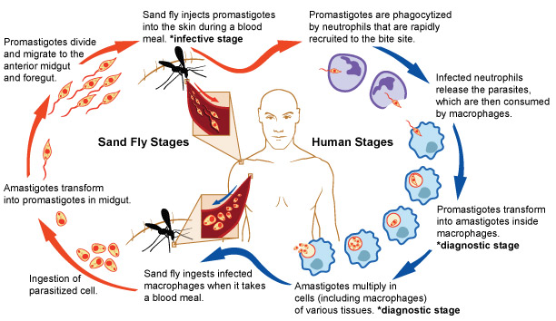
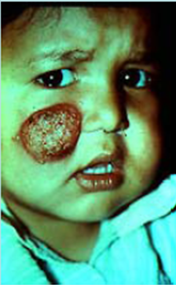
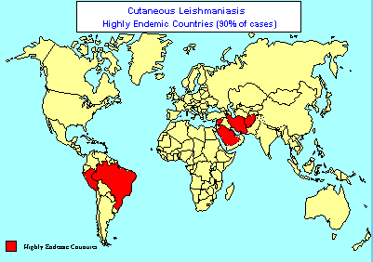

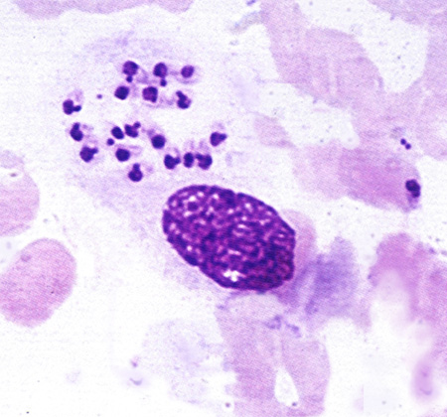
Leishmaniasis

Slide 25
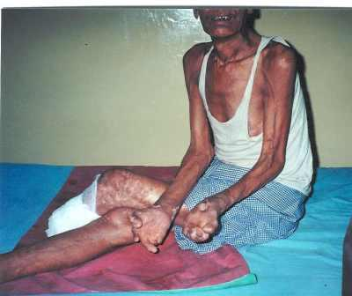
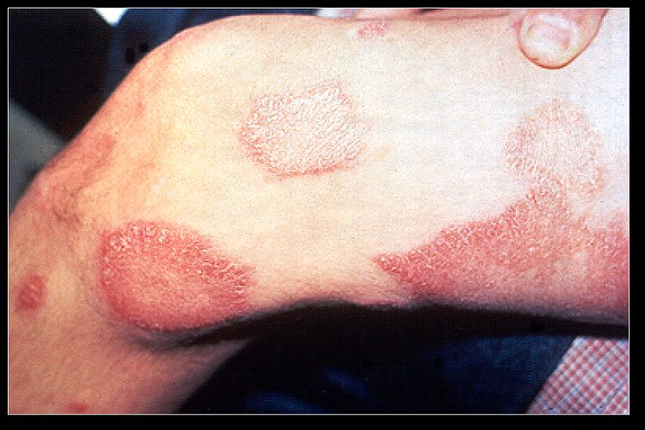
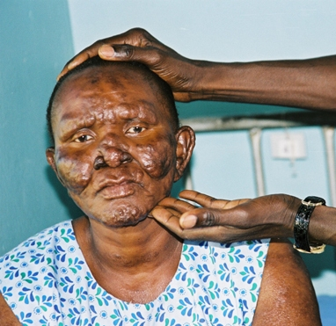
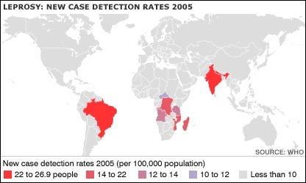
Leprosy

Slide 26
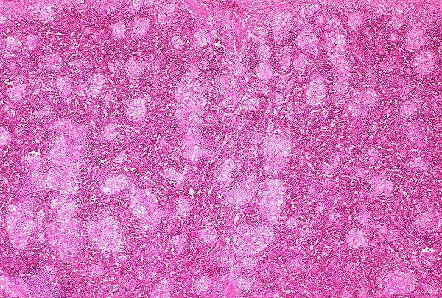
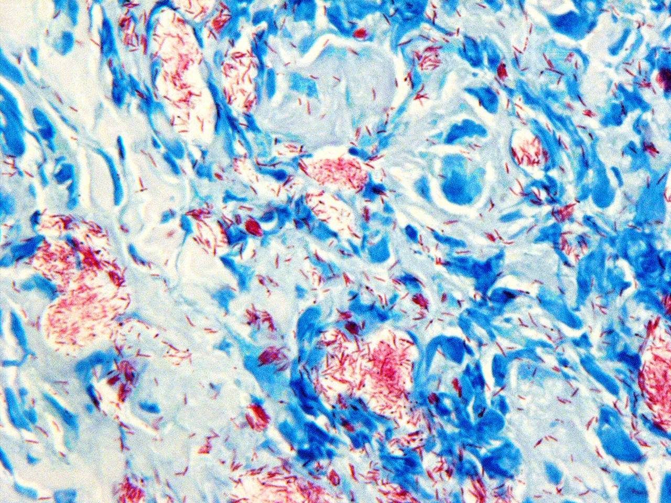
Leprosy

Slide 27
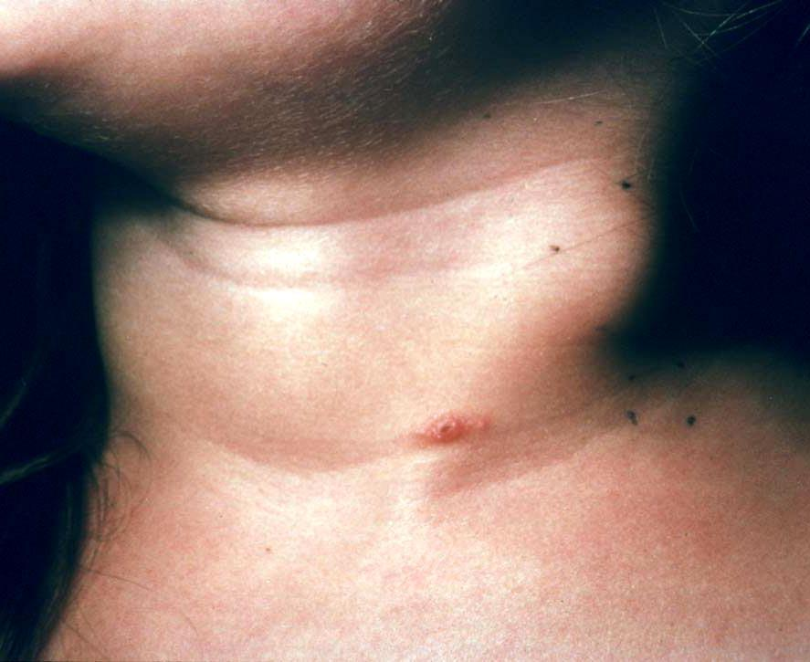
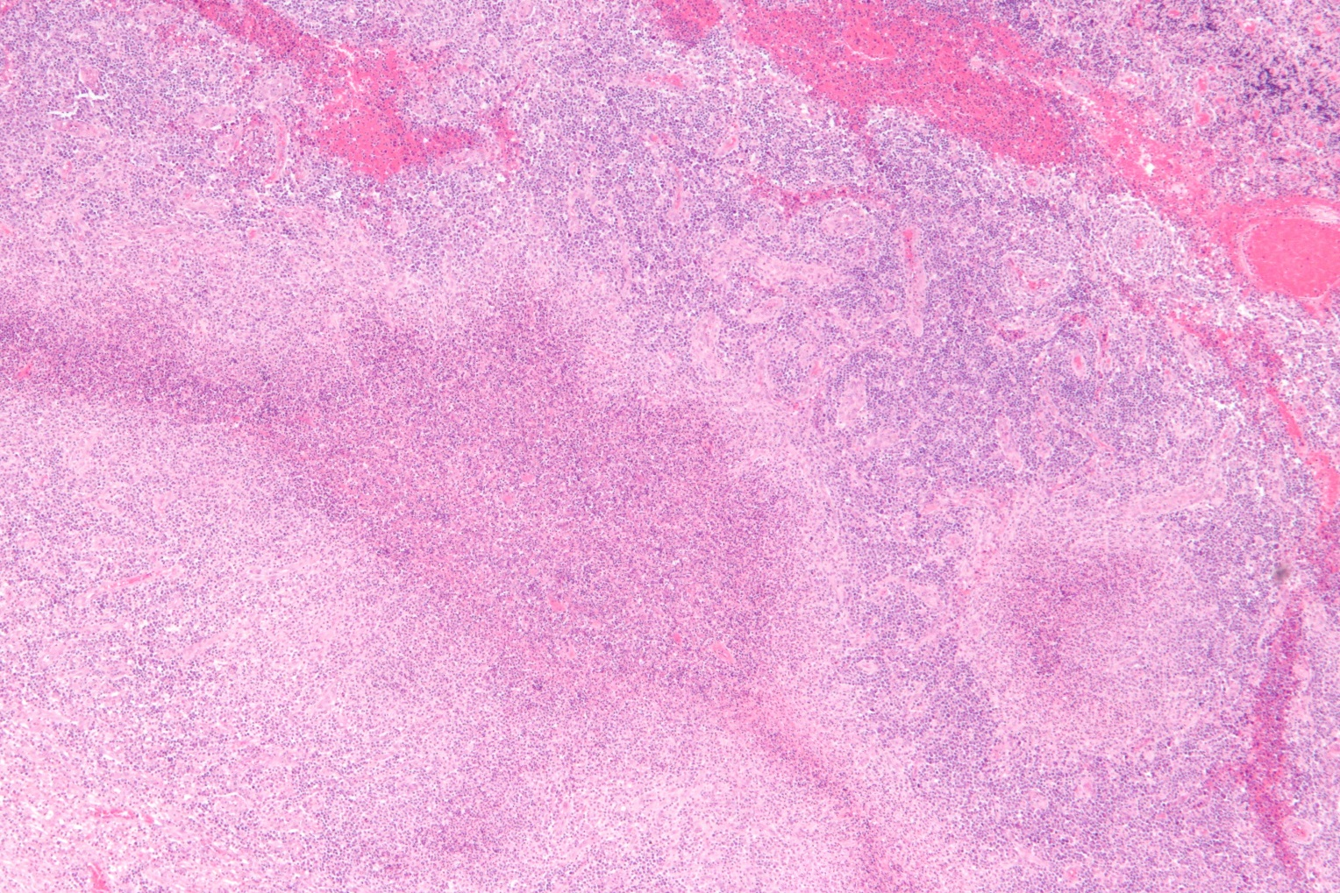
Cat-scratch disease
Gram-negative bacillus
Rounded or stellate granuloma containing central granular debris and neutrophils

Slide 28
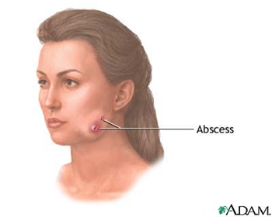
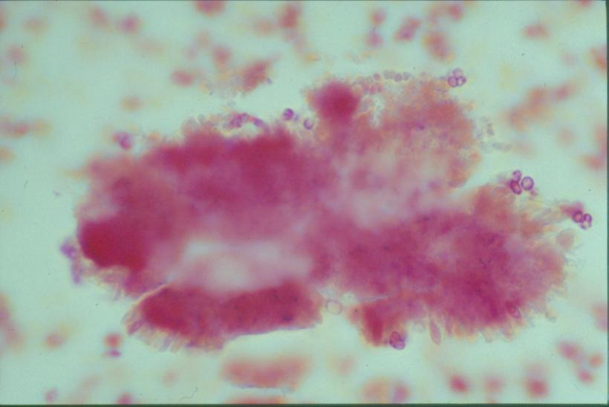
Actinomycosis is a long-term (chronic) granulomatous bacterial infection that commonly affects the face and neck
Actinomycosis
Examination of drained fluid under a microscope shows "sulfur granules" in the fluid. They are yellowish granules made of clumped organisms.
filamentous, gram-positive, non–acid-fast, anaerobic-to-microaerophilic bacteria

Slide 29
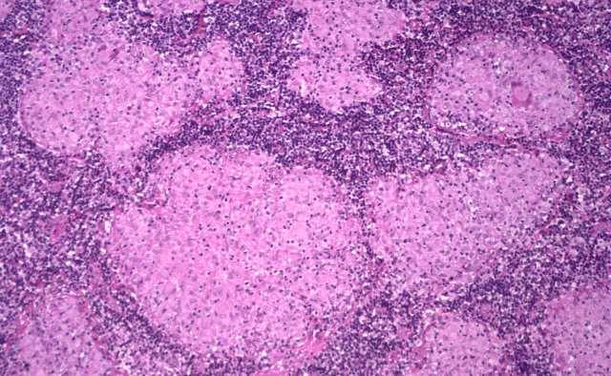
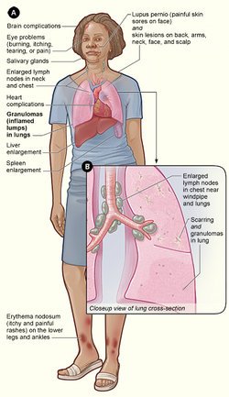
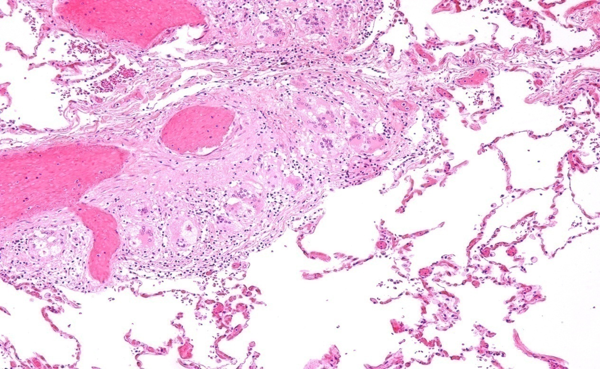
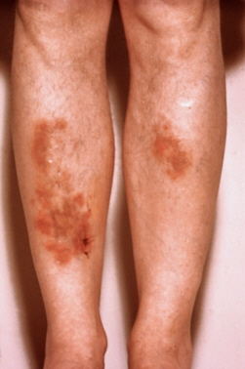
Sarcoidosis
Non-caseating granuloma
bilateral hilar lymph nodes enlargement

Slide 30
Match A and B
A
B
The most important cell in granulomatous inflammation
A cytokines that is important in activating macrophages and transforming them into epithelioid cells
Multinucleated cell in TB
Antigen presenting cells
pathogenesis of immune type granulomatous inflammation
Microscopic finding of TB
Found in the cell wall of TB
IFN-γ
Langhans cells
Epitheliod histiocyes
Cord factor
Langerhan’s cells
Type IV hypersensitivity reaction
Caseating granuloma

Slide 31
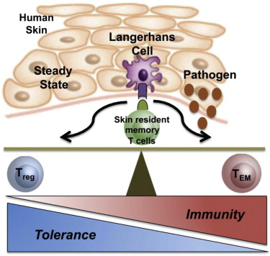
Langerhan’s cells
Antigen presenting cells

Slide 32
Which of the following diseases does not cause granulomatous inflammation
Cat-scratch disease
Actinomycosis
Sarcoidosis
Leishmaniasis
Staphylococcus infection

Slide 33
What are the causes of caseous necrosis?
Caseous necrosis is caused by tuberculosis, leprosy, and fungal infections.

Slide 34
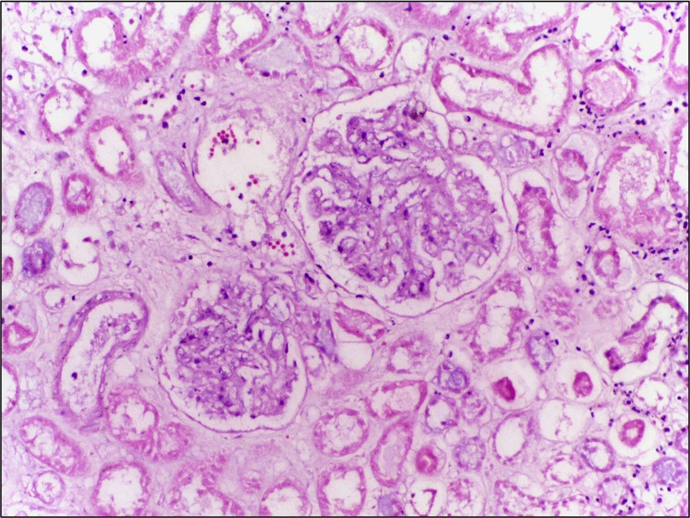
How does caseous necrosis differ from coagulative necrosis under the microscope?
- In caseous necrosis, there is total loss of tissue structure, whereas in coagulative necrosis, cell outlines are retained.

Slide 35
What is the origin of epithelioid cells?
They are transformed macrophages.
Do you know the difference between granulation tissue and granulomatous inflammation?
Granulation tissue contains new small blood vessels, fibroblasts, and mononuclear cells in an edematous extracellular matrix; it is part of the repair response. A granuloma is a circumscribed collection of epithelioid cells, usually surrounded by lymphocytes; it is a form of chronic inflammation.

Slide 36
What are the causes of granulomatous inflammation?
Causes are
  (1) bacterial (e.g., Mycobacterium tuberculosis, M. leprae, Treponema pallidum)
  (2) parasitic (e.g., schistosomiasis)
  (3) fungal (e.g., histoplasmosis, blastomycosis)
  (4) inorganic dusts (e.g., silicosis, berylliosis)
  (5) foreign body
  (6) unknown (e.g., sarcoidosis).

Slide 37
How are giant cells formed in granulomas?
Giant cells are formed by fusion of macrophages.
What are the other cells in a granuloma?
Lymphocytes, mainly CD4+, that caused the granulomatous reaction are present. Healing granulomas are surrounded by fibroblasts.
In TB do granulomas in different organs look different?
No, all granulomas look similar.

Slide 38
TAKE HOME MESSAGES:
Granulomatous inflammation is a distinctive pattern of chronic inflammation characterized by aggregates epithelioid macrophages
Damaging stimuli which provoke a granulomatous inflammatory response include: Microorganisms which are of low inherent pathogenicity but which excite an immune response.
Granuloma are produced in response to:
    Bacterial infection
    parasitic infection: e.g. Schistosoma infection
    Certain fungi cannot be dealt with adequately by neutrophils, and thus excite granulomatous reactions.
    Non-living foreign material deposited in tissues, e.g. keratin from ruptured epidermal cyst.
    Unknown factors, e.g. in the disease 'sarcoidosis' and Crohn's diseas

