Slide 1
Properties of benign and malignant tumors
Dr. Maria A. Arafah
Assistant Professor – Department of Pathology
http://fac.ksu.edu.sa/mariaarafah/courses

Slide 2
Objectives
Compare between benign & malignant tumors in terms of differentiation, rate of growth, local invasion & metastases.
Identify the morphological features that differentiate between benign & malignant tumors.
Define the terms: differentiation & anaplasia.
List the pathways by which malignant tumors spread.
Define the terms: dysplasia & carcinoma in situ.

Slide 3
Introduction
Features to distinguish between benign & malignant tumors:
Differentiation & anaplasia
Rate of growth
Local invasion
Metastasis

Slide 4
Differentiation & Anaplasia
Differentiation & anaplasia are characteristics seen only in the parenchymal cells that constitute the transformed elements of neoplasms.
Differentiation: the extent to which the parenchymal cells of the tumor resemble their normal counterparts morphologically and functionally

Slide 5
Differentiation & Anaplasia
Differentiation:
Well differentiated = closely resemble their normal counterparts
Moderately differentiated
Poorly differentiated
Undifferentiated (Anaplasia)

Slide 6
Differentiation & Anaplasia
Benign neoplasms are composed of well-differentiated cells that closely resemble their normal counterparts.
Lipoma: mature fat cells laden with cytoplasmic lipid vacuoles.
Chondroma: mature cartilage cells that synthesize their usual cartilaginous matrix (evidence of morphologic and functional differentiation)
In well-differentiated benign tumors, mitoses are usually rare and are of normal configuration.

Slide 7
Differentiation & Anaplasia
The more differentiated the tumor cell, the more completely it retains the functional capabilities of its normal counterparts.
e.g. benign neoplasms and even well-differentiated cancers of endocrine glands frequently elaborate the hormones characteristic of their origin.

Slide 8
Differentiation & Anaplasia
The stroma carrying the blood supply is crucial to the growth of tumors but does not aid in the separation of benign from malignant ones.
However the amount of stromal connective tissue determines the consistency of a neoplasm.
e.g. certain cancers induce a dense, abundant fibrous stroma (desmoplasia), making them hard, so-called scirrhous tumors.

Slide 9
Differentiation & Anaplasia
Lipoma
Chondroma

Slide 10
Differentiation & Anaplasia
Malignant neoplasms are characterized by a wide range of parenchymal cell differentiation: from well differentiated to completely undifferentiated.
Between the two extremes lie tumors loosely referred to as moderately differentiated.

Slide 11
Differentiation & Anaplasia
Leiomyosarcoma
Squamous cell carcinoma

Slide 12
Differentiation & Anaplasia
Malignant neoplasms that are composed of undifferentiated cells are said to be anaplastic.
Anaplasia: loss of the structural and functional differentiation. It is a hallmark of malignancy.

Slide 13
Differentiation & Anaplasia

Slide 14
Differentiation & Anaplasia
It is important to recognize the following histopathological features in any neoplasm:
Pleomorphism: variation in size and shape
Enlarged nuclei resulting in an increase of nuclear to cytoplasm ratio (that may approach 1:1 instead of the normal 1:4 or 1:6)
Hyperchromasia (dark nuclei) due to coarse & clumped chromatin
Prominent nucleoli
Mitoses (typical or atypical forms)
Giant cells: larger than their neighbors & possess either one enormous nucleus or several nuclei.

Slide 15
Differentiation & Anaplasia
Tumor Giant Cells
Atypical Mitosis

Slide 16
Dysplasia
Definition: a loss in the uniformity of the individual cells and a loss in their architectural orientation.
It is a non-neoplastic process but a premalignant condition.
It occurs mainly in the epithelia.
Dysplastic cells show a degree of: pleomorphism, ⬆N:C ratio, hyperchrmasia, irregular nuclei, increased mitoses, loss of polarity & a disordered maturation or total failure of maturation.

Slide 17
Dysplasia
Dysplasia does not mean cancer.
Dysplasia does not necessarily progress to cancer.
Dysplasia may be reversible.
The risk of invasive cancer varies with:
grade of dysplasia (mild, moderate, severe)
duration of dysplasia
site of dysplasia
Notes:
In dysplastic stratified squamous epithelium, mitoses are not confined to the basal layers, where they normally occur, but may be seen at all levels and even in surface cells.

Slide 18
Dysplasia

Slide 19
Dysplasia
Differences between dysplasia & cancer:
Lack of invasiveness.
Reversibility

Slide 20
Carcinoma in Situ
If dysplastic changes involve the entire thickness of the epithelium it is called: carcinoma in-situ.
Definition: an intraepithelial malignancy in which malignant cells involve the entire thickness of the epithelium without penetration of the basement membrane.

Slide 21
Carcinoma in Situ
It is applicable only to epithelial neoplasms.
It is a true neoplasm with all of the features of malignant neoplasm except invasiveness.
It displays the cytological features of malignancy without invading the basement membrane.

Slide 22
Carcinoma in Situ

Slide 23
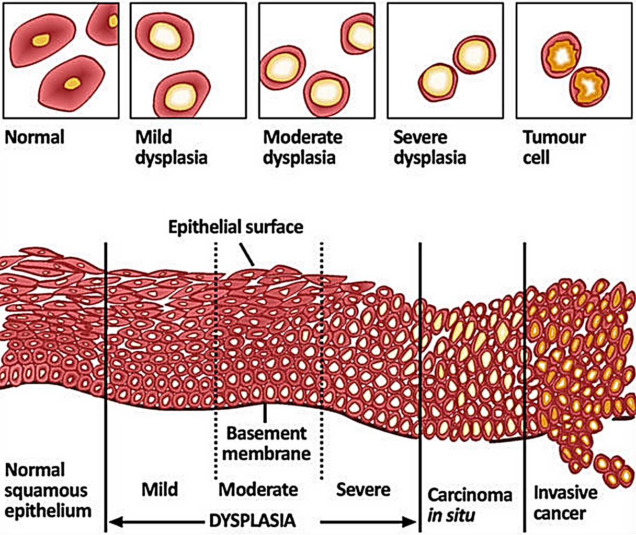
Dysplasia & Carcinoma in Situ

Slide 24
Reminder…
Features to distinguish between benign & malignant tumors:
Differentiation & anaplasia
Rate of growth
Local invasion
Metastasis

Slide 25
Rate of Growth
Benign tumors:
They usually grow slowly.
Their growth is affected by: adequate blood supply, location or hormones e.g. leiomyoma of the uterus.

Slide 26
Rate of Growth
Malignant tumors:
They usually grow fast.
The rate of growth of malignant tumors usually correlates inversely with their level of differentiation.

Slide 27
Local Invasion
Benign tumors:
They remain localized.
They cannot invade.
They are usually encapsulated.

Slide 28
Local Invasion

Slide 29
Local Invasion
Malignant tumors:
They invade the underlying basement membrane or stroma.
They are destructive.
They are usually not encapsulated.

Slide 30
Local Invasion*
Notes:
Next to the development of metastases, local invasiveness is the most reliable feature that distinguishes malignant from benign tumors.

Slide 31
Metastasis
Definition: it is the development of secondary implants of a tumor that are discontinuous with the primary tumor & located in remote tissues.
More than any other attribute, the property of metastasis identifies a neoplasm as malignant.

Slide 32
Metastasis
Cancer have different ability to metastasize.
Approximately 30% patients present with clinically evident metastases.
Generally, the more anaplastic and the larger the primary tumor, the more likely it metastasizes.

Slide 33
Metastasis
Malignant neoplasms disseminate by one of three pathways:
(1) seeding within body cavities
(2) lymphatic spread
(3) hematogenous spread

Slide 34
Metastasis
Spread by seeding occurs when neoplasms invade a natural body cavity.
This mode of dissemination is particularly characteristic of cancers of the ovary, which often cover the peritoneal surfaces widely.

Slide 35
Metastasis
Lymphatic spread is more typical of carcinomas.
Breast carcinoma → axillary lymph node
Lung carcinomas → bronchial lymph nodes

Slide 36
Metastasis
Hematogenous spread is favored by sarcomas but can also occur in carcinomas.
Veins are more commonly invaded.

Slide 37
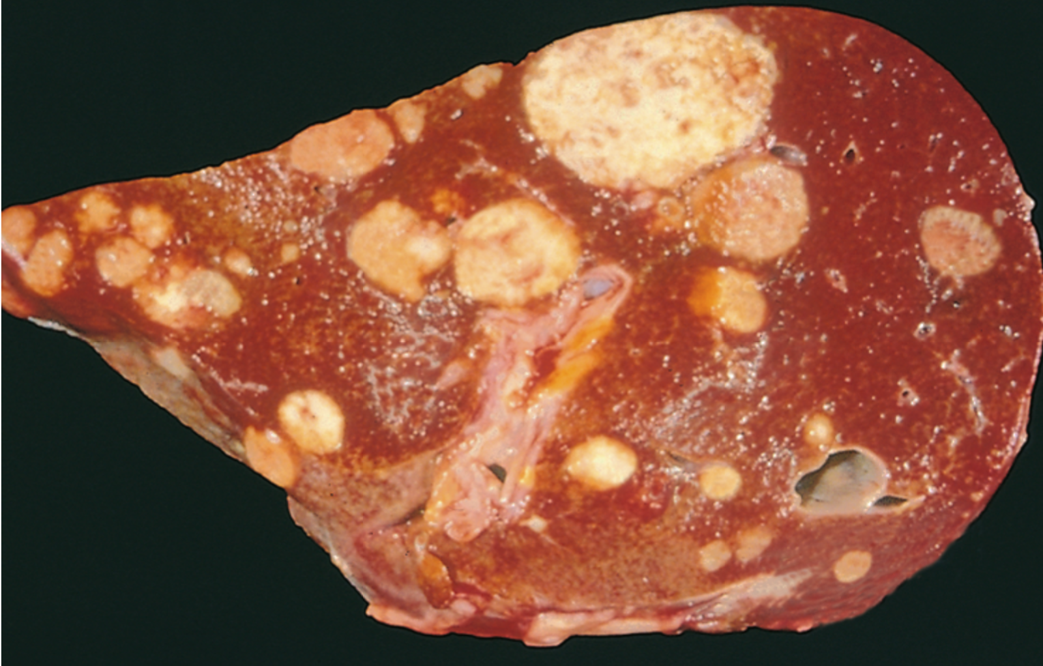
Metastasis
The liver and lungs are the most frequently involved secondary sites.

Slide 38
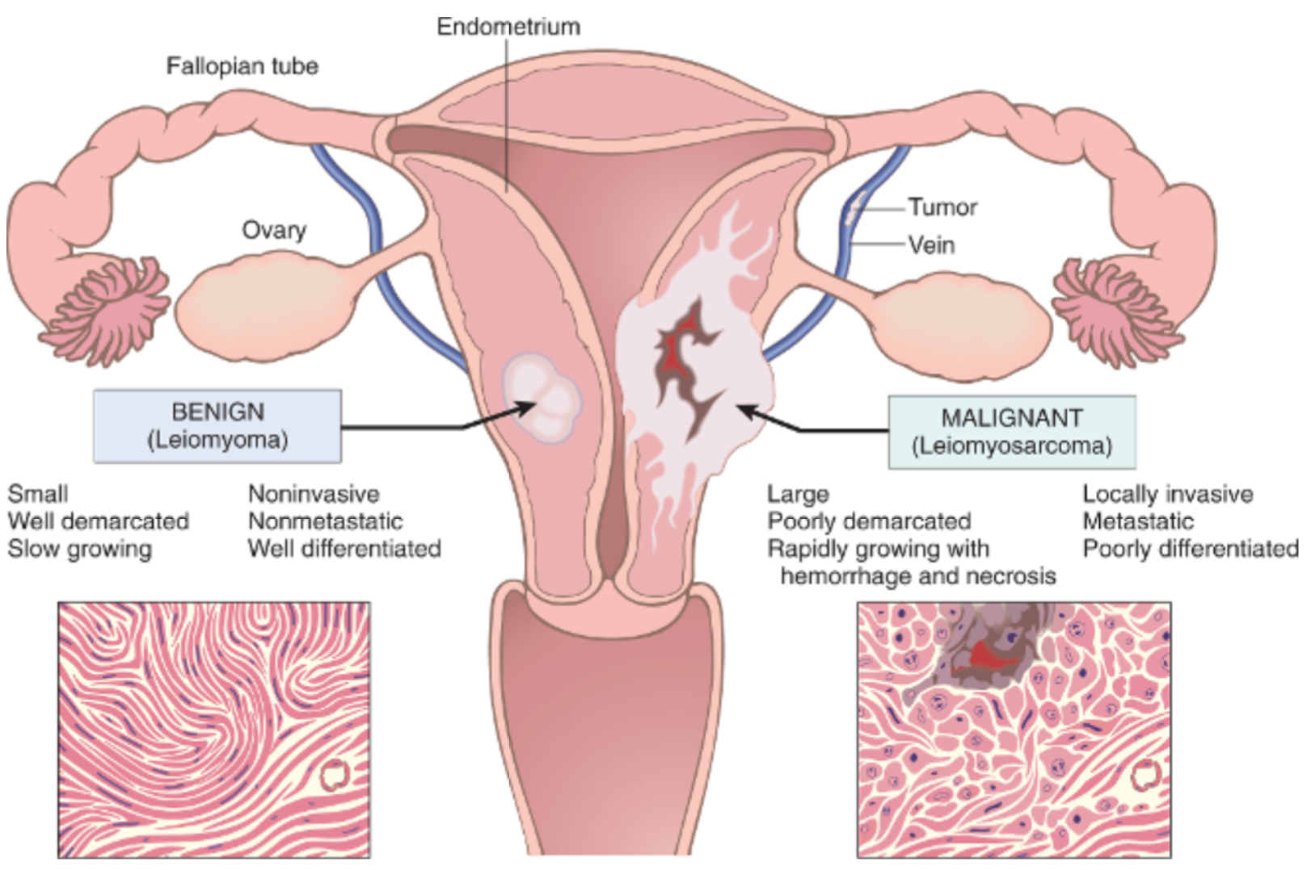
Summary

Slide 39
Summary

Slide 40
Reference
Kumar V, Abbas AK, Aster JC. Robbins Basic Pathology. 10th ed. Elsevier; 2018. Philadelphia, PA.

Slide 41
End of lecture
Thank You

