Slide 1
EPIDEMIOLOGY AND Etiology of Tumors
Dr. Maria A. Arafah
Assistant Professor – Department of Pathology
http://fac.ksu.edu.sa/mariaarafah/courses

Slide 2
Objectives
To understand that the incidence of cancer varies with age, race, geographic and genetic factors.
To explain the genetic predisposition to cancer.
To identify the precancerous conditions.
To list the various causes of tumors.

Slide 3
Epidemiology
Studying the epidemiology of tumors will aid in the following:
Discover etiologic factors
Plan preventive measures
Know what types of tumors are common and what are rare
Develop screening methods for early diagnosis

Slide 4
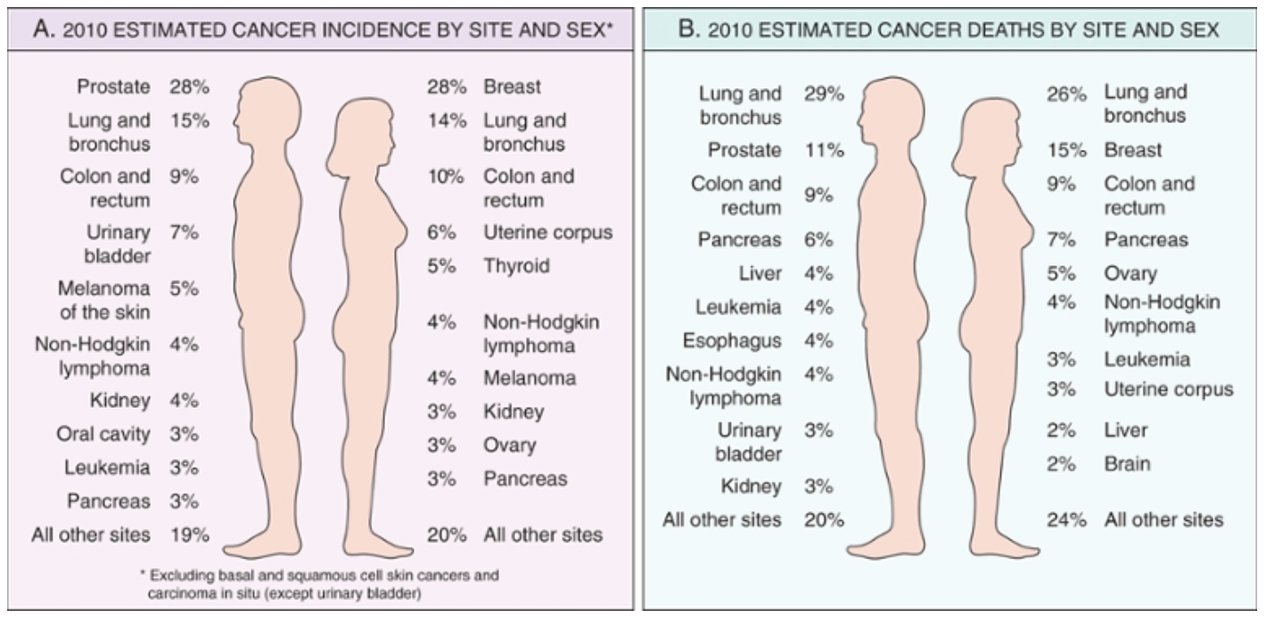
Cancer Incidence

Slide 5
Cancer Incidence
Factors affecting the incidence of cancer:
Geographic and environmental factors
Age
Hereditary factors
Acquired preneoplastic conditions

Slide 6
Geographic & Environmental Factors
The rate of gastric carcinoma in Japan is 7 times its rate in North America & Europe.
The rate of breast carcinoma in North America is 5 times its rate in Japan.
Liver cell carcinoma is more common in African populations.

Slide 7
Geographic & Environmental Factors

Slide 8
Geographic & Environmental Factors
Exposure to asbestos → mesothelioma
Smoking → lung carcinoma
Multiple sexual partners → cervical carcinoma
Fat-rich diet → colon carcinoma

Slide 9
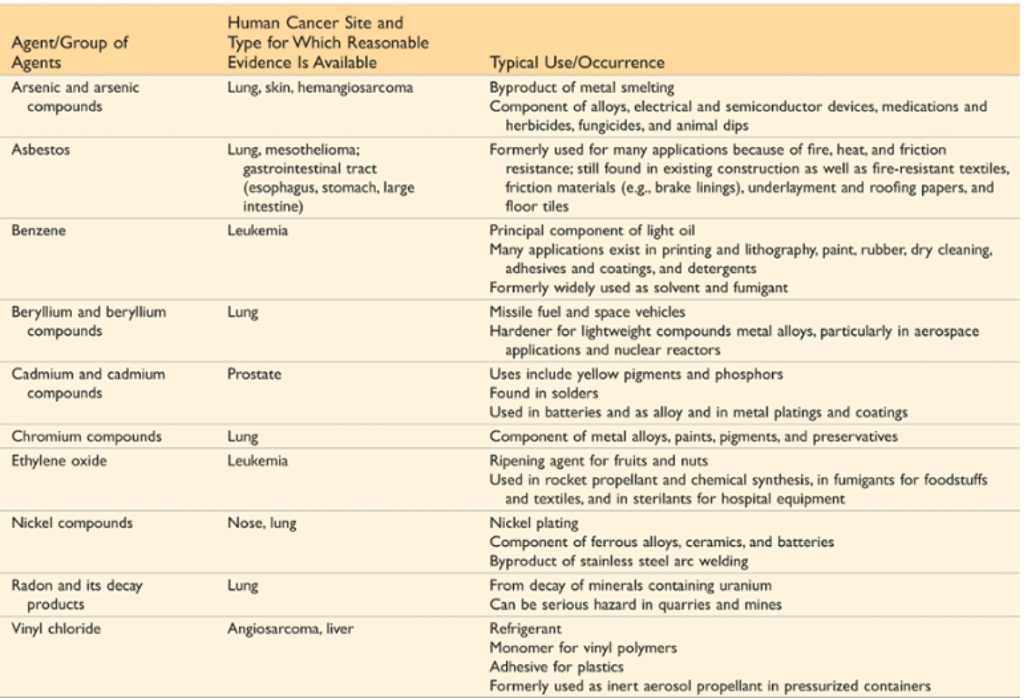
Geographic & Environmental Factors

Slide 10
Age
Generally, the frequency of cancer increases with age.
Most cancer mortality occurs between 55 and 75 years of age and it also increases during childhood.
The most common malignant tumors in children are:
Leukemia
CNS tumors
Lymphomas
Soft tissue & bone sarcomas.

Slide 11
Hereditary Factors
Hereditary factors include:
Autosomal dominant cancer syndromes
Autosomal recessive syndromes of defective DNA repair
Familial cancers of uncertain inheritance

Slide 12
Hereditary Factors
Autosomal dominant cancer syndromes
Several well-defined cancers in which inheritance of a single mutant gene greatly increases the risk of developing a tumor.
e.g. retinoblastoma in children:
40% of retinoblastomas are familial in nature.
Carriers of this mutation have 10000 fold increase in the risk of developing retinoblastoma
e.g. multiple endocrine neoplasia (MEN syndrome)

Slide 13
Hereditary Factors
Autosomal recessive syndromes of defective DNA repair
A group of rare autosomal recessive disorders is collectively characterized by chromosomal or DNA instability and high rates of certain cancers.
e.g. xeroderma pigmentosum

Slide 14
Hereditary Factors
Familial cancers of uncertain inheritance
All the common types of cancers that occur sporadically have been reported to occur in familial forms where the pattern of inheritance is unclear.
e.g. breast, colon, ovary, brain
Familial cancers usually have unique features:
They start at early age
They are multiple or bilateral
They occur in two or more relatives

Slide 15
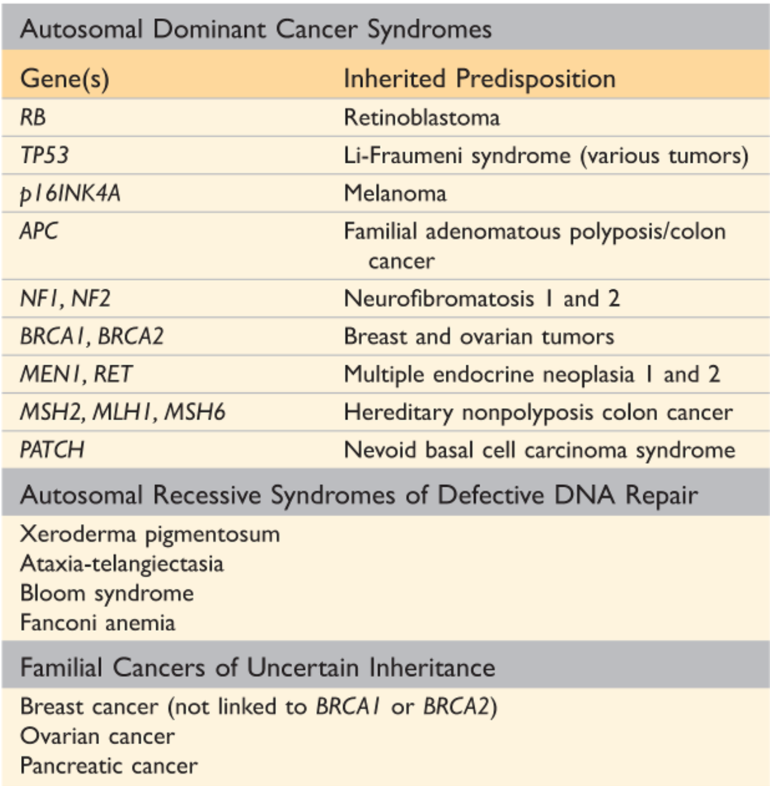
Hereditary Factors

Slide 16
Acquired Pre-neoplastic Conditions
Acquired preneoplastic conditions are conditions that predispose to cancer.
Dysplastic bronchial mucosa in smokers→ lung carcinoma
Liver cirrhosis → liver cell carcinoma
Margins of chronic skin fistulae → squamous cell carcinoma
Endometrial hyperplasia → endometrial carcinoma
Leukoplakia of the oral cavity, vulva or penis → squamous cell carcinoma
Villous adenoma of the colon or rectum → colorectal adenocarcinoma

Slide 17
Etiology of Tumors
Classes of carcinogenic agents:
Chemicals
Radiant energy
Microbial agents

Slide 18
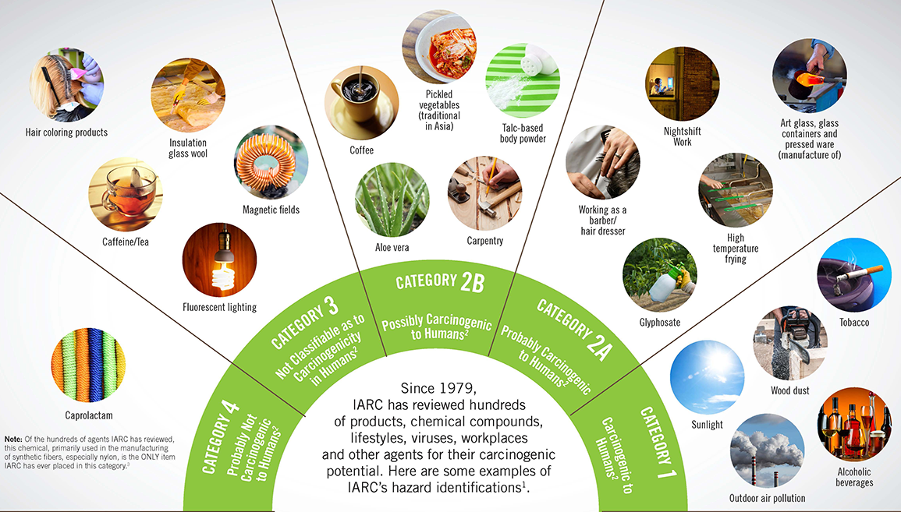
Etiology of Tumors

Slide 19
Chemical Carcinogens
Chemical carcinogens can be natural or synthetic.
They can cause cellular damage via:
Direct
Indirect

Slide 20
Chemical Carcinogens
Direct-acting agents
They require no metabolic conversion to become carcinogenic.
They are in general weak carcinogens but are important because some of them are cancer chemotherapy drugs (e.g. alkylating agents).

Slide 21
Chemical Carcinogens
Indirect-acting agents
They require metabolic conversion of the chemical compound (procarcinogen) to active & carcinogenic products (ultimate carcinogen).
e.g. benzo[a]pyrene, aromatic amines, azo dyes & Aflatoxin B₁

Slide 22
Chemical Carcinogens
Mechanisms of action:
Most chemical carcinogens are mutagenic i.e. cause genetic mutations.
the commonly mutated oncogenes & tumor suppressors are RAS and TP53.
All direct chemical carcinogens & ultimate chemical carcinogens are highly reactive as they have electron-deficient atoms.
They react with the electron rich atoms in the RNA, DNA & other cellular proteins.

Slide 23
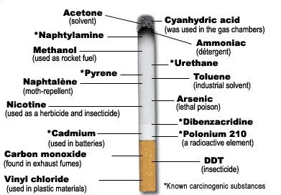
Chemical Carcinogens
Alkylating agents
Polycyclic hydrocarbons
Cigarette smoking
Animal fats during broiling meats
Smoked meats & fish

Slide 24
Chemical Carcinogens
Aromatic amines & azo dyes:
B-naphthylamine cause bladder cancer in rubber industries & aniline dye.
Some azo dyes, used to color food, cause bladder cancer.

Slide 25
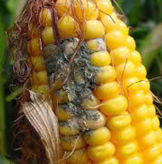
Chemical Carcinogens
Nitrosamines & nitrosamides are used are preservatives & cause gastric carcinoma.
Alfatoxin B₁, produced by Aspergillus which grow on improperly stored grains, it causes hepatocellular carcinoma.

Slide 26
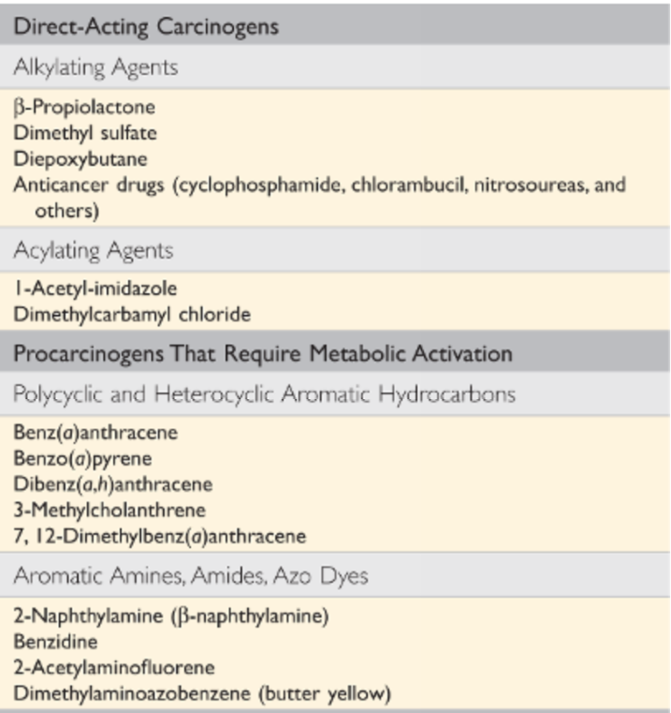
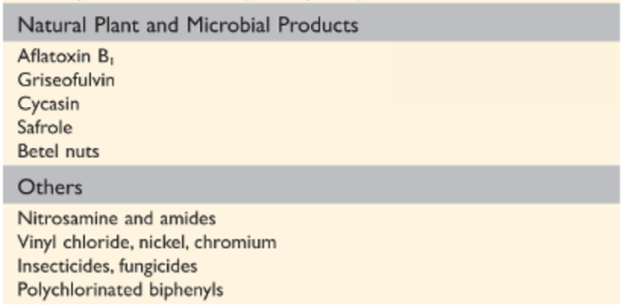
Chemical Carcinogens

Slide 27
Radiation
Radiation, whatever its source (UV rays of sunlight, x-rays, nuclear fission, radionuclides) is an established carcinogen.
Radiation has mutagenic effects: chromosomes breakage, translocations & point mutations.

Slide 28
Radiation
UV rays of sunlight
It causes skin cancers: melanoma, squamous cell carcinoma & basal cell carcinoma.
It is capable of DNA damage & mutations of p53 tumor suppressor gene.
When extensive exposure to UV rays occurs, the repair system is overwhelmed → skin cancer.

Slide 29
Viral & Microbial Oncogenes
Viral & microbial oncogenes include:
RNA viruses
DNA viruses
Other micro-organisms e.g. H. Pylori bacteria

Slide 30
Viral & Microbial Oncogenes
Host cells have endogenous gene to maintain a normal cell cycle.
Oncogene viruses induce cellular proliferation, mimic or block cellular signals necessary for the cell cycle regulation.

Slide 31
Viral & Microbial Oncogenes
RNA oncogenic viruses:
Human T cell lymphotropic virus-1 (HTLV-1), a retrovirus, infects & transforms T-lymphocytes.
It causes T-Cell leukemia/Lymphoma after a prolonged latent period (20-30 years).
It is endemic in Japan & the Caribbean.

Slide 32
Viral & Microbial Oncogenes
RNA oncogenic viruses:
It is transmitted like HIV but only 1% of infected patients develop T-cell leukemia/Lymphoma.
No cure or vaccine to HTLV-1.
Treatment: chemotherapy with common relapses.

Slide 33
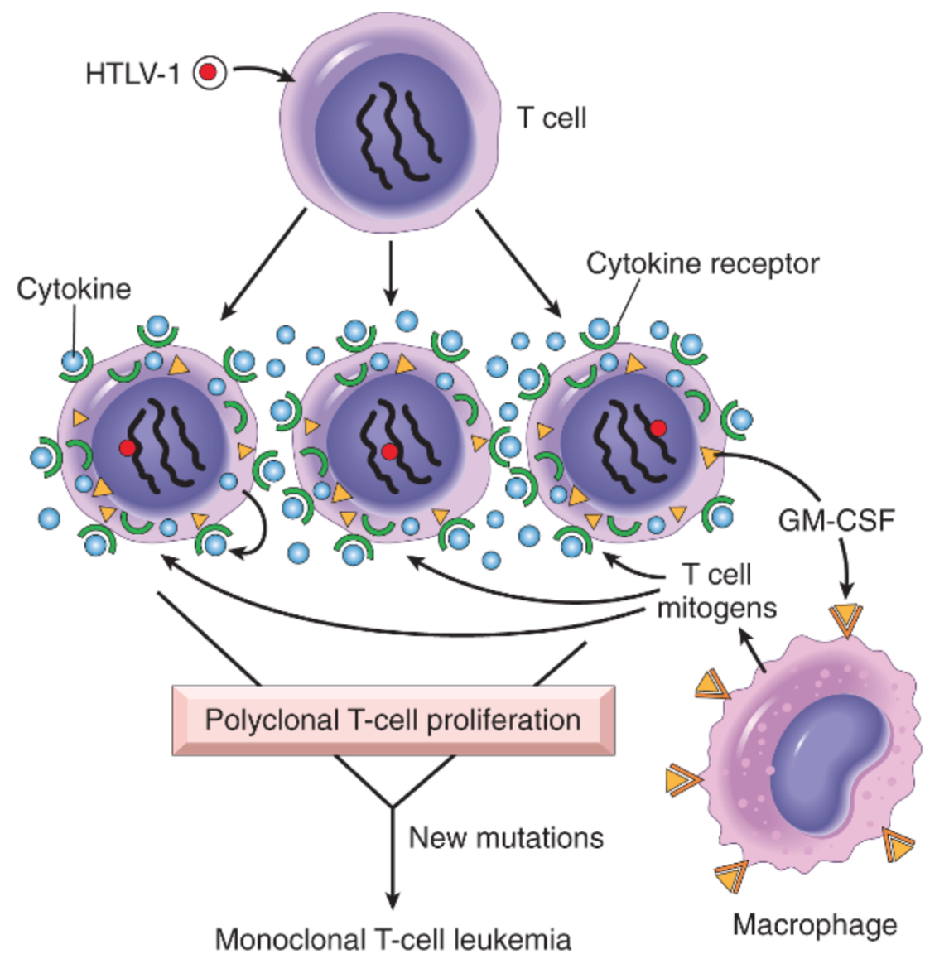
HTLV-1 Infection

Slide 34
Viral & Microbial Oncogenes
DNA oncogenic viruses:
DNA viruses form stable associations with hosts DNA, thus the transcribed viral DNA transforms the host cells.
e.g.
Human papilloma virus (HPV)
Epstein Barr virus (EBV)
Hepatitis B virus (HBV)
Kaposi sarcoma herpesvirus (KSHV, also called human herpesvirus-8 [HHV-8])

Slide 35
Viral & Microbial Oncogenes
HPV infection:
HPV has more than 70 serotypes.
It is a sexually transmitted.
It causes benign warts, squamous cell carcinoma of the cervix, anogenital region, mouth & larynx.

Slide 36
Viral & Microbial Oncogenes
HPV infection:
HPV types 6 and 11:
Genital warts
HPV types 16, 18, 31:
85% of cervical carcinomas are caused by HPV 16 or 18
High risk HPV types integrates with the host’s DNA

Slide 37
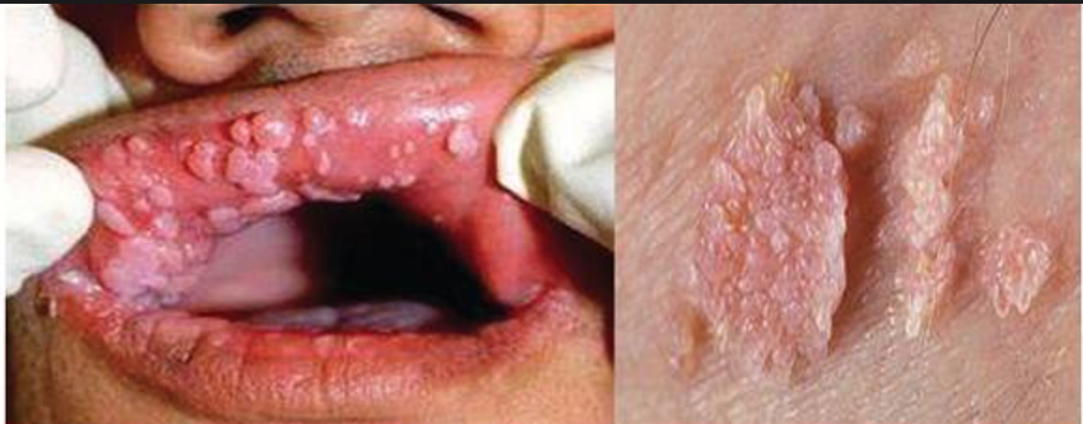
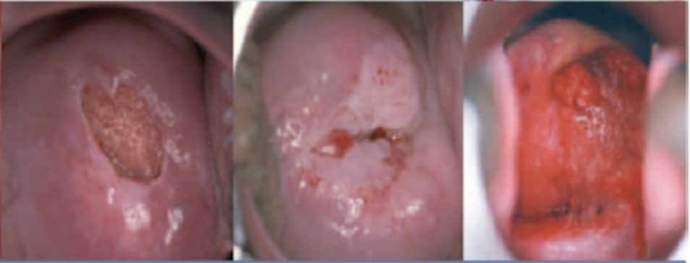
HPV Infection

Slide 38
Viral & Microbial Oncogenes
HPV infection:
The oncogenic potential of HPV 16 and 18 can be related to products of two early viral genes, E6 and E7.
E6 protein binds to Rb tumor suppressor and releases the E2F transcription factors that normally are sequestered by Rb, promoting progression through the cell cycle.
E7 protein binds to p53 & facilitates its degradation.

Slide 39
Viral & Microbial Oncogenes
HPV infection:
HPV infection alone is not sufficient to cause carcinoma and other factors also contribute to the development of cervical carcinoma e.g.
cigarette smoking
coexisting infections
hormonal changes

Slide 40
Viral & Microbial Oncogenes
EBV infection:
It is a common virus worldwide.
It infects B lymphocytes & epithelial cells of the nasopharynx.
It causes infectious mononucleosis.
It causes several malignant tumors e.g.
Burkitt’s Lymphoma
B-cell lymphoma in immunosuppressed
Nasopharyngeal carcinoma

Slide 41
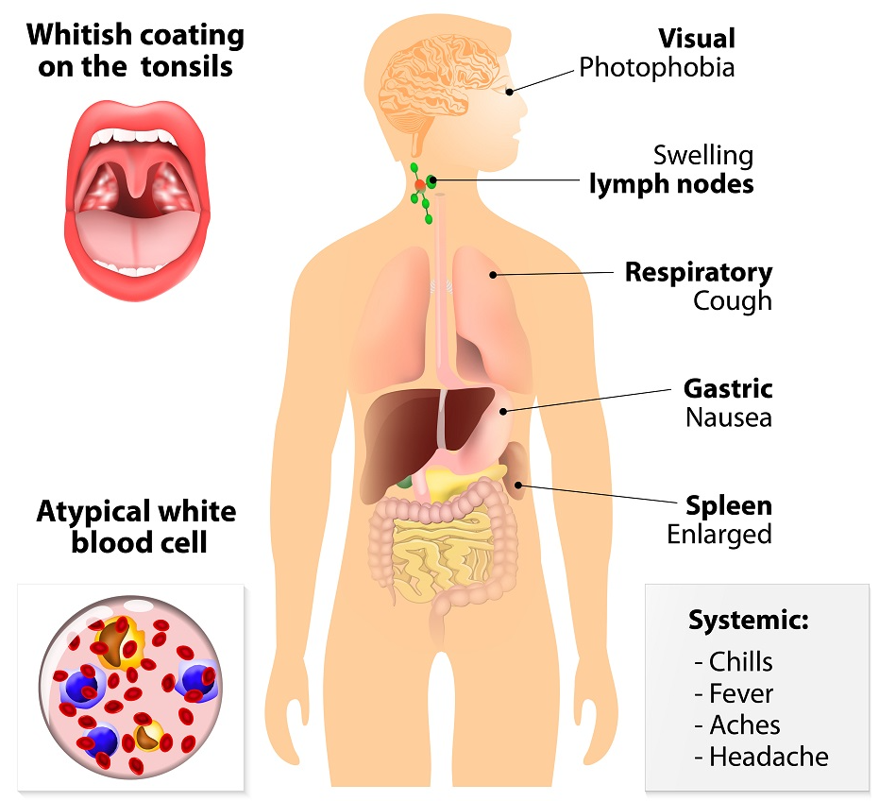
EBV Infection – Infectious Mononucleoses

Slide 42
Viral & Microbial Oncogenes
EBV infection:
Nasopharyngeal carcinoma is a malignant neoplasm arising from the nasopharygeal epithelium.
It is endemic in South China and parts of Africa.
100% of cases contain EBV genome in these endemic areas.

Slide 43
Viral & Microbial Oncogenes
EBV infection:
EBV also causes Burkitt’s lymphoma, a highly malignant B-cell tumor.
However, rare sporadic cases occur worldwide.
EBV-related Burkitt’s lymphoma is the most common childhood tumor in Africa.
All cases have t(8:14) genetic mutation.

Slide 44
Viral & Microbial Oncogenes
EBV infection:
EBV causes B lymphocyte cellular proliferation.
It causes loss of growth regulation.
It predisposes the cells to genetic mutations, especially t(8:14).

Slide 45
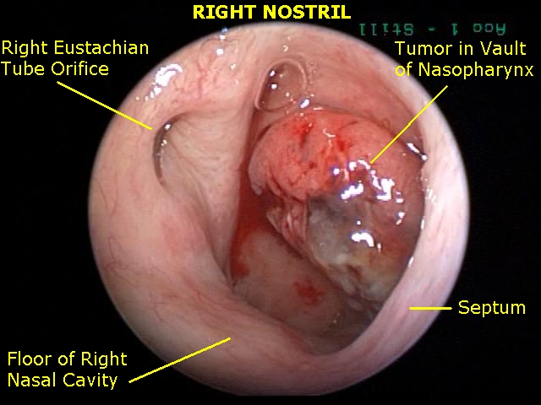
EBV Infection

Slide 46
Viral & Microbial Oncogenes
HBV infection:
HBV infection has a strong association with liver cell carcinoma (HCC).
It is present world-wide, but most commonly in the far East & Africa.
HBV infection incurs up to 200-fold risk of HCC.

Slide 47
HBV Infection

Slide 48
Viral & Microbial Oncogenes
Helicobacter Pylori bacteria:
It is bacteria that infects the stomach
It causes:
Peptic ulcers
Gastric lymphoma (Mucosal Associated Lymphoid Tumor (MALT)
Gastric carcinoma

Slide 49
H. Pylori Infection

Slide 50
Reference
Kumar V, Abbas AK, Aster JC. Robbins Basic Pathology. 10th ed. Elsevier; 2018. Philadelphia, PA.

Slide 51
End of lecture
Thank You

