Slide 1
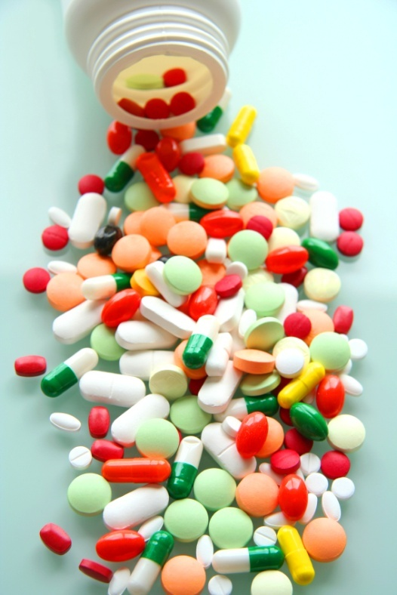
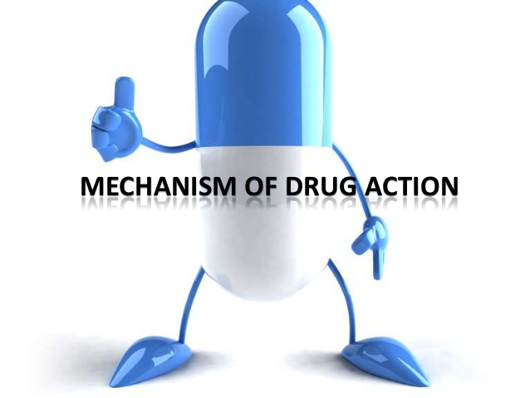
TOLERANCE / DESENSITIZATION
&ADVERSE DRUG REACTIONS
Dr. Aliah Alshanwani

Slide 2
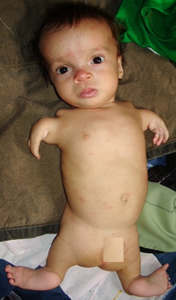
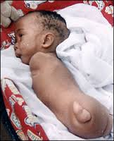
Phocomelia
Thalidomide crisis
Thalidomide was marketed in 1958 in West Germany as a hypnotic & as for morning sickness during pregnancy
Iatrogenic disease
In 1961 a report of out break of phocomelia in the newborn babies(40000-100000 cases)
Notes:
Phocomelia is a condition that involves malformations of the arms and legs.
Iatrogenic disease Dr-induced disease, a disease result by the tr of the physician

Slide 3
Ilos
Distinguish difference between tolerance and desensitization (tachyphylaxis) and reasons for their development
Recognize patterns of adverse drug reactions (ADRs)

Slide 4
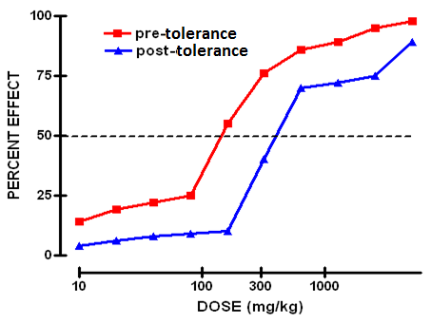
TOLERANCE and DESENSITIZATION
Phenomenon of variation in drug response, whereby there is a gradual diminution of the response to the drug when given continuously or repeatedly.
Notes:
Is the response / efficacy of the drug always the same ?
Individuals may vary considerably in their response to a drug; indeed, a single individual may respond differently to the same drug at different times during the course of treatment.
Why do responses to other drugs diminish rapidly with prolonged or repeated administration?
Right word shift of the dose response curve

Slide 5
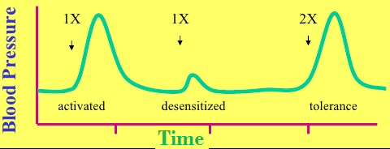
DIMINUTION OF A RESPONSE
Rapid, in the course of few minutes
Gradual in the course of few days to weeks
TACHYPHYLAXIS / DESENSITIZATION
TOLERANCE
These SHOULD BE DISTINGUISHED FROM
Loss of effectiveness of antimicrobial agent
Resistance
Notes:
With some drugs, the intensity of response to a given dose may change during the course of therapy; in these cases, responsiveness usually decreases as a consequence of continued drug administration, producing a state of relative tolerance to the drug’s effects.
When responsiveness diminishes rapidly after administration of a drug, the response is said to be subject to tachyphylaxis.
One of the best-studied examples of R regulation is the desensitization of adrenoceptors that may occur after exposure to catecholamines & other sympathomimetic drugs. After a cell or tissue has been exposed for a period of time to an agonist, that tissue often becomes less responsive to further stimulation by that agent.
Rapid modulation of R function in desensitized cells may involve critical covalent modification of the R, especially by phosphorylation of specific amino acid residues, association of
these Rs with other proteins, /changes in their subcellular location.
Graph: dose 1 give the dose after continuous use the same dose give very small effect then double the dose can give the same response of dose 1 bec of tolerance

Slide 6
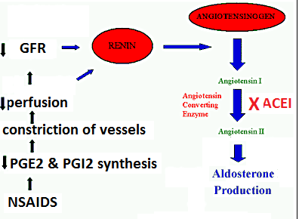
REASONS FOR DEVELOPMENT OF TOLERANCE
PRE RECEPTOR EVENTS
EVENTS AT RECEPTORS
POST RECEPTOR EVENTS
↓ Drug availability at the relevant receptors due to pharmaco- kinetic variables
Nullification of drug response by a physiological adaptative homeostatic response
Drug becomes:
> metabolized or excreted
< absorbed
altered distribution to tissues
Antihypertensive effects of ACEIs become nullified by activation of renin angiotensin system by NSAIDs
eg. Barbiturates  metabolism of Contraceptive pills =  it availability
LOSS OF THERAPEUTIC EFFICACY
Refractoriness
Notes:
Alteration in Concentration of Drug that Reaches the Receptor
patients may differ in the rate of absorption of a drug, in distributing it through body compartments, /in clearing the drug from the blood.
By altering the conc of drug that reaches relevant Rs, such pk differences may alter the clinical response.
So conception can happen when using barbiturates (sedative) with oral contraceptives
Some differences can be predicted on the basis of age, weight, sex, disease state, & liver & kidney function, & by testing specifically for genetic differences that may result from inheritance of a functionally distinctive complement of drug-metabolizing enzymes.
Another important mechanism influencing drug availability is active transport of drug from the cytoplasm, mediated by a family of membrane transporters encoded by the so-called multidrug resistance (MDR) genes. For example, up-regulation of MDR gene-encoded transporter expression is a major mechanism by which tumor cells develop resistance to anti-cancer drugs.

Slide 7
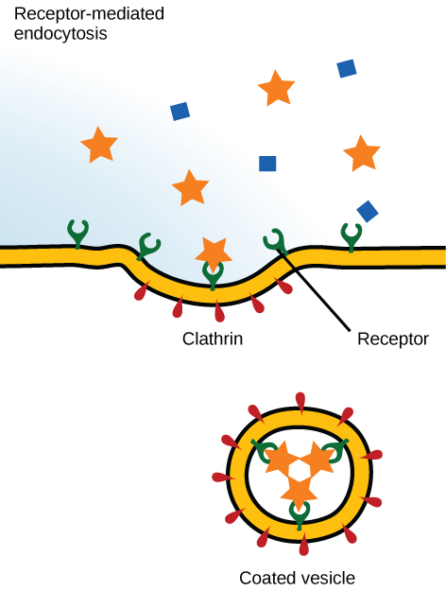
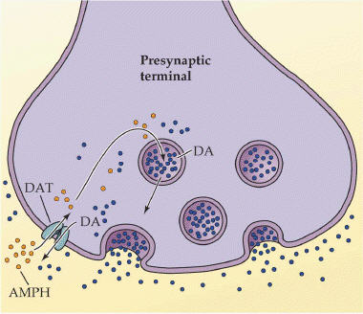
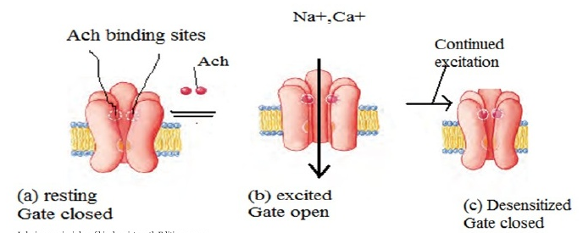
REASONS FOR DEVELOPMENT OF TOLERANCE
PRE RECEPTOR EVENTS
EVENTS AT RECEPTORS
POST RECEPTOR EVENTS
EXHUSTION
OF MEDIATORS
BINDING ALTERATION
DOWN REGULATION
Depletion of mediator stores by amphetamine
1-Phosphorylation of receptors i.e. Tight binding of ß-adrenoceptors agonists → ↓ activation of AC
2-Desenzitiation of Ach- receptors
[Functional defect]
↓ Number of receptors.
Isoprenaline activation to β receptors →↑ receptor recycling by endocytosis [Structural defect]
Notes:
Chronic amphetamine (powerful stimulator of CNS) intake leads to depletion of dopamine from synaptic store
Isoprenaline is a non-selective beta-adrenergic agonist
G protein-coupled receptor kinases (GRKs) : regulate the activity of GPCRs by phosphorylating their intracellular
Arrestin is a protein that prevent the re-association of the G proteins with their Rs, thereby preventing reactivation of the signaling pathway.
There are 2 major categories of desensitization of responses mediated by G protein-coupled Rs.
Homologous desensitization refers to loss of responsiveness exclusively of the Rs that have been exposed to repeated or sustained activation by an agonist.
Heterologous desensitization refers to the process by w desensitization of one R by its agonists also results in desensitization of another R that has not been directly activated by the agonist in question.
A major mechanism of desensitization that occurs rapidly involves phosphorylation of Rs by members of the G protein coupled R kinase (GRK) family, of w there are seven members. Specific adrenoceptors become substrates for these kinases only when they are bound to an agonist. This mechanism is an example of homologous desensitization because it specifically involves only agonist-occupied Rs.
Phosphorylation of these Rs enhances their affinity for arrestins, a family of 4 proteins, of w the 2 nonvisual arrestin subtypes are widely expressed. Upon binding of arrestin, the capacity of the R to activate G proteins is blunted, presumably as a result of steric hindrance. Arrestin then interacts with clathrin & clathrin adaptor AP2, leading to endocytosis of the R.
Downregulation = interalization

Slide 8
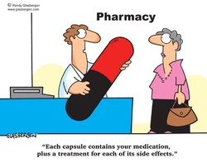
ADVERSE DRUG REACTIONS [ADRs]
Harmful or seriously unpleasant effects occurring at doses intended for therapeutic effects.

Slide 9
Types of adrs
Notes:
Augmented or exaggerated
Like bronchospasm from beta blocker
C from long term use
D: Teratogenic from anticonvulsant drugs
E: withdrawal symptoms of BDZ

Slide 10
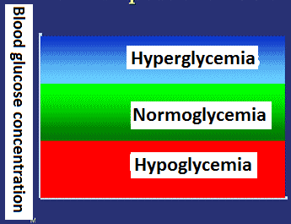
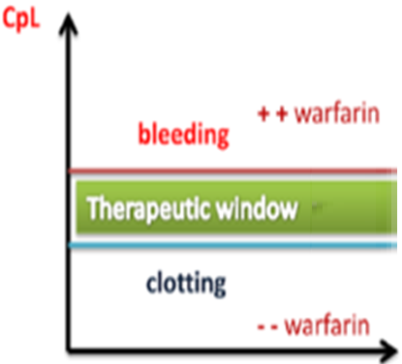
Type a
Augmented
80% of ADRs
Is it dose dependent?
Is the incidence high or low?
Is it predictable?
How mortal is it ?
A consequence of the primary effect of the drug
How is it treated?
Is the ADR quantitatively or qualitatively different from the primary effect?
e.g. Hypoglycemia from hypoglycemic drugs
Bleeding from warfarin
Notes:
Is it predictable ? Yes
Quant bec increase in the effect
High
Mostly not mortal
Tr. Adjust the dose, or replace it with more suitable drug

Slide 11
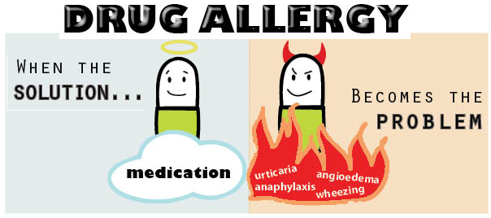
Type b
bizarre
Occurs different to known drug pharmacological effect [idiosyncratic]
Is it predictable?
Idiosyncratic reactions are drug reactions that occur rarely and unpredictably amongst the population
Is the ADR quantitatively or qualitatively different from the primary effect?
Is the incidence high or low?
How mortal is it ?
Is it dose dependent?
How is it treated?
Usually due to
[1] immunological response or [2] patient’s genetic defect
Penicillin Anaphylactic shock
Quinine Thrombocytopenia
Notes:
Idiosyncratic: unknown mechanism, in small No of patient
Penicilin is given for eradication of bacteria, but it can induce SE not related to its MOA
Quinine antimalarial (genetic effect)

Slide 12
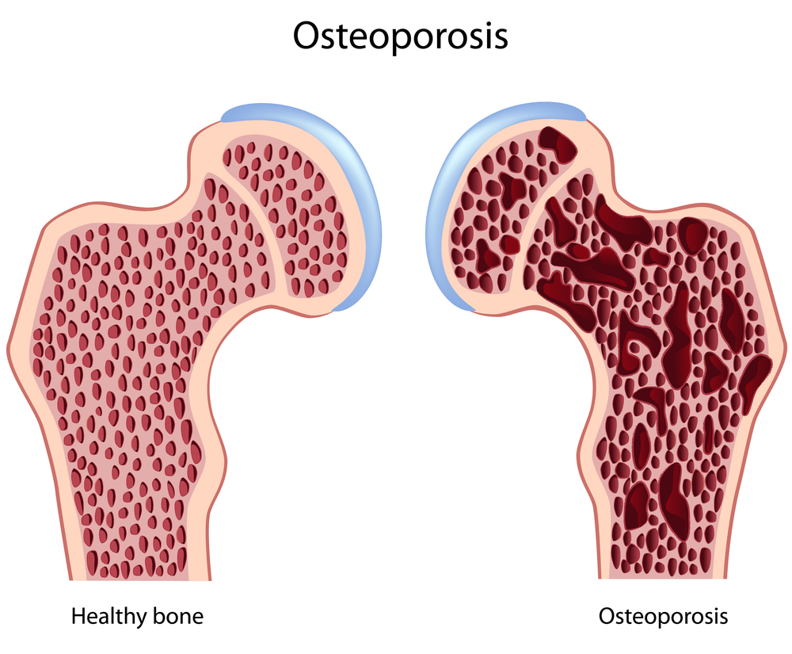
Type c
COntinued
Occurs during chronic drug administration
Osteoporosis  chronic
corticosteroid intake

Slide 13
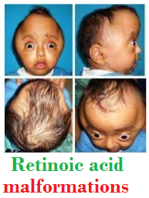
Type d
delayed
Occurs after long period of time even after drug stoppage (delayed in onset)
Refers to carcinogenic and teratogenic effects
Teratogenicity→Retinoids
Carcinogenicity→ Tobacoo smoking
Notes:
retinoid was approved for acne

Slide 14
Type e
End of use
Occurs after sudden stoppage of chronic drug use due to existing adaptive changes
Withdrawal syndrome  Morphine
↑ Body ache, insomnia, diarrhea, goose flesh, lacrimation
Withdrawal of diazepam  anxiety, insomnia

Slide 15
TYPE B
[1] If due to immunological response
1st exposure to a drug
Repeated exposures
Sensitization
HYPERSENSITIVITY REACTION
TYPE I
Anaphylaxsis
TYPE II
Cytotoxic
TYPE III
Immune complex
TYPE IV
Cell mediated
Release of mediators from mast cells or blood basophils
Antibody-directed cell-mediated lysis
Deposition of soluble antigen–antibody- complement complexes in small blood vessels
Interaction release cytokines that attracts inflammatory cell infiltrate
Urticaria rhinitis, bronchial asthma
by Penicillin,
Haemolytic anaemia thrombocytopenia by Quinine
Serum sickness (fever arthritis enlarged lymph nodes, urticaria)
by Sulphonamides,
Streptomycin
Contact dermatitis by local anaesthetics creams
Notes:
Quinine=anti-malarial drug can occasionally cause damage to the ear when given in high or prolonged doses
Thrombocytopenia: antibody-mediated platelet destruction caused by exposure to a drug

Slide 16
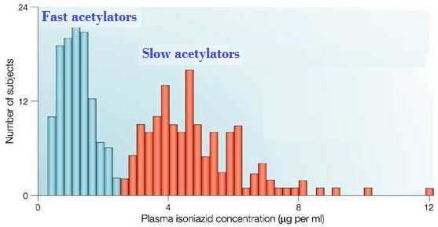
TYPE B
[2] If due to genetic defect
When isoniazid is given in identical doses /kg, two distinct groups can be identified, a group with low blood level acetylate the drug more rapidly ‘fast acetylators’ & ‘a group with high blood level acetylate the drug slowly “slow acetylators’
Relapse of infection & hepatitis occur in fast acetylators
Isoniazid causes peripheral neuropathy in slow acetylators

