Slide 1
                HAND & WRIST
Dr. Jamila El-Medany

Slide 2
OBJECTIVES
At the end of the lecture, students should be able to:
Describe the anatomy of the deep fascia of the wrist & hand (flexor & extensor retinaculae & palmar aponeurosis).
List the structures passing superficial & deep to flexor retinaculum.
Describe the anatomy of the insertion of long flexor & extensor tendons.
Describe the anatomy of the small muscles of the hand (origin, insertion action & nerve supply)

Slide 3
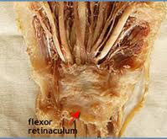
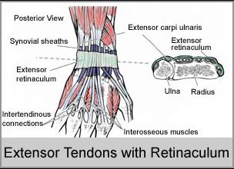
Retinacula
Flexor & Extensor Retinaculua:
Bands of Deep Fascia at the Wrist
Function:
  Hold the long flexor and extensor tendons at the wrist in position.
Attachments:
  Medially: Both retinacula attached to Pisiform & Hook of Hamate.
  Laterally:
  Flexor Retinaculum attached to Tubercle of Scaphoid & Trapezium.
  Extensor Retinaculum attached to Distal end of Radius

Slide 4
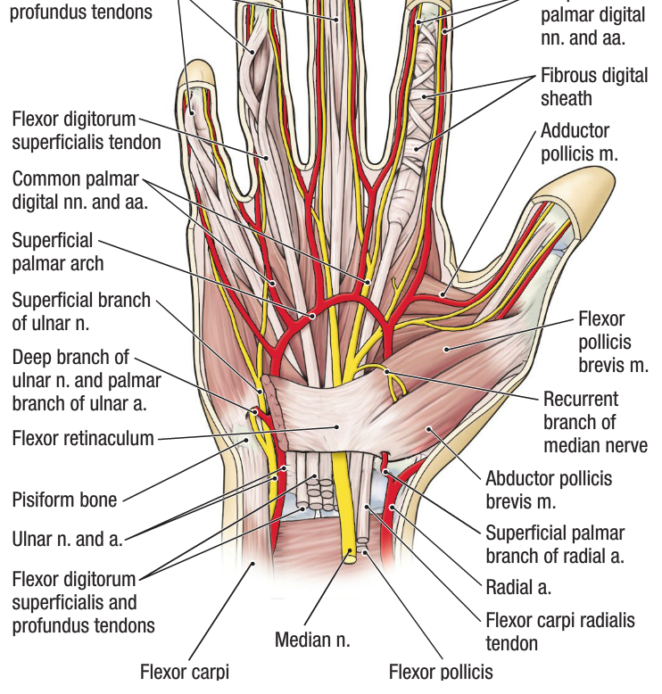
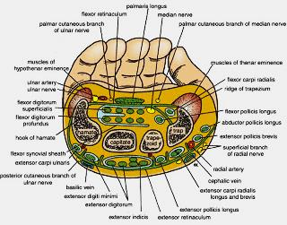
Structures Superficial to Flexor Retinaculum
From Medial to Lateral
Tendon of Flexor carpi ulnaris.
Ulnar nerve.
Ulnar artery.
Palmar cutaneous branch of ulnar nerve.
Palmaris longus tendon.
Palmar cutaneous branch of median nerve.

Slide 5
Carpal Tunnel
Formed from Concave anterior surface of the Carpus covered by Flexor Retinaculum
Contents
From Medial to Lateral
  Tendons of flexor digitorum superficialis & profundus
  Median nerve
  Flexor Pollicis Longus
  (Flexor carpi radialis)

Slide 6
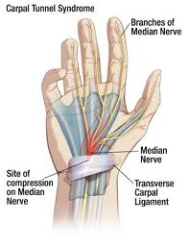
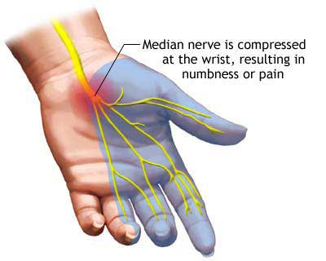
Carpal Tunnel Syndrome
Causes :
  Compression of the median nerve within the carpal tunnel
Manifestations:
1. Burning pain (pins and needles ) in the lateral three and half fingers.
No paresthesia over the thenar eminence?

Slide 7
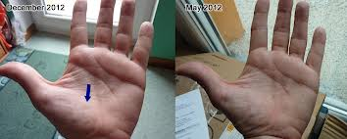
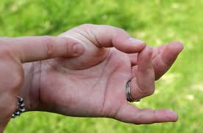
Carpal Tunnel Syndrome
N
2. Weakness or atrophy of the thenar muscles (Ape Hand).
Inability to Oppose the thumb.

Slide 8
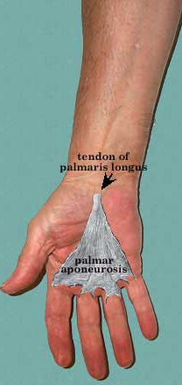
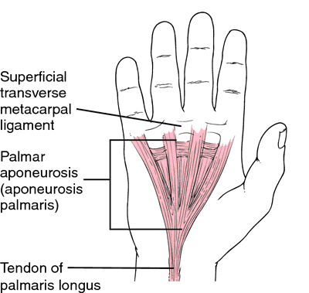
Palmar Aponeurosis
The Thickened deep fascia of the Palm.
It is Triangular in shape , occupies the central area of the palm.
Apex:
  Attached to the distal border of flexor retinaculum and receives the insertion of palmaris longus tendon.
Base:
  Divides at the bases of the fingers into four slips that pass into the fingers.
Functions:
  1. Firmly attached to the overlying skin and improves the grip.
  2. Protects the underlying tendons, vessels & nerves.
  3. Gives origin to palmaris brevis muscle.

Slide 9
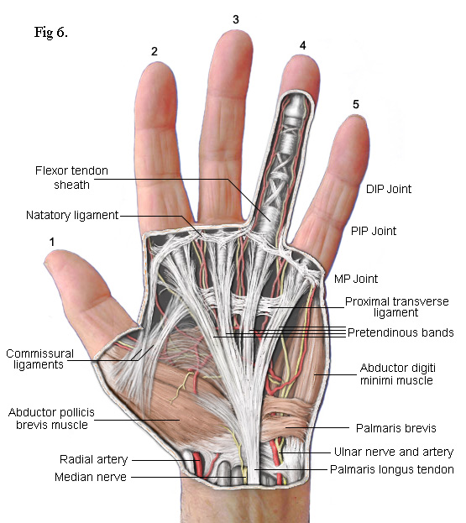
Palmaris Brevis
Origin | Insertion | NS | Action
FR and PA. | Skin of Palm | UN (Superficial). Branch | Prevents Corrugation of skin to improve grip

Slide 10
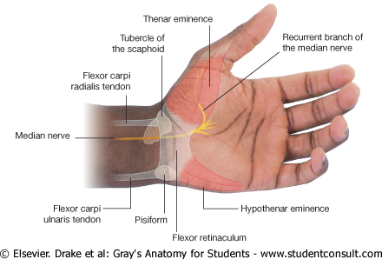
Short Muscles of Thumb & Little Finger

Slide 11
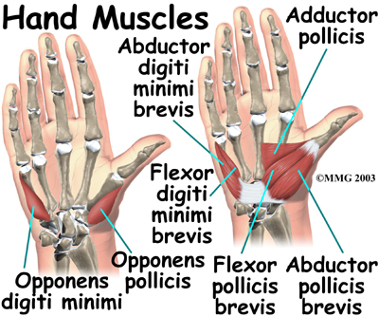
Hypothenar Eminence (3)
Action | NS | Insertion | Origin
Abduction | All by Deep branch of Ulnar | Base of Prox ph | Pisiform | Ab Dig Min
Flexion |  | With AB DIG MIN | FR | Flx Dig Min
Pulls the 5th metacarpal forward (Cup the palm) |  |  | Palmar surface of 5th metacarpal | Opp Dig Min

Slide 12
Thenar Eminence (3)
ACT | NS | Insertion | Origin
AB | All from Median N | (Base of Prox ph) | FR Scaphd& Trapez | Ab Poll B
FLX |  | With AB Poll B | FR | Flex Poll B
Opp |  | Lateral part of 1ST Met | FR | Opp Poll

Slide 13
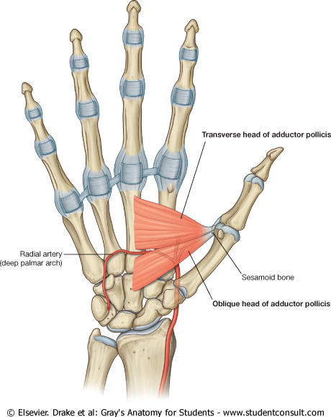
Adductor Pollicis
NS | Action | Insertion | Origin
Deep branch of Ulnar | Add | Medial side of base of prox.ph of thumb | Oblique Head: Ant. bases of 2nd &3rd meta Trans H: 3rd meta

Slide 14
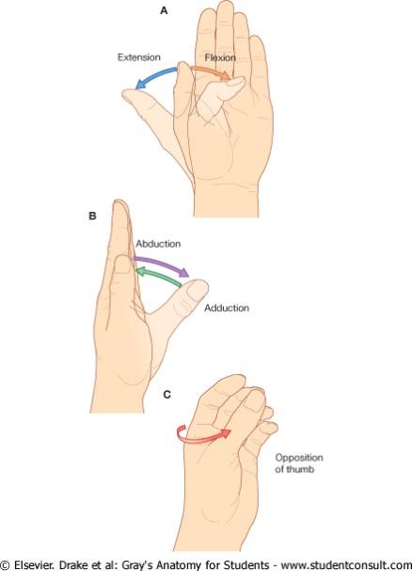
Movements of Thumb

Slide 15
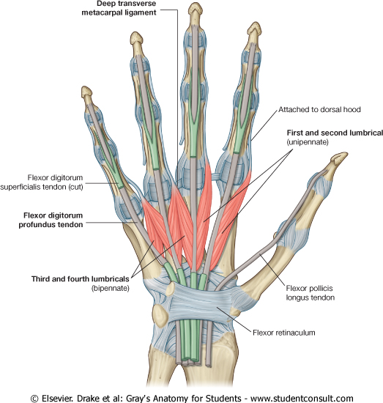
Insertion of
Flexor Dig Superficialis & Profundus
Flexor dig superficialis
Each tendon:
  Divides into two halves & pass around the Profundus Tendon.
  The two halves Meet on the posterior aspect of Profundus tendon (partial decussation of fibers).
  Reunion of the two halves.
  Further Division into two slips attached to the Borders of Middle Phalanx.
Flexor dig Profundus
  Inserted into the Base of the Distal Phalanx.

Slide 16
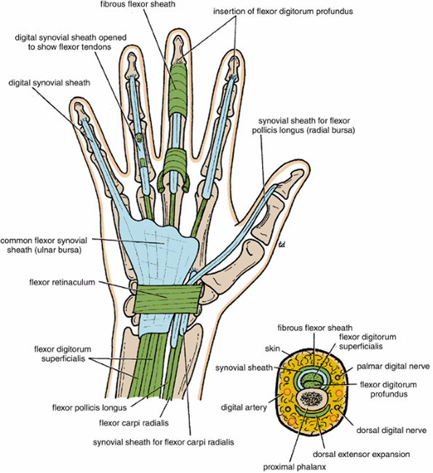
Fibrous Flexor (Digital) Sheath
A Strong Fibrous Sheath, which covers the anterior surface of the fingers and attached to the sides of the phalanges.
Its Proximal end is opened
Its Distal end is closed
The Sheath with the anterior surfaces of the phalanges & the interphalangeal joints form an Osteofibrous blind Tunnel for the long flexor tendons of the fingers.

Slide 17
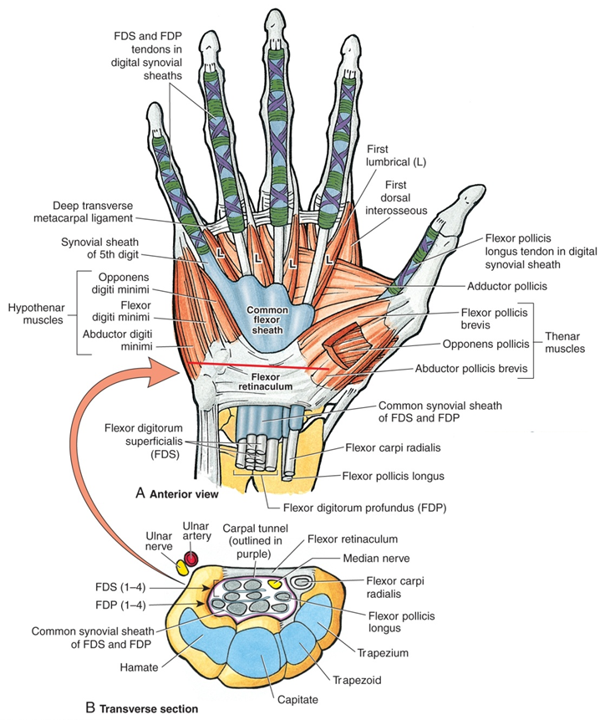
Synovial Flexor Sheaths
Common Synovial sheath (Ulnar Bursa)
  Contains tendons of Flexor Digitorum Superficialis & Profundus
  The Medial part of the sheath extends distally (without interruption) on the tendons of the little finger.
  The Lateral part of the sheath stops on the middle of the palm.
  The distal ends of the long flexor tendons to(Index, Middle & Ring) fingers acquire Digital Synovila Sheaths.

Slide 18
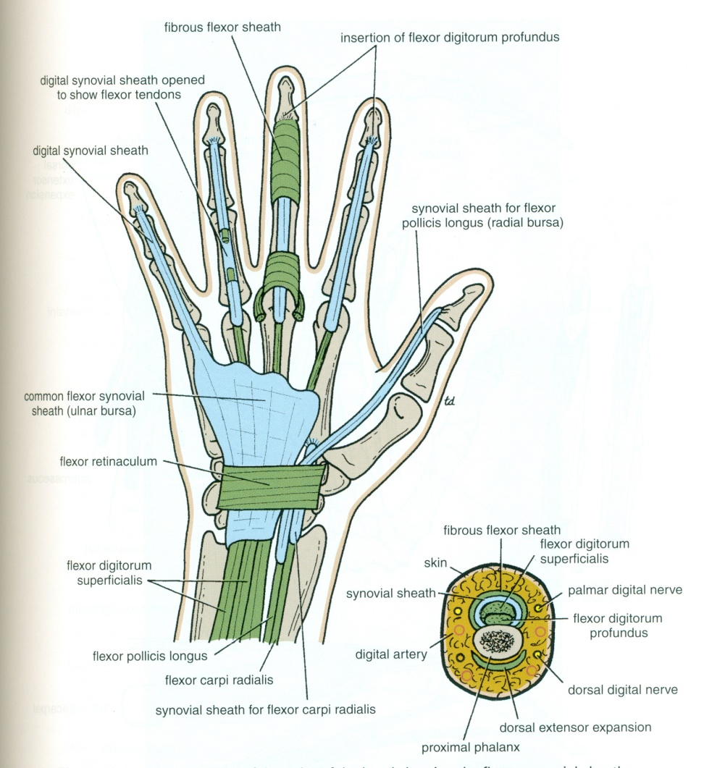
Synovial Flexor Sheaths
Flexor Pollicis Longus tendon has its own synovial sheath (Radial Bursa)
Function of Synovial Sheaths:
They allow the long tendons to move smoothly with a minimum of friction beneath the flexor retinaculum and the fibrous flexor sheaths.

Slide 19
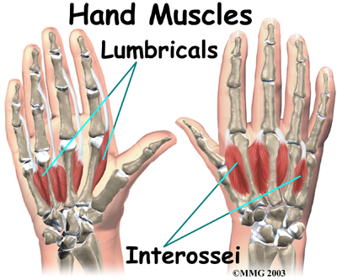
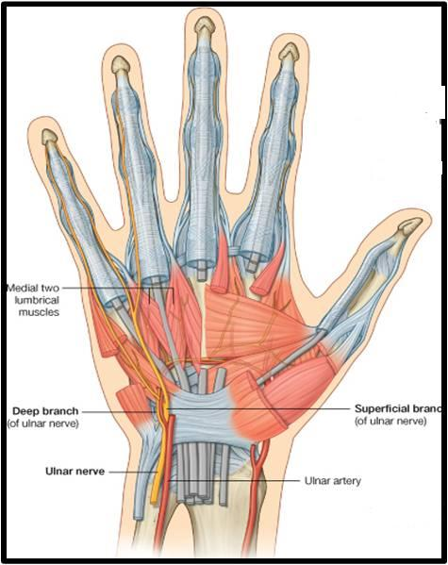
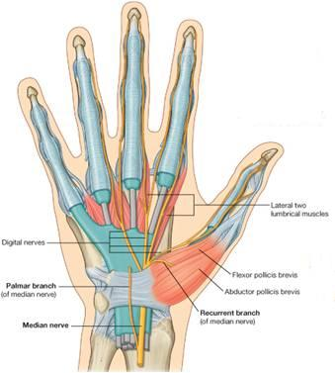
Lumbrical Muscles (4)
Origin | Insertion | NS
Tendons of Flex.dig. profundus | EXT. EXP of medial four fingers | 1ST & 2ND (Lateral two) : Median N. 3RD & 4^{TH :} Ulnar N (Deep branch)
Action:
Flex metacarpophalangeal joints and extend interphalangeal joints of fingers Except thumb

Slide 20
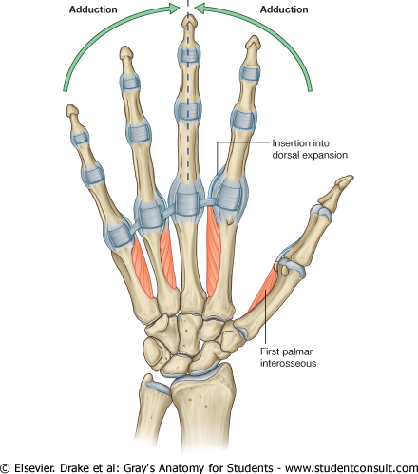
Palmar Interossei (4)
Origin | Insertion | NS
1st : Base of 1st metacarpal. Other three: Ant. Surface of Shafts of 2nd , 4rd & 5th metacarpals. | Proximal phalanges of thumb ,index, ring, & little fingers and Extensor expansion | Un: deep Branch
3
2
4
2
1
3
4
Action:
Adduction of fingers toward center of the 3rd one.

Slide 21
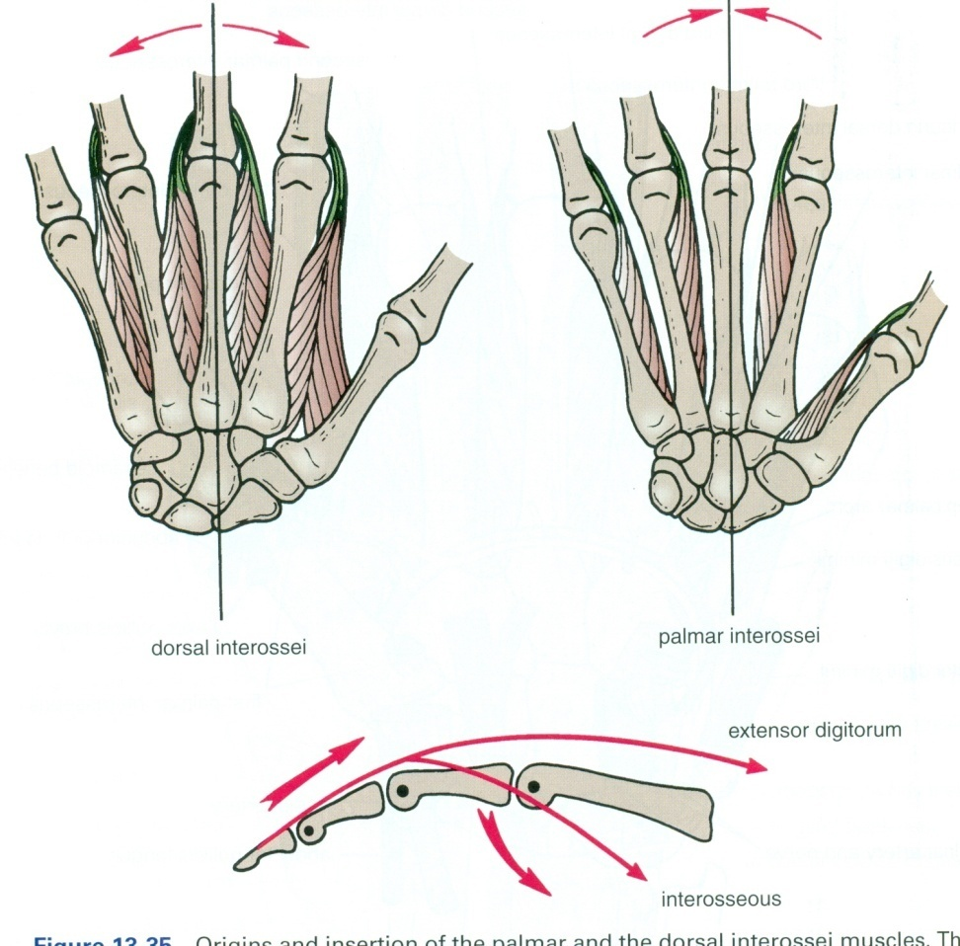
Dorsal Interossei (4)
AB
Origin | Insertion | NS
Contiguous sides of shafts of Metacarpals | Proximal Phalang of index, ring ,mid finger & EX | Un deep Branch
AB
4
3
2
1
Action:
Abduction of fingers away from the 3rd one.

Slide 22
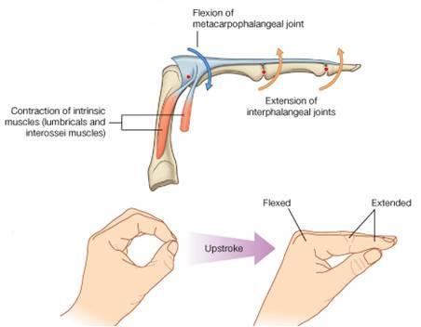
Action of Lumbricals & Interossei
Writing position

Slide 23
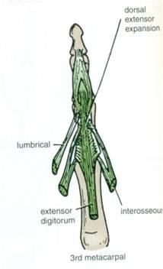
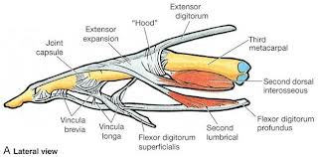
Extensor Expansion
Formed from the expansion of the tendons of extensor dig. at the PIJ,
The tendon splits into three parts:
  One Central: inserted into the base of Middle phalanx.
  Two laterals: inserted into the base of the Distal phalanx.
The Expansion Receives the insertions of:
  Corresponding Interosseous muscle (on each side).
  Lumbrical muscle (on the lateral side).

Slide 24
Thank You

