Slide 1
RADIOLOGY ANATOMY OF UPPER LIMB
Practical (2)
Radiology

Slide 2
SHOULDER

Slide 3
X-RAY

Slide 5
acromion
Clavicale
Greater teberosity
coracoid
Lesser teberosity
scapula
glenoid

Slide 6
Y view

Slide 7
Y view
acromion
Humeral head
spine
coraocid
scapula
humors shaft

Slide 8
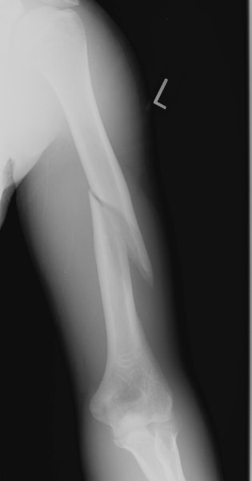
Humerus fracture

Slide 9
MRI

Slide 10
acromion
clavicle
Supraspinatus muscle
Humeral head
Deltoid muscle
Glenoid cavity
Subscapularis muscle
Teres minor muscle

Slide 11
ARM MRI

Slide 12
1-Biceps Muscle.
2-Brachialis Muscle.
3-Brachial Artery.
4-Humerus.
5-Triceps Muscle

Slide 13
ELBOW

Slide 14
X RAY

Slide 15
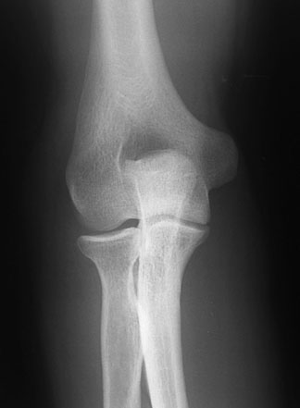

Slide 16
Olecranon fossa
medial epicondyle
Lateral epicondyle
capitulum
trochlea
Radial head
ulna
Radial teberosity

Slide 17
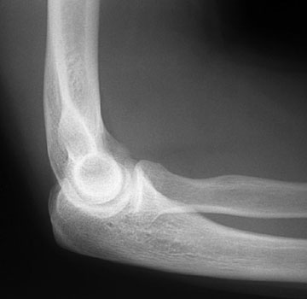

Slide 18
humerus
Coroniod process
Radial teberosity
Olecranon
fossa
Radial head
olecranon
ulna

Slide 19
CHILD
ADULT

Slide 20
HAND

Slide 21
X RAY

Slide 22
Hock of hamate
Ulnar styloid process

Slide 23
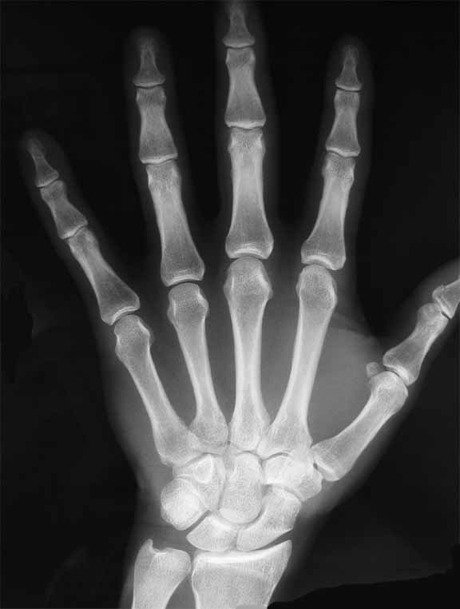
Distal phalanx
Distal interphalanx joint
Middle phalanx
Proximal interphalanx joint
Proximal phalanx
Metacarpophalangeal joint

Slide 24
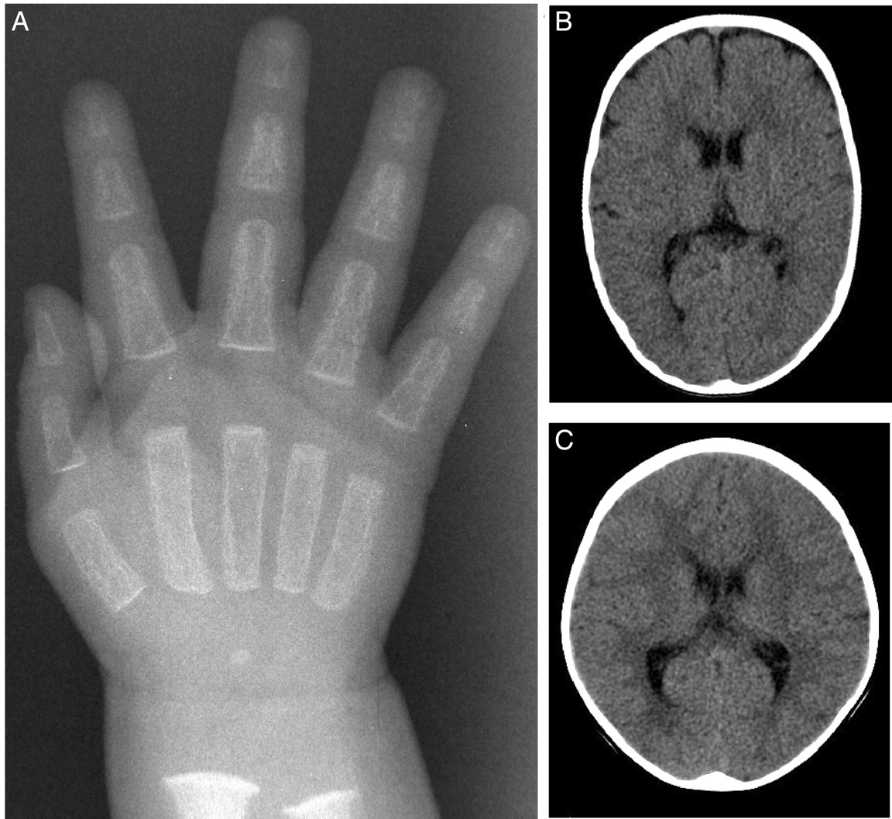
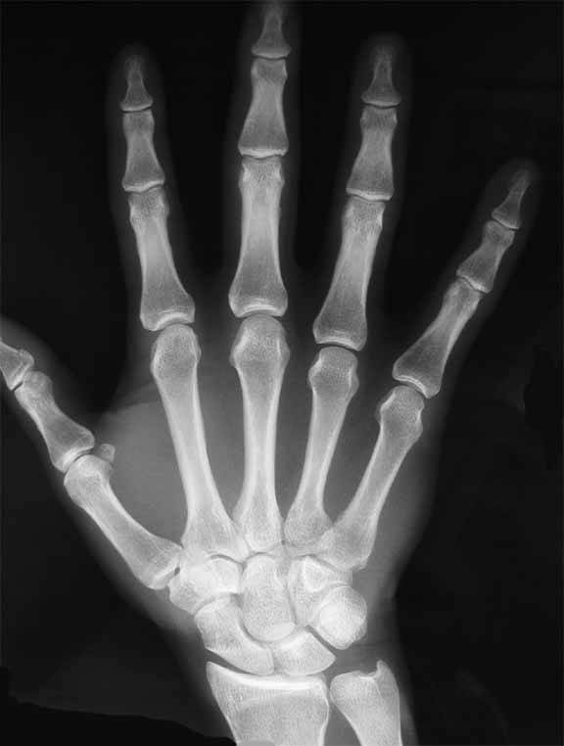
CHILD
ADULT

Slide 25
MRI

Slide 26
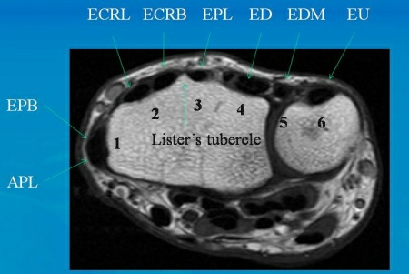

Slide 27
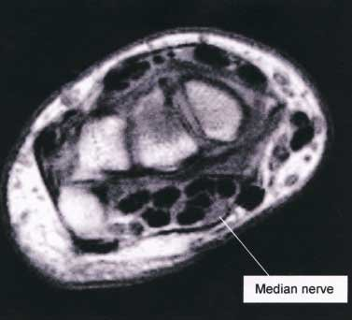

Slide 28
UPPER LIMB VESSELS

Slide 29
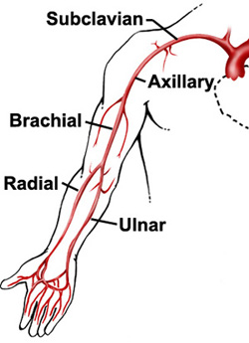

Slide 30
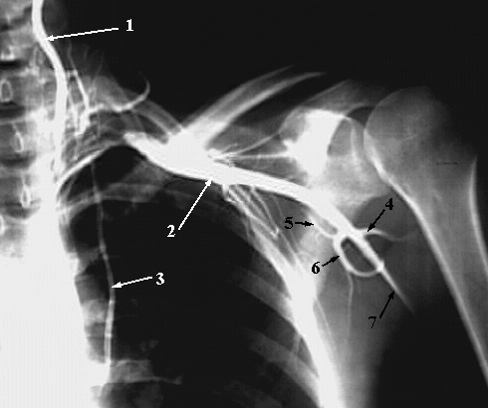
1-Vertebral Artery.
2-Axillary Artery.
3-Internal Thoracic Artery.
4-Posterior Humeral Circumflex Artery.
5-Circumflex Scapular Artery.
6-Subscapular Artery
7-brachial artery

Slide 31
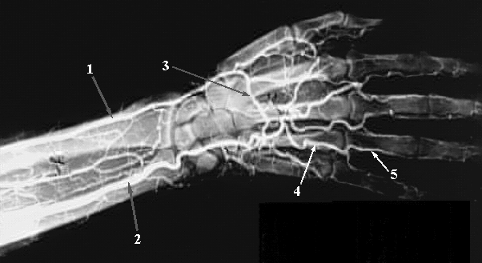
1-Radial Artery.
2-Ulnar Artery.
3-Deep Palmar Arch.
4-Common Palmar Digital Artery.
5-Proper Palmar Digital Artery

Slide 32
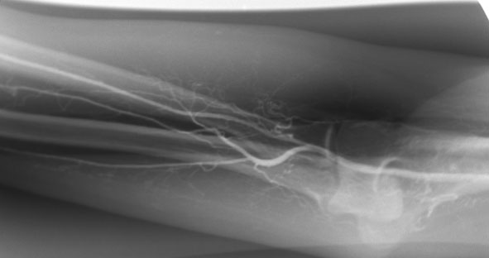
RT. UPPER EXTREMITY ANGIOGRAM
RADIAL ARTERY
ELBOW JOINT
INTEROSSEOUS
ARTERY
ULNAR ARTERY
BRACHIAL ARTERY
RT

Slide 33
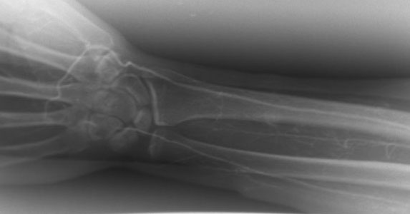
RT. UPPER EXTREMITY ANGIOGRAM
PALMAR
ARCH
RADIAL ARTERY
ULNAR ARTERY
RT

Slide 34
THE END

