Slide 1
Diseases of the Respiratory System
Respiratory block
Pathology
Lec 1
2020
Dr. Ammar C. Al-Rikabi
Dr. Maha Arafah

Slide 2
Diseases of the Respiratory System
Lecture 1
2018
Review of the normal Anatomy and Histology of the Respiratory System
Bronchial asthma

Slide 3
Page 504

Slide 4
The respiratory system
Diseases of Lung

Slide 5
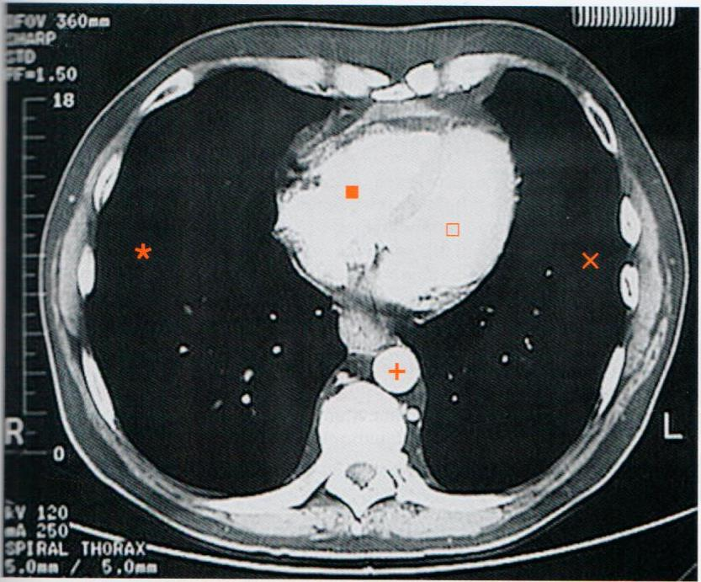
Normal lung, CT image

Slide 6
The lower respiratory tract
Diseases of Lung

Slide 7
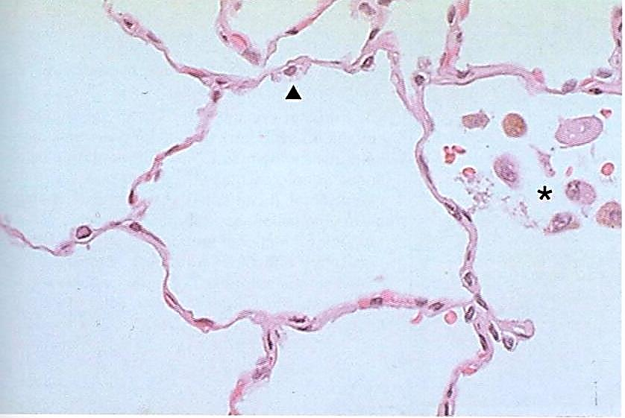
Normal adult lung

Slide 8
Diseases of the Respiratory System
Chronic Obstructive Pulmonary Diseases (COPD) including Bronchial Asthma

Slide 9
Bronchial asthma Objectives
BA is an episodic, reversible bronchoconstriction caused by increased responsiveness of the tracheobronchial tree to various stimuli.
Define bronchial asthma (BA)
Understand the pathogenesis
Understanding the morphological changes
Know the manifestation and clinical coarse of BA
List the complications of BA
Define status asthmaticus
Know the prognosis and prevention of BA

Slide 10
Asthma is a chronic inflammatory disorder of the airways that causes recurrent episodes of wheezing, breathlessness, chest tightness, and cough, particularly at night and/or early in the morning.
The hallmarks of asthma are:
intermittent, reversible airway obstruction
chronic bronchial inflammation with eosinophils
bronchial smooth muscle cell hypertrophy and hyperreactivity
increased mucus secretion.

Slide 11
Many cells play a role in the inflammatory response:
Eosinophils
Mast cells
Macrophages
Lymphocytes
Neutrophils
Epithelial cells

Slide 12
Epidemiology:
Asthma has increased in incidence significantly in the Western world over the past 4 decades.
One explanation is: the hygiene hypothesis
A lack of exposure to infectious organisms (and possibly nonpathogenic microorganisms as well) in early childhood results in defects in immune tolerance and subsequent hyperreactivity to immune stimuli later in life

Slide 13
Pathogenesis
Major factors contributing to the development of asthma include:
Genetic predisposition to type I hypersensitivity (atopy)
Acute and chronic airway inflammation
Bronchial hyperresponsiveness to a variety of stimuli.

Slide 14
Classification
Atopic (Extrinsic) asthma: (with evidence of allergen sensitization)
Type 1 Hypersensitivity reaction, IgE
Childhood
Viral infection
Positive family Hx of allergy
The onset of asthmatic attacks is often preceded by allergic rhinitis, urticaria, or eczema.
Attacks may be triggered by allergens in dust, pollen, animal dander, or food, or by infections.
A skin test with the offending antigen results in an immediate wheal-and-flare reaction.
Nonatopic (Intrinsic) asthma:
BA associated with aspirin, exercise, cold, fumes, organic and chemical dusts.
No Hx of allergy and skin test results usually are negative
A positive family history of asthma is less common.
Trigger factors:
Respiratory infections due to viruses (e.g., rhinovirus, parainfluenza virus)
Inhaled air pollutants (e.g., sulfur dioxide, ozone, nitrogen dioxide)
These lowers the threshold of the subepithelial vagal receptors to irritants
Humoral and cellular mediators of airway obstruction (e.g., eosinophils) are common to both atopic and nonatopic variants of asthma, so they are treated in a similar way.

Slide 15
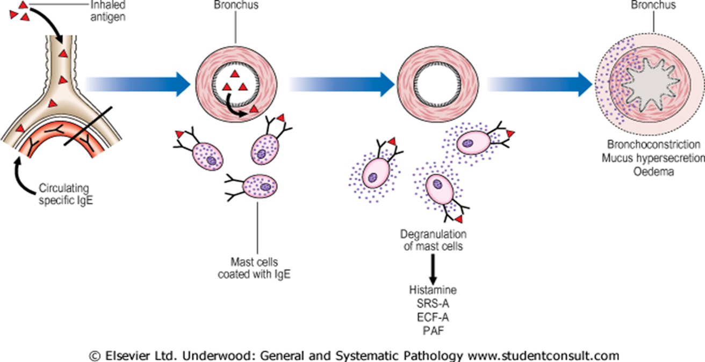
Pathogenesis of allergic asthma
Pollen
dust, virus, animal fur, sand bacteria

Slide 16
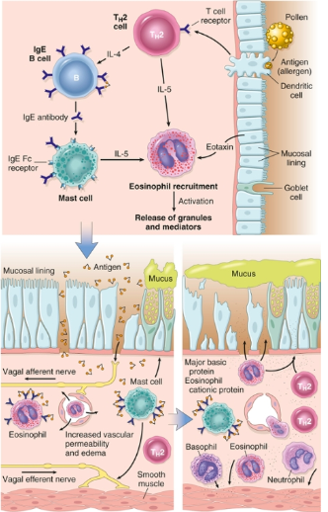
Pathogenesis
Inhaled allergens (antigen) elicit a TH2-dominated response favoring IgE production and eosinophil recruitment.
On reexposure to antigen, the immediate reaction is triggered by Ag-induced cross-linking of IgE bound to Fc receptors on mast cells. These cells release preformed mediators that directly and via neuronal reflexes induce bronchospasm, increased vascular permeability, mucus production, and recruitment of leukocytes.
Leukocytes recruited to the site of reaction (neutrophils, eosinophils, and basophils; lymphocytes and monocytes) release additional mediators that initiate the late phase of asthma.
Several factors released from eosinophils (e.g., major basic protein, eosinophil cationic protein) also cause damage to
the epithelium.

Slide 17
Pathogenesis: Genetic factor
Asthma tends to “run” in families, but the role of genetics in asthma is complex.
The precise contribution of asthma-associated genetic variants to the development of disease remains to be determined.

Slide 18
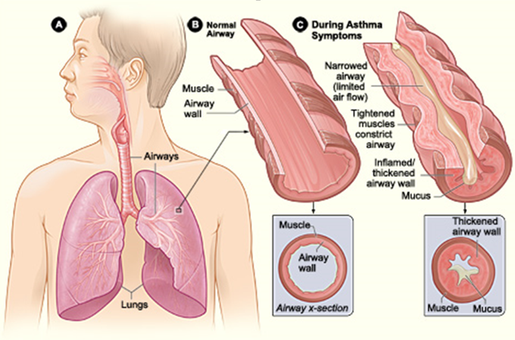
Morphological changes 0f BA

Slide 19
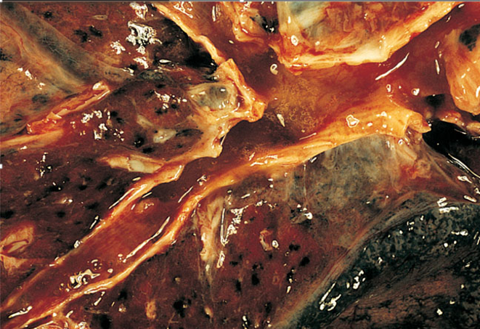
Morphological changes 0f BA
Bronchitis in an asthmatic patient. Note the presence of congested mucosa and mucoid secretions.

Slide 20
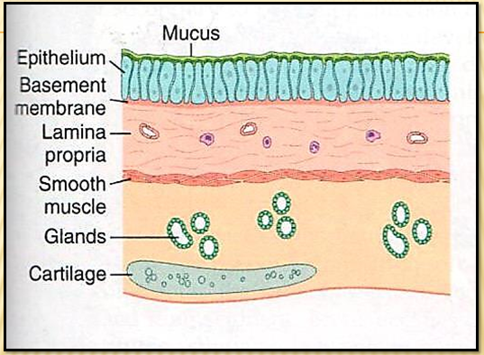
Bronchial airway in normal lung
Morphological changes 0f BA

Slide 21
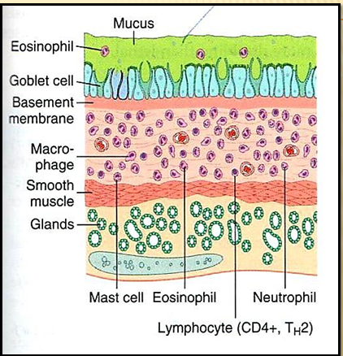
Morphological changes 0f BA
Occlusion of bronchi and bronchioles by thick, tenacious mucous plugs
Mucous contains numerous eosinophils with Curschmann spirals and Charcot-Leyden crystals.
Bronchial airway in asthma patient

Slide 22
Morphological changes 0f BA
Airway remodeling, include:
Thick Basement Membrane.
Sub-basement membrane fibrosis
Increased submucosal vascularity
Submucosal glands increased and goblet cell metaplasia of the airway epithelium.
Hypertrophy of the bronchial wall muscle.

Slide 23
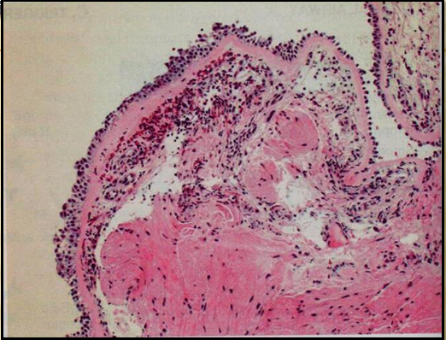
Bronchial biopsy specimen from an asthmatic patient showing sub-basement membrane fibrosis, eosinophilic inflammation and smooth muscle hyperplasia
Morphological changes 0f BA

Slide 24
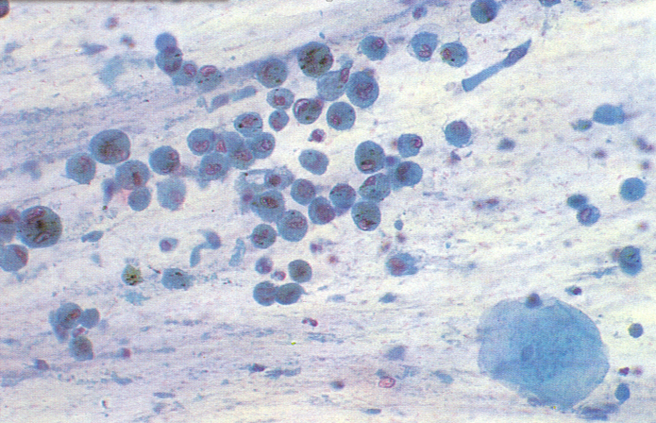
Morphological changes 0f BA
Composition of satisfactory specimen : Sputum

Slide 25
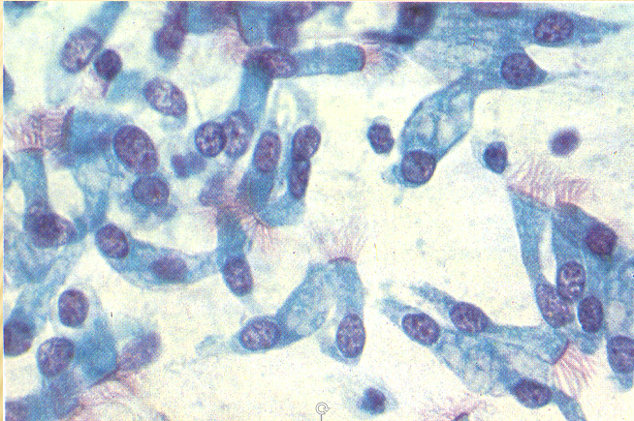
Morphological changes 0f BA
Ciliated columnar cells

Slide 26
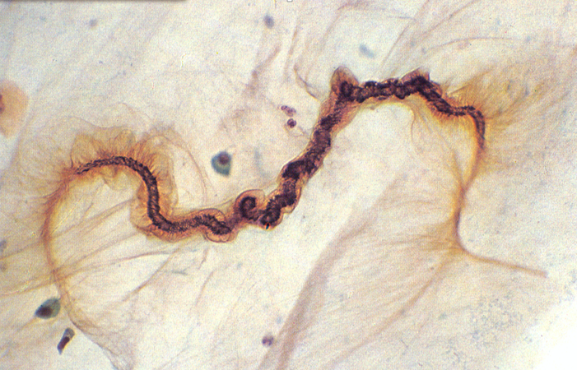
Morphological changes 0f BA
Curschmann’s spiral : Sputum

Slide 27
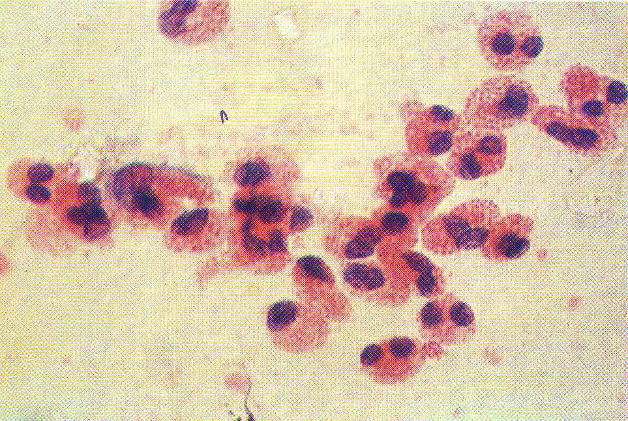
Morphological changes 0f BA
Eosinophils from a case of Bronchial Asthma

Slide 28
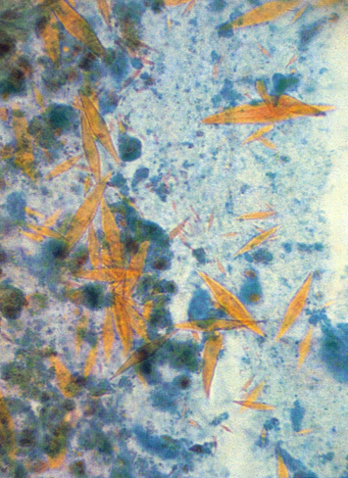
Morphological changes 0f BA
Bronchial asthma : Charcot – Leyden Crystals

Slide 29
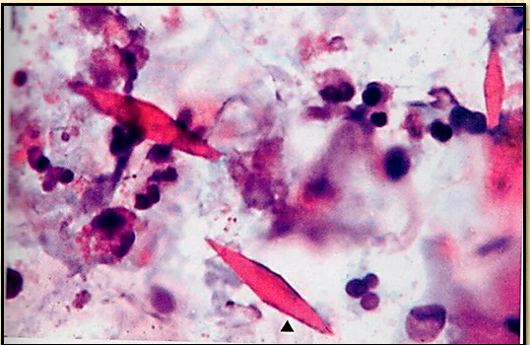
Morphological changes 0f BA
Bronchial Asthma, microscopic

Slide 30
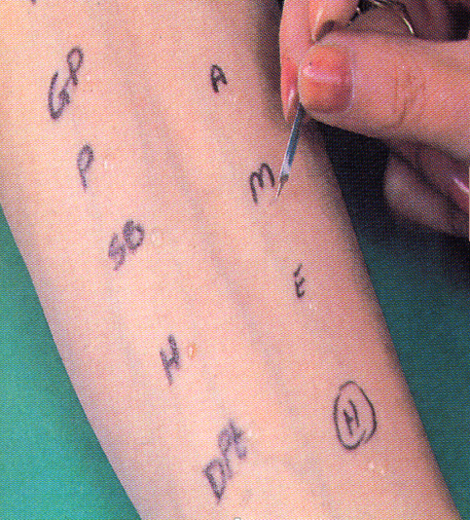
Skin prick testing in a patient with asthma.
IgE mediated type I hypersensitivity reaction to inhaled allergens

Slide 31
CLINICAL Features
Clinical features of Asthma
manifestations vary from occasional wheezing to paroxysms of dyspnea and respiratory distress.
In a classic asthmatic attack there is dyspnea, cough, difficult expiration, progressive hyperinflation of lung and mucous plug in bronchi. This may resolve spontaneously or with treatment.
Nocturnal cough
Increased anteroposterior diameter, due to air trapping and increase in residual volume
Status asthmaticus – Overinflated lungs with sever obstruction and air trapping leading to severe cyanosis and persistent dyspnea, may be fatal

Slide 32
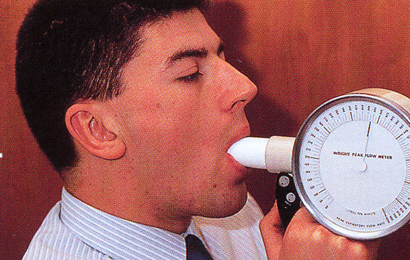
Clinical coarse of BA
The range of presentation in asthma. This patient was found incidentally to have a degree of reversible airways obstruction during a routine medical examination.

Slide 33
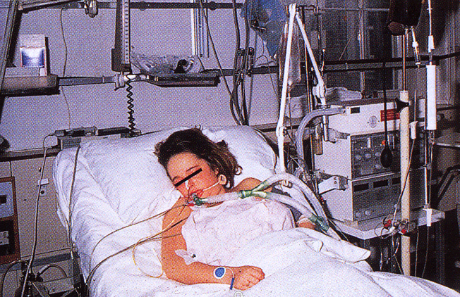
Status asthmaticus
This patient presented as a medical emergency with acute severe breathlessness and diagnosed as a case of status asthmaticus (Overinflated lungs because of sever obstruction and air trapping) which required immediate intensive care including intermittent positive-pressure ventilation.

Slide 34
COMPLICATIONS OF ASTHMA
Complications of Asthma
Airway remodeling:
some persons with long standing asthma develop permanent structural changes in the airway with sub-basement membrane fibrosis, hypertrophy of muscle and progressive loss of lung function that increase airflow obstruction and airway responsiveness.
Superimposed infection i.e. pneumonia
Chronic bronchitis
i.e. Asthmatic bronchitis: chronic bronchitis with superimposed asthma
Emphysema, pneumothorax and pneumomediastinum
Bronchiectasis
Status asthmaticus (Overinflated lungs with sever obstruction and air trapping)
Respiratory failure
requiring intubation in severe exacerbations i.e. status asthmaticus
In some cases cor pulmonale and heart failure develop.

Slide 35
Prognosis
Prognosis of Asthma
Remission- approximately 50% of cases of childhood asthma resolve spontaneously but may recur later in life; remission in adult-onset asthma is less likely.
Mortality- death occurs in approximately 0.2% of asthmatics. Mortality is usually (but not always) preceded by an acute attack and about 50% are more than 65 years old.

Slide 36
Prevention
Prevention of Asthma
Control of factors contributing to asthma severity.
Exposure to irritants or allergens has been shown to increase asthma symptoms and cause exacerbations.
Skin test
results should be used to assess sensitivity to common indoor allergens.
All patients with asthma should be advised to avoid exposure to allergens to which they are sensitive.

Slide 37
Asthma: Summary Episodic attacks of bronchoconstriction (reversible)
Types
Extrinsic asthma: Type 1 Hypersensitivity reaction, IgE, viral infection, childhood, family Hx of allergy.
Morphology
Hypertrophy of bronchial smooth muscle & hyperplasia of goblet cells e eosinophils, thickened BM
Mucous plug e Curschmann spirals & Charcot-Leyden crystals.
Complication
Superimposed infection
Chronic bronchitis
Pulmonary emphysema
Status asthmaticus (Overinflated lungs with sever obstruction and air trapping)
Intrinsic asthma: BA associated with, aspirin, exercise, cold induced. No Hx of allergy
Remodeloing with sub-basement membrane fibrosis and hypertrophy of muscle layer
Cor pulmonale

