Slide 1
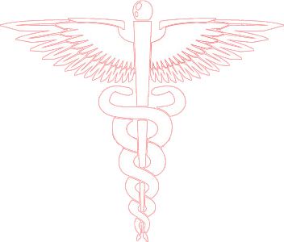
Diseases of the Respiratory System
Dr. Ammar C. Al-Rikabi
Dr. Maha Arafah
Respiratory block
Pathology
Lec 2
2020

Slide 2
Diseases of the Respiratory System
Chronic Obstructive Pulmonary Diseases (COPD)

Slide 3
Objectives:
Give introduction for diffuse lung disease
Compare and contrast the major clinical and functional differences between predominant chronic bronchitis versus predominant emphysema in patients with COPD
Define Bronchiectasis, its causes, presentation, morphology and significant.

Slide 4
Obstructive Lung Diseases
Obstructive lung disease
(diffuse)
Bronchial Asthma
2) Chronic obstructive pulmonary disease (COPD) They are of two types:
a) Chronic bronchitis
b) Emphysema
3) Bronchiectasis
Common symptoms in lung disease
Dyspnea: difficulty with breathing
Cough
Hemoptysis

Slide 5
Diseases of the Respiratory System
Chronic Bronchitis
Objectives:
Define chronic bronchitis.
Describe the causes, pathogenesis and the morphology of chronic bronchitis.
Describe the mechanism of airway obstruction in a patient with chronic bronchitis.
Understand that when severe obstruction is present in chronic bronchitis, significant emphysema is nearly always present

Slide 6
Chronic Bronchitis
Chronic Bronchitis: defined as persistent productive cough for at least 3 consecutive months in at least 2 consecutive years
Causes
Cigarette smoking is the most important risk factor
Air pollutants
Cystic fibrosis

Slide 7
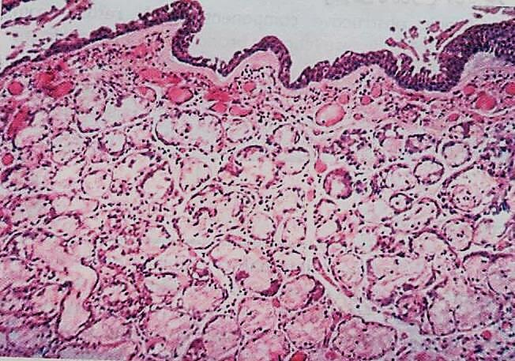
Chronic Bronchitis: morphology
Chronic bronchitis

Slide 8
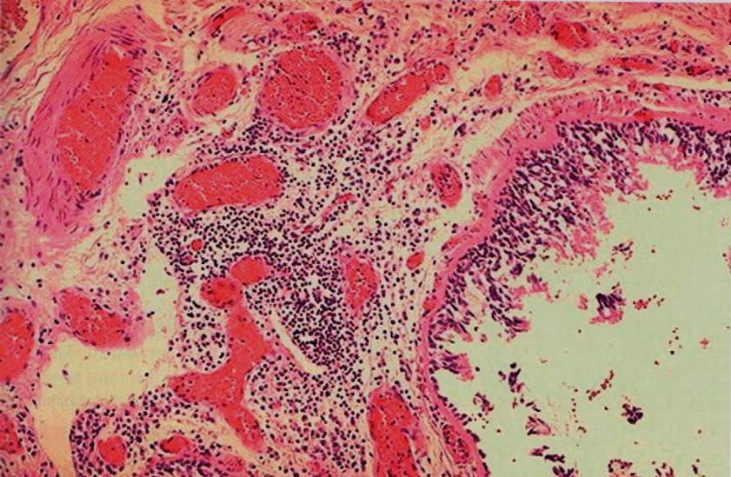
Chronic Bronchitis: morphology
Chronic bronchitis

Slide 9
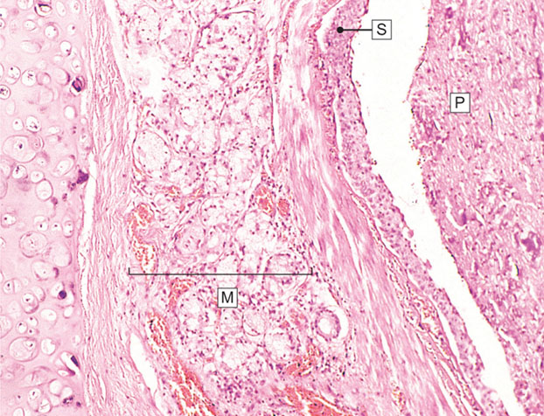
Chronic Bronchitis: morphology
Chronic bronchitis. In chronic bronchitis the main abnormality is secretion of abnormal amounts of mucus, causing plugging of the airway lumen (P).

Slide 10
Clinical features and compilcations
Chronic Bronchitis
Persistent reproductive cough
Dyspnea on exertion
Hypercapnia, hypoxemia, cyanosis
Emphysema
Cor pulmonale
Death due to further impairment of respiratory functions after superimposed acute baterial infections.

Slide 11
Chronic Bronchitis
Definition: Persistent productive cough (with sputum) for at least 3 months in at least 2 consecutive years
Causes
Cigarette smoking is the most important risk factor; air pollutants also contribute
Features
enlargement of mucous-secreting glands, goblet cell hyperplasia, chronic inflammation, and bronchiolar wall fibrosis.
Complications
Persistent reproductive cough, dyspnea on exertion, hypercapnia, hypoxemia, cyanosis, cor pulmonale with edema (blue bloater)
Death may result from further impairment of respiratory function due to superimposed acute infections.

Slide 12
Diseases of the Respiratory System
Emphysema
Objectives:
Define emphysema.
Describe the gross and microscopic changes in emphysema.
Discuss the typical clinical presentation and causes of death.
Describe the most likely mechanism of emphysema (the protease-antiprotease mechanism).
Describe the pathophysiologic mechanisms of emphysema

Slide 13
Emphysema Is abnormal permanent enlargement of all or part of the respiratory unit accompanied by destruction of their walls
Emphysema
Associated with loss of elastic recoil and support of small airways leading to tendency to collapse with obstruction

Slide 14
Emphysema
Diseases of Lung

Slide 15
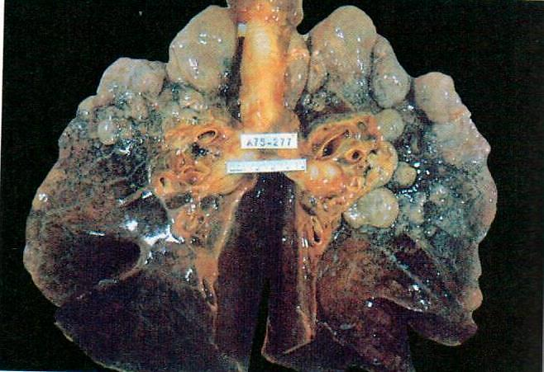
Bullous emphysema with large apical and subpleural bullae

Slide 16
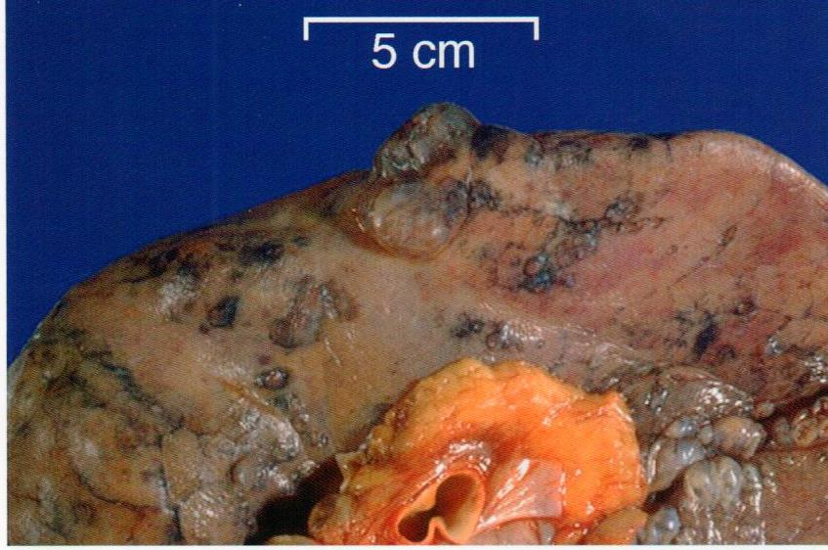
Distal acinar /paraseptal:
forming multiple cyst-like structures with spontaneous pneumothorax.

Slide 17
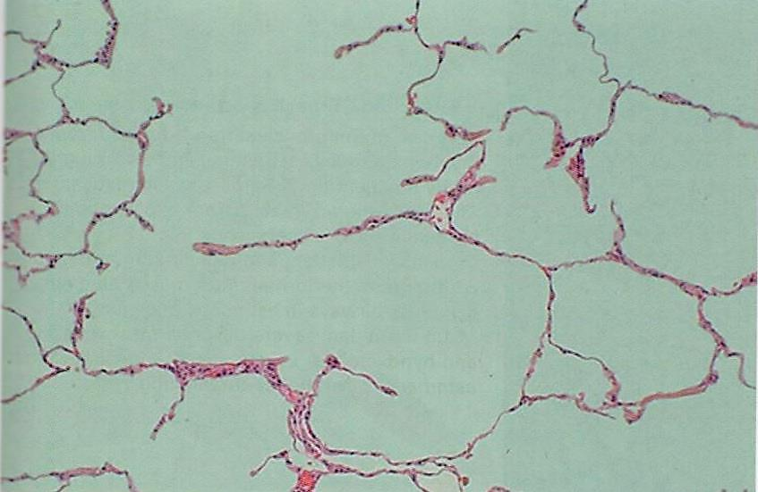
Paraseptal emphysema, microscopic
destruction of alveolar walls

Slide 18
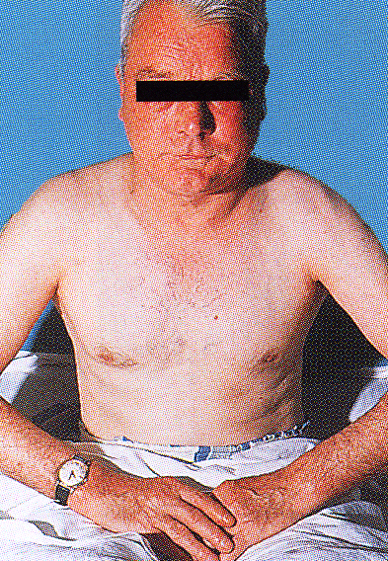
Pursed lip expiration is a common maneuver adopted by patients with severe chronic obstructive pulmonary disease including emphysema.
The patient starts to breathe out closed or nearly closed lips to keep the intrabronchial pressure high and prevent collapse of the bronchial wall and expiratory obstruction. Later in expiration the lips are blown forwards and open, often with a grunt (“fish-mouth breathing).

Slide 19
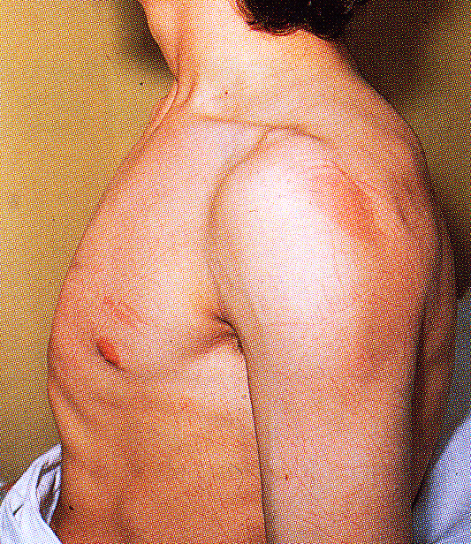
Barrel-shaped chest in a patient with emphysema.
The hyperinflation result from
air-trapping with inflammatory changes
hypersecretion of viscid contraction in the small airways.
Note the associated indrawing of the intercostal muscles. Similar changes are seen in patients with chronic bronchitis and asthma.

Slide 20
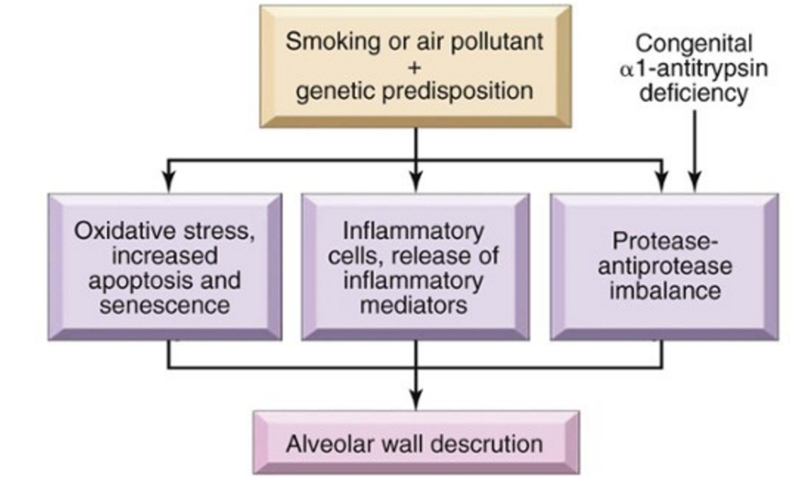
Emphysema
Emphysema: Pathogenesis
Pathogenesis of Emphysema

Slide 21
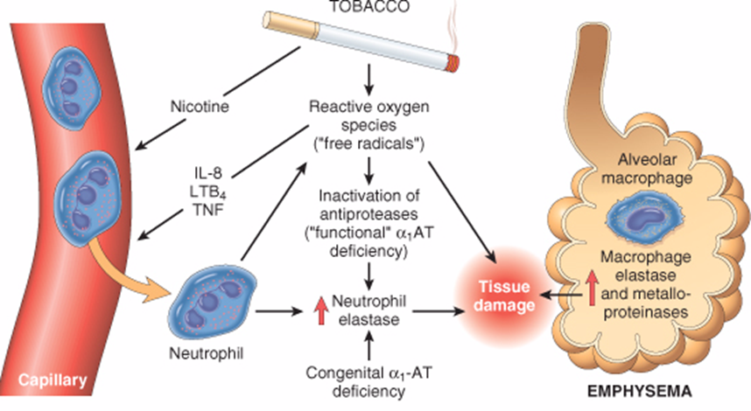

Slide 22
Classification of emphysema
Diseases of Lung
Centriacinar:
in heavy smoker, severe in upper lobes
2. Alpha 1 antitrypsin deficiency:
Commonly affect both lower lobes
3.Distal acinar /paraseptal:
adjacent to areas of fibrosis, scarring or atelectasis
More severe in the upper half of the lungs.
4. Irregular
Associated with scarring, e.g. in TB
Asymptomatic

Slide 23
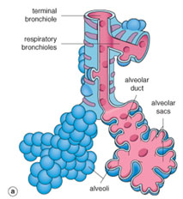
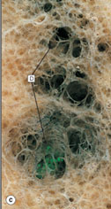
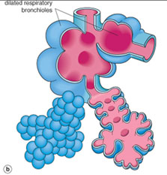
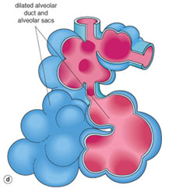
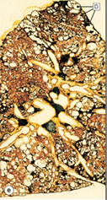
Diseases of Lung
Emphysema: morphology
Generalized emphysema. (a) Normal distal lung acinus. (b) Centriacinar emphysema. (c) Centriacinar emphysema. (d) Panacinar emphysema. (e) Panacinar emphysema (Gough-Wentworth section).

Slide 24
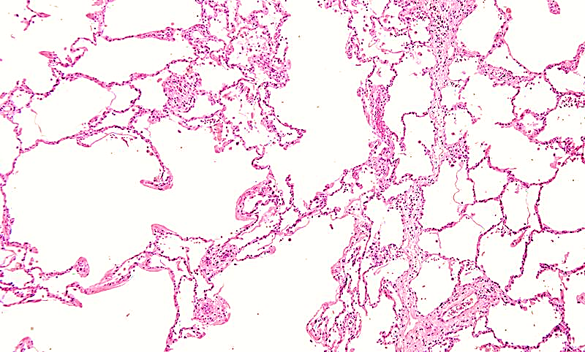
Emphysema: morphology
Destruction of some alveolar septi

Slide 25
Emphysema:
Emphysema: SUMMARY
Dilated air spaces beyond respiratory arteriols
Types
Centriacinar: Smoking
Clinical features
Cough and wheezing. Respiratory acidosis
Complications
Pneumothorax
Panacinar: deficiency of α1 AT
Paraseptal: Occurs adjacent to areas of fibrosis or atelectasis.
Irregular: scar
Weight loss
Pulmonary function tests reveal low FEV1
Pulmonary failure with respiratory acidosis, hypoxia and coma.
Right-sided heart failure ( Cor pulmnale)
Death from emphysema is related to:
Pulmonary hypertension.

Slide 26
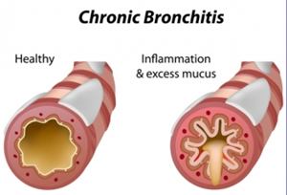
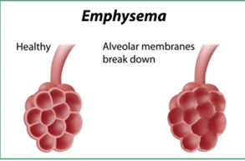

Slide 27
Bronchiectasis
Objectives:
Definition
Causes
Presentation
morphology and significant

Slide 28
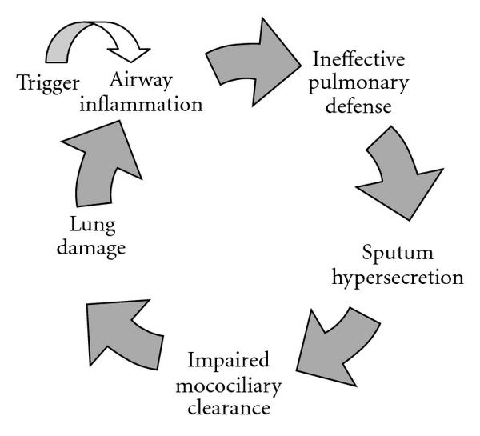
Bronchiectasis is permenat dilatation of bronchi with destruction of their walls. It is a result of chronic inflammation associated with an inability to clear mucoid secretions.
Bronchiectasis

Slide 29
us
Causes of bronchiectasis
Bronchial obstruction
Congenital or hereditary conditions
Chronic or severe infection / necrotizing pneumonia
Localized:
- tumor, foreign bodies or mucous impaction
Generalized:
- bronchial asthma
- chronic bronchitis
- Congenital bronchiectasis
- Cystic fibrosis.
- Intralobar sequestration of the lung.
- Immunodeficiency status.
- Immotile cilia and kartagner syndrome
Caused by TB, staphylococci or mixed infection

Slide 30
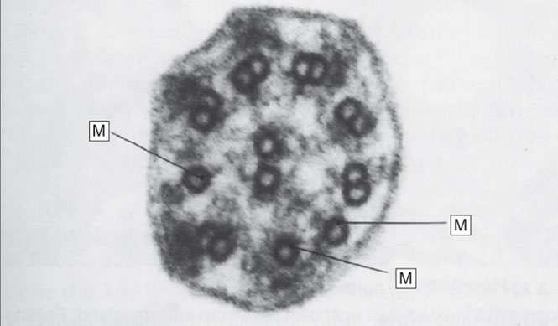
Diseases of Lung
Cilial dysmotility syndrome. Electron micrograph of cilia from a person with recurrent chest infections since childhood. The outer dynein arms are absent and there are abnormal single microtubules (M), which prevent normal motility.

Slide 31
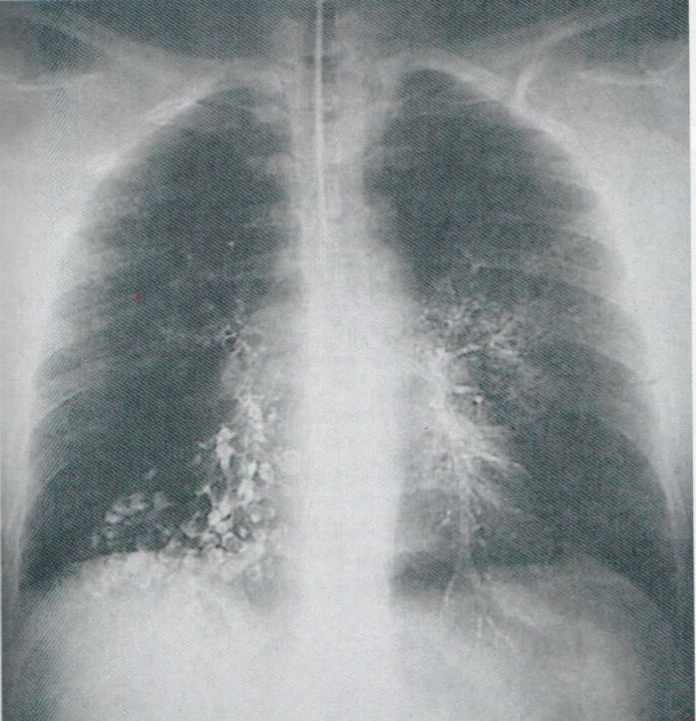
Presentation
Bronchiectasis, chest radiograph

Slide 32
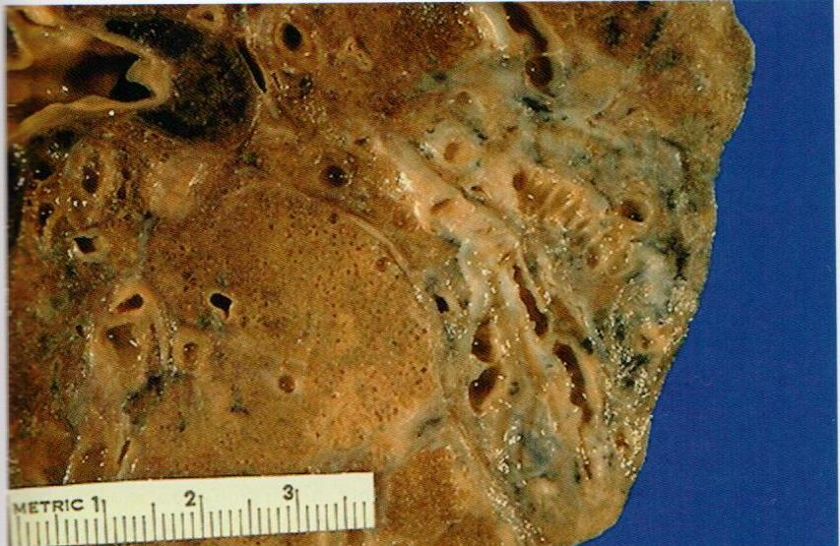
Bronchiectasis, gross

Slide 33
Diseases of Lung
Bronchiectasis
Dilatation of bronchi with destruction of bronchial walls

Slide 34
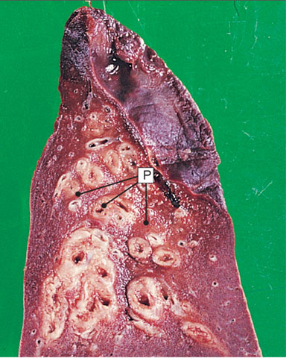
Diseases of Lung
Bronchiectasis. This is a lower lobe of lung surgically resected for bronchiectasis.

Slide 35
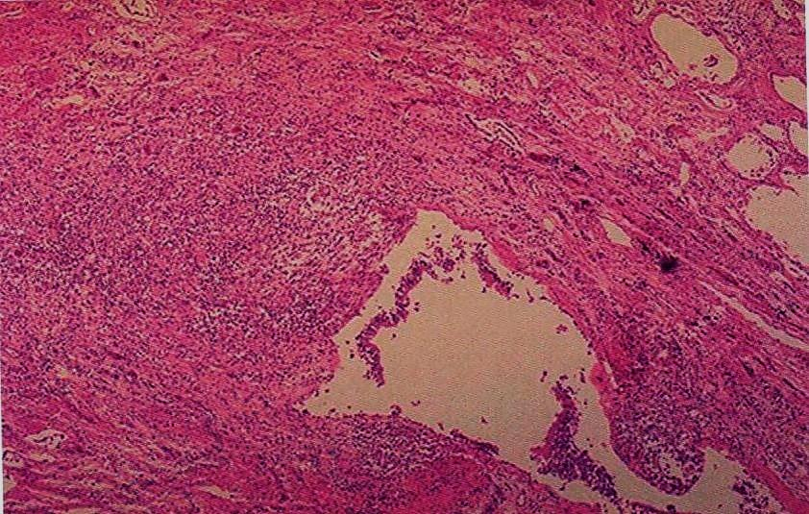
Bronchiectasis, micropscopic

Slide 36
Bronchiectasis:
Bronchiectasis
Dilatation and destruction of bronchi and bronchioles secondary to chronic inflammation and obstruction
Causes
Infection/ Necrotizing pneumonia
Congenital (Cystic fibrosis, Kartagener’s Syndrome)
Clinical features
Sever persistent cough with sputum (mucopurulent sputum) sometime with blood.
Complications
Rare complications: metastatic brain(cerebral) abscess and amyloidosis.
Obstruction
Clubbing of fingers.
Lung Abscess
If sever, obstructive pulmonary function

Slide 37
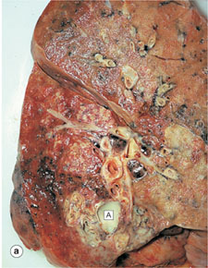
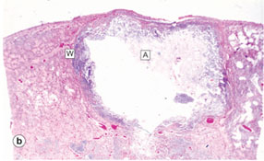
Diseases of Lung
Lung abscess.

Slide 38
Diseases of Lung
Key Facts Chronic obstructive pulmonary disease
. Definition: a disease state characterized by airflow limitations that are not fully reversible. The airflow limitation is usually both progressive and associated with an abnormal inflammatory response of the lungs to noxious particles or gases.
. Cigarette smoking remains the most important cause of COPD. Other risks are recurrent chest viral infections in childhood, atopy, asthma, and occupational exposure to dusts (especially mining).
. Respiratory bronchiolitis is one of the earliest lesions seen in smokers.
. Chronic bronchitic airways show mucous hypersecretion with mucous gland hyperplasia.
. Chronic bronchitis and bronchiolitis cause airway narrowing.
. Emphysema causes loss of elastic recoil in lungs and contributes to functional airways obstruction.
. Generalized emphysema is defined as permanent dilatation of any part of the respiratory acinus, with destruction of tissue in the absence of scarring.
. There are two patterns of generalized emphysema: centrilobular and panacinar.
. Many patients with COPD have a reversible component to functional airways obstruction.
. Pulmonary hypertension and right-sided heart failure are common in long-standing chronic obstructive pulmonary disease.
. Acute deterioration in COPD is usually caused by viral or bacterial infection.

Slide 39
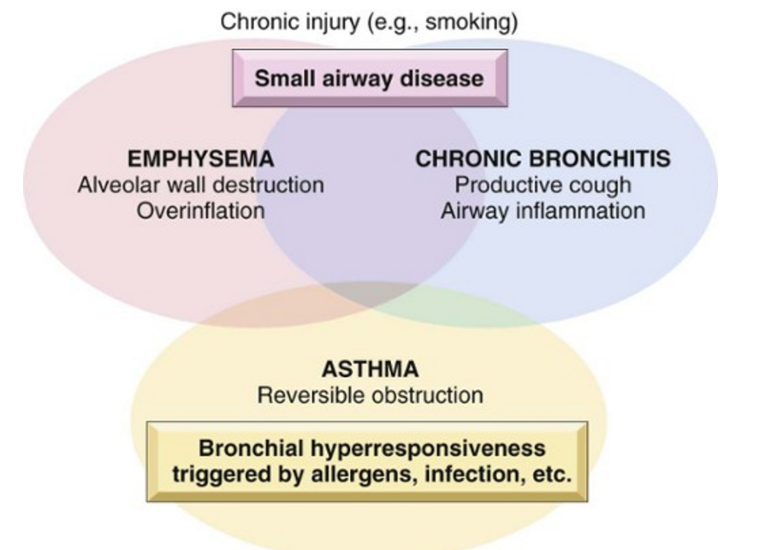

Slide 40
