Slide 1
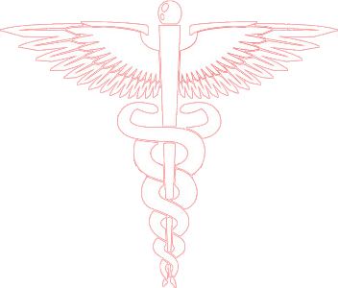
Diseases of the Respiratory System
Chronic Interstitial Lung Diseases (Restrictive, Infiltrative)
Prof. Ammar C. Al-Rikabi
Dr. Maha Arafah
Respiratory block
2020
Pathology
Lecture 3

Slide 2
Objectives
Understand the structure and constituents of the lung interstitium as well as the restrictive changes which occur in diseases of the interstituim (ILD)
Know the symptoms of ILD: progressive breathlessness and cough
Know subtypes of ILD: acute and chronic
Discuss the causes, morphology and outcome of acute ILD
Appreciate the pathogenesis of chronic ILD regardless of their type.
Become aware of the classification of interstitial lung diseases.
Discuss examples of interstitial lung diseases including:
idiopathic pulmonary fibrosis
Pneumoconiosis
Hypersensitivity pneumonitis
Sarcoidosis

Slide 3
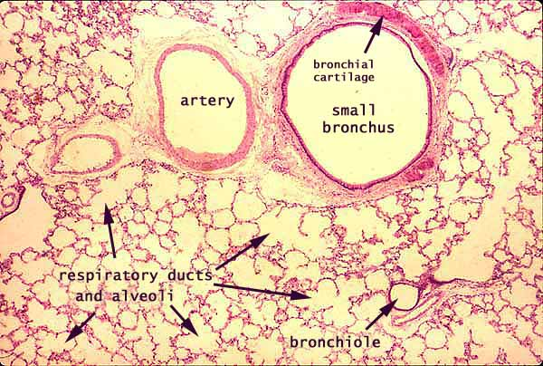
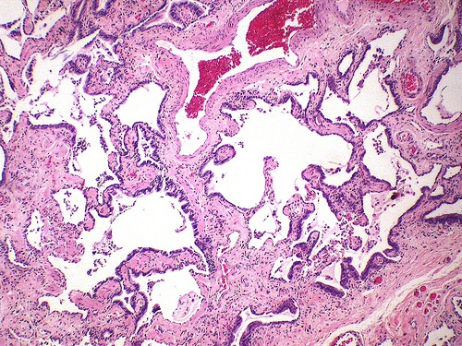
Interstitial lung diseases
Normal
Honeycomb lung

Slide 4
Restrictive Lung Disease
Causes of interstitial lung diseases
The restrictive lung diseases are divided into:
Intrinsic lung diseases/ diseases of the lung parenchyma/primary ILD:
Extrinsic disorders or extraparenchymal diseases:
The diseases cause inflammation or scarring of the lung tissue (ILD) or result in filling of the air spaces with exudate and debris (pneumonitis). They are characterized by inflammatory infiltrates in the alveolar interstitial space and the interstitium becomes thickened and fibrotic (Stiff Lung).
Therefore there is decreased oxygen-diffusing capacity.
They are acute or chronic.
The chest wall, pleura, and respiratory muscles are the components of the respiratory pump, and they need to function normally for effective ventilation.
Abnormalities of the chest wall include:
bony abnormalities (kyphosis or kypho-scoliosis)
massive pleural effusion
morbid obesity
neuromuscular disease of respiratoy muscles

Slide 5
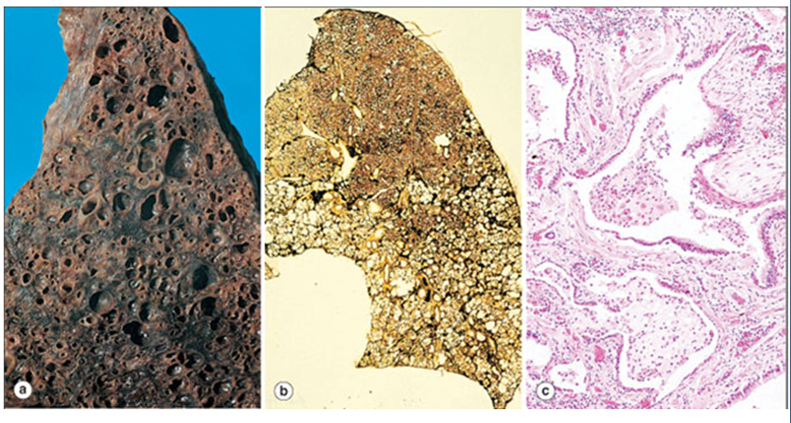
Diseases of Lung
Intrinsic lung diseases
Honeycomb lung. Macroscopically (a) honeycomb lung appears as large (b) the extent of abnormality and interstitial fibrosis can be better appreciated. (c) shows coalescence of air spaces, both alveoli and bronchioles, to form cysts lined with cuboidal epithelium.

Slide 6
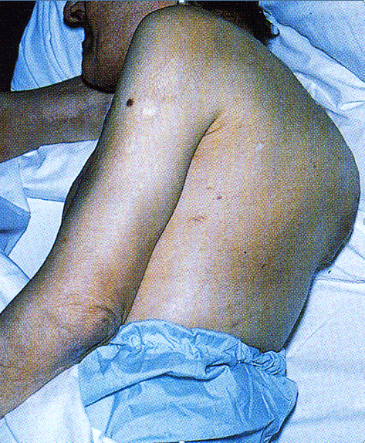
Severe kyphoscoliosis of unknown etiology. Flexion (kyphosis) and lateral deviation (scoliosis) of the spine have the combined effect of reducing chest volume. This compromises respiratory function and may cause restrictive lung disease.
Extrinsic disorders or extraparenchymal diseases

Slide 7
Acute restrictive lung disease
Know subtypes of ILD: acute and chronic
(INTRINSIC TYPE)

Slide 8
Acute restrictive lung diseases
Acute restrictive lung diseases (INTRINSIC TYPE)
Adult respiratory distress syndromes (ARDS)
Neonatal respiratory distress syndromes (NRDS)

Slide 9
ARDS Can be caused by many conditions:
Acute adult restrictive lung diseases
Pneumonia and sepsis are the most common causes
Direct injury to lung
Pneumonia
Aspiration of gastric contents
Pulmonary trauma
Fat embolism
Near drowning
Toxic inhalation injury (irritants
such as chlorine, O2 toxicity)
Post lung transplant
Severe acute respiratory
syndrome (SARS): The virus is
a coronavirus that destroys the
type II pneumocytes and
causes diffuse alveolar damage
Indirect injury to lung:
Sepsis
Severe trauma (e.g. bone fracture, head injury, burns, radiation)
Shock
Cardiopulmonary bypass
Acute pancreatitis
Transfusion
Uremia
Overdose with street drugs such as heroin
Therapeutic drugs such as bleomycin
Hematologic conditions e.g multiple transfusion, coagulation disorders

Slide 10
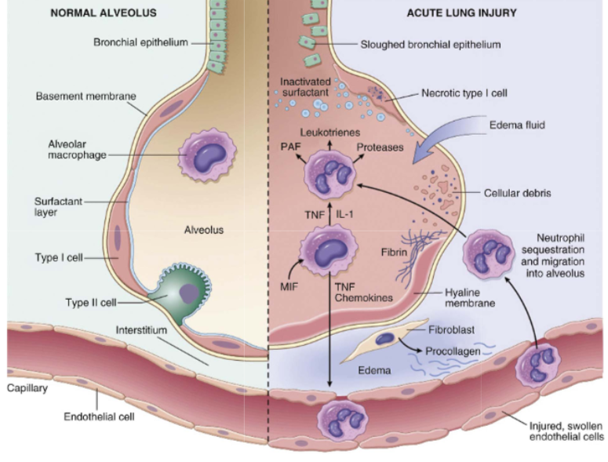

Slide 11
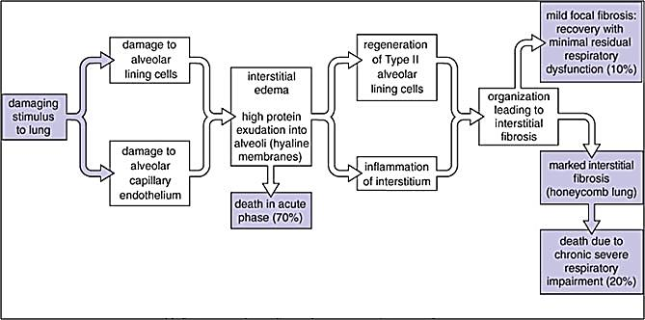
Diseases of Lung
The main events and outcomes of ARDS

Slide 12
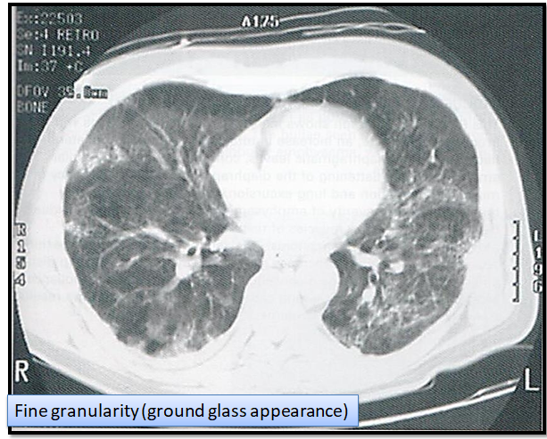
Diffuse alveolar damage, CT image

Slide 13
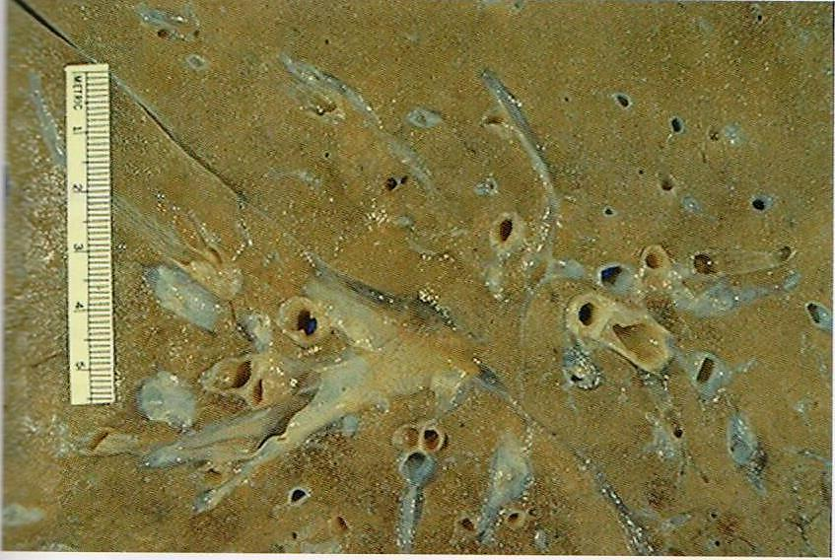
Diffuse alveolar damage, gross: lung edema

Slide 14
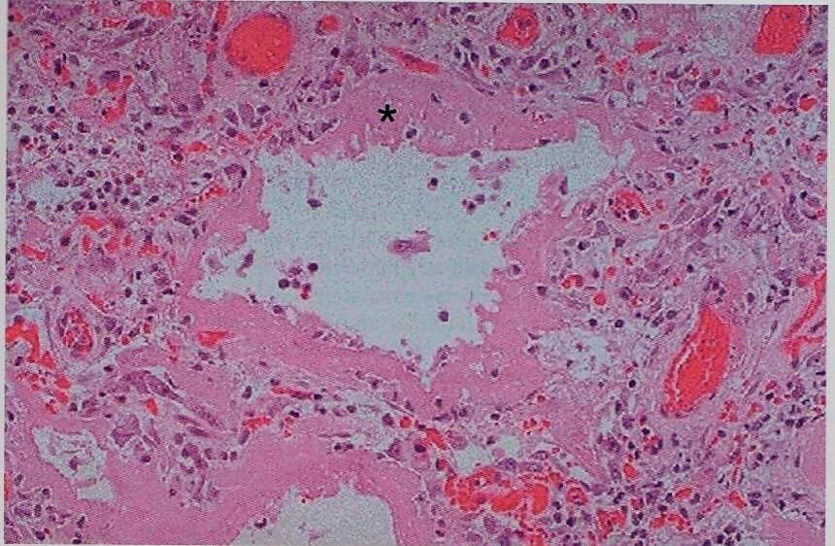
Diffuse alveolar damage, microscopic

Slide 15
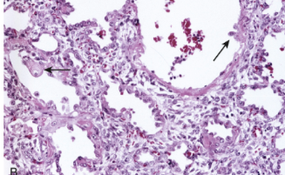
The healing stage is marked by resorption of hyaline membranes and thickening of alveolar septa by inflammatory cells, fibroblasts, and collagen. Numerous reactive type II pneumocytes also are seen at this stage (arrows), associated with regeneration and repair.

Slide 16
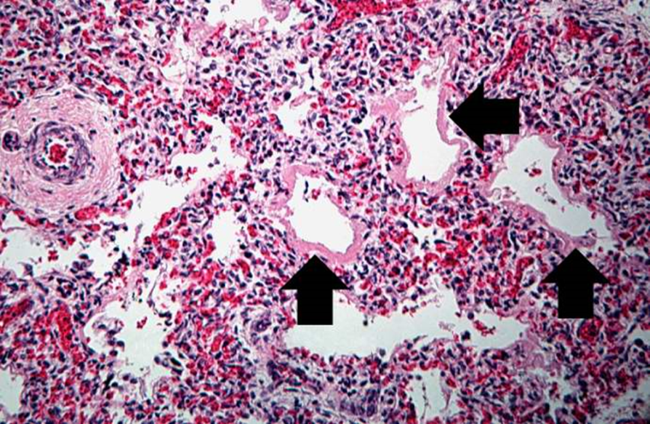
Neonatal Respiratory Distress Syndrome/Hyaline membrane disease
Neonatal Respiratory Distress Syndrome
It is the most common cause of respiratory failure in the newborn and is the most common cause of death in premature infants.
It is the same as ARDS except that it is caused by a deficiency of pulmonary surfactants in newborns, most often as a result of immaturity.

Slide 17
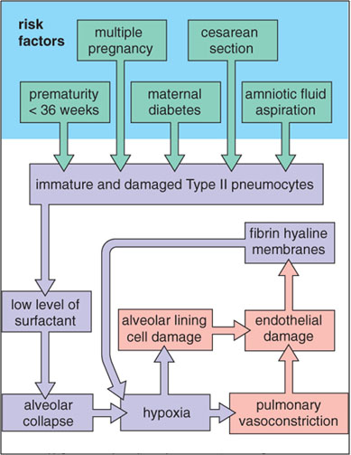
Diseases of Lung
Pathogenesis of NRDS.

Slide 18
Chronic restrictive lung disease
(INTRINSIC TYPE)

Slide 19
Major Categories of Chronic Interstitial Lung Disease
Chronic restrictive lung disease: Categories
Idiopathic fibrosing:
Usual interstitial pneumonia (idiopathic pulmonary fibrosis)
Drug:
Chemotherapy, methotrexate, bleomyxin toxicity
Amiodarone: antiarrythemic drug (cause pulmonary fibrosis and pneumonitis)
Occupational: Pneumoconiosis
Anthracosis and coal worker's pneumoconiosis,
Silicosis
Berylliosis
Asbestosis
Smoking related:
Eosinophilic granuloma
Desquamative interstitial pneumonia
Respiratory bronchiolitis-associated interstitial lung disease
Immune diseases:
Sarcoidosis
Goodpasture syndrome
Hypersensitibity pneumonitis (extrinsic allergic alveolitis)
Systemic lupus erythematosus
Systemic sclerosis (scleroderma)
Wegener granulomatosis
Radiation Reactions
Occur after radiation with diffuse alveolar damage, severe atypia of hyperplastic type II cells and fibroblasts

Slide 20
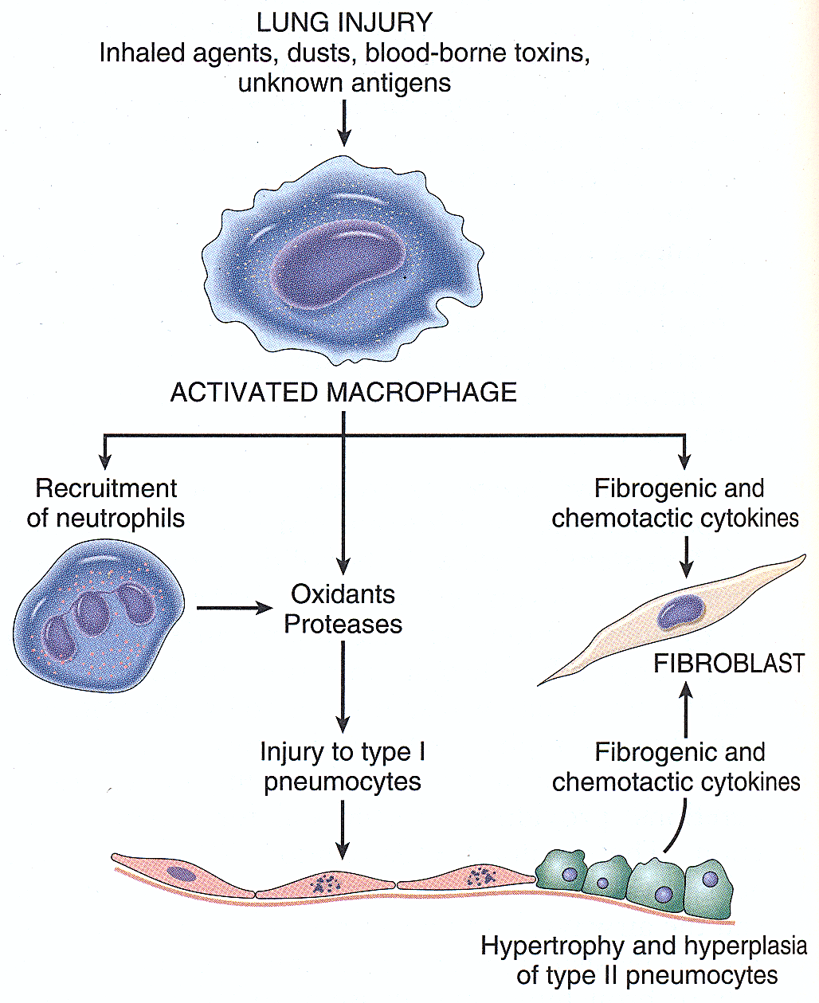
Pathogenesis of Chronic Interstitial Lung Disease
Lung injury
Influx of inflammatory cells into the alveoli and alveolar walls
Release of chemical mediators and promotion of fibrosis
Distortion of the normal structure of alveoli

Slide 22
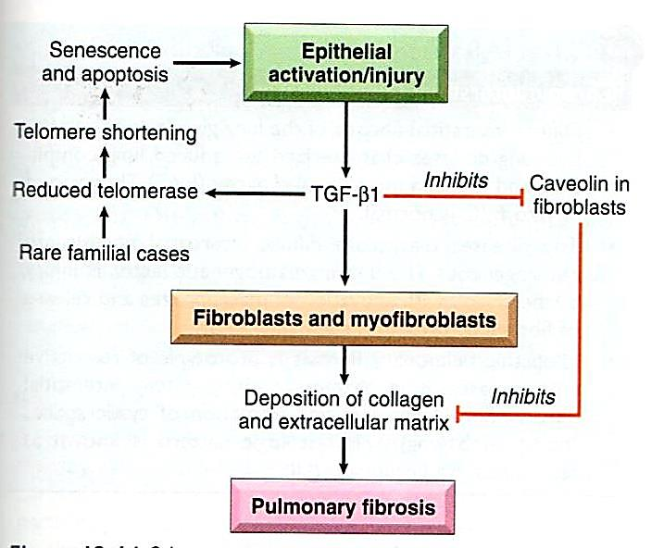
Pathogenesis of idiopathic pulmonary fibrosis
The injured epithelial cells are the source of profibrogenic factors such as TGF-βI secondary to down regulation of caveolin I
susceptible host

Slide 23
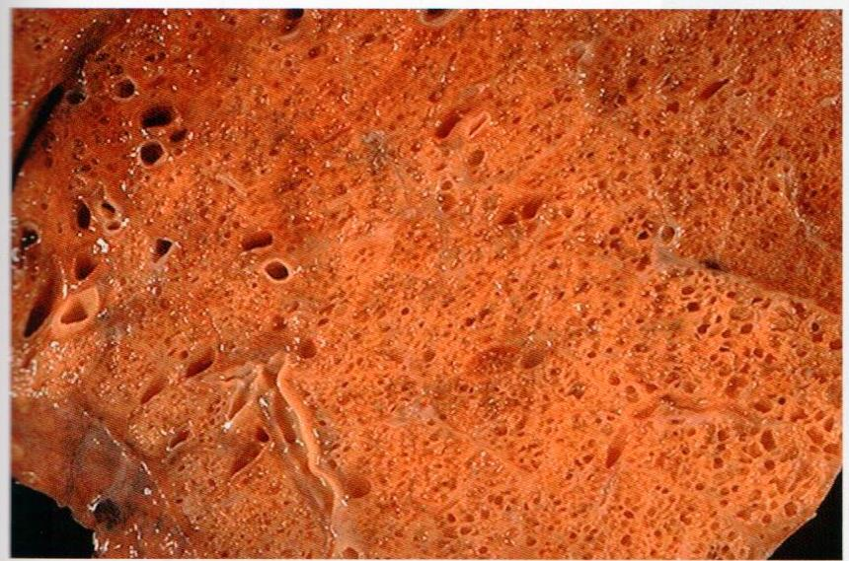
Honeycomb change, gross
Fibrosis in the subpleural region

Slide 24
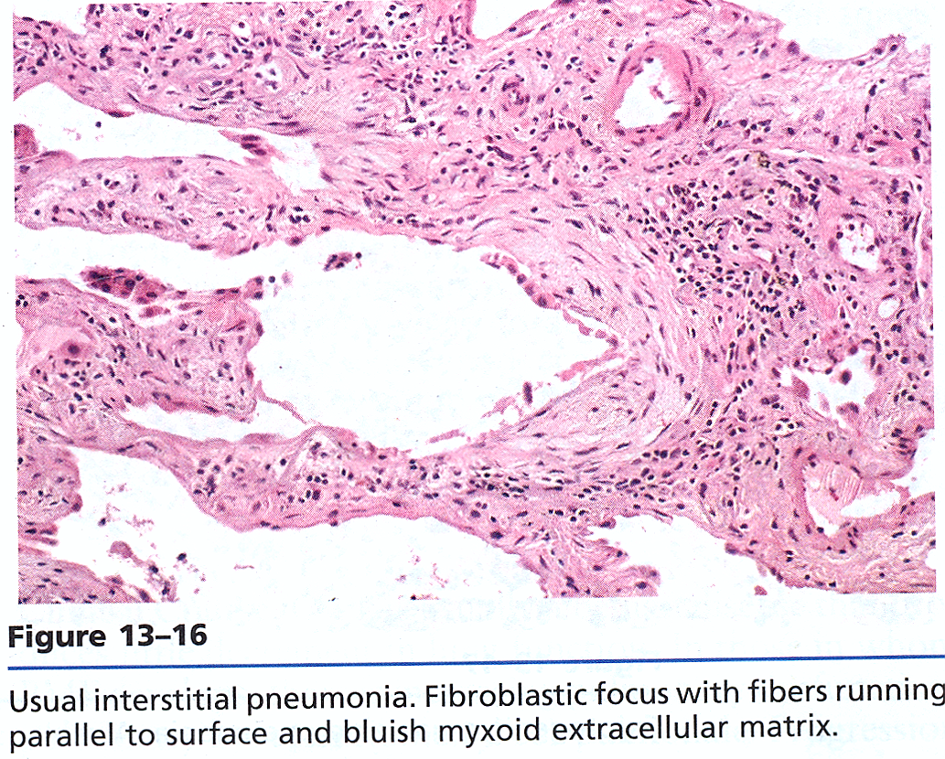
fibroblastic focus

Slide 25
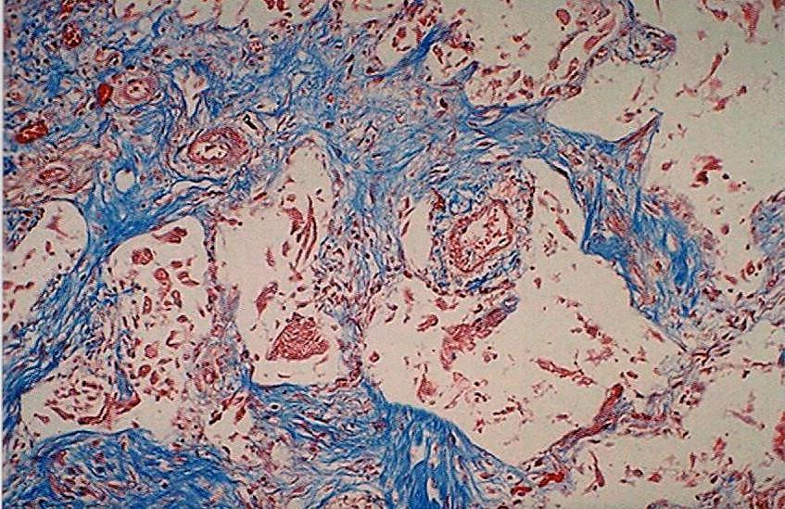
Interstitial fibrosis, microscopic

Slide 26
Idiopathic pulmonary fibrosis (Usual interstitial pneumonia) :
A restrictive lung diseases characterized by reduced lung compliance. It is characterized by subpleural patchy interstitial fibrosis, fibroblastic foci and formation of cystic spaces (honeycomb lung).
Causes
Unknown? Genetic
Clinical features
Gradually increasing dyspnea on exertion and dry cough
Complications
Hypoxemia, cyanosis and clubbing
The resulting injury to alveolar epithelial cells set in motion event that lead to increase local production of fibrogenic cytokines such as TGF-β
Most patients are 55 to 75 years
gradual deterioration in pulmonary status despite medical treatment
The median survival is about 3 years
X ray: early: ground glass fine granularity, advanced: honeycomb lung

Slide 27
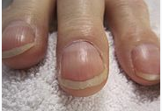
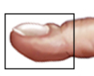
Clubbing of nail
Periosteal reaction of distal phalanx with bulbous swelling of the connective tissue in the terminal phalanxes.
a symptom of diseases of the heart or lungs which cause chronically low blood levels of oxygen.
Pathogenesis:
The megakaryocytes bypass the breakdown within the pulmonary circulation and enter the systemic circulation. They are then trapped within the capillary beds within the extremities, such as the digits, and release platelet-derived growth factor (PDGF) and vascular endothelial growth factor (VEGF) leading to hypertrophy of connective tissua.

Slide 28
Occupational: Pneumoconiosis
Anthracosis and coal worker's pneumoconiosis,
Silicosis
Berylliosis
Asbestosis
The development of pneumoconiosis depends on:
- The amount of dust retained in the lung and airways.
a. Concentration of the dust in the ambient air.
b. Duration of the exposure.
c. Effectiveness of the clearance mechanisms.
- The size (1-5μ) shape.
- Their solubility and physiochemical activity.
-The possible additional effects of other irritants, tobacco smoking.
Robbins Basic Pathology Table: 13.3 page 508

Slide 29
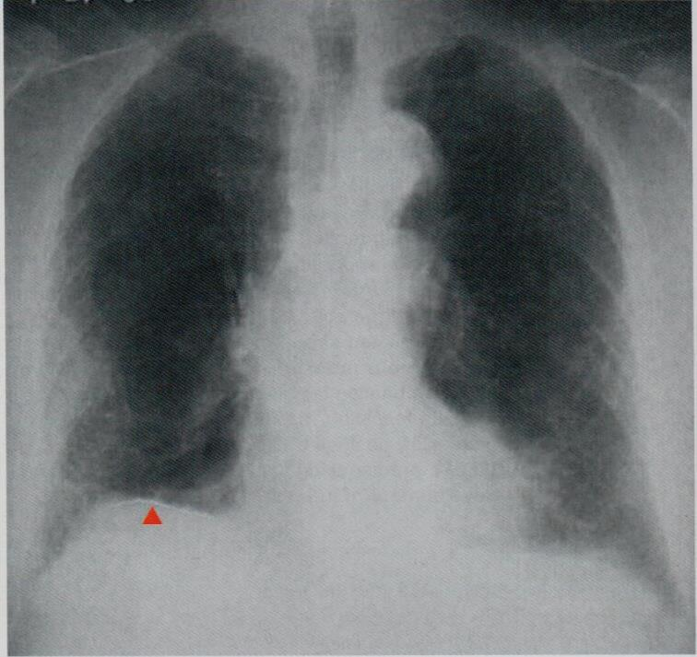
Pneumoconiosis, radiograph

Slide 30
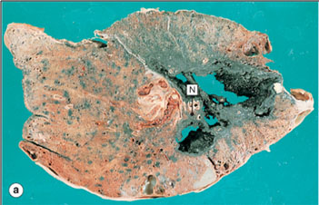
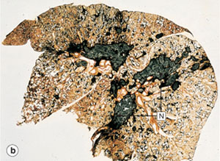
Coal worker's pneumoconiosis
to progressive massive fibrosis (complicated coal worker’s pneumoconiosis).
(a) Cut surface (b) thin section of whole lung.

Slide 31
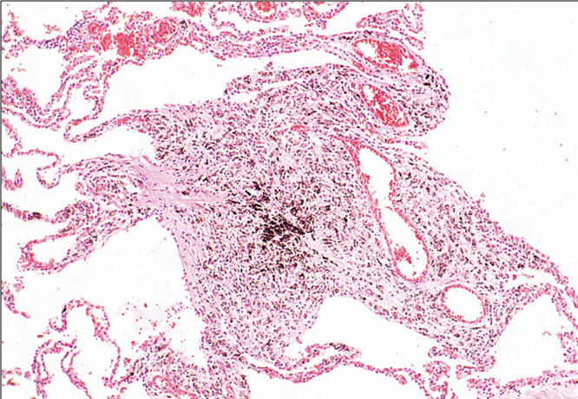
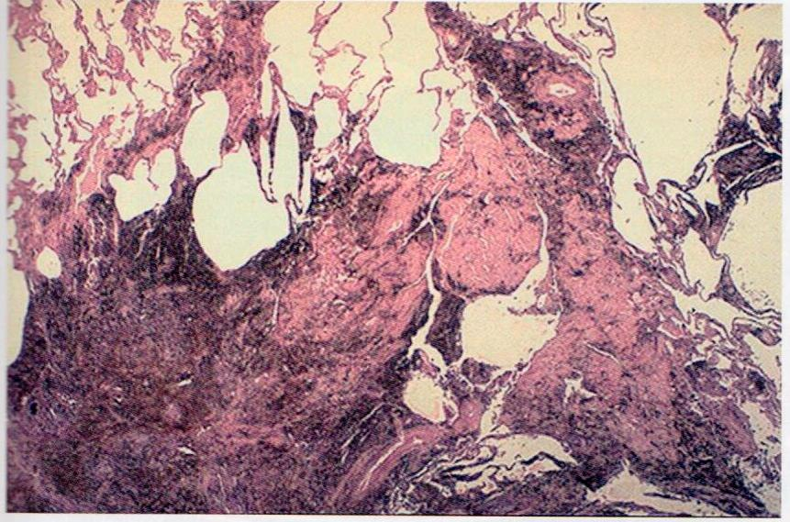
Coal worker's pneumoconiosis
microscopic

Slide 32
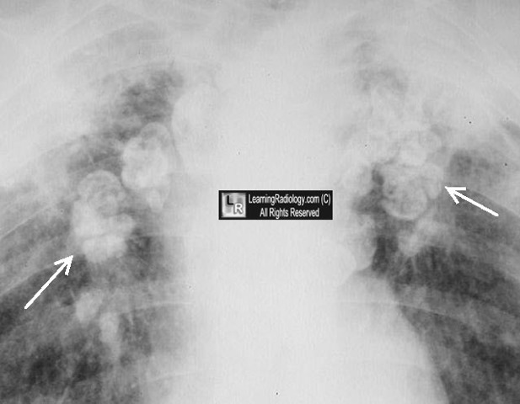
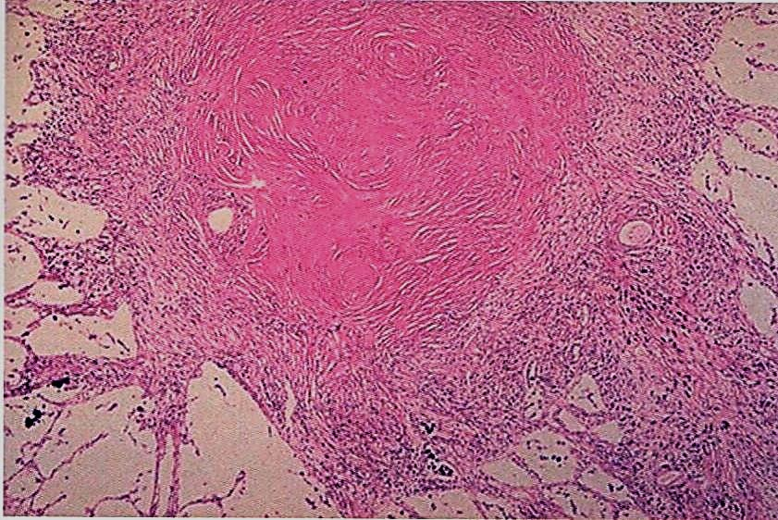
Silicosis
eggshell calcification

Slide 33
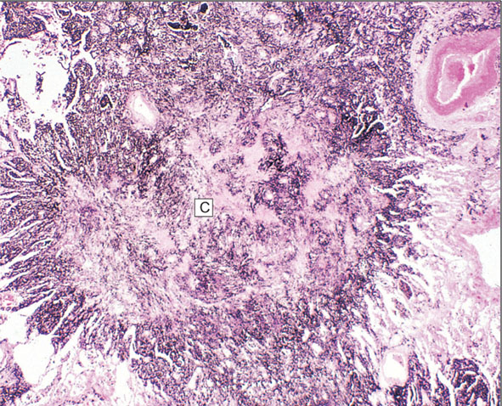
Silicosis
Silicosis of lung. In silicosis, nodules of collagen (C) contain silica particles.

Slide 34
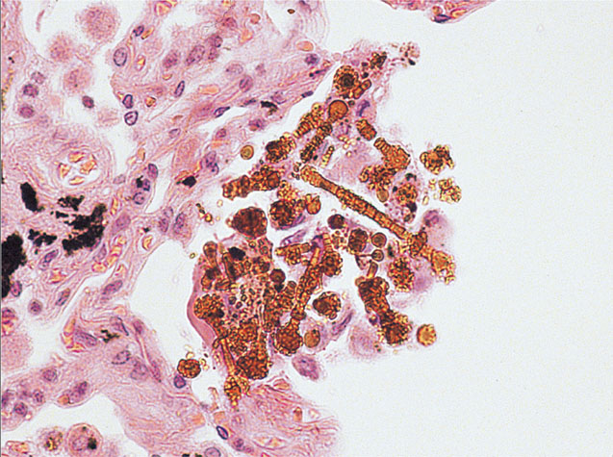
Asbestosis
fibers coated with iron-containing proteinaceous material
Asbestos bodies. Asbestos bodies are long, thin asbestos fibers coated with hemosiderin and protein to form brown filaments with a beaded or drumstick pattern.

Slide 35
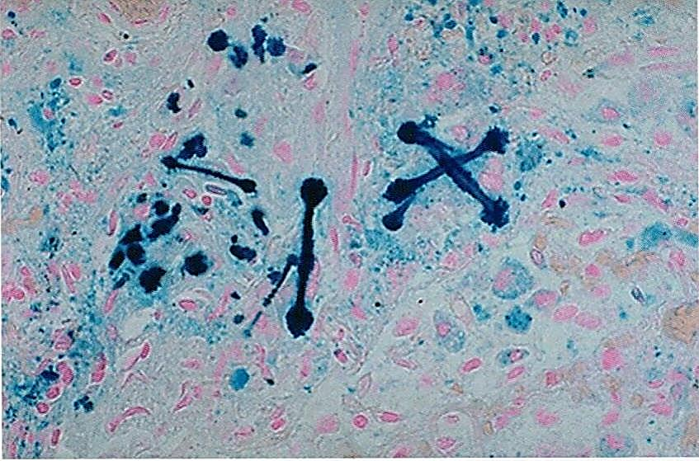
Asbestosis
Ferruginous bodies, microscopic

Slide 36
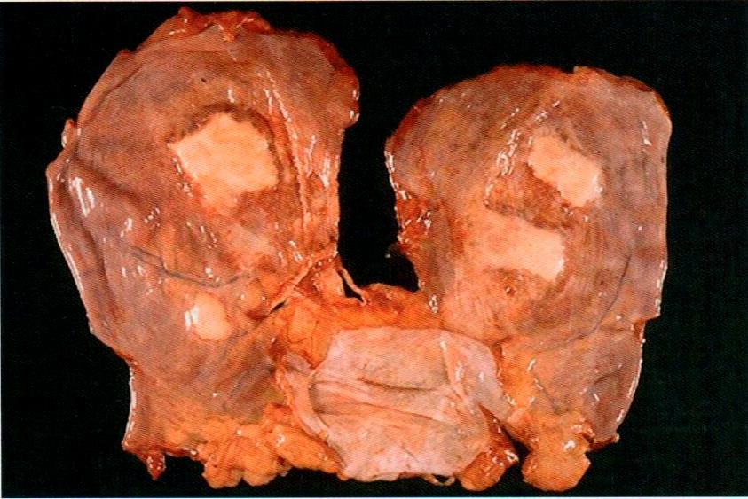
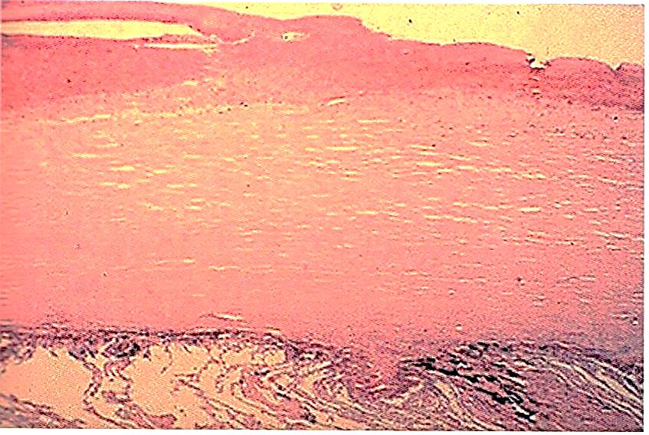
Asbestosis
Parenchymal interstitial fibrosis (asbestosis)
Pleural effusion.
Pleural adhesions.
Parietal pleural fibrocalcific plaques
Some types of asbestos are carcinogenic (especially crocidolite) and prolong asbestos exposure can predisposes to bronchogenic carcinoma, malignant mesothelioma and laryngeal carcinoma.
Pleural fibrous plaques

Slide 37
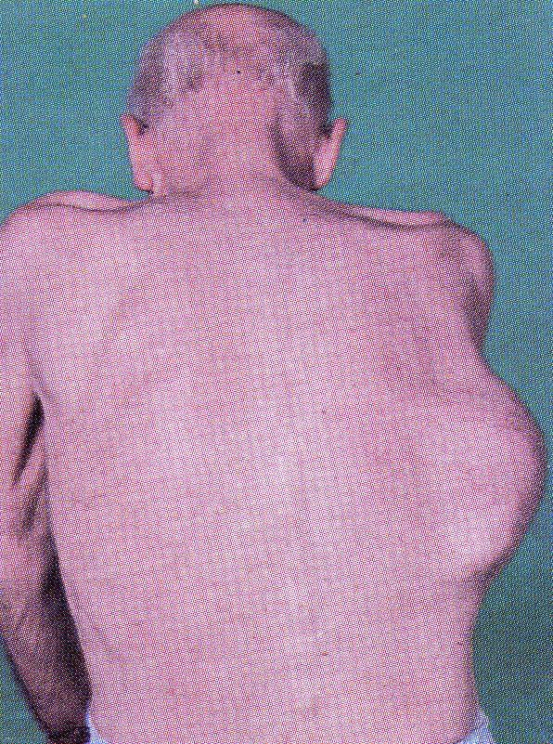
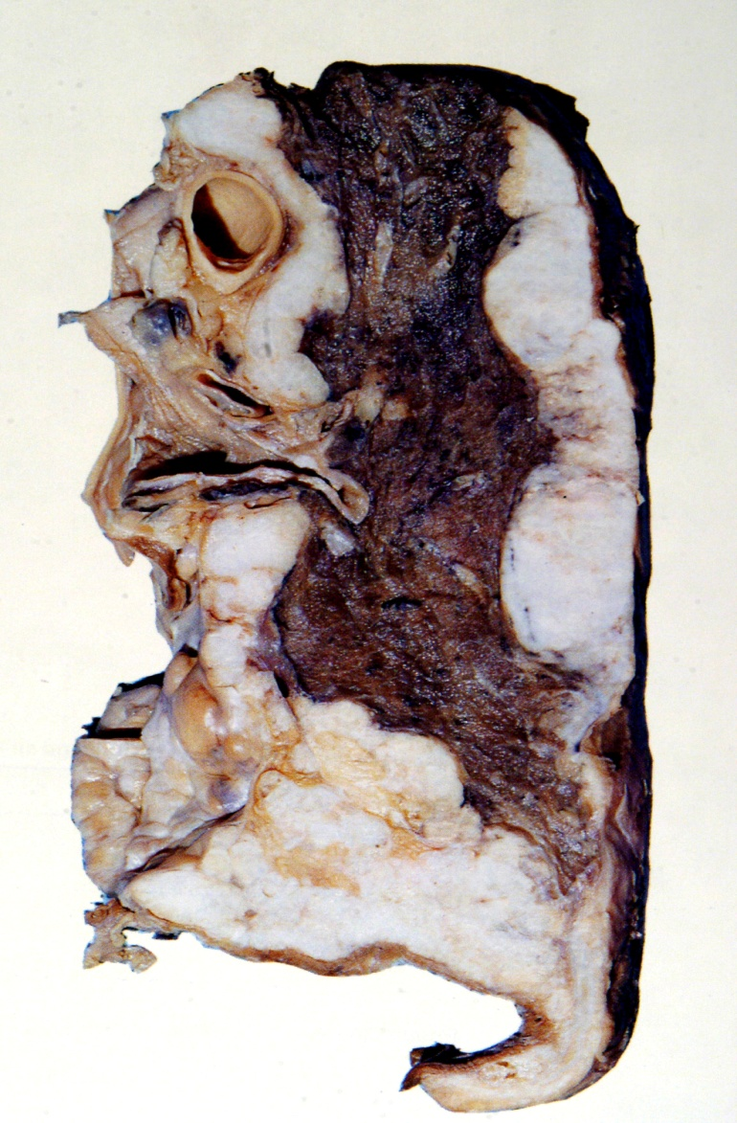
Mesothelioma. This patient presented with an asbestos link pleural plaque.

Slide 38
Pneumoconiosis
A nonneoplastic lung reaction to inhalation of mineral dusts (size: 1-5 μm) and fumes encountered in the workplace
Coal related pneumoconiosis
Simple Coal worker pneumoconiosis: Black macules 1 to 5 mm are scattered through the lung
Silicosis
Industrial exposure: mining of gold, tin, copper and coal, sandblasting, metal grinding, ceramic manufacturing
Asbestosis
Complicated coal worker’s: produces cough, dyspnea, and lung function impairment. Complication: cor pulmonale
stony-hard large fibrous scars
eggshell calcification
Fibrous pleural plaques may develop
predispose to lung cancer and tuberculosis
Asbestos bodies are long, thin asbestos fibers coated with hemosiderin and protein (ferrogenous bodies)
They can cause pleural effusion, pleural adhesions, parietal pleural fibrocalcific plaques’ and mesothelioma.
lead to lung scars containing asbestos bodies.
Some types are carcinogenic and the risk of bronchogenic carcinoma is fivefold and for mesothelioma is 1000 fold and laryngeal carcinoma

Slide 39
Immune Granulomatous Diseases
Sarcoidosis
A multisystem disease of unknown etiology, > female
lymph node enlargement (almost all cases), eye involvement [dry eyes], iritis, skin lesions (erythema nodosum, painless sub­cutaneous nodules), and viscera (liver, skin, marrow). Lung involvement occurs in 90% of cases, with formation of granulomas and interstitial fibrosis
Hypersensitibity pneumonitis (extrinsic allergic alveolitis)
inhalation of organic dust containing antigens:-
noncaseating granulomas in various tissues:-
Farmer’s lung: thermophilic actinomycetes or Micropolyspora faeni (spores in mouldy hay).
Pigeon breeder’s lung: excreta, or feathers of birds
Air-conditioner lung: thermophilic bacteria
Interstitial pneumonitis, with lymphocytes, plasma cells, macrophages and noncaseating granulomas peribronchiolar
If exposure is continuous, lead to progressive respiratory failure, dyspnea, and cyanosis and a decrease in compliance

Slide 40
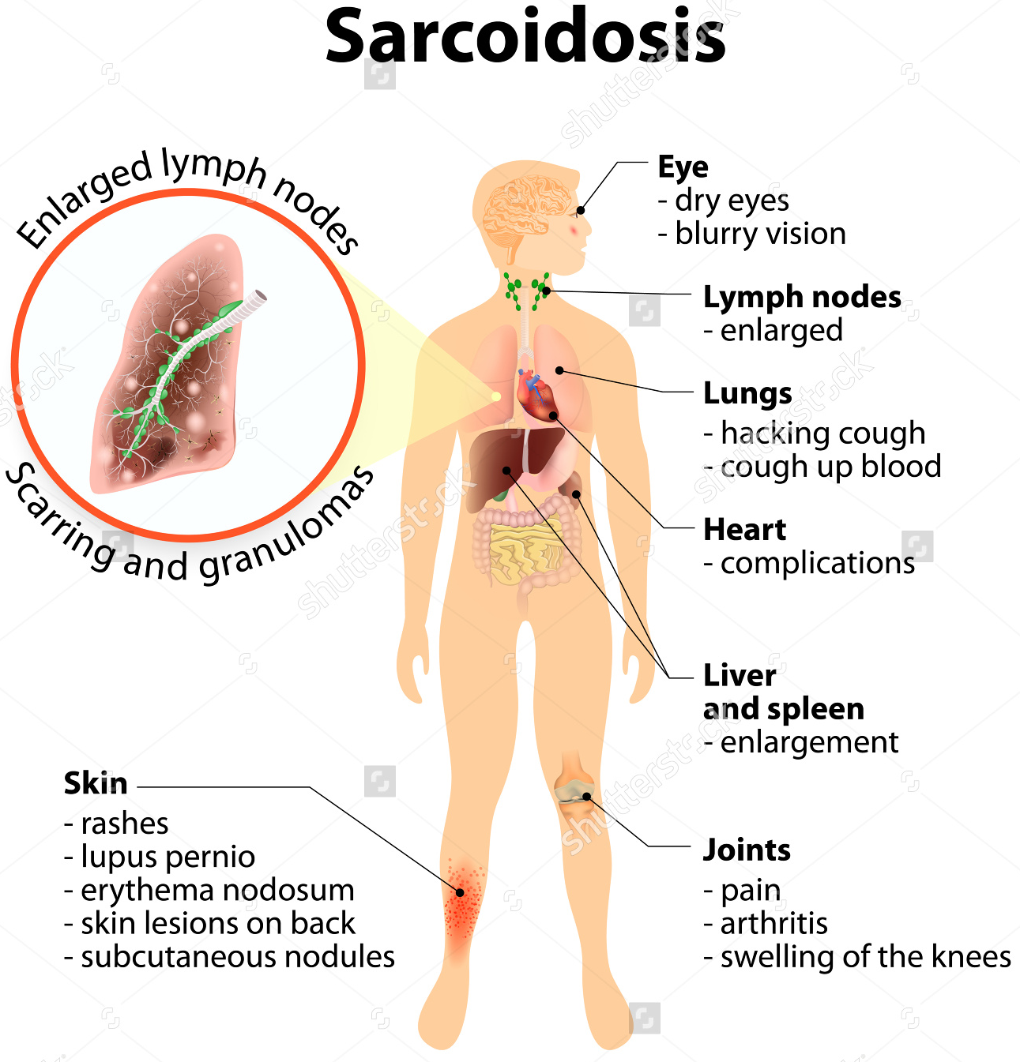
Immune diseases: Sarcoidosis
The prognosis of sarcoidosis is unpredictable.
It can progressive and chronic. It may present as episodes of activity.
Granuloma: small, non caseating
Majority of the patients respond well to treatment.

Slide 41
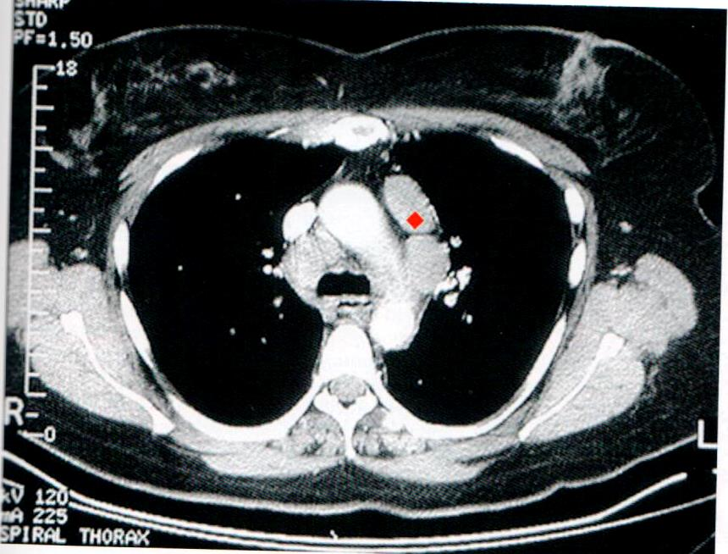
Bilateral hilar lymphadenopathy
Sarcoidosis, CT image

Slide 42
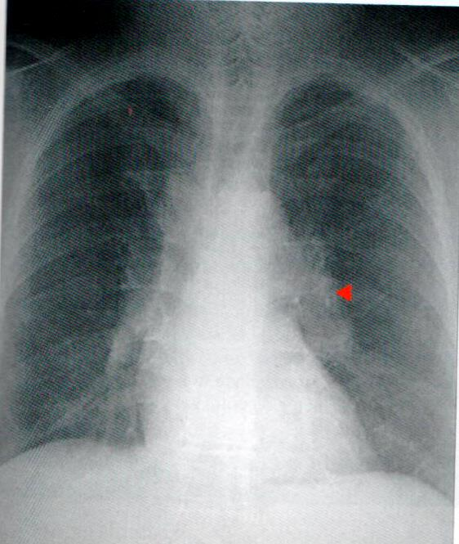
Bilateral hilar lymphadenopathy
Sarcoidosis, radiograph

Slide 43
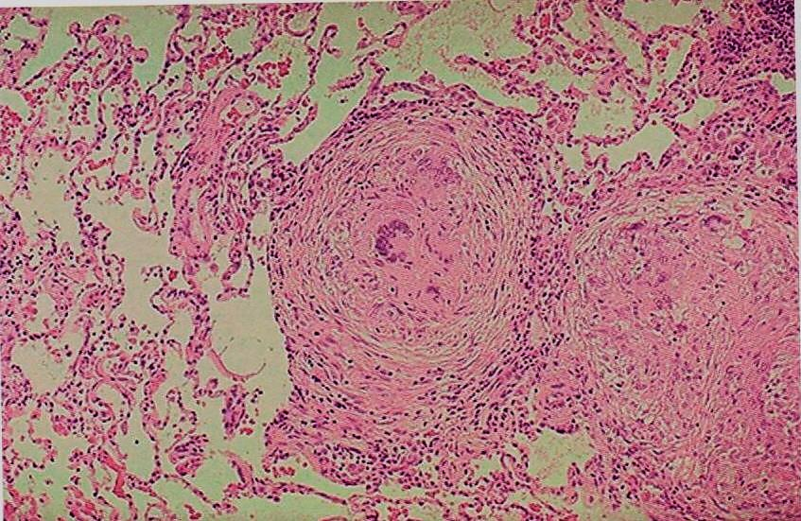
Sarcoidosis
Sarcoidosis, microscopic
noncaseating interstitial granulomas

Slide 44
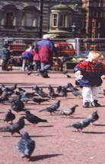
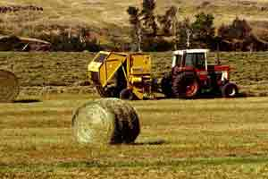
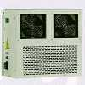
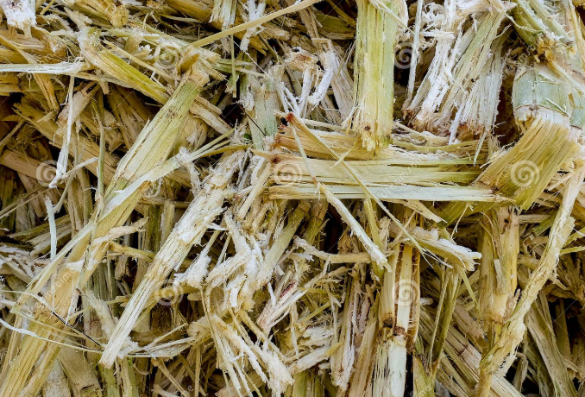
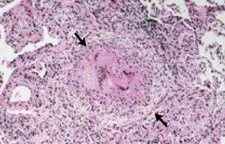
Hypersensitivity pneumonitis
Hypersensitivity pneumonitis
Immunologically mediated disorder affecting airways and interstitium
Pigeon breeder’s (psittacosis)
Farmer’s lung
Thermophilic actinomycetes or Micropolyspora faeni in hay
in hay
Air-cooler lung
Thermophilic bacteria
Sugarcane bagasse
(Bagassosis)
pneumonitis with non-necrotizing granulomas

Slide 45
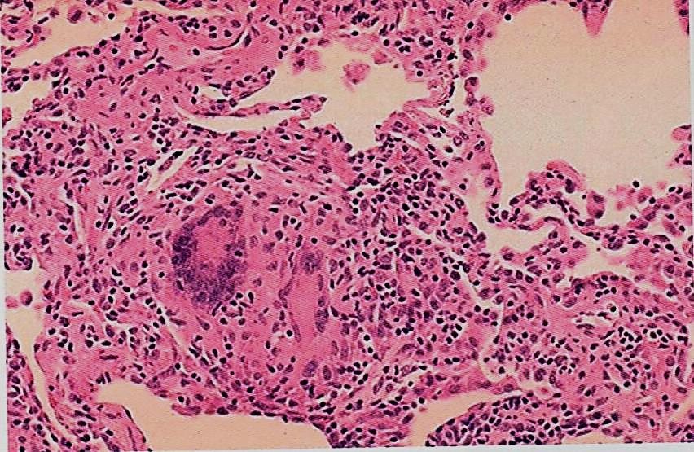
Hypersensitivity pneumonitis, microscopic
noncaseating interstitial granulomas and chronic inflammation along the bronchiols

