Slide 1
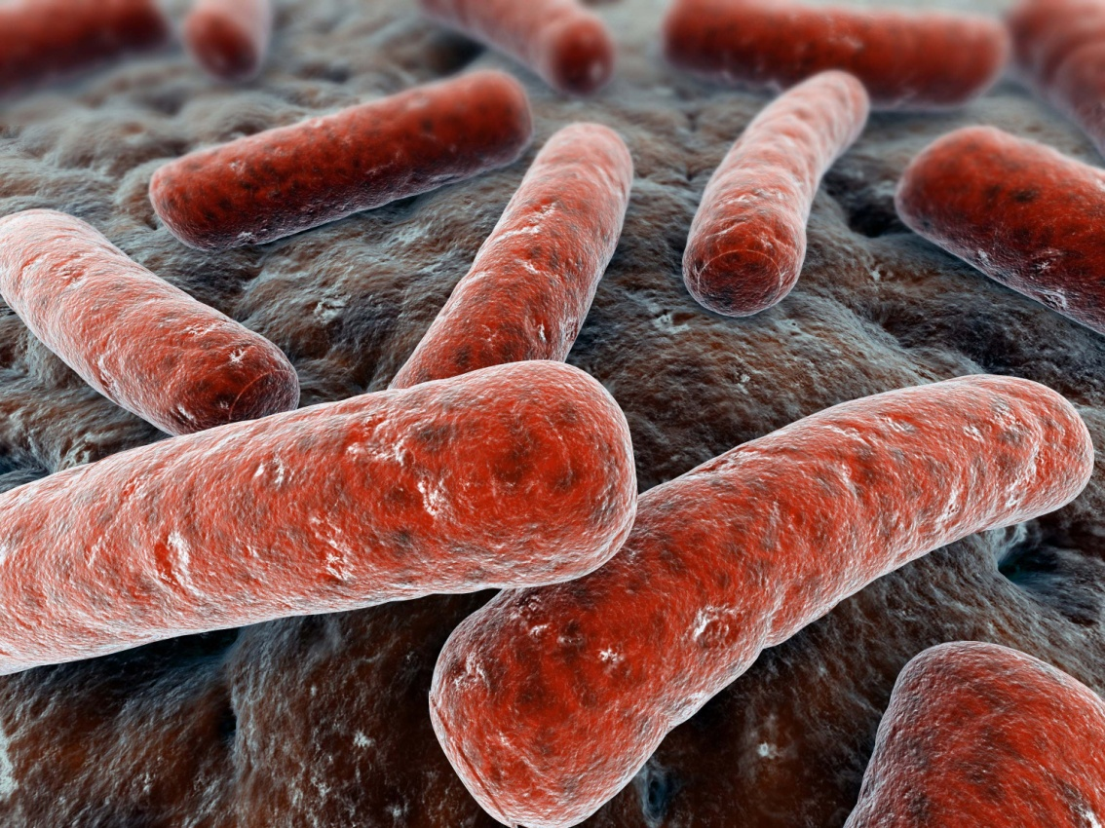
Diseases of the Respiratory System
Pathology of tuberculosis
Respiratory block
Pathology
Lec 4
2020
Dr. Maha Arafah and Prof. Ammar Rikabi

Slide 2
TUBERCULOSIS Objectives:
Tuberculosis is a communicable chronic granulomatous disease caused by Mycobacterium tuberculosis. It usually involves the lungs but may affect any organ or tissue in the body.
Define tuberculosis
Know the epidemiology of tuberculosis (TB)
List conditions associated with increased risk of Tuberculosis
Recognize the morphology of Mycobacteria and its special stain (the Ziehl-Neelsen) as well as the morphology of granulomas in TB (tubercles).
Know the Pathogenesis of tuberculosis
In regards to Mycobacterial lung infection: Compare and contrast the following in relation to their gross and histologic lung pathology:
Primary tuberculosis (include a definition of the Ghon complex).
Secondary or reactivation tuberculosis.
Miliary tuberculosis.
List organs other than lung that are commonly affected by tuberculosis.
Know the basis and use of tuberculin skin (Mantoux) test.
List the common clinical presentation of tuberculosis.
List the complication and prognosis of tuberculosis.

Slide 3
Epidemiology
Contracted by inhalation of Mycobacterium tuberculosis (TB)
TB bacilli are strict aerobe, acid-fast (due to mycolic acid in cell wall)
It is estimated that 1.7 billion individuals are infected by tuberculosis worldwide, with 8 to 10 million new cases and 1.5 million deaths per year

Slide 4
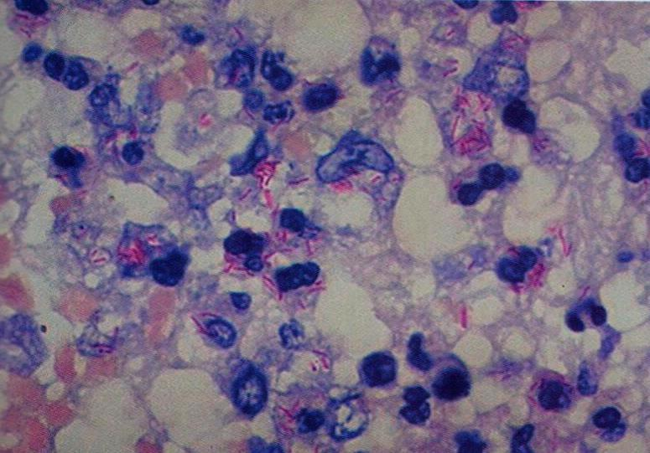
Acid-fast bacilli, microscopic

Slide 5
Epidemiology and pathogenesis
Predisposing factors
Increased risk factors
People with AIDS
Diabetes mellitus
Hodgkin's lymphoma
Alcoholism
Chronic lung disease (particularly silicosis)
Immunosuppression
Tuberculosis flourishes wherever there is
Poverty
crowding
Malnutrition
chronic debilitating illness

Slide 6
Primary TB: First time exposure to TB
Within the first three weeks after exposure to mycobacterium tuberculosis
Organism resides in phagosomes of alveolar macrophages
Produces a protein (cord factor) that prevents fusion of lysosomes with phagosome

Slide 7
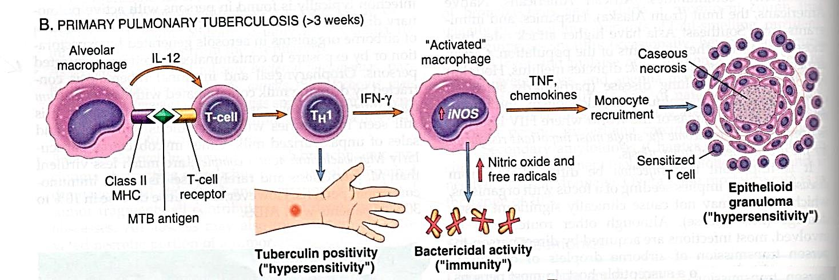
Primary TB
Sequence of events in the natural history of primary pulmonary tuberculosis

Slide 8
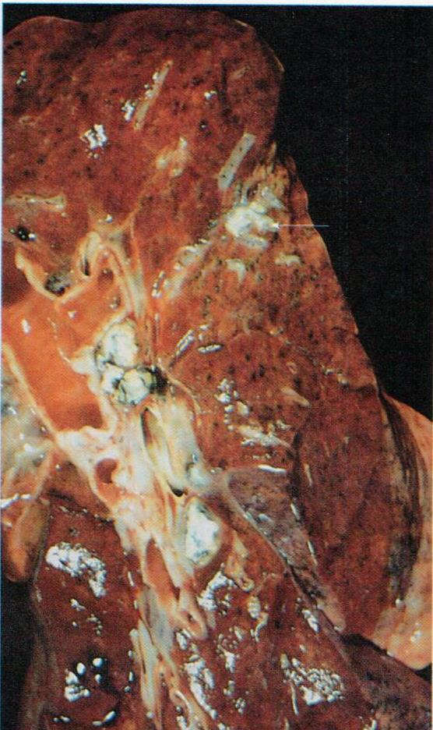
Primary pulmonary tuberculosis, Ghon complex
Subpleural location
Upper part of the lower lobes or lower part of the upper lobes
Ghon focus (caseous necrosis) in periphery
Ghon complex (caseous necrosis) in hilar lymph nodes

Slide 9
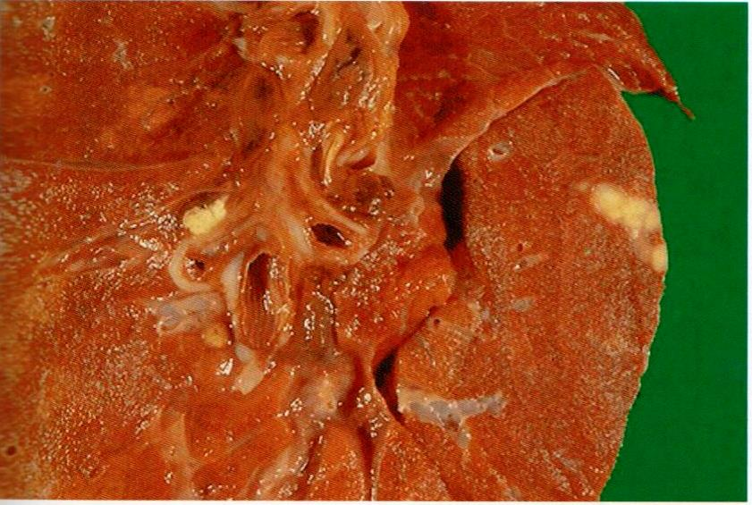
Primary tuberculosis, microscopic
Ghon complex

Slide 10
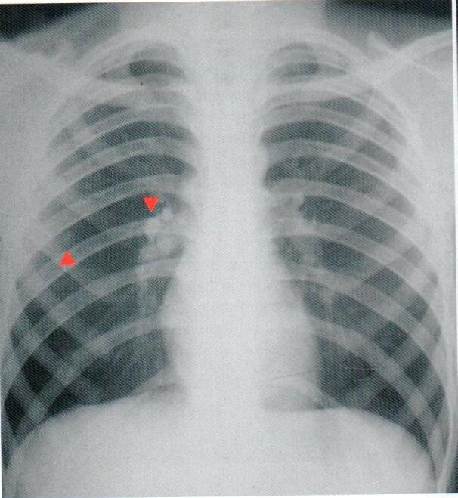
Primary tuberculosis, radiograph
Ghon complex with calcification

Slide 11
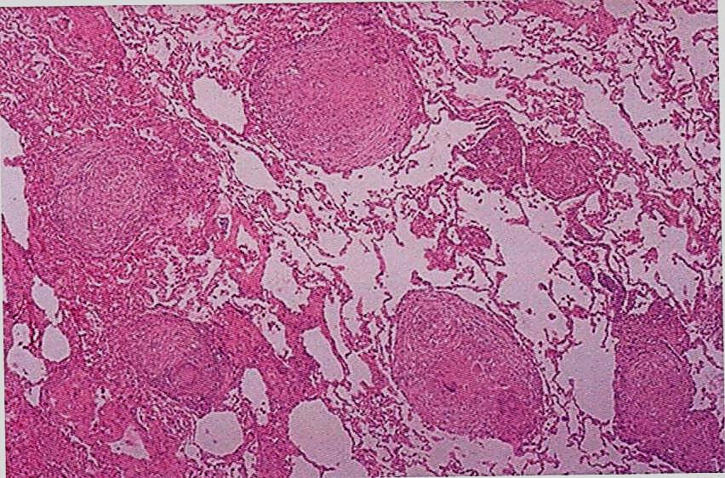
Tuberculosis, microscopic
Granuloma with caseation necrosis

Slide 12
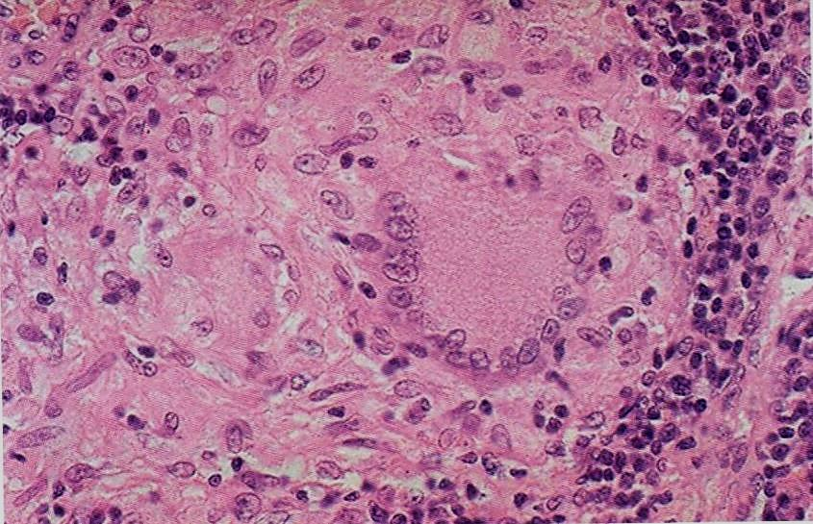
Tuberculosis, microscopic
List cells seen granuloma

Slide 13
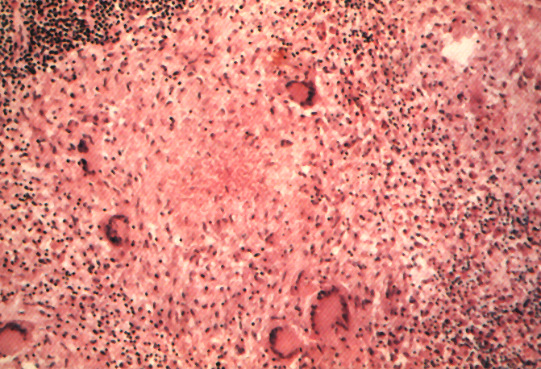
Recognize the morphology of granulomas in TB (tubercles).
Langhans Giant Cell
Lymphocytic Rim
Caseous Necrosis
Epithelioid Macrophage

Slide 14
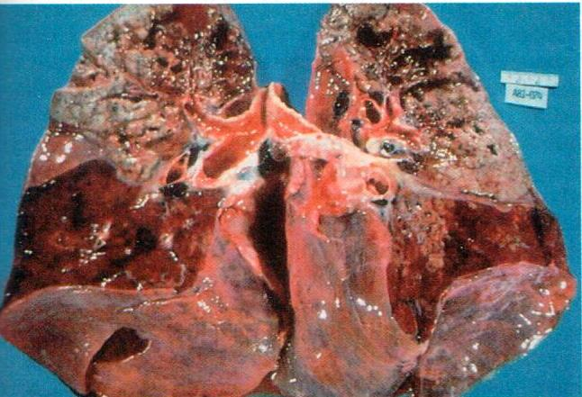
Secondary Tuberculosis (Reactivation Tuberculosis)
The apex of one or both upper lobes are affected with cavitation leading to erosion into and dissemination along airways, patient become infective

Slide 15
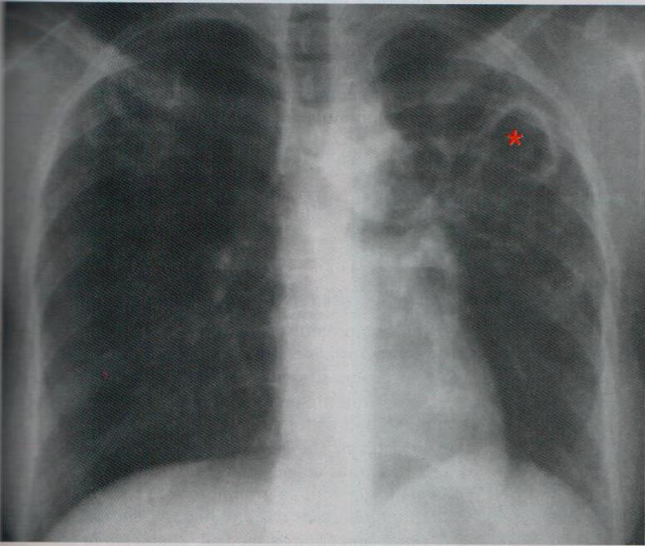
cavity formation on chest x-ray
Secondary tuberculosis, radiograph

Slide 16
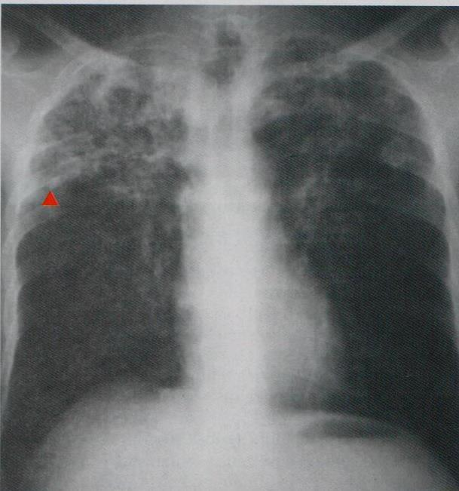
Secondary tuberculosis, radiograph
both upper lobes are affected
Systemic spread via:
Vein – via left ventricle to whole body
Artery – miliary spread within the lung

Slide 17
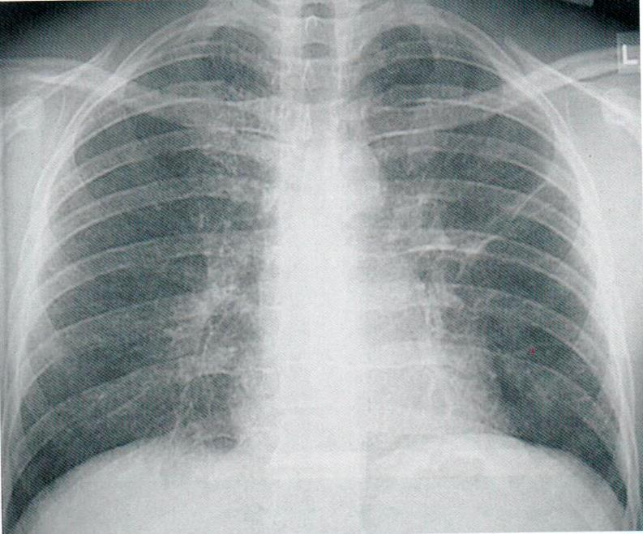
Miliary tuberculosis, radiograph

Slide 18
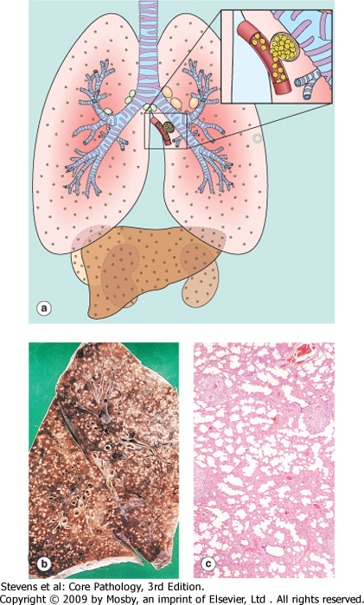
Miliary Tuberculosis: Haematogenous spreed of TB organism throughout the body
when bacteria in the lungs enters the pulmonary venous return to the heart; the organisms subsequently disseminate through the systemic arterial system and the lymphatic channels
Systemic miliary tuberculosis
It produces multiple small yellow nodular lesions in several organs. Almost every organ in the body may be seeded. Lesions resemble those in the lung.
In the lungs there multiple lesions either microscopic or small, visible (2-mm) foci of yellow-white consolidation scattered through the lung parenchyma.

Slide 19
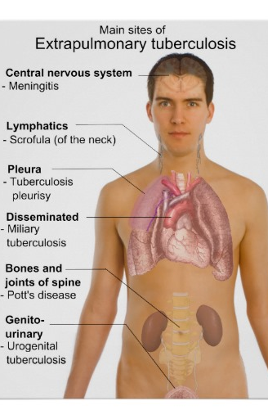
Extrapulmonary tuberculosis
Lymph nodes (tuberculous lymphadenitis): are the most frequent form of extrapulmonary tuberculosis esp. in the cervical region
Pleura with pleural effusion (exudate)
Liver and spleen
adrenals
fallopian tube and endometrium
Epididymis and prostate
kidneys
meninges around the base of the brain (tuberculous meningitis),
Bone marrow
Vertebrae (Pott's disease)
Intestinal tuberculosis

Slide 20
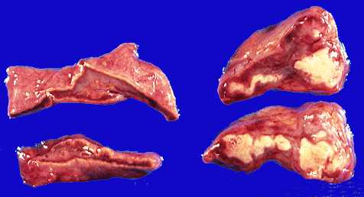
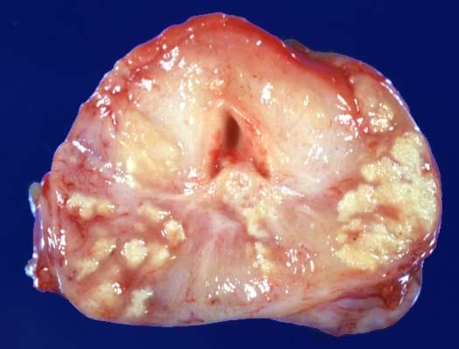
TB epididymis
TB adrenal gland
TB Prostate

Slide 21
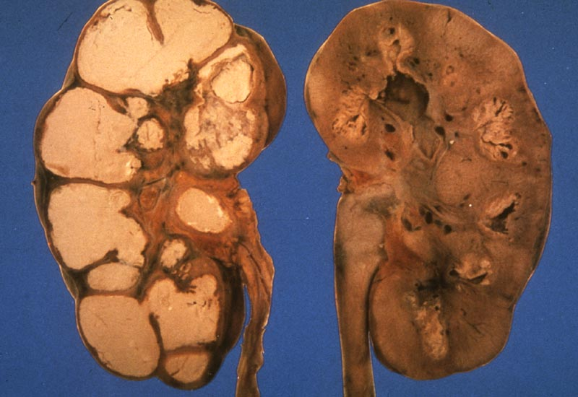
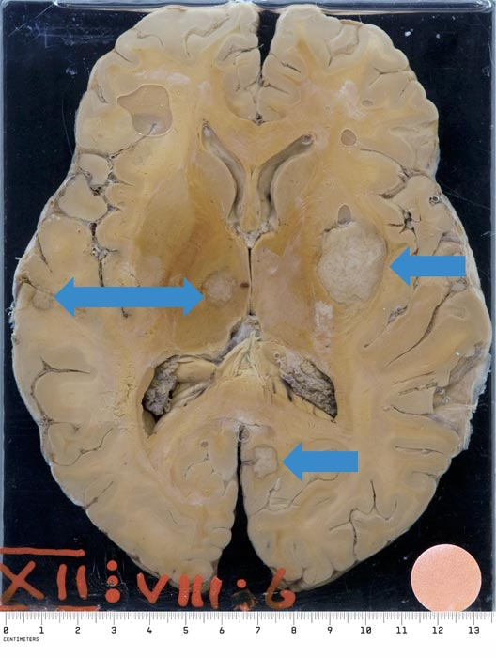
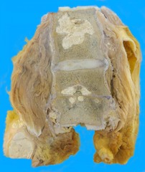
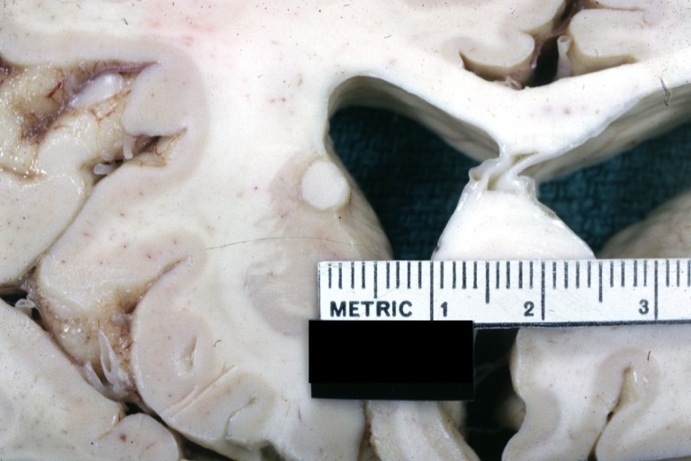
Tuberculoma
Renal TB
TB Vertebra (Potts Spine)

Slide 22
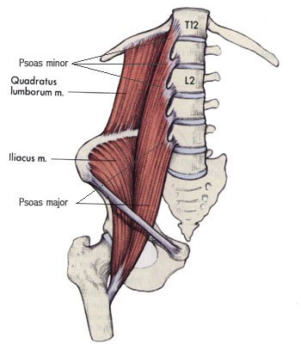
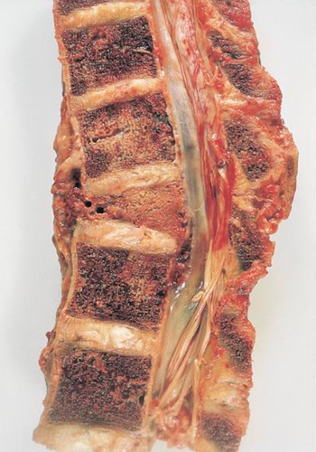
Pott’s disease
Psoas abscess
Vertebrae (Pott's disease). It collapses the spine and leads to paraspinal "cold" abscesses
in these patients, infected material may track along the tissue planes to present as an abdominal or pelvic mass

Slide 23
Clinical Features
May be asymptomatic
Systemic manifestations:
malaise, anorexia, weight loss, and fever (low grade).
hemoptysis is present in about half of all cases of pulmonary tuberculosis.
Depend on the organ system involved (e.g., tuberculous salpingitis may present as infertility, tuberculous meningitis with headache and neurologic deficits, Pott disease with back pain and paraplegia).

Slide 24
Diagnosis
Demonstration of acid-fast organisms in sputum (Sputum analysis, culture and PCR)
Chest X-ray
Mantoux skin test

Slide 25
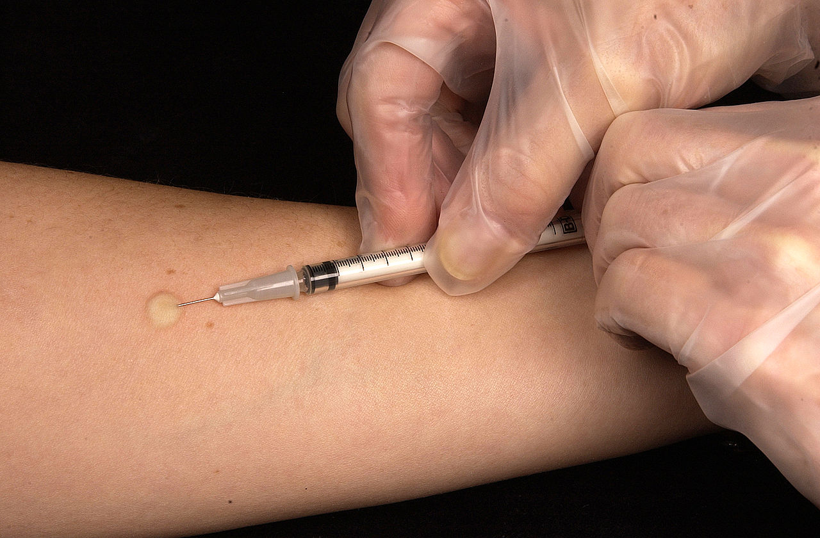
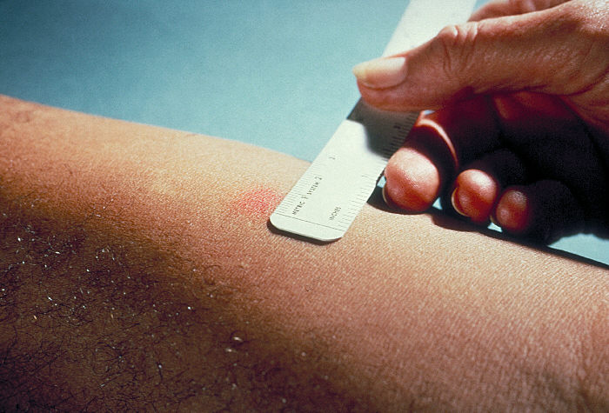
Diagnosis: Mantoux skin test
A positive tuberculin skin test result signifies cell-mediated hypersensitivity to tubercular antigens, but does not differentiate between infection and disease.
The size of induration is measured 48–72 hours later
Positive results: induces a visible and palpable induration (at least 5 mm in diameter)
False-negative reactions may be produced by certain viral infections, sarcoidosis, malnutrition, Hodgkin lymphoma, immunosuppression and AIDS.
False-positive reactions may result from infection by atypical mycobacteria

Slide 26
Prognosis
The prognosis with proper treatment is generally good if infections are localized to the lungs, except when they are caused by drug-resistant strains or occur in aged debilitated, or immunosuppressed persons, who are at high risk for developing miliary TB
The outcome depends on the adequacy of the host immune response and treatment

