Slide 1
Lecture-4 Gas exchange
Dr. Maha Saja
Msaja@ksu.edu.sa
Office no. 8 level 3

Slide 2
Let’s summarize what have been discussed so far!

Slide 3
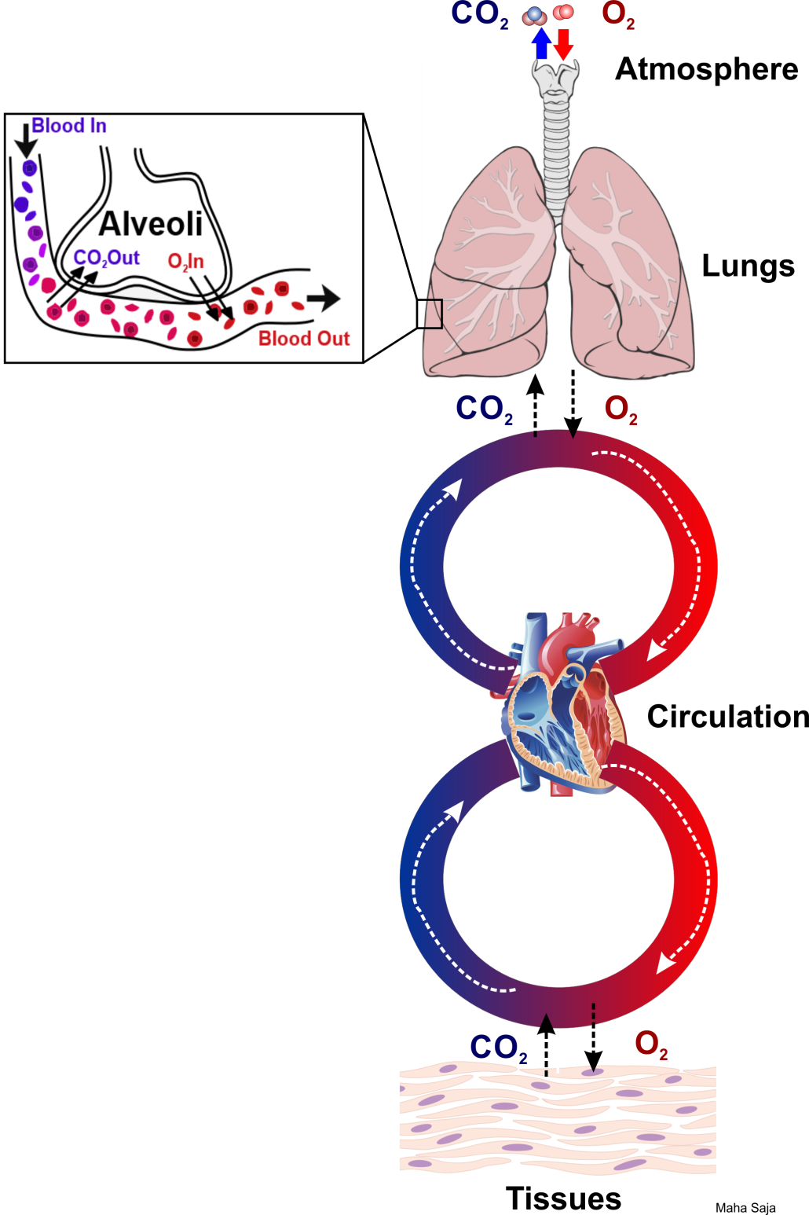
What is the aim of respiration?
Remove CO₂ from
tissues
Deliver O₂ to tissues

Slide 4
Four processes help respiration achieve its goal… What are they?

Slide 5
1
Pulmonary ventilation
Inflow & outflow of air between atmosphere & lung alveoli
2
Gas diffusion
4
Movement of O₂ & CO₂ between alveoli & blood
Regulation
3
Gas transport
The alveolus is the gas exchange site in respiratory system
Transport of O₂ & CO₂ in blood and body fluids to tissue cells

Slide 6
In the past 3-4 lectures we discussed the 1st step
Pulmonary ventilation
Let’s revise what we know!

Slide 7
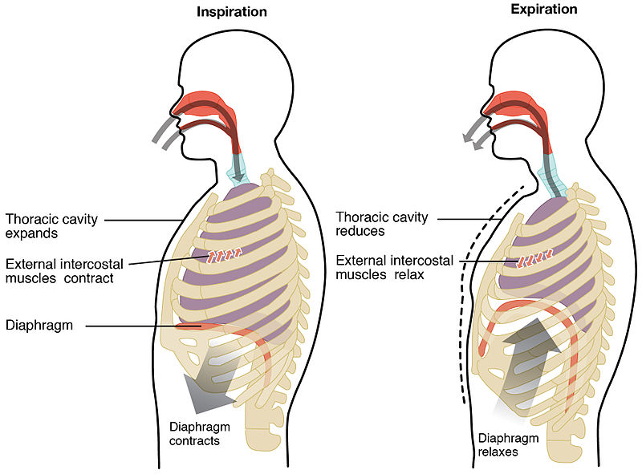
Mechanism of Ventilation

Slide 8
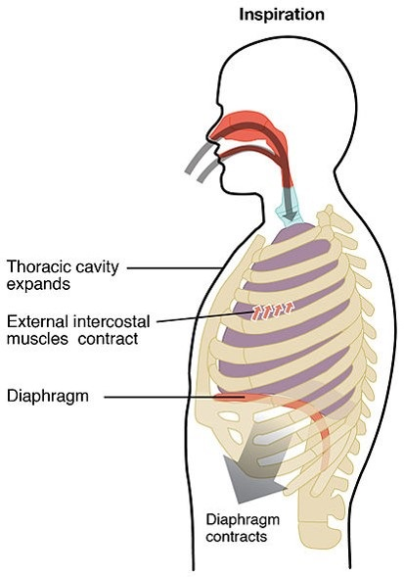
Inspiration
Contraction of inspiratory muscles
↑ chest volume
↓ IPP (more negative)
-7.5 cm H₂O
↑ TPP
(P_{alv} – IPP = 0-[-7.5]=+7.5 cm H₂O)
Lung (alveoli) expand
(↓ P_{alv} to -1 cm H₂O)
P_{B} > P_{alv}
Air moves from atmosphere into the lungs

Slide 9
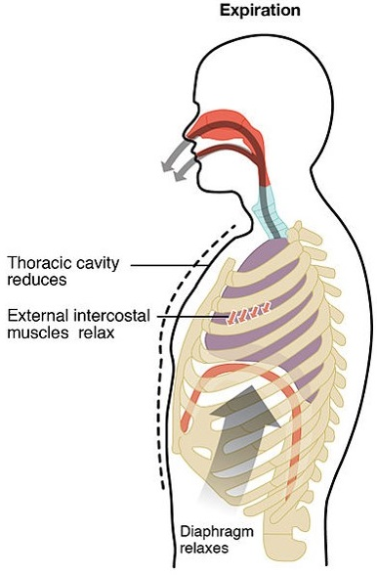
Expiration
Relaxation of inspiratory muscles
↓ chest volume
↑ IPP (less negative)
-5 cm H₂O
↓ TPP
(P_{alv} – IPP = 0-[-5]=+5 cm H₂O)
Lung (alveoli) will recoil to preinspiratory volume
(↑ P_{alv} to +1 cm H₂O)
P_{alv} > P_{B}
Air moves out from lungs into the atmosphere

Slide 10
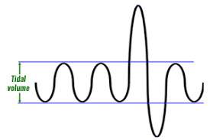
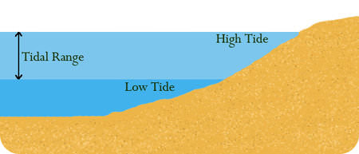
Under normal resting conditions,
How much air moves in or out of the lung during this process (ventilation)? | 500 ml
What is it called? | Tidal volume

Slide 11
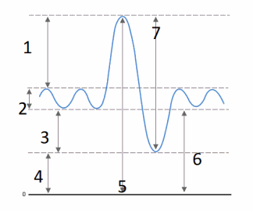
Is the tidal volume the only volume of air that can be breathed in or out of the lungs?

Slide 12
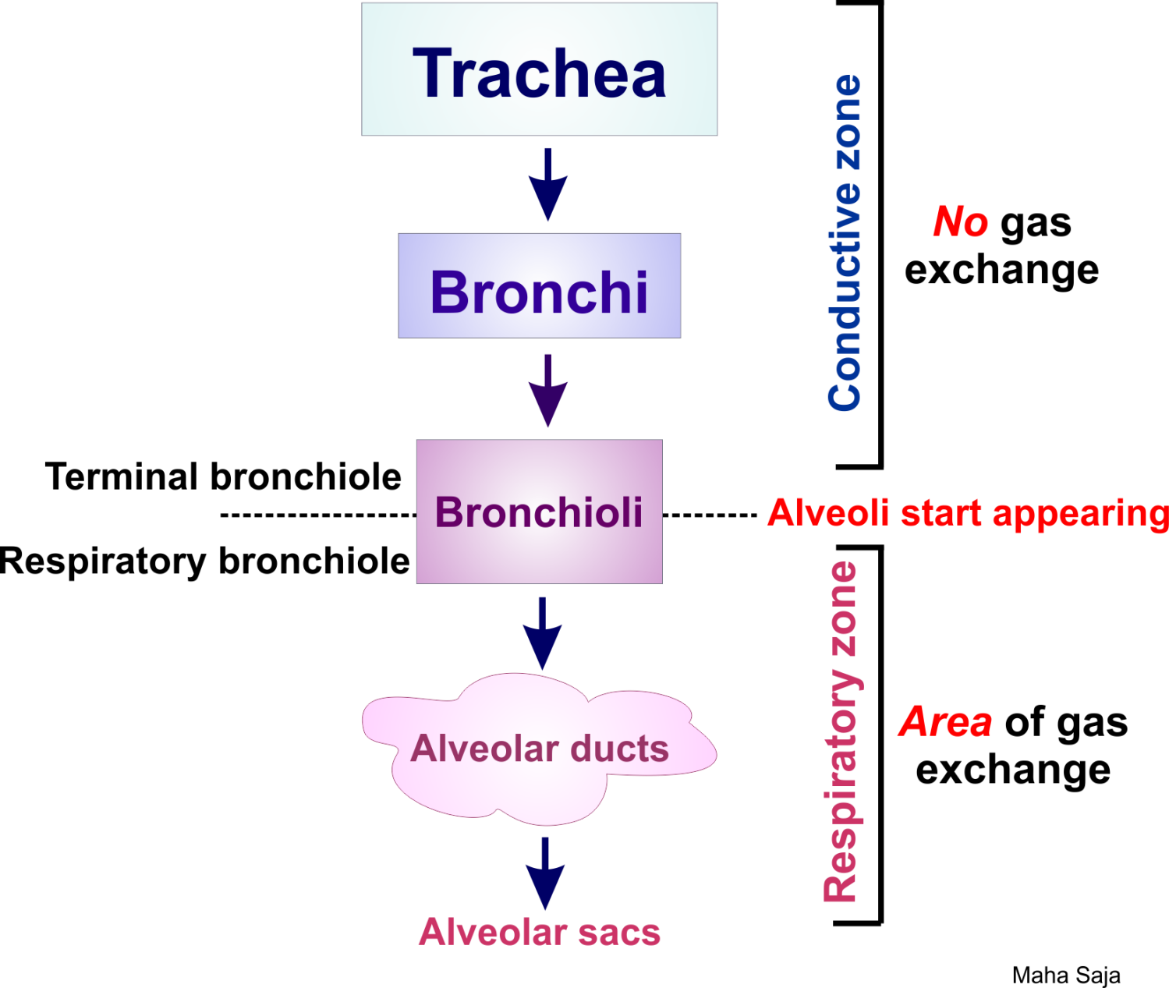
What happens to the TV when it enters the respiratory passages?
The volume of air occupying the conductive zone is around 150ml
This is called “Anatomical dead space”.
V_{D}
V_{A}
TV = V_{D} + V_{A}

Slide 13
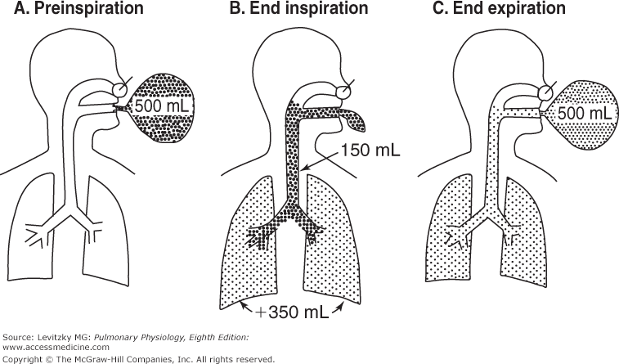
What happens to the TV when it enters the respiratory passages?

Slide 14
What are the Partial Pressures of O₂ & CO₂ in Inspired & Expired Air?
1st we define pressure.
Pressure is force exerted by a fluid (gas/liquid) per unit area.
$$P=\frac{F}{A}$$
Atmospheric pressure = the force per unit area exerted by the weight of the atmosphere = 760 mmHg = 1 atm (at sea level).
Atmospheric dry air is a gas mixture composed of;
N₂ = 78.06%
O₂ = 20.98% ≈ 21%
CO₂ = 0.04%

Slide 15
Partial Pressures of Gases
In a gas mixture, the pressure exerted by any one gas in the mixture is equal to the total pressure of all gases in the mixture X the fractional concentration of that gas in the mixture = Partial pressure (P)
PO₂ = 760 mmHg X 21% ≈ 160 mmHg.
Can you calculate the PN₂ and PCO₂ at sea level?

Slide 16
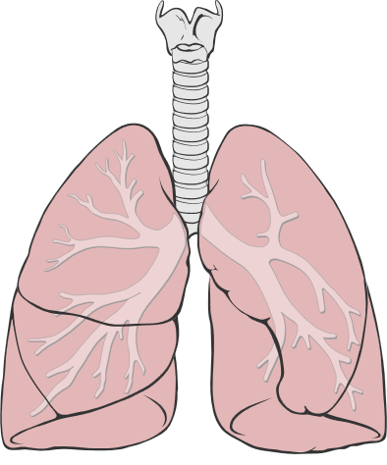
What Happens to PO₂ and PCO₂ as Inspired Air Passes Through the Respiratory Tract?
Atmospheric air
PO₂ = 160 mmHg
PCO₂ = 0.3 mmHg
Air gets humidified as it passes through the airways
If you know that water vapour pressure at 37⁰C is
PH₂O = 47 mmHg, what would happen to PO₂ and PCO₂ flowing in?
Humidified air
PO₂ = 150 mmHg
PCO₂ = 0.3 mmHg
The 350ml of TV that reaches the alveoli mixes with the air present there (FRC)
What are the factors affecting alveolar PO₂ and PCO₂?
Alveolar air
PO₂ = 104 mmHg
PCO₂ = 40 mmHg
FRC

Slide 17
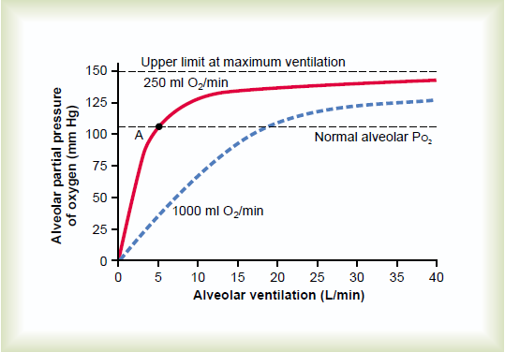
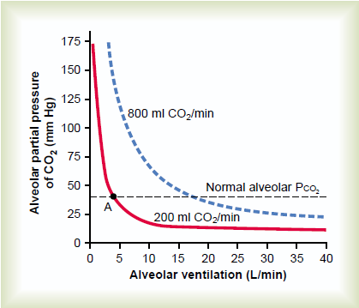
Factors Affecting Alveolar PO₂ and PCO₂
Rate of alveolar ventilation
Rate of absorption of O₂ or excretion of CO₂
At rest, 250ml of O₂ are extracted by tissues at ventilatory rate of 4.2 L/min.
At rest, 200ml of CO₂ are excreted by tissues at ventilatory rate of 4.2 L/min.

Slide 18
Summary
How do you explain the readings of expired air?!!!

Slide 19
Ventilation is done and air has reached the alveoli
What’s next?
Gas Diffusion from alveoli into the blood

Slide 20
Gas Exchange & Gas transfer

Slide 21
Objectives
Define partial pressure of a gas, how is influenced by altitude.
Understand that the pressure exerted by each gas in a mixture of gases is independent of the pressure exerted by the other gases (Dalton's Law)
Understand that gases in a liquid diffuse from higher partial pressure to lower partial pressure (Henry’s Law)
Describe the factors that determine the concentration of a gas in a liquid.
Describe the components of the alveolar-capillary membrane (i.e., what does a molecule of gas pass through).
Identify the various factors determining gas transfer: -
Surface area, thickness, partial pressure difference, and diffusion coefficient of gas
State the partial pressures of oxygen and carbon dioxide in the atmosphere, alveolar gas, at the end of the pulmonary capillary, in systemic capillaries, and at the beginning of a pulmonary capillary.

Slide 22
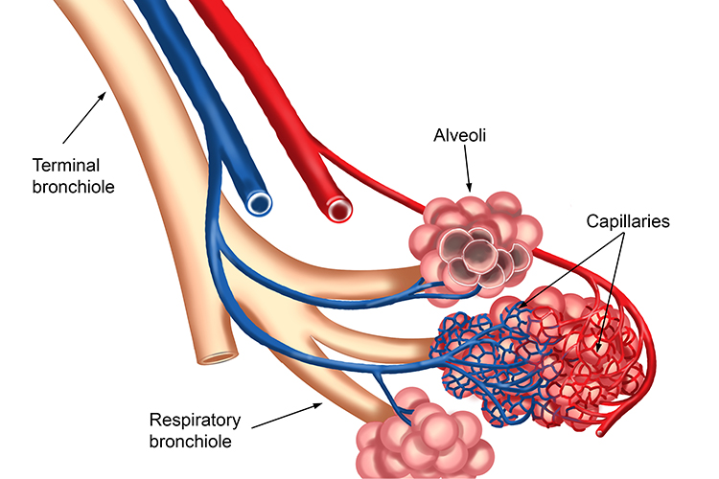
The Respiratory Unit
Respiratory bronchioles + alveolar ducts + alveoli. The site of gas exchange in the lungs.
There are around 300 million alveoli in humans.
The total surface area ≈ 70m² (area of a tennis court).
The blood present in the capillary bed at any time = 60-140ml.

Slide 23
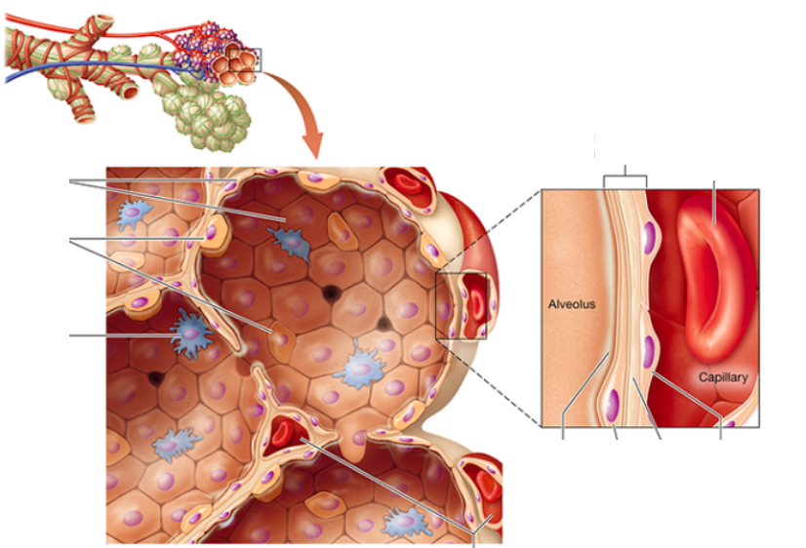
The Respiratory Membrane
For gas to diffuse from alveoli to blood, it should pass through the respiratory membrane.
What is it made of?
Layer of fluid.
Alveolar epithelium.
Epithelial BM.
+/- Thin interstitial space.
Endothelial BM.
Capillary endothelial membrane.
0.2-0.6 μm thick

Slide 24
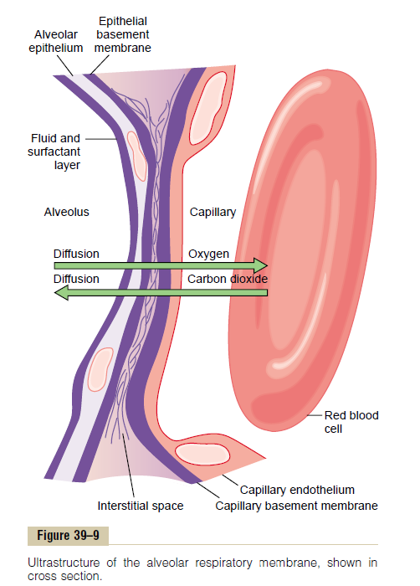
Factors Affecting Gas Diffusion Across the Membrane
Thickness of the membrane.
Membrane surface area.
Diffusion coefficient of the gas.
Depends on: gas solubility and square root of the MW.
Partial pressure difference of the gas between the two sides of the membrane.
$$D α \frac{ΔP x A x S}{d x \sqrt{MW}}$$

Slide 25
What Determines the Partial Pressure of a Gas in a Liquid (Blood)
According to Henry’s law;
$$Partial Pressure=\frac{Concentration of dissolved gas}{Solubility coefficient}$$
When a molecule has high solubility, far more can be dissolved without building up excess partial pressure within a solution.
The solubility coefficient of different gases.
What do you notice?

Slide 26
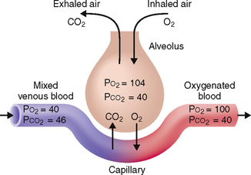
Diffusion of Oxygen
Diffusion of O₂ from tissue capillaries to tissues
Diffusion of O₂ from alveoli to pulmonary capillaries

Slide 27
Diffusion of Carbon Dioxide
Diffusion of CO₂ from pulmonary capillaries to alveoli
Diffusion of CO₂ from tissues to tissue capillaries

Slide 28
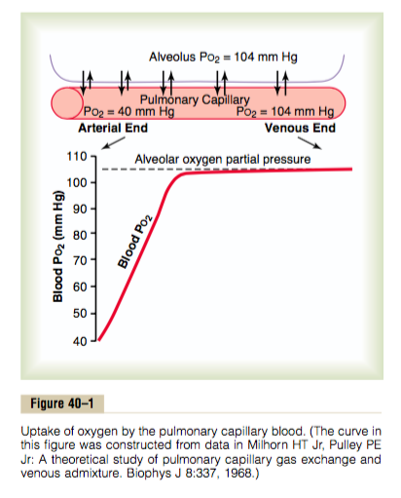

Slide 29
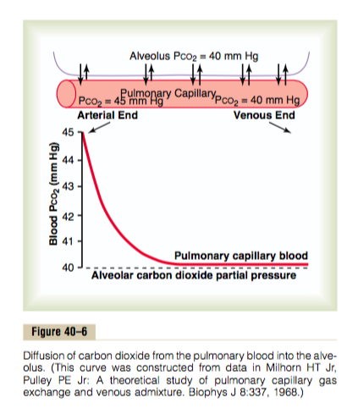

Slide 30
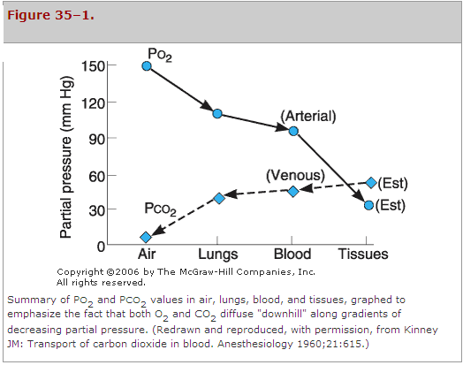
Summary

Slide 31
Thank you

