Slide 1
Lecture-5 Ventilation Perfusion Ratio
Dr. Maha Saja
Msaja@ksu.edu.sa
Office no. 8 level 3

Slide 2
Objectives
Recognize the high pressure and low pressure circulations supplying the lung.
Identify the meaning of the physiological shunt in the pulmonary circulation.
State the different lung zones according to the pulmonary blood flow.
Define the V/Q ratio and its regional variation.
Explain the clinical significance of the V/Q ratio
Describe the abnormal patterns of the V/Q ration vice, shunt and dead space patterns.

Slide 3
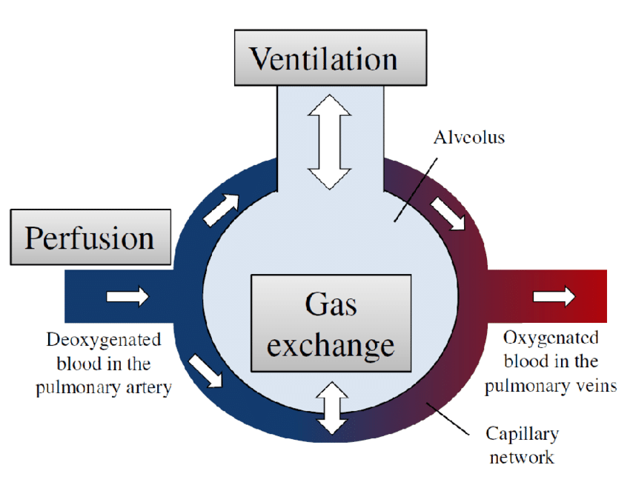
Introduction
For normal gas exchange to occur, ventilated alveoli must also be perfused with blood to achieve proper gas exchange.
Ventilation
Perfusion

Slide 4
Introduction
If alveolus is ventilated but NOT perfused
If alveolus is perfused but NOT ventilated
PO₂ = 104mmHg
PCO₂ = 40mmHg
PO₂ = 104mmHg
PCO₂ = 40mmHg
PO₂ = 40mmHg
PCO₂ = 45mmHg
PO₂ = 104mmHg
PCO₂ = 40mmHg
Wasted ??
Wasted ventilation

Slide 5
We talked a lot about ventilation in previous lectures, so why don’t we discuss
“Pulmonary Perfusion”

Slide 6
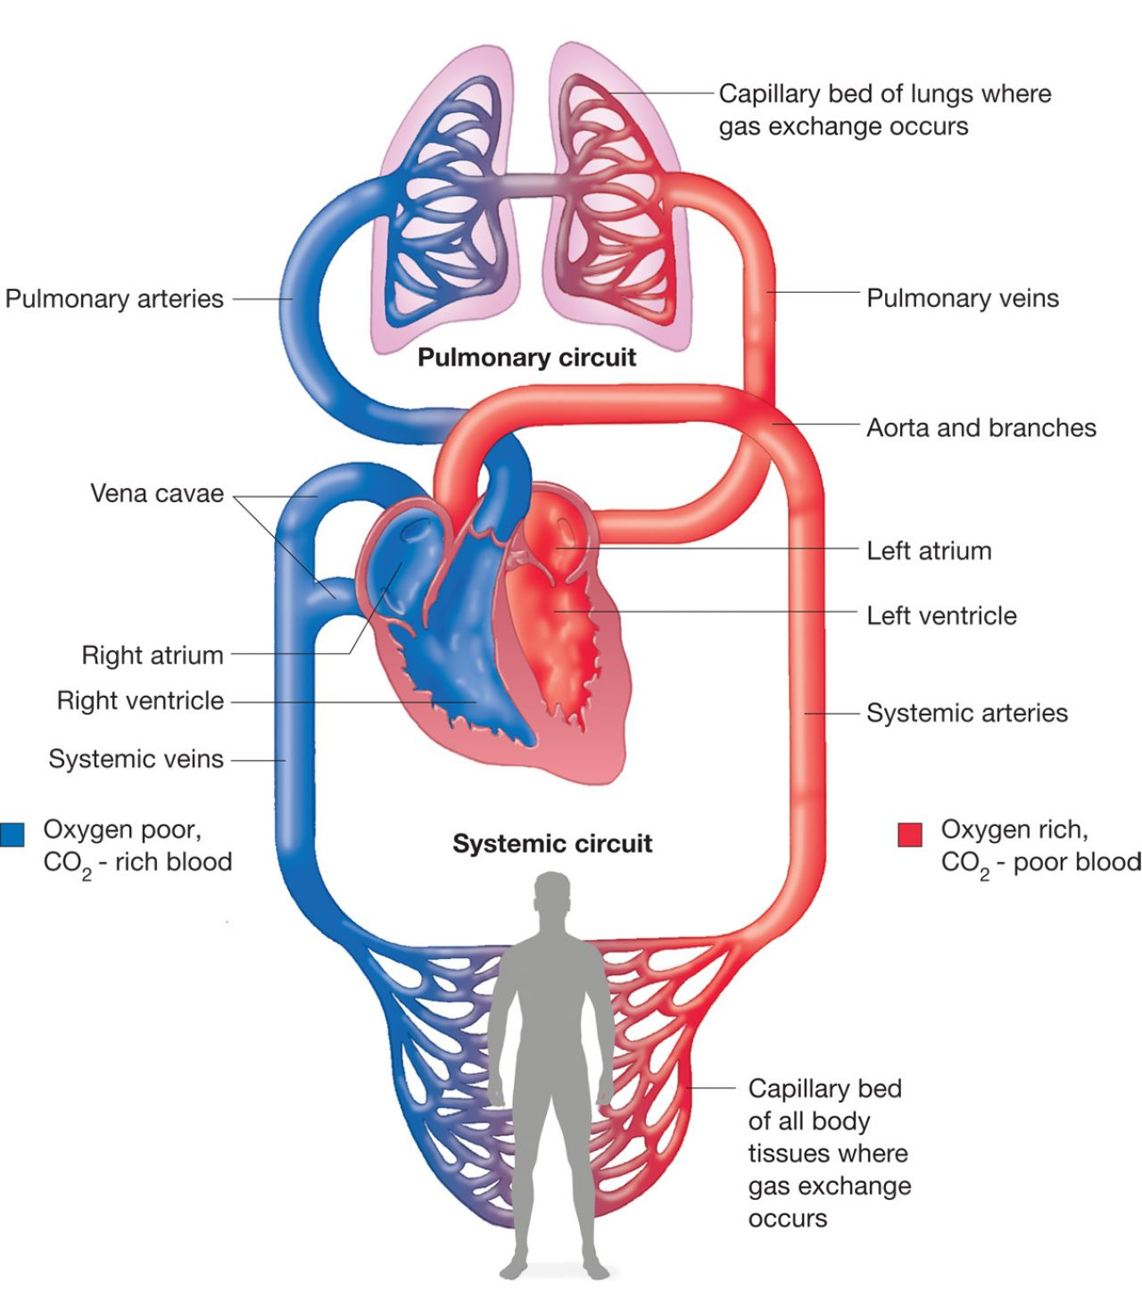
Circuitry
Low pressure circulation
Why??
High pressure circulation
Why??

Slide 7
Blood Supply of the Lung
The lung has dual blood supply
Pulmonary Circulation
Bronchial Circulation
Starts at Rt atrium → Rt ventricle → Pulmonary art. → Capillaries → Pulmonary veins → Lt atrium.
Supplies deoxygenated blood to lungs to become oxygenated.
100% of CO
Low pressure, high flow circulation.
Starts from Aorta → Bronchial arteries → capillaries → Bronchial veins which drain either into pulmonary veins (i.e. Lt atrium) or right atrium.
Supplies oxygenated blood to lung tissue.
Approximately 1-2% of CO
High pressure, low flow circulation.

Slide 8
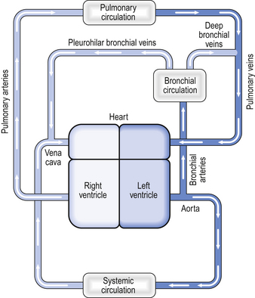
Bronchial Circulation
Supplies O₂-rich blood to lung tissue. After lung tissue extracts the needed O₂, $2/3$of the resultant deoxygenated blood drains into pulmonary veins (which carry O₂-rich blood to the Lt atrium) causing venous admixture of deoxygenated blood with newly oxygenated blood coming from the pulmonary circulation.
Anatomic
Rt-to-Lt Shunt
Venous blood enters the O₂-rich pulmonary vein

Slide 9
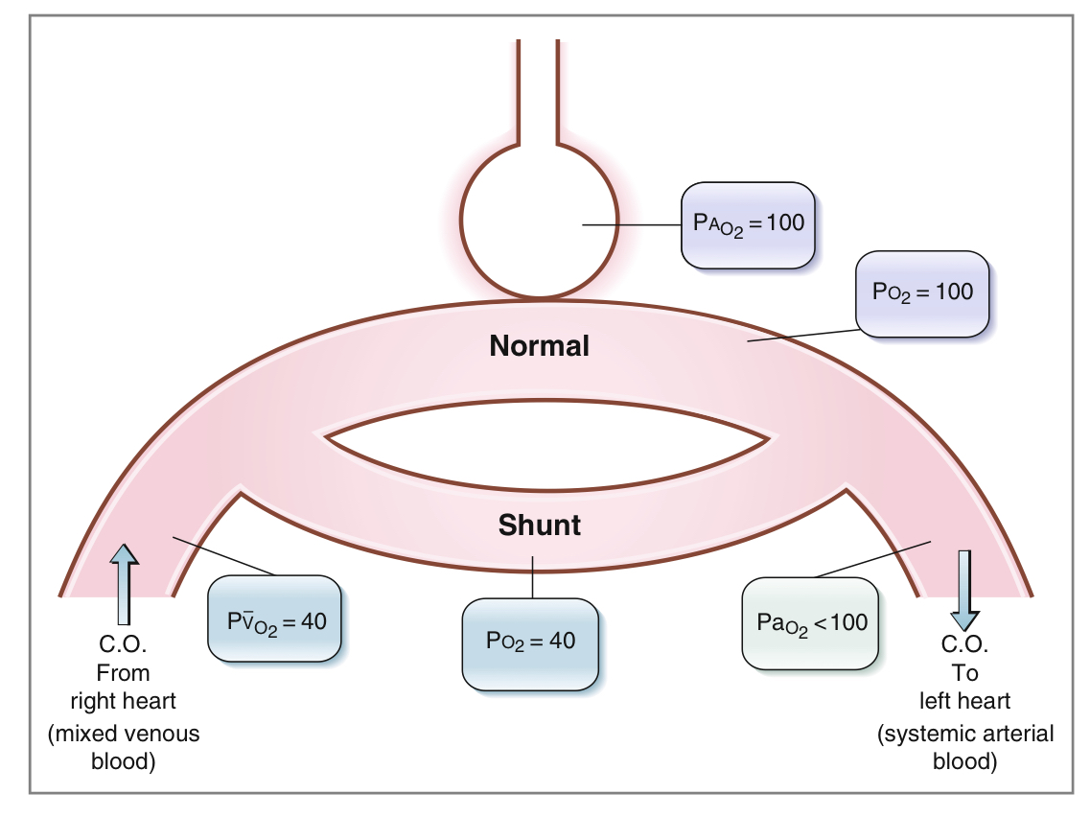
Right-to-Left Shunt
Normally, deoxygenated blood should pass to the lungs to get oxygenated.
If deoxygenated blood bypasses the lungs and enters the left side of the circulation → “Rt-to-Lt shunt”

Slide 10
Pulmonary Perfusion
Pulmonary perfusion refers to the blood flow through the lung that supplies deoxygenated blood to the lung to be oxygenated.
This means “pulmonary circulation”.
From now on we will focus on pulmonary circulation.

Slide 11
Pulmonary Blood Flow
Pulmonary perfusion or pulmonary blood flow is affected by several factors:
Alveolar oxygenation.
Hydrostatic pressure gradient (the effect of gravity).
And other factors that will not be discussed.

Slide 12
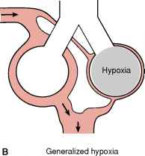
Alveolar Oxygenation
↓ in alveolar PO₂
(PO₂ < 73mmHg)
Vasoconstriction of the vessels surrounding the hypoxic alveolus
This causes blood to flow to areas of the lungs that are better aerated
N. B. This is opposite to the effect observed in systemic vessels

Slide 13
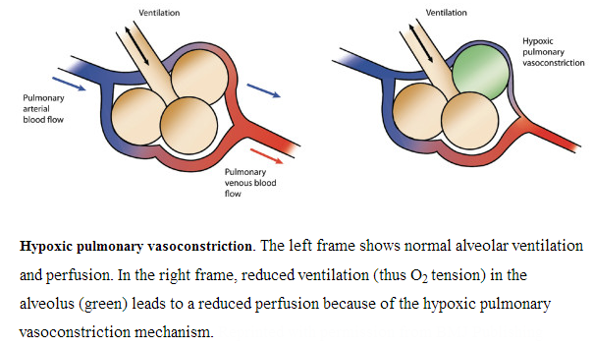
Alveolar Oxygenation

Slide 14
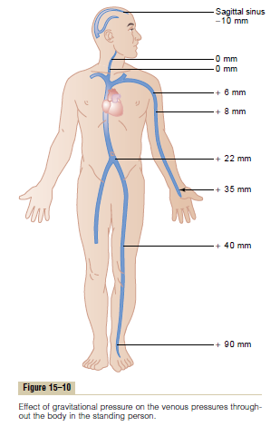
The Hydrostatic Pressure Gradient
In the upright position, the pressure of blood is not the same around the body… Why?
Due to weight of the blood column, the effect of gravity.
For each cm distance above or below the heart the pressure changes 0.77mmHg.

Slide 15
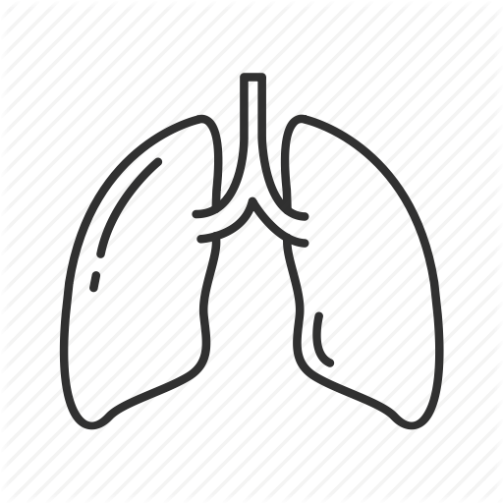
The Hydrostatic Pressure Gradient in the Lung
The same effect happens in the lung.
The distance between apex and base of lung ≈ 30cm.. Which means 23mmHg pressure difference between apex and base of the lung.
15mmHg above the heart and 8mmHg below the heart.
15 mmHg less that Pulmonary arterial pr. at the level of the heart
30cm = 23 mmHg
8 mmHg more that Pulmonary arterial pr. at the level of the heart

Slide 16
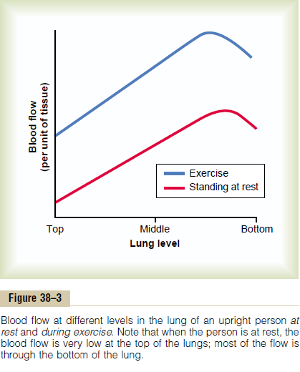
Regional Differences in Pulmonary Blood Flow
The variation in arterial & venous pressures in the upright posture causes regional differences in blood flow.
Base has more blood flow than apex in the upright posture.

Slide 17
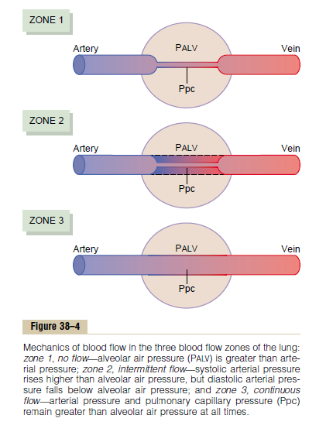
Perfusion Zones of the Lung
Classically, the lung has been divided into 3 different zones:
Zone 1: No blood flow.
Zone 2: Intermittent blood flow.
Zone 3: Continuous blood flow.

Slide 18
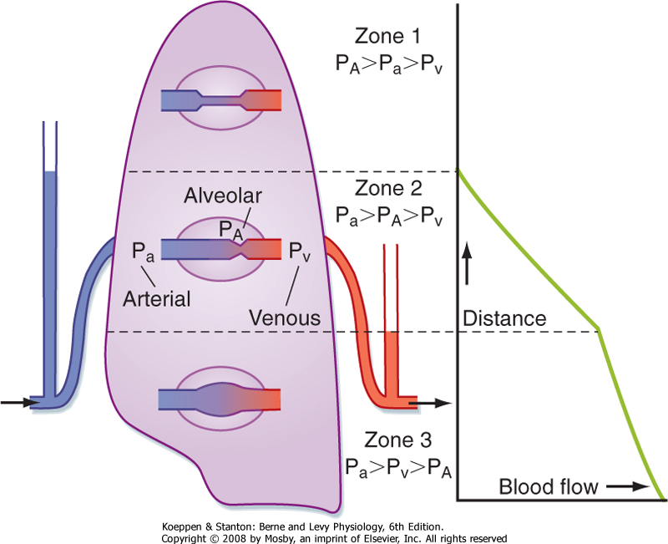
Perfusion Zones of the Lung
Zone 1-the alveolar capillary pressure never rises higher than alveolar air pressure throughout the cardiac cycle.
Zone 2-the alveolar capillary pressure becomes higher than alveolar air pressure only during systole.
Zone 3-the alveolar capillary pressure remains higher than alveolar air pressure throughout the cardiac cycle.

Slide 19
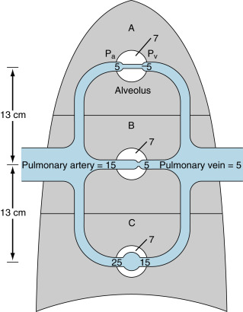
Perfusion Zones of the Lung
Zone 1 is not normally seen in the lung.. When can zone 1 be seen in the lung?
Normal lungs have only zones 2 & 3;
Zone 2 at the apices.
Zone 3 in all lower areas.
Zone 2 blood flow begins in the normal lung about 10cm above the midlevel of the heart and extends from there to the top of the lungs.
What happens in a person who is lying down?

Slide 20
What about ventilation?!!
Is it affected by gravity as well?

Slide 21
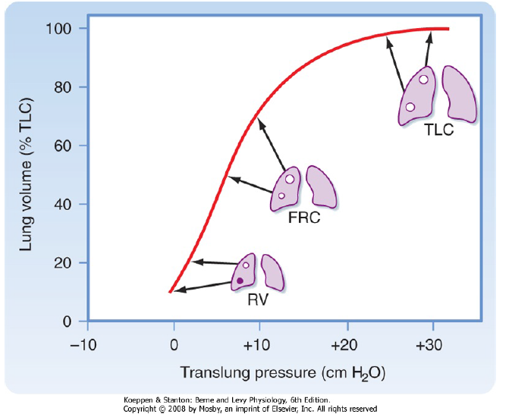
Regional Differences in Pulmonary Ventilation
Regional distribution of lung volume, including alveolar size and location on the pressure volume curve of the lung at different lung volumes. Because of suspension of the lung in the upright position, the pleural pressure (Ppl) and translung pressure (PL) of units at the apex will be greater than those at the base. These lung units will be larger at any lung volume than units at the base. The effect is greatest at residual volume (RV), is less at functional residual capacity (FRC), and disappears at total lung capacity (TLC). Note also that because of their location on the pressure-volume curve, inspired air will be differentially distributed to these lung units; the lung units at the apex are less compliant and will receive a smaller proportion of the inspired air than the lung units at the base, which are more compliant (i.e., reside at a steeper part of the pressure-volume curve).

Slide 22
Ventilation/Perfusion Ratio (V/Q Ratio)
It is the ratio of alveolar ventilation to pulmonary blood flow per minute.
The alveolar ventilation at rest (4.2 L/min)
The pulmonary blood flow is equal to right ventricular output per minute (5L/min)
V/Q ratio= 4.2/5 = 0.84
Alveolar ventilation is 80% of the value for pulmonary blood flow if the tidal volume and cardiac output are normal.

Slide 23
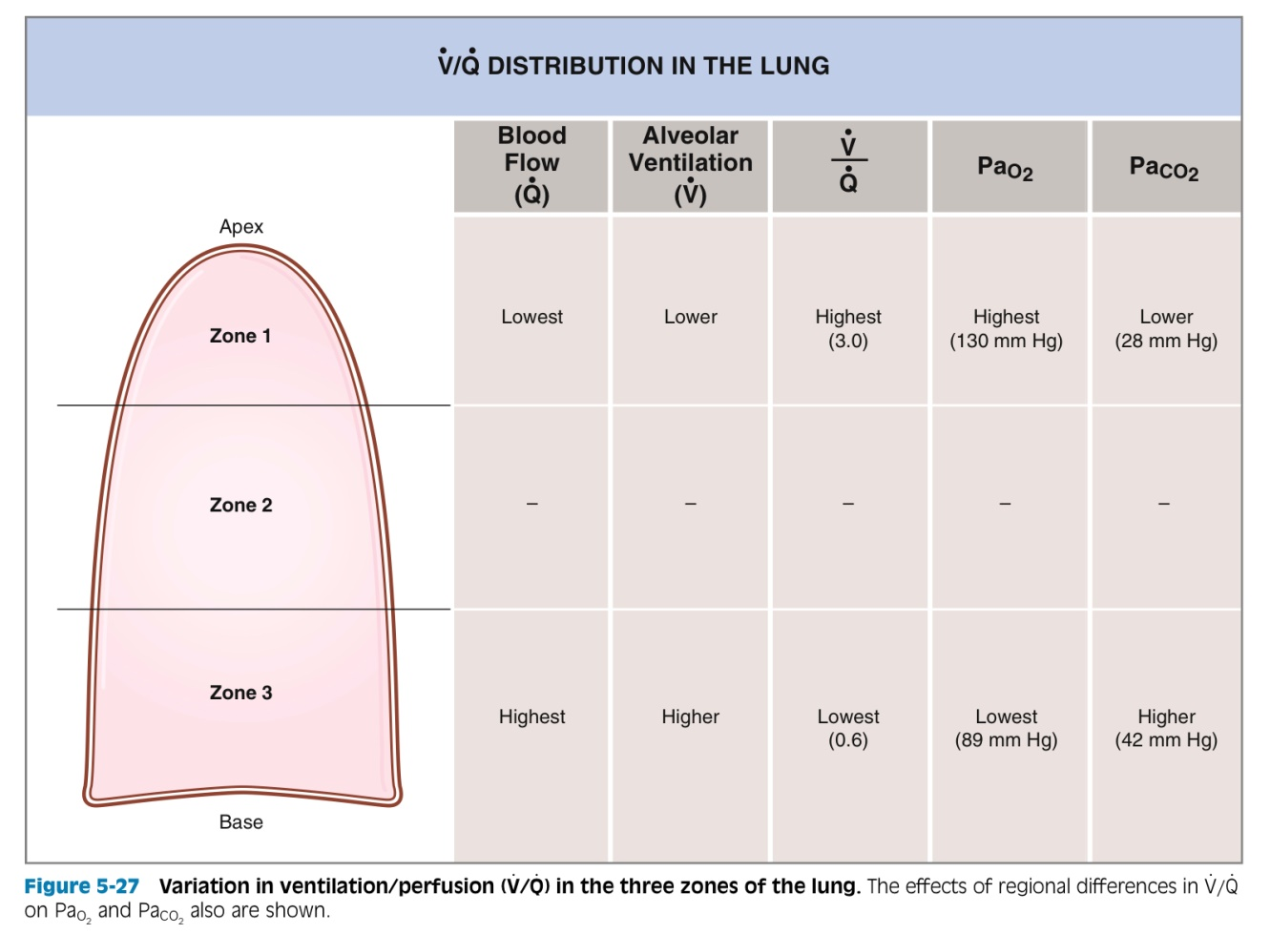
Variation in V/Q in the zones of the lung
V/Q is uneven in the three zones.
At the apex V/Q ratio = 3
At the base V/Q ratio=0.6
The apex is more ventilated than perfused and the base is more perfused than ventilated.
During exercise the V/Q ratio becomes more homogenous among different parts of the lung.

Slide 24
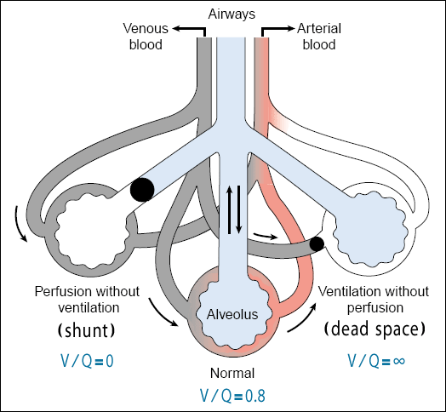
V/Q Ratio
The main function of this ratio is to determine the state of oxygenation in the body.
Apex V/Q ratio = 3 (moderate degree of physiologic or normal dead space).
Base V/Q ratio= 0.6 ( represent a physiologic or normal shunt).
Any mismatch in the ratio can result in hypoxia.

Slide 25
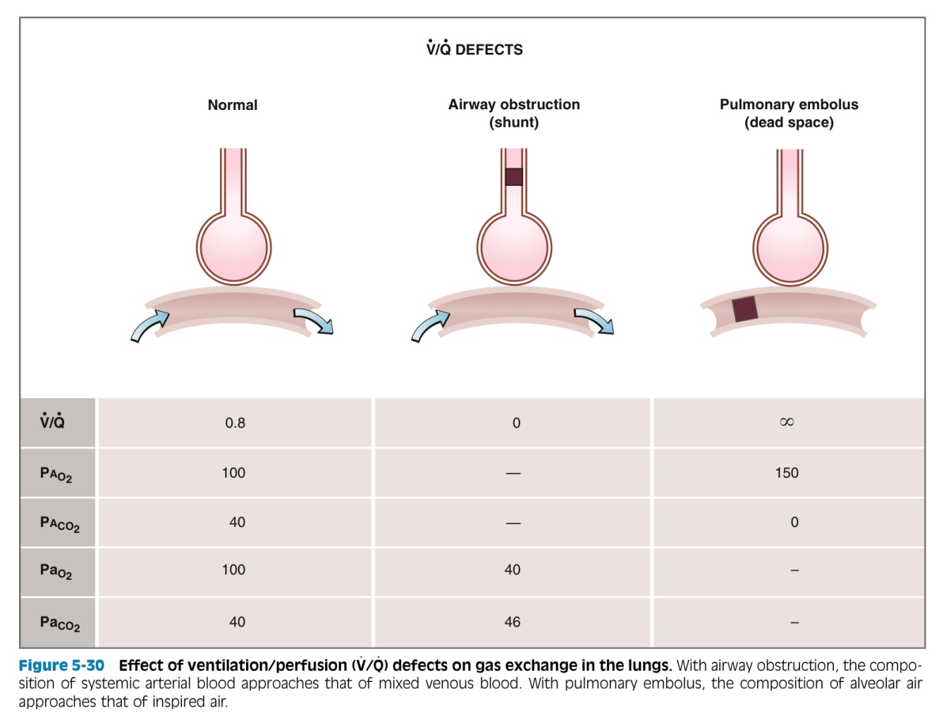
Abnormalities in V/Q Ratio
Changes in V/Q ratio can be caused by changes in ventilation or perfusion or both.
In airway obstruction: alveolar ventilation is affected (shunt).
In pulmonary embolism: perfusion is affected (dead space).

