Slide 1
Simple Spirometry
By
Dr. Ola Mawlana

Slide 2
Objectives
Describe how a bell-type spirometer is used to measure lung volumes and capacities.
List and define the different lung volumes and capacities.
State the normal values of each lung volume and capacity.
Discuss the physiological and pathological factors that may affect the different lung volumes and capacities.

Slide 3
Simple Spirometry
Is a pulmonary function test that measure lung volumes and capacities

Slide 4
Equipments
Simple spirometer (many types are available, Bell-type spirometer or water-gauge spirometer)
Nose clip.
Disposable mouth piece.

Slide 5
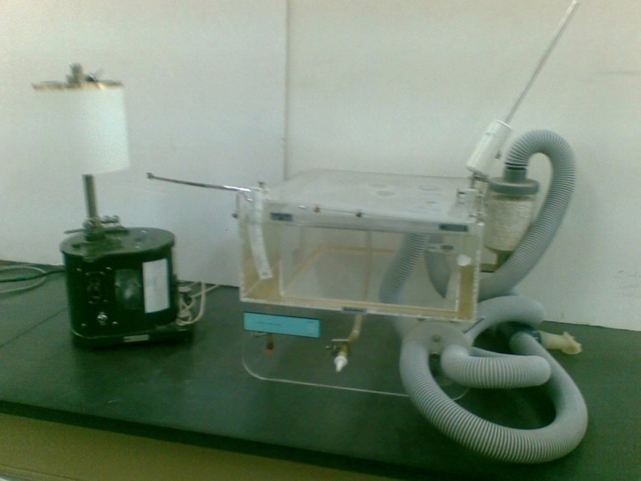
Simple (volumetric) spirometer.

Slide 6
Procedure
Insert the mouthpiece in the subject’s mouth.
Place the nose clip on the subject’s nose.
Ask the subject to take normal breaths through the mouthpiece for a short while.
After recording few normal breaths, ask the subject to take a deep forceful inspiration filling their lungs to their maximum ability, then exhale gently and follow it with few normal breaths.
Then ask the subject to expire quickly, forcibly and as completely as possible. Followed by an inhalation and a period of normal breathing.
Finally, ask the subject to take a deep forceful inspiration and to follow it immediately with maximum quick and forceful expiration. Once this is complete, ask the subject to breath normally for a short time.
The spirogram is recorded on a moving drum.

Slide 7
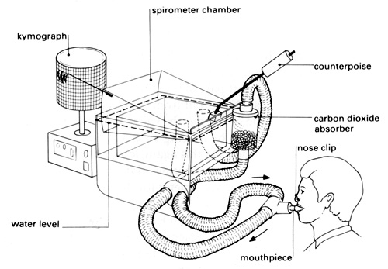
The subject breaths through a mouthpiece while a nose clip is placed on the nose to avoid air escaping through the nose. While breathing, air moves in and out of the spirometer chamber causing displacement in the pen attached to it surface. The moving pen draws the spirometry graph on the kymograph. The degree of displacement is proportional to the volume of air moving in and out of the lungs. With proper calibration, the volume of air moving in and out of the lungs can be calculated.

Slide 8
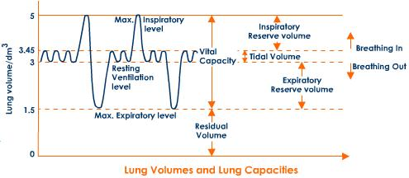
Lung Volumes & Capacities

Slide 9
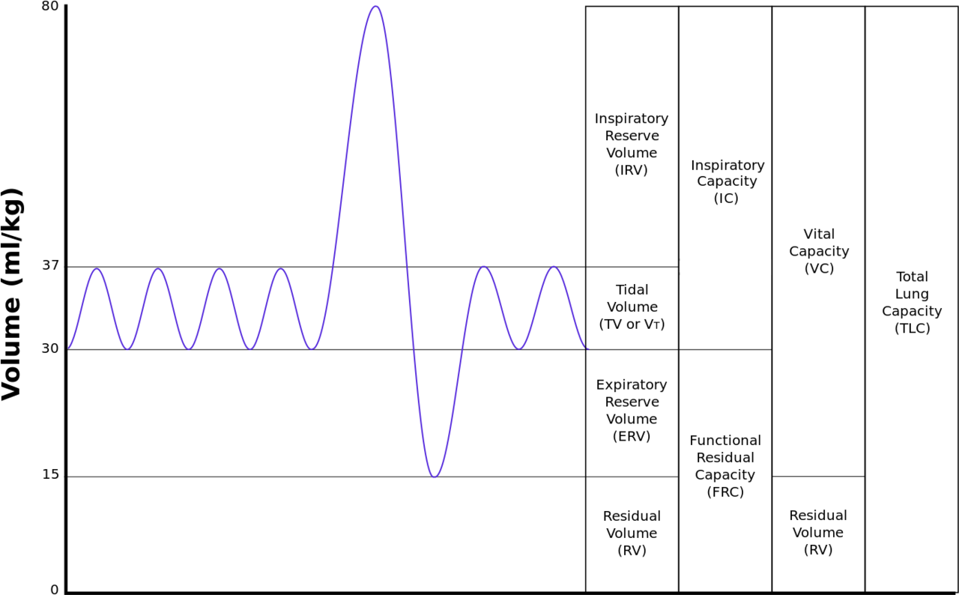

Slide 10
Lung Volumes & Capacities
1. TIDAL VOLUME (TV)
- Volume of air inspired or expired during normal (quit) breathing
- N = 500 ml or 0.5 L (male and female)
2. INSPIRATORY RESERVE VOLUME (IRV)
- The extra volume of air that can be inspired by a maximal inspiratory effort after normal inspiration.
- Average : 3000 ml or 3 L
- Male : 3.3 L Female : 1.9 L

Slide 11
3. EXPIRATORY RESERVE VOLUME (ERV)
- The extra volume of air that can be expired by forceful
expiration after the end of a normal tidal expiration.
- Average : 1100 ml or 1.1 L
- Male : 1 L Female : 700 ml
4. RESIDUAL VOLUME (RV)
- The volume of air remaining in the lungs after the most forceful expiration.
- Average : 1.2 L
( RV & FRC can not be measured directly by Spirometry but measured by Hilum dilution method

Slide 12
5. INSPIRATORY CAPACITY (IC)
- Volume of air inspired by a maximal inspiratory effort
after normal expiration.
- TV + IRV –
- Average : 3.5 L
- Male : 3.8 L Female 2.4 L
FUNCTIONAL RESIDUAL CAPACITY (FRC)
- The amount of air that remains in the lungs at the end of normal expiration.
- ERV + RV
- Average : 2.3 L

Slide 13
7. VITAL CAPACITY (VC)
- The volume of air that can be maximally expired after
maximum inspiration..
= TV + IRV + ERV
- Average : 4600 ml or 4.6 L
- Male : 4.8 L Female : 3.1 L
8. TOTAL LUNG CAPACITY (TLC)
- Is the maximum volume to which the lungs can be
expanded with the greatest possible effort
=VC + RV
- Average : 5800 ml or 5.8 L

Slide 14
Physiological factors affecting lung volumes and capacities
Age
- ↑ RV, ↑ FRC with ↑ age
- ↓ VC with age
Sex
- females have 20 – 25% less values in all pulmonary volume and capacities than males.
Body size
- Obese : ↓ VC
↓ FRC because there's ↑ elastic recoil of the lungs
4. Athletes
- ↑ VC

Slide 15
Pathological conditions affecting lung volumes and capacities
Restrictive Lung diseases
( e.g. Alveolar Fibrosis)
- Reduce the compliance of the lungs ---
compressed lung volumes
--- ↓ VC, ↓ IRV, ↓ ERV, ↓ RV, ↓ TV
--- ↑ breathing frequency

Slide 16
Obstructive Lung diseases
(e.g. Emphysema)
- ↑ resistance to airflow
--- ↑ TLC, ↑ FRC, ↑ RV, ↑ TV
--- ↓ VC, ↓ ERV

Slide 17
THANK YOU

