Slide 1

Major arteries
of
the body
Prof. ahmed fathalla & Dr. jamila elmedany

Slide 2
OBJECTIVES
At the end of the lecture, the student should be able to:
Define the word ‘artery’ and understand the general principles of the arterial system.
Define arterial anastomosis and describe its significance.
Define end arteries and give examples.
Describe the aorta and its divisions & list the branches from each part.
List major arteries and their distribution in the head & neck, thorax, abdomen and upper & lower extremities.
List main pulse points.

Slide 3
“ARTERIES”
Blood vessels that carry blood from the heart to the body.
All arteries, carry oxygenated blood, EXCEPT the PULMONARY ARTERY which carry deoxygenated blood to the lungs.

Slide 4
GENERAL PRINCIPLES OF ARTERIES
The flow of blood depends on the pumping action of the heart.
Arteries have ELASTIC WALL containing NO VALVES.
The branches of arteries supplying adjacent areas normally ANASTOMOSE with one another freely providing backup routes for blood to flow if one artery is blocked, e.g. arteries of limbs.
The arteries whose terminal branches do not anastomose with branches of adjacent arteries are called “END ARTERIES”. End arteries are of two types:
  Anatomic (True) End Artery: When NO anastomosis exists, e.g. artery of the retina.
  Functional End Artery: When an anastomosis exists but is incapable of providing a sufficient supply of blood, e.g. splenic artery, renal artery.

Slide 5
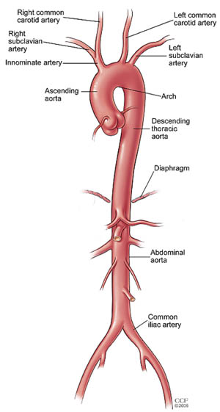
AORTA
The largest artery in the body
Carries oxygenated blood to all parts of the body
Is divided into 4 parts:
  Ascending aorta
  Arch of aorta
  Descending thoracic aorta
  Abdominal aorta
2
1
3
4

Slide 6
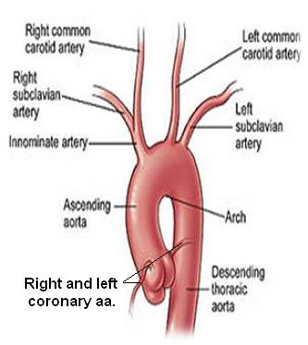
ASCENDING AORTA
Originates from left ventricle.
Continues as the arch of aorta
Has three dilatations at its base, called aortic sinuses
Branches:
  Right & Left coronary arteries (supplying heart), arise from aortic sinuses

Slide 7
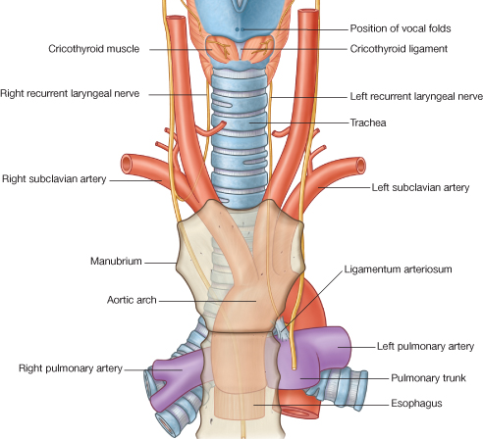
ARCH OF AORTA
Continuation of the ascending aorta.
Leads to descending aorta.
Located behind the lower part of manubrium sterni and on the left side of trachea.
2
1
3
Branches:
  Brachiocephalic trunk.
  Left common carotid artery.
  Left subclavian artery.

Slide 8
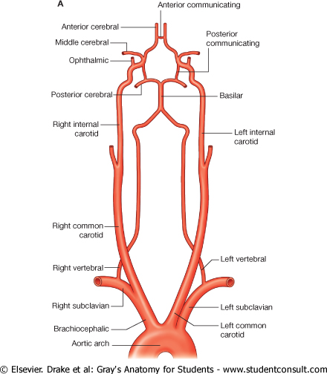
COMMON CAROTID ARTERY
Origin:
  LEFT from aortic arch.
  RIGHT from brachiocephalic trunk.
Each common carotid divides into two branches:
  Internal carotid
  External carotid

Slide 9
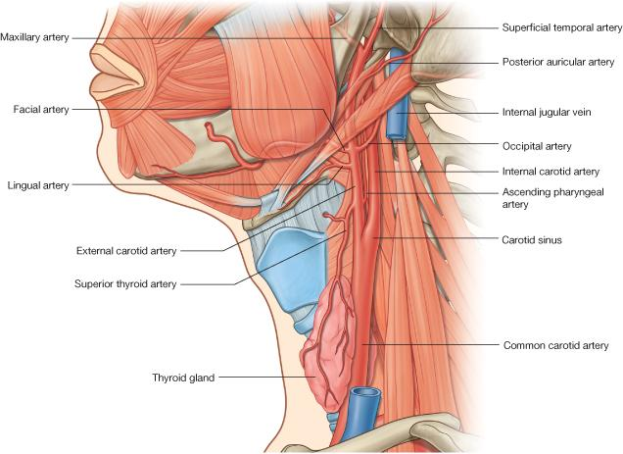
EXTERNAL CAROTID ARTERY
It divides behind neck of mandible into: Superficial temporal & maxillary arteries
It supplies:
  Scalp: Superficial temporal, occipital, & posterior auricular arteries
  Face: Facial artery
  Maxilla & mandible: Maxillary artery
  Tongue: Lingual artery
  Pharynx: ascending pharyngeal artery
  Thyroid gland: Superior thyroid artery
8
7
6
4
5
3
2
1

Slide 10
INTERNAL CAROTID ARTERY
Has NO branches in the neck
Enters the cranial cavity, joins the basilar artery (formed by the union of two vertebral arteries) and forms ‘arterial circle of Willis’ to supply brain.
In addition, it supplies
  Nose
  Scalp
  Eye

Slide 11
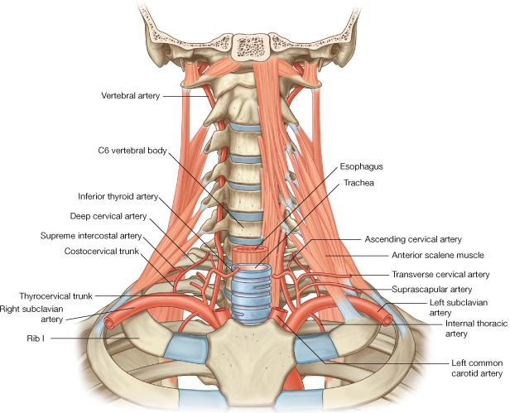
SUBCLAVIAN ARTERY
Origin:
  LEFT: from arch of aorta
  RIGHT: from brachiocephalic trunk
It continues, at lateral border of first rib, as axillary artery: artery of upper limb
Main branches:
  Vertebral artery: supplies brain & spinal cord
  Internal thoracic artery: supplies thoracic wall

Slide 12
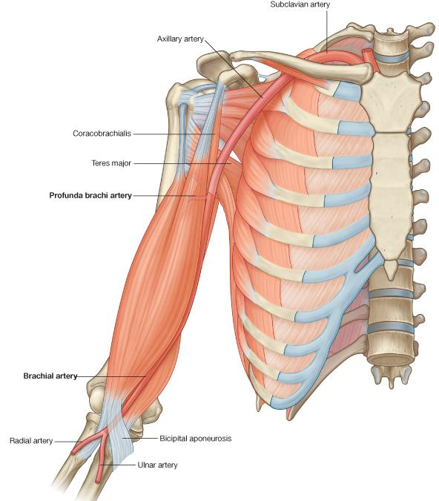
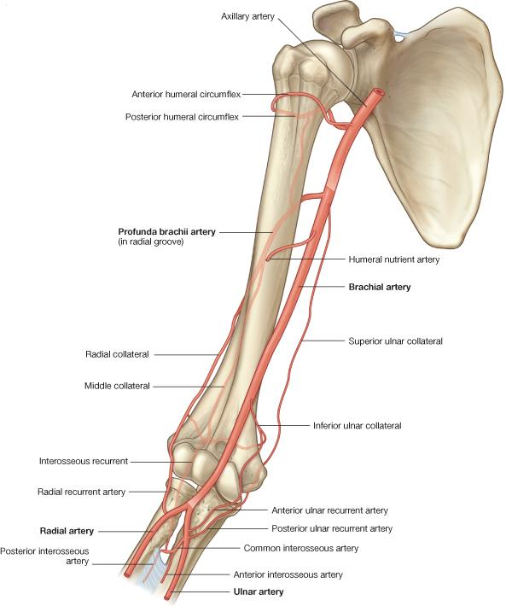
ARTERIES OF UPPER LIMB
At lateral border of 1st rib
At lower border of teres major
Opposite neck of radius

Slide 13
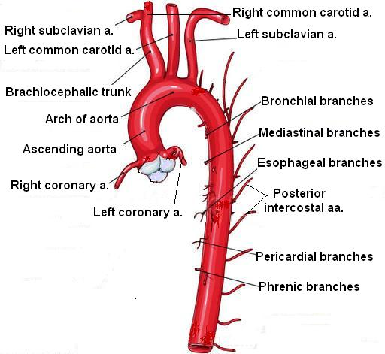
DESCENDING THORACIC AORTA
It is the continuation of aortic arch
At the level of the 12th thoracic vertebra, it passes through the diaphragm and continues as the abdominal aorta
Branches:
  Pericardial
  Esophageal
  Bronchial
  Posterior intercostal

Slide 14
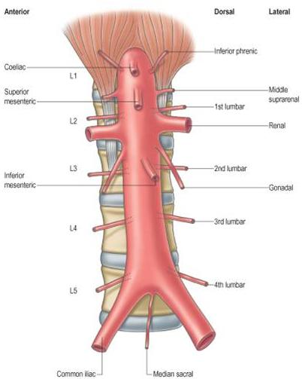
ABDOMINAL AORTA
It enters the abdomen through the aortic opening of diaphragm.
At the level of lower border of L4, it divides into two common Iliac arteries.
Branches: divided into two groups:
  Single branches
  Paired branches

Slide 15
MAIN BRANCHES OF
ABDOMINAL AORTA
1
1
2
2
SINGLE BRANCHES
SUPPLYING
GASTROINTESTINAL TRACT
3
3
4
PAIRED BRANCHES
5

Slide 16
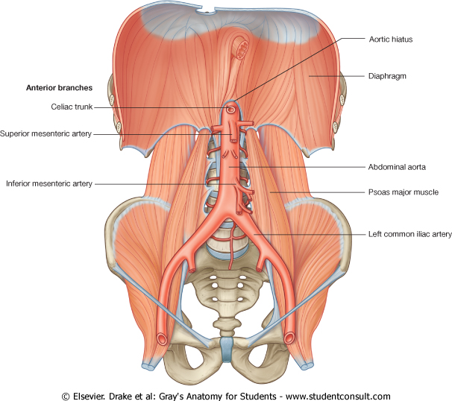
BRANCHES OF COMMON ILIAC ARTERY
EXTERNAL ILIAC ARTERY:
continues (at midpoint of inguinal ligament) as femoral artery the main supply for lower limb
INTERNAL ILIAC ARTERY:
supplies pelvis

Slide 17
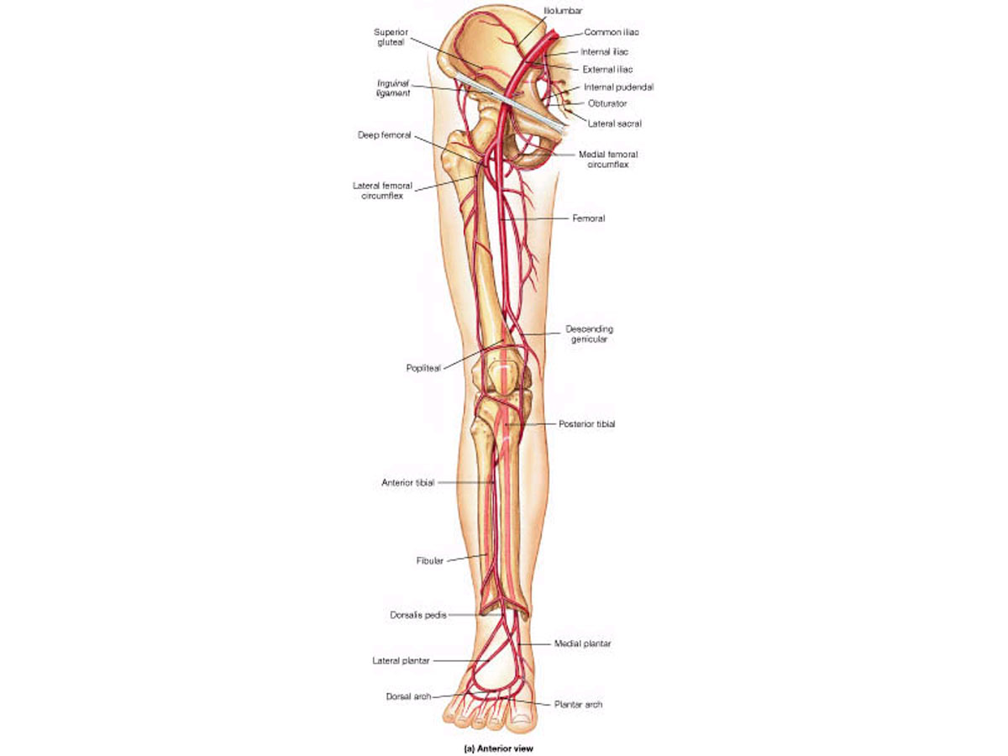
ARTERIES OF LOWER LIMB
Femoral Artery
  Is the main arterial supply to lower limb
  Is the continuation of external iliac artery behind the midpoint of the inguinal ligament
  Passes through adductor hiatus and continues as:
Popliteal Artery
  Deeply placed in the popliteal fossa.
  Divides, at lower end of popliteal fossa into:
1-Anterior Tibial Artery
2-Posterior Tibial Artery

Slide 18
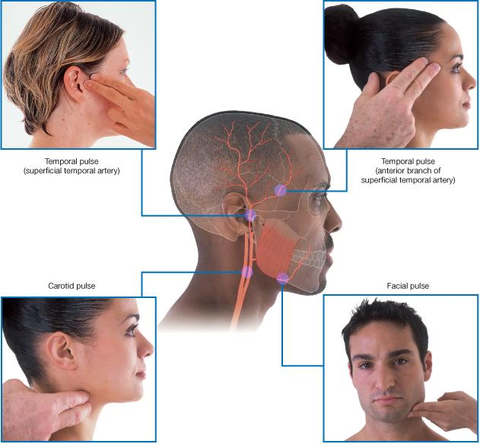
PULSE POINTS IN HEAD & NECK

Slide 19
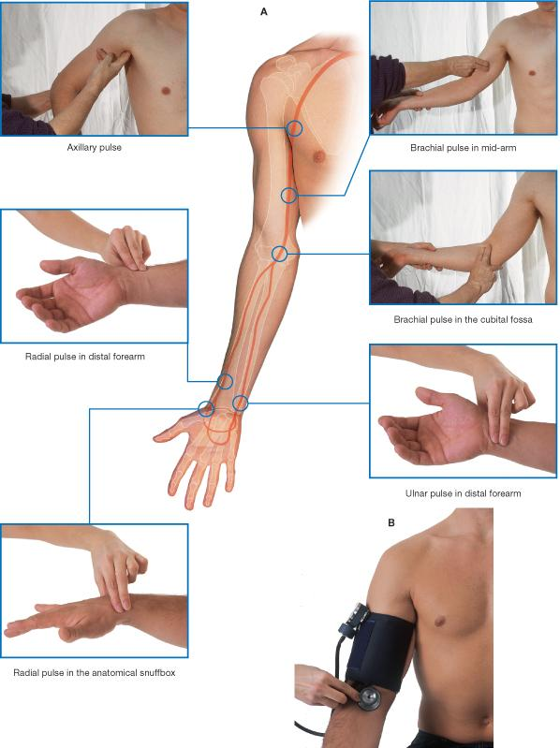
PULSE POINTS IN UPPER LIMB

Slide 20
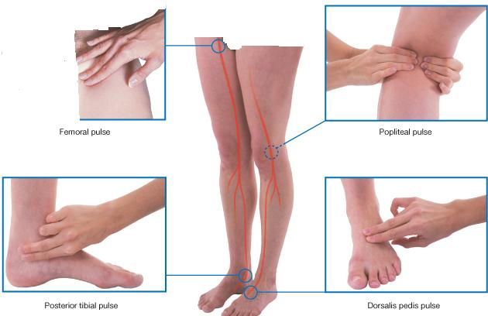
PULSE POINTS IN LOWER LIMB

Slide 21
THANK YOU

