Slide 1
CARDIOVASCULAR SYSTEM
Pathology Practical
Prepared by:
Prof. Ammar Al Rikabi
Dr. Sayed Al Esawy

Slide 2
Normal anatomy and histology
Pathology Dept, KSU
CVS- Block

Slide 3
Objectives:
At the end of the 2nd P2 practical sessions of the cardiovascular block, the medical students will be able to:
Identify the morphologic histopathological features of:
chronic venous congestion of the liver
chronic venous congestion of the lung
Hypertensive changes in blood vessels
Myocardial hypertrophy
Thromboangitis obliterans
Giant cell arteritis
Leukocytoclastic vasculitis.

Slide 4
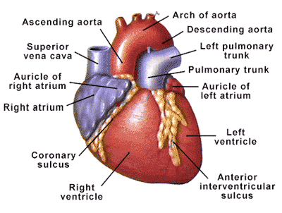
Anatomy of the Heart
The heart serves as a mechanical pump to supply the entire body with blood, both providing nutrients and removing waste products.
The great vessels exit the base of the heart.
Blood flow: body→ sup & inf venae cava → right atrium→ right ventricle→ lungs → left atrium → left ventricle→ Aorta → body
Pathology Dept, KSU
CVS- Block

Slide 5
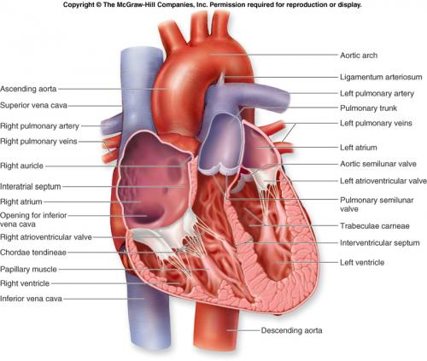
Anatomy of the Heart – inside view
Pathology Dept, KSU
CVS- Block

Slide 6
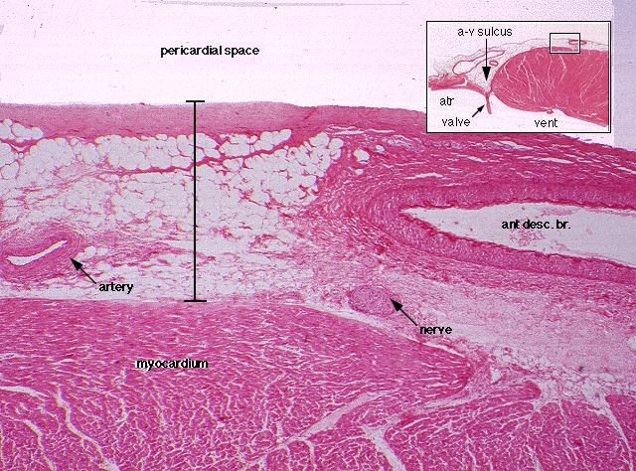
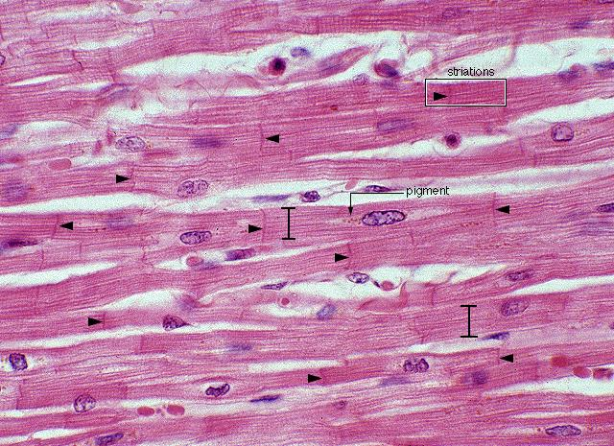
Histology of the Heart
The heart consists of 3 layers
- the Endocardium,
- the Myocardium, and
- the Pericardium.
The Pericardium consists of arteries, veins, nerves, connective tissue, and variable amounts of fat.
The Myocardium contains branching, striated muscle cells with centrally located nuclei. They are connected by intercalated disks (arrowheads).
Pathology Dept, KSU
CVS- Block

Slide 7
PRACTICAL - 2
Pathology Dept, KSU
CVS- Block

Slide 8
Chronic venous congestion of the liver
(seen in right sided heart failure)
Pathology Dept, KSU
CVS- Block

Slide 9
Additional information Hyperemia & Congestion
Hyperemia is an active process resulting from tissue inflow because of arteriolar dilation, e.g. skeletal muscle during exercise or at sites of inflammation. The affected tissue is redder because of the engorgement of vessels with oxygenated blood.
Congestion is a passive process resulting from impaired outflow from a tissue. It may be systemic e.g. cardiac failure, or local e.g. an isolated venous obstruction. The tissue has a blue-red color (cyanosis), due to accumulation of deoxygenated hemoglobin in the affected tissues.

Slide 10
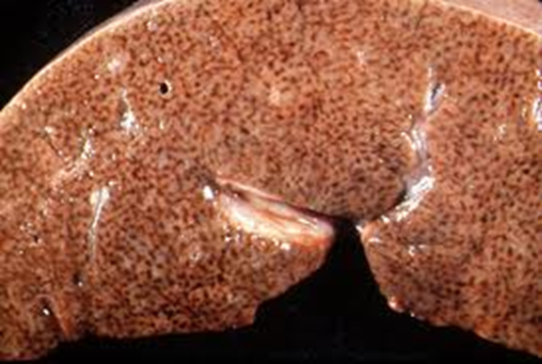
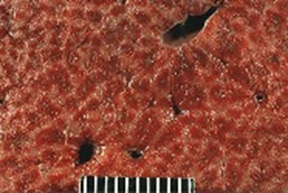
Chronic Congestion of the Liver - HPF
In chronic passive congestion of the liver: on cut surface of liver shows red dots. These red dots represent venous congestion with accumulation of RBC's in centrilobular regions. And they are surrounded by grey/ tan /pale zones of uncongested normal liver. This appearance is described as nutmeg liver. The most common cause is passive congestion secondary to right sided heart failure.
Pathology Dept, KSU
CVS- Block

Slide 11
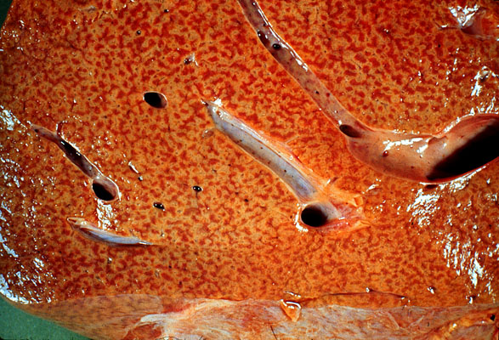
Chronic Congestion of the Liver - CS
A gross view of nutmeg appearance of liver characteristic of centrolobular necrosis or passive congestion of the liver.
Pathology Dept, KSU
CVS- Block

Slide 12
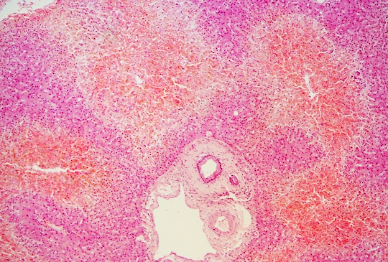
Chronic Congestion of the Liver - CS
Microscopically, there is passive congestion in the central portion of each liver lobule. The central veins (which are present in the center of each liver lobule) become congested and dilated (arrows) → leads to congestion in the surrounding sinusoids → which ultimately leads to necrosis of the hepatocytes around the central vein called centrilobular necrosis (lightning arrows). The portal tracts (star) are unaffected.
Pathology Dept, KSU
CVS- Block

Slide 13
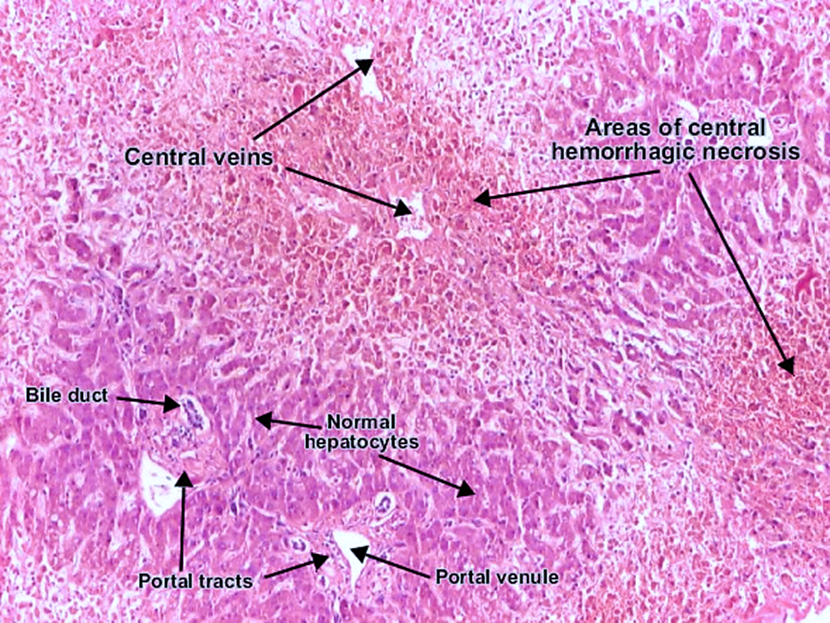
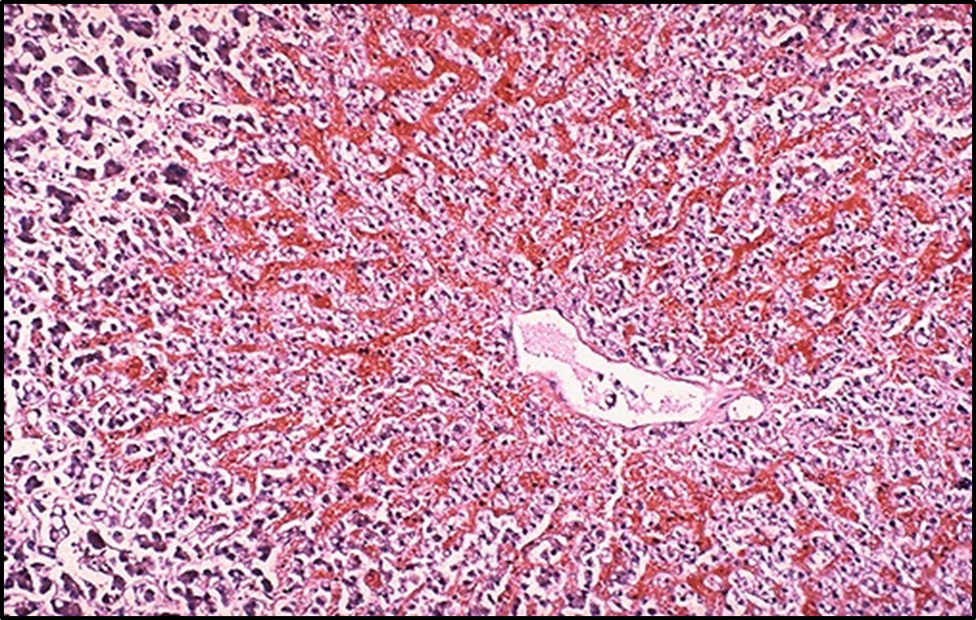
Chronic Congestion of the Liver - LPF
Central veins are dilated and congested surrounded by necrotic hepatocytes (called centrilobular necrosis) with associated hemorrhage and hemosiderin-laden macrophages. In long-standing cases these areas are replaced by fibrosis. This type of fibrosis is called hepatic fibrosis or cardiac cirrhosis.
Pathology Dept, KSU
CVS- Block

Slide 14
Chronic venous congestion of the lung
(seen in left sided heart failure)
Pathology Dept, KSU
CVS- Block

Slide 15
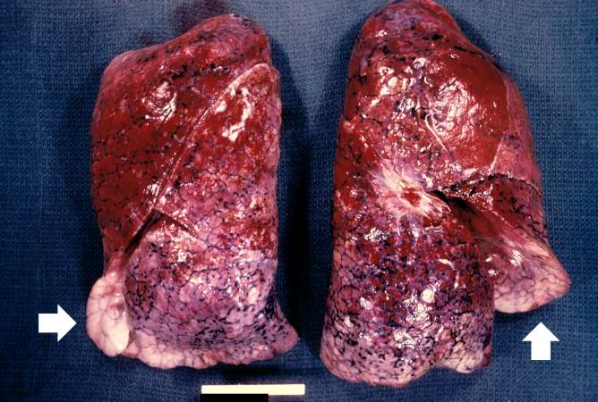
Chronic venous congestion of the lung - Gross
The lungs are enlarged, heavy, distended and red. The reddish coloration of the tissue is due to congestion. Some normal pink lung tissue is seen at the edges of the lungs (arrows) The cut surface is hemorrhagic and wet and frothy blood oozes on squeezing.
Pathology Dept, KSU
CVS- Block

Slide 16
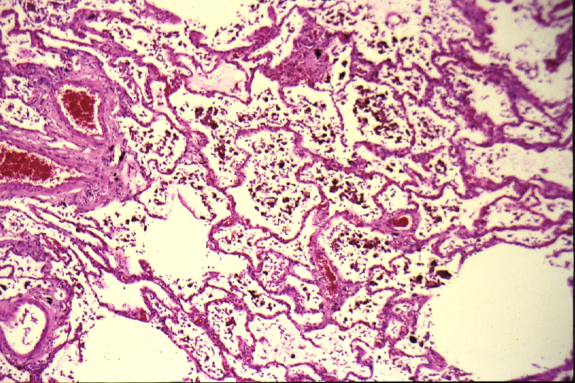
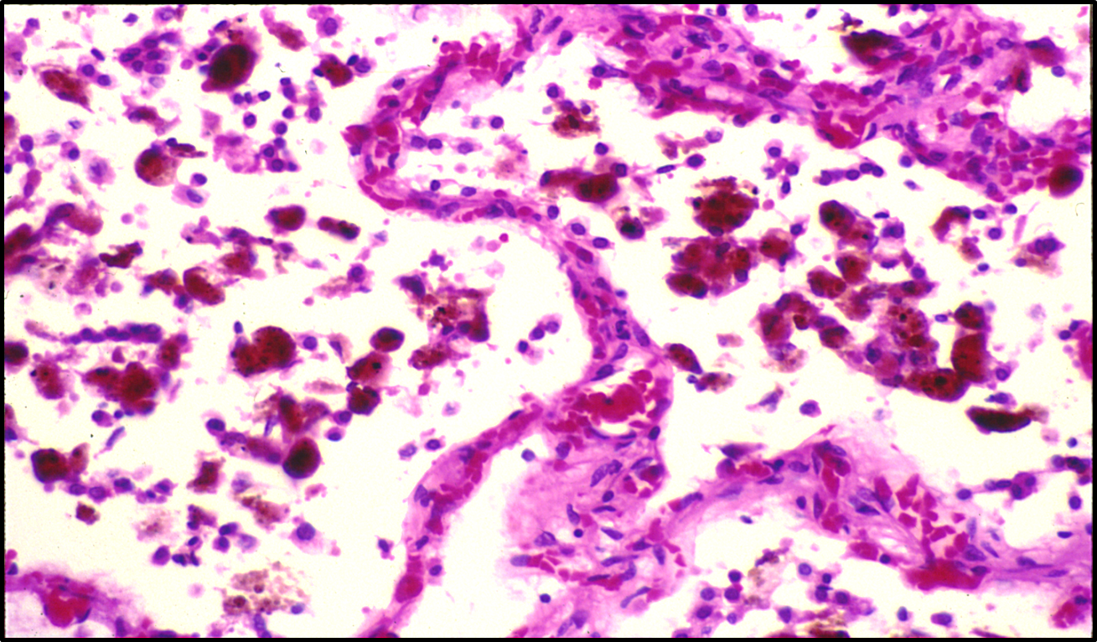
Chronic venous congestion of the lung - LPF
The alveolar walls are thickened by dilated and engorged capillaries and edema fluid. The alveoli are filled with edematous fluid, red blood cells and many alveolar macrophages which are filled with hemosiderin pigment derived from red cells breakdown. These alveolar macrophages are called heart failure cells. With time the alveolar septa become fibrosed.
Pathology Dept, KSU
CVS- Block

Slide 17
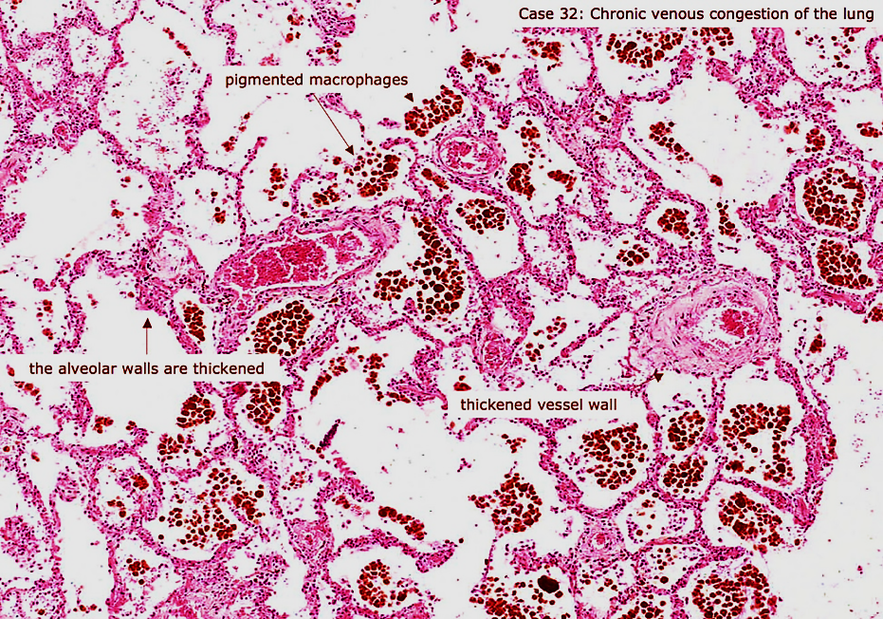
Chronic venous congestion of the lung - LPF
Pathology Dept, KSU
CVS- Block

Slide 18
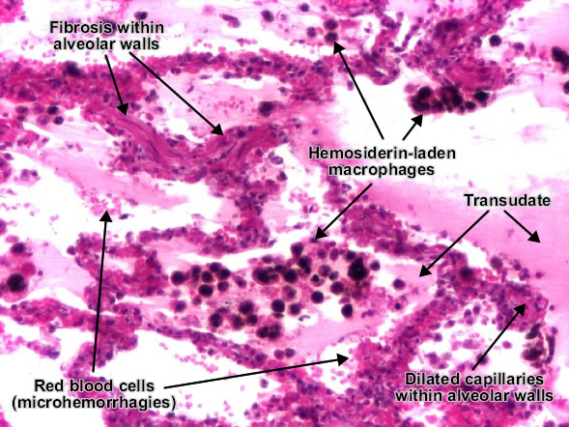
Chronic venous congestion of the lung - HPF
The alveoli contain edematous fluid, red blood cells and large alveolar macrophages (heart failure cells), which are filled with haemosiderin pigment derived from red cells breakdown.
Pathology Dept, KSU
CVS- Block

Slide 19
Blood vessels in Hypertension

Slide 21
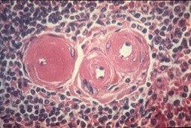
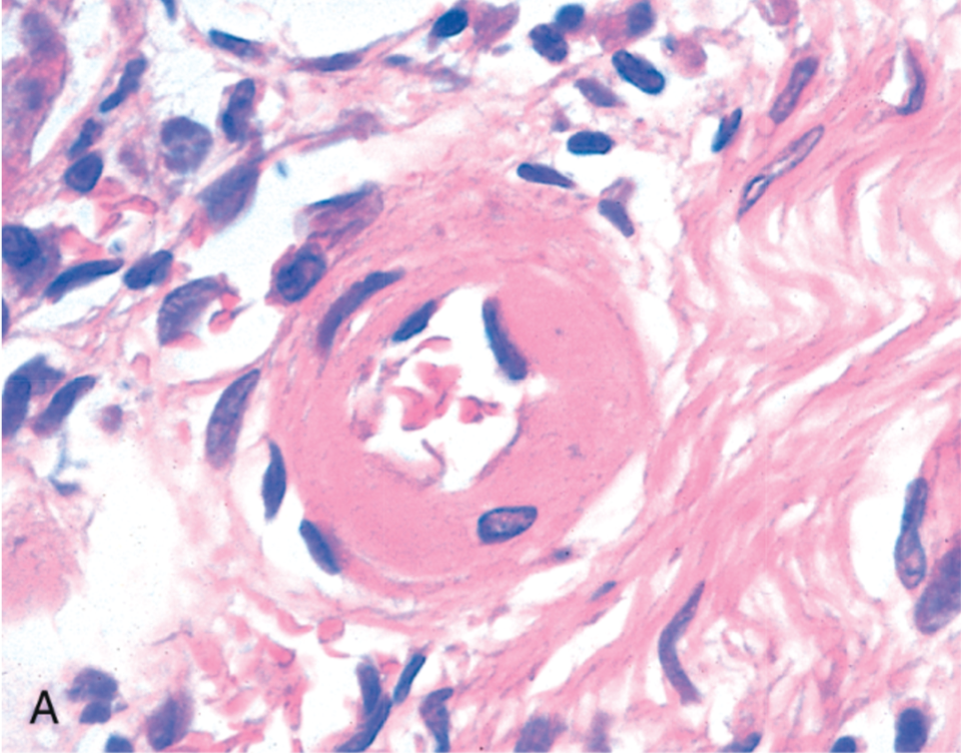
Hyaline arteriolosclerosis - HPF
Hyaline arteriolosclerosis (arterial hyalinosis or arteriolar hyalinosis): it is the thickening of the walls of arterioles by the deposits that appear as homogeneous pink hyaline material. It is commonly found in diabetics, hypertensives and elderly.
Pathology Dept, KSU
CVS- Block

Slide 22
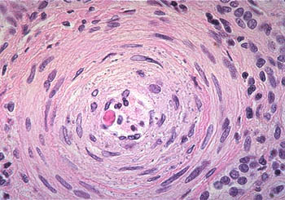
Hyperplastic arteriolosclerosis - HPF
Hyperplastic arteriolosclerosis: It is characterized by thickening of the arteriolar
wall due to the concentric proliferation of smooth muscle cells, giving the
arterioles an “onion skin” appearance. These changes represent an adaptive
response of arterioles to severe (“malignant”) hypertension. The onion-skinning
causing luminal obliteration of the arteriole (arrow). May be associated with necrotizing arteriolitis and fibrinoid necrosis of the blood vessel.
Pathology Dept, KSU
CVS- Block

Slide 23
Hyaline arteriolosclerosis - HPF
A. Hyaline arteriolosclerosis Arteriosclerosis (hardening of the arteries) involves both small and large vessels. It is commonly found in diabetics, hypertensives and elderly.
B. Hyperplastic arteriolosclerosis: is a type of small vessel arteriosclerosis, it is characteristic of malignant hypertension. The “onionskinning” is causing luminal obliteration. Hyperplastic arteriolosclerosis is often accompanied by fibrinoid necrosis of the arterial intima and media (most prominent in the kidney and can lead to acute kidney failure).
Pathology Dept, KSU
CVS- Block

Slide 24
Left ventricular HYPERTROPHY
Pathology Dept, KSU
CVS- Block

Slide 25
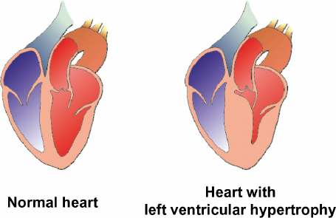
Causes of ventricular hypertrophy
Common causes of left ventricular hypertrophy :
Long standing poorly controlled systemic hypertension
Aortic valve stenosis
Pathology Dept, KSU
CVS- Block

Slide 26
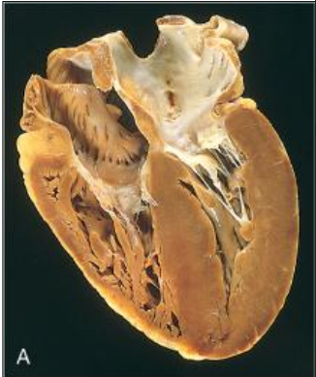
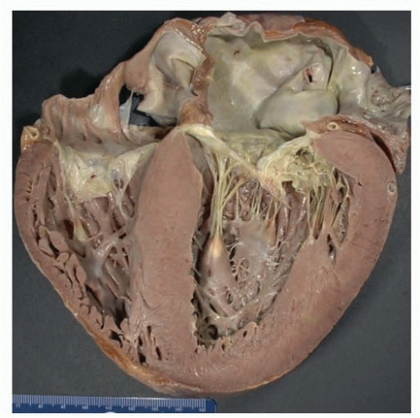
Left ventricular hypertrophy - Gross
Heart from a hypertensive patient. The left ventricle wall is very thick. However the rest of the heart is fairly normal in size as is typical for hypertensive heart disease. The hypertension creates a greater pressure
load on the left side of the heart to induce the hypertrophy
Pathology Dept, KSU
CVS- Block

Slide 27
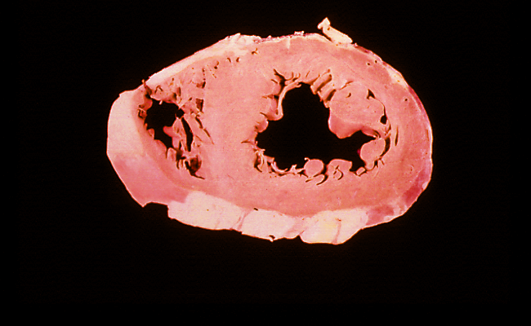
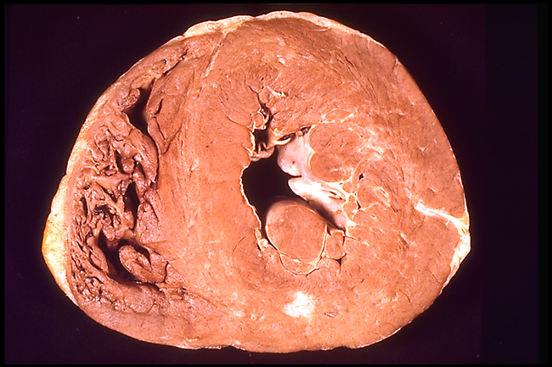
Normal and hypertrophied left ventricle –
cross section
Normal ventricles
Left ventricular hypertrophy
Pathology Dept, KSU
CVS- Block

Slide 28
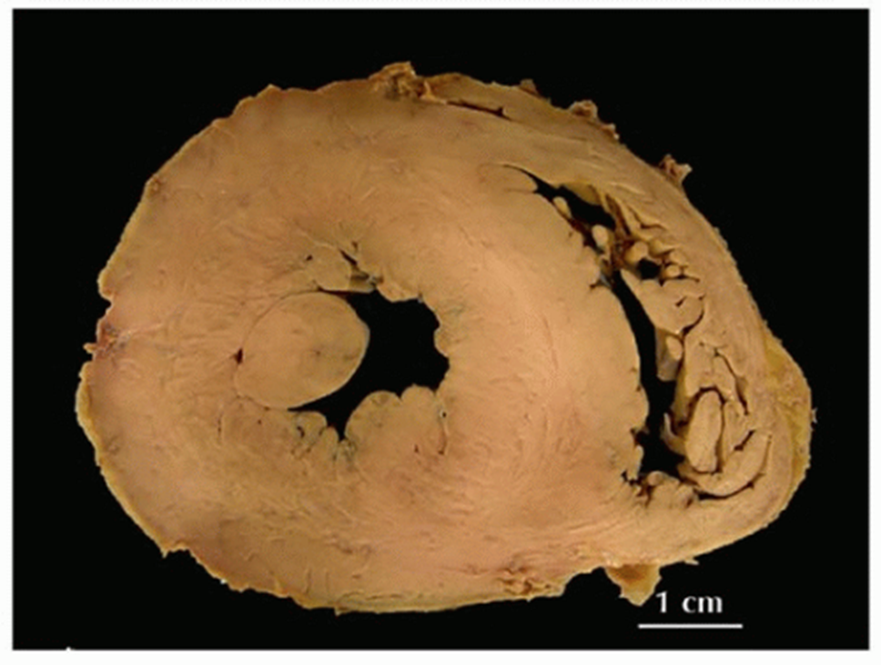
Left ventricular hypertrophy - Gross
This cross section view of the heart shows the left ventricle in the left of the picture. The heart is from a severe hypertensive. The left ventricle is grossly thickened. The myocardial fibers have undergone hypertrophy.
Pathology Dept, KSU
CVS- Block

Slide 29
Thromboangitis oblitrans (Buerger’s disease)

Slide 30
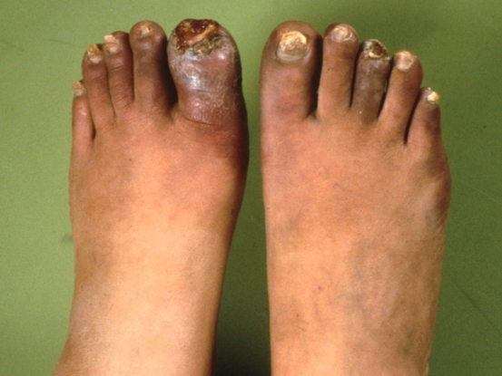
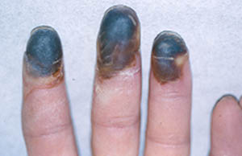
Thromboangitis oblitrans
(Buerger`s disease)
Pathology Dept, KSU
CVS- Block

Slide 31
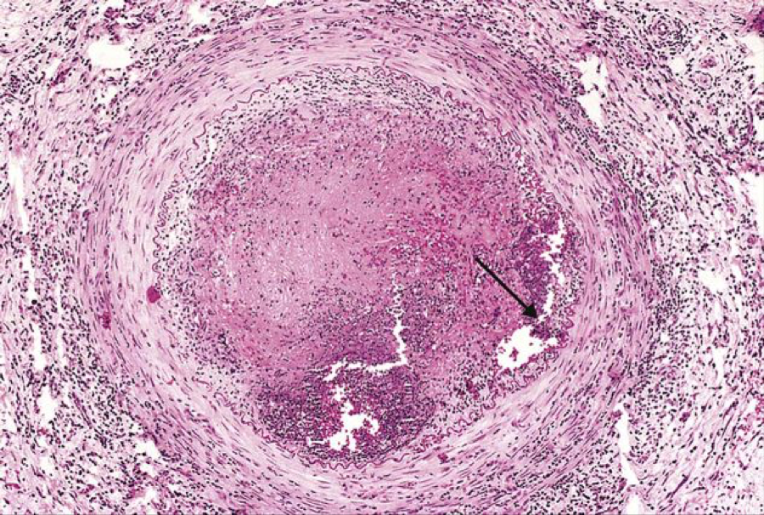
Active stage of Thromboangitis obliterans (Buerger’s disease)
Thromboangitis obliterans (Buerger disease). The lumen is occluded by a thrombus containing abscesses (arrow), and the vessel wall is infiltrated with leukocytes.
Pathology Dept, KSU
CVS- Block

Slide 32
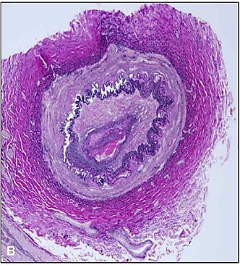
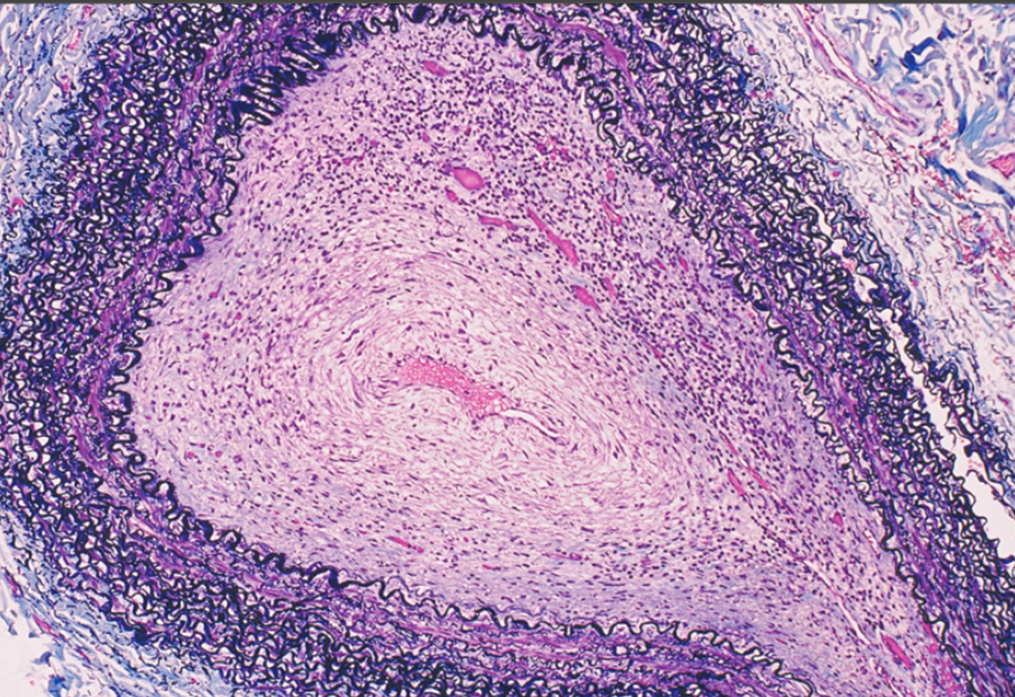
Chronic stage Thromboangitis obliterans (Buerger’s disease)
https://doi.org/10.1016/j.jvs.2005.03.016
Thromboangiitis obliterans (Buerger’s disease) is a non atherosclerotic, segmental, inflammatory, vaso-occlusive disease that affects the small- and medium-sized arteries and veins of the upper and lower extremities. Both pictures show cut-section of artery with near total occlusion of the lumen by a fibrotic thrombus. There are inflammatory cells in the fibrotic occlusive thrombus in the picture on the right (PAS stain & trichrome elastic stain).
Pathology Dept, KSU
CVS- Block

Slide 33
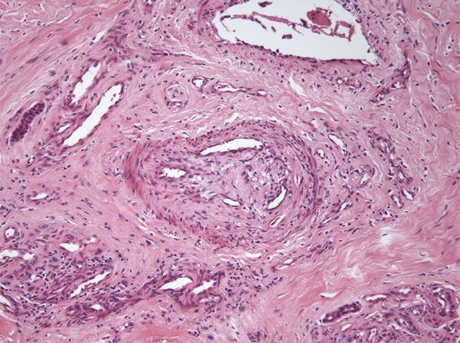
Chronic stage Thromboangitis obliterans (Buerger’s disease)
Blood vessel shows chronic stage of TAO with occlusive organized thrombi (arrow) with recanalization and fibrosis around the blood vessel.
Pathology Dept, KSU
CVS- Block

Slide 34
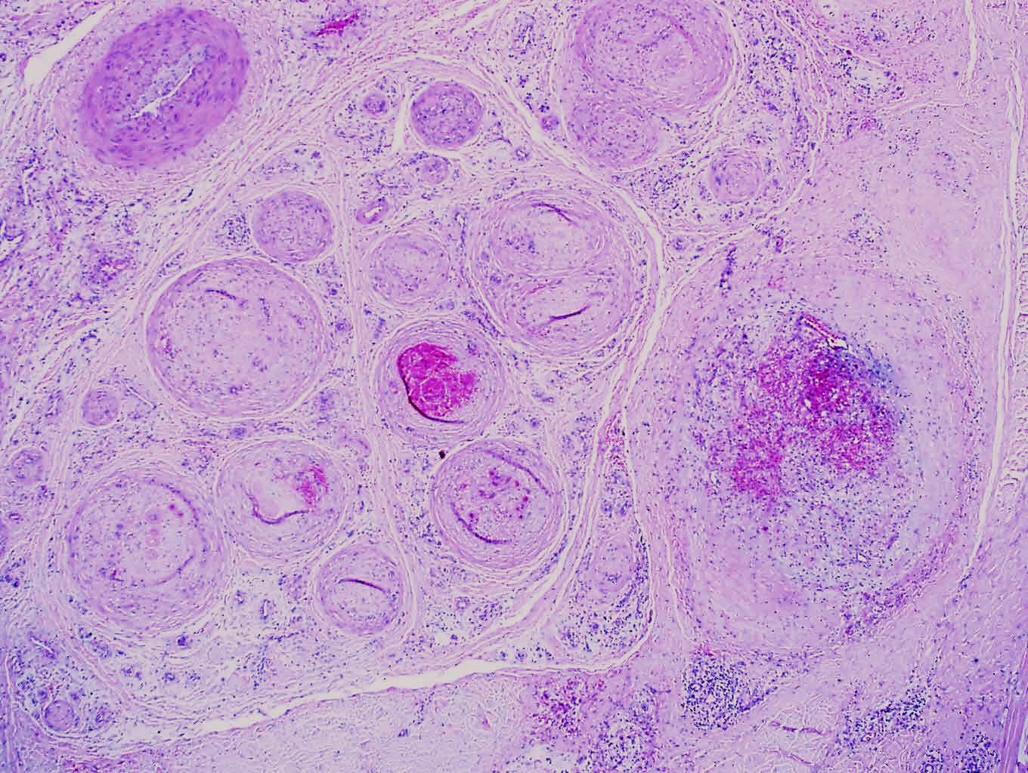
Thromboangitis obliterans (Buerger’s disease)
Several blood vessels showing occlusive organized thrombi (arrow). Some vessels show chronic inflammatory cell infiltration in their wall. There is fibrosis in the surrounding tissue.
Pathology Dept, KSU
CVS- Block

Slide 35
Giant cell (temporal) arteritis
Pathology Dept, KSU
CVS- Block

Slide 36
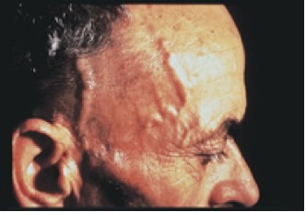
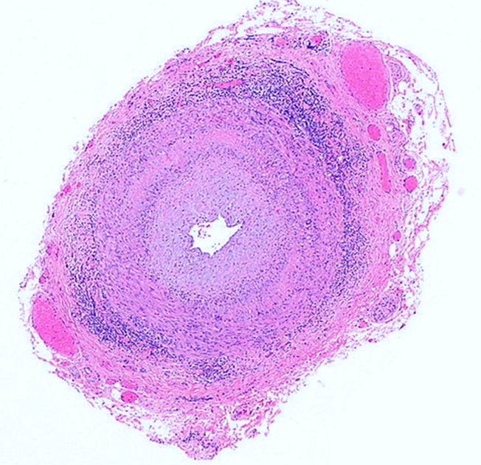
GIANT CELL / TEMPORAL ARTERITIS
A. Tender and thickened scalp veins
B. Cut section of temporal artery showing circumferential chronic lymphocytic inflammation/ arteritis
Pathology Dept, KSU
CVS- Block

Slide 37
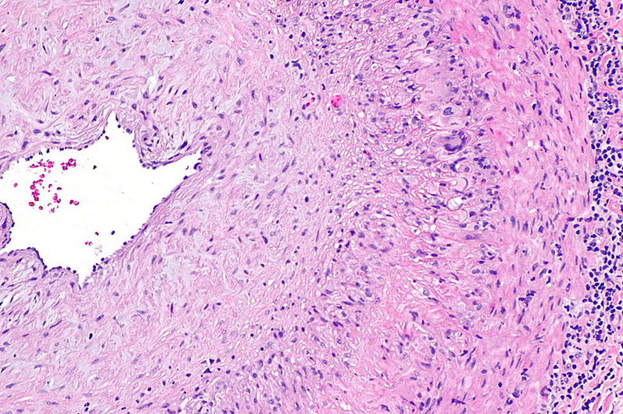
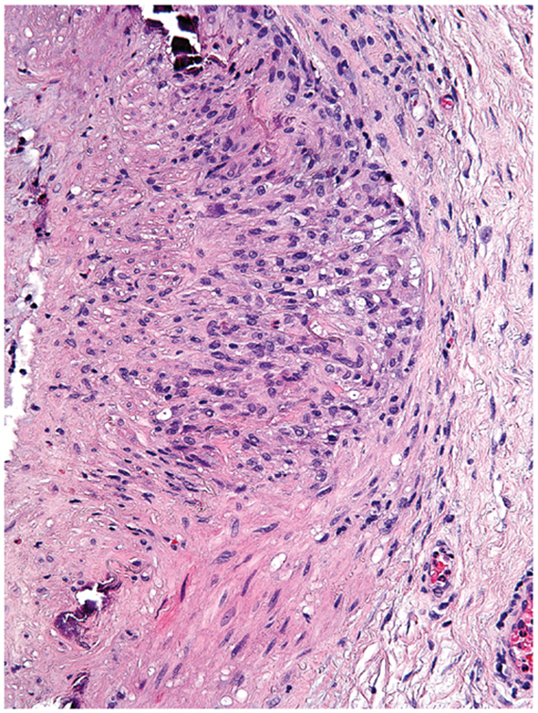
GIANT CELL (TEMPORAL) ARTERITIS - HPF
Temporal artery showing lymphocytic inflammation, granuloma (lightning arrow) and multinucleated giant cells (arrow). The lumen (star) of the artery shows narrowing because reactive intimal fibrosis.
Pathology Dept, KSU
CVS- Block

Slide 38
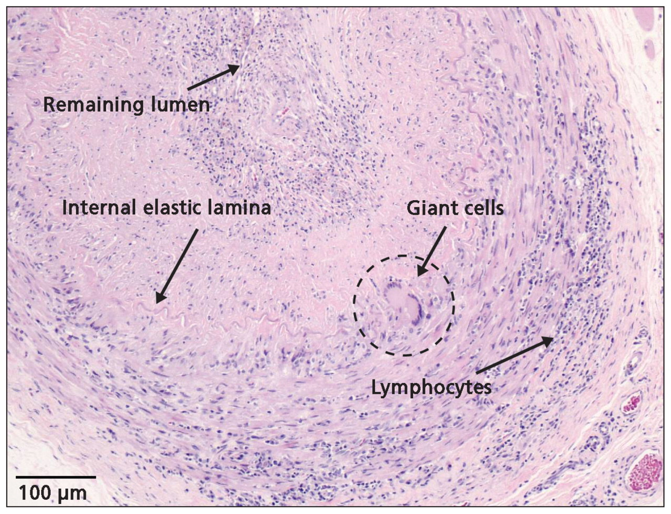
GIANT CELL (TEMPORAL) ARTERITIS
Jocelyn Zwicker et al. CMAJ 2011;183:E301-E305
Inflammation of temporal artery showing multinucleated giant cells, fragmentation of the internal elastic lamina and chronic lymphocytic infiltrate consistent with giant cell arteritis. The lumen of the artery is narrowed by intimal fibrosis.
Pathology Dept, KSU
CVS- Block

Slide 39
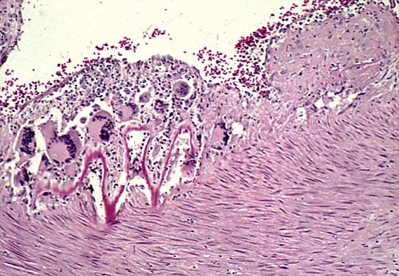
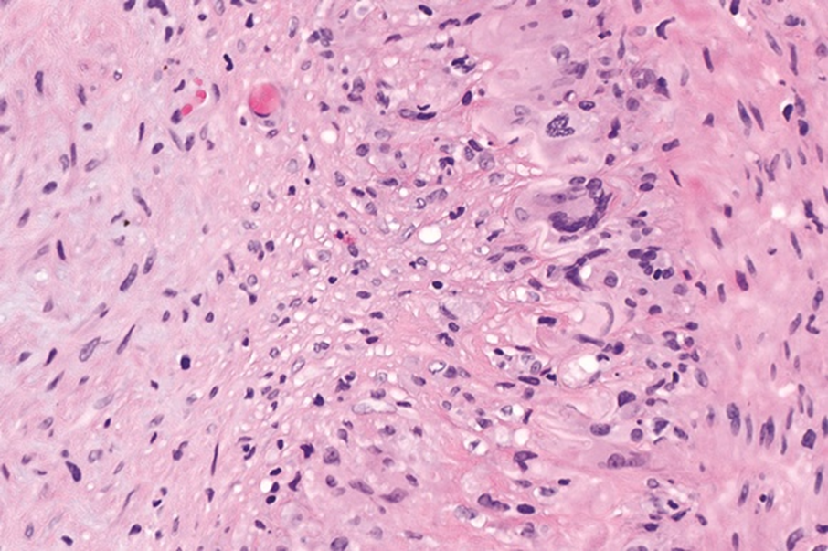
GIANT CELL (TEMPORAL) ARTERITIS - HPF
Disruptions of the elastic lamina with inflammation and giant cells.
Segmental inflammatory lesions with intimal thickening , medial granulomatous inflammation with giant cells (arrows) and chronic inflammatory cells and there is fragmentation of the(pink) internal elastic lamina (curved arrow)
Pathology Dept, KSU
CVS- Block
Notes:
.

Slide 40
Leukocytoclastic / hypersensitivity vasculitis ( microscopic polyangitis )
Pathology Dept, KSU
CVS- Block

Slide 41
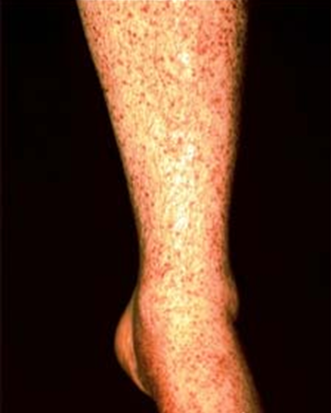
Hypersensitivity vasculitis – Clinical sign
Hypersensitivity vasculitis might be complicated with glomerulonephritis and hemoptysis due to pulmonary capillaritis
Pathology Dept, KSU
CVS- Block

Slide 42
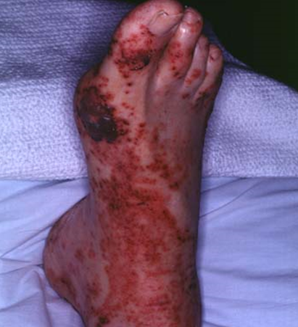
Leukocytoclastic vasculitis - Clinical sign
Leukocytoclastic vasculitis
The purpuric eruption (Subcutaneous bleeding patches) of the foot tends to be most pronounced on dependent areas.
Pathology Dept, KSU
CVS- Block

Slide 43
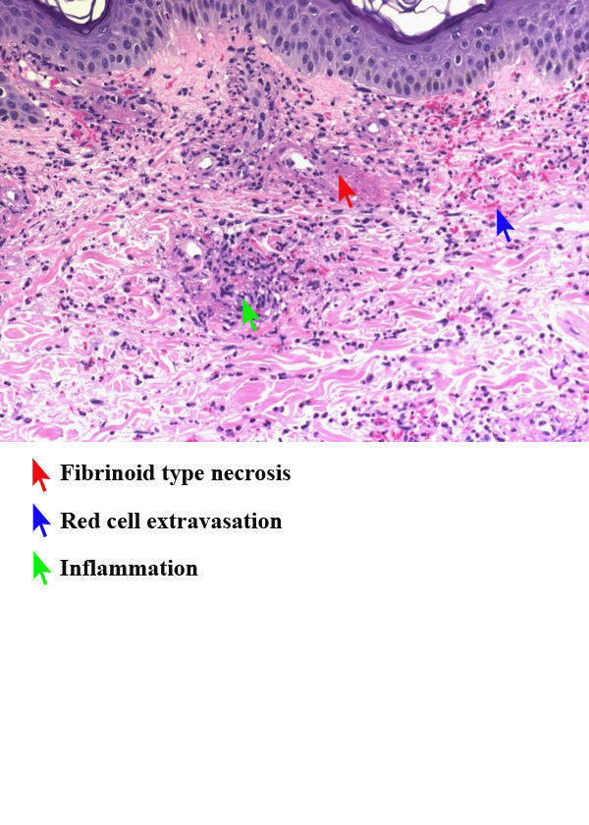
Leukocytoclastic vasculitis - HPF
Vasculitis, leukocytoclasis ( high power)
Section of the skin shows fibrinoid necrosis of blood vessels with extravasation of RBCs , neutrophilic infiltration with debris (leukocytoclasis /nuclear dust)
Pathology Dept, KSU
CVS- Block

Slide 44
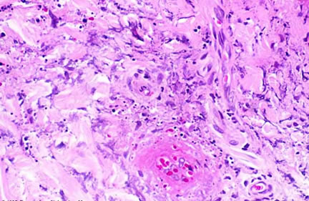
Leukocytoclastic vasculitis - HPF
Fibrinoid necrosis of small dermal vessels is present, necessary to establish the diagnosis of leukocytoclastic vasculitis.
Pathology Dept, KSU
CVS- Block

Slide 45
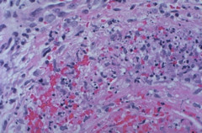
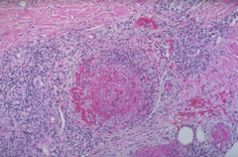
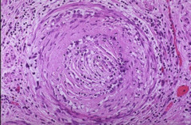
Severe vasculitis – Microscopic views
This muscular artery shows a more severe vasculitis with acute and chronic inflammatory cell infiltrates, along with necrosis of the vascular wall
Pathology Dept, KSU
CVS- Block

Slide 46
THE END

