Slide 1
THE ELECTROCARDIOGRAPHY
ECG
BY
Dr. Ola Mawlana

Slide 2
Objectives
To understand and record normal electrocardiogram

Slide 3
Definition
- ECG = electro + cardio + graphy.
- Is the process of recording the electrical activity of the heart over a period of time using electrodes placed over chest wall
- The algebraic sum of all the electrical potentials of the heart recorded from the body surface

Slide 4
Equipment
ECG recording machine (electrocardiograph).
ECG graph paper.
Disposable ECG electrodes.
Alcohol swabs and gauze.

Slide 5
ECG

Slide 6
Function of the ECG
Assessment of the electrical and muscular function of the heart
Detection of heart rate
Detection of heart rhythm
Detection of the heart’s orientation
Presence of ischemia or infarction in the heart along with its location and extent
Detection of electrolytes imbalance (hypocalcaemia and hypercalcemia)
Detection of drug toxicity

Slide 7
Before recording
- The subject should be supine and relaxed.
- The temperature of the room should be neutral.
- Sweating and muscle movements should be avoided so as to minimize artifacts.

Slide 8
Leads of ECG
- A lead is a pair of electrodes joined together to record the potential difference between the two electrodes.
- Each lead looks at heart from a different angle so as to locate an abnormality in the heart that can be detected by ECG.
- A bipolar lead records the potential difference between two active electrodes
- Unipolar lead records the potential of one active electrode as compared to the other inactive electrodes, as it provides resistance to the inactive electrodes making their potential zero.

Slide 9
- There are 12 standard leads to record ECG.
Out of 12 leads, 6 are limb leads and 6 are chest leads:
3 bipolar limb leads (Leads I, II and III)
3 Unipolar limb leads (aVR, aVL and aVF),
6 Unipolar chest leads

Slide 10
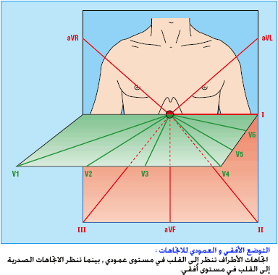
- Lead = view
- 12 views of the heart:
From the frontal plane:
- Limb leads.
- Augmented limb leads.
From the horizontal plane:
- Chest leads.

Slide 11
Types of leads | Limb Leads | Chest Leads
Bipolar | I, II, III Standard limb leads
Unipolar | aVR, aVL, aVF | V1- V6

Slide 12
Einthoven's triangle

Slide 13
Chest Leads

Slide 14
Chest Leads
V1 - placed in the 4th intercostal space, right of the sternum
V2 - placed in the 4th intercostal space, left of the sternum
V3 - placed between V2 and V4
V4 - placed in the 5th intercostal space and the mid-clavicular
line.
V5 - placed in the anterior axillary line horizontal to V4.
V6 - placed in the mid-axillary line horizontal to V5.

Slide 15
Procedure
Ask a student volunteer to lie on their back on the examination bed with arms by their side.
Expose the volunteer appropriately (exposing chest and ankles).
Make sure that the skin over the precordium is dry, hairless and oil-free to ensure that electrodes stick nicely on the skin. If not, the skin can be cleaned with an alcohol swab and dried using gauze.
Place 10 electrodes on the skin surface, and connect them correctly with the wires of the machine. When placing the electrodes avoid pressing hard on the center of the electrode to avoid gel from spilling to the edge reducing conductivity.
Ask the subject to relax and start recording the ECG.

Slide 16
ECG trace
An ECG trace will be recorded. Analyze the trace for the following parameters:
Calculate the heart rate of the subject.
Comment on the rhythm of the heart.
Name the waves and intervals and calculate their duration.
Calculate the cardiac axis.

Slide 17
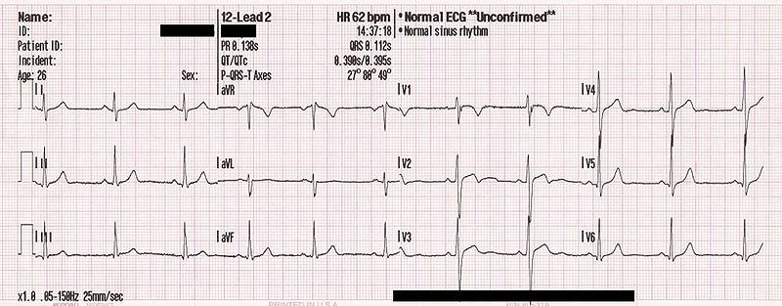

Slide 18
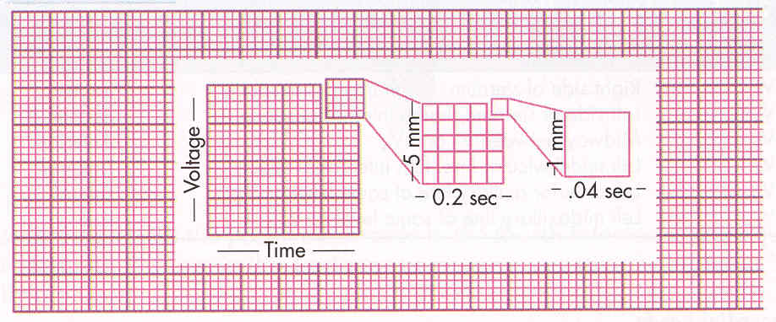
ECG Paper calibration
Calibration of 25 mm/sec

Slide 19
ECG paper calibration
The ECG is recorded on graph paper divided into large and small squares (boxes). Each small box is 1mm in length. Five small boxes make one large box. The horizontal axis denotes time (seconds) while the vertical axis denotes voltage (mv). The paper runs at a standard speed of 25mm/sec. This means that horizontally each small box=0.04 seconds while the large box=0.2 seconds. Vertically, 10mm=1mv.

Slide 20
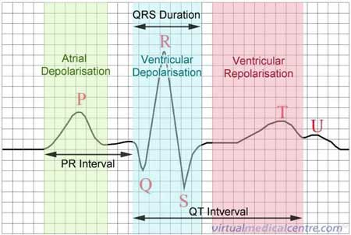
ECG Waves
ECG wave | Physiologic phenomenon
P wave | Atrial depolarization
QRS complex | Ventricular depolarization
T wave | Ventricular repolarization
U wave | Papillary muscle repolarization

Slide 21
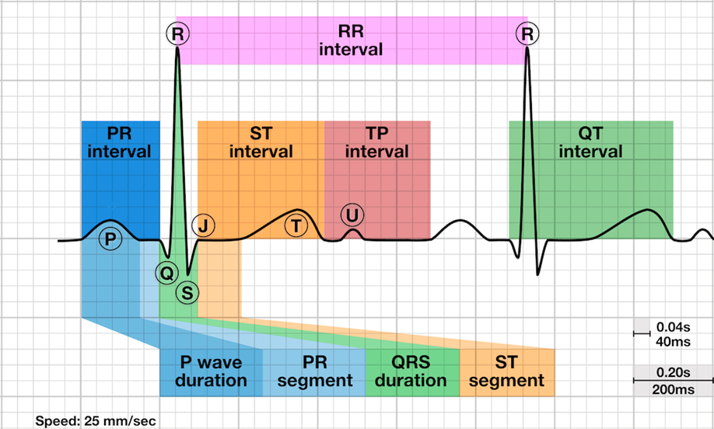
ECG waves and intervals

Slide 23
Interval | Measurement | Normal duration/characteristics | Abnormalities
PR interval | From beginning of P wave to beginning of Q (R) wave | 0.12-0.2 seconds (3-5 small squares) | Prolonged in 1st degree heart block, Digitalis toxicity
QRS complex | From beginning of Q wave to the end of the S wave | Not more than 0.12 seconds (3 small squares) | Prolonged QRS in cases of Rt & Lt BBB
QT interval | From beginning of Q wave to the end of T wave | 0.35-0.43 seconds (9-11 small squares) | Prolonged in cases of hypocalcaemia and Shortened in cases of hypercalcemia
ST interval | From end of S wave to the end of the T wave | 0.28-0.36 seconds (7-9 small squares)
ST segment | From the end of the S wave to the beginning of the T wave | Normally isoelectric | ST segment elevation or depression can be seen in myocardial damage (ischemia or infarction)

Slide 24
Determination of the heart rhythm
-The heart rhythm refers to the regularity with which the heart beats.
- Heart rhythm can be determined by observing the R-R intervals on the strip recording of the ECG.
- If the heart beats regularly(R-R interval have the same duration) the rhythm is said to be normal.
- If the heart beats irregularly (R-R interval have different duration) it is called arrhythmia.
Sinus Arrhythmia
Is a physiological arrhythmia as the heart beats faster during inspiration and slower during expiration, due to the different firing rate of SA node during inspiration and expiration.

Slide 25
Heart rate calculation Regular heart rate
$Heart Rate= \frac{\text{1500}}{\text{Number} \text{of} \text{small} \text{squares} \text{between} \text{R}\text{ − }\text{R}}$
Or = $\frac{\text{3}\text{00}}{\text{Number} \text{of} \text{large} \text{squares} \text{between} \text{R}\text{ − }\text{R}}$
- The normal range of heart rate is between 60 – 100 beats/min.
- Tachycardia : heart rate > 100 beats / min
- Bradycardia : heart rate < 60 beats / min

Slide 26
Regular heart rate

Slide 27
The rule of 1500
No of boxes | Rate
1 | 300
2 | 150
3 | 100
4 | 75
5 | 60

Slide 28
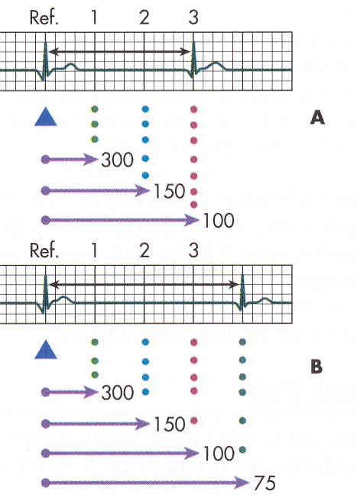
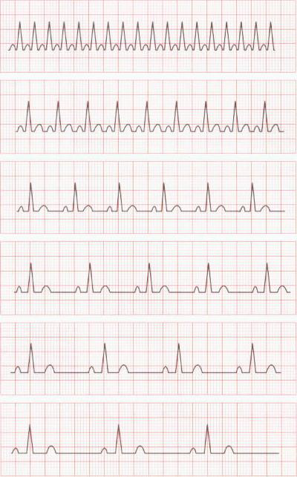

Slide 29
Irregular heart rhythm
In case of Irregular heart rhythm , heart rate can be calculated by first, counting the number of QRS complexes in 30 large squares (which equals the number of QRS complexes in 6 seconds). Then multiply the number of QRS complexes counted in 6 seconds by 10 to get the number of QRS complexes in one minute.

Slide 30
Cardiac axis
Definition:
It is the average direction of the current flow in the heart during a cardiac cycle.
It is expressed as an angle and is measured in degrees.
The depolarization wave normally spreads through the ventricles in a direction from base of the heart to its apex. If limb leads are superimposed on each other, lead one will be looking at the heart from the left at an angle of 0⁰. This horizontal line is considered the reference or zero point. Any deviation below that line is expressed as a positive number whereas deviations above the line are expressed as negative numbers. As such, lead II is considered to be looking at the heart at an angle of +60⁰ while lead III looks at the heart at +120⁰.

Slide 31
Cardiac axis

Slide 32
Cardiac axis
The normal cardiac axis:
- lies between -30º to 90º.
left axis deviation (LAD):
- Deviation of the cardiac axis to the left (between -30º to -90º) in obese people, at the end of deep expiration and due to some pathological conditions (LBBB)
Right axis deviation (RAD):
- Deviation of the cardiac axis to the right (90º to 180º) at the end of deep inspiration ,in tall people and due to some pathological conditions (RBBB, right ventricular hypertrophy)
Extreme or right /left axis deviation:
- Beyond the above values

Slide 33
Cardiac axis

Slide 34
Determination of the cardiac axis Accurate method
Use two limb leads, namely leads I and III. Looking at the QRS complexes in these leads, calculate the overall size and polarity of the QRS complex in each by subtracting the depth of S wave from the height of the R wave. Construct a vector diagram and draw arrows that represent the sum of size and polarity for each lead on the diagram. The cardiac axis lies between the two arrows. Drop a perpendicular line from the tip of each arrow. The point at which the two perpendicular lines meet, constitute the tip of the cardiac axis. Draw a line from that point to zero point and this will be the cardiac axis.
N.B. the height of the R wave and the depth of the S wave are both measured starting from the isoelectric line.

Slide 36
Quick & easy method (Rule of thumb)
Is by applying the “rule of thumb” on the direction of QRS complex in leads I and III/aVF of the ECG
If the QRS complex is predominantly positive in both leads I and III, then the cardiac axis is normal.
If the QRS complex is predominantly positive in lead I and predominantly negative in lead III, this means left axis deviation.
If the QRS complex is predominantly negative in lead I and predominantly positive in lead III, this means right axis deviation.
If the QRS complex is predominantly negative in both leads I and III, this is extreme axis deviation.

Slide 37
Rule of thumb

Slide 38
THANK YOU

