Slide 1
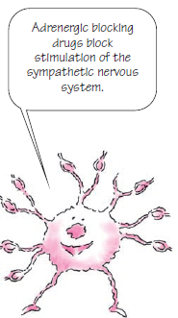
Sympatholytic Drugs
Adrenergic neuron blockers
Adrenergic
receptor
blockers

Slide 2
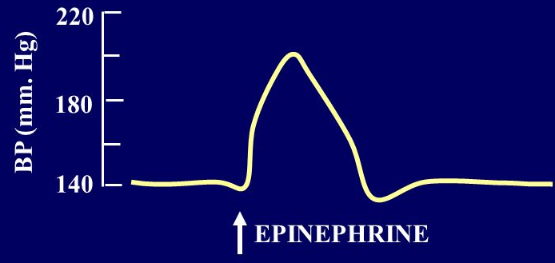
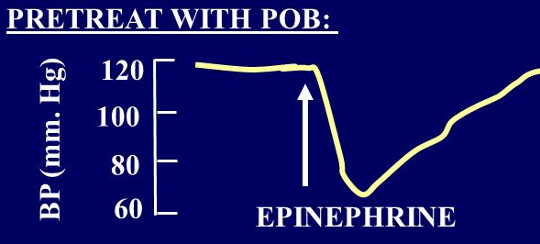
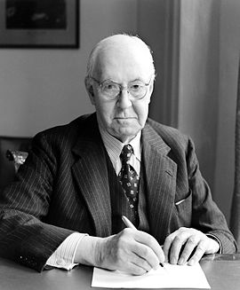
Adrenaline reversal
Sir Henry Dale, awarded the Nobel prize in 1936

Slide 3
ILOS
Outline the mechanisms of action of adrenergic neuron blockers
Classify α-receptor blockers into selective & non- selective
Study in detail the pharmacokinetic aspects & pharmacodynamic effects of α adrenergic blockers

Slide 4
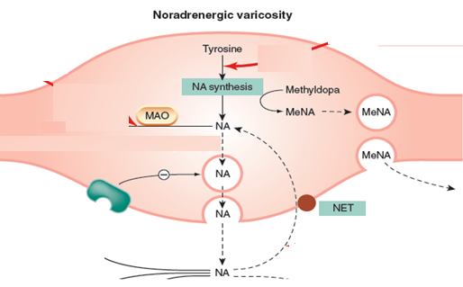
mechanisms of Adrenergic blockers
1-Formation of False Transmitters
α-Methyl dopa

Slide 5
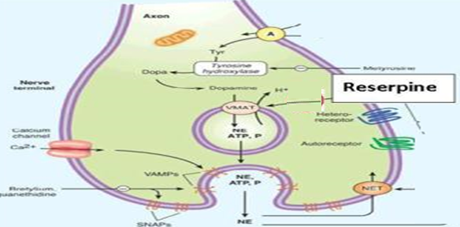
mechanisms of Adrenergic blockers
2-Depletion of Storage sites
Reserpine

Slide 6
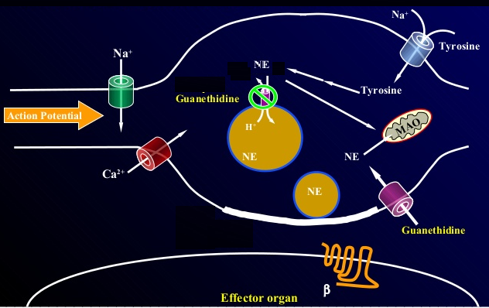
mechanisms of Adrenergic blockers
3-Inhibition of release
Guanethidine

Slide 7
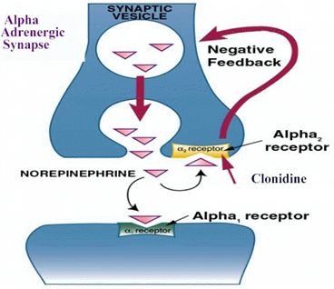
mechanisms of Adrenergic blockers
4-Stimulation of presynaptic α₂ receptors
Clonidine and α-Methyldopa

Slide 8
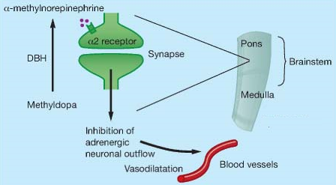
α-Methyldopa
Forms false transmitter that is released instead of NE
Acts centrally as α₂ receptor agonist to inhibit NE release
Drug of choice in the treatment of hypertension in pregnancy (pre-eclampsia - gestational hypertension)

Slide 9
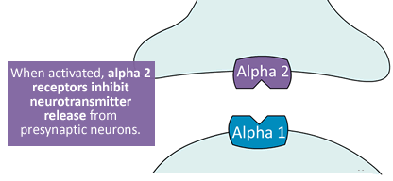
Clonidine
Apraclonidine is used in open angle glaucoma as eye drops.
acts by decreasing aqueous humor formation
Acts directly as α₂ receptor agonist to inhibit NE release
Suppresses sympathetic outflow activity from the brain
Little Used as Antihypertensive agent due to rebound hypertension upon abrupt withdrawal

Slide 10
Adrenergic neuron blockers
False neurotransmitter formation
α-Methyldopa
Depletion of stores
Reserpine
Inhibition of release
Guanethidine
Stimulation of presynaptic α-receptors
Clonidine
α-Methyldopa
Synopsis

Slide 11
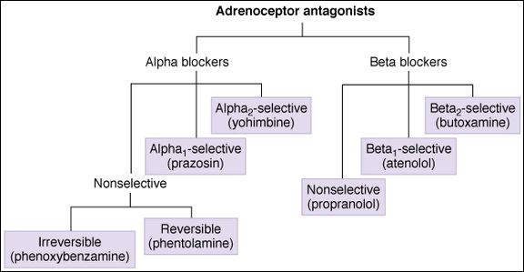

Slide 12
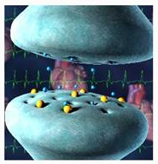
Adrenergic receptor blockers
They block sympathetic actions by antagonizing:-
α-receptor
β-receptor

Slide 13
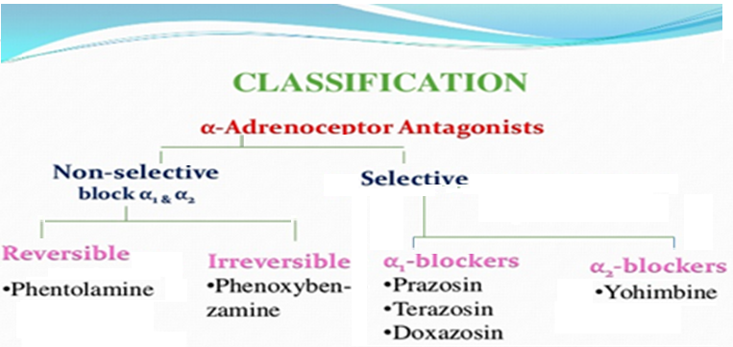
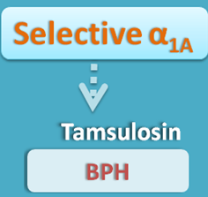

Slide 14
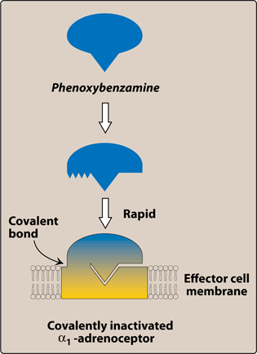
Non-Selective α- Adrenoceptor Antagonists
Phenoxybenzamine:
Irreversible blocks
both α₁ and α₂ receptors
Long-acting (24 hrs).

Slide 15
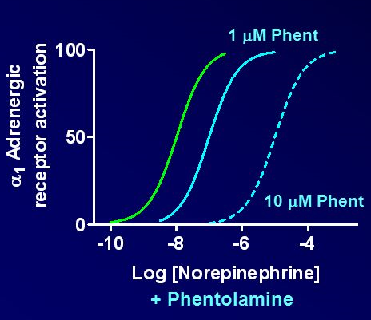
Non-Selective α- Adrenoceptor Antagonists
Phentolamine
Reversible blocking of
α1 & α2 receptors
Short acting (4 hrs)

Slide 16
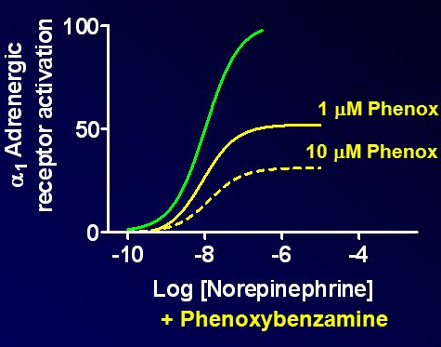
Both drugs cause:
Postural hypotension
Decrease peripheral
vascular resistance
Increase cardiac output (α2 block)

Slide 17
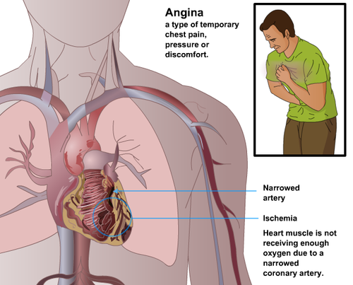
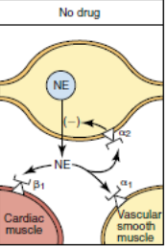
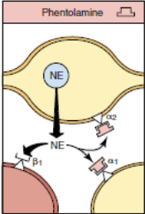
Both drugs can precipitate arrhythmias and angina and are contra-indicated in patients with decreased coronary perfusion
Reflex tachycardia

Slide 18
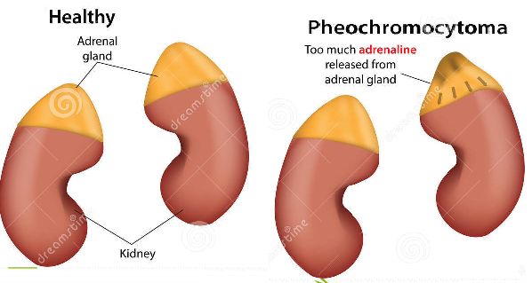
Therapeutic Uses:
Pheochromocytoma: Before surgical removal to protect against hypertensive crisis

Slide 19
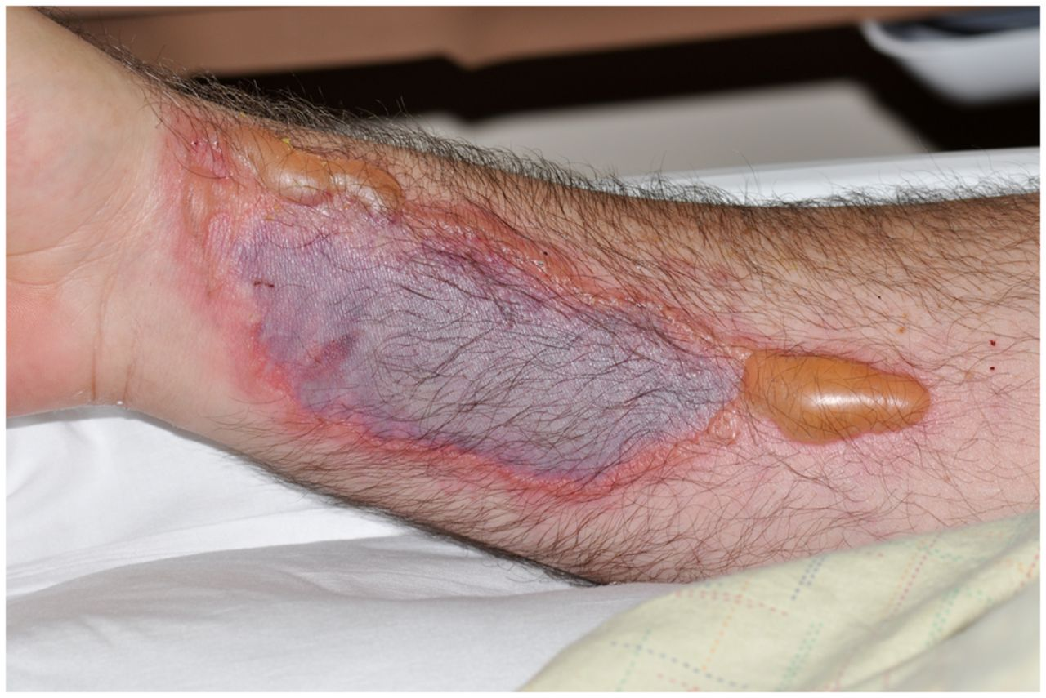
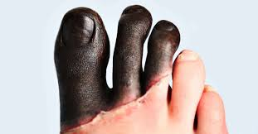
Phentolamine
Dermal necrosis following extravasation of NA
Reversal of local anasthesia
Hypertensive crisis following abrupt withdrawal of clonidine or ingestion of tyramine in patients on MAO inhibitors
Phenoxybenzamine:
Raynaud disease & frostbite

Slide 20
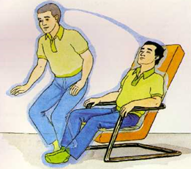
ADRS
Postural hypotension
Nasal stuffiness or congestion
Vertigo & drowsiness

Slide 21
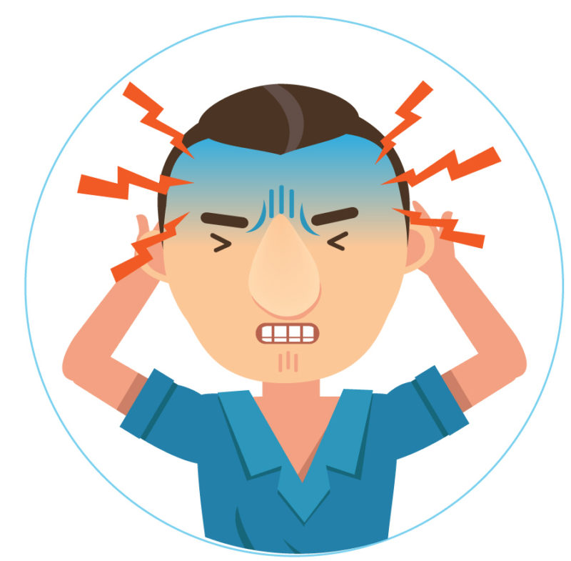
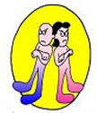
ADRS
Tachycardia
Headache
Male sexual dysfunction (inhibits ejaculation)

Slide 22
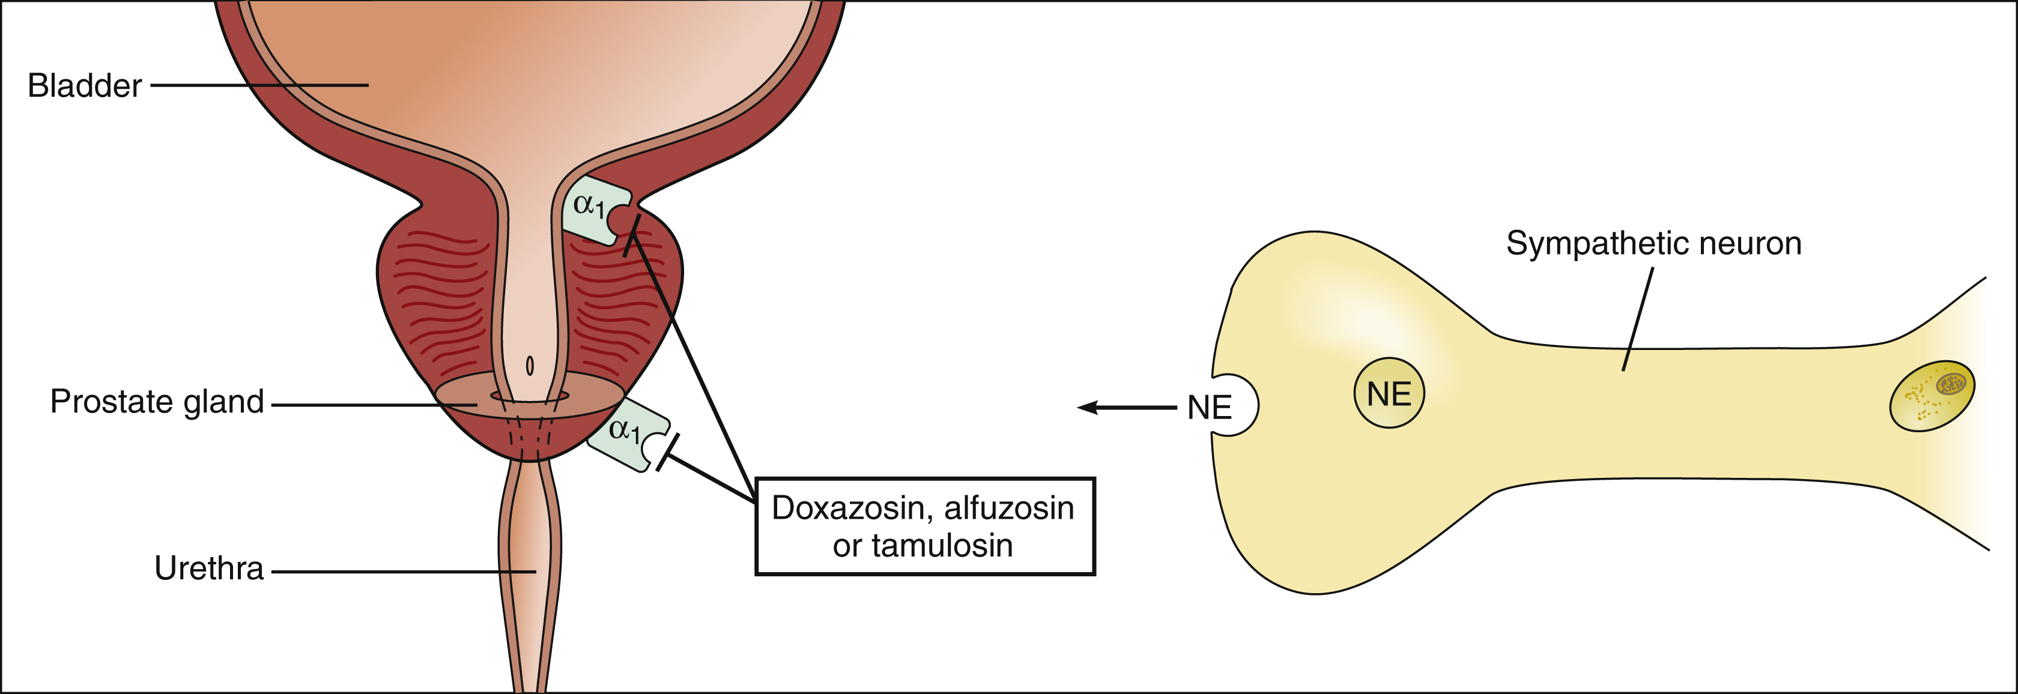
Selective α₁- Antagonists
Prazosin & doxazosin
Prazosin (short half-life)
Doxazosin, terazosin (long half life )

Slide 23
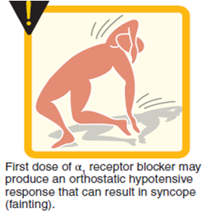
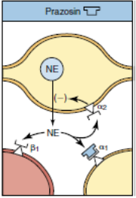
Selective α₁- Antagonists
α₁–antagonists cause:-
Vasodilatation due to relaxation of arterial and venous smooth muscles
Fall in arterial pressure with less tachycardia than with non-selective α blockers

Slide 24
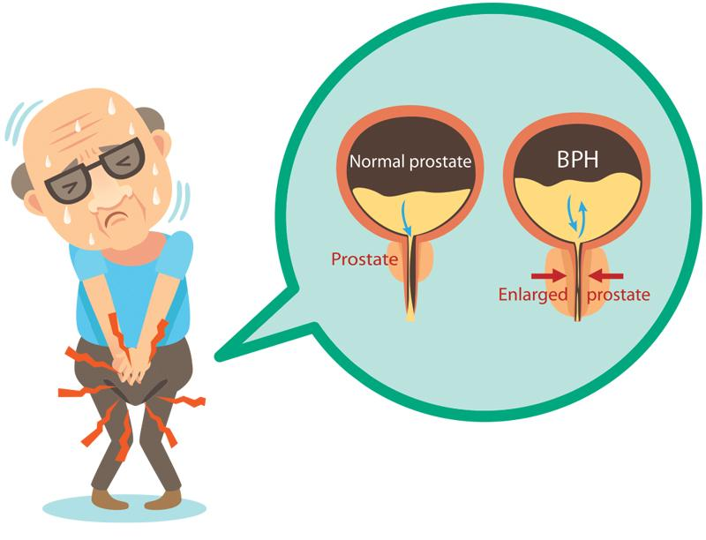
Therapeutic Uses:
Benign
Prostatic
hyperplasia

Slide 25
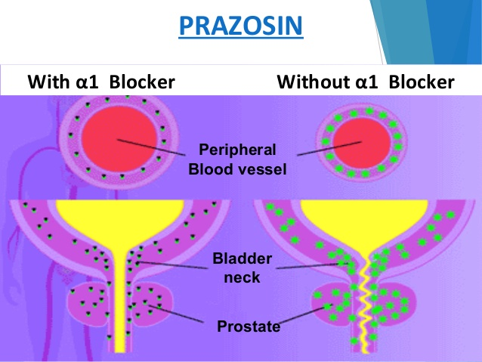
Therapeutic Uses:
Treatment of hypertension with prostate enlargement

Slide 26
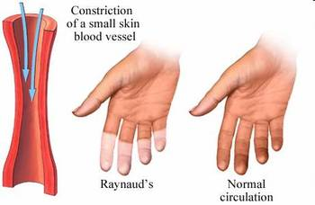
Therapeutic Uses:
Reynaud's disease (vasospasm)
(Reynaud's disease causes some areas of the body such as fingers and toes to feel numb and cold in response to cold temperatures or stress)

Slide 27
Selective α1A–antagonist
Tamsulosin (Uroselective)
α1A receptors present in prostate
Tamsulosin is used in treatment of benign prostatic hypertrophy (BPH)
BPH

Slide 28
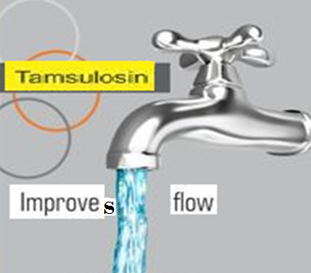
Selective α1A–antagonist
Tamsulosin (Uroselective)
Tamsulosin produces: relaxation of smooth muscles of bladder neck & prostate →improves urine flow
Has minimal effect on blood pressure

Slide 29
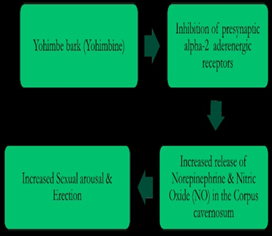
α₂-selective antagonists
Yohimbine
Used as aphrodisiac in the treatment of erectile dysfunction
Increase nitric oxide release in the corpus cavernosum thus producing vasodilator action and contributing to the erectile process

