Slide 1
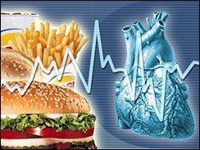
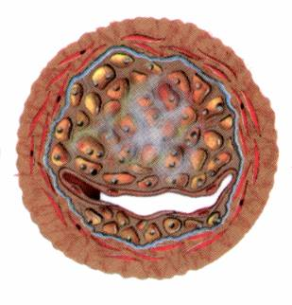
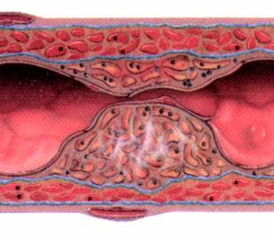
Drugs for hyperlipidemia

Slide 2
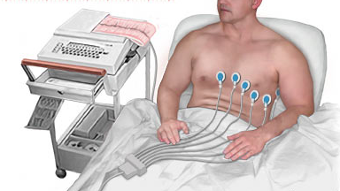
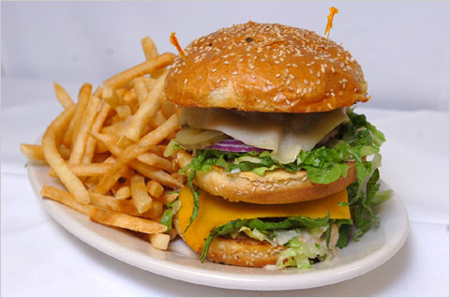
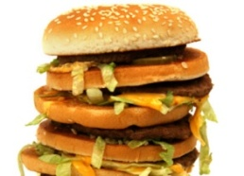
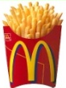
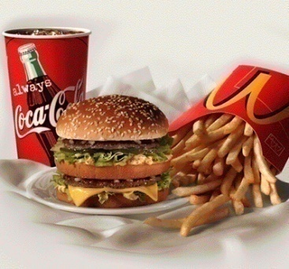
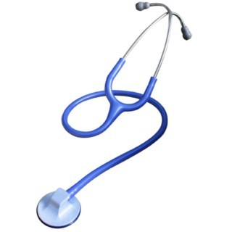
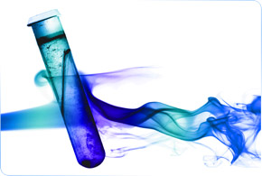
?
?
AMI
HEART ATTACK

Slide 3
ILOs
By the end of those 2 lectures the student will be able to:
Define hyperlipidemia vs normal lipid levels
Discuss the non-pharmacological treatment of hyperlipidemia
Classify lipid lowering agents targeting exogenous & endogenous pathways
Expand on the pharmacology of drugs related to each group
Hint on adjuvant drugs that can help in lipid lowering

Slide 4
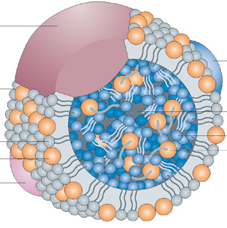
Hyperlipidemia
Hyperlipidemia is a major cause of atherosclerosis which may lead to CAD and ischemic cerebrovascular disease
Denotes abnormally  levels of any or all Lipids and/or Lipoproteins [LP] in blood
Lipids originate from two sources:
endogenous lipids, synthesized in the liver
exogenous lipids, ingested and processed
in the intestine
The principle lipids in the blood are:
- Cholesterol (C) - Triglycerides (TG)
- Phospholipids (PL) - Cholesterol esters (CE)
- Non-estrified fatty acids (NEFA)

Slide 5
Familial Hyperlipoproteinemia
LProteinemia | LP | Lipids | Risk
Type I | CM | TGs | -
Type IIa | LDL | C | 
Type IIb | VLDL & LDL | TG & C | 
Type III | IDL | TGs & C | 
Type IV | VLDL | TGs | 
Type V | VLDL & CM | TGs & C | _

Slide 6
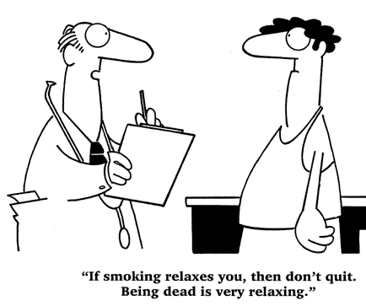
Therapeutic strategies for treatment of hyperlipidemia
Therapeutic lifestyle changes
Antihyperlipidemic agents
1. Healthy diet; optimal Quantitative & Qualitative fat content:
Diet has <30% of calories as fat, <7% as saturated fat and <200mg cholesterol/day
Avoid trans-fatty acids & acute increase in C intake
Use vegetable oils rich in unsaturated fatty acids: oleic acid,
linoleic acid & linolenic acids. Diet should also contain plant
stanols (interfere with the formation of micellar cholesterol)
& soluble fibers
Eat food high in antioxidants vitamins
2. Regular exercise
3. Cessation of hazardous habits; smoking, alcohol, …etc
4. Losing weight
Can achieve a fall in LDL-C of 8-15% … but long-term compliance is a problem

Slide 7
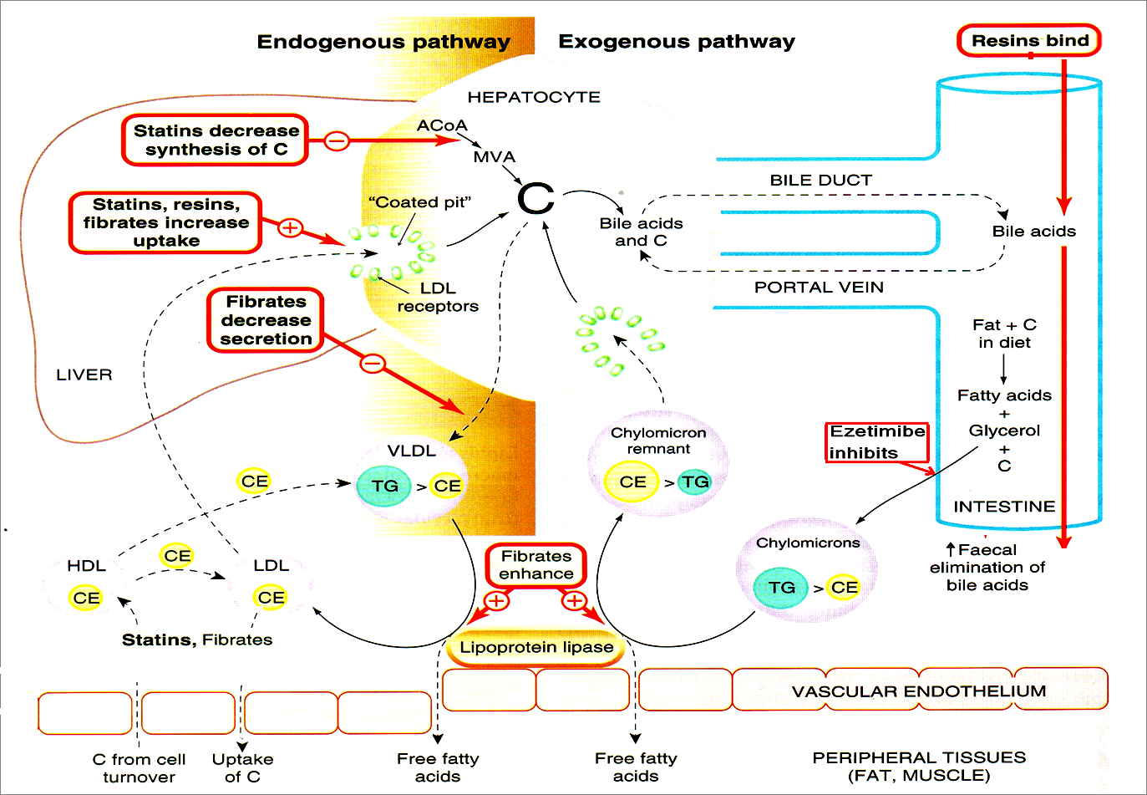
TARGETING ENDOGENOUS PATHWAYS
TARGETING EXOGENOUS PATHWAYS
Improve endothelial function

Slide 8
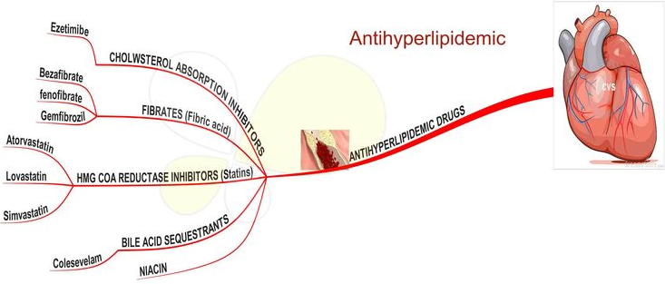
Antihyperlipidemic agents
A-According to the mechanism of action:
1- Inhibits cholesterol absorption in the intestine
Ezetimibe
2-Sequester bile acids in the intestine
Exchange resins
3-Inhibits synthesis of cholesterol
Inhibitors of hydroxymethylglutaryl coenzyme
A reductase (Statins)
4-Alter relative levels & patterns of different
plasma LPs
Fibrates, Nicotinic acids

Slide 9
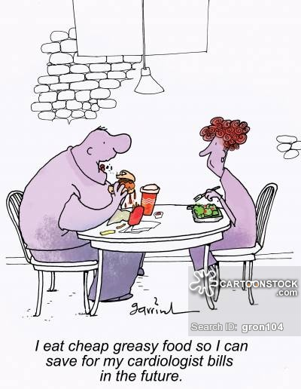
B-According to site of action
I-Agents targeting exogenous cholesterol
Ezetimibe
Colestipol & cholestyramine
II-Agents targeting endogenous cholesterol
Statins
Fibrates
Nicotinic acid
III-Adjuvant agents
Omega-3-Fatty Acids, Stanols

Slide 10
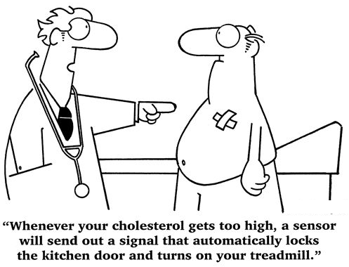
Cholesterol Absorption Inhibitors
Ezetimibe
Notes:
Bile Acid Sequestrants

Slide 11
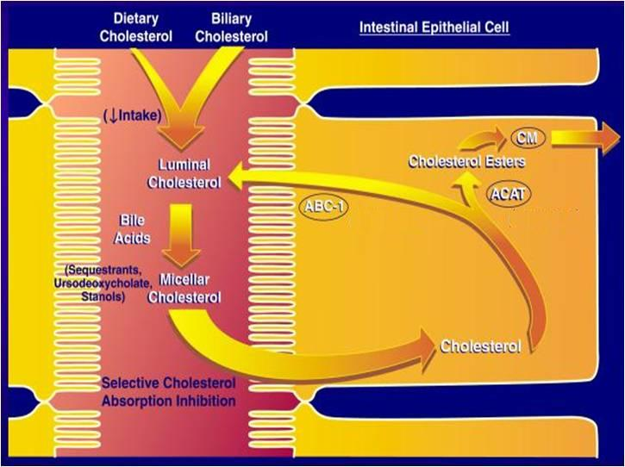
Mechanism of action of Ezetimibe
Blocks C transporter located on brush border of small intestine  pool of C available to the liver  upregulate LDL receptor, trapping more LDL particles from blood.
Pharmacological action
LDL 20%  TG 8% ,  HDL 1-4%
No effect on steroids, lipid-soluble vitamins,
bile acids.
Pharmacokinetics
Absorbed & conjugated in intestine to
active glucuronide
Reaches peak blood level in 12–14 hours
Undergoes enterohepatic circulation
Its half-life is 22 hours
Most of the drug is excreted in feces
NPC1L1

Slide 12
Indications
As Monotherapy;
Primary prevention of low risk of CHD which needs modestLDL
As Combination Therapy; safe
-With statins; synergistic in
moderate/severe  LDL
-Or If must  statin dose because of side effects
-Or with other lipid lowering drugs; as fibrates
ADRs
Not common
GIT disturbance, headache, fatigue, artheralgia & myalgia
Ezatimibe

Slide 13
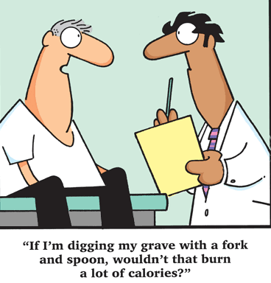
Exchange resins Bile acid sequestrants
Cholestyramine
& Colestipol
Colesevelam

Slide 14
Resins: Mechanism of Action

Slide 15
Bile Acid-Binding Resins
Moderately effective with excellent safety record
Large MW polymers which bind to bile acids and the acid-resin complex is excreted so their fecal excretion  10 folds
prevents enterohepatic cycling of bile acids
obligates the liver to synthesize replacement bile acids from cholesterol
The liver increases the number of LDL receptors to obtain more cholesterol
The levels of LDL-C in the serum are reduced as more cholesterol is delivered to the liver
Excellent choice for people that cannot tolerate other types of drugs

Slide 16
Resins : Adverse Effects
Resins are clinically safe as they are not systemically absorbed
GIT upset: abdominal discomfort, bloating, constipation
Decreased absorption of: fat soluble vitamins (Vitamin A, D, K)
The concentration of HDL-C is unchanged

Slide 17
Resins: Drugs interactions
Interfere with the absorption of:
Statins, Ezetimibe
Chlorothiazides, Digoxin, Warfarin
N.B. wait 1 hour before or 4 hrs after administration of resins
Colesevelam has not been shown to interfere with the absorption of co-administered medications and is a better choice for patients on multiple drug regimens

Slide 18
Contraindications of resins
1- Complete biliary obstruction ( because bile is not secreted into the intestine)
2- Chronic constipation
3-Severe hypertriglyceridemia (TG >400 mg/dL) ??

Slide 19
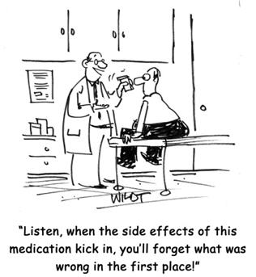
HMG-Co A Reductase Inhibitors
Statins
Notes:
Bile Acid Sequestrants

Slide 20
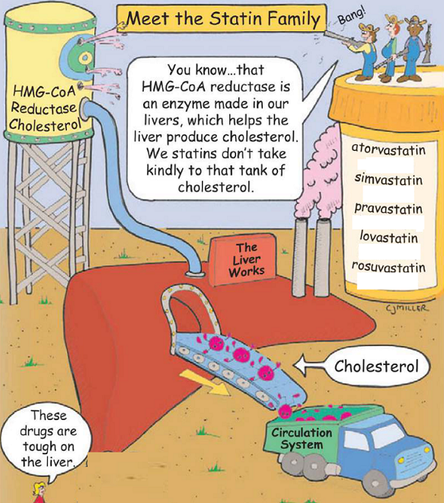
HMG-Co A Reductase Inhibitors
Hydroxy MethylGlutaryl-Coenzyme A reductase inhibitors or statins are the most effective and best-tolerated agents for treating hyperlipidemia
Statins are considered as first-line drugs when LDL-lowering drugs are indicated

Slide 21
Statins: Mechanism of Action
Statins are potent competitive inhibitors of 3-hydroxy-3-methyl glutaryl coenzyme A (HMG-CoA) reductase, which catalyzes an early, rate-limiting step in do-novo hepatic C synthesis. Thus, HMG-Co A is not converted to mevalonic acid

Slide 22
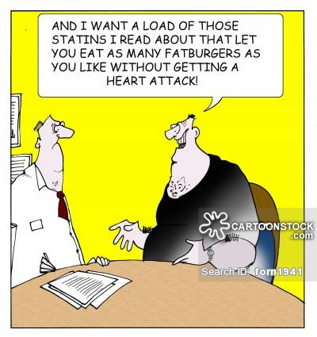
Statins: Preparations
Rosuvastatin
Atorvastatin
Simvastatin
Pravastatin
Lovastatin
Used alone or with other anti-hyperlipidemic drugs ( ezetimibe ) for treatment of drug-resistant dyslipidaemia

Slide 23
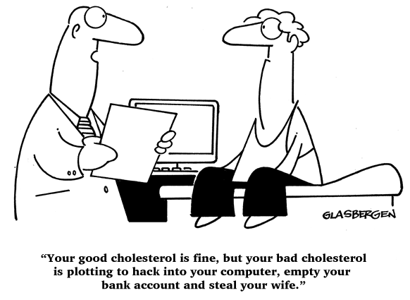
PLEIOTROPIC ANTIATHEROGENIC effects [> in Vessels]
Improve endothelial function
vascular inflammation
Stabilization of atherosclerotic
Plaque
platelet aggregability
Antithrombotic actions
Enhanced fibrinolysis …etc

Slide 24
Statins: Pharmacokinetics
Most statins have a high first-pass clearance by the liver
Greater than 95% of most of these drugs are bound to plasma proteins with short half-life
Drug-drug interactions involve specific interactions with the cytochrome P-450 drug metabolizing system, especially CYP3A4
All statins are taken orally at bedtime because of hepatic C synthesis is maximal between midnight and 2:00 a.m. , except atorvastatin taken at any time because of its long half-life (14 hours)

Slide 25
Indications
As monotherapy;
2nd ry Prevention; In all ischemic insults [stroke, AMI, …..etc.] So given from1st day of ischemic attack
Pry Prevention;
1. Patients with hyperlipidemia and with other risks for ischemic insults.
2. Type IIa Hyperlipoprotinemia.
If no control  combine (sequestrants / ezatimibe, niacin,.. ) to  C
As Combination therapy;
1. Mixed dyslipidaemias; added to fibrates or niacin if necessary
2. In diabetics and patients with insulin resistance [metabolic syndrome] because these patients will possess small dense LDL (severely atherogenic) + evident endothelial dysfunction + increased thrombotic profile

Slide 26
Statins: Adverse Effects
Common side effects: Headache , myalgia, fatigue, GI intolerance, and flu-like symptoms
Hepatotoxicity, raised concentrations of liver enzymes (serum aminotransferases)
Myopathy (increased creatine kinase [CK] released from muscles)
Teratogenicity, statins should be avoided during pregnancy

Slide 27
Statins: Drug Interactions
Statins potentiate the action of oral anticoagulant and anti-diabetic drugs (by displacement from plasma protein binding sites)
Drugs that increase the risk of statin-induced myopathy include:
Other antihyperlipidemics ( fibrates )
Drugs metabolized by 3A4 isoform of cytochrome P450: erythromycin, verapamil, cyclosporin, ketoconazole
Pravastatin and fluvastatin are the statins of choice in patients taking other drugs metabolized by cytochrome 3A4 system.

Slide 28
Statin-induced myopathy
Muscle aches, soreness, or weakness associated with an elevation of creatine kinase (CK) , are the best indicator of statin-induced myopathy.
Failure to recognize myopathy and to discontinue drug therapy can lead to rhabdomyolysis, myoglobinuria, and acute renal necrosis.
serum transaminase  can progress to evident hepatotoxicity
So lab investigations recommended every 6 month  if levels  up
to 3 folds at any time, statin must be stopped then dose adjusted.
 creatine kinase activity (index of muscle injury) 
Measured only if myalgia or myositis develops  if  3-5 folds  we
◉ statin doses / omit combination with fibrates…..

Slide 29
Niacin (Nicotinic Acid)

Slide 30
Niacin (Nicotinic Acid)
Water soluble B-complex vitamin with multiple actions
Niacin is the most effective medication for increasing HDL cholesterol levels and it has positive effects on the complete lipid profile
It is useful for patients with mixed dyslipidemias
Niacin exerts greatest beneficial effects on wide range of lipoprotein abnormalities

Slide 31
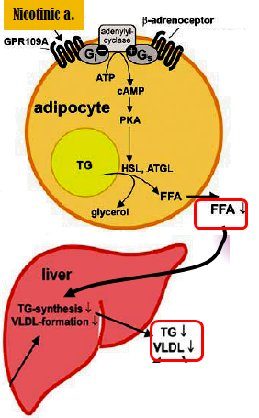
Mechanism of action:
In adipose tissue: it binds to adipocytes nicotinic acid receptors, this will lead to decrease in free fatty acids mobilization from adipocytes to the liver resulting in ↓ TG and thus VLDL synthesis
In liver: niacin inhibits hepatocyte
2-diacylglycerol acyltransferase, a key enzyme for TG synthesis
Thus, it decreases VLDL production (decreased TG synthesis and estrification)
3. In plasma: it increases LPL activity that increases clearance of VLDL & chylomicron

Slide 32
Pharmacological actions
Effect on VLDL:  VLDL by:
1)  synthesis in liver
2) increased clearance in plasma
3)  mobilization of free fatty acids from adipose tissue
Effect on LDL:  LDL due to reduction in its precursor (VLDL)
Effect on HDL: Induces remarkable increase in HDL-C (The catabolism of HDL can be inhibited by nicotinic acid through a mechanism that is largely unknown)
Niacin also promotes hepatic apoA-I production and slows hepatic clearance of apoA-I and HDL

Slide 33
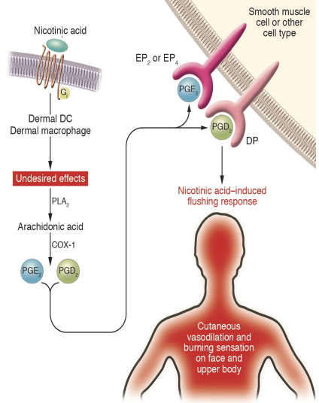
Niacin : Adverse Effects
The most common side effect is cutaneous flushing, (which is prostaglandin -mediated , can be avoided by low dose aspirin ½ h before niacin)
GIT disturbances: Dyspepsia , nausea , vomiting , reactivation of peptic ulcer ( can be decreased if taken after meal)
High doses:
Reversible  liver enzymes hepatotoxicity.
Impairment of glucose tolerance  overt diabetes
 uric acid

Slide 34
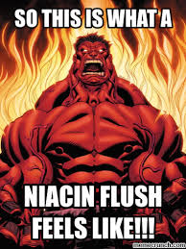
Indications
Monotherapy or in combination with fibrate, resin or statin
Type IIa hypercholestrolemia
Type IIa, IIb hypercholesterolemia & any combined hyperlipidemia
Patient with hypertriglyceridemia & low HDL-C
Contraindications
Gout
Peptic ulcer
Hepatotoxicity
Diabetes mellitus

Slide 35
Fibric acid Derivatives (Fibrates)

Slide 36
Fibrates :Mechanism of Action
Fibrates are agonists of peroxisome proliferator activated receptors (PPARα) which are a class of intracellular receptors that modulate fat metabolism
They increase genes transcription for lipoprotein lipase (LPL) leading to increased catabolism of TG in VLDL and chylomicrons
Examples: Clofibrate & Gemfibrozil & Fenofibrate

Slide 37
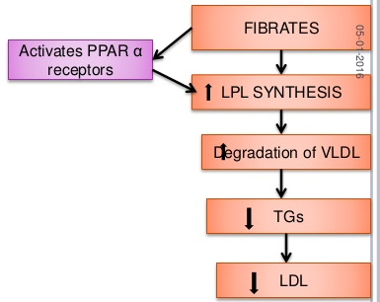
Fibrates: pharmacological effects
 LPL activity, which increases clearance of VLDL & chylomicron in plasma
A marked reduction in TG (due to
stimulation of catabolism of VLDL)
 FFA uptake by the liver
 LDL-C uptake by the liver
in HDL-C (by increasing the
production of the apoprotein components of HDL)
 excretion of hepatic C in bile , thus endogenous hepatic C synthesis may be decreased

Slide 38
Fibrates : Adverse Effects
GIT (indigestion, abdominal pain, diarrhea)
Myositis : can occur resulting in weakness and tenderness of muscles, use of fibrates with statins is generally inadvisable
Gallstones: Clofibrate increases C content of bile, predisposes to gallstones, and its use is therefore limited to patients who have cholecystectomy
Notes:
.

Slide 39
Indication of Fibrates
1st-line defense for:
*mixed dyslipidemia (i.e. raised serum TG and C)
* Patients with low HDL and high risk of atheromatous disease (often type 2 diabetic patients)
* Patients with severe treatment- resistant dyslipidemia (combination with other lipid-lowering drugs).

Slide 40
ADRs
G.I.T upset, headache, fatigue, weight gain
2. Rash, urticaria, hair loss
3. Myalagia, Myositis, Rhabdomyolysis Acute renal failure  Occurs >
-In alcoholics,
-If combined with statins (each –ve metabolism of other )
-Or In impaired renal function
4. fibrates should be used with caution in patients with biliary tract disease, as they increase the risk of cholesterol gallstones as a result of an increase in the cholesterol content of bile.

Slide 41
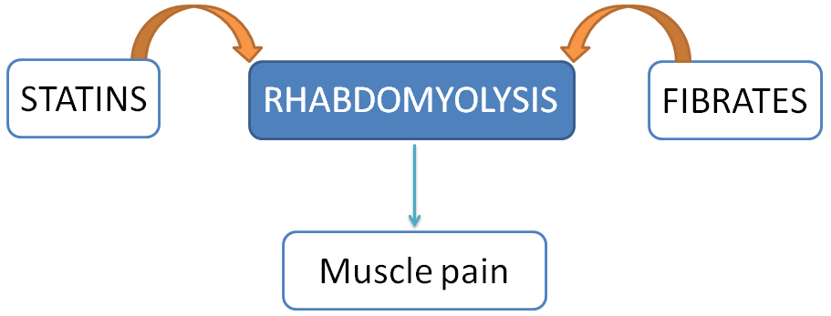
Drug interactions
Increased risk of myopathy when combined with statins.
Displace drugs from plasma proteins (e.g.oral anticoagulants and oral hypoglycemic drugs)
Contraindications
Patients with impaired renal functions
Pregnant or nursing women
Preexisting gall bladder disease

Slide 42
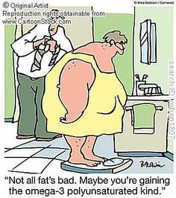
Adjuvants in hyperlipidemia
Omega -3-FA
β-Sitosterol

Slide 43
Omega -3-FA
found in fish oils containing highly unsaturated FA
Mechanism
Pharmacological Effects
◉ enzymes involved in TG synthesis
 beta-oxidation of FFA
◉ TGs
◉ platelet function
Prolongation of bleeding time
Anti-inflammatory effects
Some vascular protection
Indications
Approved as adjunctive for treatment of very high TGs
β-Sitosterol
found in plants with structure similar to C
Mechanism &Pharmacological Effects
Compete with dietary & biliary C absorption  levels LDL levels +10%
Indications
Given as food supplement before meal in hypercholestrolemia

Slide 44
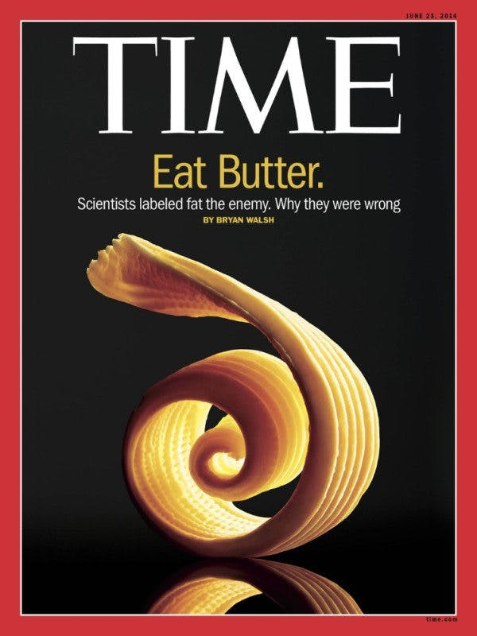
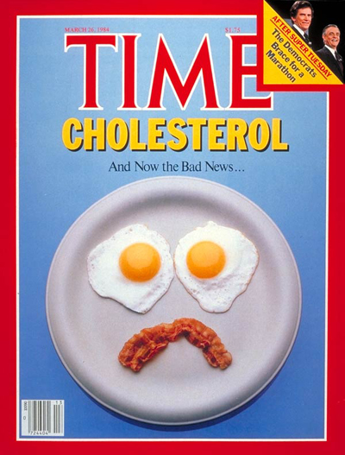
A meta-analysis of prospective epidemiologic studies showed that there is no significant evidence for concluding that dietary saturated fat is associated with an increased risk of CHD or CVD.

