Slide 1
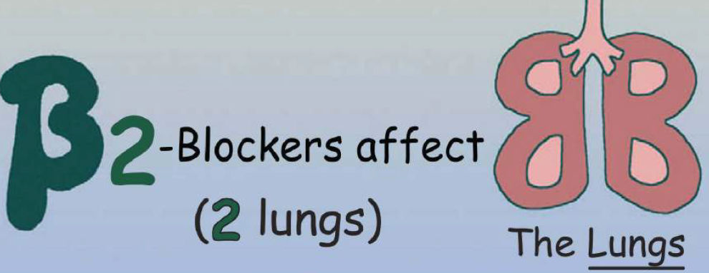
β- Adrenoceptors blockers

Slide 2
Classify β- blockers
Discuss pharmacokinetic properties, pharmacodynamic actions, clinical uses, ADRs & contraindications of β- blockers
ilos

Slide 3
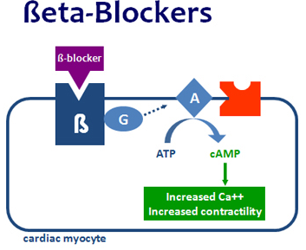
Study in detail the pharmacokinetic properties & pharmacodynamic effects of selected β- blockers
ilos

Slide 4
Classification of β- Adrenoceptors Blockers

Slide 5
 | Lipophilic | Hydrophilic
Oral absorption | Complete | Irregular
Liver metabolism | Yes | No
t _{1/2} | Short | Long
CNS side effects | High | low
 | Metoprolol Propranolol, Timolol Labetalol , Carvedilol | Atenolol, Bisprolol, Esmolol Sotalol
According to water & lipid solubility

Slide 6
1-First generation:- Non-selective ß- blockers
2-Second generation:- ß1- selective blockers
3-Third generation:- ß- blockers with additional effects
α1 adrenergic receptor blockade (labetalol, carvedilol)
Increased production of NO (celiprolol, nebivolol)
Ca2+ entry blockade (carvedilol)
β2 agonist properties (celiprolol)
Antioxidant action (carvedilol)
Opening of K+ channels (tilisolol)

Slide 7
Pharmacokinetics
Most of them are lipid soluble
Lipid soluble β–blockers are well absorbed orally
are rapidly distributed, cross readily BBB
Have CNS depressant actions
Most of them have half-life from 3-10 hrs except Esmolol (10 min. given intravenously).
Most of them metabolized in liver & excreted in urine

Slide 8
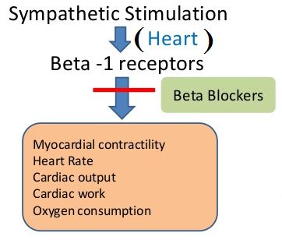
Pharmacodynamic effects
CVS:- Negative inotropic, chronotropic, dromotropic   CO
Antianginal effects (ischemic heart disease):
↓ Heart rate (bradycardia)
↓ force of contraction  cardiac work
↓ Oxygen consumption due to bradycardia
Anti-arrhythmic effects:
excitability,  automaticity &  conductivity (due to its sympathetic blocking)

Slide 9
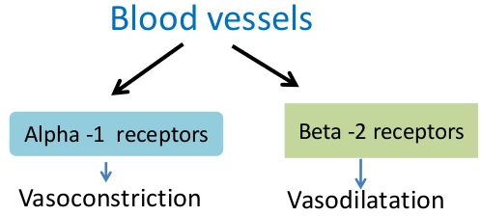
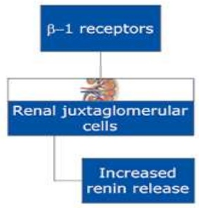
Pharmacodynamic effects
Blood vessels β₂
 peripheral resistance (PR) by blocking vasodilator effect
blood flow to organs  cold extremities. Contraindicated in peripheral diseases like Reynaud's disease
Blood pressure:- Antihypertensive   BP in hypertensive patients due to effects on:
Inhibiting heart properties   cardiac output (β₁)
β Blockade  renin secretion  Ang II & aldosterone secretion (β₁).
Presynaptic inhibition of NE release from adrenergic nerves

Slide 10
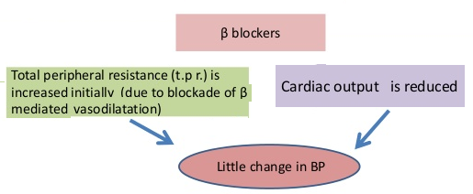
Respiratory tract: β₂
Bronchoconstriction
Contraindicated in asthmatic patients
Pharmacodynamic effects
Intestine:  Intestinal motility
Eye:
Aqueous humor production from ciliary body
Reduce intraocular pressure (IOP)
e.g. timolol as eye drops

Slide 11
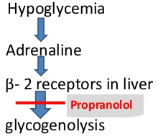
Metabolic effects:
Hypoglycemia
↓ glycogenolysis in liver
↓ glucagon secretion in pancreas
↓ lipolysis in adipocytes
Na⁺ retention 2^{ndry} to BP renal perfusion
All β–Adrenergic blockers mask hypoglycemic manifestations in diabetic patients  COMA
Pharmacodynamic effects

Slide 12
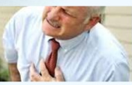
In Hypertension:
Propranolol, atenolol, bisoprolol
Labetalol: α, β blockers
in hypertensive pregnant women & hypertensive crisis.
In cardiac arrhythmias:
In supraventricular & ventricular arrhythmias.
Bisoprolol and carvedilol are preferred
Angina pectoris:
↓ heart rate, ↓ cardiac work & oxygen demand.
↓ the frequency of angina episodes.
.
Clinical
uses

Slide 13
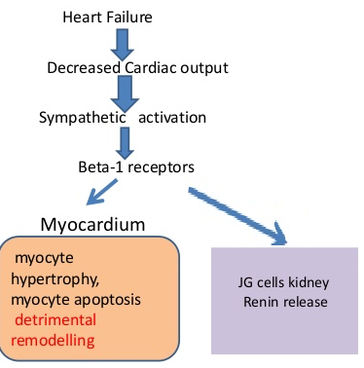
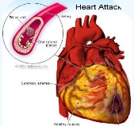
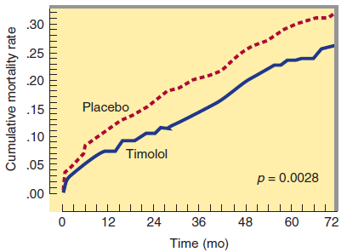
Congestive heart failure:
e.g. carvedilol:
antioxidant and non selective α & β blocker
↓ myocardial remodeling & ↓ risk of sudden death.
Myocardial infarction:
Have cardio-protective effect
◉ infarct size
morbidity & mortality 
◉ myocardial O2 demand.
Anti-arrhythmic action.
◉ incidence of sudden death
Clinical
uses

Slide 14
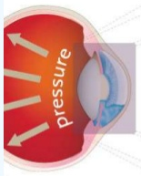
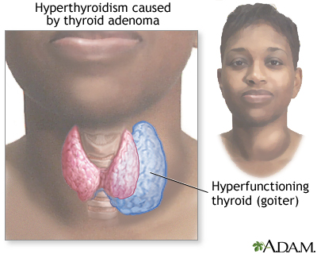
In anxiety (Social and performance type)
e.g. Propranolol
Controls symptoms; tachycardia, tremors, sweating.
In glaucoma
e.g. Timolol as eye drops
In Hyperthyroidism
Protect the heart against sympathetic over stimulation
Controls symptoms; tachycardia, tremors, sweating.
Clinical
uses

Slide 15
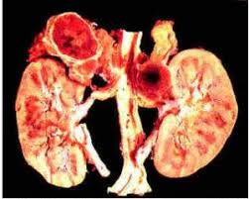
Migraine:
Prophylactic
reduce episodes of chronic migraine
catecholamine-induced vasodilatation in the brain vasculature
e.g. propranolol
Pheochromocytoma
used with α-blockers (never alone)
α-blockers lower the elevated blood pressure.
β-blockers protect the heart from NA.
Clinical
uses

Slide 16
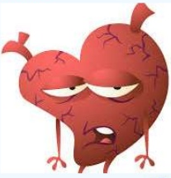
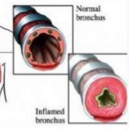
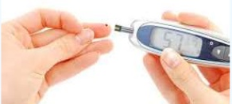
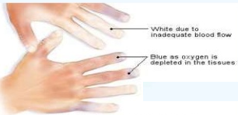
Due to blockade of β1- receptor:
Bradycardia, hypotension, heart failure
Due to blockade of β2- receptor:
(only with non-selective β blockers)
ADRS
Hypoglycemia
Bronchoconstriction (# Asthma, emphysema).
Cold extremities & intermittent claudication by vasoconstriction

Slide 17
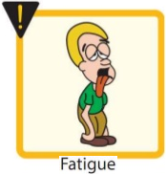
Erectile dysfunction & impotence, Nebivolol NO
 TG  hypertriglyceridemia
ADRS
Coronary spasm  in variant angina patients
Fatigue
All β–Adrenergic blockers mask hypoglycemic manifestations i.e. tachycardia, sweating,  COMA

Slide 18
Depression, and hallucinations
Gastrointestinal disturbances
Sodium retention
ADRS
Precautions: Sudden stoppage will give rise to a withdrawal syndrome:
Rebound angina, arrhythmia, myocardial infarction &
Hypertension WHY ?  Up-regulation of β-receptors.
To prevent withdrawal manifestations  drug withdrawn gradually.

Slide 19
Heart Block (beta blockers can precipitate heart block)
Peripheral vascular disease (safer with cardio-selective β-blockers)
Bronchial Asthma (safer with cardio-selective β-blockers)?
Contraindications
Diabetic patients  Masking of hypoglycaemia / GIVEN CAUSIOUSLY
Hypotension
Alone in pheochromocytoma (must be given with an α-blockers).

Slide 20
propranolol
Non-Selective Competitive Blocker of β₁ & β₂
Membrane stabilizing action/ quinidine-like /local anesthetic effect
sedative actions /No ISA
pharmacokinetics
Lipophilic, completely absorbed, 70% destroyed during 1st pass hepatic metabolism, 90-95% protein bound, cross BBB and excreted in urine.
Can be given p.o. or parenteral

Slide 21
Pharmacodynamic effects
Membrane Stabilization: Block Na channels  direct depressant to myocardium has local anesthetic effect (anti-arrhythmic effects).
CNS Effect: Has sedative action,  tremors & anxiety  used to protect against social anxiety & performance anxiety.
Heart; by block β₁
Inhibit heart properties   cardiac output
Has anti -ischemic action   cardiac work +  O₂ consumption
Has anti-arrhythmic effects  excitability, automaticity & conductivity + by membrane stabilizing activity

Slide 22
Pharmacodynamic effects
BP; by block β₁
Has antihypertensive action by
Inhibiting heart properties   cardiac output
β blockade :  renin & RASS system
Presynaptic inhibition of NE release from adrenergic nerves
Inhibiting sympathetic outflow in CNS
Blood Vessels [BV]; by blocking β₂ Vasoconstriction  blood flow specially to muscles, other organs except brain  cold extremities

Slide 23
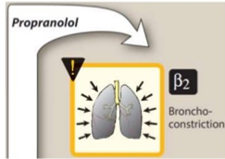
Pharmacodynamic effects
Bronchi: by block β_{2 .} Bronchospasm specially in susceptible patients
Intestine: by block β₂  Intestinal motility
Metabolism: by blocking mainly β₂
In liver;  Glycogenolysis  Hypoglycemia
In pancreas;  Glucagon secretion
In adipocytes;  Lipolysis
In skeletal muscles; glycolysis
On peripheral & central nervous systems:-Has local anesthetic effect.  tremors &  anxiety

Slide 24
Hypertension)
Myocardial infarction
Angina
Hyperthyroidism
Chronic glaucoma
Arrhythmias
indications
Migraine [Prophylaxis]
Tremors
Pheochromocytoma; used with α-blockers (never alone)
Anxiety; (specially social & performance type)

Slide 25
labetalol
Blocks α₁ & β
Rapid acting, non-selective with ISA & local anesthetic effect
Does not alter serum lipids or blood glucose
Used in:- (given p.o and i.v)
Hypertensive crisis (e.g. during abrupt withdrawal of clonidine)
Used in pregnancy-induced hypertension
ADRs:- Orthostatic hypotension, sedation & dizziness

Slide 26
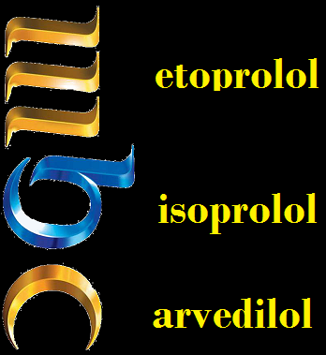
carvedilol
Blocks α₁ & β
Non-selective with no ISA & no local anesthetic effect
Has ANTIOXIDANT action
Favorable metabolic profile
Used effectively in  CONGESTIVE HEART FAILURE  reverses its pathophysiological changes.
ADR;- Edema

