Slide 1
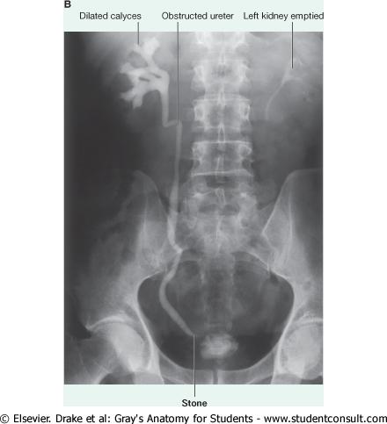
ANATOMY OF KIDNEYS
Dr Jamila EL Medany

Slide 2
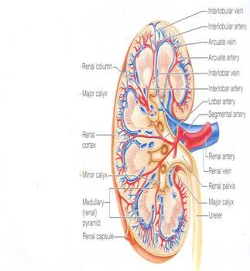
Objectives
By the end of this course you should be able to discuss :
COMPONENTS OF THE
URINARY SYSTEM.
KIDNEY:
SHAPE & POSITION.
SURFACE ANATOMY.
EXTERNAL FEATURES.
HILUM and its CONTENTS.
RELATIONS.
INTERNAL STRUCTURE.
BLOOD SUPPLY
LYMPH DRAINAGE..
NERVE SUPPLY.

Slide 3
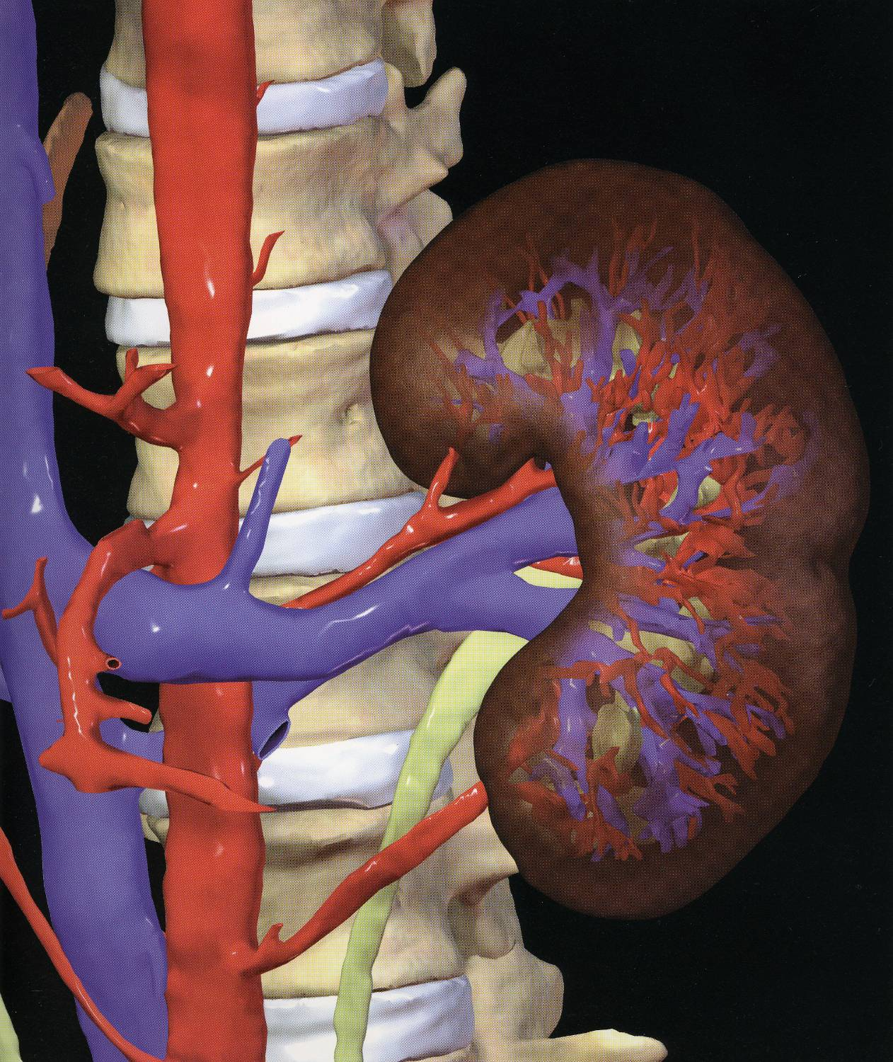
INTRODUCTION
Every day, each kidney filters liters of fluid from the bloodstream.
Although the lungs and the skin also play roles in excretion, the kidneys bear the major responsibility for eliminating nitrogenous (nitrogen-containing) wastes, toxins, and drugs from the body.

Slide 4
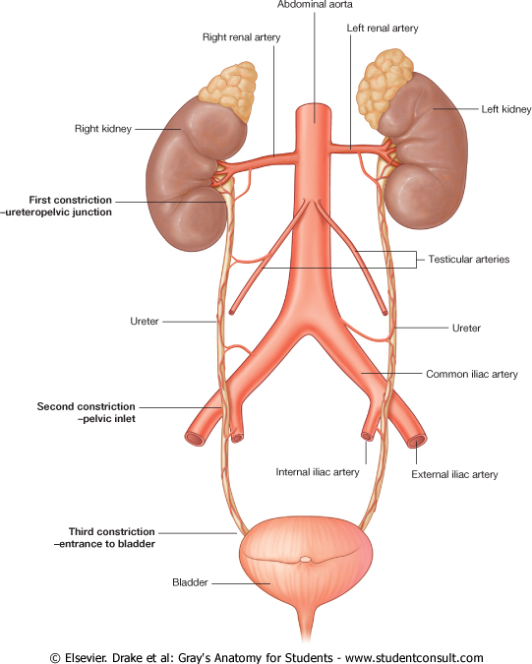
Kidney
Functions:
Excretes most of the waste products of metabolism.
Controls water & electrolyte balance of the body.
Maintain acid-base balance of the blood.
Erythropoietin hormone stimulates bone marrow for RBCs formation.
Rennin enzyme regulates the blood pressure.
Converts vitamin D to its active form.

Slide 5
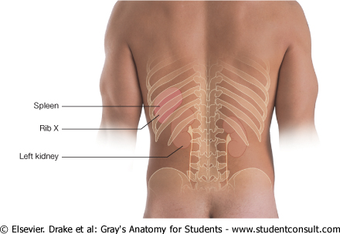
Kidney
Kidneys are reddish brown in color.
Lie behind the peritoneum on the posterior abdominal wall on either side of the vertebral column.
They are largely under cover of the costal margin.
The right kidney lies slightly lower than the left due to the large size of the right lobe of the liver.
The upper border of the right kidney is at the level of 11th intercostal space.
The upper border of the left kidney is at the level of 11th rib

Slide 6
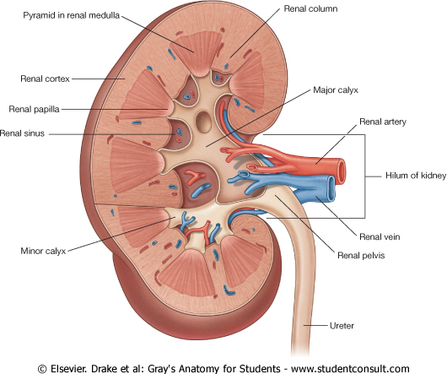
Kidneys
With contraction of the diaphragm the kidney moves downward as much as 2.5 cm.
The lateral border is convex, while the medial border is convex at both ends but its middle pat shows a vertical slit called the hilum.
The hilum extends into a large cavity called the renal sinus.
The hilum transmits the renal vein, two branches of renal artery, ureter, and the third branch of renal artery from the front backward (V.A.U.A.)

Slide 7
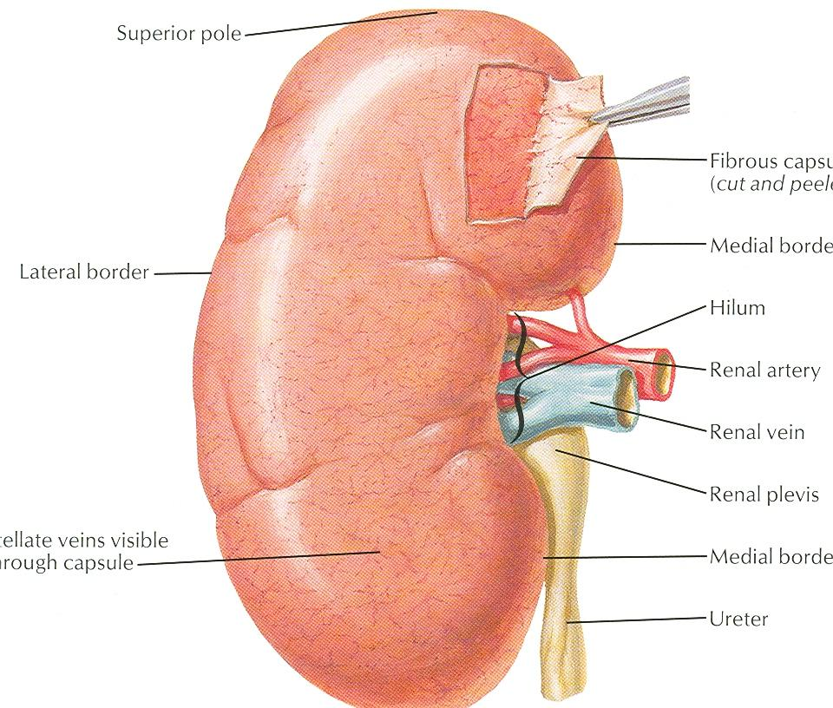
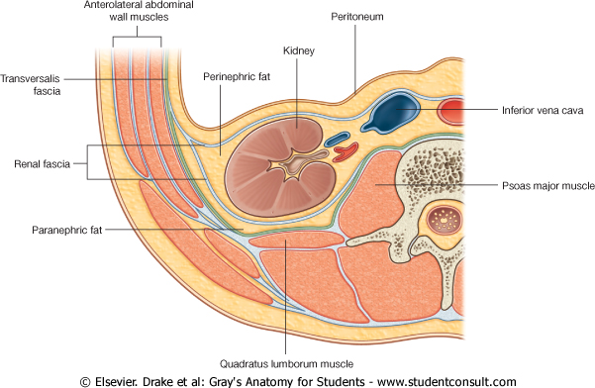
Coverings
1- Fibrous capsule:
It surrounds the kidney.
2- Perirenal (perinephric) fat :
It covers the fibrous capsule
3- Renal fascia:
It encloses the kidneys and suprarenal glands.
4- Pararenal (paranephric) fat :
It lies external to the renal fascia, and forms part of the retroperitoneal fat.
N.B. The last 3 structures support the kidney in position.

Slide 8
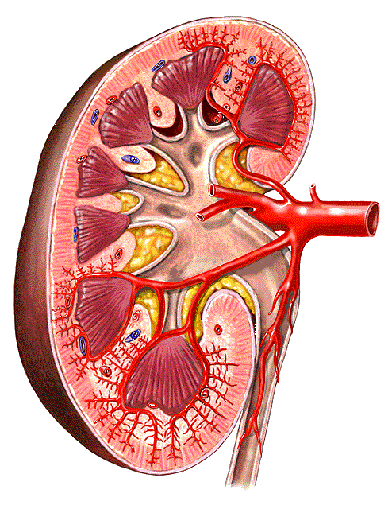
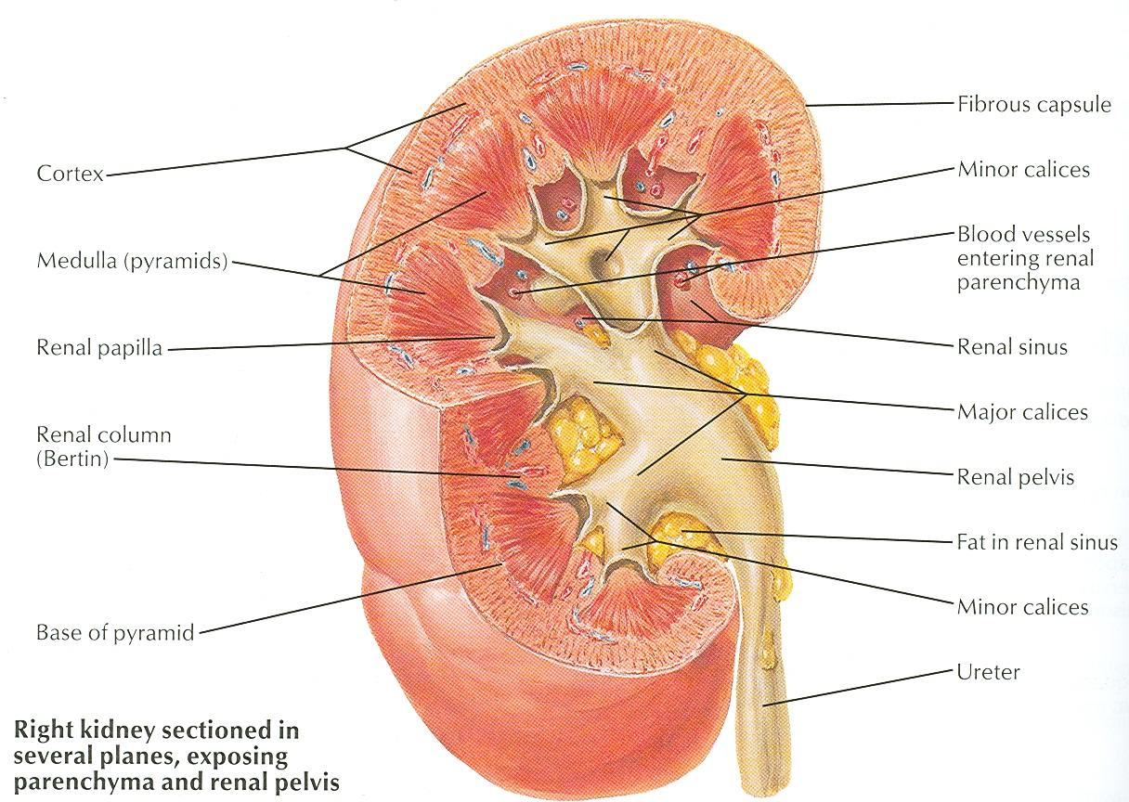
Renal Structure
Each kidney has an outer cortex and an inner medulla.
Medulla is composed of about 12 renal pyramids.
The base of each pyramid is directed toward the cortex & its apex (the renal papilla) is projecting medially.
The cortex extends into the medulla between adjacent pyramids as the renal column.

Slide 9
Renal Structure
Extending from the bases of the renal pyramids into the cortex are striations known as medullary rays.
The renal sinus within the hilum, contains the upper expanded end of the ureter, the renal pelvis.
Renal pelvis divides into two or three major calyces, which divides into two or three minor calyces.

Slide 10
Posterior relations
Twelfth rib,
Costodiaphragmatic pleural recess.

Slide 11
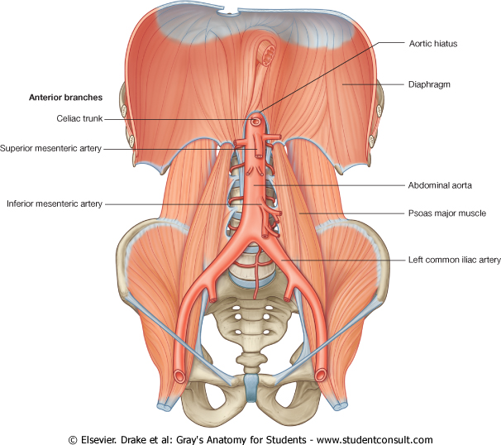
4Muscles:
Diaphragm
Psoas major m.,
Quadratus lamborum m.,
Transversus abdominis m.
Quadratus lumborum

Slide 12
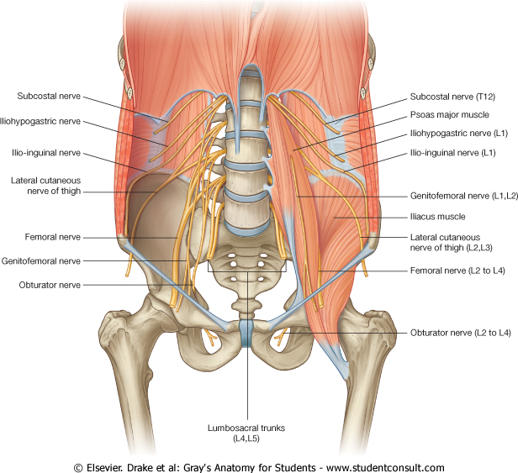
Posterior Relation
3 Nerves:
Subcostal nerve (T12),
Iliohypogastric (L1) nerve.
Ilioinguinal (L1) nerve

Slide 13
A
N
T
E
R
I
O
R
R
E
L
A
T
I
O
N
Right Kidney :
1- Right suprarenal gland
2- Liver,
3- Second part of the
duodenum
4- Right colic flexure
5- Coils of small intestine
Left Kidney :
1- Left suprarenal gland,
2- Stomach,
3- Spleen,
4- Pancreas,
5- Left colic flexure,
6- Descending colon
7- Coils of jejunum

Slide 14
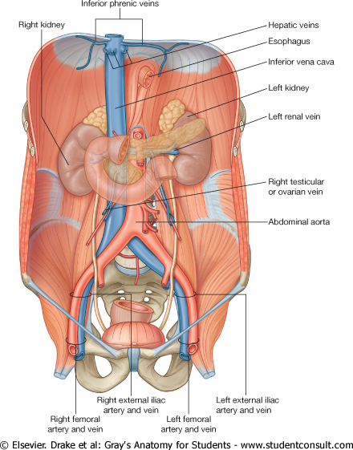
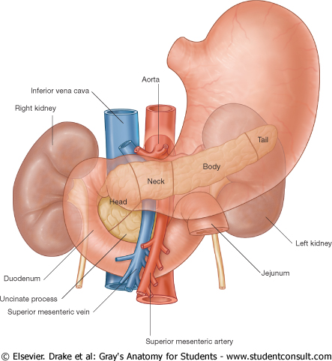

Slide 15
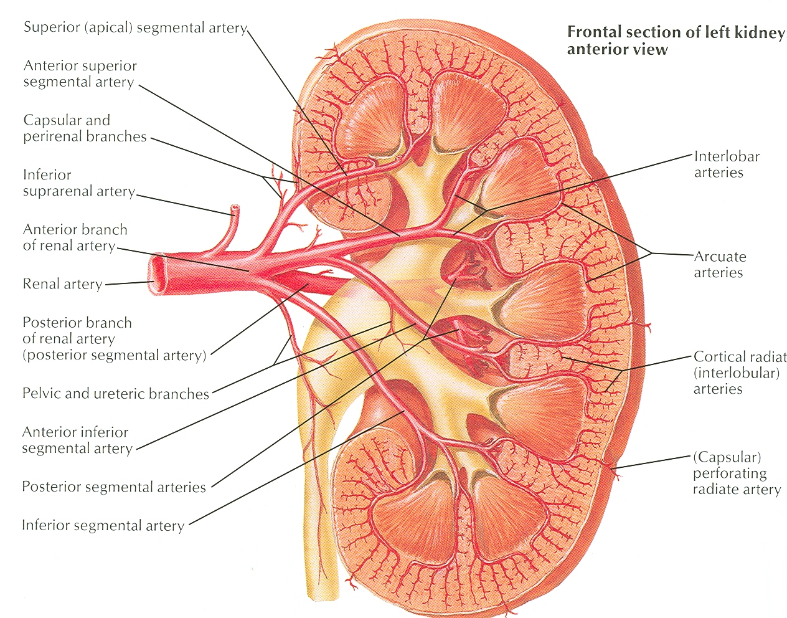
Blood Supply
The renal artery arises from the aorta at the level of the second lumbar vertebra.
Each renal artery divides into five segmental arteries that enter the hilum of the kidney, four in front and one behind the renal pelvis
They are distributed to different segments of the kidney.
Lobar artery arises from each segmental artery, one for each renal pyramid.

Slide 16
Blood Supply
Each lobar artery gives off 2 or 3 interlobar arteries.
The interlobar arteries run toward the cortex on each side of the renal pyramid.
Interlobar arteries give off the arcuate arteries at the junction of the cortex and medulla
The arcuate arteries give off several interlobular arteries

Slide 17
Interlobular artery gives off afferent glomerular arterioles .

Slide 18
Each nephron is associated with two capillary beds:
The glomerulus and
The peritubular capillary bed.
The glomerulus is both fed and drained by arterioles.
The afferent arteriole, which arises from an interlobular artery, is the "feeder vessel," and
the efferent arteriole receives blood that has passed through the glomerulus.

Slide 19
Venous Drainage
Renal vein emerges from the hilum in front of the renal artery and drains into the IVC.
The left renal vein is longer than the right renal vein.
The left renal vein receives the left gonadal & the left suprarenal veins.

Slide 20
Lymph
Lymph Drainage:
Lateral aortic lymph nodes around the origin of the renal artery.

Slide 21
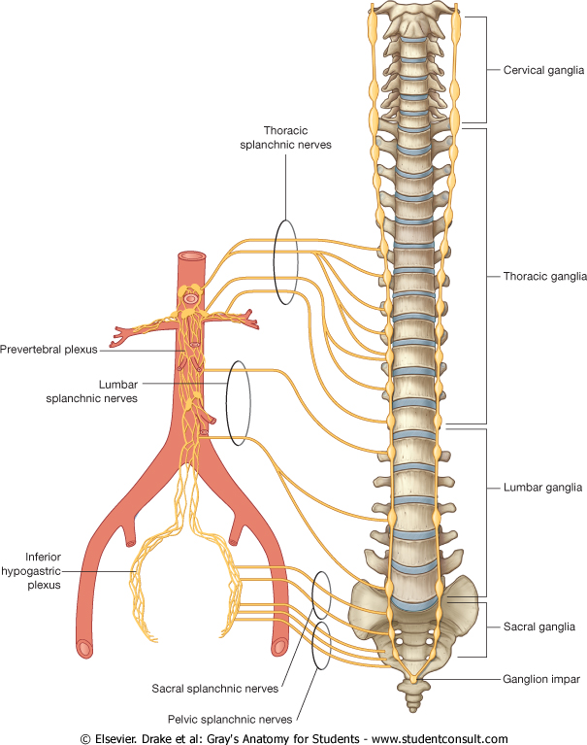
Nerve Supply
Nerve Supply
Renal sympathetic plexus.
The afferent fibers that travel through the renal plexus enter the spinal cord in the 10th, 11th, and 12th thoracic nerves.

Slide 22
