Slide 1
The urinary passage

Slide 2
Juxtaglomerular apparatus

Slide 3
Juxtaglomerular apparatus

Slide 4
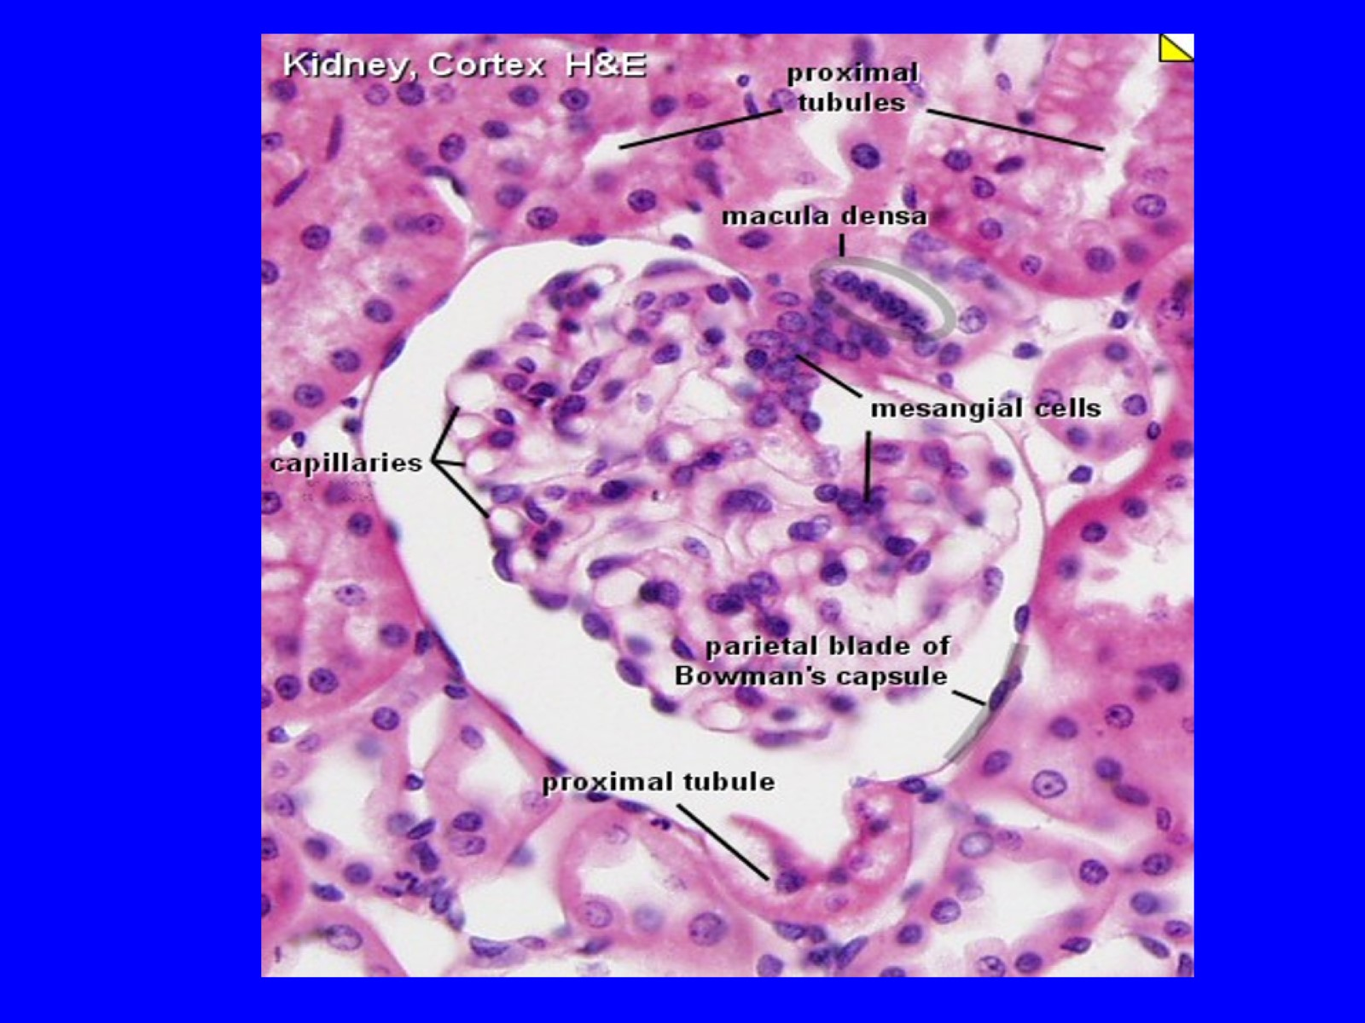

Slide 5
Renal Calyces

Slide 6
Ureter

Slide 7
Urinary bladder

Slide 9
Female Urethra

Slide 10
Male Urethra

Slide 11
BEST WISHES

