Slide 1
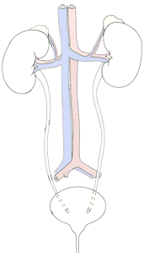
RENAL BLOCK
Pathology Practicals 1 & 2
Prepared by:
Prof. Ammar Al Rikabi
Dr. Sayed Al Esawy

Slide 2
NORMAL ANATOMY AND HISTOLOGY
Pathology Dept , KSU
Renal Block

Slide 3
Objectives:
At the end of the practical sessions for the renal block, the students will be able to:
Describe the normal constituents of the nephron, renal glomeruli and tubules.
Identify the gross and microscopic features of:
Practical 1
Acute tubular necrosis/injury
Autosomal dominant polycystic kidney disease.
Practical 2
Acute pyelonephritis
Chronic pyelonephritis
Renal stone
Hydronephrosis

Slide 4
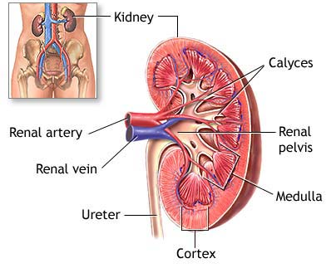
Anatomy of the Kidney
Pathology Dept , KSU
Renal Block

Slide 5
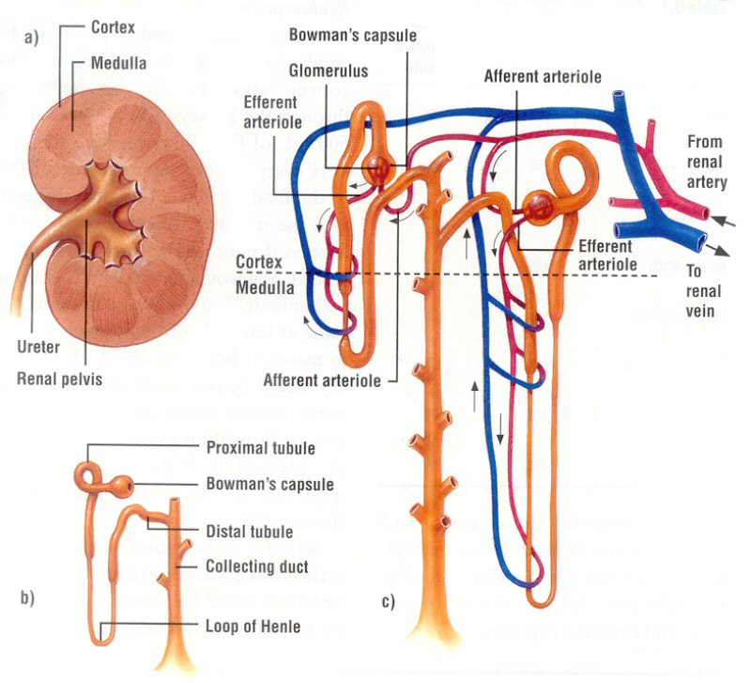
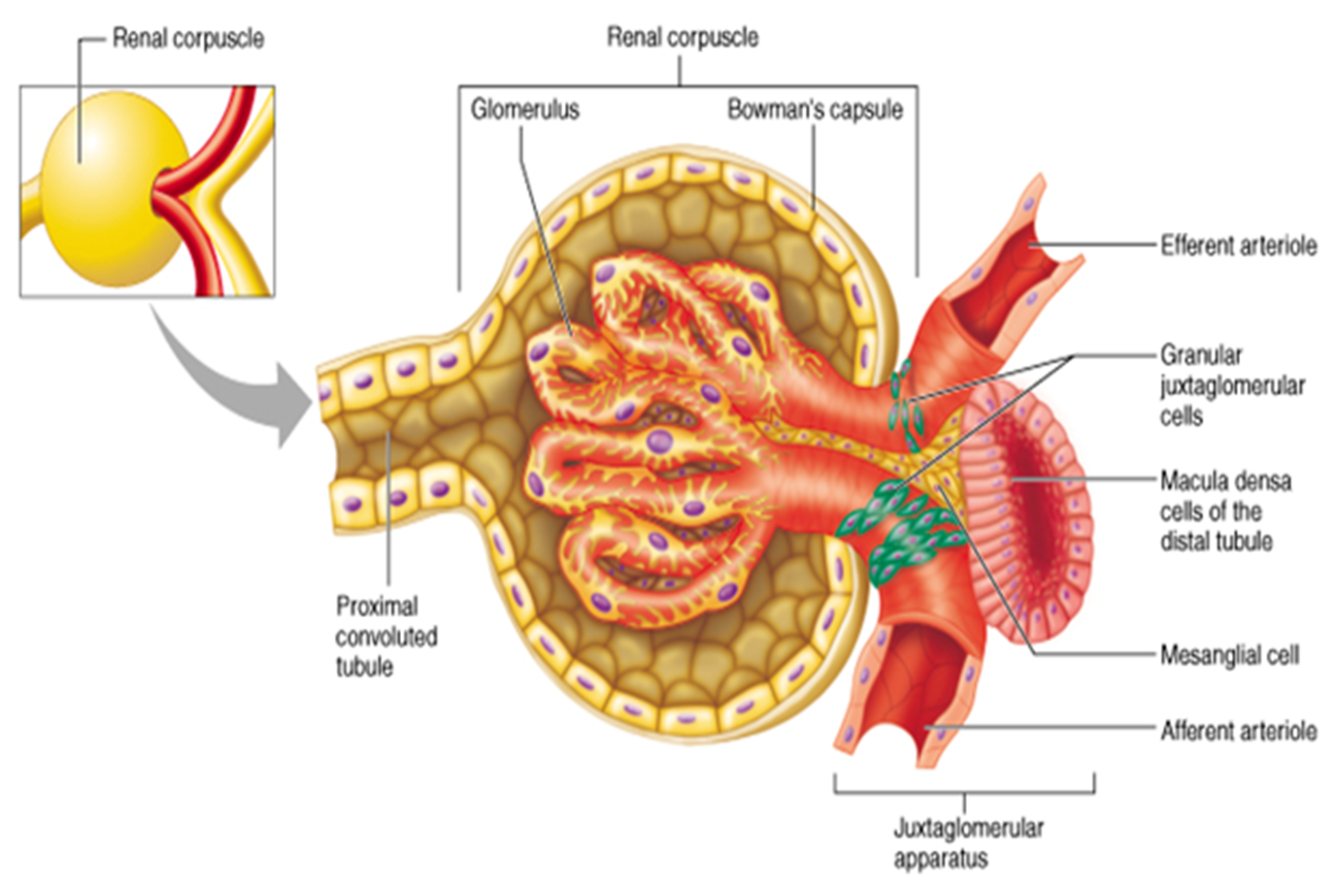
NEPHRON STRUCTURE
Pathology Dept , KSU
Renal Block

Slide 6
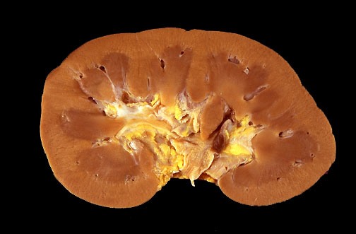
Normal Kidney - Gross
In cross section, this normal adult kidney demonstrates the lighter outer cortex and the darker medulla, with the renal pyramids into which the collecting ducts coalesce and drain into the calyces and central pelvis.
Pathology Dept , KSU
Renal Block

Slide 7
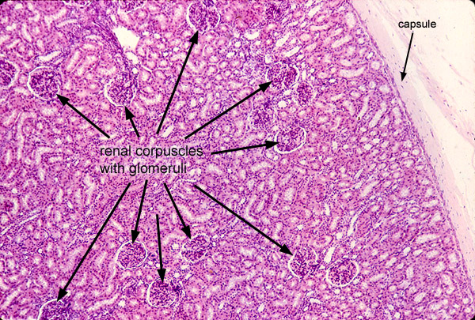
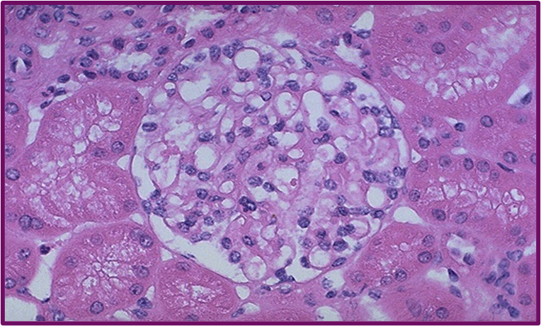
Kidney – Normal Histology
Pathology Dept , KSU
Renal Block

Slide 8
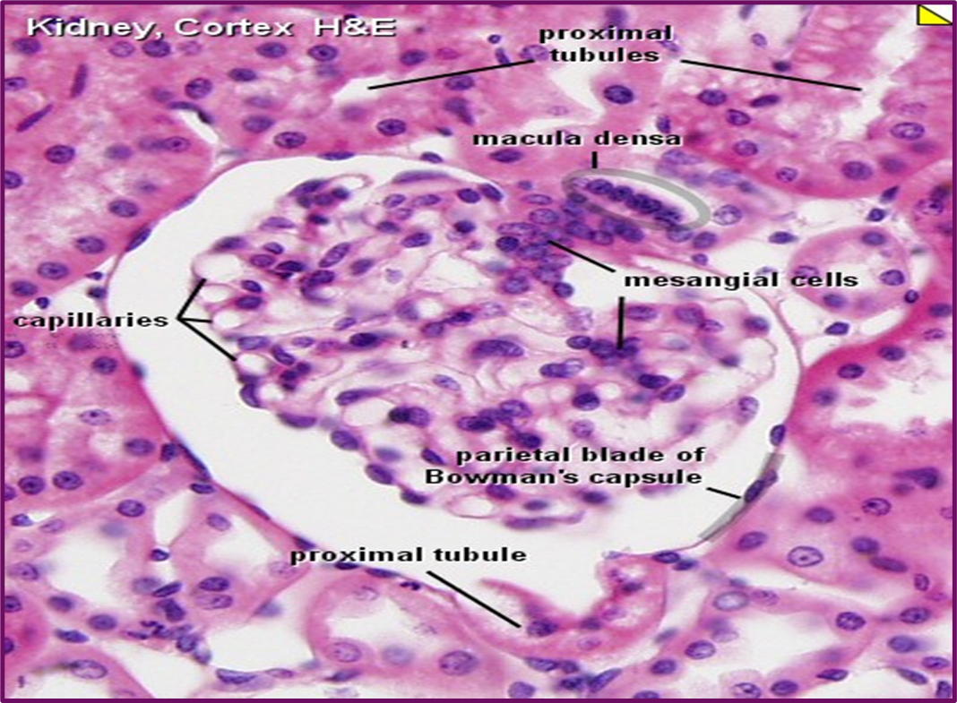
Renal Corpuscle – Normal Histology
Normal glomerulus by light microscopy. The glomerular capillary loops are thin and delicate. Endothelial and mesangial cells are normal in number. The surrounding tubules are normal
Pathology Dept , KSU
Renal Block

Slide 9
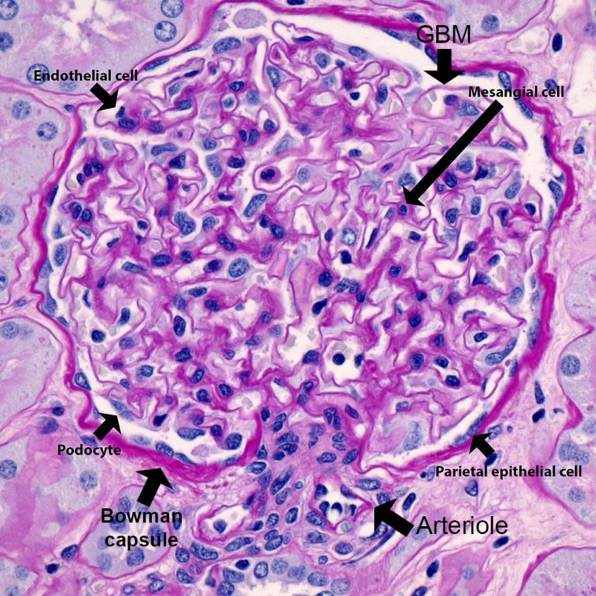
Renal Corpuscle – Normal Histology
Normal glomerulus is stained with PAS to highlight basement membranes of glomerular capillary loops and tubular epithelium.
Pathology Dept , KSU
Renal Block

Slide 10
Acute tubular necrosis Autosomal dominant polycystic kidney disease
PRACTICAL SESSION: 1
Pathology Dept , KSU
Renal Block

Slide 11
Acute tubular injury/ necrosis

Slide 12
Acute Kidney Injury
Causes:
Pre-renal
(All those that decrease effective blood flow to the kidney)
Low blood volume, low blood pressure, and heart failure.
Renal artery stenosis, and renal vein thrombosis.
Renal ischemia.
Renal:
Glomerulonephritis (GN).
Acute tubular necrosis (ATN).
Acute interstitial nephritis (AIN).
Post-renal:
(is a consequence of urinary tract obstruction)
Benign prostatic hyperplasia.
Kidney stones.
Obstructed urinary catheter.
Bladder stone .
Bladder, ureteral or renal malignancy.
Pathology Dept , KSU
Renal Block

Slide 13
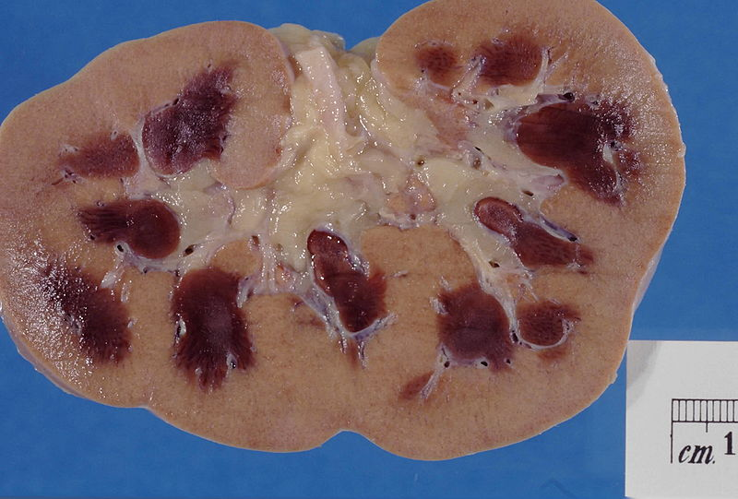
Acute Kidney Injury
Kidney showing marked pallor of the cortex, contrasting to the darker areas of surviving medullary tissue.
Pathology Dept , KSU
Renal Block

Slide 14
Acute Tubular Necrosis
Normal tubule
Acute tubular necrosis
Acute tubular necrosis shows irregularly shaped tubules lined by necrotic and flattened tubular epithelial cells (arrows). The intervening interstitium is edematous.
Pathology Dept , KSU
Renal Block

Slide 15
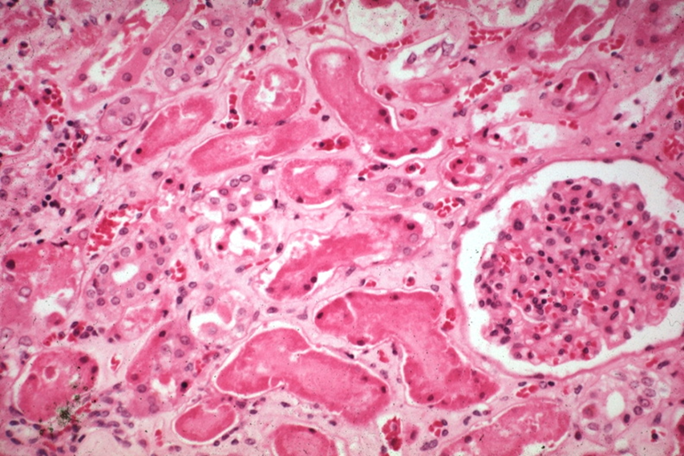
Acute Tubular Necrosis
Acute tubular necrosis shows irregularly shaped tubules lined by necrotic tubular epithelial cells (arrows). The nucleus of the tubular cells is lost and ghost outline of cells remain. The intervening interstitium is edematous.
Pathology Dept , KSU
Renal Block

Slide 16
POLYCYSTIC KIDNEY
Pathology Dept , KSU
Renal Block

Slide 17
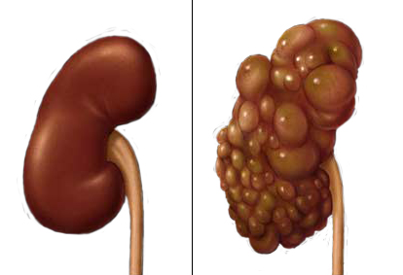
Normal vs Polycystic Kidney
Pathology Dept , KSU
Renal Block

Slide 18
Autosomal Dominant (Adult) Polycystic Kidney Disease
Autosomal Dominant (Adult) Polycystic Kidney Disease is a disease of autosomal dominant inheritance caused by mutations in the genes encoding polycystin-1 or -2. It accounts for about 10% of cases of chronic renal failure.
It usually produces symptoms by the fourth decade of life, by which time the kidneys are quite large (the cysts start to develop in adolescence).
Common clinical features
flank pain or a heavy, dragging sensation
Intermittent gross hematuria
palpable abdominal mass.
Complications of adult polycystic kidney
acute distention of a cyst, intracystic hemorrhage.
urinary infection.
Hypertension.
Saccular aneurysms of the circle of Willis are present in 10% to 30% of patients and they can rupture → subarachnoid hemorrhage.
Renal failure/uremia (end-stage kidney disease) usually occurs by age 50.
Patients in whom the disease progresses to renal failure are treated by renal transplantation.
Death usually results from uremia or hypertensive complications.

Slide 19
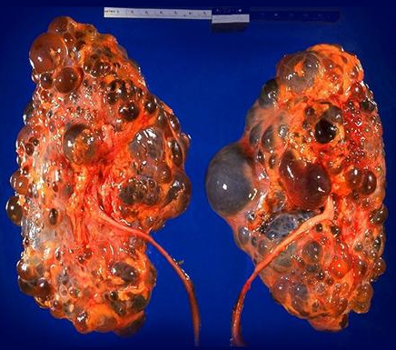
Autosomal Dominant (Adult) Polycystic Kidney Disease – Gross Anatomy
Bilateral autosomal dominant polycystic kidney disease
Markedly enlarged kidney and replacement of the renal parenchyma by numerous cysts of variable sizes
Pathology Dept , KSU
Renal Block

Slide 20
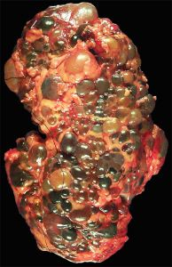
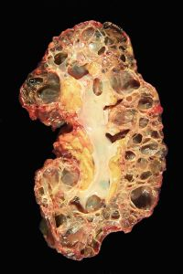
Gross Autosomal Dominant (Adult) Polycystic Kidney Disease and its Cut Section
Massively enlarged kidney disrupted by numerous cysts
Cut surface of the kidney, showing extensive cortical destruction by cysts
Pathology Dept , KSU
Renal Block

Slide 21
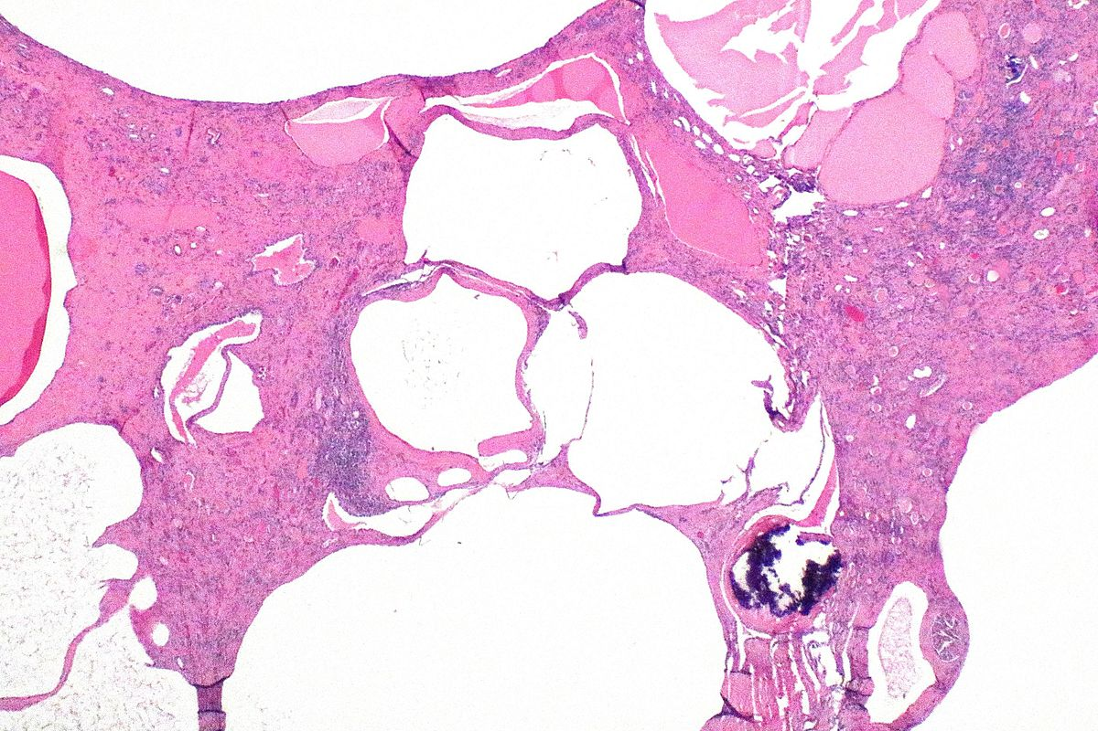
Autosomal dominant polycystic kidney – histopathology
Sections show cortical cysts lined by simple flattened epithelium, with interspersed atrophic renal parenchyma (sclerosed glomeruli, atrophic tubules, interstitial fibrosis) and dystrophic calcification.
Pathology Dept , KSU
Renal Block

Slide 22
Acute pyelonephritis Chronic pyelonephritis Renal stones Hydronephrosis
PRACTICAL SESSION : 2
Pathology Dept , KSU
Renal Block

Slide 23
ACUTE PYELONEPHRITIS
Pathology Dept , KSU
Renal Block

Slide 24
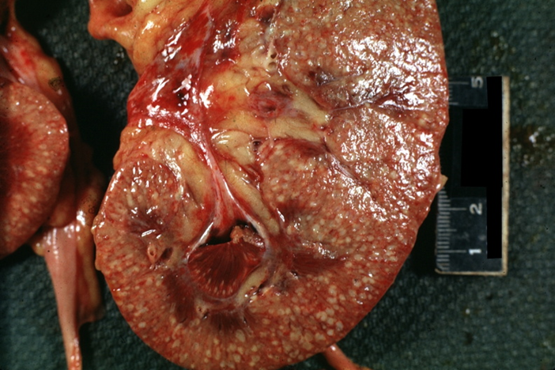
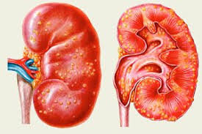
Acute Pyelonephritis with small cortical abscesses
Acute Pyelonephritis with small cortical abscesses
Pathology Dept , KSU
Renal Block

Slide 25
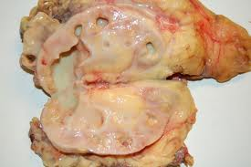
Classic picture of Acute Pyelonephritis
This kidney is bisected to reveal a dilated pelvis and calyxes filled with a yellow pus which is consistent with a pyelonephritis. The cortex and medulla are pale and the corticomedullary junction is ill-defined.
No tumors are seen.
Pathology Dept , KSU
Renal Block

Slide 26
Acute Pyelonephritis - Histopathology
Acute pyelonephritis is diagnosed by intratubular aggregation of neutrophils. There is surrounding interstitial inflammation with a mixture of inflammatory cells (neutrophils, lymphocytes and plasma cells).
Pathology Dept , KSU
Renal Block

Slide 27
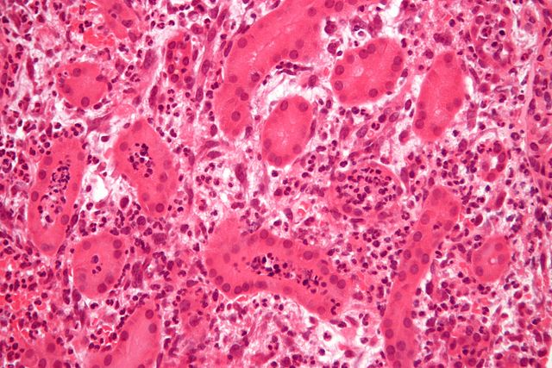
Acute Pyelonephritis - Histopathology
Kidney biopsy. ” by Nephron. License: CC BY-SA 3.0
Neutrophilic aggregates are seen in the lumen of renal tubules (arrows). These leukocytes may form into a cast within the tubule which are passed out in the urine.
Pathology Dept , KSU
Renal Block

Slide 28
CHRONIC PYELONEPHRITIS
Pathology Dept , KSU
Renal Block

Slide 29
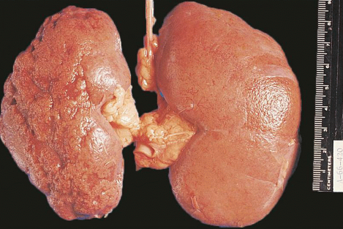
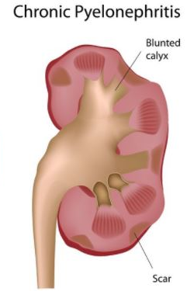
Chronic Pyelonephritis - Gross Pathology
https://abdominalkey.com/wp-content/uploads/2016/06/C24-FF16.gif
The most common causes are:
Obstruction by renal stones and others.
Reflux uropathy – urinary reflux.
Drugs like NSAID’s, methicillin etc.
Recurrent urinary tract infections.
The picture shows slightly atrophic and deformed kidney
with irregular, coarse, depressed scars on the cortical surface of the left kidney. The right kidney appears normal with smooth surface.
Pathology Dept , KSU
Renal Block

Slide 30
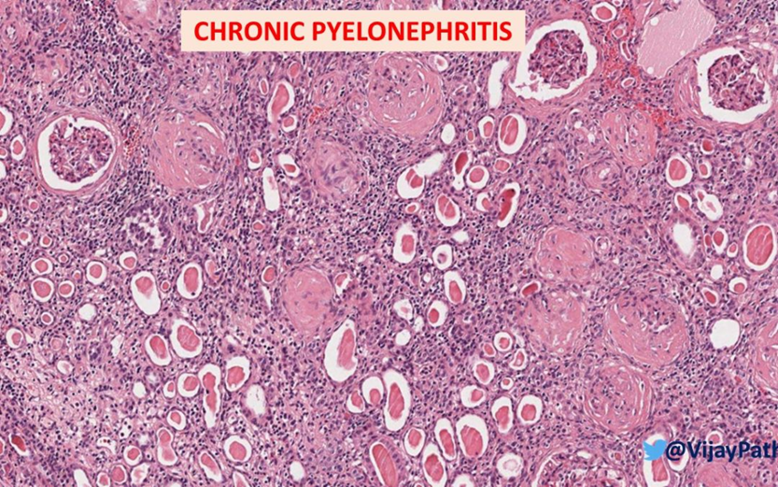
Chronic Pyelonephritis - Histopathology
.
In chronic pyelonephritis:
Tubules→ tubular atrophy with thyroidization of tubules(tubules are filled with eosinophilic hyaline casts resembling colloid of thyroid gland).
Interstitium → interstitial fibrosis and chronic interstitial inflammation (lymphocytes and plasma cells)
Glomeruli → periglomerular fibrosis and glomerulosclerosis
Chronic pyelonephritis ultimately can lead to renal failure /end stage renal disease).
Pathology Dept , KSU
Renal Block

Slide 31
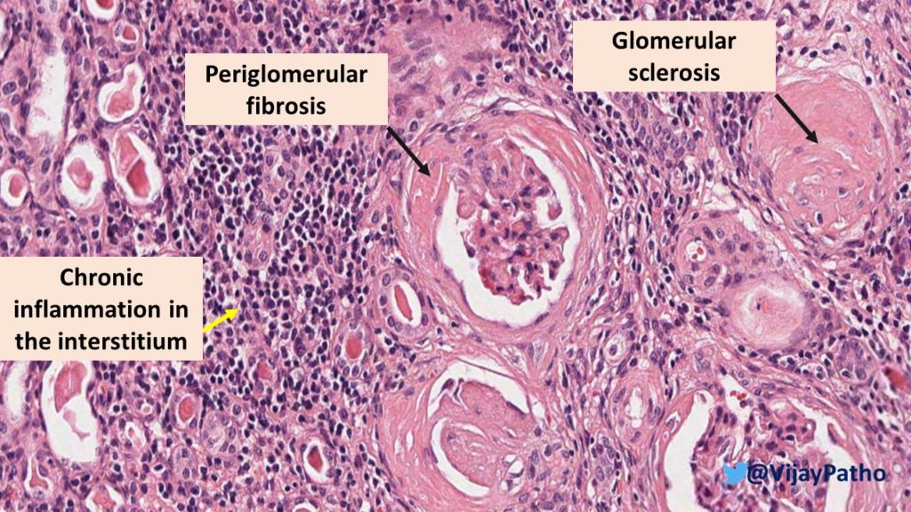
Chronic Pyelonephritis - Histopathology
Pathology Dept , KSU
Renal Block

Slide 32
Chronic Pyelonephritis - Histopathology
Periglomerular fibrosis & glomerulosclerosis.
Chronic interstitial inflammation.
Thyroidization and atrophy of renal tubules.
Pathology Dept , KSU
Renal Block

Slide 33
Nephrolithiasis (renal stones)

Slide 34
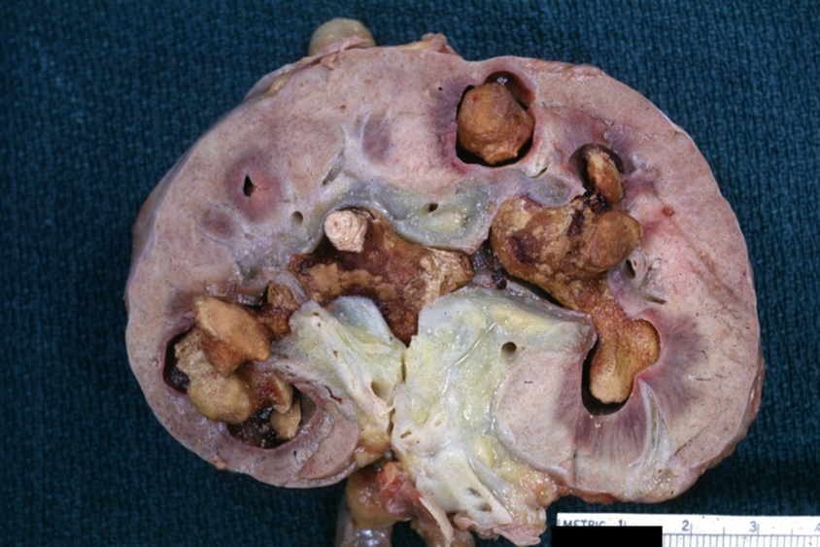
Stone in renal pelvis (nephrolithiasis) → Staghorn calculi
Usually renal stones are unilateral and multiple.
Stones vary in size from few mm to large stones that dilate the entire renal pelvis. They range from hard to soft , from smooth to rough.
Staghorn calculi take the shape of the pelvicalyceal system. They are large stones are usually composed of magnesium ammonium phosphate.
What are the predisposing factors of urolithiasis? What are the types of stones found in the kidney?
Pathology Dept , KSU
Renal Block

Slide 35
HYDRONEPHROSIS
Pathology Dept , KSU
Renal Block

Slide 36
Hydronephrosis
The most common causes are:
Foreign bodies like calculi with
obstruction,
Atresia of the urethra,
Benign prostatic hyperplasia ,
Neoplasia of the prostate and
bladder
Spinal cord damage with paralysis of the bladder .
Cut section of kidney shows markedly dilated renal pelvis and calyces with atrophic and thin renal cortex /parenchyma
The picture shows markedly dilated renal pelvis and calyces with atrophic and thin renal cortex /parenchyma
Pathology Dept , KSU
Renal Block

Slide 37
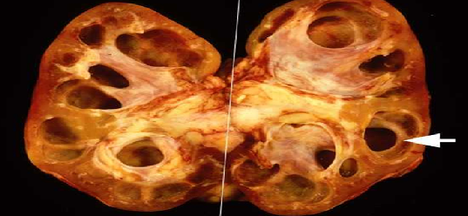
Hydronephrosis
Markedly dilated renal pelvis and calyces with atrophic and thin renal cortex
Pathology Dept , KSU
Renal Block

Slide 38
THE END

