Slide 1
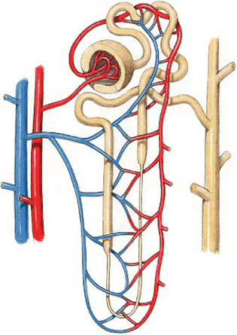
Tubular processing of filtrate
Dr. Maha Saja
MBBS, MSc Physiology, PhD
Msaja@ksu.edu.sa

Slide 2
Objectives
Define tubular reabsorption and secretion.
Identify the role of each tubular segment in glomerular filtrate modification and the types of substances being transported through each.
Describe the hormonal/physiological factors regulating tubular function at each segment.
Describe tubular reabsorption of sodium and water.
Identify and describe mechanism involved in glucose reabsorption.
Identify the tubular site and describe how amino acids and urea are reabsorbed.
Identify and describe the characteristics of the loop of Henle, distal convoluted tubule and collecting ducts for reabsorption and secretion
Describe the role of ADH in the reabsorption of water.
Identify the site and describe the influence of aldosterone on reabsorption of Na+.
List and explain the factors that control aldosterone and ADH release
Identify and describe the juxtamedullary apparatus and its role in checking the filtrate.

Slide 3
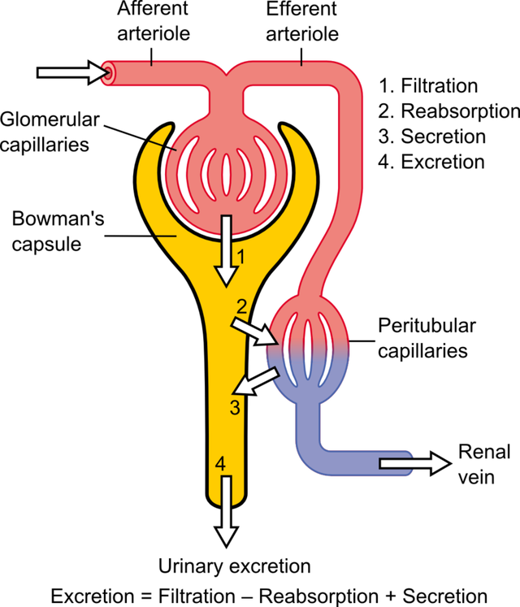
What did we discuss so far?
What are we going to discuss in this lecture?

Slide 4
Contents
The mechanisms of tubular transport through the different parts of the nephron.
Tubular reabsorption and tubular secretion.
Regulation of tubular processing.

Slide 5
Introduction
From the previous lecture,
The kidney filters around 180L/day of protein & cell-free filtrate by the glomerulus.
However, a normal human excretes around 0.5-1.5L of urine..
What happened to the remaining 178.5L of filtered fluid?

Slide 6
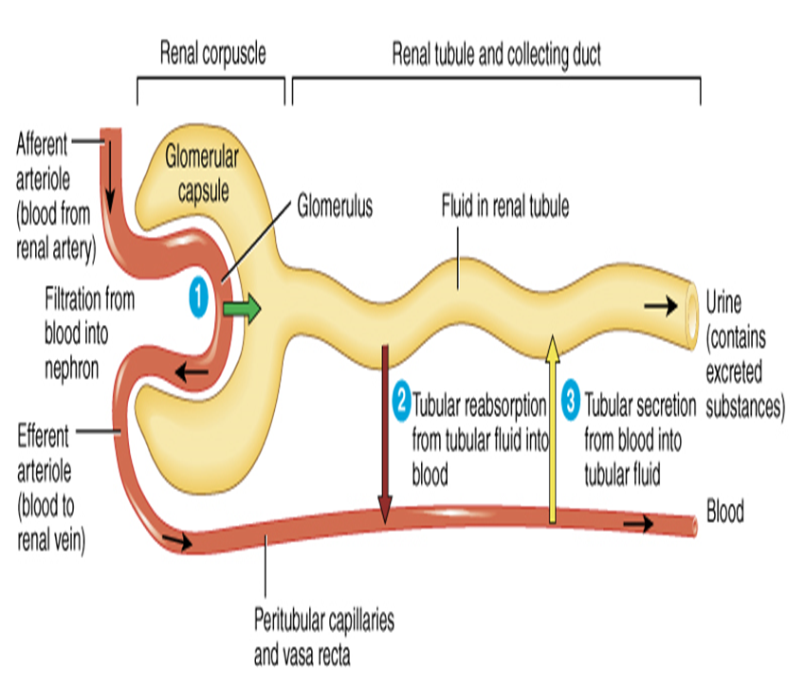
Tubular Reabsorption
Glomerular filtration and tubular reabsorption are quantitatively very large relative to the amount excreted!
Glomerular filtration is non-selective whereas tubular reabsorption is highly selective.
1.5 L/day
180L/day
178.5 L/day

Slide 7
Tubular Processing of Ultrafiltrate
After glomerular filtration the ultrafiltrate gets modified as it passes through the nephron tubule before it is finally excreted.
Tubular processing includes:
Tubular reabsorption = reabsorption of substances from the glomerular filtrate into peritubular capillary blood.
Tubular secretion = secretion of substances from peritubular capillary blood into tubular fluid

Slide 8
Before we discuss the mechanisms by which the nephron modifies the glomerular filtrate,
Let us understand the histologic structure of the different parts of the nephron.

Slide 9
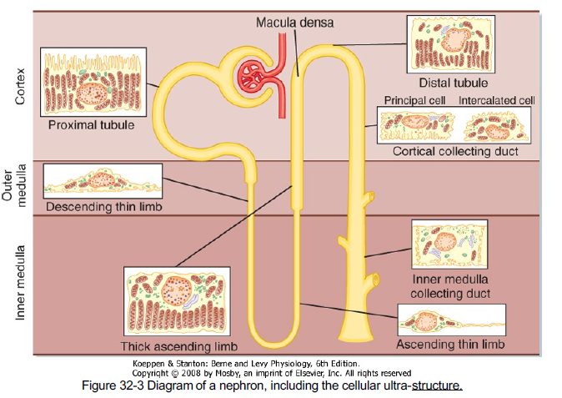
Differences in Renal Tubular Cells Reflect Their Function in Tubular Processing

Slide 10
Tubular reabsorption & Secretion

Slide 11
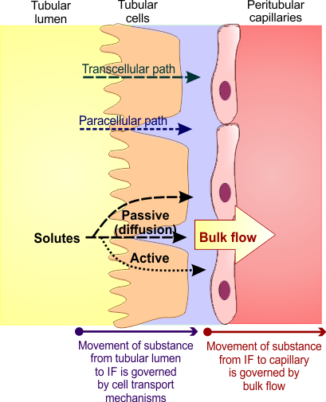
How Does the Nephron Reabsorb Substances
Reabsorption is a 2 step process:
Transport of substances from tubular lumen to IF.
Transport from IF to blood.
From tubular lumen to IF;
Transport involves active & passive mechanisms.
Occur through paracellular and/or transcellular routes.
From IF to blood:
By ultrafiltration (bulk flow).

Slide 12
Transport Mechanisms Across the Tubule
Active Transport
Passive Transport
Requires energy.
Moves substances against their electrochemical gradient.
Does not need energy.
Moves substances down their electrochemical gradient.
Primary active
Secondary active
Passive diffusion
Osmosis
Directly coupled to energy source.
e.g. Na+-K+ ATPase.
Indirectly coupled to energy source.
Carrier protein.
e.g. Glucose & a.a.
Water
Solutes like Cl-
Urea

Slide 13
Tubular reabsorption in each part of the nephron

Slide 14
Proximal Tubule
Most of the reabsorption occurs in the PCT.. Why?
Highly metabolic cells.
Extensive brush border.
Lots of mitochondria.
Glucose
Amino acids
100%
Water
Na⁺
65%
Bile salts
Urate
Catecholamines
Drugs
Toxins
PAH

Slide 15
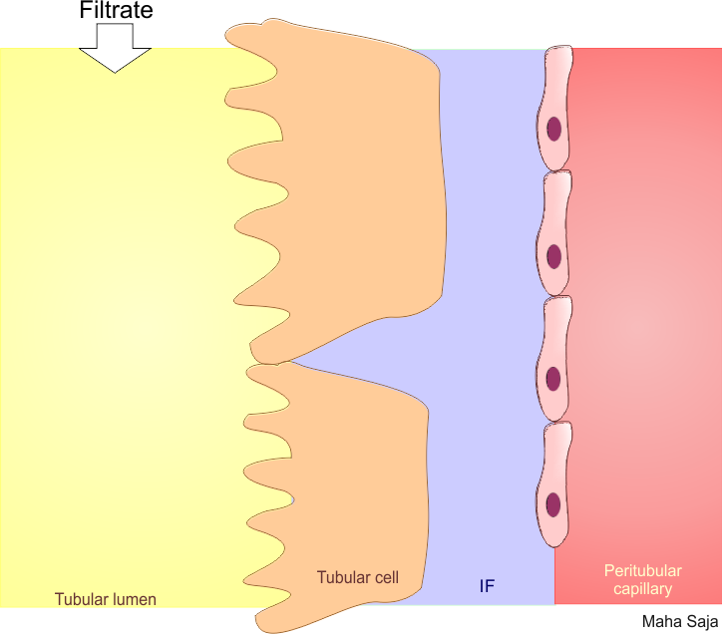
How Does the Proximal Tubule Reabsorb Sodium (Na⁺)?
Basolateral Na⁺-K⁺
ATPase pumps 3Na⁺ out and 2K⁺
into the cell
2 K⁺
Na⁺
Na⁺
Na⁺
ATPase
Na⁺
Na⁺
3 Na⁺
Na⁺
↓ [Na⁺]_{i}
Na⁺
Na⁺
Na⁺
Na⁺
Results in low [Na⁺]i
NBC
HCO₃⁻
Paracellular
This gradient favours passive entry of Na⁺ into the tubular cell across the apical membrane via transporter proteins
Transcellular
Basolateral
membrane
Apical
Many types of transporter proteins;
Co-transporters.
Exchangers (counter-transporters).

Slide 16
How Does the Proximal Tubule Reabsorb Glucose?
Basolateral Na⁺-K⁺
ATPase pumps 3Na⁺ out and 2K⁺
into the cell
2 K⁺
Na⁺
Na⁺
Na⁺
SGLT
ATPase
Glu
3 Na⁺
Na⁺
Glu
Glu
Glu
Glu
Results in low [Na⁺]i
↓ [Na⁺]_{i}
GLUT
This gradient favours passive entry of Na⁺ into the tubular cell across the apical membrane via SGLT carrying glucose with it.
Transcellular
Basolateral
membrane
Apical
Amino acids and other substances are absorbed in a similar way using transporters specific for the substrate being transported

Slide 17
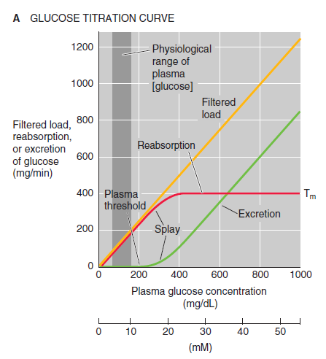
The Relationship Between Plasma [Glucose] and its Urine Excretion
What are the features of this glucose titration curve?
What is the plasma threshold of glucose?
What is meant by transport maximum (Tm)? Why does it occur?
What happens if blood glucose level increased to 400mg/dl?
(Boron & Boulpaep. Medical Physiology. Updated edition)

Slide 18
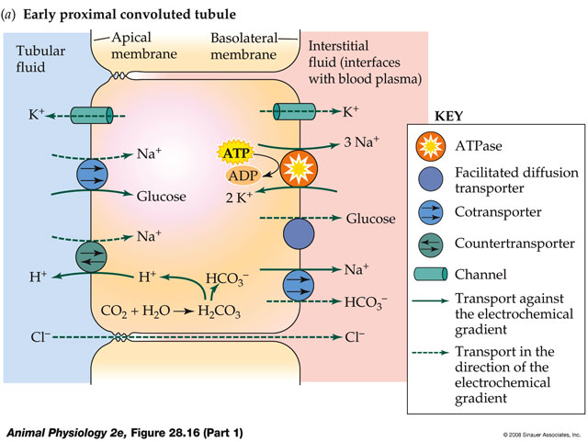
Summary of PT Transport Mechanisms
Basolateral Na⁺-K⁺
ATPase pumps 3Na⁺ out and 2K⁺
into the cell
Results in low [Na⁺]i
This gradient favours Na⁺ entry across the apical membrane via transporter proteins

Slide 19
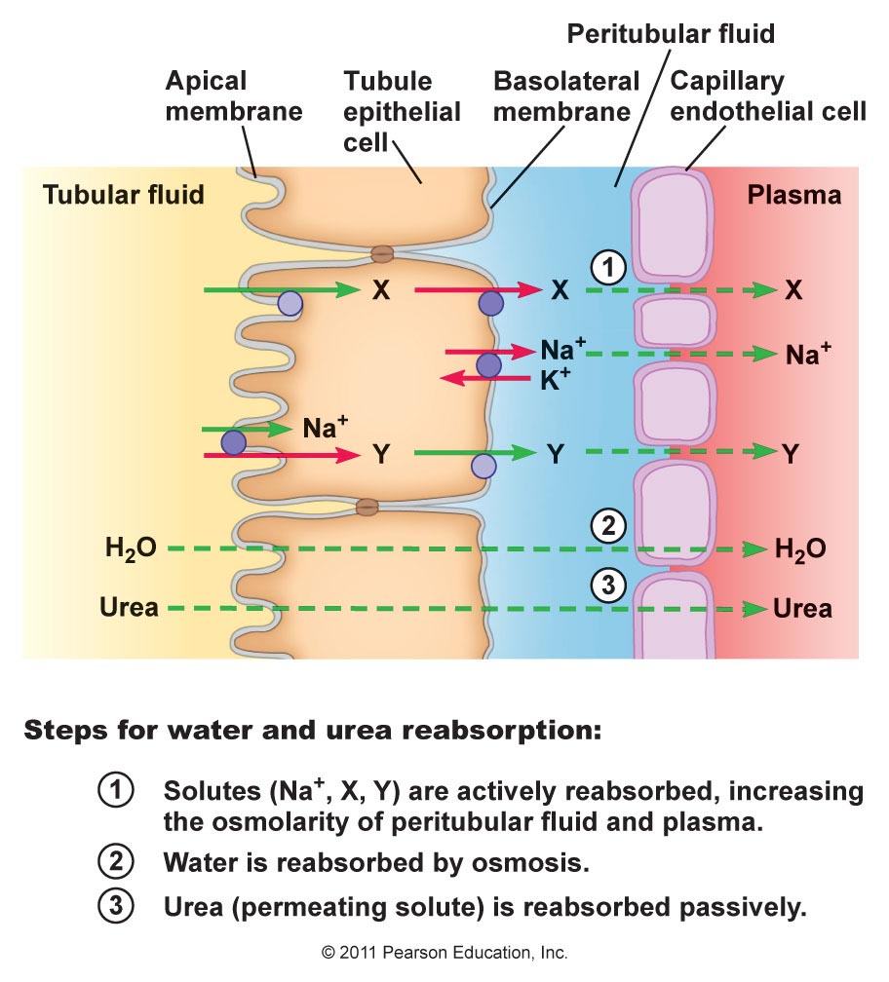
How Does the Proximal Tubule Reabsorb Water?
Water is reabsorbed through both;
Paracellular path
Transcellular path
Transcellular movement is facilitated by the presence of water channels (AQP1)

Slide 20
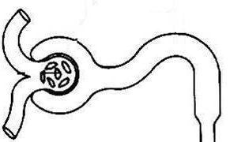
Differences in Sodium Reabsorption Along PT
Na⁺ reabsorption is coupled to that of;
Glucose.
Amino acids.
Lactate.
Phosphate
H⁺
Na⁺ reabsorption is mainly coupled to that of;
Cl⁻
Why??
Symporters
Antiporter
Na⁺
Glu
aa
H₂O
↑ [Cl⁻]
1st half
2nd half

Slide 21
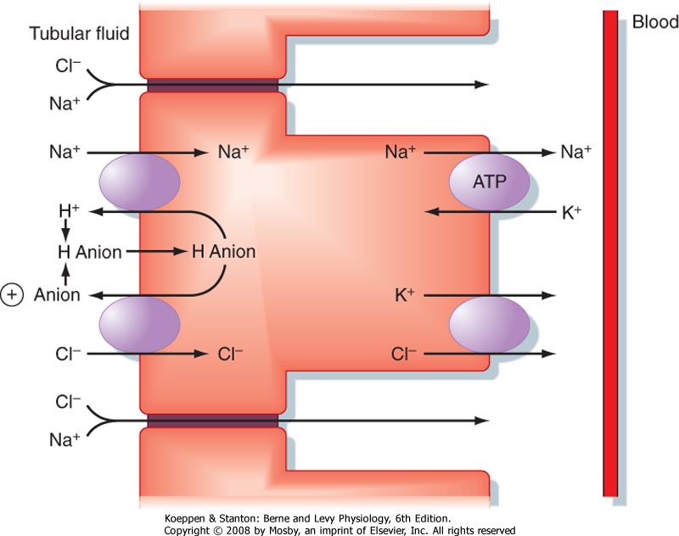
Sodium Chloride Reabsorption in the 2nd Half of PT
e.g.
Formate
Oxalate
Sulfate

Slide 22
How Does the Proximal Tubule Secrete Hydrogen Ions?
Basolateral Na⁺-K⁺
ATPase pumps 3Na⁺ out and 2K⁺
into the cell
↓ [Na⁺]_{i}
2 K⁺
Na⁺
Na⁺
Na⁺
ATPase
Na⁺
NHE3
H⁺
3 Na⁺
Na⁺
H⁺
HCO₃⁻
Results in low [Na⁺]i
H₂CO₃
CO₂ + H₂O
This gradient favours passive entry of Na⁺ into the tubular cell across the apical membrane via NHE in exchange with H⁺.
Basolateral
membrane
Apical

Slide 23
Organic Anion/Cation Secretion
Organic Anions
Organic cations
Endogenous:
Bile salts.
Oxalate.
Urate.
Vitamins (ascorbate, folate).
Exogenous:
Acetazolamide.
Furosemide.
Salicylates.
Penicillin.
Endogenous;
Creatinine.
Dopamine.
Epinephrine.
Norepinephrine.
Exogenous;
Atropine.
Morphine.
Amiloride.
Procainamide.

Slide 24
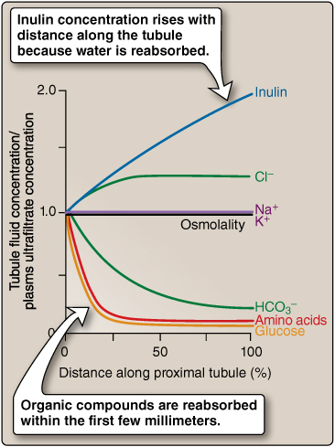
Summary of PCT Filtrate Modification

Slide 25
Loop of henle

Slide 26
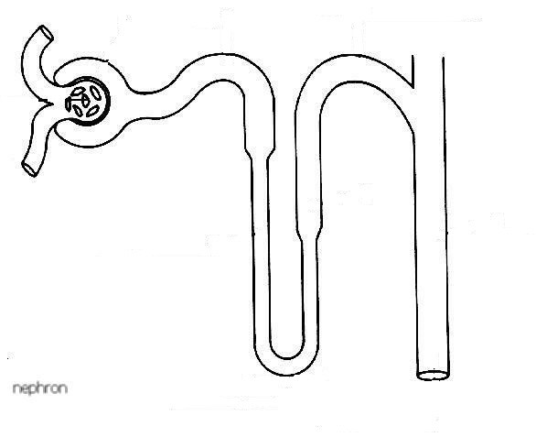
Loop of Henle
Descending limb
Ascending limb
25% of Na+, Cl-, K+ load is reabsorbed
H+
Na+
Cl-
K+
Ca++
Mg++
Active transport
1-Na+, 2-Cl-, 1-K+ co-transporter
Thick
Diffusion
20%
Thin descending
H2O
H2O
Highly permeable to water
Moderate permeability to solutes
Impermeable to water
Reabsorption of solutes in the thick segment

Slide 27
Transport Mechanisms in the TAL
Basolateral Na⁺-K⁺
ATPase pumps 3Na⁺ out and 2K⁺
into the cell
↓ [Na⁺]_{i}
Na⁺
2 K⁺
Na⁺
Na⁺
2Cl⁻
NKCC2
ATPase
K⁺
3 Na⁺
Na⁺
K⁺
Results in low [Na⁺]i
Na⁺
Na⁺
NHE3
H⁺
H⁺
Ca⁺²
Mg⁺²
This gradient favours passive entry of Na⁺ into the tubular cell across the apical membrane via NKCC2 along with Cl⁻ & K⁺.
Basolateral
membrane
Apical
Loop diuretics block NKCC2

Slide 28
Distal tubule & Collecting duct

Slide 29
Transport Across the Distal Tubule
Resembles the thick ascending loop of Henle
Known as the diluting segment
Reabsorbs 5% of NaCl
Early part
Late part
Resembles the cortical collecting tubule
Impermeable to urea
Principal cells
Intercalated cells
Type A
Reabsorb Na+ & H2O
Secrete K+
Reabsorb K+
Secrete H+
Controlled by Aldosterone
Acid-base regulation
Permeability to H2O depends on ADH
(Guyton & Hall Medical Physiology, 12e)

Slide 30
Transport Mechanisms in the Early DT
Basolateral Na⁺-K⁺
ATPase pumps 3Na⁺ out and 2K⁺
into the cell
Na⁺
2 K⁺
Na⁺
Na⁺
NCC
ATPase
Cl⁻
3 Na⁺
Na⁺
Results in low [Na⁺]i
↓ [Na⁺]_{i}
This gradient favours passive entry of Na⁺ into the tubular cell across the apical membrane via NCC along with Cl⁻.
Basolateral
membrane
Apical
Thiazide diuretics block NCC

Slide 31
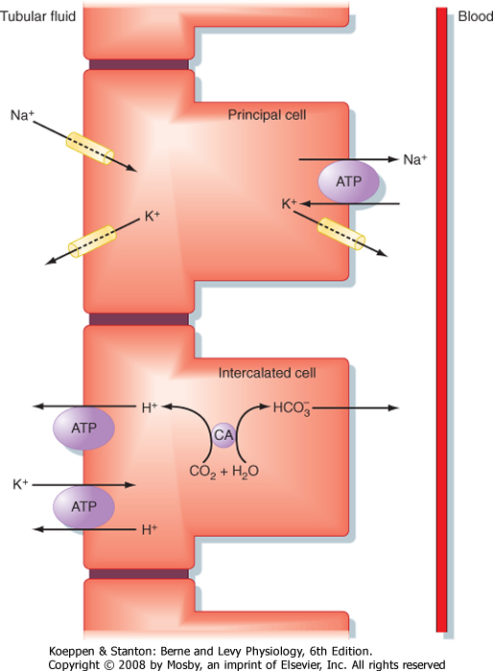
Late Distal Tubule & Collecting Tubule
Aldosterone
Aldosterone antagonists
e.g. Spironolactone
Na+ channel blockers
Potassium-sparing diuretics

Slide 32
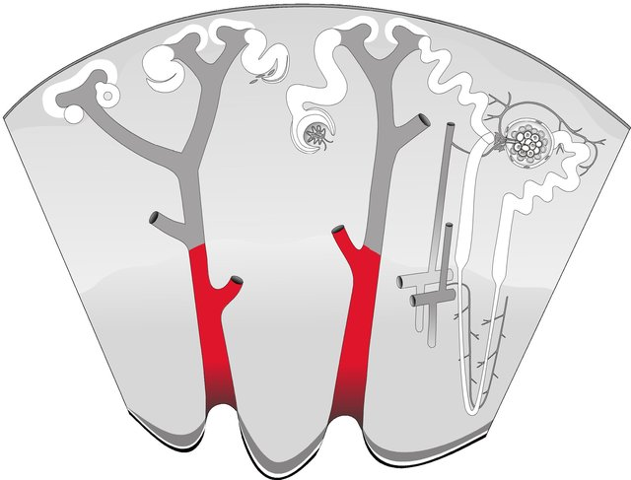
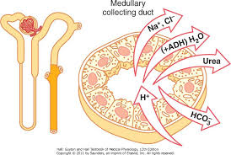
Medullary Collecting Duct
Reabsorbs ≈ 3% of filtered Na⁺
Permeability to water is under ADH control
Permeable to urea
Secrete H+
Reabsorbs ≈ 3% of filtered Na⁺

Slide 33
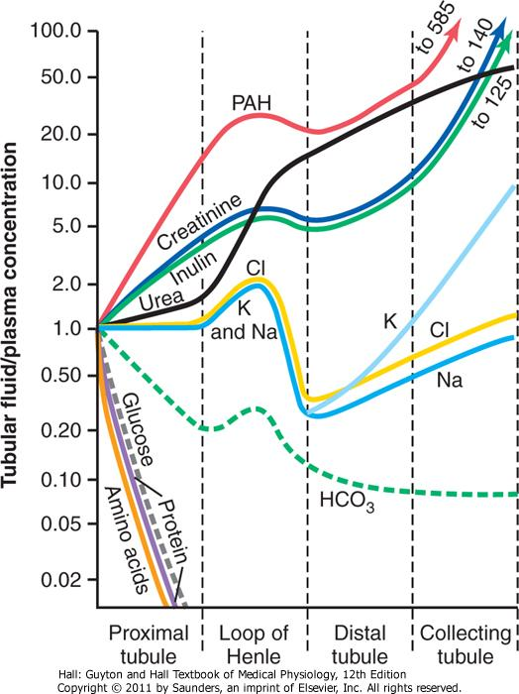
Summary of the Concentrations of the different Solutes in the Different Tubular Segments

Slide 34
Regulation of tubular reabsorption

Slide 35
Regulation of Tubular Reabsorption
Regulation of tubular reabsorption depends on:
Physical forces that govern reabsorption.
Hormonal and neural mechanisms.
Tubules can increase their reabsorption in response to increased tubular load → glomerulo-tubular balance.
What are the physical forces that govern tubular reabsorption?
Pushes fluid out
Pulls fluid in
Hydrostatic Pr. (P)
Oncotic Pr. (π)

Slide 36
Physical Forces that Govern Tubular Reabsorption
P_{C} is influenced by:
ABP.
Aff & Eff arteriolar resistance
π_{C} is influenced by:
FF.
Systemic plasma colloid osmotic pr.
Reabsorption
Net absorptive force
10mmHg
P_{C}
Reabsorption
Favouring
Opposing
π_{C}
π_{C}
= 32
P_{C}
= 13mmHg
P_{IF}
P_{IF}
= 6
π_{IF}
= 15
π_{IF}
38
>
28
(Guyton & Hall Medical Physiology, 12e)

Slide 37
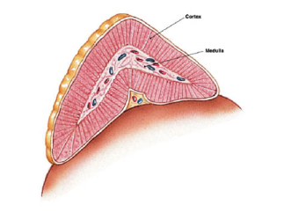
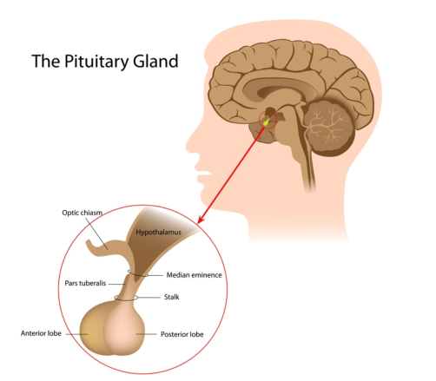
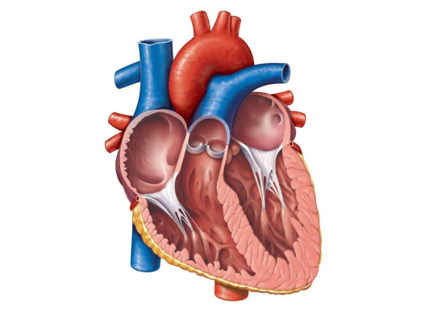
Hormonal Regulation of Tubular Reabsorption
Adrenal gland
↓↓ ABP
↓↓ Blood volume
↓↓ NaCl
Renin
Angiotensin II
Efferent constriction
Na+
Aldosterone
P cells
Na+
K+
Na+ &
H2O
ADH
ANP
H2O
↑↑ Blood volume

Slide 38
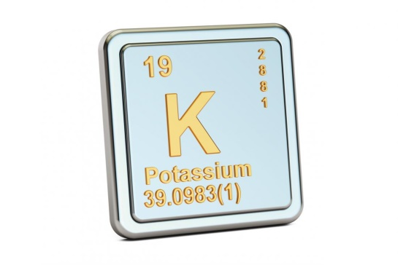
Regulation of potassium

Slide 39
Potassium
One of the most abundant cations in the body.
98% in ICF and 2% in ECF.
[K⁺]_{I} > [K⁺]_{o} → 150 mEq/L > 3.5-5 mEq/L.
Why is K⁺ important?
Cell volume regulation.
Cell pH regulation.
Resting membrane potential.
Cardiac and neuronal activity.

Slide 40
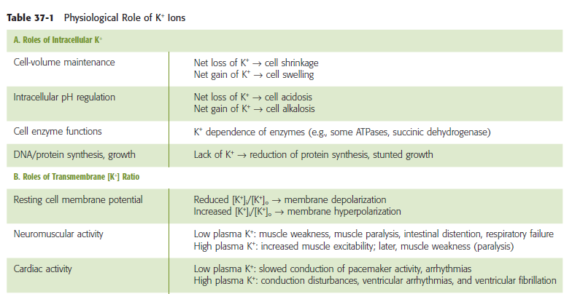
The Importance of Regulating K⁺
(Boron & Boulpaep. Medical Physiology)

Slide 41
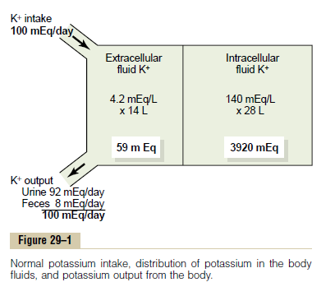
Potassium Homeostasis
2%
98%
Diet 50-200mEq/day
How does the body protect against this risk of hyperkalemia following each meal?
Absorption of 40mEq of K⁺
↑ [K⁺] in ECF ≈ 2 mEq/L!!
Potassium output:
GI loss ≈ 5-10%
Renal excretion ≈ 90-95%.

Slide 42
Body Defense Against K⁺ Abnormalities
Cellular shift
Renal excretion
1st line of defence
Redistribution of K⁺ between ICF and ECF.
↑↑ ECF [K⁺] → shift K⁺ into the cells
↓↓ ECF [K⁺] → shift K⁺ out of the cells.
What are the factors altering K⁺ distribution between both compartments?
Depending on K⁺ body status, the kidney may;
↑↑ excretion of K⁺
↓↓ excretion of K⁺
How does the kidney achieve that?

Slide 43
Cellular shift

Slide 44
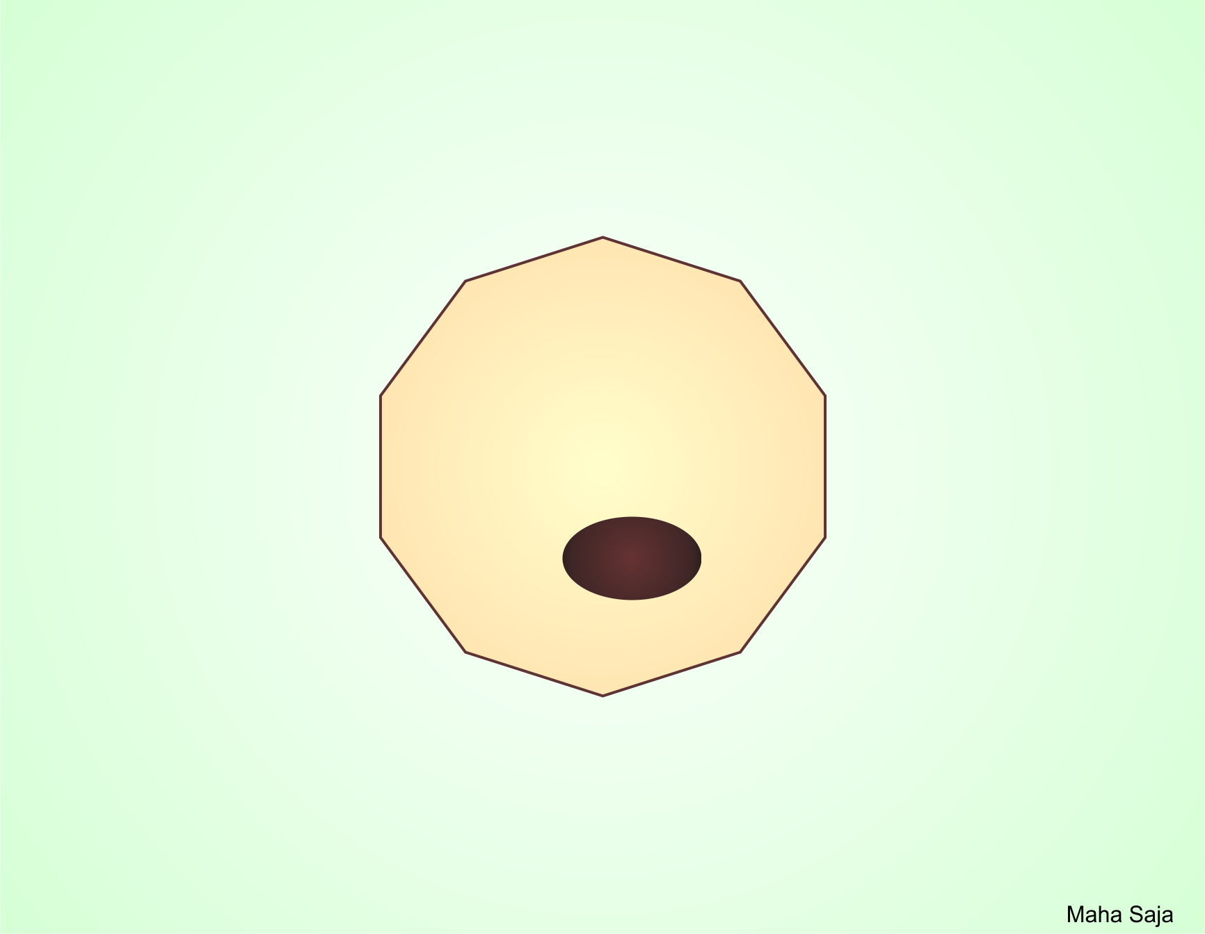
Factors That Can Shift K⁺ In and Out of Cells
Shift K⁺ out
Shift K⁺ in
Insulin deficiency
Insulin
Aldosterone deficiency
Aldosterone
β-adrenergic blockers
β-adrenergic stimulation
H⁺
K⁺
Acidosis
K⁺
H⁺
Alkalosis
↑ [H⁺]
↓ [H⁺]
Cell lysis
Strenuous exercise
↑ ECF osmolarity

Slide 45
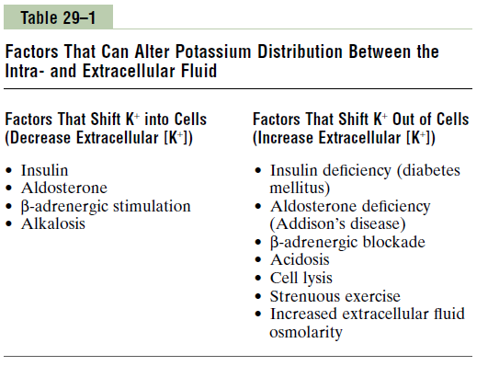
Factors Affecting K⁺ Distribution Between ICF and ECF
(Guyton & Hall Medical Physiology, 12e)

Slide 46
Physiologic factors affecting K⁺ distribution between ICF and ECF:
Help regulate plasma [K⁺]: keep plasma [K⁺] constant.
Aldosterone.
Insulin.
Epinephrine.
(Boron & Boulpaep Medical Physiology-updated edition)

Slide 47
Pathophysiologic Factors Affecting K⁺ Distribution Between ICF and ECF
Acid base disturbance.
Change in plasma osmolality.
Cell lysis.
Exercise.
How do these factors affect K⁺ distribution between ICF and ECF compartments?

Slide 48
Renal potassium Excretion

Slide 49
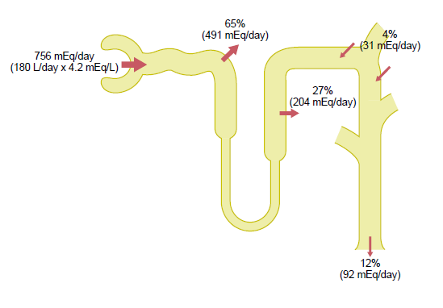
Renal Potassium Handling
≈ 65% reabsorbed by PT.
≈ 25-30% reabsorbed by TAL.
≈ 5-10% enters the distal portions of the nephron.
If K⁺ intake is low only 1-3% of filtered K⁺ will be excreted.
If K⁺ intake is normal/high, 10-15% of filtered K⁺ will be excreted

Slide 50
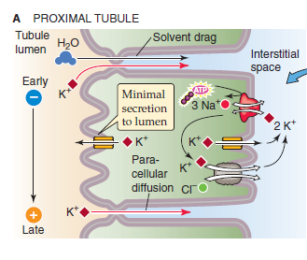
Potassium Handling by the kidney
In the PCT → K⁺ reabsorption is a passive process.. How?
Water reabsorption through the paracellular route drags K⁺ with it (solvent drag).

Slide 51
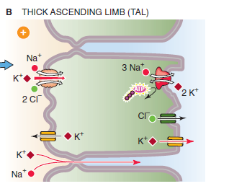
Potassium Handling by the TAL
By secondary active transport using the apical triple transporter (NKCC2).

Slide 52
Potassium Handling by the Distal Portions of the Nephron
High K⁺ intake → ↑ secretion of K⁺.
Principle cells
Aldosterone
+
Reabsorb Na⁺ and water & secrete K⁺
Low K⁺ intake → ↓ secretion of K⁺.
α-intercalated cells
In K⁺ depletion → ↑ reabsorption of K⁺.
Secrete H⁺ and reabsorb K⁺

Slide 53
Factors Regulating Potassium Secretion
Factors that stimulate potassium secretion:
↑↑ ECF [K⁺].
↑↑ aldosterone.
↑↑ tubular flow rate.
Factors that decrease potassium secretion:
Acidosis (↑↑ [H⁺])

Slide 54
Thank you

