Slide 1
Regulation of extracellular fluid volume
Dr. Maha Saja
Physiology department,
Email: msaja@ksu.edu.sa

Slide 2
Objectives
Identify and describe the role of the sensors and effectors in the renal regulation of body fluid volume.
Describe the role of the kidney in regulation of body fluid volume.
Identify the site and describe the influence of aldosterone on reabsorption of Na⁺ in the late distal tubules.

Slide 3
Introduction
Regulation of ECF
Control of ECF volume
Control of ECF osmolarity
Why is it important to regulate ECF volume & osmolarity?
Determines;
blood pressure → tissue perfusion
Affect;
Cell volume → cell function

Slide 4
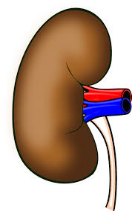
Introduction
Regulation of ECF
ECF volume is regulated by
ECF osmolarity is regulated by
Adjusting total body Na⁺ content
The two systems use different;
Sensors
Hormonal transducers
Effectors
Adjusting total body water content
This is the focus of this lecture
This was discussed in the last lecture
Na⁺ Excretion
Water Excretion
urine

Slide 5
Why does the body regulate ECF volume by adjusting body Na⁺ content??
Let’s revise a few concepts!

Slide 6
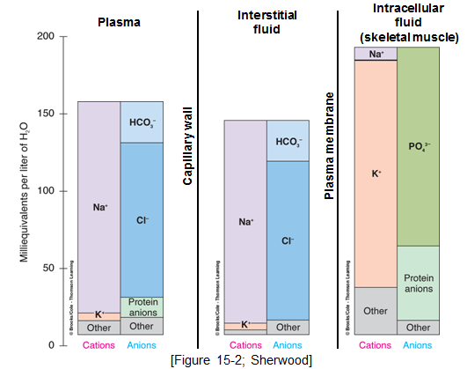
Electrolyte Composition of Body Fluids
ECF
The main osmotic constituents of ECF

Slide 7
ECF Volume
The most abundant cation in ECF is Na⁺
The most abundant anions in ECF are Cl⁻ and HCO3⁻
The body regulates ECF volume by monitoring and adjusting total body content of Na⁺
ECF volume is closely linked to Na⁺ balance… How??

Slide 8
Why is Na⁺ Content the Main Determinant of ECF Volume?
↑↑ [Na⁺] in ECF
↑↑ ECF osmolarity
↑↑ H2O reabsorption by kidney and stimulate thirst
Increases ECF volume
Na⁺ and its associated anions are the main osmotic constituents of ECF volume.
When Na⁺ salts move, water must follow.

Slide 9
Sodium Balance
Input
Output
Dietary intake;
RDA = 1.5-2.3 g/day
Actual content in western diet = 7g/day
Kidney (most important).
GI loss
Sweat
Minor pathways under normal conditions
(Preston & Wilson. Lippincott’s illustrated reviews Physiology)

Slide 10
Sodium Distribution in the Body
Body sodium distribution
ECF
(65%)
ICF
(5-10%)
Bones
(25-30%)
As Na⁺ apatite salts
Exchangeable
(Boron & Boulpaep. Medical Physiology)

Slide 11
ECF volume Regulation

Slide 12
ECF Volume Regulation
What does the body sense?
What are the sensors?
How does it execute its action? What are the effectors?

Slide 13
What Does the Body Sense?
The body does not sense ECF volume per se! But it senses Effective circulating volume (ECV).
Effective circulating volume (ECV) = a functional blood volume that reflects the extent of tissue perfusion in specific regions, as evidenced by the pressure in their blood vessels.
In short, ECV reflects adequacy of circulation. Fullness and pressure in the vessels.
Usually changes in ECV parallel those of ECF volume.
(Boron & Boulpaep. Medical Physiology)

Slide 14
Effective Circulating Volume
Normal ECF volume
Normal ECV
Normal ABP and Adequate tissue perfusion
Decrease in ECF volume
Increase in ECF volume
Decrease in ECV
Increase in ECV
Decrease in tissue perfusion
Increase in ABP & tissue perfusion

Slide 15
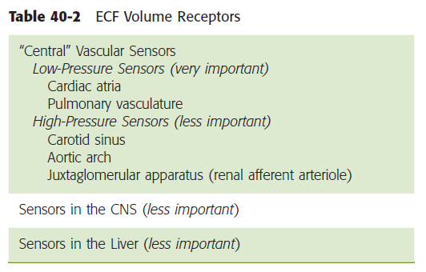
What are the Sensors?
Changes in ECV are sensed by baroreceptors.
Low-pressure baroreceptors.
High-pressure baroreceptors.
(Boron & Boulpaep. Medical Physiology)

Slide 16
What are the Effectors?
Change in ECV (ECF volume)
Affects ECV sensors
Baroreceptors
This generates 4 distinct hormonal/neural pathways
RAAS
Sympathetic NS
ADH
ANP

Slide 17
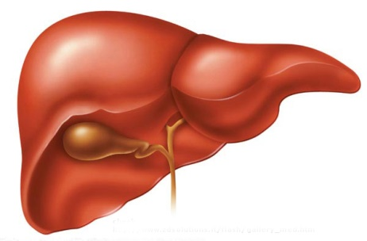
The Renin-Angiotensin-Aldosterone System (RAAS)
↓↓ ECV
↓↓ stretch of baroreceptors in the afferent arteriole
Causes granular cells to release Renin
Angiotensinogen
Renin
ACE
Angiotensin-I
Angiotensin-II
↑↑ Aldosterone
↑↑ ADH
↑↑ reabsorption of Na⁺ from tubule
Vasoconstrictor
↓↓ Na⁺ excretion
(Boron & Boulpaep. Medical Physiology)

Slide 18
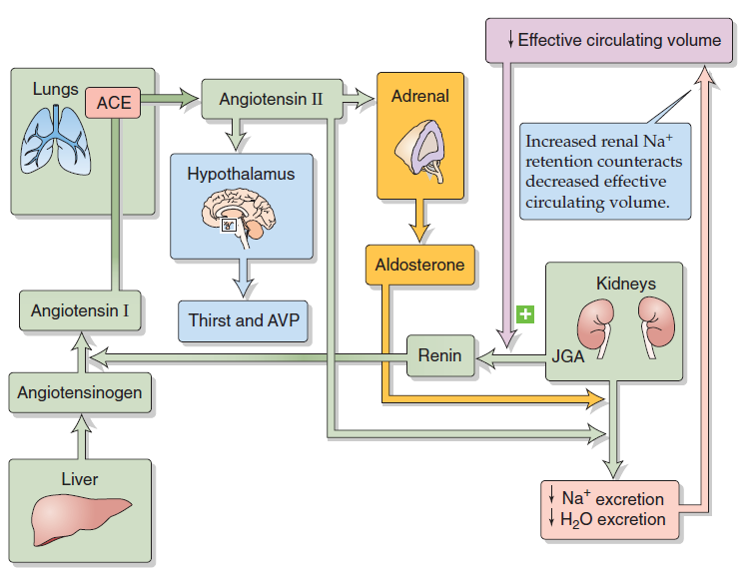
The Renin-Angiotensin-Aldosterone System (RAAS)
↓ ABP
↓ [NaCl] at macula densa
↓ renal perfusion pressure
(Boron & Boulpaep. Medical Physiology)

Slide 19
Sympathetic Nervous System (SNS)
Its role is thought to be especially important during stressful conditions, e.g. hemorrhage.
Stimulates SNS
Direct
↑↑ Na⁺ reabsorption
↑↑ Renal vascular resistance
Indirect
Stimulate renin release
↓↓ ECV

Slide 20
Atrial Natriuretic Peptide (ANP)
ANP promotes natriuresis (Na⁺ excretion).
Secreted by atrial myocytes in response to stretch.
↓↓ ECV
↓↓ ANP release
↓↓ Na⁺ excretion

Slide 21
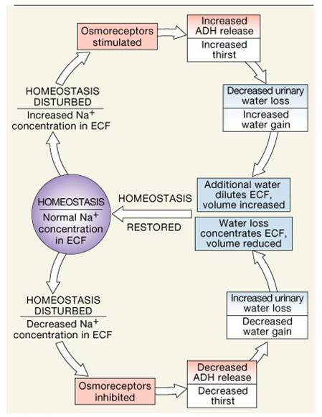
Antidiuretic Hormone (ADH)
Large ↓↓ in ECV
↑↑ ADH (AVP)

Slide 22
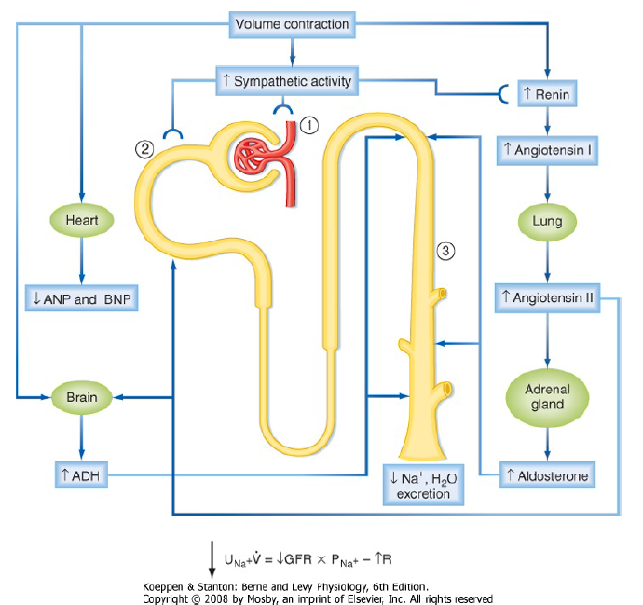
Summary

Slide 23
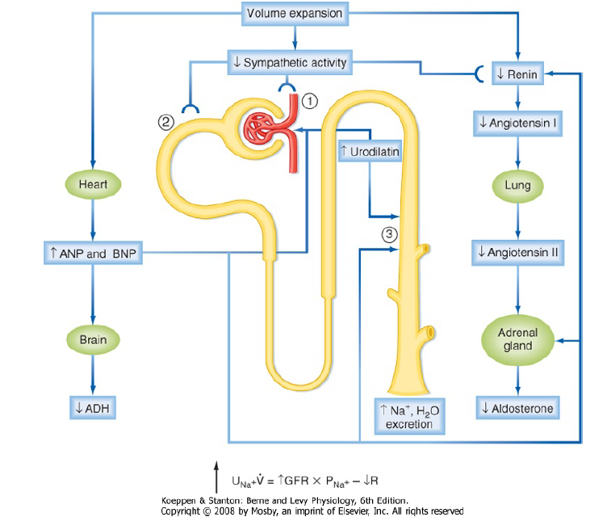
Summary

Slide 24
Final Note
Although, under physiologic conditions, the body regulates plasma volume & plasma osmolarity independently.
Severe derangements in fluid & electrolyte balance may challenge the system by presenting two conflicting changes in osmolarity and volume.
In general, the body defends volume at the expense of osmolarity.

Slide 25
Thank you

