Slide 1
Diuresis
By
Dr. Ola Mawlana

Slide 2
Objectives
To measure the volumes and determine the compositions of urine excreted by 4 groups:
( fasting / drunk 1 L water/ drunk 1L saline / took 1 tab of lasix).
To be able to discuss the mechanisms by which the body maintain the water and sodium homeostasis in the 4 different conditions.
Definition and clinical applications of:
- GFR ( Glomerular Filtration Rate)
- C_{Cr} ( Creatinine Clearance )

Slide 3
Urine samples examination
Volume (measuring cylinder)
Sodium and potassium concentration (flame photometry)
PH (PH meter)
Osmolality (Osmometer)

Slide 4
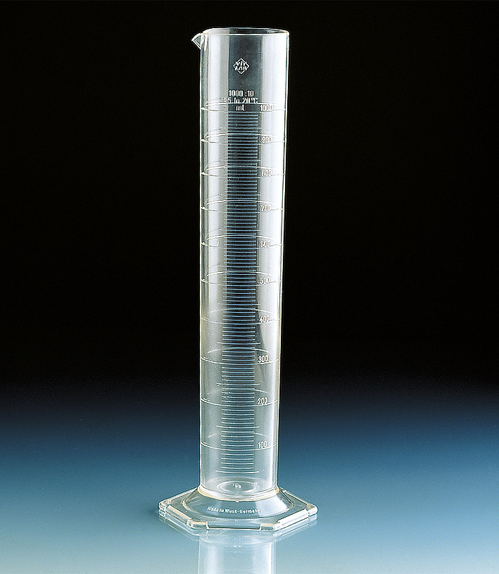
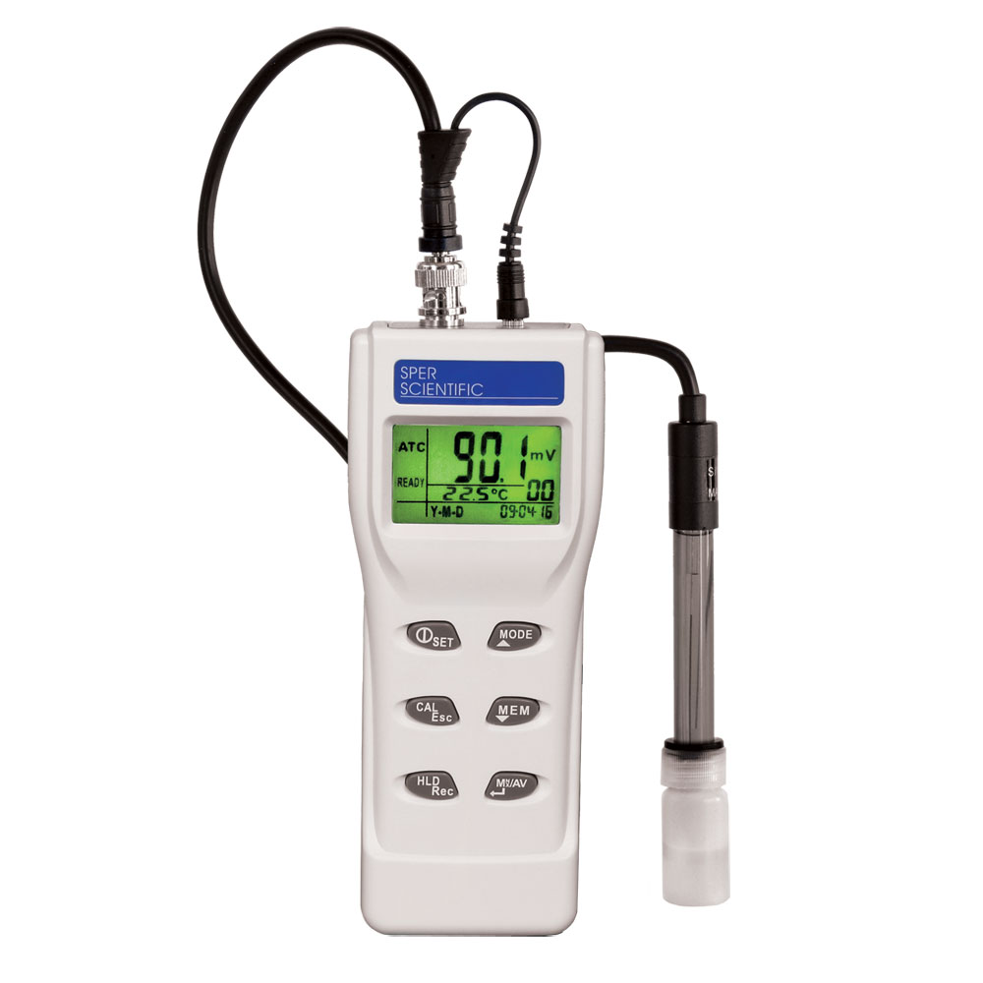
Measuring cylinder
PH meter

Slide 5
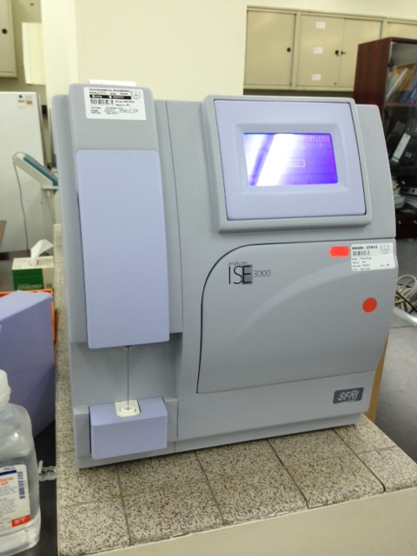
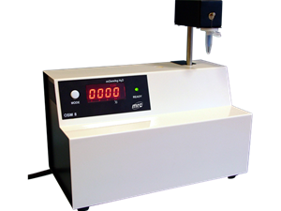
Flame photometry
Osmometer

Slide 6
Group 1
Emptied their bladders at 8:00 am and discarded the urine.
From 8:00 they are restricted to take any fluids and they are asked to provide various urine samples for analysis at:
10:00 am, 12:00 noon, 2:00 pm and 3:00 pm.

Slide 7
Group 1
What will happen?
Subsequent urine sample is lesser in volume and darker yellow in color that shows the kidneys try to conserve water in fasting state.

Slide 8
Group 1
Deprive of H₂O
1
Plasma osmolarity
2
Stimulates Osmoreceptors in anterior hypothalamus
Thirst
3
3
ADH secretion from posterior pituitary
H₂O drinking
4
H₂O permeability in late distal tubule and collecting duct
5a
Plasma Osmolarity Toward Normal
H₂O reabsorption
5b
Urine osmolarity and urine volume
6

Slide 9
Group 2(Water Diuresis)
Emptied their bladder at 08:00 am and discarded the urine.
At 10:00 am emptied their bladder again, but this time they measured its volume and provided a sample for analysis. This sample will be pre-experimental sample.
Drank 1 liter of water immediately after providing the pre-experimental sample.
Were then asked to empty their bladders and provide post-experimental samples every half an hour after drinking water until 3:00 pm.

Slide 10
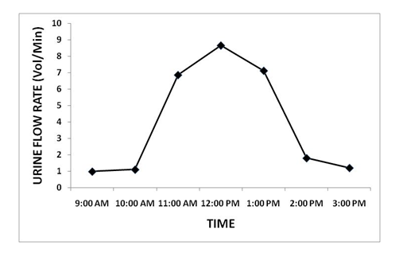
Group 2

Slide 11
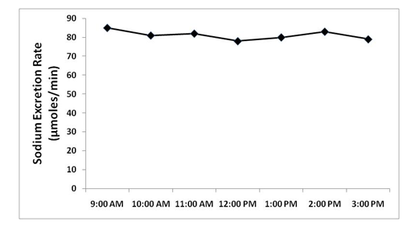
Group 2

Slide 12
m
Group 2
1
Drink 1L H₂O
Plasma Osmolarity
2
3
Thirst
Inhibits osmoreceptors in anterior hypothalamus
3
ADH secretion from posterior pituitary
H₂O drinking
4
H₂O permeability in late distal tubule and collecting duct
5a
H₂O reabsorption and excretion
Plasma osmolarity toward Normal
5b
Urine Osmolarity and
urine volume
6

Slide 13
Group 3
Emptied their bladder at 7:00 am and discarded the urine.
At 9:00 am emptied their bladder again, but this time they measured its volume and provided a sample for analysis. This sample will be pre-experimental sample.
Drank 1 liter of 0.9% saline (isotonic saline) immediately after providing the pre-experimental sample.
Were then asked to empty their bladders and provide post-experimental samples every hour after drinking saline until 3:00 pm.

Slide 14
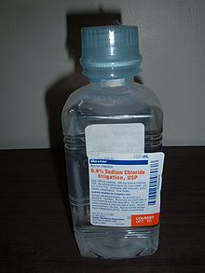
Isotonic saline 0.9%
Contains 154 mmol of NaCI, equivalent to 9 g of salt or 3.6 g of sodium.
The sodium concentration of isotonic saline is equivalent to the normal sodium concentration of plasma water.

Slide 15
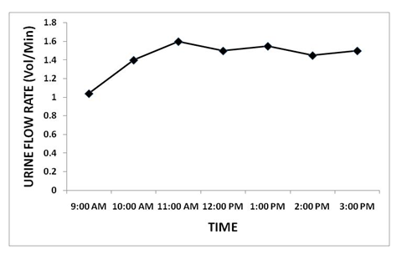
Group 3

Slide 16
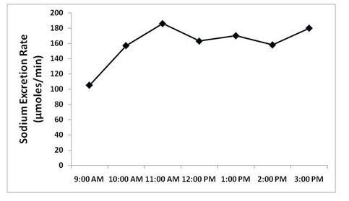
Group 3

Slide 17
Group 3
Isotonic Saline (0.9%)
1 liter
Volume of E.C.F. Osmolality same (as isotonic saline)
Stretch on right atrium (volume receptors in right atrium)
ANP
↑ blood flow to the kidney
↑GFR
↑Na loss in urine
↓ Aldosterone
↓ Na reabsorption in DCT (↑ Na loss in urine)
ANP (Atrial Natriuretic peptide)
Na excretion by Kidneys

Slide 18
Group 4(Osmotic Diuresis)
Emptied their bladder at 8:00 am and discarded the urine.
At 10:00 am emptied their bladder again, but this time they measured its volume and provided a sample for analysis. This sample will be pre-experimental sample.
Swallowed a Lasix (Furosemide) tablet 40 mg with the help of 25 ml of water immediately after providing the pre-experimental sample.
Were then asked to empty their bladders and provide post-experimental samples every hour after taking Lasix until 12:00 noon and then every half an hour until 3:00 pm.

Slide 19
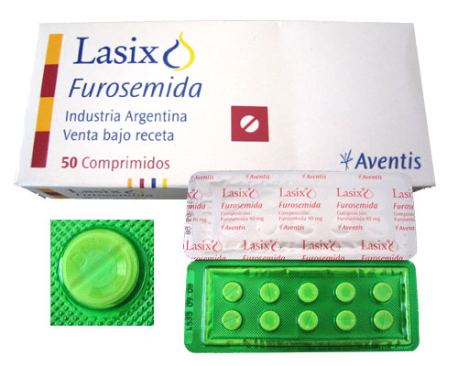
What is Lasix?
Furosemide is a loop diuretic
used in the treatment of
hypertension, congestive
heart failure and edema.
It inhibits the sodium-potassium-chloride co-transport system located within the ascending limb of the Loop of Henle.

Slide 20
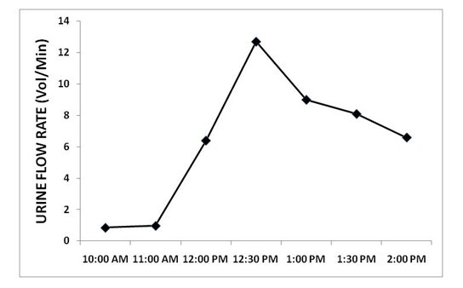
Group 4

Slide 21
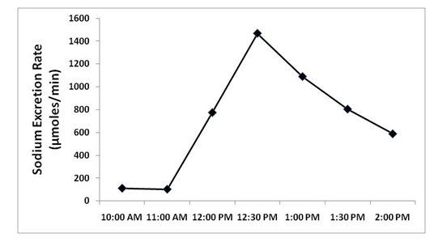
Group 4

Slide 22
Group 4
1 tab of Lasix (furosemide) (40mg)
with 25ml of water
Action starts 1-2 hours and lasts for 4-6 hours
(1/2 life of furosemide is 6hr)
Acts on thick ascending limb of loop of Henle and blocks the Na-K-2Cl co-transport (called loop diuretic)
Na excretion in urine and
water excretion (osmotic drag)

Slide 23
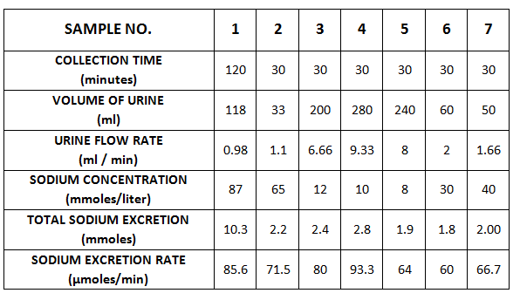
The table that we fill out during the experiments

Slide 24
Calculation
Total sodium excretion is obtained by applying following equation:
Sodium excretion rate is obtained by applying the following equation:

Slide 25
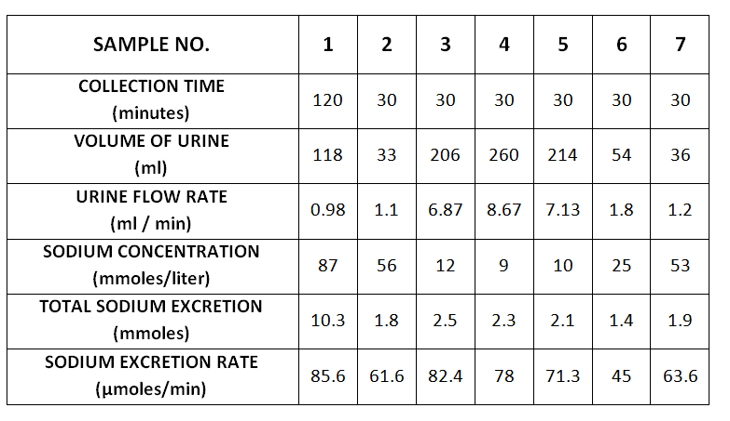
Group 2

Slide 26
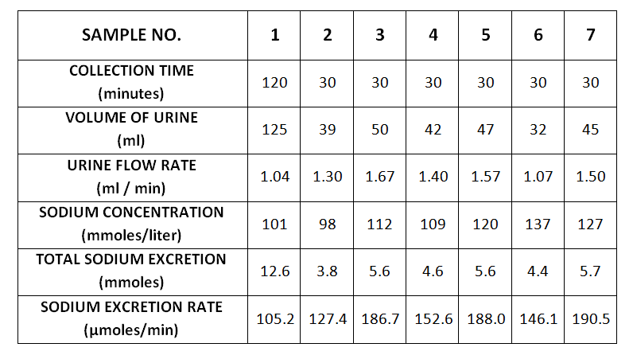
Group 3

Slide 27
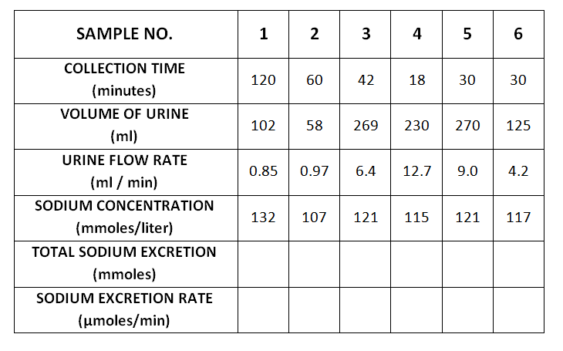
Group 4

Slide 28
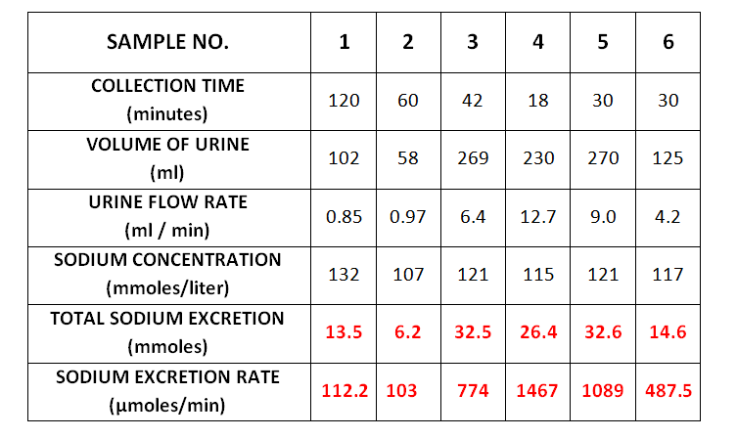
Group 4

Slide 29
Thank You

