Slide 1
Chemical Examination of Urine
Renal Block

Slide 2
Objectives
Upon completion of this lecture, students should be able to:
Differentiate between normal and abnormal constituents of urine including: Proteins, sugars, ketone bodies, nitrite, bile pigments, blood etc.
Know the clinical conditions in different types of proteinuria, blood-uria and glycosuria etc.

Slide 3
Overview
Introduction
Normal composition of urine
Abnormal composition of urine
Proteinuria:
Pre-renal (multiple myeloma)
Renal
Post-renal
Glycosuria: fructosuria, galactosuria
Ketonuria
Hematuria: hemoglobinuria

Slide 4
Urine
Urine is a fluid excreted by most animals including humans
It is formed in the kidneys (renal glomeruli)
The fluid undergoes chemical changes before it is excreted as urine
Normal urine excretion by a healthy person is about 1.5 L per day
Notes:
4

Slide 5
Normal composition of urine
Urine contains organic and inorganic constituents:
Major inorganic constituents:
Sodium
Potassium
Chloride
Small amounts of Ca, Mg, sulfur and phosphates
Traces of Fe, Cu, Zn, I
Major organic constituents:
Non-protein nitrogen (NPN) compounds
Organic acids
Sugars
Traces of proteins, vitamins, hormones, pigments
Notes:
5

Slide 6
Abnormal composition of urine
Proteins:
Normal urine contains small amount of protein:
< 200 mg/day
Excretion of more than this level causes proteinuria
Proteinuria:
Excretion of abnormal amounts of protein in urine
Proteinuria has three types:
Pre-renal
Renal
Post-renal
Notes:
6

Slide 7
Pre-renal proteinuria
Some diseases or conditions increase plasma protein levels not involving the kidneys
Causes increased filtration of these proteins in the kidneys
This exceeds the normal reabsorptive capacity of renal tubules
Results in overflow of proteins in the urine
Multiple myeloma:
Cancer of the antibody-producing plasma cells
Causes pre-renal proteinuria
Notes:
7

Slide 8
Pre-renal proteinuria
The serum contains elevated levels of light-chain monoclonal antibodies called Bence-Jones protein
This protein is filtered in the kidneys in high amounts
Exceeding the tubular reabsorption capacity
Hence excreted in the urine
Bence-Jones protein coagulates at 40–60 ºC and dissolves at 100 ºC
Multiple myeloma cases are diagnosed by:
Serum electrophoresis
Immunoelectrophoresis
Notes:
8

Slide 9
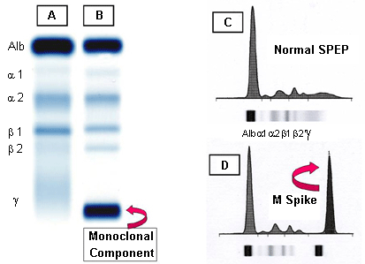
A: Normal serum
B: Multiple myeloma (M component in γ region)
C: Densitometry of “A”
D: Densitometry of “B” (M component is called M Spike)

Slide 10
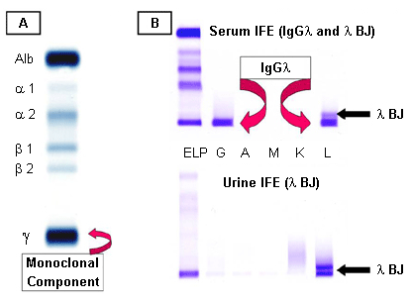
Multiple myeloma
A: Serum protein electrophoresis showing the M component
B: Serum and urine immunofixation electrophoresis

Slide 11
Renal proteinuria
Associated with renal disease
Glomerular proteinuria:
High glomerular permeability causes filtration of high molecular weight proteins
Example: glomerulonephritis
Tubular proteinuria:
Low tubular reabsorption with normal glomerular permeability
Causes excretion of low mol. wt. proteins
Example: chronic nephritis
Notes:
11

Slide 12
Renal proteinuria
Orthostatic (postural) proteinuria:
A form of benign or physiological proteinuria
Occurs frequently in young adults due to periods spent in a vertical posture (body position) or during muscular exercise
Increased pressure on the renal vein in the vertical position causes orthostatic proteinuria
Disappears in horizontal posture
Notes:
12

Slide 13
Renal proteinuria
Microalbuminuria:
Presence of small amounts of albumin in the urine
20–200 mg/L
Cannot be detected by ordinary urine testing
Needs special tests for detection
Early indicator of glomerular dysfunction due to:
Uncontrolled diabetes mellitus
Hypertension
Notes:
13

Slide 14
Post-renal proteinuria
Proteins are added to the urine after kidney filtration
While passing through the lower urinary tract (ureters, bladder, urethra, prostate, vagina)
Due to:
Lower urinary tract infection
Trauma
Tumors
Stones
Notes:
14

Slide 15
Glycosuria
Presence of sugar in urine
Glucosuria:
Presence of detectable amount of glucose in urine
Due to diabetes mellitus
Plasma glucose level exceeds the renal threshold
Due to renal disease (renal glucosuria)
Normal plasma glucose level with proximal tubular malfunction
Decreased renal threshold as observed in gestational diabetes and Fanconi’s syndrome
Notes:
15

Slide 16
Glycosuria
Fructosuria:
Presence of fructose in urine
Nutritional cause:
High fructose intake
Metabolic cause:
Low fructokinase or aldolase B in the liver
Galactosuria:
Presence of galactose in urine
Nutritional cause: high galactose intake
Metabolic cause:
Low galactokinase or galactose -1-PO4 uridyl transferase in the liver
Notes:
16

Slide 17
Ketonuria
Presence of ketones, acetone, acetoacetic acid and β-hydroxybutyric acid in urine
Due to:
Diabetic ketoacidosis
Starvation
Dietary imbalance: high fat and low CHO diet
Phenylketonuria (PKU)
Notes:
17

Slide 18
Choluria
Presence of bile, bilirubin and bile salts in urine
Bilirubin: normally no bilirubin is detected in urine
It is detected in:
Hepatocellular damage
Obstruction of bile duct due to stones (extrahepatic) and hepatic tumors (intrahepatic)
Urobilinogen: normally present in trace amounts
High urobilinogen is found in:
Hemolytic anemia
Hepatocellular damage
Nitrites:
Positive nitrite test indicates bacteria in urine
Notes:
18

Slide 19
Hematuria
Presence of detectable amount of blood in urine
Due to:
Acute / chronic glomerulonephritis
Local disorders of kidney and genito-urinary tract
Trauma, cystitis, renal calculi, tumors
Bleeding disorders
Hemophilia
Notes:
19

Slide 20
Hematuria
Hemoglobinuria:
Presence of hemolysed blood in urine
Due to:
Hemoglobinopathies
Sickle cell anemia
Thalassemia
Malaria
Transfusion reaction
Blood group incompatibility
Notes:
20

