Slide 1
Renal Excretion of Drugs
Dr. Ishfaq Bukhari
Pharmacology Department

Slide 2
Routes of Excretion
Main Routes of Excretion
Renal Excretion
Biliary Excretion
Minor Routes of Excretion.
Exhaled air (Exhalation)
Salivary
Sweat
Milk
Tears
Notes:
2

Slide 3
Renal Excretion
Structure of kidney
The structure unit of kidney is nephron
That consists of :
Glomerulus
Proximal convoluted tubules
Loop of Henle
Distal convoluted tubules
Collecting ducts
Notes:
3

Slide 4
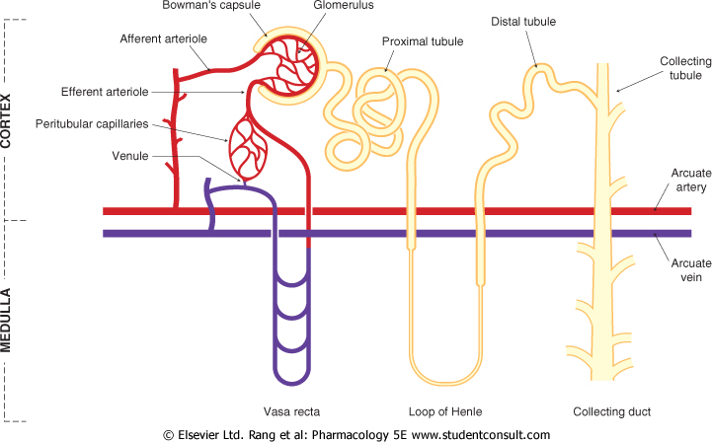
Kidney

Slide 5
Renal Excretion includes
Glomerular filtration
Active tubular secretion
Passive or active tubular reabsorption
Notes:
5

Slide 6
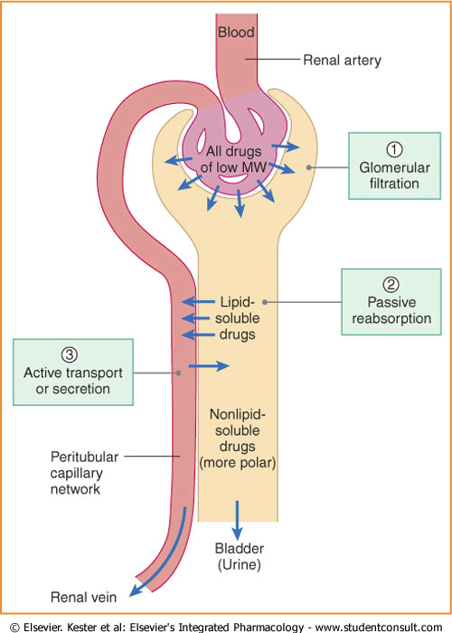

Slide 7
Glomerular filtration (GFR):
Depends upon renal blood flow (Normal GFR = 125-130 ml/min).
GFR depends on hydrostatic pressure of blood flowing in the capillaries.
Glomerular filtration occurs to
Low MW drugs (most proteins have high MW and are not filtered)
Only free drugs (unbound to plasma proteins) are filtered.
Polar or ionized or water soluble drugs are easily filtered e.g aminoglycosides
GFR is determined by creatinine, inulin, inulin is easily filtered by kidney not reabsorbed .
Notes:
7

Slide 8
ActiveTubular secretion:
occurs mainly in proximal tubules; increases drug conc. in lumen
It is carrier mediated and saturable
Requires energy to transport drugs against conc. gradients.
Notes:
8

Slide 9
ActiveTubular secretion:
Organic acids/anions e.g Penicillin and aspirin, uric acid
Organic bases/cations e.g morphine, catecholamine are actively secreted
Two drugs using the same carrier compete for excretion e.g probenicid increases half life of penicillin .
Notes:
9

Slide 10
Active tubular secretion
Therapeutic advantages of competition: Probenicid inhibits active tubular secretion of organic acids e.g. Penicillin, increases their plasma conc. 2 fold.
Probenecid acts as a uricosuric agent in treatment of gout.
It suppresses the carrier mediated reabsorption of endogenous metabolite uric acid.
Therapeutic disadvantages of competition: Inhibition of nitrofurantoin secretion by probenecid decreased efficacy in UTIs

Slide 11
Passive tubular reabsorption
In distal convoluted tubules & collecting ducts.
Passive diffusion of unionized, lipophilic drugs reabsorbed back into blood circulation and urinary excretion will be Low.
Ionized drugs are poorly reabsorbed & so urinary excretion will be High.
Notes:
11

Slide 12
Active Tubular Reabsorption
Active Tubular Reabsorption (energy dependant):
Endogenous substances or nutrients that the body needs to conserve. e.g. glucose, electrolytes, amino acids, uric acid

Slide 13
Tubular re-absorption and Urinary pH trapping (Ion trapping)
Most of the drugs are weak acids or weak base,
changing pH of urine can inhibit or enhance the tubular drug reabsorption.
used to enhance renal clearance of drugs during toxicity.
Urine is normally slightly acidic and favors excretion of basic drugs.
Urine pH varies from 4.5 to 8 depending upon the diet e.g meat causes more acidic urine and carbohydrates rich food may increase urinary pH.
Notes:
13

Slide 14
Urine acidification: by ammonium chloride (NH4Cl) increases excretion of basic drugs (amphetamine, gentamicin).
Urine alkalization: by sodium bicarbonate NaHCO3 increases excretion of acidic drugs (aspirin, barbiturates).
Notes:
14

Slide 15
Ion trapping
Urine pH varies (4.5 - 8.0). Consider a barbiturate (weak acidic drug) overdose. Sodium bicarbonate may be given to make the urine alkaline
Urine Rest of body
pH 8.0 pH 7.4
Non-ionised Non-ionised
Ionised Ionised
Barbiturate moves into urine - eliminated from body.

Slide 16
Renal Excretion
Drugs excreted mainly by the kidney include:
Aminoglycosides antibiotics (Gentamycin)
Penicillin
Lithium
Vancomycin
Imipinem
These drugs may be contraindicated or need dose adjustment
Renal disease.
Elderly people
Notes:
16

Slide 17
Biliary Excretion
Occurs to few drugs that are excreted into feces. e.g ceftriaxone is mainly excreted via bile and doest need dose adjustment in renal impairment.
Some drugs undergo enterohepatic circulation back into systemic circulation
Notes:
17

Slide 18
Drug renal clearance:
Renal clearnce is the unit volume (ml) of plasma cleared by the kidney per unit time (min).
Excretion rate (mg/min)
Clearance =
(ml/min) Plasma concentration (mg/ml)
Renal clearance of many drugs and their metabolites depends on adequate renal function.
Renal clearance is especially important for some drugs with narrow therapeutic index (e.g. lithium, digoxin, warfarin).

Slide 19
Decreased renal clearance may occur in:
Reduced renal blood flow
Congestive heart failure.
Hemorrhage
Cardiogenic shock
Decreased renal excretion :
Renal disease (e.g. glomerulonephritis).
This may increase half-life (t ½ ) of drugs
Notes:
19

Slide 20
So what should we do in this situation?
Dose reduction of drugs is required to prevent toxicity especially with a narrow therapeutic index drugs.
Dose adjustment is needed when the creatinine clearance is below 60 mL/min.
keep the usual dose but prolong the dosing intervals (e.g. gentamicin)
decrease the dose without changing dosing intervals (e.g. digoxin)

Slide 21
So what should we do in this situation?
Monitor blood levels of drugs (therapeutic drug monitoring).

Slide 22
Physicochemical factors affecting renal excretion of drug.
molecular size
lipophilicity
ionization
protein binding
Plasma concentration
Volume of distribution
Renal blood flow

Slide 23
Factors Affecting Renal Excretion
a) Drug Molecular size: larger molecular size of the drugs are difficult to be excreted than smaller molecular size especially by glumerular filtration.
Drug lipid solubility: urinary excretion is inversely related to lipophilicity, increased lipid solubility increase volume of distribution of drug and decrease renal excretion.
Plasma Conc. Glomerular filtration and Reabsorption are directly affected by plasma concentration Of drug
Distribution and binding characteristics of the drug: Clearance is inversely related to apparent volume of distribution of drugs. A drug with large V d is poorly excreted in urine. Drugs restricted to blood compartment have higher excretion rates

Slide 24
Factors Affecting Renal Excretion
Renal blood flow (Important for drugs excreted by Glomerular filtration). Irrespective of the mechanism of excretion : increased perfusion leads to increased contact of drug with secretary site and increased excretion.
Protein-Drug binding: The renal clearance of drugs extensively bound to plasma proteins is increased after displacement with another drugs. E.g. Gentamicin induced nephrotoxicity by Furosemide .. ( Furosemide displaces gentamicin from protein)
Alteration of urine pH: Discussed before

Slide 25
Orders of elimination
For first-order drug elimination, half-life t(1/2) is equal at two places on the curve and
a constant percentage is lost per unit time.
Most drugs follow the first order kinetic of excretion e.g pencillin, amino gylcoside , quinilones ect.
In first order kinetic the rate of excretion increased with increased in concentration of drug in plasma.

Slide 26
If a drug with a 2-hour half life is given with an initial dose of 8 mcg/ml, assuming first-order kinetics, how much drug will be left at 6 hours?
a) 8 mcg/ml
b) 4 mcg/ml
c) 2 mcg/ml
d) 1 mcg/ml
50% is lost every 2 h
2h : 8 mg 4 mg
2h : 4 mg 2 mg
2h : 2 mg 1 mg

Slide 27
Orders of elimination
For zero-order drug elimination, half-life t(1/2) is not equal at two places on the curve and a constant amount is lost per unit time.
E.g. Ethanol, phenytoin, aspirin
In zero order the rate of excretion is independent of the concentration of drugs in the plasma.

Slide 28
Risk Factors for NSAIDs-Associated Acute Renal Failure
Prostagalndins (PGs) have major role in the preservation of renal function when pathologic states compromise physiologic kidney processes.
PGI₂ and PGE₂ antagonize the local effects of circulating angiotensin II, endothelin,vasopressin, and catecholamines that reduce renal circulation.
Prostaglandins preserve GFR by antagonizing arteriolar vasoconstriction.
A significant reduction in GFR can occur following administration of an NSAID to a patient with any underlying disease states (NSAIDs inhibit production of PGs)

Slide 29
Creatinine clearance and drugs excretion-For self Reading
The Cockcroft-Gault equation for creatinine clerance estimation
Male: CrClest (140 − age)BW
_________________
SCr × 72
Female: CrClest 0.85(140 − age)BW
____________________
SCr × 72
CrClest= estimated creatinine clearnce, BW= body wieght, Scr= serum creatinine
Minor dose adjustment if CrClest is 30-60 mL/min, Major dose adjustment if CrClest less that 15 mL/min.

Slide 30
Summary
Polar drugs are readily excreted and poorly reabsorbed.
Lipid soluble drugs are reabsorbed back and excretion will be low
Acidic drugs are best excreted in alkaline urine (sodium bicarbonate).
Basic drugs are best excreted in acidic urine (ammonium chloride).
Enterohepatic circulation prolongs half life of the drug.
Inulin and creatinine are used to assess renal function.

Slide 31
Summary
Competition for active secretion prolongs half life of some drugs e.g penicillin and probenicid
Protein binding of drugs inhibits renal excretion of drugs except those that are actively secreted.
NSAIDS e.g aspirin and ibuprofen inhbits the production of PGs and thefore reduces renal perfusion and GFR.
Irrespective of the mechanism of excretion renal of drugs , decreased renal blood flow decrease excretion of drugs.

Slide 32
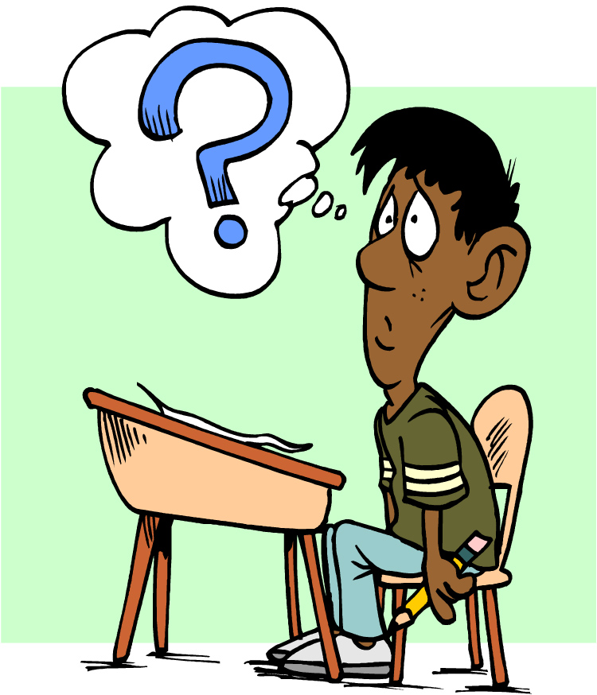
Questions?

