Slide 1
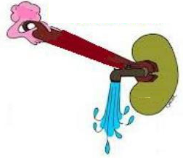
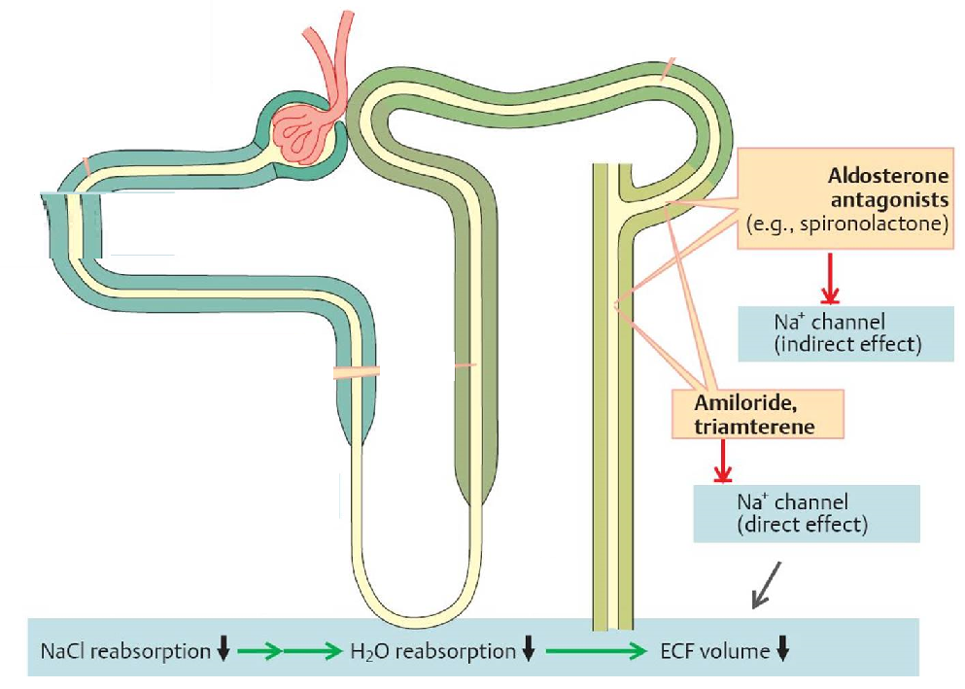
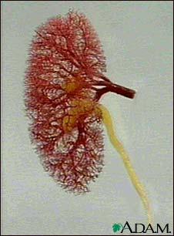
Diuretics-iii
Aldosterone antagonists &
Sodium Channel Inhibitors

Slide 2
Diuretics-iii
Potassium-sparing diuretics
Steroidal
Nonsreroidal
Competitive
aldosterone
antagonists:
Spironolactone
Eplerenone
Inhibitors of Na⁺ channels:
Amiloride
Triamterene

Slide 3
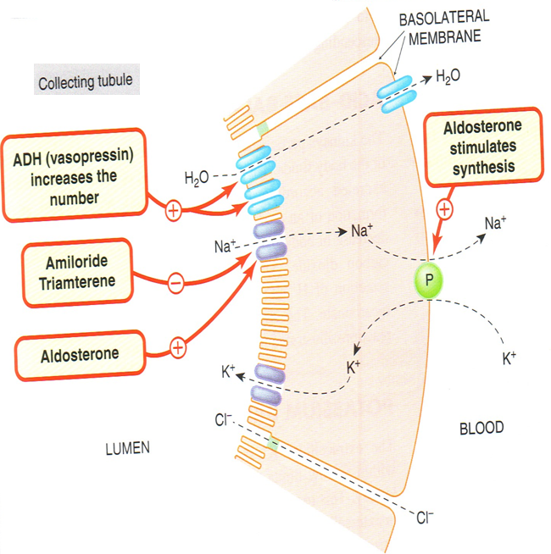
Potassium-sparing diuretics
mechanism

Slide 4
Diuretics-iii
MINERALOCORTICOID RECEPTOR ANTAGONISTS
Also Called:
K-Sparing Diuretics
Aldosterone Antagonists
Spironolactone
Eplerenone

Slide 5
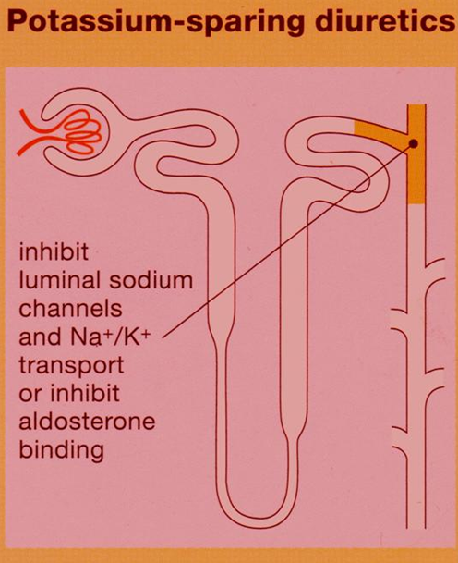
Aldosterone antagonists
Aldosterone antagonists are competitive antagonist at the collecting duct→↑ Excretion of Na+,Cl-&↓Excretion of K+,H+,NH4
Actions depend on renal PGs production

Slide 6
Aldosterone antagonists
pharmacokinetics
spironolactone
Well absorbed from the GIT ,t½=1.6h.
Highly protein- bound
Undergoes enterohepatic recycling.
Delayed onset of action (nuclear receptor), maximum diuretic action 4 days.
Converted in gut & liver to canrenone [active metabolite, t½=16h].
It binds androgen receptors with high affinity

Slide 7
Aldosterone antagonists
pharmacokinetics
eplerenone
Eliminated by metabolism(CYP3A4),t½ 5h
Low affinity for progesterone and androgen receptors
Both ineffective in adrenalectomized patients

Slide 8
Aldosterone antagonists
Therapeutic uses
Used in Combination with Loop &
Thiazide Diuretics
Enhances Natriuresis
Caused by Other Diuretics
Prevents Hypokalemia
Blocks Aldosterone
Secondary hyperaldosteronism
Improve
survival
Treatment for
Heart Failure
Treatment for
Primary Hyper-aldosteronism
Treatment for
Edema of Liver Cirrhosis
Treatment for
Hypertension
Treatment for
Nephrotic
syndrome
Resistant hypertension

Slide 9
Aldosterone antagonists
adrs
Gastritis
Hyperkalemia
Metabolic
Acidosis in cirrhotic
patients
Peptic Ulcers
CNS Side
Effects
Deepening of
Voice
Impotence
Hirsutism
Gynecomastia
Menstrual
Irregularities

Slide 10
Aldosterone antagonists
Drug- drug interactions
↓Secretion of
canrenone
↓Efficacy of
spironolactone
Salicylates
Spironolactone
alters clearance
Digitalis

Slide 11
Aldosterone antagonists
contraindications
Hyperkalemia
Increased Risk of
Hyperkalemia
Renal failure
Other K+
sparing diuretics
ACE-I
K+ suplement

Slide 12
Sodium channel inhibitors
Also Called:
K-Sparing Diuretics
Triamterene
Potency 0.1,
t½ 4.2 h,
elimination
by metabolism
Amiloride
Potency 1,
t½ 21h,
renal
elimination

Slide 13
Sodium channel inhibitors
Therapeutic uses
Enhance Natriuresis
Caused by Other Diuretics
Used in Combination with Loop &
Thiazide Diuretics
Prevent Hypokalemia
Block Na+ Channels
Treatment for
Lithium-Induced Diabetes Insipidus
Treatment for
Liddle’s Syndrome

Slide 14
Sodium channel inhibitors
ADRS
Amiloride
Triamterene
Hyperkalemia
Hyperkalemia
Renal Stones
Interstitial
Nephritis
Megaloblastosis
in cirrhotic patients

Slide 15
Sodium channel inhibitors
contraindications
Increased Risk of
Hyperkalemia
Hyperkalemia
Renal failure
Other K+
sparing diuretics
ACE-I &
ARBs
Aliskiren
K+ suplement

Slide 16
Sodium channel inhibitors
DRUG-Drug INTERACTIONS
↑Hyperkalemia-
induced by
K-Sparing
diuretics
ACE Inhibitors
Beta-Blockers
K Supplements
K-Sparing
diuretics
Aliskiren

Slide 18
Effects | Mechanism of action | Diuretics
Urinary Na HCO3, K Urinary alkalosis Metabolic acidosis | Inhibition of NaHCO3 reabsorption in PCT | CA inhibitors Acetohexamide Dorzolamide
Urine excretion Little Na | Osmotic effect in PCT & DLH | Osmotic diuretic Mannitol
Urinary Na, K, Ca, Mg | Na/K/2Cl transporter in TAL the most effective | Loop diuretics Furosemide
Urinary Na, K, Mg BUT↓ urinary Ca (hypercalcemia) Metabolic alkalosis | Na and Cl cotransporter in DCT | Thiazide diuretics hydrochlorothiazide
↑ Urinary Na ↓ K, H secretion Metabolic acidosis | competitive antagonist of aldosterone in CCT | K-sparing diuretic Spironolactone.

Slide 19
Uses | Diuretics
Glaucoma, epilepsy Mountain sickness | CA inhibitors Acetohexamide Dorzolamide (topically) for glaucoma
Cerebral edema Acute renal failure | Osmotic diuretic Mannitol
Acute pulmonary edema (Drug of choice) Heart failure Hyperkalemia, Hypercalcemia | Loop diuretics Furosemide
Commonly used Hypertension, heart failure, hypercalciuria, kidney stones, diabetes inspidus | Thiazide diuretics hydrochlorothiazide
Hepatic cirrhosis (Drug of choice) | K-sparing diuretic Spironolactone.

Slide 20
Side effects | Diuretics
Metabolic acidosis , Urinary alkalosis Hypokalemia | CA inhibitors Acetohexamide Dorzolamide
Extracellular water expansion Dehydration Hypernatremia | Osmotic diuretic Mannitol
Hypokalemia, hypovolemia, hyponatremia, hypomagnesemia, hypocalcemia Precipitate gout, alkalosis | Loop diuretics Furosemide
Hypokalemia, hyponatremia, hypovolemia, hypomagnesemia, hypercalcemia Alkalosis, precipitate gout Hyperlipidemia, hyperglycemia | Thiazide diuretics hydrochlorothiazide
Gynaecomastia Hyperkalaemia, Metabolic acidosis. GIT upset and peptic ulcer | K-sparing diuretic Spironolactone.

Slide 21
