Slide 1
BLOOD PHYSIOLOGY
Lecture 2
Blood Physiology
Red Blood cells (RBCs)
Dr Nervana Mostafa

Slide 2
Objectives
At the end of this lecture you should be
able to:
Describe essential elements needed for RBC formation.
Describe the process of Vit B12 absorption and its malabsorption.
Recognize haemaglobin structure and its
functions.
Discuss iron metabolism (absorption,
storage and transport)
2

Slide 3
Objectives – cont.
Describe the fate of old RBC.
Describe anemia and its causes.
Recognize causes of polycythemia.
3

Slide 4
Topics:
Essential elements for RBC formation
Proteins
Vitamins: B12, Folic acid, Vit C
Iron Metabolism.
2. Structure & functions of Hb
3. Anemia
4. Polycythemia

Slide 5
Nutrients required for Erythropoiesis
1- Amino acids (a.a.).
2- Iron.
3- Vitamins;
• B12 (cyanocobalamin) & folic acid
[important for DNA synthesis]
• Vitamin C
[important for iron absorption]
[present in vegetables & is heat liable as folic acid]
• Pyridoxine (B6);
[important for haem production its deficiency leads to microcytic hypochromic anaemia]
4 -Trace elements (e.g. cobalt, copper, zinc).

Slide 6
Essential elements for RBCs formation & Maturation
Amino acids: formation of globin in haemoglobin
- sever protein deficiency → anaemia
Iron: formation of haemoglobin
Deficiency → anaemia
5

Slide 7
Vitamin B12 & Folic acid
Important for DNA synthesis and final maturation of RBC.
Dietary source: meat, milk, liver, fat, green vegetables.
Deficiency leads to:
Failure of nuclear maturation & division
Abnormally large & oval shape RBC
Short life span
reduced RBC count & Hb
Macrocytic (megaloblastic) anemia

Slide 8
Vitamin B12 metabolism

Slide 9
Malabsorption of Vit. B12
Pernicious Anemia
VB12 absorption needs intrinsic factor secreted by parietal cells of stomach.
VB12 + intrinsic factor is absorbed in the
terminal Ileum.
Deficiency arise from (Causes of deficiencies):
Inadequate intake
Poor absorption due to Intestinal
disease

Slide 10
HAEMOGLOBIN
Hb molecules consist 4 chains each formed of heme & polypeptide chain (globin)

Slide 11
Haemoglobin (Hb) = 14 - 16 gm/dl
Structure:
- Composed of 4 subunits (2 ∝ & 2 β chains), each unit contains haem (iron-porphyrin).
- Iron in the haem is ferrous (fe ²+ ), combines reversibly with oxygen.

Slide 12
* Function of Hb:
1- carriage of oxygen & carbon dioxide
2 - Buffer.

Slide 13
Types of normal Hb.:
-Hb A (2 α & 2 beta chains) (adult Hb) (98%).
- Hb A2 (2 α & 2 delta chains) (2%)
- Hb F (2 α & 2 γ chains) (Hb of intrauterine life).
* Abnormality in the polypeptide chain results in an abnormal Hb (hemoglobinopathies) e.g. thalassemias, sickle cell (HbS).

Slide 14
Fate of RBC
RBC life span in circulation = 120 days.
Old cell has a fragile cell membrane, cell will rupture as it passes in narrow capillaries (Reticulo-endotheilal system/Spleen).
Released Hb is taken up by macrophages in liver, spleen & bone marrow:
* Hb is broken into its component:
1-Globin protein pool.
2- Haem iron (reused)
porphyrin is converted to bilirubin.
Jaundice

Slide 15
Functions of Hemoglobin
O2 & CO2 transport:
Hb reversibly bind O₂ to form oxyhemoglobin.
- Carriage of CO2
Hb bind CO₂ = carboxyhemaglobin
Buffer
25

Slide 16
Iron metabolism
Total amount in the body = 3- 5 gm, distributed as follows:
1- Hb (65-75%)
2- storage iron (available) (20%) in the liver, spleen & bone marrow (ferritin).
3- cellular (non-available).
4- transport or plasma iron.
Iron in food = (10 -20 mg/day)
 Sources; liver-beef- mutton-fish- egg yolk-beans- lentils & green vegetables.
 Forms; 1- organic. 2- inorganic.
Absorption:
1- Iron in food is in the oxidized form (ferric)(Fe³+), to be absorbed it is reduced to the ferrous state (Fe ²+).
In the stomach:
Ferric Ferrous
Hcl
Vit C & proteins

Slide 17
Duodenum & upper part of small intestine:
- Active transport of ferrous ions at the luminal border.
- once in the intestinal mucosal cell iron is attached to a non-ferritin protein carrier & either ;
➲ transported across the serosal border to be picked up by transferrin. OR
➲ stored as ferritin by combing with apoferrtin.
Iron absorption is dependent on:
- Size of iron stores. - Rate of erythropoiesis.
Normally, 10- 15% of ingested iron is absorbed.
Iron transport:
In plasma; iron now in the ferric form combines to transferrin to form the ferric-transferrin complex.
Iron storage = (1 gm)
Site: reticuloendothelial cells (liver - spleen - bone marrow)
storage forms: ferritin & haemosiderin

Slide 18
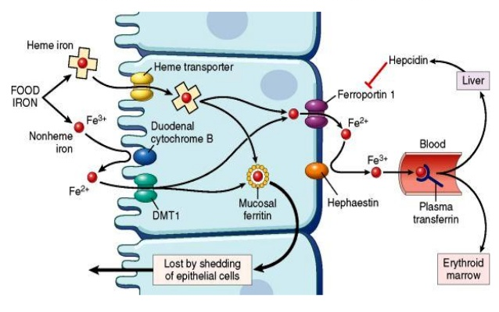

Slide 19
Transport and storage of iron
Iron is transport in plasma in the form of Transferrin (apotransferrin + iron).
Iron is stored in two forms:
Ferritin (apoferritin + iron)
Haemosiderin (insoluble complex molecule, in liver, spleen, bone marrow)

Slide 20
Factors decreasing iron absorption:
- Phosphates, phytates & oxalates in diet.
- Achlorhydria (↓ Hcl ) , gastrectomy.
- Malabsorption syndromes or chronic diarrhea.
Iron excretion: (0.5 -1.0 mg)
Daily loss of iron is 0.6 mg in male & 1.3mg/day in females.
[mainly feces & skin]

Slide 21
Anaemia
Definition:
↓ Hb concentration below the normal level of the same age and gender.
due to
1- ↓ RBCs count below normal level for same age & gender.
2- ↓ Hb load in each RBC (MCH) below normal level.
.

Slide 22
Blood Film

Slide 23
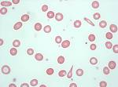
Microcytic hypochromic
Normocytic normochromic
Megaloblastic or macrocytic

Slide 24
Signs and Symptoms:
are due to ↓ oxygen supply to tissues.
- Depending on the severity, the symptoms of anemia may include:
Pale skin
Fatigue
Weakness
Tiring easily
Breathlessness
Postural (orthostatic) hypotension: Drop in blood pressure when standing from a sitting or lying position
Frequent headaches
Racing heart or palpitations
Becoming irritated easily
Concentration difficulties
Loss of appetite
Strange food cravings.

Slide 25
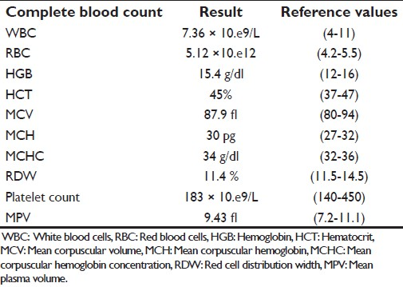
CBC - FBC

Slide 27
Causes of anaemia
1.Blood Loss
– acute
–Chronic
accident (RBC return to normal 3-6w)
microcytic hypochromic anaema (ulcer, worms)
2.Decrease RBC production
Nutritional causes:
•Iron
microcytic hypochromic anaemia.
•Vit B12 & Folic acid megaloblastic anaemia / pernicious anaemia .
➢Bone marrow failure (Aplastic anaemia): destruction by cancer, radiation, drugs.
3.Haemolytic excessive destruction
Abnormal cells or Hb
•Spherocytosis
•sickle cells
Incompatible blood transfusion.
Erythroblastosis fetalis .

Slide 28
⬥ Causes & Types of anaemias:
I- Bleeding:
i- Chronic → { iron deficiency anaemia}
- Menstruation.
- GIT bleeding (peptic ulcer- Bilharziasis- piles-hook worms).
ii- Acute. (normocytic- normochromic)

Slide 29
II- Decreased production:
i- Nutritional deficiency
- Iron deficiency leads to (microcytic hypochromic).
- Vit. B12 & folic acid  leads to megaloblastic anaemia.
Pernicious anaemia: is a special type of megaloblastic anaemia due to intrinsic factor deficiency causing vit B12 deficiency.
ii – Increased demands
(childhood & pregnancy)

Slide 30
iii- Bone marrow failure ---- Aplastic anemia.
Due to;
a- irradiation or excessive X-ray usage.
b- drugs e.g. chloramphenicol.
c- invasion of bone marrow by (secondary malignant cells or fibrosis).

Slide 31
III-  destruction of RBCs;
(Haemolytic anaemia)
i- membrane defect spherocytosis.

Slide 32
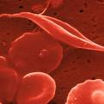
ii- Abnormal Hb (Hb S) = Sickle cell anaemia

Slide 33
Haemolytic anaemia (excessive destruction);
Abnormal cells or Hb
• Spherocytosis
• sickle cells
Incompatible blood transfusion.
Erythroblastosis fetalis .
Enzymatic defect ------- glucose 6 phosphate dehydrogenase deficiency (G6PD):
G6P deficiency is an inherited condition.
The body doesn't have enough of the enzyme G6PD, which helps (RBCs) function normally.
This deficiency can cause hemolytic anemia, usually after exposure to certain medications, foods, or even infections.

Slide 34
Microcytic hypochromic anemia
The RBC's are smaller than normal and have an
increased zone of central pallor.
- This is indicative of a microcytic (smaller size of each RBC) and hypochromic (less hemoglobin in each RBC) anemia.
There is also increased anisocytosis (variation in size)
and poikilocytosis (variation in shape).

Slide 35
Macrocytic anemia
Note the hypersegmented neurotrophil and also that the RBC are almost as large as the lymphocyte.
Finally, note that there are fewer RBCs.

Slide 36
Groups at high risk: * Certain people are at increased risk of anaemia, including: - Menstruating women - Pregnant and breastfeeding women - Babies, especially if premature - Children going through puberty - Vegetarians - People with cancer, stomach ulcers and some chronic diseases - People on weight reduction diets - Athletes
Treatment:
Treatment depends on the cause and severity, but may include:
- Vitamin & mineral supplements – in the case of deficiency.
- Iron injections – if the person is very low on iron.
Vitamin B12 oral or by injection – required for pernicious anaemia.
- Folic acid suplements
- Blood transfusions – if required.

Slide 37
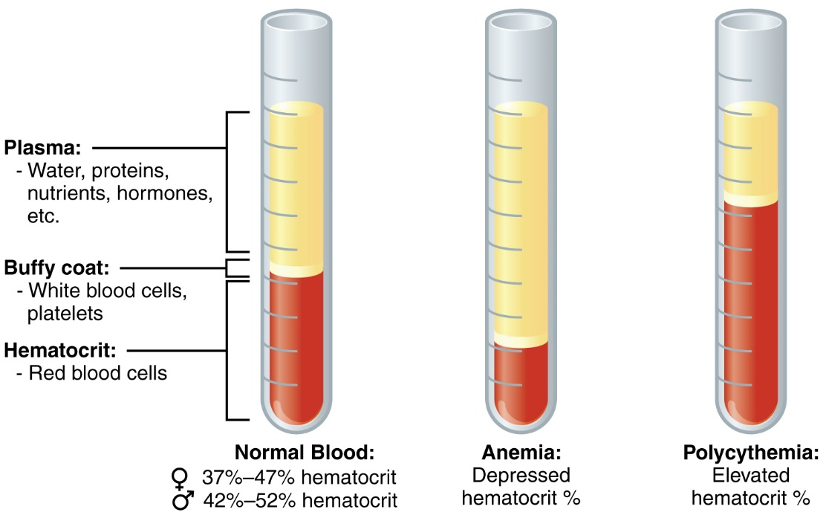

Slide 38
Polycythaemia
Increase in the number of RBCs per unit volume of blood.
Classification & Causes:
1- True or absolute;
a- primary (Polycythaemia Rubra Vera - PRV)
b- secondary, due to hypoxia.
2- Relative; in cases of dehydration (haemoconcentration)

