Slide 1
Lecture Two
Human Genetics
CHROMOSOME ANOMALIES

Slide 2
Lecture Objectives:
By the end of this lecture, the students should be able to:
Describe and explain the events in mitosis & meiosis.
Define non-disjunction and describe its consequences on meiosis.
Classify chromosomal abnormalities: Numerical & structural
3a Understand the common numerical autosomal disorders: trisomies 21, 13, 18.
3b Understand the common numerical sex chromosome disorders: Turner`s & Klinefelter`s syndromes
3c Recognize the main structural anomalies in chromosomes

Slide 3
1) Mitosis & Meiosis

Slide 4
Typical mitotic cell cycle
During G1 = one diploid
S phase = duplication of each
chromosome’s DNA → Two sister chromatids
G2 Phase = chromosomes begin to condense and become visible
G1, S, and G2 phases = constitute interphase
Two daughter cells = equal genetic information

Slide 5
Events of mitosis
Prophase.
formation of mitotic Spindle & pair of centrosomes
Prometaphase.
- Nuclear membrane dissolves
- Chromosomes to disperse & attach by kinetochores to mitotic spindle microtubules
Metaphase.
Chromosomes condensed & line up at the equatorial plane
Anaphase.
- Chromosomes separate at centromere &
- Sister chromatids of each chromosome become independent daughter chromosomes
Telophase.
- Chromosomes de-condense from their highly contracted state,
- Nuclear membrane re-form around each of the two daughter nuclei,
- resume their interphase

Slide 6
Events of meiosis I & II

Slide 9
2-) Non-disjunction and its impact on meiosis

Slide 10
Non-disjunction in Meiosis
- The failure of chromosomes to disjoin normally during meiosis phase 1 or phase 2.
- Two chromosome homologs migrate to the same daughter cell instead of disjoining normally and migrating to different daughter cells.
- The result of this error is a cell with an imbalance of chromosomes (Aneuploidy)

Slide 11
Meiotic non-disjunction
Can affect each pair of chromosomes
is not a rare event
Non disjunction in first meiotic division produces 4 unbalanced gametes.
Non disjunction in second division produces 2 normal gametes & 2 unbalanced gametes:
Gamete with an extra autosome
Nullosomic gamete (missing one chromosome)

Slide 12
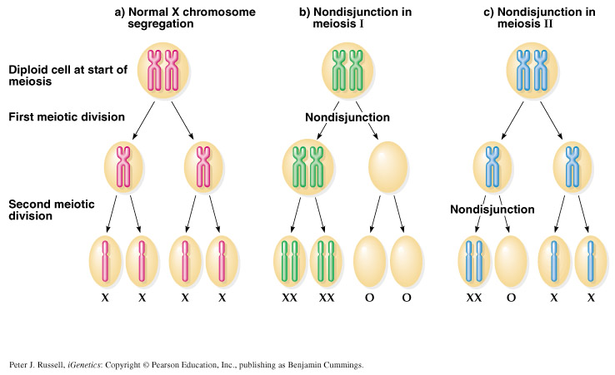

Slide 13
In meiotic nondisjunction
- This product of fertilization with normal gamete would be monosomic and trisomic offspring (Aneuploidy)

Slide 14
3- Classifications of chromosomal abnormalities

Slide 15
CHROMOSOME ANOMALIES
TYPES:
- Numerical
affect the number of complete haploid set (n) of chromosomes
Structural
Affect the structure and organization of genomic content of the chromosome

Slide 16
3a. NUMERICAL CHROMOSOMAL ANOMALIES
Numerical anomalies in autosomes

Slide 17
Down syndrome, trisomy 21 Karyotype: 47, XY, +21
- Most cases arise from non disjunction in the first meiotic division
- The incidence of trisomy 21 rises sharply with increasing maternal age
- The father contributing the extra chromosome in 15% of cases
- The symptoms include characteristic facial dysmorphologies, and an IQ of less than 50.

Slide 18
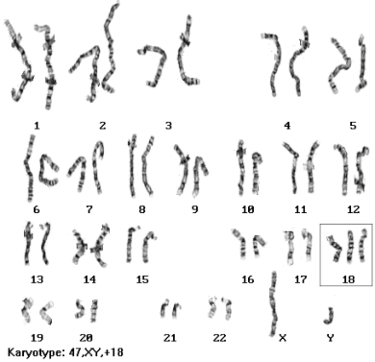
Edward's syndrome, Trisomy 18 Karyotype: 47, XY, +18
- the second most common autosomal trisomy, after Down syndrome
- It occurs in around one in 6,000 live births
- Most babies die in the first year and many within the first month & has a very low rate of survival
- Common anomalies are heart abnormalities, kidney malformations, and other internal organ disorders

Slide 19
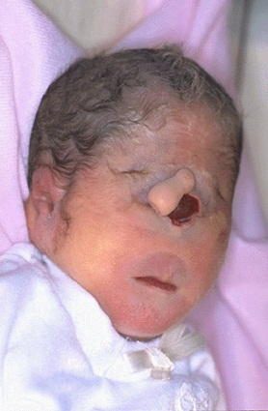
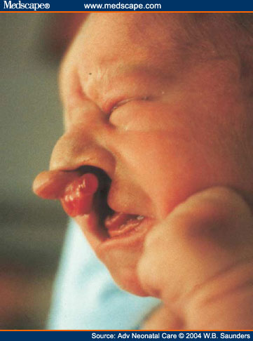
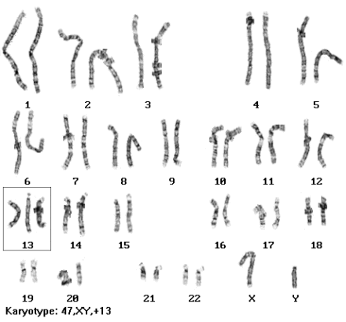
Patau Syndrome, Trisomy 13 Karyotype: 47, XY, +13
- 50 % of these babies die within the first month and very few survive beyond the first year.
- There are multiple dysmorphic features.
Most cases, as in Patau syndrome, involve maternal non-disjunction.

Slide 20
3b. NUMERICAL CHROMOSOMAL ANOMALIES
Numerical anomalies in Sex chromosomes

Slide 21
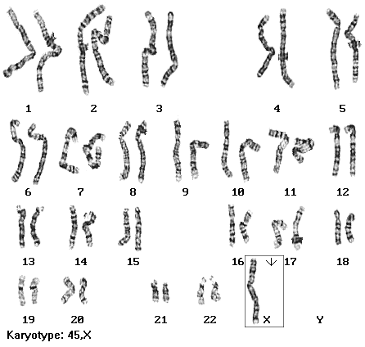
Monosomy X (Turner’s syndrome, 45,XO)
- Occurring in 1 in 4000 phenotypic females
- As a result of paternal meiotic nondisjunction
- The only viable monosomy in humans
- Characteristics:
Webbed neck, Individuals are genetically female, not mature sexually, Sterile, Short stature, Boad chest, Low hairline, Streak ovaries, Normal intelligence, Normal life span

Slide 22
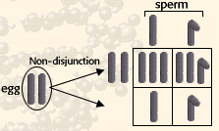
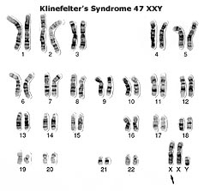
Klinefelter Syndrome: 47,XXY males
- 1/600 males
- Due to nondisjunction of X chromosomes during meiosis I in females
- Male sex organs; unusually small testes which fail to produce normal levels of testosterone→ breast enlargement (gynaecomastia) and other feminine body characteristic
- Patients are taller and thinner than average and may have a slight reduction in IQ but generally they have normal intelligence
- No spermatogenesis → sterile

Slide 23
MOSAICISM
The presence of more than one genetically distinct cell line in the body
A mosaic individual is made of 2 (or more) cell populations, coming from only 1 zygote

Slide 24
MOSAICISM
A mosaic individual is made of 2 (or more) cell populations, coming from only 1 zygote
Is denoted by a slash between the various clones observed e.g.46, XY / 47, XY, +21).
Numerical mosaic anomaly is usually due to a mitotic non-disjunction
A mosaic must not be confused with a chimeras.
Chimerism is the presence in an individual of two or more genetically distinct cell lines derive from more than one zygote (e.g. 2 sperms fertilize 2 ova → 2 zygotes that fuse to form 1 embryo

Slide 25
3c. STRUCTURAL CHROMOSOMAL ANOMALIES

Slide 26
Reciprocal translocation
- Reciprocal translocation between chromosome 22 and the long arm of chromosome 9 (the Philadelphia chromosome).
- The occurrence of this translocation in hematopoietic cells can produce chronic myelogenous leukemia (CML)

Slide 27
Robertsonian translocation
- Short arms of two non homologous chromosomes are lost and the long arms fuse at the centromere to form a single chromosome
- Confined to the acrocentric chromosomes(13, 14, 15, 21, and 22)
- Although carriers have only 45 chromosomes in each cell, they are phenotypically unaffected

Slide 28
Deletion
- Loss of a segment from a chromosome, either terminal or interstitial
Invariably, but not always, results in the loss of important genetic material
Deletion is therefore an unbalanced rearrangement.
Indicated in nomenclature del

Slide 29
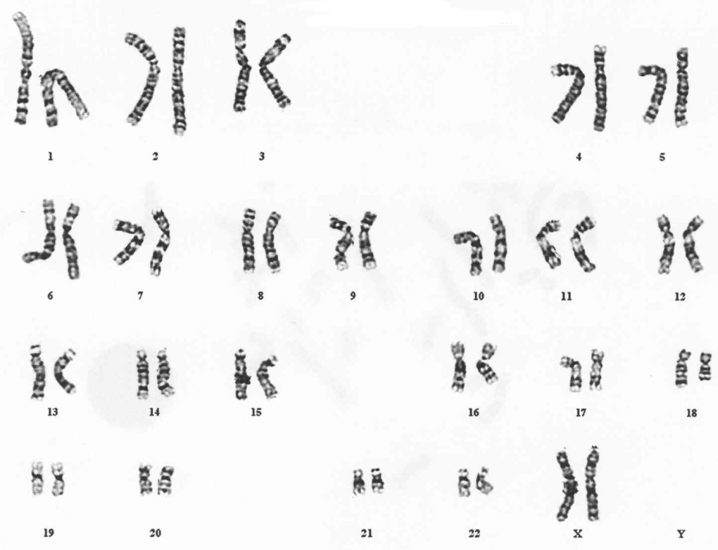
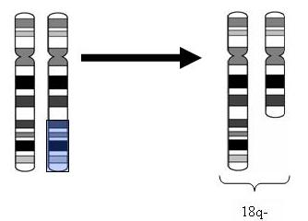
Terminal deletion
⬇
46,XX,del(18)(q21.3)

Slide 30
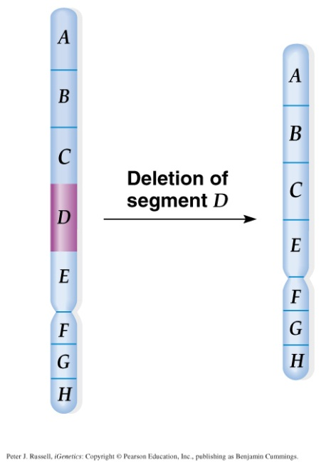
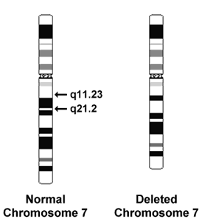
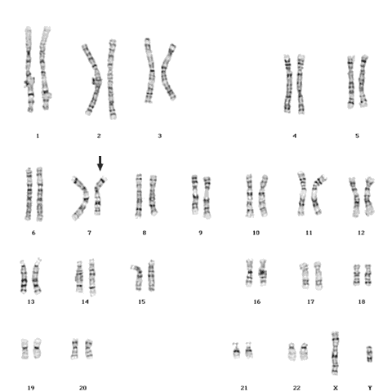
Interstitial deletion
Sample karyogram
karyotype description is as follows:
- 46: the total number of chromosomes.
- XY: the sex chromosomes (male).
- del(7): deletion in chromosome 7.
- (q11.23q21.2): breakpoints of the deleted segment.
46,XY,del(7)(q11.23q21.2)

Slide 31
Inversion
- Occurs when a segment of chromosome breaks, and rejoining within the chromosome effectively.
- Written in nomenclature as inv.
- Only large inversions are normally detected.
They are balance rearrangements that rarely cause problems in carriers
Pericentric
Paracentric

Slide 32
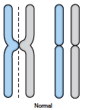
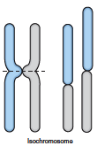
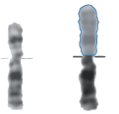
Isochromosome
The most probable explanation for isochromosome is that the centromere has divided transversely rather than longitudinally
Normal
Isochromosome
Normal
Isochromosome

Slide 33
Ring formation (Ring chromosome)
- A break on each arm of a chromosome
- Two sticky ends
- Reunion of the ends as a ring loss of the 2 distal chromosomal fragments
- Ring chromosomes are often unstable in mitosis

Slide 34
Take home message
Chromosome abnormalities can be numerical or structural.
Normal meiotic division result in four haploid gametes
In trisomy, a single extra chromosome is present, usually as a result of non-disjunction in the 1st or 2nd meiotic division.
Mosaicism arize from one zygote while Chimera from the fusion of two fertilized eggs
Structural abnormalities include translocations (balanced or unbalanced), inversions, deletions, isochromosome & rings.

