Slide 1
Human Genetics
Lecture Four
Atypical Mode of Inheritance

Slide 2
Objectives:
By the end of this lecture, students should understand atypical patterns of inheritance with special emphasis on:
  Codominant traits
  Pseudodominant inheritance
  The mitochondrial inheritance
  Anticipation
  Pleiotropy
  Variable expressivity
  Heterogeneity
  New mutation
  Complex trait: multifactorial/Polygenic

Slide 3
  Codominant traits
- This pattern occurs when the heterozygote expresses both alleles simultaneously without forming an intermediate phenotype.
For example,
in blood typing, an individual carrying the A and B alleles has an AB blood type.
- most genes exist in multiple alleles
Notes:
Alleles of the ABO Blood Group Can Be Dominant, Recessive, or Codominant
Thus far, we have considered examples in which a gene exists in two different alleles. As researchers have probed genes at the molecular level within natural populations of organisms, they have discovered that most genes exist in multiple alleles. Within a population, genes are typically found in three or more alleles.
The ABO group of antigens, which determine blood type in humans, is an example of multiple alleles and illustrates an allelic relationship called codominance.

Slide 4
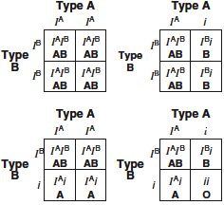
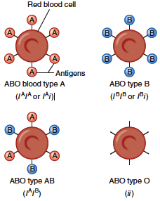
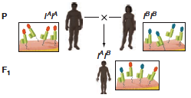
Codominance inheritance
Notes:
ABO blood types illustrate codominance
The I ^{A} and I ^{B} alleles of the I gene are codominant, but they follow Mendel’s law of segregation. These Punnett squares follow the genotypes that could result when a person with type A blood has children with a person with type B blood.
this example illustrates, when both alleles produce a functional gene product, they are usually codominant for phenotypes analyzed

Slide 5
Possible genotypes, phenotypes & gametes formed from the four alleles: A₁, A₂, B, & O at the ABO locus
Gamete | Phenotype | Genotype
A₁ | A₁ | A₁A₁
A₂ | A₂ | A₂A₂
B | B | BB
O | O | OO
A₁ or A₂ | A₁ | A₁A₂
A₁ or B | A₁B | A₁B
A₁ or O | A₁ | A₁O
A₂ or B | A₂B | A₂B
A₂ or O | A₂ | A₂O
B or O | B | BO

Slide 6
  PSEUDODOMINANT INHERITANCE
is the situation in which the inheritance of a recessive trait mimics a dominant pattern.

Slide 7
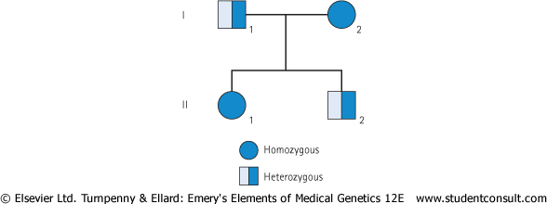
Pedigree: Pseudodominant inheritance
A woman homozygous for an autosomal recessive disorder whose husband is heterozygous for the same disorder.
Their children have a 1 in 2 (50%) chance of being affected (homozygous ) i.e. pseudodominant

Slide 8
Atypical inheritance of single-gene disorders
What are the situations in which the inheritance of single-gene disorders diverges from typical mendelian patterns?

Slide 9
Maternal inheritance of mitochondrial mutations
Anticipation
Atypical presentation for Autosomal Dominant defects:
  Pleotropy
  Variable expressivity
  Reduced penetrance
  New mutation
Unusual inheritance patterns due to Genomic Imprinting
Mosaicism:
  Somatic mosaicism
  Germline mosaicism

Slide 10
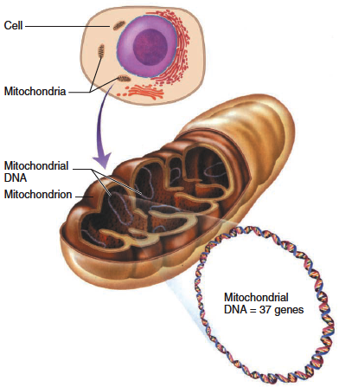
  MITOCHONDRIAL INHERITANCE
Each cell contains thousands of copies of mitochondrial DNA with more being found in cells having high energy requirement (e.g. brain & muscle)
Mitochondria (& their DNA) are inherited from the mother (through ova)
mtDNA is a small circular double-stranded molecule containing 37 genes (coding for rRNA, tRNA, and some of the proteins of the mitochondrial electron transport chain)

Slide 11
Homoplasmy vs. Heteroplasmy
Homoplasmy = normally the mtDNA from different mitochondria is almost identical.
Heteroplasmy = the presence of two populations of mtDNA in a cell; the normal mtDNA & the mutant mtDNA.
The proportion of mutant mtDNA varies between cells & tissues → a range of phenotypic severity in mitochondrial inheritance.

Slide 12
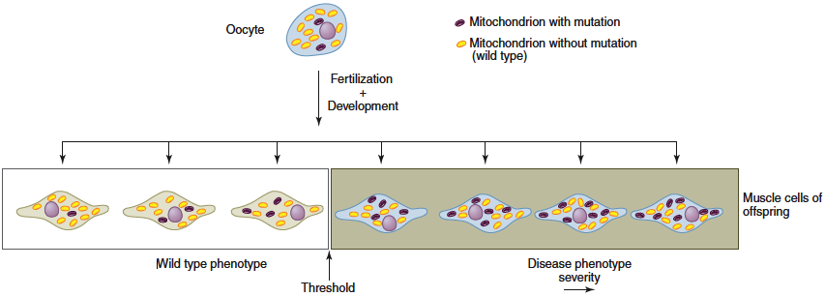
  Mitochondrial inheritance
- Mitochondria and their genes are passed only from the mother.
- Cells have many mitochondria. If an oocyte is heteroplasmic, differing numbers of copies of a mitochondrial mutation may be transmitted.
- The phenotype reflects the proportion of mitochondria bearing the mutation.
- Typical Example of Mitochondrial Disorders
Leber hereditary optic neuropathy (LHON)
Rapid Optic nerve death → blindness in young adult life

Slide 13
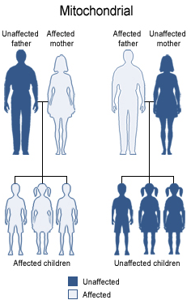
Mitochondrial inheritance
Males do not transmit the disease as the cytoplasm is inherited only from the mother since the mitochondria are present in the cytoplasm

Slide 14
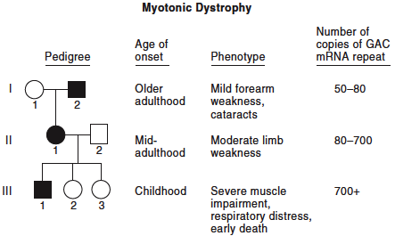
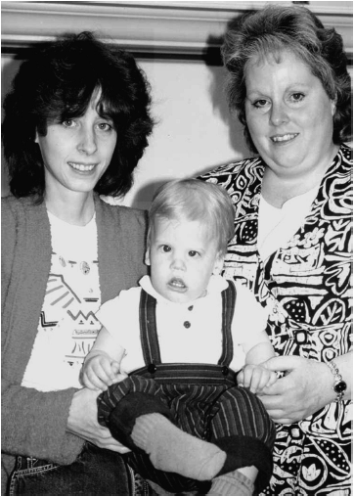
  ANTICIPATION
A pattern of inheritance in which individuals in the most recent generations of a pedigree develop a disease at an earlier age or with greater severity than do those in earlier generation.
The reason might be the gradual expansion of trinucleotide repeat polymorphisms within or near a coding gene
Examples of diseases showing anticipation:
Huntington disease
Myotonic dystrophy
Notes:
With the ability to sequence genes, researchers found that myotonic dystrophy indeed worsens with each generation because the gene expands!
The gene that causes the first recognized type of myotonic dystrophy, on chromosome 19, has an area rich in repeats of the DNA triplet CTG. The wild type repeat number is 5 to 37; a person with the disorder has from 50 to thousands of copies
Figure shows how expanding genes explain anticipation. In some disorders, symptoms that worsen from one generation to the
next—termed anticipation —have a physical basis: The gene is expanding as the number of repeats grows.
The image shows a three-generation family affected with myotonic dystrophy. The degree of severity increases in each generation.
The grandmother (right) is only slightly affected, but the mother (left) has a characteristic narrow face and somewhat limited facial expression. The baby is more severely affected and has the facial features of children with neonatal-onset myotonic dystrophy, including an open, triangle-shaped mouth. The infant has more than 1000 copies of the trinucleotide repeat, whereas the mother and grandmother each have approximately 100 repeats.

Slide 15
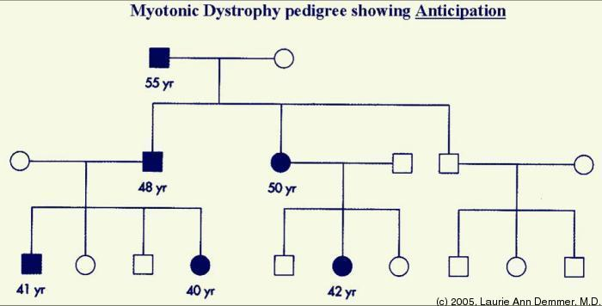
  Pedigree analysis for Myotonic dystrophy
Notes:
Myotonic dystrophy
Autosomal dominant disease
Relatively common
The affected gene is on chromosome 19
The mutation is triplet repeat (CTG) expansion in the 3’ untranslated region of the myotonic dystrophy gene
Clinical manifestations:
Myotonia (Muscular loss & weakness)
Cataracts
Testicular atrophy
Heart disease: arrhythmia
Dementia
Baldness

Slide 16
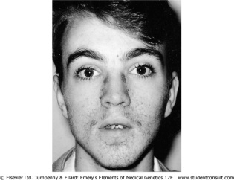
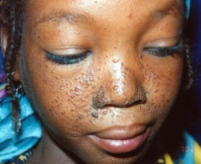
pleiotropy
- A single-gene disorder with many symptoms, or a gene that controls several functions or has more than one effect, is termed pleiotropic.
Causes autosomal dominant disorders
- Example:
tuberous sclerosis
affected individuals can present with either learning difficulties, Epilepsy, facial rashes , or all features

Slide 17
Variable expressivity
The clinical features in autosomal dominant disorders can show striking variation from person to person, even in the same family.
Example:
Autosomal dominant polycystic kidney disease
some affected individuals develop renal failure in early adulthood
others have just a few renal cysts that do not significantly affect renal function

Slide 18
Reduced penetrance
In some individuals heterozygous for gene mutations giving rise to certain autosomal dominant disorders there may be no abnormal clinical features, representing so-called reduced penetrance or 'skipping a generation‘
Reduced penetrance might be due to:
  modifying effects of other genes
  interaction of the gene with environmental factors
Notes:
Penetrance is the probability that a mutant allele or alleles will have any phenotypic expression at all. When the frequency of expression of a phenotype is less than 100%—that is, when some of those who have the relevant genotype completely fail to express it—the disorder is said to show reduced or incomplete penetrance. Penetrance is all or nothing. It is the
percentage of people at any given age with a predisposing genotype who are affected, regardless of the
severity.
Penetrance of some disorders is age dependent; that is, it may occur any time, from early in intrauterine development all the way to the postreproductive years. Some disorders are lethal prenatally, whereas others can be recognized prenatally but are consistent with a liveborn infant; still others may be recognized only at birth (congenital ). Other disorders have their onset typically or exclusively in childhood or in adulthood. Even in these, however, and sometimes even in the same family, two individuals carrying the same disease causing genotype may develop the disease at very different ages.

Slide 19
New mutations
In autosomal dominant disorders an affected person will usually have an affected parent.
However, this is not always the case and it is not unusual for a trait to appear in an individual when there is no family history of the disorder.
The sudden unexpected appearance of a condition arising as a result of a mistake occurring in the transmission of a gene is called a new mutation.

Slide 20
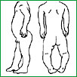
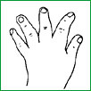
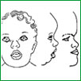
Achondroplasia
A form of short-limbed dwarfism, in which the parents usually have normal stature
Diagnosis/testing:
  Characteristic clinical and radiographic finding
  Molecular genetic tests: mutation in the FGFR3 gene on chromosome 4p16.3 (coding for fibroblast growth factor receptor 3)
The offspring of persons with achondroplasia had a 50% chance of having achondroplasia
What other possible explanations for the 'sudden' appearance of this disorder?
  non-penetrance: One of the parents might be heterozygous for the mutant allele but so mildly affected that it has not previously been detected
  Variable expressivity
  the family relationships not being as stated, e.g. non-paternity

Slide 21
MULTIFACTORIAL/
POLYGENIC DISORDERS

Slide 22
Complex Traits
Complex traits are conditions which are likely to be due to the interaction of more than one gene.
The effects may be additive, one may be rate-limiting over the action of another, or one may enhance or multiply the effect of another.
e.g. Digenic inheritance: where a disorder has been shown to be due to the additive effects of heterozygous mutations at two different gene loci
In man one form of retinitis pigmentosa, a disorder of progressive visual impairment, is caused by double heterozygosity for mutations in two unlinked genes, which both encode proteins present in photoreceptors. Individuals with only one of these mutations are not affected.

Slide 23
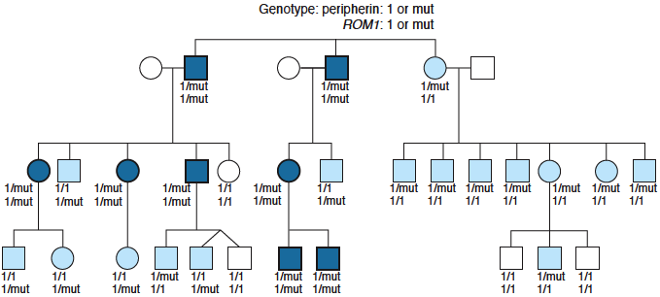
Pedigree of a family with retinitis pigmentosa due to digenic inheritance
Notes:
Dark blue symbols are affected individuals. Each individual’s genotypes at the peripherin locus (first line) and ROM1 locus (second line) are written below each symbol. The normal allele is 1; the mutant allele is mut. Light blue symbols are unaffected, despite carrying a mutation in one or the other gene.

Slide 24
Multifactorial/Polygenic Disorders
Human characteristics such as height, skin color and intelligence could be determined by the interaction of many genes, each exerting a small additive effect.
This model of quantitative inheritance can explain the pattern of inheritance for many relatively common conditions including
  congenital malformations such as cleft lip and palate
  late-onset conditions such as
    Hypertension
    Diabetes mellitus
    Alzheimer disease
The prevailing view is that genes at several loci interact to generate a susceptibility to the effects of adverse environmental trigger factors.

Slide 25
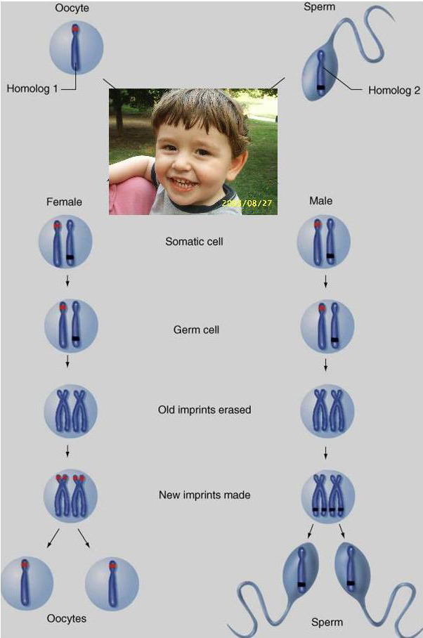
Genomic Imprinting
An example of Non-Mendelian Inheritance
Certain chromosomes retain a memory or “imprint” of parental origin that influences whether genes are expressed or not during gametogenesis

Slide 26
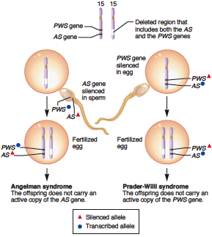
The role of imprinting in the development of Angelman and Prader-Willi syndromes
- A small region on chromosome 15 contains two different genes designated the AS gene and PWS gene in this figure.
- If a chromosome 15 deletion is inherited from the mother, Angelman syndrome occurs because the offspring does not inherit an active copy of the AS gene (left).
- Alternatively, the chromosome 15 deletion may be inherited from the father, leading to Prader-Willi syndrome. The phenotype of this syndrome occurs because the offspring does not inherit an active copy of the PWS gene (right).

Slide 27
Take home Messages:
An accurate determination of the family pedigree is an important part of the workup of every patient
Exceptions to Mendelian inheritance do occur in single-gene disorders.
The inheritance pattern of an individual pedigree may be obscured by a number of other factors that may make the mode of inheritance difficult to interpret
Some characteristics and many common familial disorders, do not usually follow a simple pattern of Mendelian inheritance.

