Slide 1
Introduction to Immunology & Lymphoid System
Immunopathology Unit
Dept. of Pathology
College of Medicine & Medical City
King Saud University

Slide 2
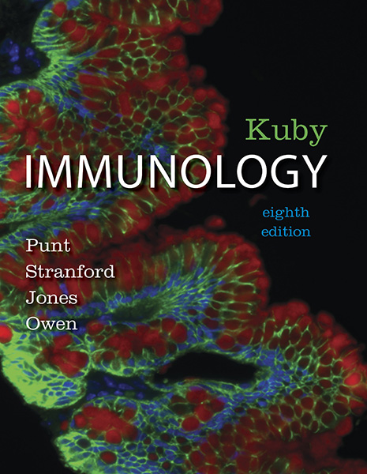
Punt • Stranford • Jones • Owen
Kuby Immunology
Eighth Edition
CHAPTER 1 & 2
© 2019 W. H. Freeman and Company

Slide 3
Objectives
To know the historical perspective of immunology
To be familiar with the basic terminology and definitions of immunology
To recognize immune response cells
To understand types of immune responses
To know about the lymphoid system
To understand T and B cell functions

Slide 4
A historical perspective of immunology
What is immunity?
Immunity is the state of protection against foreign pathogens or substances (antigens)
Latin term immunis, meaning “exempt,” is the source of the English word immunity
Observations of immunity go back over 2000 years
Thucydides, an ancient historian, wrote in 430 bc of a plague in Athens where those who had recovered could safely nurse the currently ill

Slide 5
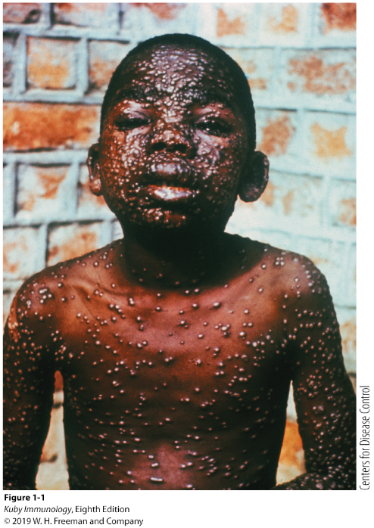
A historical perspective of immunology
Can we generate immunity without inducing disease? YES…through vaccination
Vaccination prepares the immune system to eradicate an infectious agent before it causes disease
Widespread vaccine use has saved many lives
Classic examples: rabies vaccine and eradication of smallpox

Slide 6
Table 1-1, Cases of selected infectious disease in the United States before and after the introduction of effective vaccines
Disease | ANNUAL CASES/YR: Prevaccine | CASES IN 2016: Postvaccine | Reduction (%)
Smallpox | 48,164 | 0 | 100
Diphtheria | 175,885 | 0 | 100
Measles | 503,282 | 79^ | 99.98
Mumps | 152,209 | 145* | 98.90
Pertussis (“whooping cough”) | 147,271 | 964* | 99.35
Paralytic polio | 16,316 | 0 | 100
Rubella (German measles) | 47,745 | 0* | 100
Tetanus (“lockjaw”) | 1,314 (deaths) | 1* (case) | 99.92
Invasive Haemophilus influenzae | 20,000 | 356* | 98.22
Notes:
Data from CDC Statistics of Notifiable Diseases (as of January, 2017).
The number of annual cases per year in 2016 increased^ or decreased* since 2010.

Slide 7
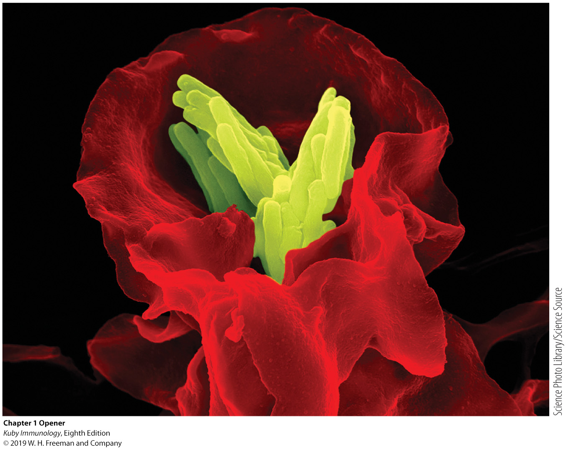
Macrophage engulfs a bacteria

Slide 8
Louis Pasteur’s Contributions
Determined through studies of cholera in chickens that the virulence of a pathogen weakens with age (chickens inoculated with old strains not only survive but become resistant)
Attenuated – weakened, non-virulent strain whose exposure can confer resistance to disease
Classical experiment
Heat attenuated anthrax bacillus and subsequent challenge with virulent Bacillus anthracis in sheep

Slide 9
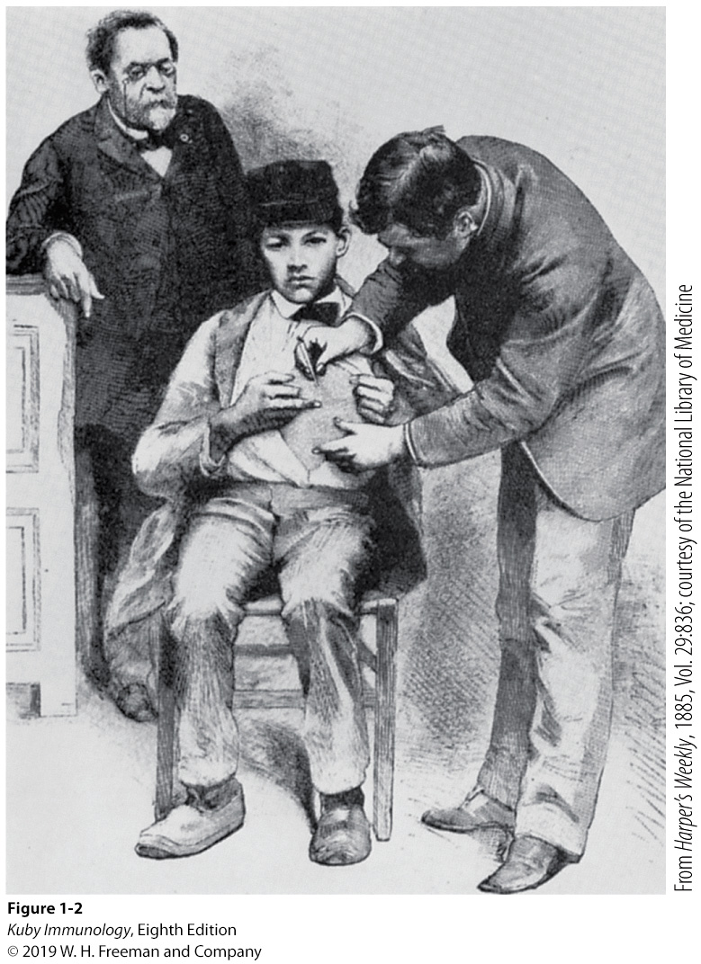
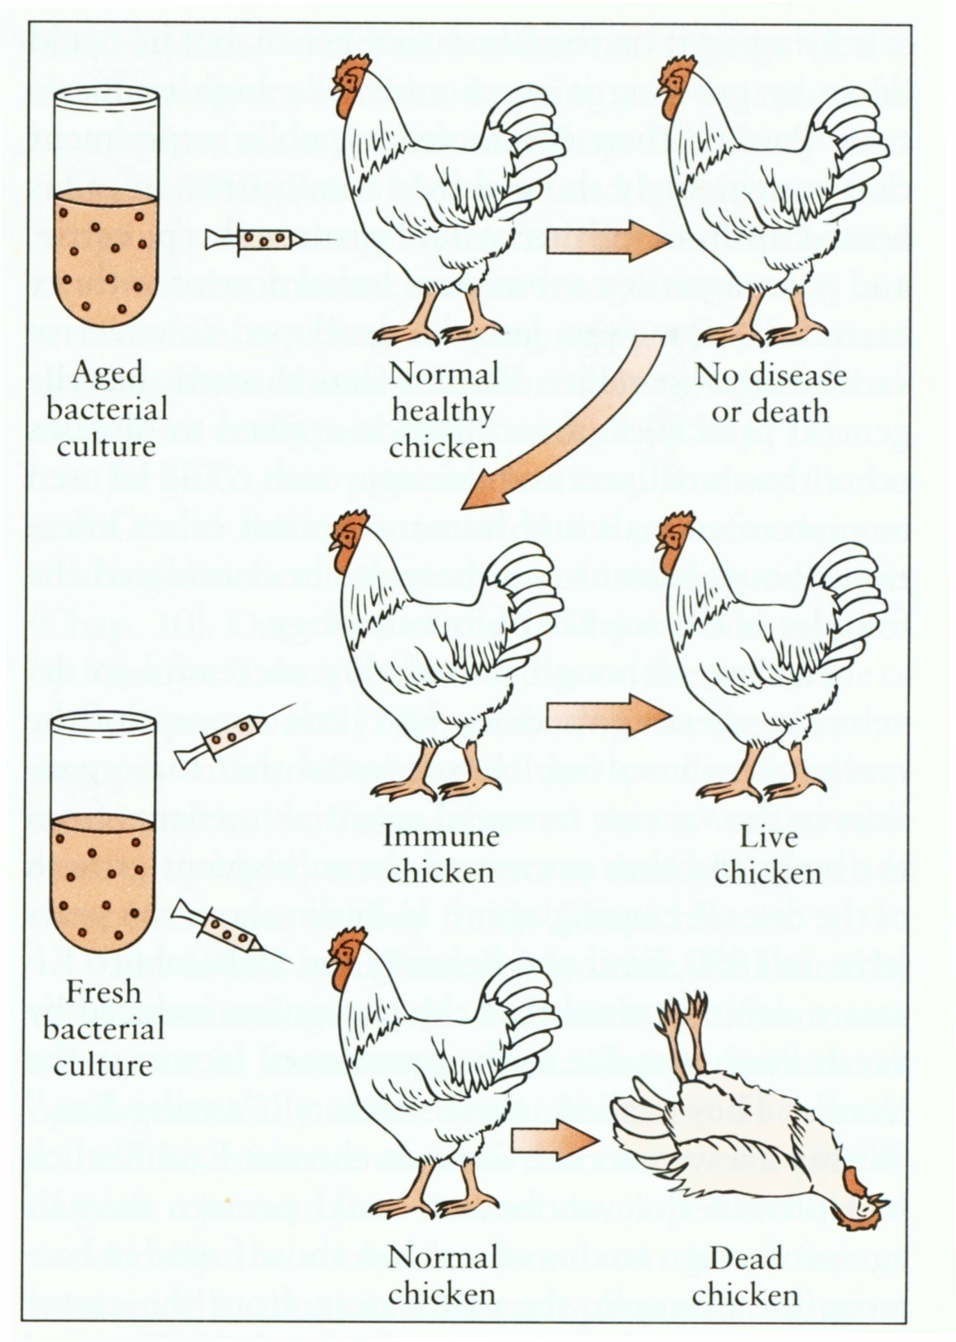
Louis Pasteur
Louis Pasteur watching the rabies vaccination
Louis Pasteur Cholera
Observation:

Slide 10
Definitions
Antigen (Ag): any substance (usually foreign) that binds specifically to a component of the adaptive immunity.
Allergen: noninfectious antigens that induce Allergy.
Innate immunity: Nonspecific host defenses that exist prior to exposure to Ag.
Adaptive Immunity: Specific host defenses that are mediated by T & B cells following exposure to Ag.

Slide 11
Definitions
Pathogen: a disease causing organism
Vaccination: deliberate induction of protective immunity to a pathogen
Immunoglobulin (Ig) or Antibodies: molecules secreted from plasma cell (B cell) as an adaptive immune response to extracellular Ag.
(CD) Cluster of Differentiation: molecule with a CD designation has a characteristic cell surface protein which are often associated with the cell’s function.

Slide 12
Three Main lymphocytes populations:
T cell, B cell & Natural Killer (NK) cell
CD3 T cell marker
CD4 T helper cell marker
CD8 T cytotoxic (CTL) marker
CD19 B cell marker
CD16, CD56 Natural Killer cell markers

Slide 13
Where & what are antigens?
- Microorganisms & their related products
(proteins, polysaccharides, lipids)
- Environmental substances
- Drugs
- Organs, tissues, cells

Slide 15
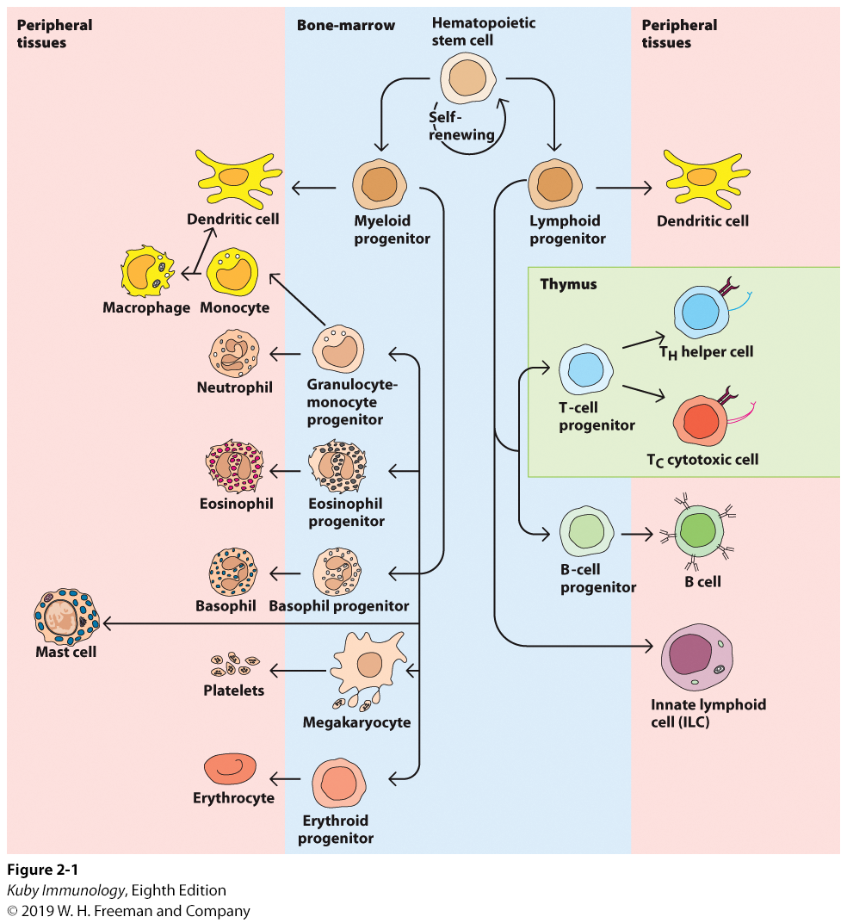
Cells of the immune system

Slide 16
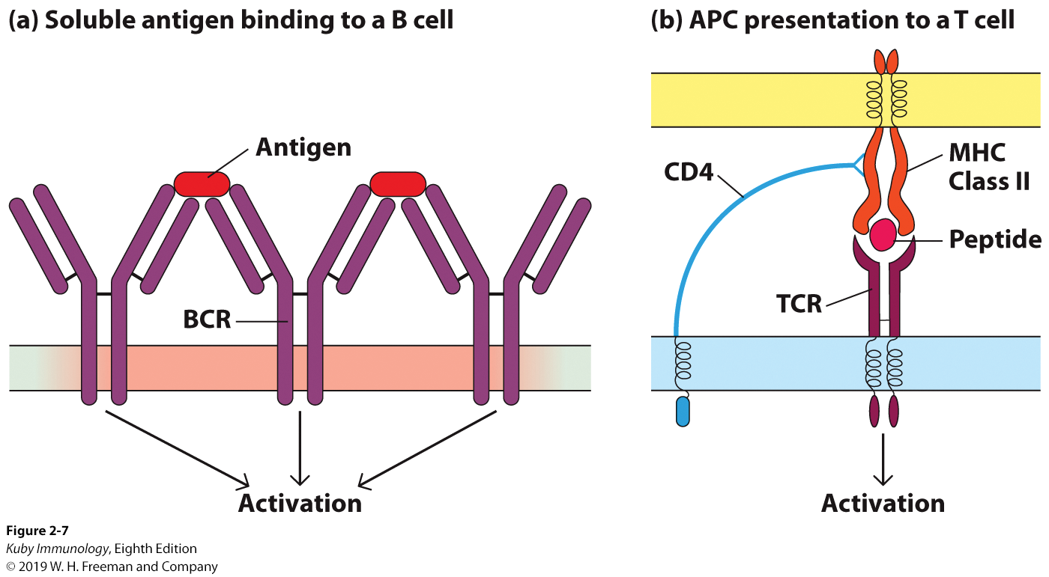
Cells of the immune system
B cells also express the B cell receptor (BCR)
T cells also express the T cell receptor (TCR)

Slide 17
Types of Immunity
Innate (Natural) Immunity
First line of defense
Fast, But Nonspecific
Also uses phagocytic cells
Shorter duration
No memory

Slide 18
2. Adaptive (Acquired) Immunity
Adaptive specific Immunity Specificity
Response of a specific B and T lymphocytes to an antigen
Exhibit Immunological Memory
Self / non-self recognition
Slower to develop 5–6 days (or more)
Two Major Branches:
Humoral immunity (AbMI)
Immunity that is mediated by antibodies (B cells)
Cell Mediated Immunity (CMI)
Immune response in which antigen specific T cells dominate

Slide 19
Important concepts for understanding the immune response
Innate and Adaptive immunity work cooperatively
Activation of innate immune responses produces signal molecules (cytokines)
▼▼▼
These signal molecules stimulate and direct adaptive immune responses

Slide 20
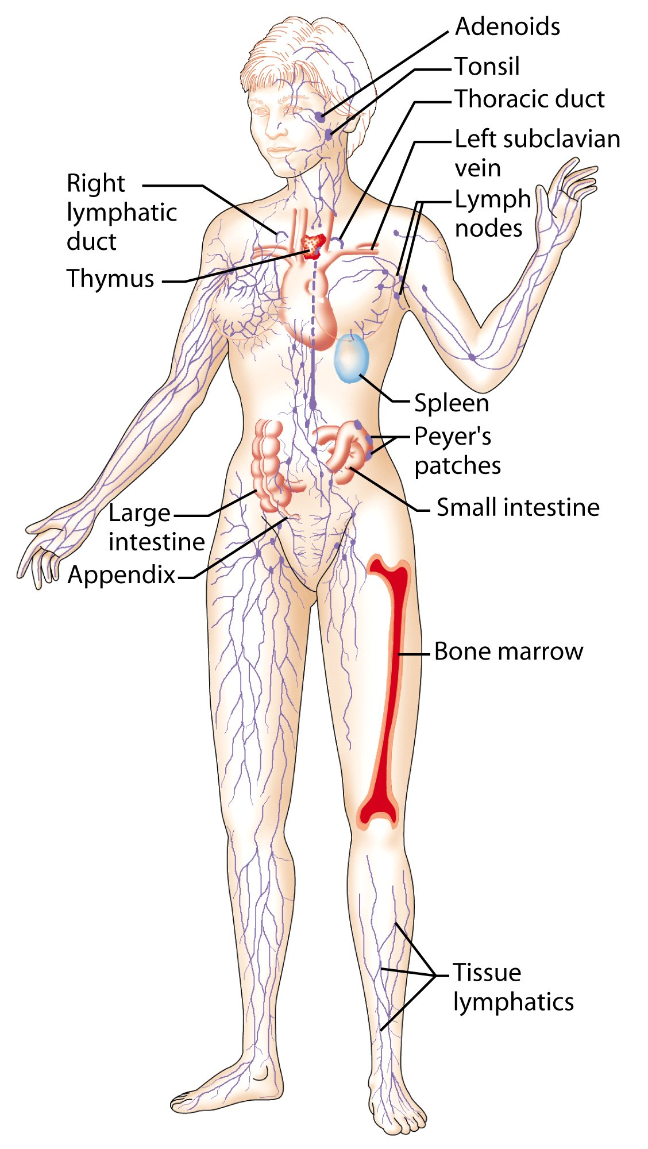
Lymphoid System
Lymphatic vessels and lymphoid organs

Slide 21
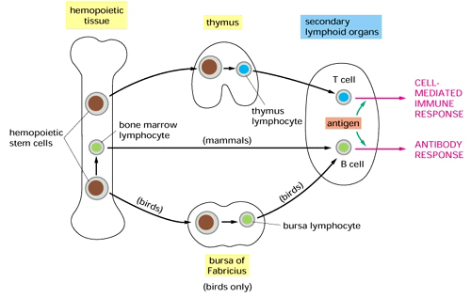
Primary Lymphoid Organs
(Development & Differentiation of immune cells)

Slide 22
Secondary Lymphoid Organs
(where the immune response occurs):
Spleen
Lymph nodes
Tonsils
MALT (Mucosa Associated Lymphoid Tissue)
Peyer’s patches
Appendix

Slide 23
Secondary Lymphoid Organs
Lymph nodes and spleen are the most highly organized secondary lymphoid organs
Differentiation into effector cells takes place in follicles of secondary lymphoid organs
Both B and T lymphocytes will develop into long-lived memory cells in these areas, as well
The spleen is the first line of defense against blood-borne pathogens
Mucosa-associated lymphoid tissue (MALT) Important layer of defense against infection at mucosal and epithelial layers.

Slide 24
Lymphoid series comprise of main lymphocyte populations
T cells / B cells / Natural Killer

Slide 25
T-Lymphocyte Differentiation
T cells originate in Bone Marrow then migrate to Thymus for development.
T cell precursors differentiate into mature T cells in Thymus. All of them have CD3 proteins on their cell surface
During their passage through thymus they differentiate into T cells expressing either markers (CD4 T helper cell or CD8 T cytotoxic cell)
Two Major populations:
T helper lymphocytes (CD4+)
OR
T cytotoxic lymphocyte (CD8+)

Slide 26
Subtypes of T Helper (CD4+) & their functions
Th1/ Th2/ Th17/ Treg / Tfh
Th1: (Inflammatory T helper cell) mediates inflammation via helping macrophages in CMI during inflammatory response. Also helps CD8+ cells to become activated cytotoxic T cells.
Th2: provides help to B cell to produce antibody
Th17: has a role in innate Immunity & the pathogenesis of autoimmune diseases.
Treg.: repress the growth and function of T cell helper and cytotoxic subsets.
Tfh: T follicular helper are critical to prevent autoimmunity.

Slide 27
T Cytotoxic (CD8+) Cells
About 35% of peripheral blood T cells
Perform cytotoxic functions
They mediate the killing of:
Virus-infected cells
Tumors
Allograft cells (transplant)

Slide 28
B cells
Origin
During embryogenesis – fetal liver
Migrate to bone marrow – final destination
They do not require thymus for maturation

Slide 29
B cells
B cell progenitors: Pro-B cells, Pre-B cells and immature B cells are normally found in bone marrow
Mature B cells are found circulating in body fluids and lymphoid organs
Mature B cells display surface IgM and IgD which serves as antigen receptor (Maturation Markers)

Slide 30
The good, bad, and ugly of the immune system
The Role of Immune system is to PROTECT
Dysfunction of this role when it is Abnormal:
Overly active: Hypersensitivity / Autoimmunity
Defects in the immune response: Immunodeficiency
Rejection of transplanted tissue or organ
Cancer

Slide 31
Take home message
Normal healthy state is maintained by intact immune response either innate (natural immunity) and/or adaptive (acquired immunity after exposure to antigens)
Cell mediated immunity and humoral immunity is mediated by T and B lymphocytes respectively
Lymphoid system provides suitable environment for development, maturation and proper functioning of cells of immune system

