Slide 1
GRAM POSITIVE & GRAM NEGATIVE BACTERIA
(Foundation Block, Microbiology)
Lecturer name: Dr. Khalifa Binkhamis & Dr. Fawzia Alotaibi
Department of Pathology, Microbiology Unit

Slide 2
Objectives:
By the end of this lecture, the student should able to:
Recall the general basic characteristics of bacteria
Differentiate between gram positive and gram negative bacteria.
Recall the different groups, genera and species of gram positive bacteria (cocci and bacilli (rods))

Slide 3
Recall the different groups, genera and species of gram negative bacteria (cocci and bacilli (rods))
Recall the common infections and diseases caused by these organisms
Recall the common identification characteristics of these groups and organisms
Recall the different non gram sustainable bacteria

Slide 4
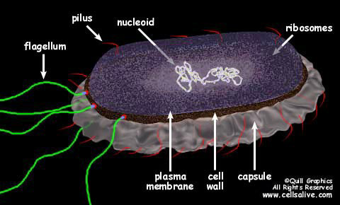
Bacterial cells

Slide 5
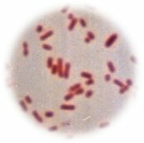
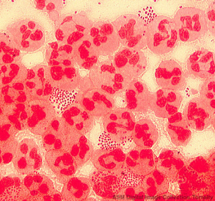
GRAM STAIN
Developed in 1884 by the Danish physician Hans Christian Gram
An important tool in bacterial taxonomy, distinguishing so-called Gram-positive bacteria, which remain coloured after the staining procedure, from Gram-negative bacteria, which do not retain dye and need to be counter-stained.
Can be applied to pure cultures of bacteria or to clinical specimens
Top: Pure culture of E. coli
(Gram-negative rods)
Bottom: Neisseria gonorrhoeae in a smear of urethral pus
(Gram-negative cocci, with pus cells)

Slide 6
CELL WALL
Gram positive cell wall
Gram negative cell wall
Consists of
a thick, homogenous sheath of peptidoglycan 20-80 nm thick
tightly bound acidic polysaccharides, including teichoic acid and lipoteichoic acid
cell membrane
Retain crystal violet and stain purple
Consists of
an outer membrane containing lipopolysaccharide (LPS)
thin shell of peptidoglycan
periplasmic space
inner membrane
Lose crystal violet and stain pink from safranin counterstain

Slide 7
Gram Positive
Gram Negative

Slide 8
The Gram Stain
Gram's
Crystal
iodine
violet
Decolorise with
acetone
Gram-positives
appear purple
Counterstain with
e.g. methyl red
Gram-negatives
appear pink

Slide 10
Gram-positive cocci
Gram-positive rods
Gram-negative cocci
Gram-negative rods

Slide 11
Gram positive bacteria
Cocci Bacilli
Aerobic /facltative Anaerobe
Anaerobe Peptostreptococci
Staphylococci
Streptococci
Enterococcci
Aerobic/facultative anaerobe Anaerobic
Cornybacterium
Listeria Clostridium
Nocardia
Latobacillus ,Bacillus

Slide 12
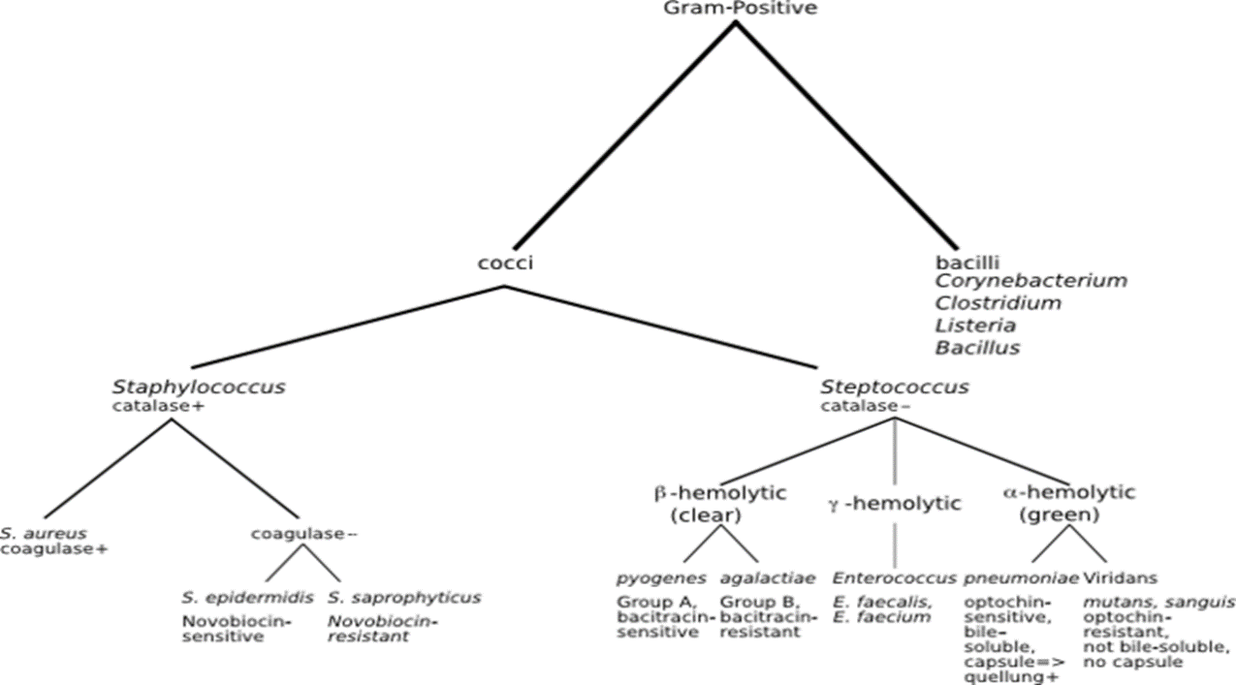

Slide 13
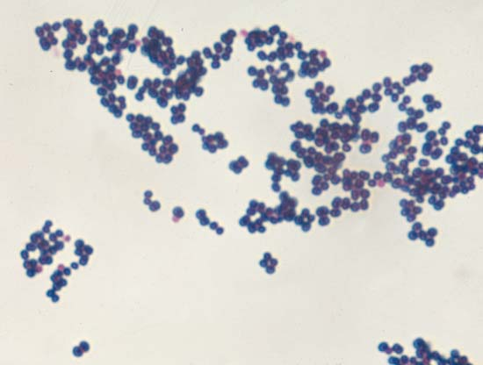
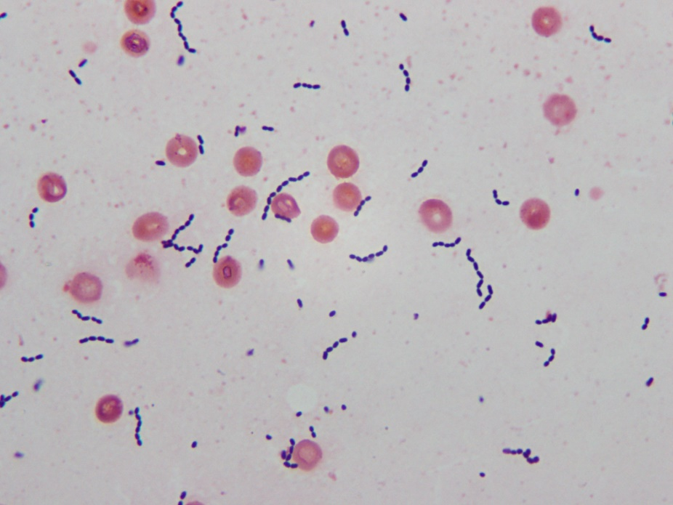
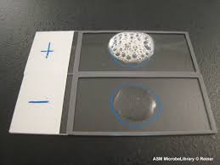
Gram positive cocci in chain
Streptococci
Gram positive cocci in clusters
Staphylococci
Catalase

Slide 14
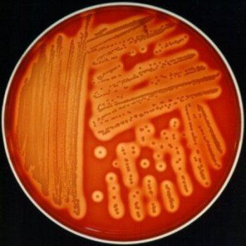
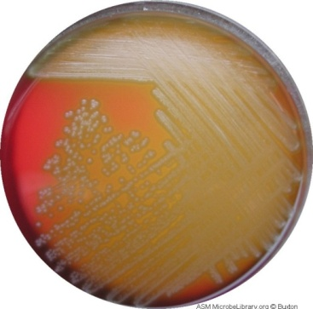
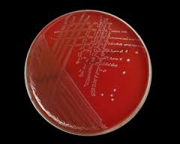
Beta-hemolytic
Alpha-hemolytic
Non-hemolytic

Slide 15
Gram | O2 | Arrangment | Example | Diseases
Gram Positive Cocci |  | Gram + cocci in chains Catalase negative | Strep.pneumoniae Alpha hemolysis | Pneumonia meningitis
 |  |  | Group A strept Beta hemolysis | Pharyngitis (Sore throat) Rheumatic fever
 | Aerobic |  | Group B strept Beta hemolysis | Neonatal infection
 |  |  | Enterococcus Non hemolysis | Urine, blood infection
 |  | Gram + cocci in clusters Catalase + | Staph aureus | Soft tissue bone joint blood and heart
 |  |  | Coagulase – staph Staph epidermidis | Catheter related infections
 | Anaerobic | Gram + cocci in chains | Peptostreptococcus | Brain abscess
Gram Negative cocci | Aerobic | Gram – cocci in pairs | Neisseria and Moraxella | Genital , Meninges and respiratory
 | Anaerobic | Gram – cocci | Veillonella | Rare cause infection

Slide 16
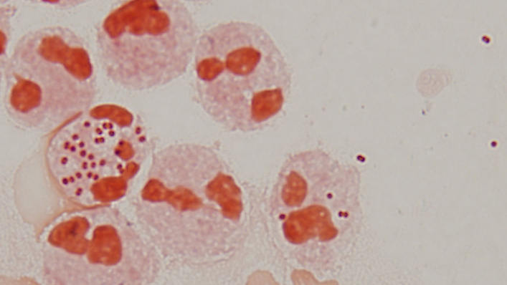
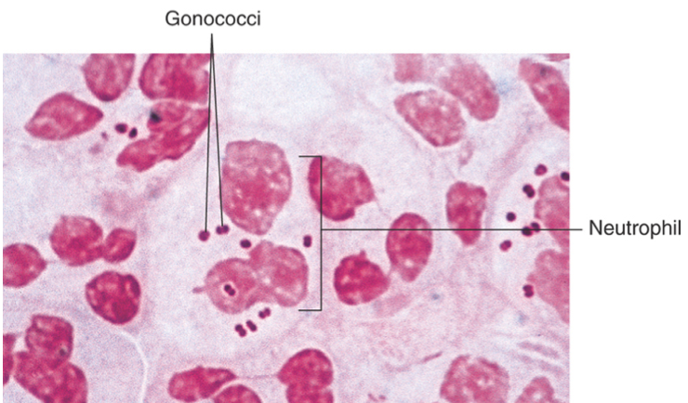

Slide 17
Gram | O2 | Characteristics | Examples
Gram Positive Bacilli | Aerobic | Spore forming | Bacillus antherasis
 |  | Non-Spore forming | Listeria Corynebacterium
 | Anaerobic | Spore forming | Clostridia
 |  | Non-Spore forming | Eubacterium
Gram negative Bacilli | Aerobic | Sugar fermenter Enteric Bacteria Oxidase - | E. coli
 |  | Sugar fermenter Oxidase + | Vibrio cholerae
 |  | Non fermenter Oxidase + | Pseudomonas
 |  | Non fermenter Oxidase - | Acinetobacter
 |  | fastidious | Haemophilus influenzae
 | Anaerobic |  | Bacteroides
Non Gram Stainable |  |  | Spirochetes
 |  |  | Mycoplasma
 |  |  | Chlamydia

Slide 18
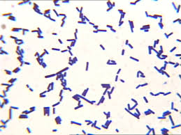
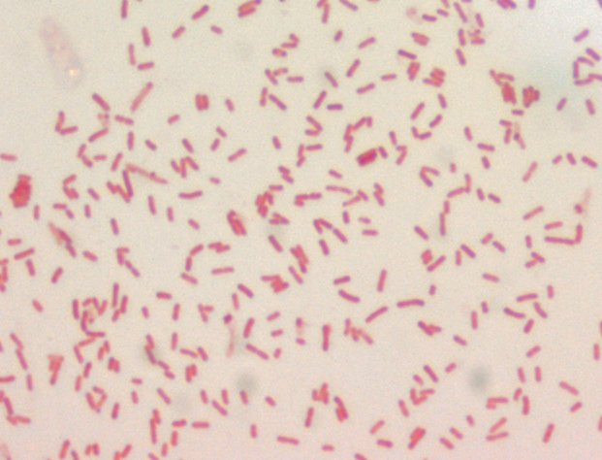

Slide 19
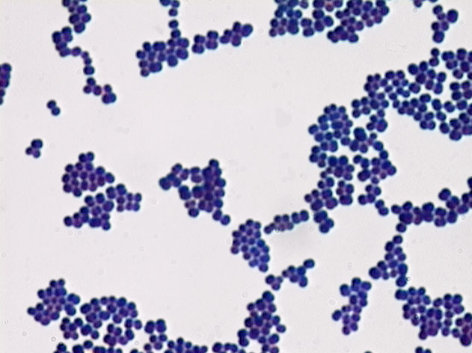
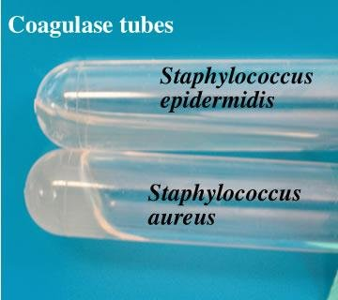
Gram-positive Cocci
Staphylococci
Catalase-positive
Gram-positive cocci in clusters
Staphylococcus aureus
coagulase-positive, most important pathogen
Staph. epidermidis
and other coagulase negative staphylococci e.g. S saprophiticus

Slide 20
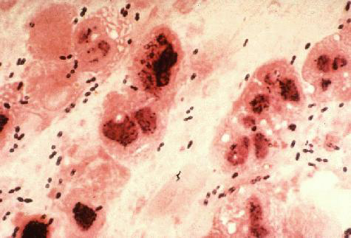
Streptococci
Catalase-negative
Gram-positive cocci in chains or pairs
Divided by type of hemolysis.
Alpha hemolytic:
S. viridans- oral flora - infective endocarditis
S. pneumoniae-important cause of community acquired pneumonia
Beta hemolytic:
S. pyogenes, group A streptococcus
Important cause of pharyngitis and cellulitis

Slide 21
S. pneumoniae

Slide 22
GRAM POSITIVE BACILLI
A-Spore forming
B-Non spore forming
Spore forming are divided into:-
Aerobic spore forming most important is Bacillus spp. (e.g. anthracis, that causes anthracis)
Anaerobic spore forming
Clostridium spp.

Slide 23
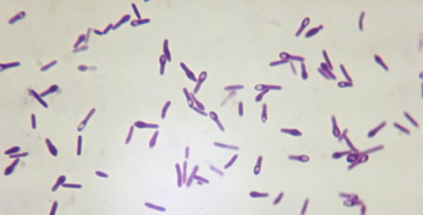
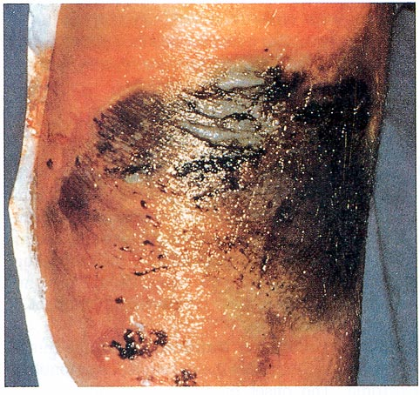
GRAM POSITIVE BACILLI
Anaerobic gram positive bacilli
C. tetani - Tetanus C. perfringens
Gas gangrene
C. botulinum - botulism
Descending weakness-->paralysis
diplopia, dysphagia-->respiratory failure

Slide 24
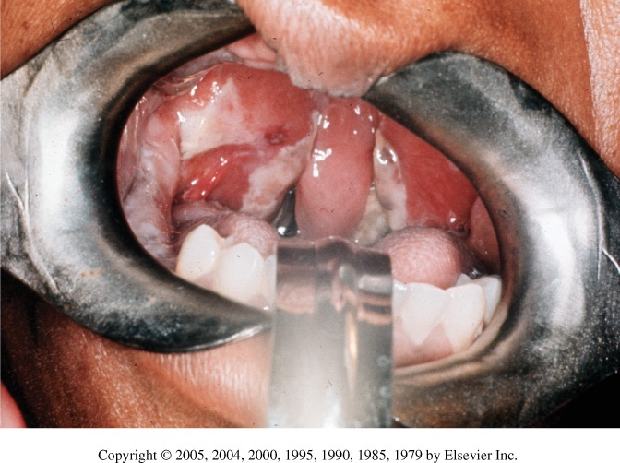
GRAM POSITIVE BACILLI
Aerobic gram positive bacilli
Corynebacterium diphtheriae
Fever, pharyngitis, cervical LAD
thick, gray, adherent membrane
sequelae-->airway obstruction, myocarditis

Slide 25
Gram-Negative Cocci
Neisseria gonorrhoeae
The Gonococcus
Neisseria meningitidis
The Meningococcus
Both Gram-negative intracellular diplococci
Moraxella catarrhalis

Slide 26
Gram-Negative Rods
Enteric Bacteria they ferment sugars most important are;
E. coli
Salmonella
Shigella
Yersinia and Klebsiella pneumoniae
Proteus

Slide 27
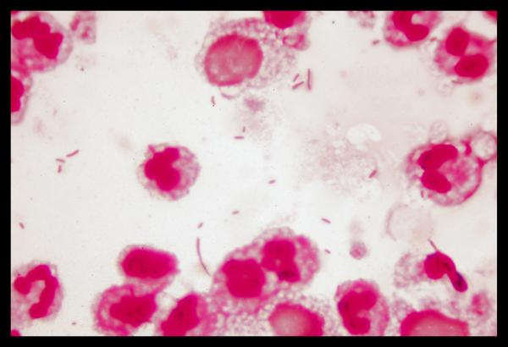
Gram-Negative Rods
Fastidious GNRs
Bordetella pertussis
Haemophilus influenzae
Campylobacter jejuni
Helicobacter pylori
Legionella pneumophila
Anaerobic GNRs
Bacteroides fragilis
Fusobacterium

Slide 28
Non fermentative gram negative rods i.e. they do not ferment sugars e.g.
Oxidase positive: Pseudomonas, causes infection in immunocompromised patients
Oxidise negative non fermentative e.g.
Acinobacter spp.

Slide 29
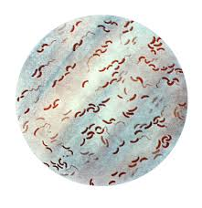
Oxidise positive comma shaped and also fermentative most important is Vibrio cholerae that causes cholera which is a disease characterized by severe diarrhea and dehydration

Slide 30
Non-Gram-stainable bacteria
Unusual gram-positives
Some spirochaetes (e.g Treponema pallidum (cause of syphilis))
Bacteria with no cell wall
Obligate intra-cellular bacteria

Slide 31
Unusual Gram-positives
Mycobacteria
Contain mycolic acid in cell wall

Slide 32
Non-Gram-stainable bacteria
No cell wall
Obligate intra-cellular
Mycoplasmas
Smallest free-living organisms
No cell wall
M. pneumonia, M. genitalium
Chlamydia
C. pneumoniae, C. trachomatis
Rickettsia

Slide 33
Gram Positive
Gram Negative
Cocci
Bacilli
Cocci
Bacilli
Aerobic
Anaerobic
Aerobic
Anaerobic
Aerobic
Anaerobic
Aerobic
Anaerobic
Bacillus
Corynebacterium
Listeria
Clostridium
Neisseria
Moraxella
Veillonella
E.coli
Klebsiella
Citrobacter
Salmonella
Shigella
etc
Bacteroides
Staphylococcus
Enterococcus
Streptococcus
Peptostreptococcus
Vibrio
Aeromonas
Campylobacter
Helicobacter
Mycoplasma, Chlamydia, Rickettsia
Spirochaetes
Mycobacterium
Pseudomonas
Acinetobacter
Haemophilus
Legionella
Bartonella

