Slide 1
Lecture Title:
Anaerobes of clinical Importance
(Foundation Block, Microbiology)
Lecturer name: Dr. Ali Somily &
Dr. Fawzia Al-otaibi
Department of Pathology, Microbiology Unit

Slide 2
LECTURE OBJECTIVES
By the end of this lecture the student should be able to:
Describe anaerobic bacteria including their sensitivity to oxygen and where they may be found in the environment and the human body.
Differentiate the various types of anaerobes with regard to atmospheric requirement (i.e. obligate anaerobes, Facultative anaerobes and aerotolerent anaerobes.
Describe how anaerobes, as part of endogenous microbiota, initiate and establish infection.
Name the endogenous anaerobes commonly involved in human infection.

Slide 3
LECTURE OBJECTIVES
Recognize specimens that are acceptable and unacceptable for anaerobic culture.
Give the clues(sign and manifestations) to anaerobic infection, name the most probable etiologic agents of the following(Wound botulism, gas gangrene,tetanus,Actinomycosis,Pseudomembranous colitis and bacterial vaginosis)
Describe the microscopic and colony morphology and the results of differentiating anaerobic isolates.
Discuss antimicrobial susceptibility testing of anaerobes including methods and antimicrobial agents to be tested.
Describe the major approaches to treat anaerobic-associated diseases either medical or surgical.

Slide 4
CLASSIFICATION
Anaerobes
Bacilli
Spore forming
Non-spore forming
Cocci
Gram Positive
Gram Positive actinomyces
Gram Negative
Bacteroides
Gram Positive
clostridium
Gram Negative
Chains
peptostreptococcus
Cluster
peptococcus
Diplococci
veillonella
Notes:
Anaerobic Gram positive spore forming bacilli (Clostridia)
Anaerobic Gram positive non-spore forming bacilli (Actinomyces)
Anaerobic Gram negative bacilli non-sporing forming (Bacteroides)
Anaerobic streptococci (Peptostreptococcus)
Anaerobic staphylococcus (Peptococcus)
Gram negative diplococci (Veillonella)

Slide 5
ANAEROBIOSIS
Contain flavoprotein so in the presence of oxygen produce H2O2 which is toxic
Lack cytochrome -cannot use oxygen as hydrogen acceptor
Most Lack Catalase & Peroxidase
Some lack enzyme superoxide dismutase so many killed
Peroxide and toxic radicles enzyme like fumarate reductase must be in reduced form to work

Slide 6
HABITAT :
These organism are normal flora in:
Oropharynx eg.
Fusobacteria
Provetella melaninogenicus
Veillonella
B. Gastrointestinal tract
Found mainly in the large colon in large numbers
Total number of anaerobes = 10 ¹¹
While all aerobes (including E. coli) = 10 ¹⁴
examples are
Bacteroides fragilis
Bifidobacterium species
C. Female genital tract (mainly in the vagina)

Slide 7
FEATURES OF ANAEROBIC INFECTIONS
Infections are always near to the site of the body which are habitat.
Infection from animal bites.
Deep abscesses
The infections are also polymicrobial
Gas formation, foul smell
Detection of "Sulphur granules"' due to actinomycosis
Failure to grow organism from pus if not culture anaerobically.
Failure to respond to usual antibiotics.

Slide 8
HOW DOES THE INFECTION BEGIN ?
Disruption in barrier
Trauma
Surgery
Cancer
Disruption in blood supply
Drop in O2 content of tissue.
Decrease in Eh potential
Tissue necrosis

Slide 9
WHAT ARE THE INFECTION CAUSED BY THESE ANAEROBIC ORGANISMS I
Post operative wound infection
Brain, dental, lung abscess
Intra abdominal abscess, appendicitis, diverculitis
Infection of the female genital tract: Septic abortion, puerperal infection and endometritis , pelvic abscess or breast abscess
Diabetic foot infections and pilonidal sinus
Notes:
WHAT ARE THE INFECTION CAUSED BY THESE ANAEROBIC ORGANISMS I
Post operative wound infection
Brain abscess
Dental abscesses
Lung abscess
Intra abdominal abscess, appendicitis, diverculitis
All these infection can cause bacteriaemia
Infection of the female genital tract
Septic abortion
Puerperal infection or sepsis
Endometritis
Pelvic abscess
12. Other infections
a) Breast abscess in puerperal sepsis
b) Infection of diabetic patients (diabetic foot infections).
c) Infection of pilonidal sinus

Slide 10
LABORATORY DIAGNOSIS:
When anaerobic infection is suspected;
a) Specimens have to be collected from the site containing necrotic tissue.
b) Pus is better than swabs.
c) Specimens has to be send to the laboratory within 1/2 hour why?
d) Fluid media like cooked meat broth are the best culture media.
e) Specimens have to incubated anaerobically for 48 hours.

Slide 11
TREATMENT:
Bacteroides fragilis is always resistant to penicillin.
But penicillin can he used for other anaerobes
Flagyl (metronidazole) is the drug of choice.
Clindamycin can also be used.

Slide 12
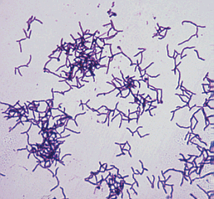
ANAEROBIC NON SPORE FORMING GRAM POSITIVE BACILLI
ORGANISM | DISEASE
ACTINOMYCES SPP | ACTINOMYCOSIS
PROPIONIBACTERIUM SPP | ACNE
MOBILUNCUS SPP | BACTERIAL VAGINOSIS
LACTOBACILLUS SPP | ENDOCARDITIS
EUBACTERIUM SPP | -
BIFIDOBACTERIUM SPP | -

Slide 13
ACTINOMYCOSIS
Actinomyces are branching anaerobic or microaerophilic Gram positive bacilli
Source of the infection is normal flora and the host usually normal host
Primary site of the infection is mouth, lung, appendix, uterus with IUD (chronic infection)
Infection can spread to the brain, liver, bone and blood
Diagnosis by Gram stain with sulfur granules and growth of molar tooth colonies
Treatment penicillin, clindamycin or tetracycline

Slide 14
ANAEROBIC GRAM NEGATIVE BACILLI
BACTEROIDES
FUSOBACTERIUM
BUTYRIVIBRIO
SUCCINOMONAS

Slide 15
STRICT ANAEROBE PLEOMORPHIC (COCCO BACILLI)GRAM NEGATIVE BACILLI
BACTEROIDES FRAGILLIS GROUP | BACTEROIDES SPECIES OTHER THAN B. FRAGILIS GROUP
ACCOUNT FOR 1/3 OF ALL ISOLATES GIT TRAC | LESS COMMON ORAL CAVITY
B. FRAGILIS-B. VULGARIS-B.THETAIOTAMICRON B. UNIFORMIS | PREVOTELLA PORPHYROMONAS
RESISTANT TO 20% BILE | BILE SENSITIVE
RESISTANT TO MANY ANTIBIOTICS PENICILLIN, KANAMYCIN, VANCOMYCIN, COLISTIN – AND MANY MORE | RESISTANT TO KANAMYCIN ONLY
NO PIGMENTATION OF COLONIES OR FLUORESCENCE | SOME PIGMENTED

Slide 16
OTHER ANAEROBIC GRAM NEGATIVE BACILLI | ANAEROBIC GRAM POSITIVE COCCI |  | ANAEROBIC GRAM NEGATIVE COCCI
BACILLI | CHAINS | CLUSTERS | SHEET-LIKE-or Pairs
FUSOBACTERIUM NECROPHORUM | PEPTOSTREPTOCOCCUS | PEPTOCOCCUS | VEILLONELLA PARVULA
PERITONISILLAR →INTRNAL JUGULAR VEIN THROMBOSIS→EMBOLI TO THE LUNG LEMIERRE SYNDROM | BRAIN ABSCESS | - | -

Slide 17
LARGE GRAM POSITIVE SPORE FORMATION BACILLI : CLOSTRIDIUM SPECIES
CLOSTRIDIUM SPECIES | MAJOR DISEASE
Cl. perfringens and other e.g septicum | Gas gangrene
Cl. tetani | Tetanus
Cl. botulinum | Botulism
Cl. difficile | 4. Toxic enterocolitis (Pseudomembernous colitis)

Slide 18
Clostridium perfringens (C. welchii)
large Gram positive bacilli with bulging sub terminal endospores
Clinical Features
Can leads to the following diseases
1) Wound infection after wound Contamination can lead to Gas Gangrene - most serious disease
2) Gas Gangrene of the uterus after criminal abortion
3) Food Poisoning : Spores are swallowed then germinate in gut after 18 hours(Toxin production) lead to abdominal pain and diarrhoea

Slide 19
Clostridium perfringens (CI . welchii)
Pathogenesis:
Traumatic open wounds or compound fractures lead to muscle damages and contamination with dirt etc,
Mainly in war wounds, old age, low blood supply and amputation of thigh (required prophylaxis with penicillin

Slide 20
Clostridium perfringens (C . welchii)
Laboratory diagnosis
Smear Gram stain Large Gram positive bacilli with few or no WBCs
Culture
Blood agar with haemolytic colonies (double zone of haemolysis )
Cooked meat medium
Gives the NAGLAR'S Reaction & toxin neutralization on Egg yolk medium & toxin is a phospholipase
Treatment and Prevention
Remove dead tissue , debris and foreign bodies .Penicillin and hyperbaric oxygen in some cases

Slide 21
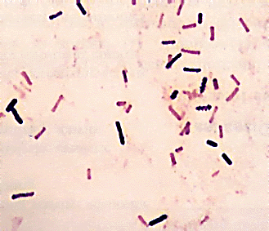
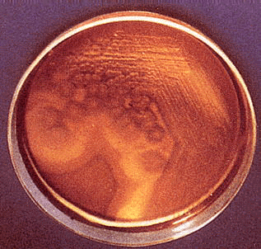
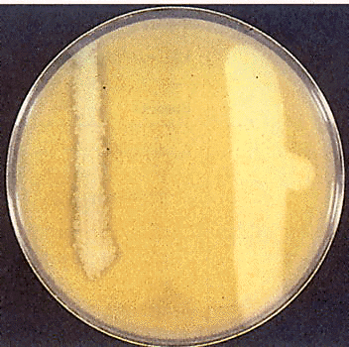
NOTE: Large rectangular gram-positive bacilli
NOTE: Double zone of hemolysis
NOTE: Lecithinase (α-toxin; phospholipase) hydrolyzes phospholipids in egg-yolk agar around streak on right. Antibody against α-toxin inhibits activity around left streak.
Inner beta-hemolysis = θ toxin Outer alpha-hemolysis = α toxin

Slide 22
Clostridium .tetani (Tetanus)
Anaerobic Gram positive bacilli with terminal spore( called drum Stick appearance)
Lives in soil and animal feaces. e,g horse and any wound can infected if contaminated by spores
Notes:
2.5 ng/kg

Slide 23
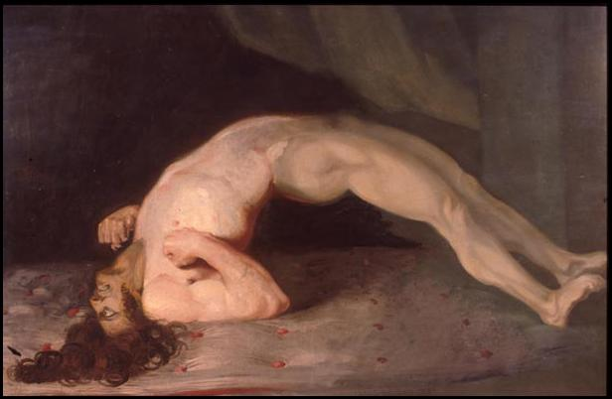
Clostridium .tetani (Tetanus)
Clinical Features
Incubation period 1-3 weeks (time from infection to the appearance of symptoms)
Face & neck wounds are more dangerous
Symptoms: local (not common), cephalic (rare), generalized (most common)
Painful muscle spasm around infected wound and Contraction of muscles in the face called Trismus (Lockjaw) , Risus Sardonicus (facial muscle)
Opisthotonus (Araching of Back)in children.
Opistho meaning "behind" and tonos meaning "tension", due to extrapyramidal effect and is caused by spasm of the axial along the spinal column .

Slide 24
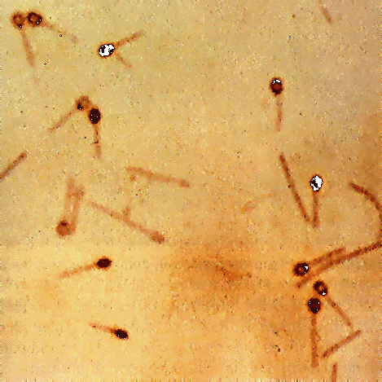
Clostridium .tetani (Tetanus)
Pathogenesis
Mainly due to tetanospasmin which is powerful exotoxin (protein) .
This organism does not lead to invasion or Bacteraemia . Its function to inhibits transmission of normal inhibitory messages from central nervous system at anterior horn cells of cord.
Laboratory Diagnosis
Mainly by clinical and it is strict anaerobe very motile , spread on agar.

Slide 25
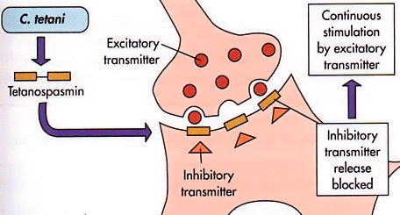
Mechanism of Action of Tetanus Toxin

Slide 26
Clostridium .tetani (Tetanus)
Treatment
Cleaning of wound and removal of Foreign body
Specific by antitoxin form horse serum but it can lead to anaphylaxis & shock must be tested first or human immunoglobulin.
Antibiotics : Penicillin.
Supportive treatment by keeping the patient in dark pace, fluids and sedative valium
Prevention
by vaccination

Slide 27
Clostridium botulinum
Found in soil ponds and lakes
Toxin is exotoxin (protein) heat labile at 100 ^{O}C and resist gastrointestinal enzymes
It is the most powerful toxin known Lethal dose 1 µg human and 3 kg kill all population of the world .It dictated for by lysogenic phage
Botulism
From canned food., sea food e_g. salmon when it is not well cooked (Spores resist heat at 100 ºC ) →then multiply and produce toxin

Slide 28
Clostridium botulinum
Clinical features
Abnormal eye movement as if cranial nerve affected when bulbar area of the brain affected.
Finally the patient might develop respiratory and circulatory collapse
Infantile Botulism
Ingestion of Spores → germination in the gut→Botulism .Child present with week child, cranial nerve and constipation
Pathogenesis
Attacks neuromuscular junctions and prevents release of acetylcholine that can leads to paralysis

Slide 29
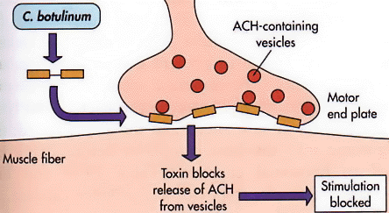
Mechanism of Action of Botulinum Toxin

Slide 30
Clostridium botulinum
Laboratory diagnosis
Suspected food from the patient faeces culture or serum toxin detection by mice inoculation after weeks → paralysis and death
Treatment
Mainly supportive and horse antitoxin in sever cases
Prevention
Adequate pressure cooking autoclaving and heating of food for 10 minutes at 100 ^{O}C

Slide 31
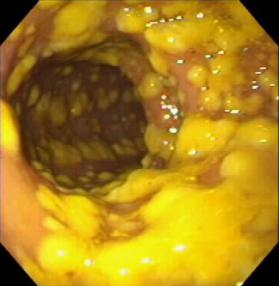
Clostridium Difficile
Normal flora in gastroentestinal tract
Clinical features
PSEUDOMEMBRANE COLITIS is the clinical manifestation of this disease which composed of bacteria , fibrin , WBCs and dead tissue cells
Sever dehydration , intestinal obstruction and perforation are some of complication of this syndrome
Pathogenesis
after exposure to antibiotics and killing of other normal flora, this organism will multiply witch then produce toxin that has two components
A–Subunit enterotoxin (cause diarrhea)
B-Subunit Cytotoxic ( kill the cells ie necrosis)

Slide 32
Clostridium Difficile
Laboratory diagnosis:
This organism hard to grow in the laboratory required special media and growth of the organism in solid media required cell line culture to illustrate cytotoxicity of the organism. The simplest method for diagnosis by detection of the toxin in the stool by immunological testing (ELISA) or molecular testing PCR

Slide 33
Clostridium Difficile
Treatment :
Metronidazole or and oral vancomycin in sever cases
Prevention:
This organism form spores and hard to control in the hospital because they are resistant to alcohol decontamination ( use Na hypochloride instead).
Patient need to be isolated and contact need to be screened to find out if they carrying the toxic strain of the bacteria.

Slide 34
Reference book and the relevant page numbers..
Sherries Medical Microbiology, an introduction to Infectious Diseases. Latest edition, Kenneth Ryan and George Ray. Publisher: Mc Graw Hill.

Slide 35
Thank You
(Foundation Block, Microbiology)
Dr. Ali Somily &
Dr. Fawzia Al-otaibi

