Slide 1
Classification of Tumors
Slides were taken from Dr. Amany Fathaddin, MD
Assistant professor- Department of Pathology
Group B & A 1st year- Oct 2020
Osamah T. Khojah
0555485892, asd@ksu.edu.sa

Slide 4
Objectives
Define the terms: neoplasm, tumor and oncology.
Classify tumors into benign and malignant.
Understand the concepts governing the classification of tumors and their nomenclature.
Define hamartoma, teratoma, choristoma and heterotropic rest.

Slide 5
General Definition
Neoplasia means “new growth,”
Neoplasm is often referred to as a tumor.
Oncology (Greek oncos = tumor) is the study of tumors or neoplasms.

Slide 6
Classification of Tumors
Benign when its microscopic and gross characteristics are considered relatively innocent, implying that it will remain localized, it cannot spread to other sites, and it is generally amenable to local surgical removal; the patient generally survives.
Malignant implies that the lesion can invade and destroy adjacent structures and spread to distant sites (metastasize) to cause death.

Slide 7
Similarity
All tumors, benign and malignant, have two basic components:
Clonal neoplastic cells that constitute their parenchyma.
Reactive stroma made up of connective tissue, blood vessels, and variable numbers of macrophages and lymphocytes.

Slide 8
Important of Stroma
Although the neoplastic cells largely determine a tumor's behavior and pathologic consequences, their growth and evolution is critically dependent on their stroma.
An adequate stromal blood supply is requisite for the tumor cells to live and divide.
The nomenclature of tumors and their biologic behavior are based primarily on the parenchymal component.

Slide 9
Benign Tumors
In general, benign tumors are designated by attaching the suffix -oma to the cell of origin.
Tumors of mesenchymal cells generally follow this rule.
For example, a benign tumor arising in fibrous tissue is called a fibroma, whereas a benign cartilaginous tumor is a chondroma.
Adenoma is applied to a benign epithelial neoplasm derived from glands, although they may or may not form glandular structures.

Slide 10
Benign Tumors
Benign epithelial neoplasms producing microscopically or macroscopically visible finger-like or warty projections from epithelial surfaces are referred to as papillomas.
Those that form large cystic masses, as in the ovary, are referred to as cystadenomas. Some tumors produce papillary patterns that protrude into cystic spaces and are called papillary cystadenomas.
Polyp is a mass that projects above a mucosal surface produces a macroscopically visible projection above a mucosal surface .

Slide 11
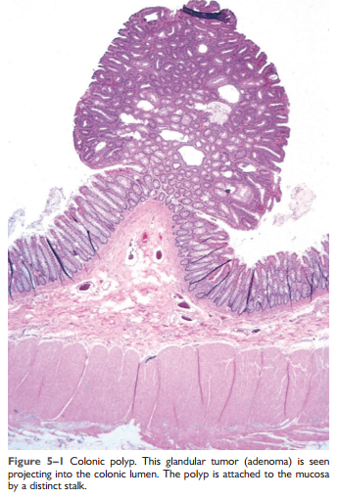
polyp

Slide 12
Malignant Tumors
Malignant tumors arising in mesenchymal tissue are usually called sarcomas .
Malignant neoplasms of epithelial cell origin, derived from any of the three germ layers, are called carcinomas.
Squamous cell carcinoma would denote a cancer in which the tumor cells resemble stratified squamous epithelium.
adenocarcinoma denotes a lesion in which the neoplastic epithelial cells grow in glandular patterns.

Slide 13
Malignant Tumors
Sometimes the tissue or organ of origin can be identified, as in the designation of renal cell adenocarcinoma. Not infrequently, however, a cancer is composed of undifferentiated cells of unknown tissue origin, and must be designated merely as an undifferentiated malignant tumor.

Slide 14
Mixed Tumors
In many benign and malignant neoplasms, the parenchymal cells bear a close resemblance to each other, as though all were derived from a single cell. However,
Divergent differentiation of a single neoplastic clone along two lineages creates what are called mixed tumors. The best example of this is the mixed tumor of salivary gland origin. These tumors contain epithelial components scattered within a myxoid stroma that sometimes contains islands of cartilage or bone . All these elements, it is believed, arise from a single clone capable of giving rise to epithelial and myoepithelial cells; thus, the preferred designation of these neoplasms is pleomorphic adenoma.

Slide 16
Teratoma
Teratoma, is a special type of mixed tumor that contains recognizable mature or immature cells or tissues representative of more than one germ cell layer and sometimes all three.
Originate from totipotential cells such as those normally present in the ovary and testis and sometimes abnormally present in sequestered midline embryonic rests. Such cells have the capacity to differentiate into any of the cell types found in the adult body.
When all the component parts are well differentiated, it is a benign (mature) teratoma; when less well differentiated, it is an immature, potentially or overtly, malignant teratoma.

Slide 17
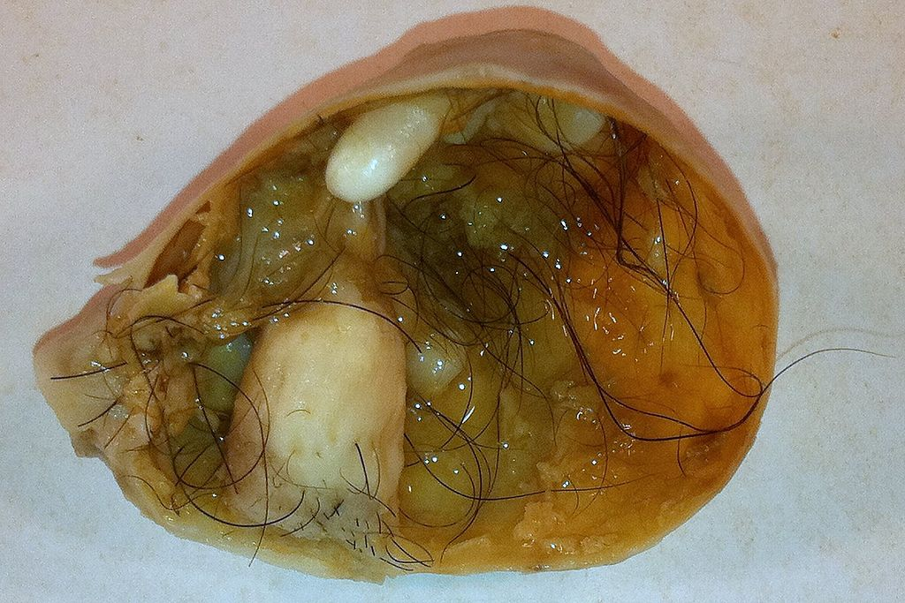

Slide 18
Critical Exceptions
Benign-sounding designations such as lymphoma, melanoma, mesothelioma, and seminoma have been used for certain malignant neoplasms.

Slide 19
Critical Exceptions
Hamartomas present as disorganized but benign-appearing masses composed of cells indigenous to the particular site. For example, pulmonary chondroid hamartoma contains islands of disorganized, but histologically normal cartilage, bronchi, and vessels.
Traditionally been considered developmental malformations, but some genetic studies have shown the presence of acquired translocations, suggesting a neoplastic origin.

Slide 20
Critical Exceptions
Choristoma is a congenital anomaly consisting of a heterotopic rest of cells. For example, a small nodule of well-developed and normally organized pancreatic tissue may be found in the submucosa of the stomach, duodenum, or small intestine. It has usual trivial significance.

Slide 21
Summary
Although the terminology of neoplasms is regrettably not simple, a firm grasp of the nomenclature is important because it is the language by which the nature and significance of tumors are categorized.
Remember the exceptions…

Slide 24
Which of the following is not a benign tumor?
Adenoma.
Lymphoma.
Fibroma.
Lipoma.
Osteoma.

Slide 25
Pathology
Fellowship of RCPA for Medical Graduates (apart from diplomas):
Anatomical Pathology: (SP/HP), (in NA other clinical pathology).
Chemical Pathology (BC, MC,…).
Clinical Pathology.
Forensic Pathology.
General Pathology.
Genetic Pathology (Cytogenetics, Molecular, Genomics).
Hematology (Blood Bank).
Immunopathology.
Microbiology.

Slide 26
KSF Pathology Programs
Hematopathology & Blood Transfusion:
Bone Marrow report: Leukemia & some lymphoma and others.
Peripheral blood smear and other routine hematology lab (core lab): cytology & HE.
Coagulation tests and anti-coagulant clinic:
Transfusion Medicine & cellular therapy in future.
Laboratory administration and quality management.

