Slide 1
Properties of Benign and Malignant Neoplasm
Slides were taken from Dr. Amany Fathaddin, MD
Assistant professor- Department of Pathology
Group B & A 1st year- Oct 2020
Osamah T. Khojah
0555485892, asd@ksu.edu.sa

Slide 2
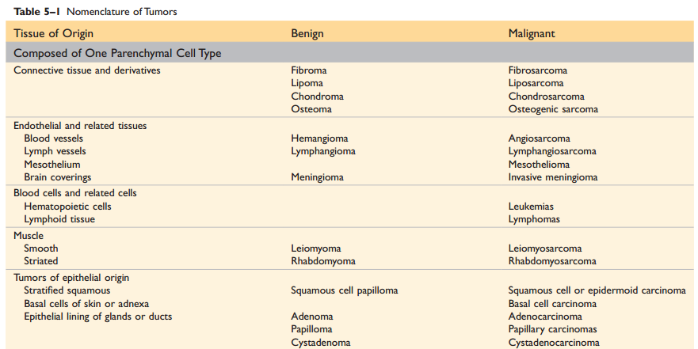

Slide 3
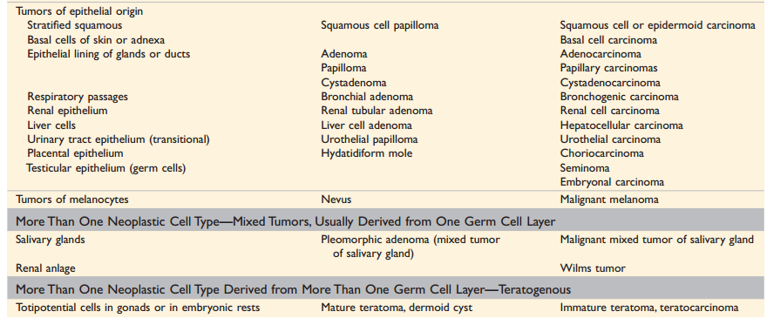

Slide 4
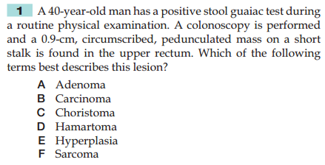

Slide 5
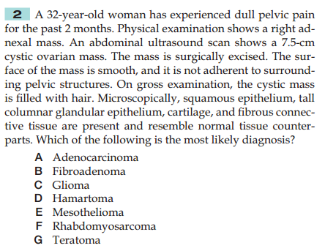

Slide 6
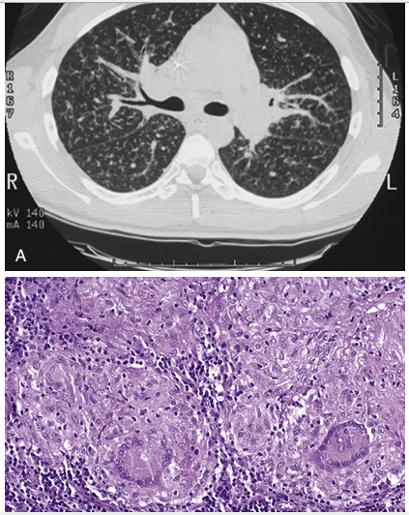
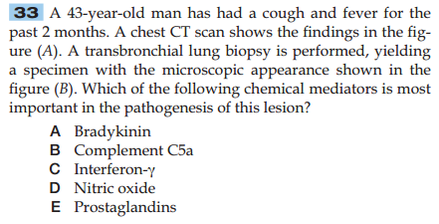

Slide 7
Objectives
Define the terms: differentiation and anaplasia.
Identify the morphological changes that differentiate between benign and malignant tumors.
Understand the terms metaplasia, dysplasia and carcinoma in situ.
Compare between benign and malignant tumors in terms of differentiation, rate of growth, local invasion and metastases.
List the pathways by which malignant tumors spread.

Slide 8
How to differentiate
There are four fundamental features by which benign and malignant tumors can be distinguished:
Differentiation and anaplasia.
Rate of growth.
Local invasion.
Metastasis.

Slide 9
Differentiation and Anaplasia
Differentiation and anaplasia are characteristics seen only in the parenchymal cells that constitute the transformed elements of neoplasms.
The differentiation of parenchymal tumor cells refers to the extent to which they resemble their normal forebears morphologically and functionally.

Slide 10
Differentiation and Anaplasia
Benign neoplasms are composed of well-differentiated cells that closely resemble their normal counterparts.
A lipoma is made up of mature fat cells laden with cytoplasmic lipid vacuoles
a chondroma is made up of mature cartilage cells that synthesize their usual cartilaginous matrix
In well-differentiated benign tumors, mitoses are usually rare and are of normal configuration.

Slide 11
Leiomyoma
Lipoma

Slide 12
Differentiation and Anaplasia
Malignant neoplasms are characterized by a wide range of parenchymal cell differentiation, from well differentiated to completely undifferentiated.
Between the two extremes lie tumors loosely referred to as moderately well differentiated.

Slide 14
Squamous Cell Carcinoma

Slide 15
Differentiation and Anaplasia
The stroma carrying the blood supply is crucial to the growth of tumors but does not aid in the separation of benign from malignant ones.
The amount of stromal connective tissue does determine the consistency of a neoplasm. Certain cancers induce a dense, abundant fibrous stroma (desmoplasia), making them hard, so-called scirrhous tumors.

Slide 16
Differentiation and Anaplasia
Malignant neoplasms that are composed of undifferentiated cells are said to be anaplastic.
Anaplasia: Lack of differentiation, is considered a hallmark of malignancy.

Slide 17
Anaplastic cells
Marked pleomorphism variation in size and shape.
The nuclei are extremely hyperchromatic (dark-staining) and large resulting in an increased nuclear-to-cytoplasmic ratio that may approach 1:1 instead of the normal 1 : 4 or 1 : 6.
Giant cells that are considerably larger than their neighbors may be formed and possess either one enormous nucleus or several nuclei.
Anaplastic nuclei are variable and bizarre in size and shape. The chromatin is coarse and clumped, and nucleoli may be of astounding size.
Mitoses often are numerous and distinctly atypical; tripolar or quadripolar mitotic figures.
They lose normal polarity: fail to develop recognizable patterns of orientation to one another.

Slide 20
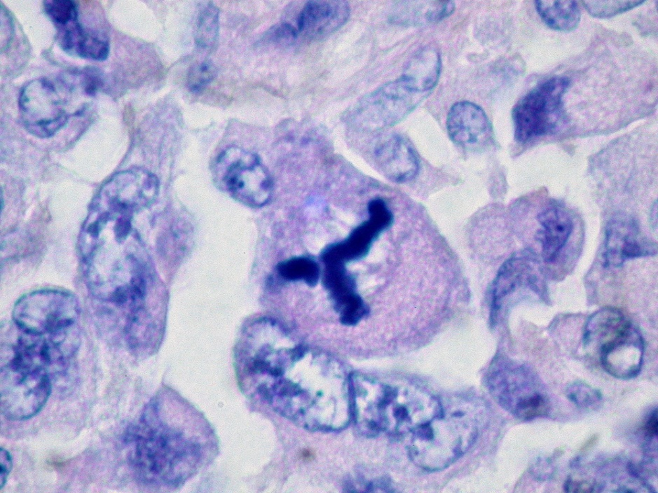
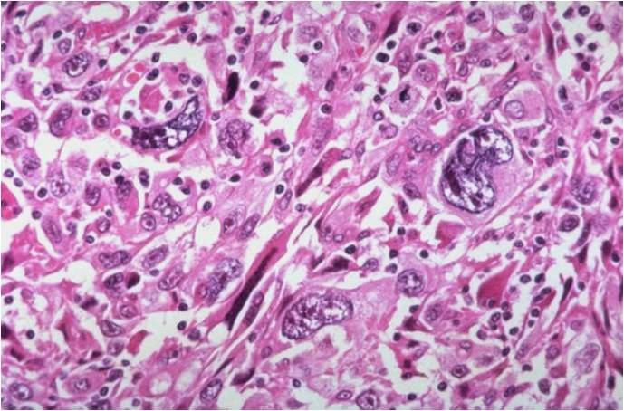
Anaplasia

Slide 21
Differentiation and Anaplasia
The more differentiated the tumor cell, the more completely it retains the functional capabilities of its normal counterparts.
Some cancers may elaborate fetal proteins not produced by comparable cells in the adult. Cancers of nonendocrine origin may produce so-called ectopic hormones.
The more rapidly growing and the more anaplastic a tumor, the less likely it is to have specialized functional activity.

Slide 22
Differentiation and Anaplasia
Metaplasia: change in mature to other mature cells, reversible, not directly links to neoplasm.
Dysplasia is encountered principally in epithelial lesions. It is a loss in the uniformity of individual cells and in their architectural orientation.
Dysplastic cells exhibit considerable pleomorphism and often possess hyperchromatic nuclei that are abnormally large for the size of the cell. Mitotic figures are more abundant than usual and frequently appear in abnormal locations within the epithelium.

Slide 24
Differentiation and Anaplasia
The term dysplasia is not synonymous with cancer; mild to moderate dysplasias that do not involve the entire thickness of the epithelium sometimes regress completely, particularly if inciting causes are removed.

Slide 25
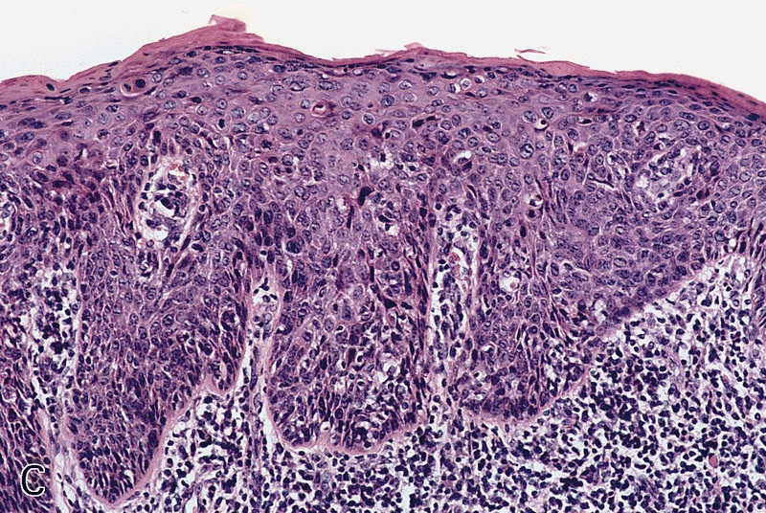
Carcinoma in situ
When dysplastic changes are marked and involve the entire thickness of the epithelium, a pre invasive stage of cancer.

Slide 27
Rate of Growth
Most benign tumors grow slowly, and most cancers grow much faster, eventually spreading locally and to distant sites (metastasizing) and causing death.
Many exceptions to this generalization, however, and some benign tumors grow more rapidly than some cancers.

Slide 28
Rate of Growth
The rate of growth of malignant tumors usually correlates inversely with their level of differentiation.
Poorly differentiated tumors tend to grow more rapidly than do well-differentiated tumors.
However, there is wide variation in the rate of growth. Some grow slowly for years and then enter a phase of rapid growth, signifying the emergence of an aggressive subclone of transformed cells. Others grow relatively slowly and steadily.
Rapidly growing malignant tumors often contain central areas of ischemic necrosis, because the tumor blood supply, derived from the host, fails to keep pace with the oxygen needs of the expanding mass of cells.

Slide 29
Rate of Growth
Cancer Stem Cells and Lineages:
The continued growth and maintenance of many tissues that contain short-lived cells, such as the formed elements of the blood and the epithelial cells of the gastrointestinal tract and skin, require a resident population of tissue stem cells that are long-lived and capable of self-renewal.
Cancers are immortal and have limitless proliferative capacity, indicating that like normal tissues, they also must contain cells with “stem-like” properties.
The cancer stem cell hypothesis posits that, in analogy with normal tissues, only a special subset of cells within tumors has the capacity for self-renewal. The concept of cancer stem cells has several important implications. Most notably, if cancer stem cells are essential for tumor persistence, it follows that these cells must be eliminated to cure the affected patient.
Thus, the limited success of current therapies could be explained by their failure to kill the malignant stem cells that lie at the root of cancer.

Slide 30
Local Invasion
A benign neoplasm remains localized at its site of origin. It does not have the capacity to infiltrate, invade, or metastasize to distant sites, as do malignant neoplasms. For example, as adenomas slowly expand, most develop an enclosing fibrous capsule that separates them from the host tissue.
Not all benign neoplasms are encapsulated.
Although encapsulation is the rule in benign tumors, the lack of a capsule does not mean that a tumor is malignant.

Slide 31
Local Invasion-Fibroadenoma

Slide 32
Local Invasion
Cancers grow by progressive infiltration, invasion, destruction, and penetration of the surrounding tissue.
They do not develop well-defined capsules.
The infiltrative mode of growth makes it necessary to remove a wide margin of surrounding normal tissue when surgical excision of a malignant tumor is attempted.
Surgical pathologists carefully examine the margins of resected tumors to ensure that they are devoid of cancer cells (clean margins).
Next to the development of metastases, local invasiveness is the most reliable feature that distinguishes malignant from benign tumors.

Slide 33
Invasive Carcinoma

Slide 34
Metastasis
Metastases are secondary implants of a tumor that are discontinuous with the primary tumor and located in remote tissues.
More than any other attribute, the property of metastasis identifies a neoplasm as malignant.
Not all cancers have equivalent ability to metastasize.
Approximately 30% of patients with newly diagnosed solid tumors (excluding skin cancers other than melanomas) present with clinically evident metastases.

Slide 35
Metastasis
In general, the more anaplastic and the larger the primary neoplasm, the more likely is metastatic spread, but as with most rules, there are exceptions. Extremely small cancers have been known to metastasize; conversely, some large and ominous-looking lesions may not.
Malignant neoplasms disseminate by one of three pathways:
Seeding within body cavities.
Lymphatic spread.
Hematogenous spread.

Slide 36
Metastasis
Spread by seeding occurs when neoplasms invade a natural body cavity. This mode of dissemination is particularly characteristic of cancers of the ovary, which often cover the peritoneal surfaces widely.
Lymphatic spread is more typical of carcinomas.
Hematogenous spread is favored by sarcomas.
There are numerous interconnections, however, between the lymphatic and vascular systems, so all forms of cancer may disseminate through either or both systems.

Slide 37
Metastasis
A “sentinel lymph node” is the first regional lymph node that receives lymph flow from a primary tumor. It can be identified by injection of blue dyes or radiolabeled tracers near the primary tumor.
Biopsy of sentinel lymph nodes allows determination of the extent of spread of tumor and can be used to plan treatment.
Although enlargement of nodes near a primary neoplasm should arouse concern for metastatic spread, it does not always imply cancerous involvement. Thus, histopathologic verification of tumor within an enlarged lymph node is required.

Slide 38
Metastasis
Hematogenous spread: is the favored pathway for sarcomas, but carcinomas use it as well.
With venous invasion, the blood-borne cells follow the venous flow draining the site of the neoplasm, with tumor cells often stopping in the first capillary bed they encounter.
Since all portal area drainage flows to the liver, and all caval blood flows to the lungs, the liver and lungs are the most frequently involved secondary sites in hematogenous dissemination.

Slide 39
Metastasis

Slide 41
Summery
Characteristics of Benign and Malignant Tumors:
Benign and malignant tumors can be distinguished from one another based on the degree of differentiation, rate of growth, local invasiveness, and distant spread.
Benign tumors resemble the tissue of origin and are well differentiated; malignant tumors are poorly or completely undifferentiated (anaplastic).
Benign tumors are slow-growing, whereas malignant tumors generally grow faster.
Benign tumors are well circumscribed and have a capsule; malignant tumors are poorly circumscribed and invade the surrounding normal tissues.
Benign tumors remain localized to the site of origin, whereas malignant tumors are locally invasive and metastasize to distant sites.

Slide 43
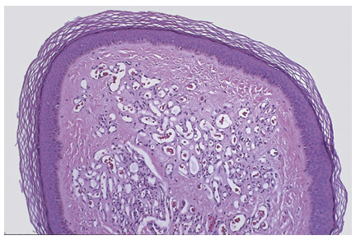
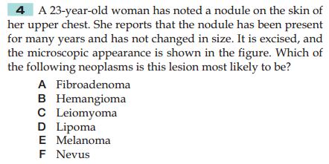

Slide 44
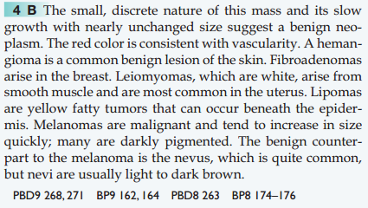

Slide 45
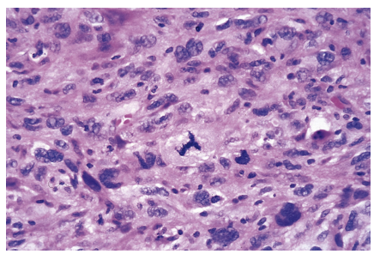
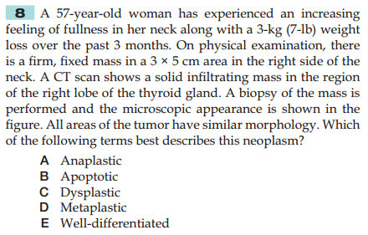

Slide 46
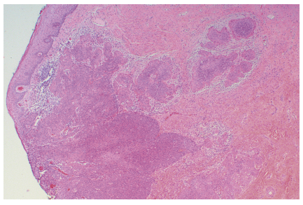
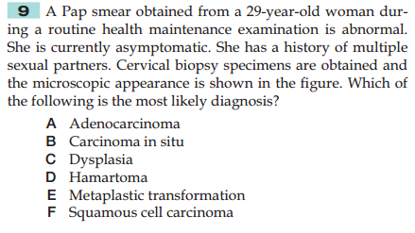

Slide 47
