Slide 1
Etiology of Tumors
Slides were taken from Dr. Amany Fathaddin, MD
Assistant professor- Department of Pathology
Group A & B 1st year- Oct 2020
Osamah T. Khojah
0555485892, asd@ksu.edu.sa

Slide 2
Objectives
Understand that incidence of cancer varies with age, race, geographic and genetic factor.
Explain the categories of genetic predisposition to cancer.
Identify the precancerous conditions.
Know the concept of chemical, radiation and microbiological carcinogenesis.

Slide 3
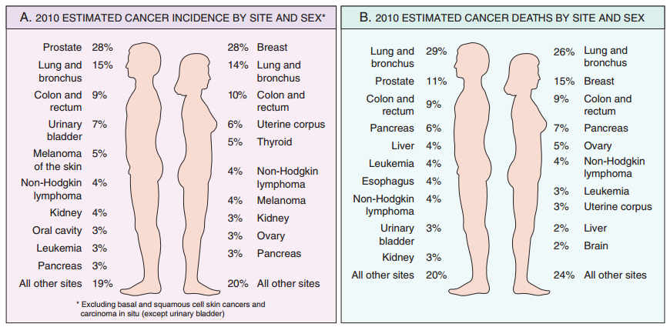
Cancer Incidence

Slide 4
Cervical Cancer
The declining death rate from cervical cancer:
is directly related to widespread use of cytological smear studies for early detection of this tumor and its precursor lesions.
The development of the human papillomavirus (HPV) vaccine may eliminate this cancer altogether in the coming years.

Slide 5
Geographic and Environmental Variables
environmental factors are the predominant cause of the most common sporadic cancers.
For example, death rates from breast cancer are about four to five times higher in the United States and Europe than in Japan. Conversely, the death rate for stomach carcinoma in men and women is about seven times higher in Japan than in the United States.
Nearly all the evidence indicates that these geographic differences are environmental rather than genetic in origin.

Slide 6
Environmental Factors
Among the possible environmental influences, the most distressing in terms of prevention are those incurred in personal practices, notably cigarette smoking and chronic alcohol consumption.

Slide 7
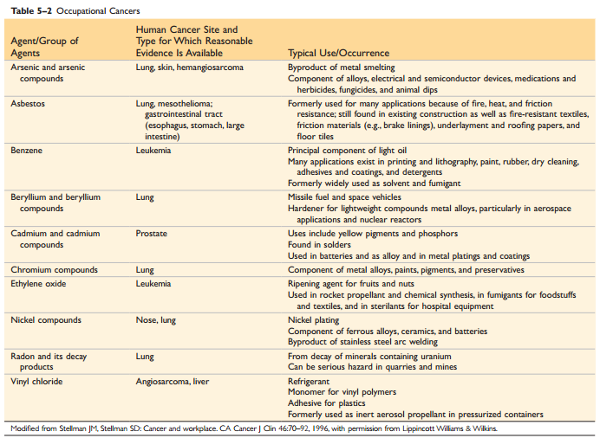

Slide 8
Age
In general, the frequency of cancer increases with age.
The rising incidence with age may be explained by the accumulation of somatic mutations associated with the emergence of malignant neoplasms.
The decline in immune competence that accompanies aging also may be a factor.
Cancer causes slightly more than 10% of all deaths among children younger than 15 years . The major lethal cancers in children are leukemias, tumors of the central nervous system, lymphomas, and soft tissue and bone sarcomas.

Slide 9
Heredity
Hereditary forms of cancer can be divided into three categories based on their pattern of inheritance:
1-Autosomal Dominant Cancer Syndromes.
2-Autosomal Recessive Syndromes of Defective DNA Repair.
3-Familial Cancers of Uncertain Inheritance.

Slide 10
Autosomal Dominant Cancer Syndromes
Include several well-defined cancers in which inheritance of a single mutant gene greatly increases the risk of developing a tumor.
The predisposition to these tumors shows an autosomal dominant pattern of inheritance.
Childhood retinoblastoma is the most striking example of this category.
Approximately 40% of retinoblastomas are familial.
Inherited disabling mutations in a tumor suppressor gene are responsible for the development of this tumor in families.
Carriers of this gene have a 10,000-fold increased risk of developing retinoblastoma.
Unlike those with sporadic retinoblastoma, patients with familial retinoblastoma develop bilateral tumors, and they also have a greatly increased risk of developing a second cancer, particularly osteosarcoma.

Slide 11
Autosomal Recessive Syndromes of Defective DNA Repair
A group of rare autosomal recessive disorders is collectively characterized by chromosomal or DNA instability and high rates of certain cancers.
One of the best-studied is xeroderma pigmentosum, in which DNA repair is defective.

Slide 12
Familial Cancers of Uncertain Inheritance
Virtually all the common types of cancers that occur sporadically have been reported to occur in familial forms where the pattern of inheritance is unclear.
Examples are carcinomas of colon, breast, ovary, and brain.
Features that characterize familial cancers include early age at onset, tumors arising in two or more close relatives of the index case, and sometimes multiple or bilateral tumors.
Familial cancers are not associated with specific marker phenotypes.

Slide 13
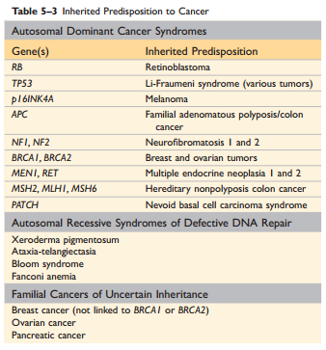

Slide 14
Acquired Pre-neoplastic Lesions
Precursor lesions arise in the setting of chronic tissue injury or inflammation, which may increase the likelihood of malignancy by stimulating continuing regenerative proliferation or by exposing cells to byproducts of inflammation, both of which can lead to somatic mutations.
Clinically, these precursor lesions are important to recognize, because their removal or reversal may prevent the development of a cancer.
A brief listing of some of the chief precursor lesions follows:
Squamous metaplasia and dysplasia of the bronchial mucosa, seen in habitual smokers, a risk factor for lung cancer
Endometrial hyperplasia and dysplasia, seen in women with unopposed estrogenic stimulation, a risk factor for endometrial carcinoma
Leukoplakia of the oral cavity, vulva, or penis, which may progress to squamous cell carcinoma.
Villous adenomas of the colon, associated with a high risk of transformation to colorectal carcinoma.

Slide 15
ETIOLOGY OF CANCER: CARCINOGENIC AGENTS
Chemicals.
Radiant Energy.
Microbial Agents.

Slide 16
Chemicals
Direct-Acting Agents:
Require no metabolic conversion to become carcinogenic.
They are in general weak carcinogens but are important because some of them are cancer chemotherapy drugs (e.g., alkylating agents) used in regimens that may cure certain types of cancer (e.g., Hodgkin lymphoma), only to evoke a subsequent, second form of cancer.
Indirect-Acting Agents:
chemicals that require metabolic conversion to an ultimate carcinogen.
For example, benzo[a]pyrene and other carcinogens are formed in the high-temperature combustion of tobacco in cigarette smoking.
These products are implicated in the causation of lung cancer in cigarette smokers.
Polymorphisms of endogenous enzymes such as cytochrome P-450 may influence carcinogenesis.

Slide 17
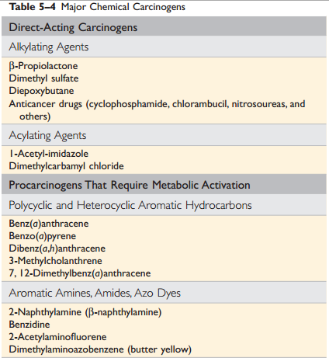
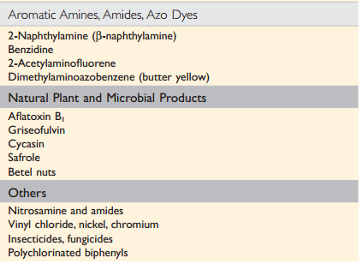

Slide 18
Mechanisms of Action of Chemical Carcinogens
All direct and ultimate carcinogens contain highly reactive electrophile groups that form chemical adducts with DNA, as well as with proteins and RNA.
Although any gene may be the target of chemical carcinogens, the commonly mutated oncogenes and tumor suppressors, such as RAS and TP53, are important targets of chemical carcinogens.
Carcinogenicity of some chemicals is augmented by subsequent administration of promoters (e.g., phorbol esters, hormones, phenols, certain drugs) that by themselves are non-tumorigenic.
To be effective, repeated or sustained exposure to the promoter must follow the application of the mutagenic chemical, or initiator.

Slide 19
Radiation Carcinogenesis
Radiation, whatever its source (UV rays of sunlight, x-rays, nuclear fission, radionuclides) is an established carcinogen.
The oncogenic properties of ionizing radiation are related to its mutagenic effects; it causes chromosome breakage, translocations, and, less frequently, point mutations.
Biologically, double-stranded DNA breaks seem to be the most important form of DNA damage caused by radiation.

Slide 20
Radiation Carcinogenesis
Natural UV radiation derived from the sun can cause skin cancers (melanomas, squamous cell carcinomas, and basal cell carcinomas).
Of particular relevance to carcinogenesis is the ability to damage DNA by forming pyrimidine dimers. This type of DNA damage is repaired by the nucleotide excision repair pathway. With extensive exposure to UV light, the repair systems may be overwhelmed, and skin cancer results.
Inherited disease xeroderma pigmentosum have a defect in the nucleotide excision repair pathway. As expected, there is a greatly increased predisposition to skin cancers in this disorder.

Slide 21
Viral and Microbial Oncogenesis
Oncogenic RNA viruses:
Human T-cell lymphotropic virus (HTLV-1) is associated with a form of T cell leukemia/lymphoma that is endemic in certain parts of Japan and the Caribbean basin but is found sporadically elsewhere.
HTLV-1 has tropism for CD4+ T cells, and this subset of T cells is the major target for neoplastic transformation.
Human infection requires transmission of infected T cells through sexual intercourse, blood products, or breastfeeding. Leukemia develops only in about 3% to 5% of infected persons after a long latent period of 20 to 50 years.

Slide 22
Human T-cell Lymphotropic Virus
The HTLV-1 genome encodes a viral TAX protein, which turns on genes for cytokines and their receptors in infected T cells.
This sets up autocrine and paracrine signaling loops that stimulate T cell proliferation.
Although this proliferation initially is polyclonal, the proliferating T cells are at increased risk for secondary mutations that lead to the outgrowth of a monoclonal leukemia.

Slide 23
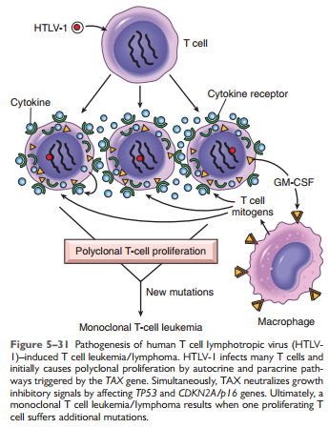

Slide 24
Viral and Microbial Oncogenesis
Oncogenic DNA Viruses:
Four DNA viruses: HPV, Epstein-Barr virus (EBV or HHV-4), Kaposi sarcoma herpesvirus (KSHV, also called human herpesvirus-8 [HHV-8]), and hepatitis B virus (HBV) are strongly associated with human cancer.

Slide 25
Human Papillomavirus
HPV is associated with benign warts (Low risk HPV e.g. types 6 & 11), as well as cervical cancer ( High risk HPV e.g. types 16 & 18).
The oncogenicity of HPV is related to the expression of two viral oncoproteins, E6 and E7; they bind to Rb and p53, respectively, neutralizing their function.
E6 and E7 from high-risk strains of HPV (which give rise to cancers) have higher affinity for their targets than do E6 and E7 from low-risk strains of HPV (which give rise to benign warts).

Slide 26
Epstein-Barr Virus
EBV is implicated in the pathogenesis of a diverse list of tumors, including Burkitt’s lymphoma, B cell lymphomas in patients with defective T cell immunity (e.g., those infected with HIV), a subset of Hodgkin lymphoma, nasopharyngeal carcinoma, a subset of T cell lymphomas, gastric carcinomas, NK cell lymphomas, and even, in rare instances, sarcomas, mainly in the immunosuppressed.
Burkitt lymphoma is endemic in certain parts of Africa and is sporadic elsewhere.
Certain EBV gene products contribute to oncogenesis by stimulating a normal B cell proliferation pathway.
Concomitant compromise of immune competence allows sustained B cell proliferation, leading eventually to development of lymphoma, with occurrence of additional mutations such as t(8;14) leading to activation of the MYC gene.

Slide 27
Hepatitis B and Hepatitis C Viruses
Between 70% and 85% of hepatocellular carcinomas worldwide are due to infection with HBV or HCV.
The oncogenic effects of HBV and HCV are multifactorial, but the dominant effect seems to be immunologically mediated chronic inflammation, with hepatocellular injury, stimulation of hepatocyte proliferation, and production of reactive oxygen species that can damage DNA.
The HBx protein of HBV and the HCV core protein can activate a variety of signal transduction pathways that also may contribute to carcinogenesis.

Slide 28
Helicobacter pylori
H. pylori infection has been implicated in both gastric adenocarcinoma and MALT lymphoma.
The mechanism of H. pylori induced gastric cancers is multifactorial, including immunologically mediated chronic inflammation, stimulation of gastric cell proliferation, and production of reactive oxygen species that damage DNA (like HBV & HCV).
H. pylori pathogenicity genes, such as CagA, also may contribute by stimulating growth factor pathways.
It is thought that H. pylori infection leads to polyclonal B cell proliferations and that eventually a monoclonal B cell tumor (MALT lymphoma) emerges as a result of accumulation of mutations.

Slide 29
Summary
The incidence of cancer varies with age, race, geographic factors and genetic background.
Most cancers are sporadic but some are familial.
Predisposition to hereditary cancers may be autosomal dominant or autosomal recessive.
Some acquired disease (pre-neoplastic disorders) are known to be associated with an increased risk of cancer.
Three classes of carcinogenic agents have been identified: chemicals, radiation and viral and microbial agents.

Slide 30
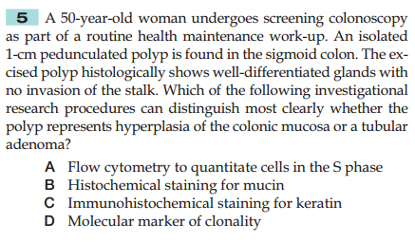

Slide 31
