Slide 1
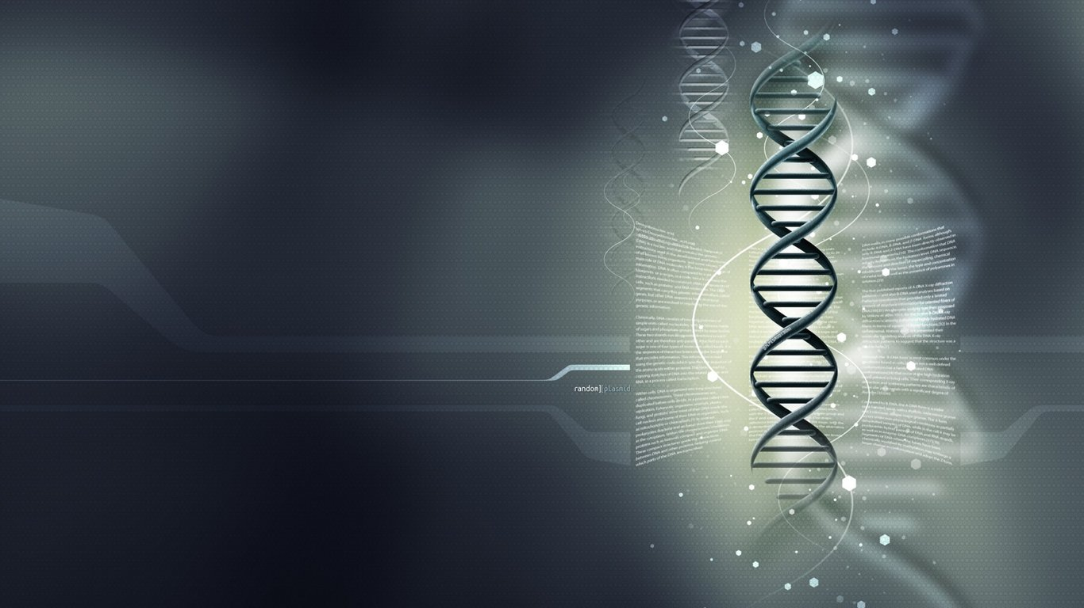
UPDATED CELL INJURY LECTURES
Professor Ammar C. Al-Rikabi
Academic Year 2014-2015

Slide 2
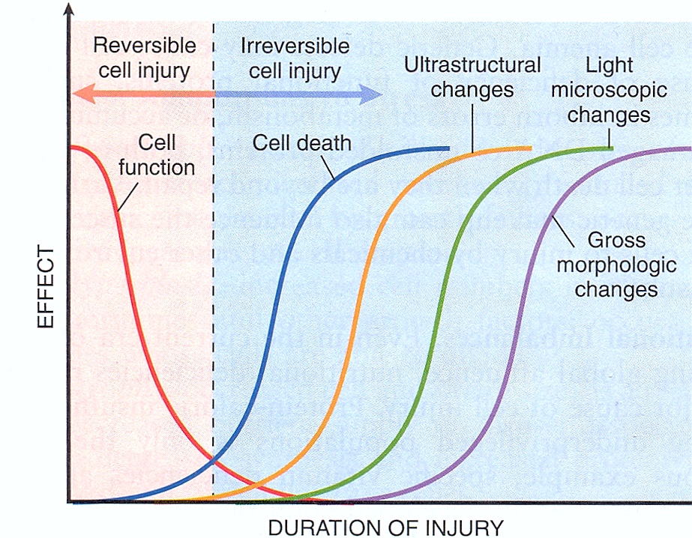

Slide 3
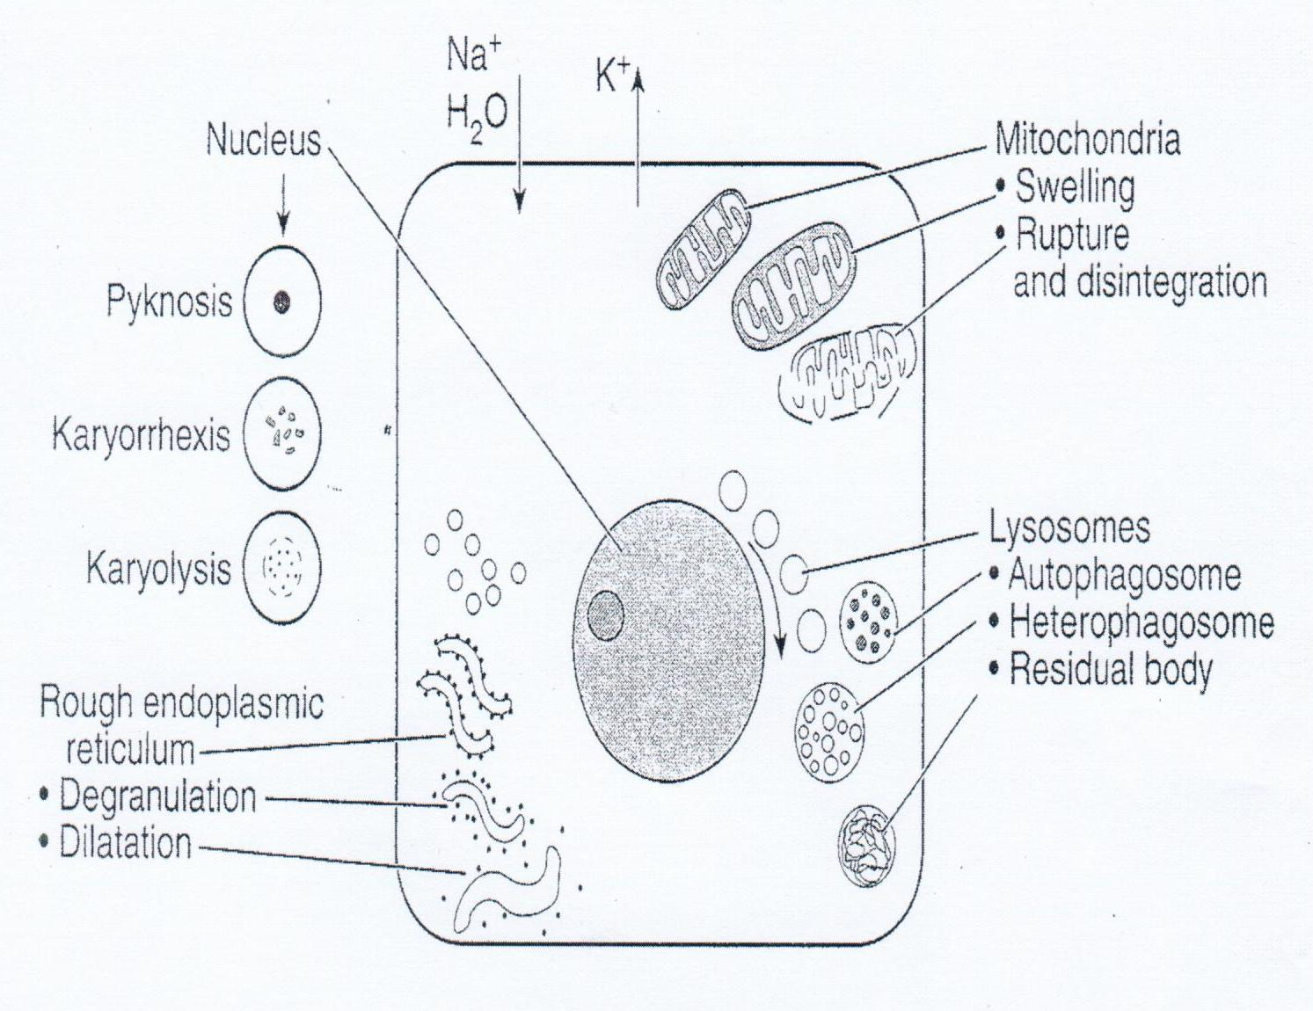
Ultrastructural signs of cell injury

Slide 4
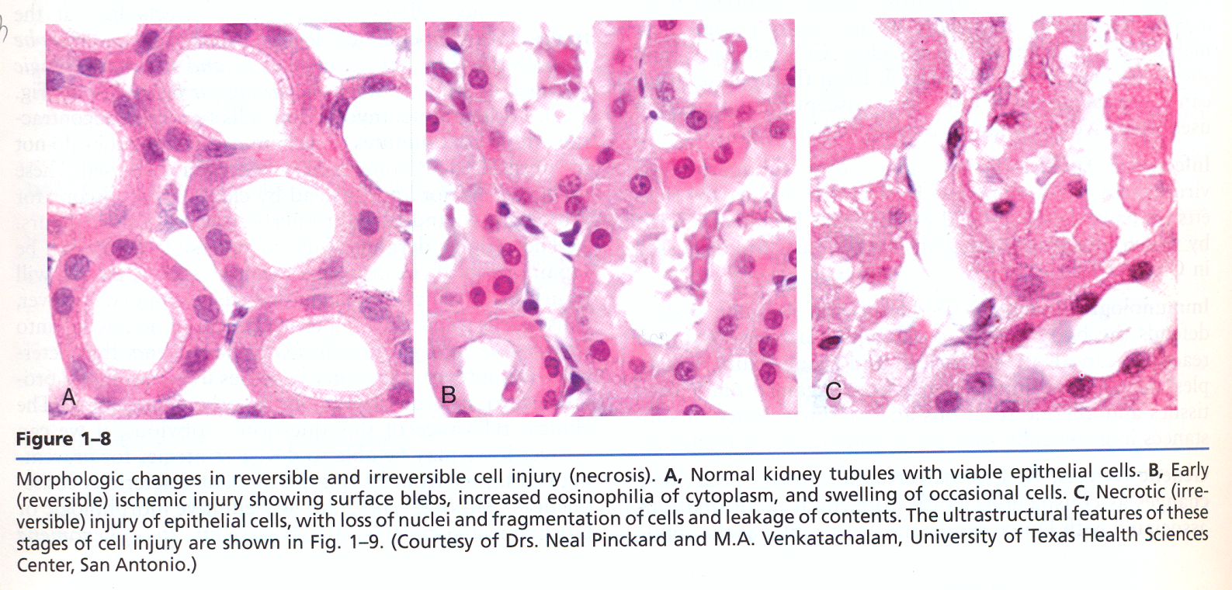

Slide 5
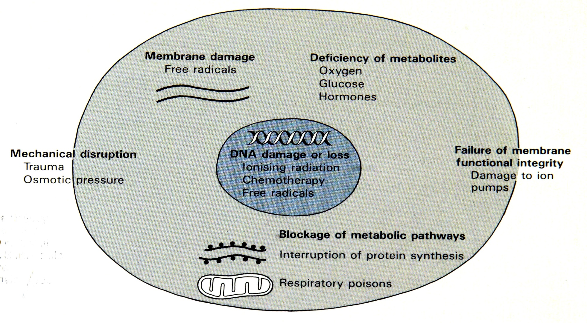
Mechanisms of Cellular Injury

Slide 7
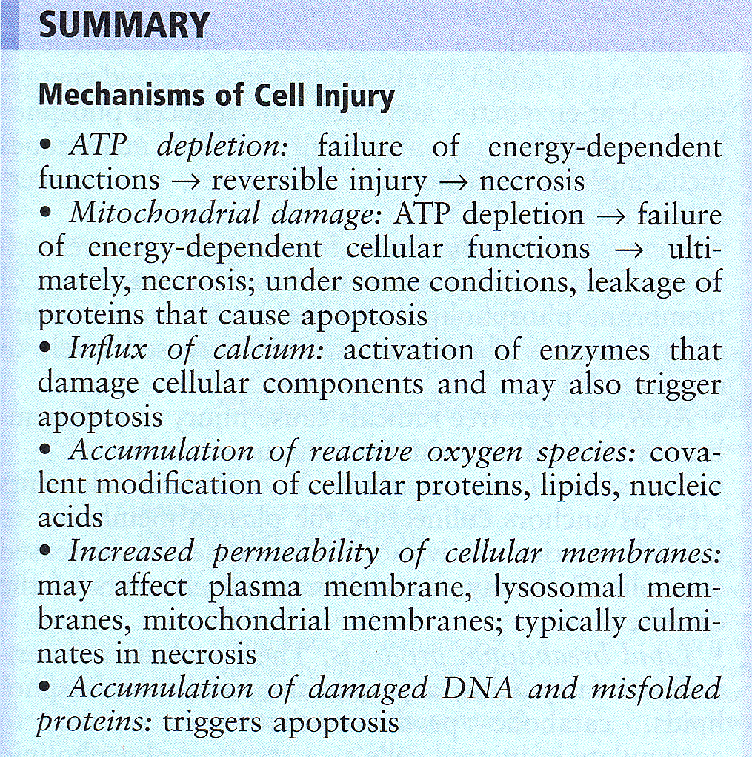

Slide 8
Role of O2 in Cell Injury

Slide 9
Apoptosis

Slide 10
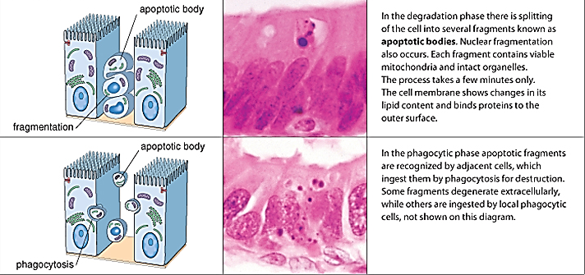
Apoptosis

Slide 11
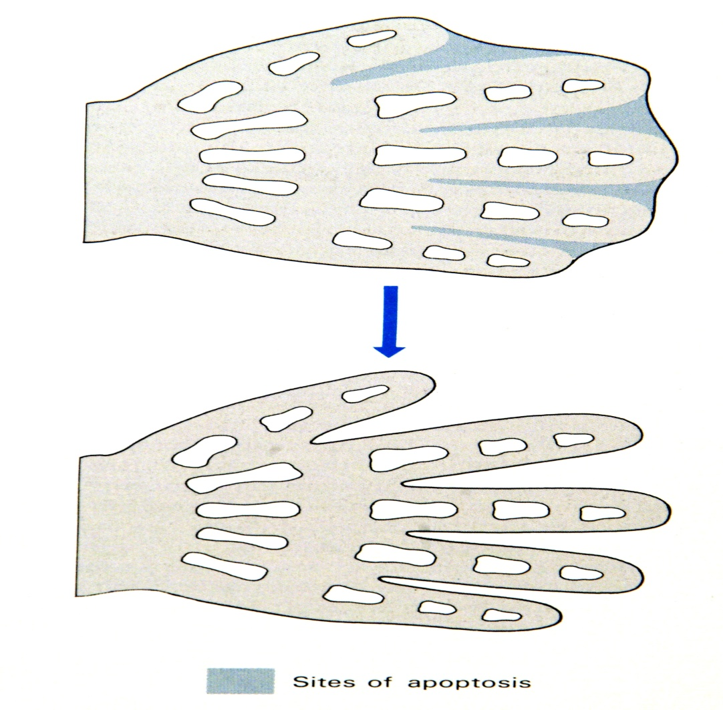
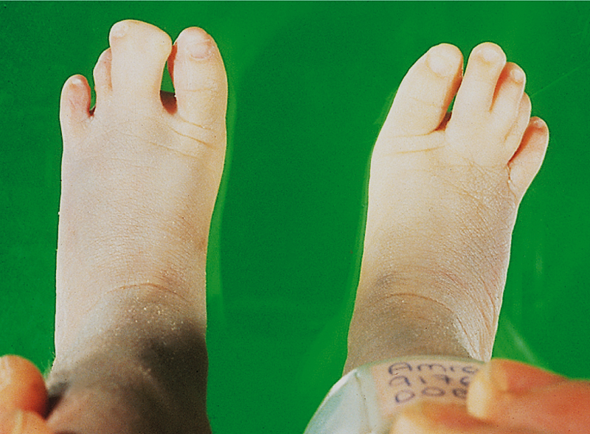
Sites of Apoptosis
Morphogenesis by Apoptosis

Slide 12
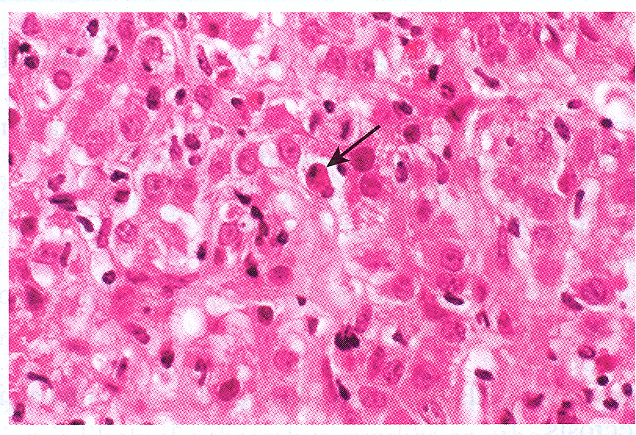
Apoptosis in viral hepatitis

Slide 13
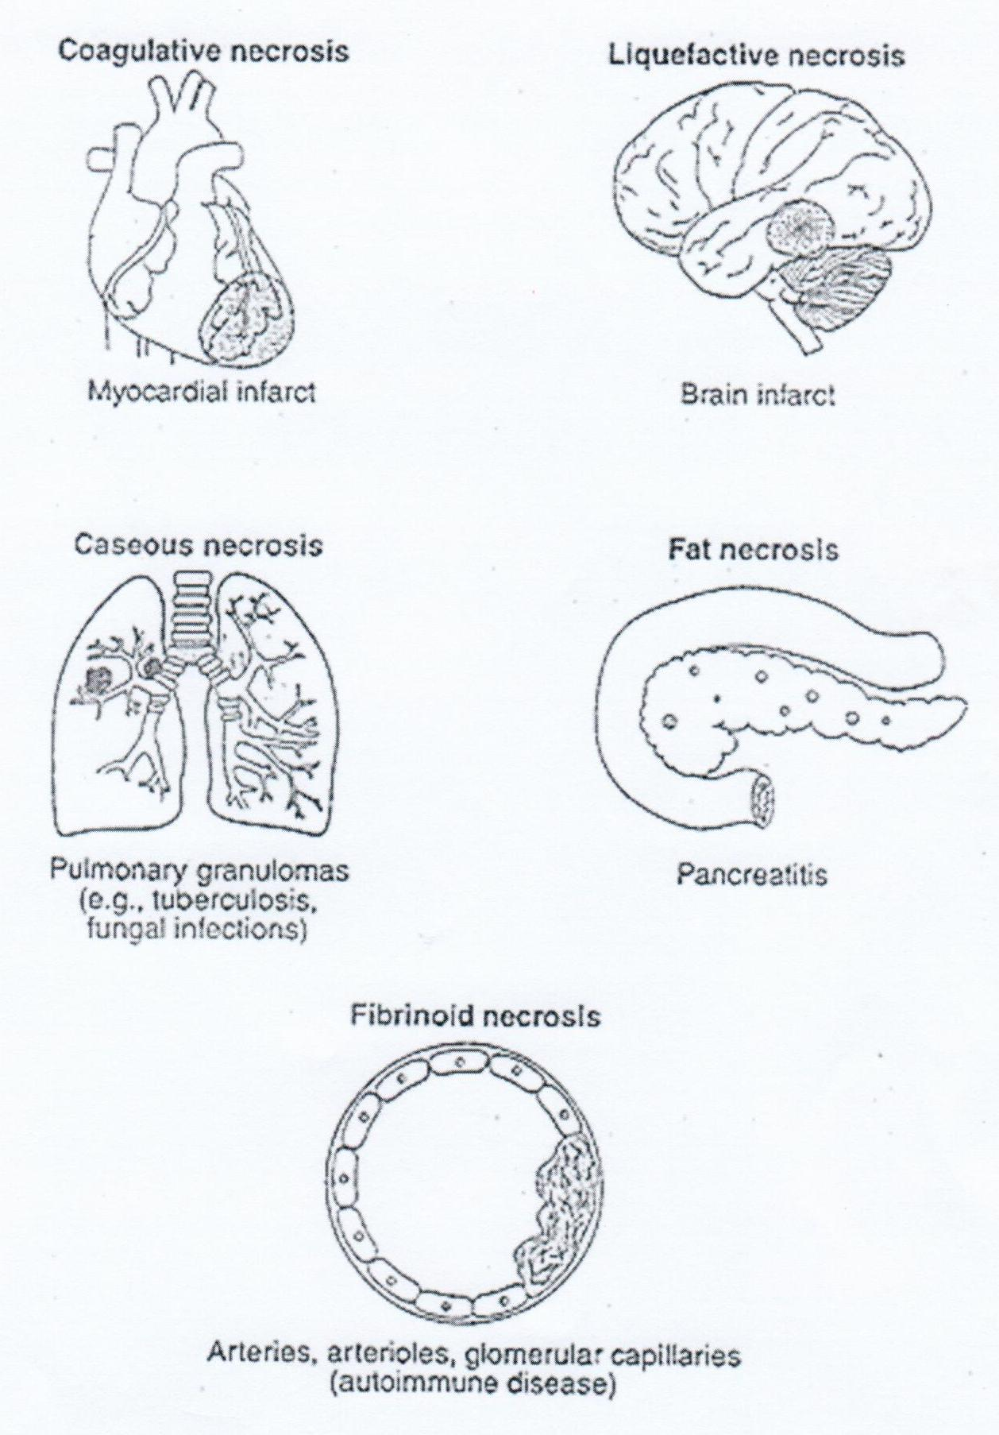
Forms of necrosis

Slide 14
Cell Injury-Myocardial Infarction

Slide 15
Coagulative Necrosis

Slide 16
Kidney Infarction

Slide 17
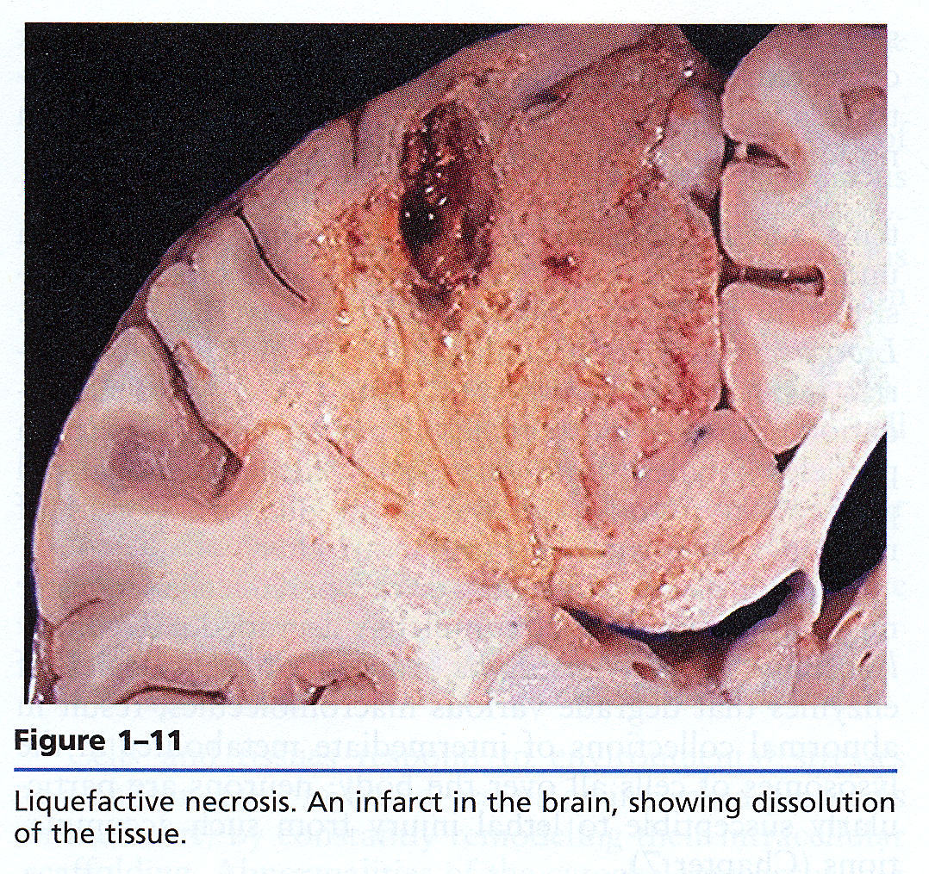

Slide 18
Liquefactive Necrosis in brain tissue.

Slide 20
Caseous Necrosis

Slide 21
Caseous Necrosis

Slide 22
Fibrinoid Necrosis in a renal blood vessel.

Slide 23
Fat Necrosis

Slide 24
Fat Necrosis

Slide 25
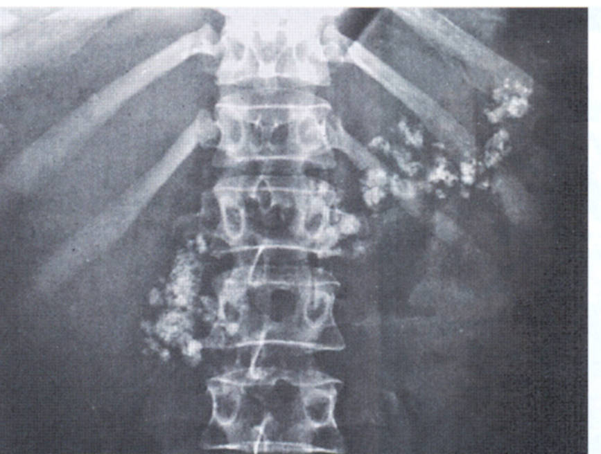
Dystrophic calcification in the pancreas

Slide 26
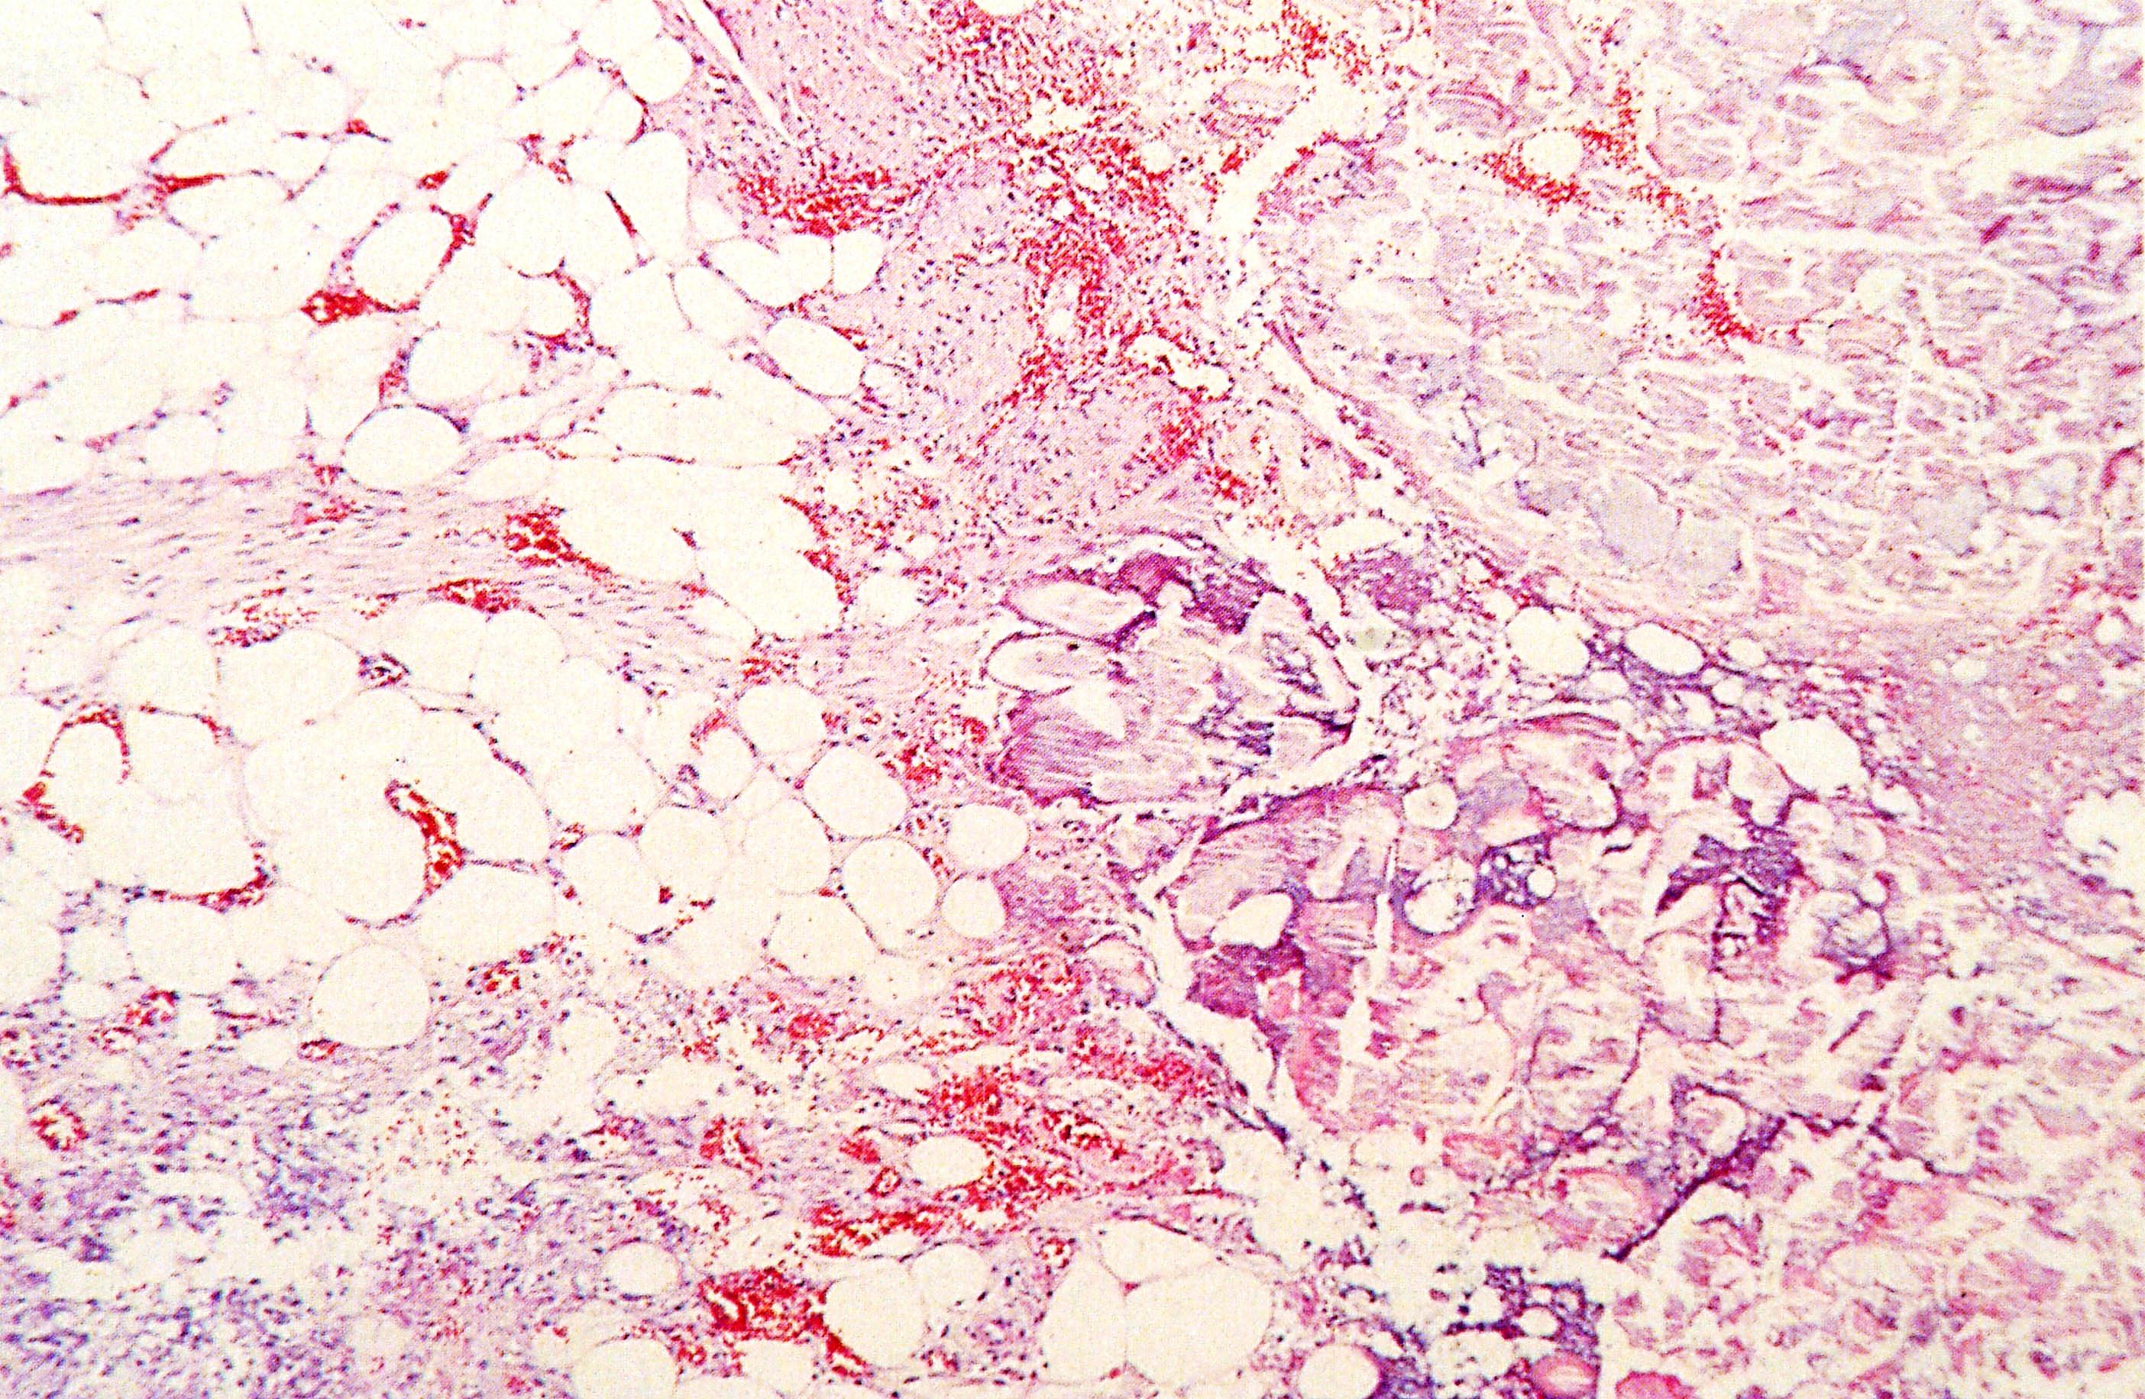
Dystrophic calcification in fat

Slide 27
Dry gangrene

Slide 28
Wet gangrene of the leg

Slide 29
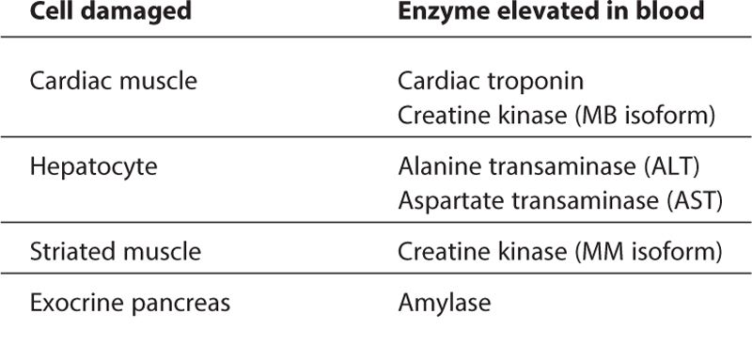
Proteins used in diagnosis of
tissue damage by blood testing.

Slide 31
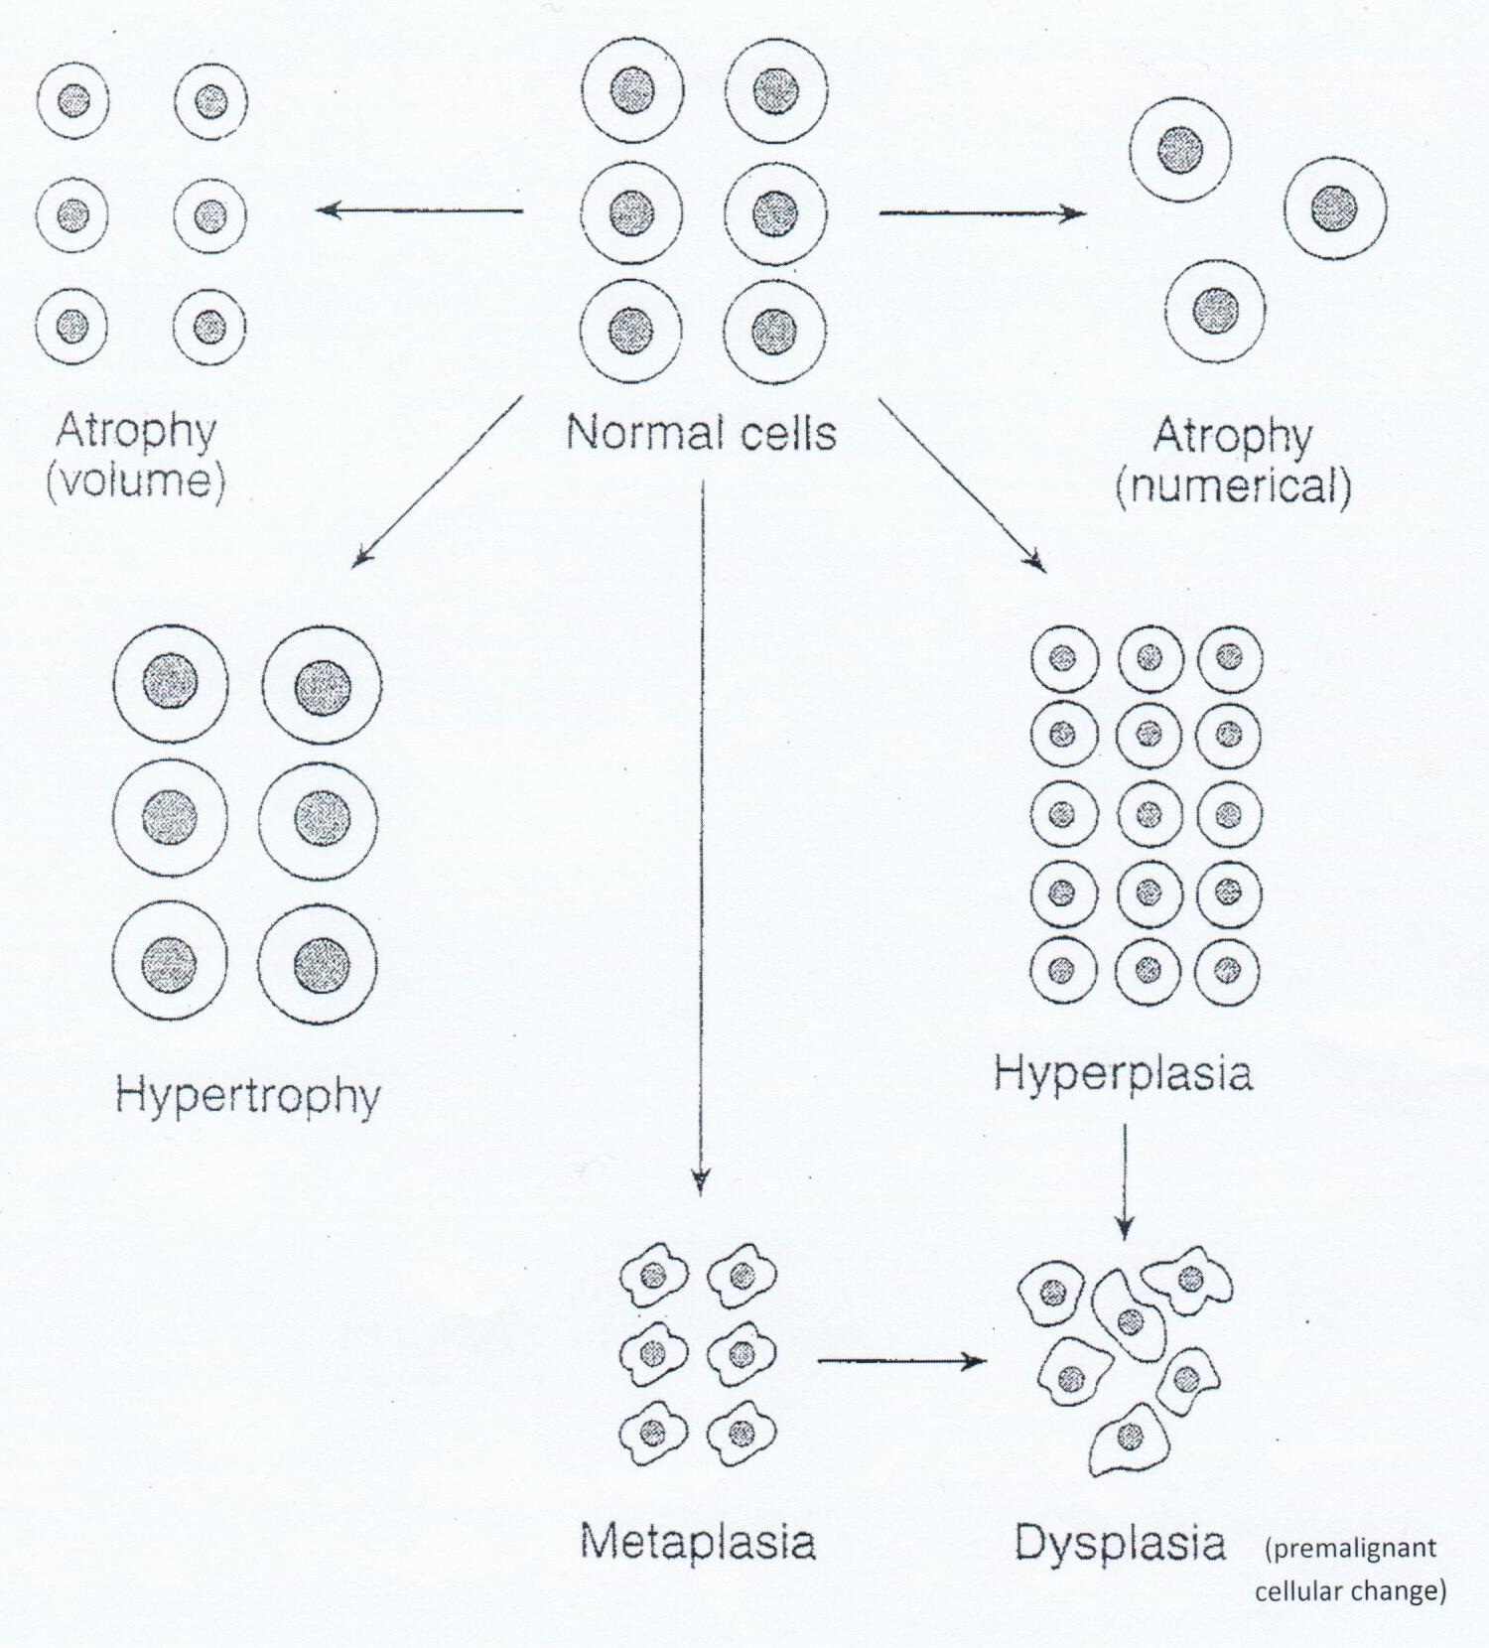
Adaptation of the cell caused by chronic stress or injury include atrophy, hypertrophy, hyperplasia, metaplasia and dysplasia

Slide 33
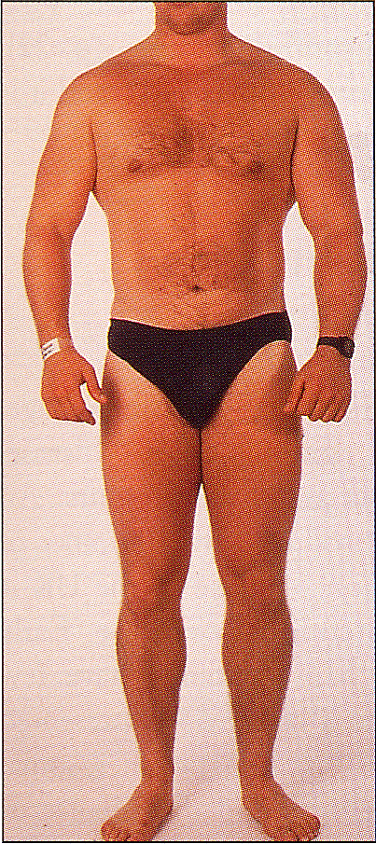
Muscular hypertrophy due to anabolic steroid misuse.

Slide 34
Hypertrophy of skeletal muscle (B).
Please notice the difference with the normal fibers in (A).

Slide 35
Myocardial Hypertrophy

Slide 36
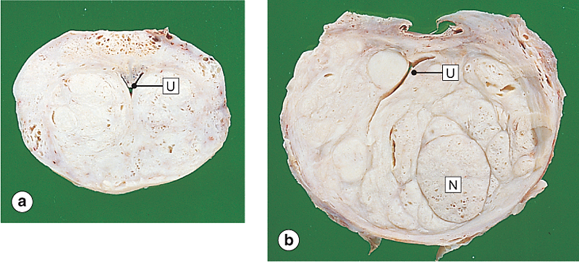
Nodular hyperplasia
of the prostate gland.
Normal prostate gland.
Nodular hyperplasia of prostate gland.

Slide 37
Squamous Metaplasia

Slide 38
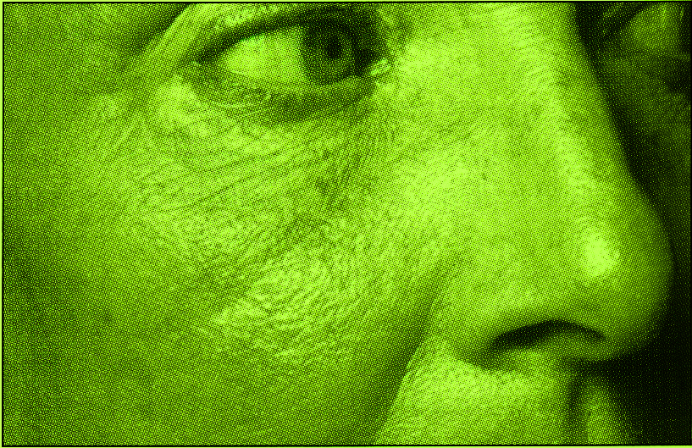
Severe Cholestatic Jaundice

Slide 39
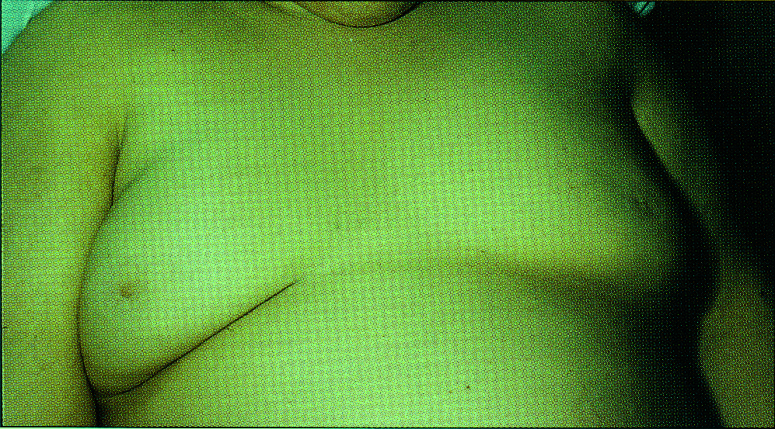
Jaundiced skin in a patient with chronic hepatitis.

Slide 40
Lipofuscin Pigment

Slide 41
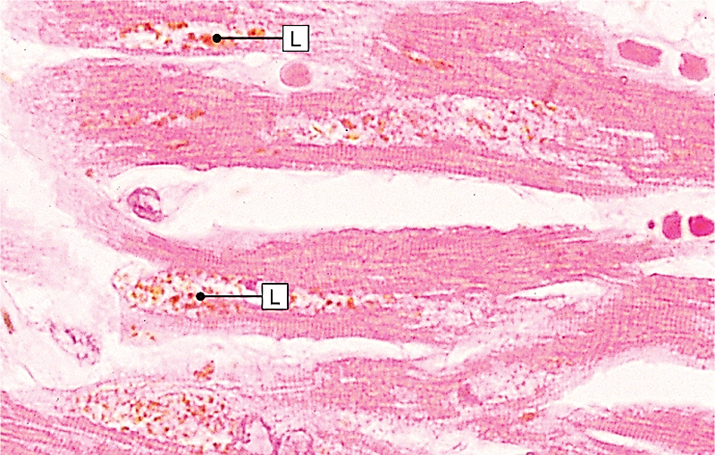
Lipofuscin in cellular atrophy,
seen in the cardiac muscle of an elderly patient.

Slide 42
Haemochromatosis. Note: The gray color of his hands.

Slide 43
Iron storage in haemochromatosis

Slide 44
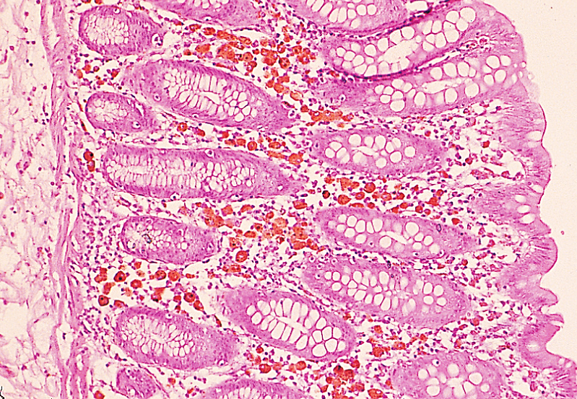
Melanosis Coli

Slide 45
Skin tattooing due to voluntary
injection of India Ink into the skin.

Slide 46
Causes of Hypercalcemia
-can lead to metastatic calcifications.
Hyperparathyroidism.
Metastatic malignant tumours.
Vitamin D intoxication.
Milk alkali syndrome.
Mild hypercalcemia can be seen
in old age.

Slide 47
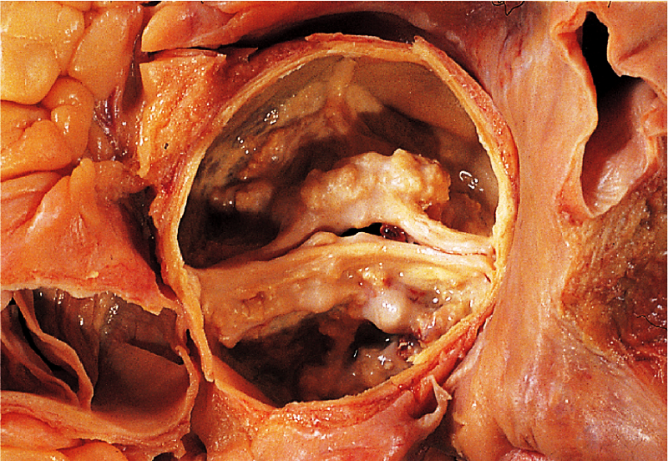
Calcific aortic valve disease.

Slide 48
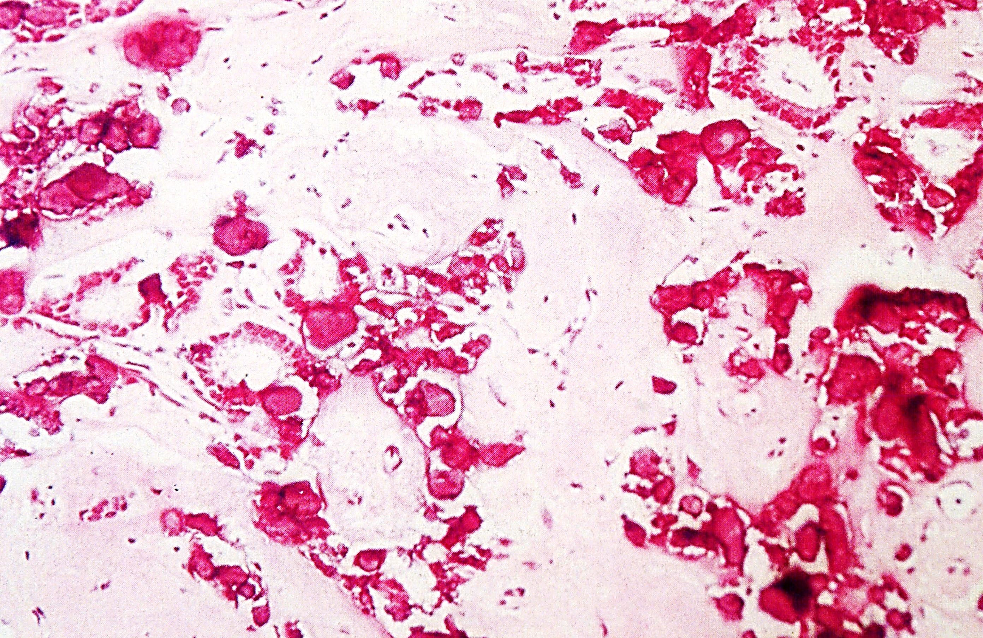
Microcalcification in breast

Slide 49
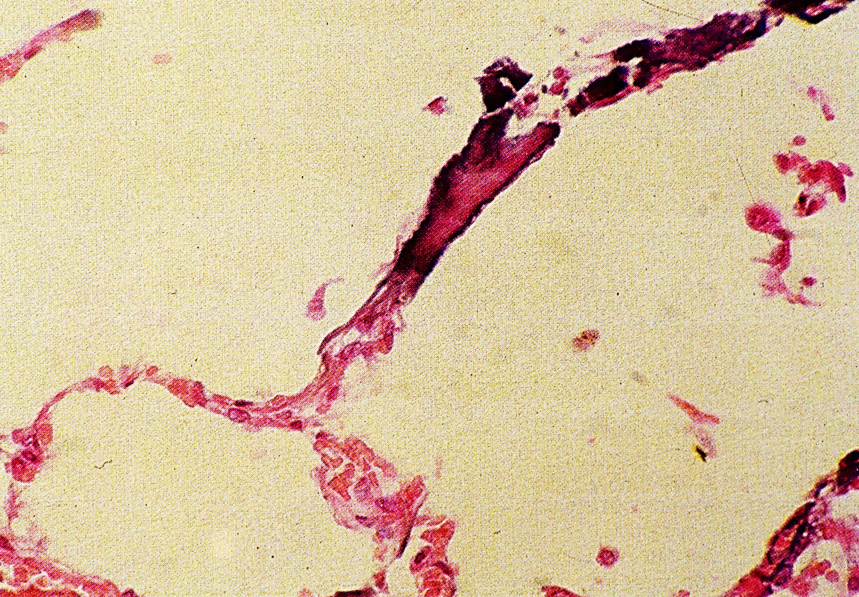
Metastatic calcification

Slide 50
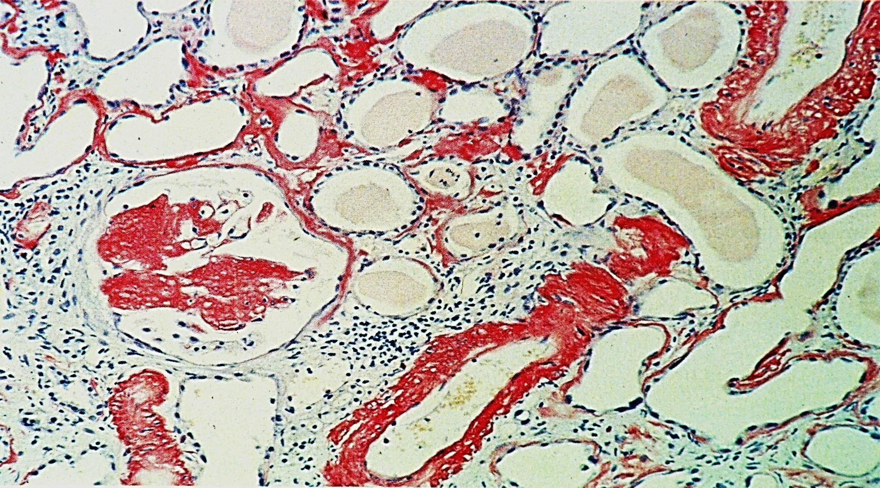
Renal Amyloidosis

Slide 51
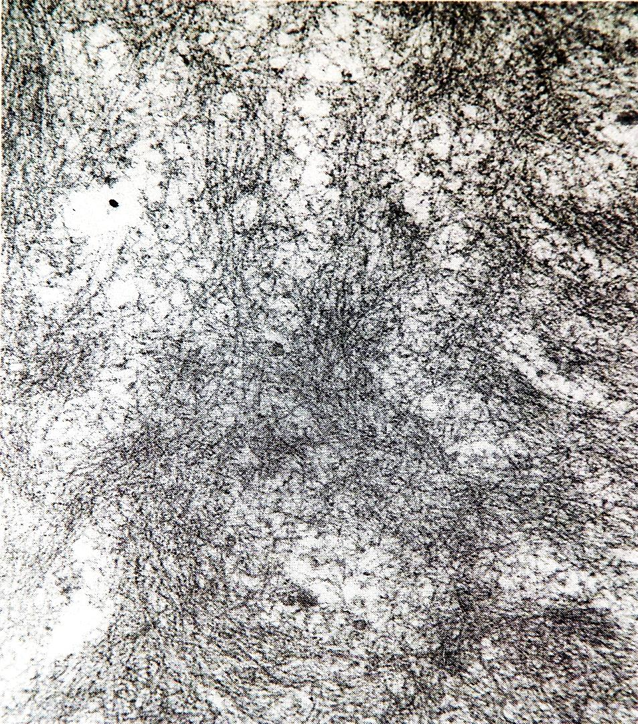
Amyloid Ultrastructure

Slide 52
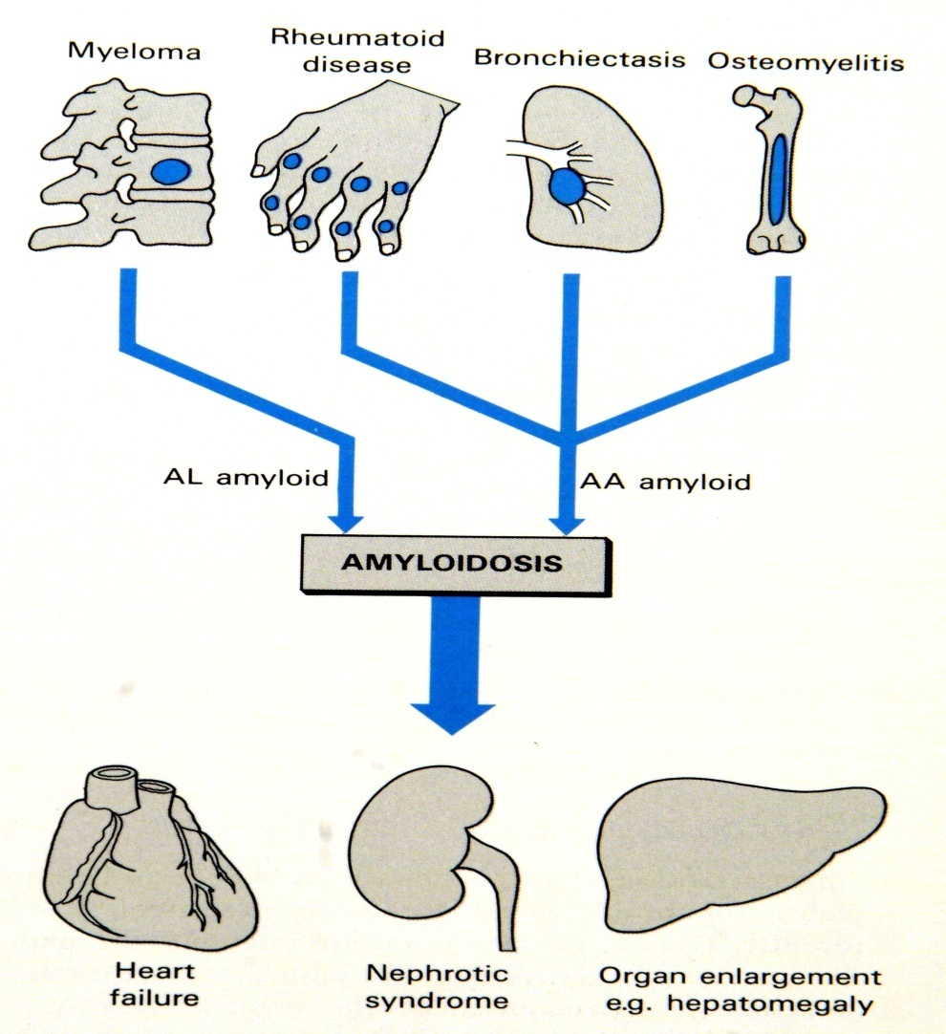
Common causes and consequences of Amyloidosis

