Slide 1





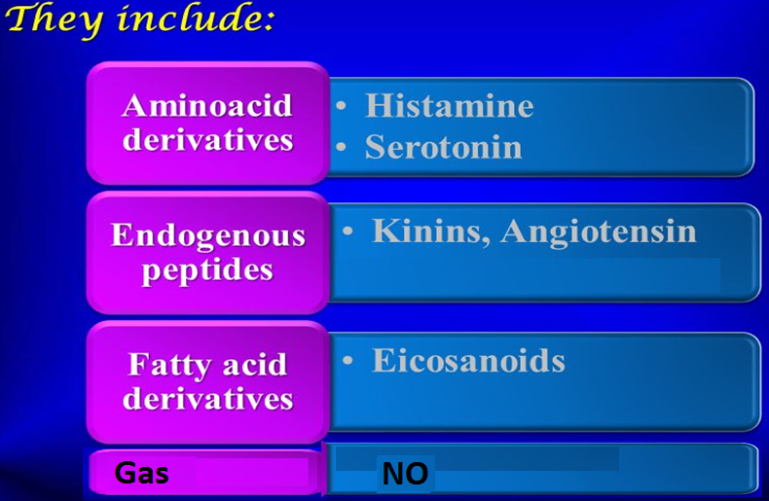
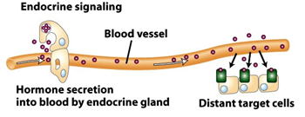
0
Autacoids
WINTER
They have autocrine or paracrine effects
Self remedy
Template
Produced locally, act locally & metabolized locally
Paracrine
Have different biological actions including modulation of the activity of smooth muscles, glands, nerves, platelets and other tissues.
Autocrine

Slide 2
01
Autocoids
WINTER
ILOS
Template
To describe the synthesis, receptors and functions of histamine, eicosanoids ,nitric oxide , angiotensin, kinins & 5-HT
To study the agents which enhance or block their effects

Slide 3

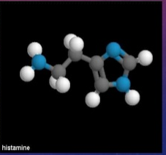
0
histamine

Slide 4
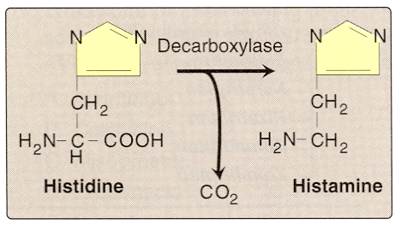
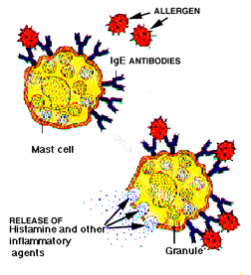
02
Histamine
Synthesis:- from L- histidine
Stored in mast cells, basophils, lung, intestinal mucosa
Release:- during allergic reaction, inflammatory reaction

Slide 5
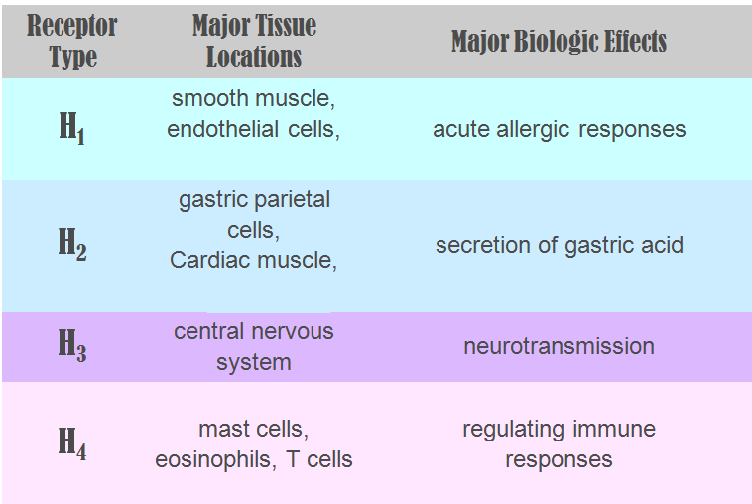
03
Histamine receptors

Slide 6
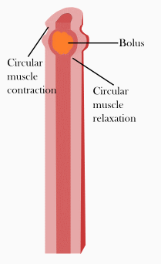
04
Actions
Histamine stimulates gastric acid secretion , through H2- receptors
Stimulation of H1-receptors contract smooth muscles, bronchioles ,uterus
Increases bowel peristalsis

Slide 7
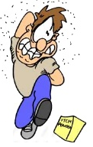
05
Actions
Slow IV or SC injection causes flushing of skin, raises temperature, increases blood flow to the periphery, increases heart rate & CO
Rapid IV bolus injection induces a fall in blood pressure , an increase in CSF pressure , headache, due to dilation of blood vessels
Intradermal injection causes itching

Slide 8
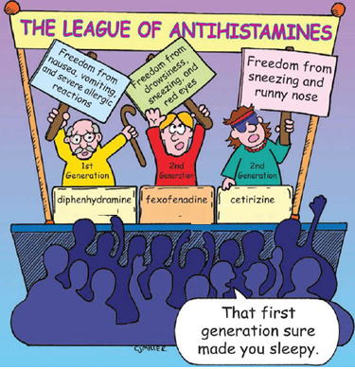
06
Histamine receptor blockers
WINTER
Histamine h1 receptor blockers
Template
First generation
Diphenhydramine, promethazine
Second generation
Citrizine, fexofenadine

Slide 9

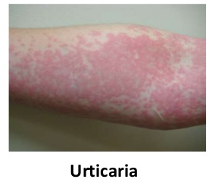

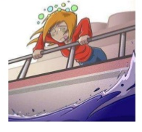
077
Histamine H1 receptor blockers
First generation
Has a sedating effect
Clinical uses
Allergic rhinitis
Urticaria
Insomnia
Motion sickness

Slide 10
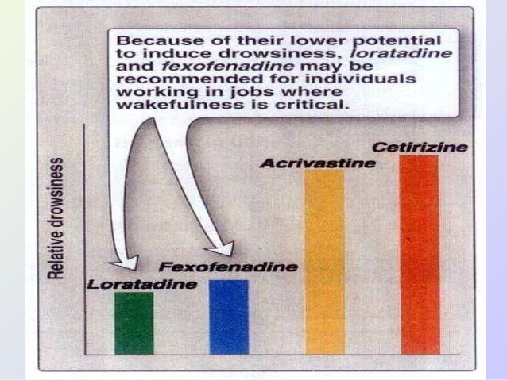
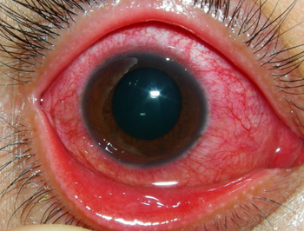
08
Histamine H1 receptor blockers
Second generation
Non-sedating effect
Clinical uses
Allergic conditions such as:-
Allergic rhinitis
Conjunctivitis
Urticaria

Slide 11
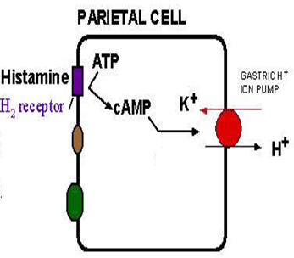
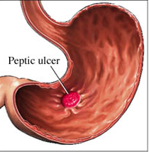
09
H2- receptor blockers
Cimetidine
Histamine plays an important role in the formation and secretion of HCl by activation of H2 receptors
Blockers of H2 receptors inhibit gastric acid secretion
Used for the treatment of:-
Gastritis
Peptic ulcers

Slide 12
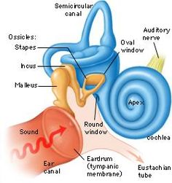

10
H3- receptor blockers
betahistine
It produces dilatation of blood vessels in inner ear
Used in treatment of:-
Vertigo and balance disturbances

Slide 13
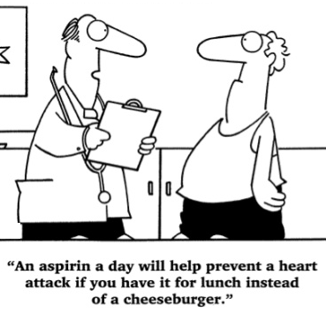
0
eicosanoids

Slide 14
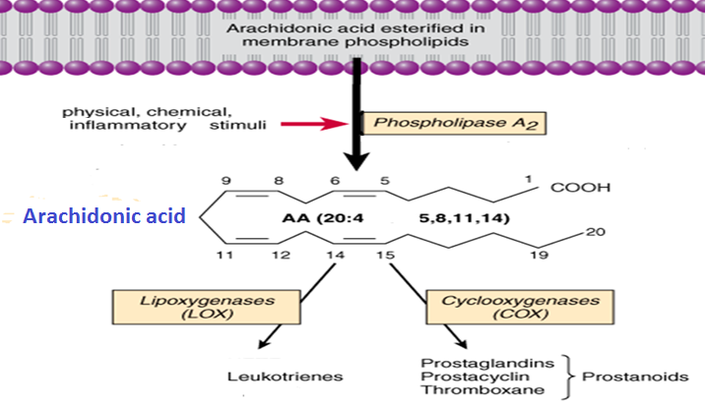
11
eicosanoids
WINTER
Glucocorticoids
synthesis
NSAIDS
Zileuton
Template

Slide 15
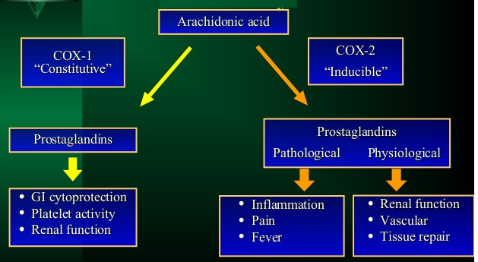
12
Cox Isozymes

Slide 16
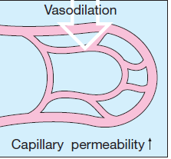
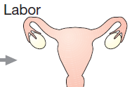
13
Actions of prostaglandins
They are proinflammatory
Cause vasodilatation of vascular smooth muscle
Inhibition of platelets aggregation/ increase platelet aggregation
Sensitize neurons to cause pain
Induce labor

Slide 17
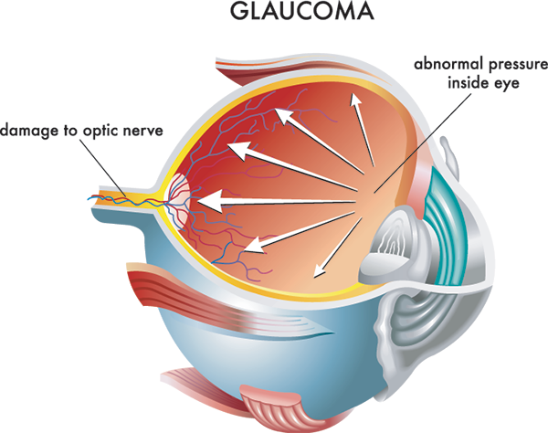
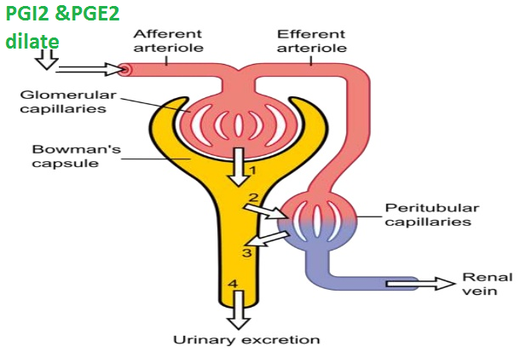
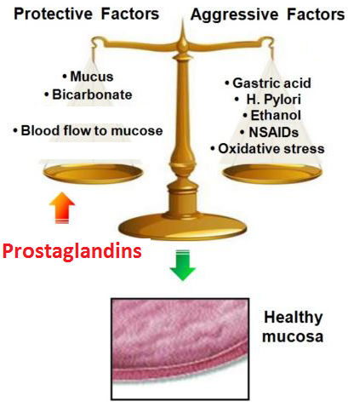
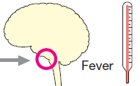
14
Actions of prostaglandins
Decrease intraocular pressure
Acts on thermoregulatory center of
Hypothalamus to ↑ body temperature
Acts on kidney to increase glomerular filtration
Acts on parietal cells of stomach to protect gastric mucosa

Slide 18
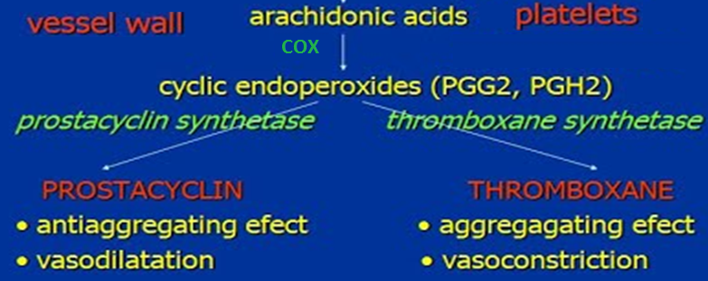
15
Prostacyclin versus thromboxane

Slide 19
16
Clinical uses of PGs analogs
WINTER
Carboprost
PGF2α
Induce abortion
in first trimester
Template
Latanoprost
PGF2α
Glaucoma
Misoprostol
PGE1
Peptic ulcer
Alprostadil
PGE1
Erectile dysfunction
Zileuton (lipoxygenase inhibitor)
Zafirlukast (leukotreine receptor blocker)
Bronchial asthma

Slide 20
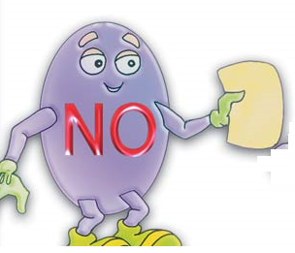
0
Nitric oxide

Slide 21
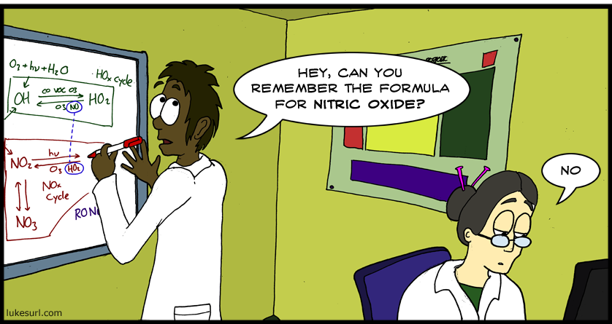
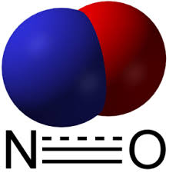
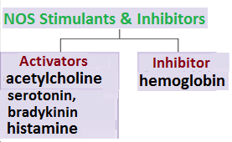
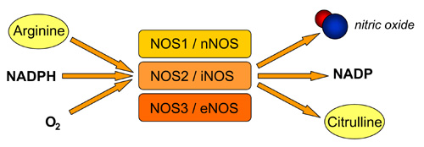
17
Nitric oxide
Biosynthesis
Synthesized from L- arganine by nitric oxide synthase
NO release is stimulated by 5-HT, acetylcholine, bradykinin & histamine
There are 3 isoforms of the enzyme nitric oxide synthase

Slide 22
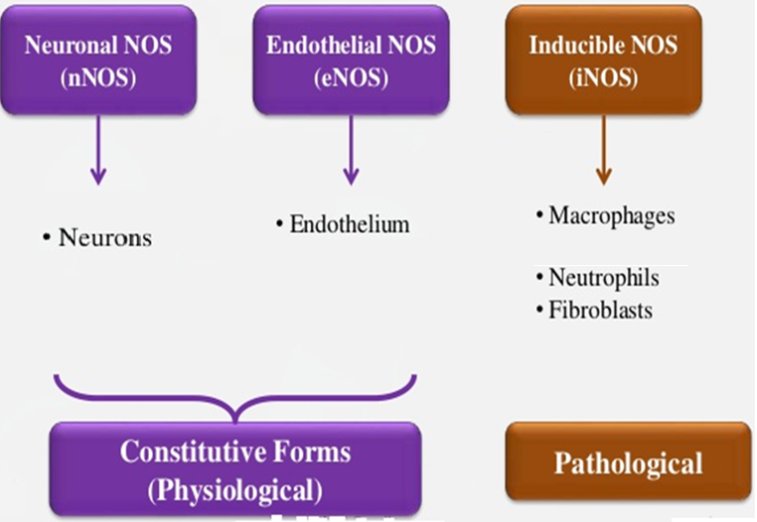
18
Isoforms of nos

Slide 23
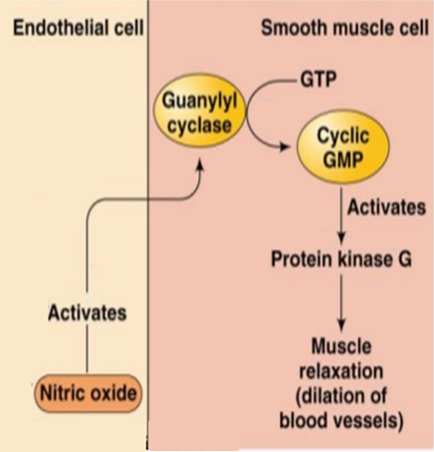
19
NO Mechanism of Action
Activates guanylate cyclase, increasing cGMP and thereby lowering [Ca²⁺]_{i}

Slide 24
20
Actions of NO
Inhibition of platelet and monocyte adhesion and aggregation
Inhibition of smooth muscle proliferation
Protection against atherogenesis
Host defense and cytotoxic effects on pathogens
Cytoprotection

Slide 25
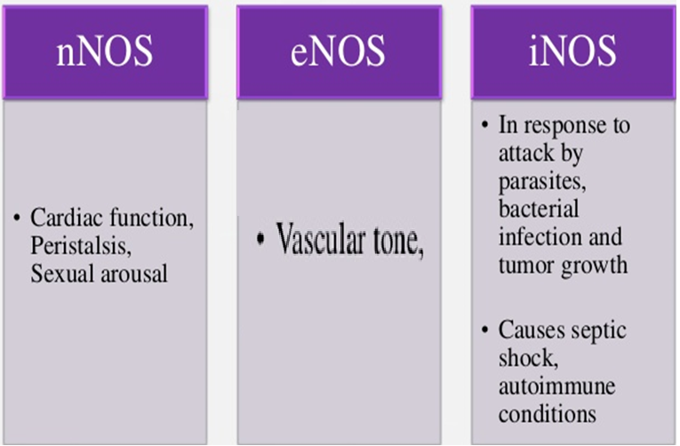
21
Actions of nos
WINTER
Template

Slide 26
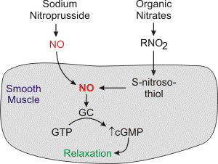
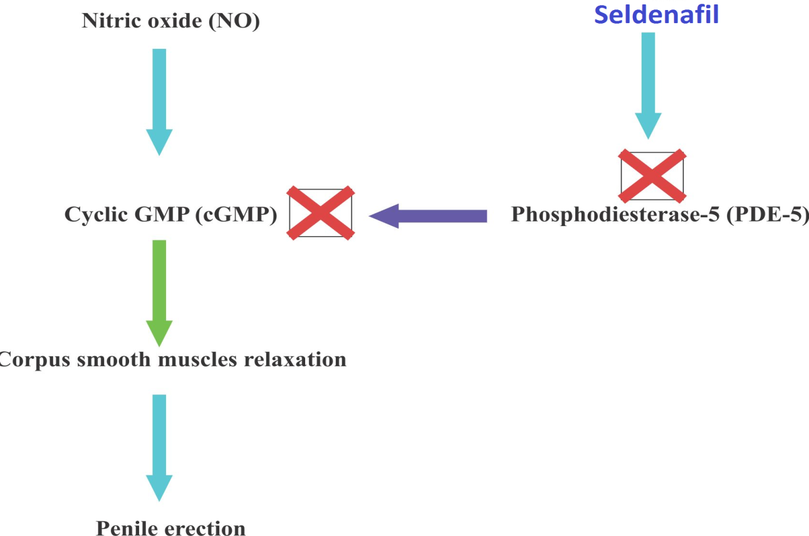
22
No in therapeutics
NO is used in critical care to treat pulmonary hypertension in neonates
Endothelial NO production is reduced in patients with diabetes, hypertension & atherosclerosis
NO donors have well established therapeutic uses e.g. in hypertension & angina pectoris
NO is used in patients with right ventricular failure secondary to pulmonary embolism
Overproduction of NO occurs in neurodegenerative diseases (e.g. Parkinsonism) and in septic shock
Sildenafil potentiates the action of NO on corpora cavernosa smooth muscle. It is used to treat erectile dysfunction

Slide 27
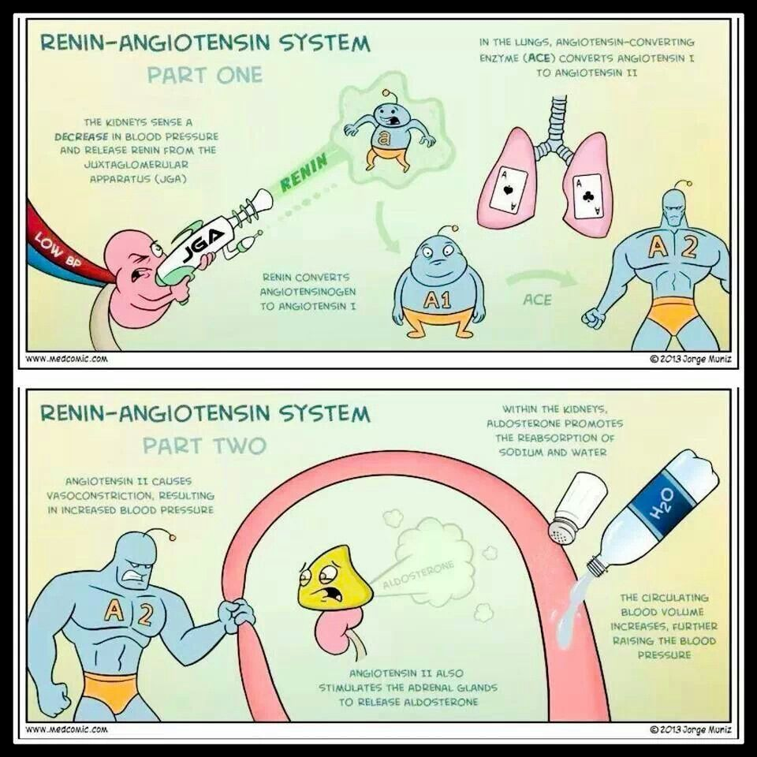
26
angiotensin
WINTER
Template

Slide 28
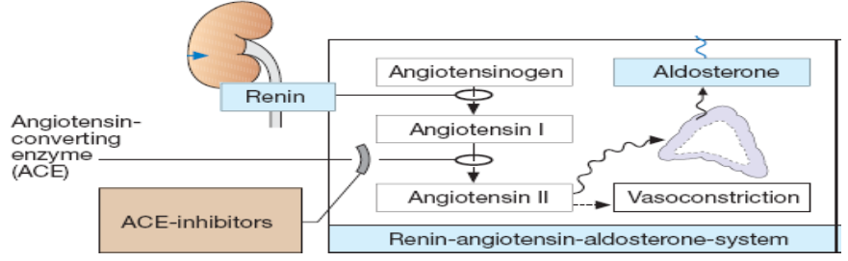
23
angiotensin
Biosynthesis
Renin released from the kidney converts angiotensinogen to Ag I
ACE converts Ag I to Ag II

Slide 29
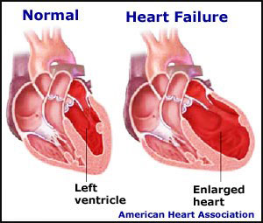
24
Actions of angiotensin II
Promotes vasoconstriction directly or indirectly by releasing NA & AD
Increases force of contraction of the heart by promoting calcium influx
Increases aldosterone release → sodium & water retention
Causes hypertrophy of vascular and cardiac cells and increases synthesis and deposition of collagen by cardiac fibroblasts (remodeling)

Slide 30
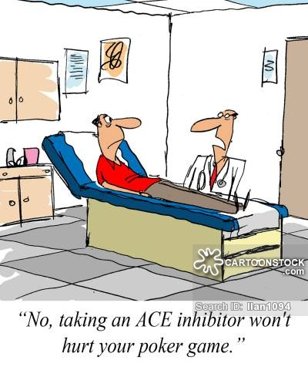
25
Angiotensin inhibitors
ACE inhibitors: captopril, enalapril
Angiotensin receptor blockers (ARBs): losartan, valsartan

Slide 31
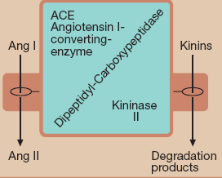
26
ACE inhibitors
WINTER
Cause a fall in blood pressure in hypertensive patients especially those with high rennin levels
Template
Clinical uses
Hypertension
Cardiac failure
Following myocardial infarction

Slide 32
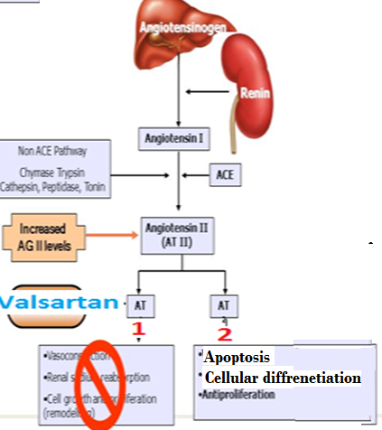
27
Angiotensin receptor blockers
Angiotensin receptors AT I & AT II
AT I receptors predominate in vascular smooth muscle, coupled to G proteins
Similar uses to ACEI

Slide 33
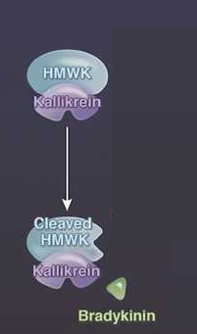
31
kinins
WINTER
Template

Slide 34
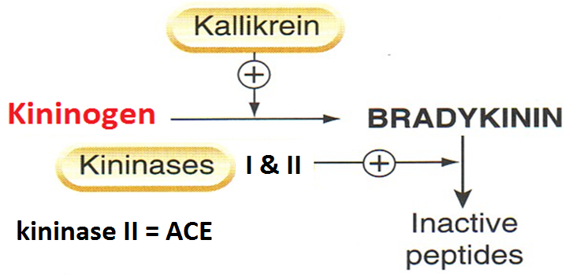
28
kinins
Are Bradykinin & kallidin
Bradykinin is formed by proteolytic cleavage of circulating proteins (kininogens)

Slide 35
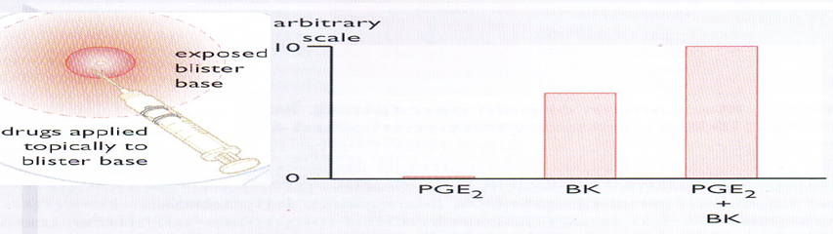
29
Actions of bradykinin
  Potent vasodilator , reduces blood pressure
Causes pain, this effect is potentiated by prostaglandins. Has a role in inflammation
If injected locally it dilates arterioles [→generation of PGI & release of NO] and increases permeability of post capillary venules
Constricts most smooth muscles , intestine , uterus, bronchiole, contraction is slow and last long
Stimulation of epithelial ion transport & fluid secretion in airways & GIT

Slide 36
30
Receptors & clinical uses
  Receptors B1 & B2
  B1 inducible under condition of inflammation
  Low affinity to bradykinin
  B1 receptor plays a significant role in inflammation & hyperalgesia
  B2 constitutive
  High affinity to bradykinin & mediates the majority of its effects

Slide 37
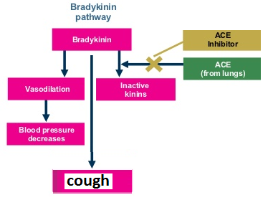
31
Therapeutic uses
WINTER
  No current therapeutic use of bradykinin
Template
  Increased bradykinin is implicated in the therapeutic efficacy and cough produced by ACEIs

Slide 38
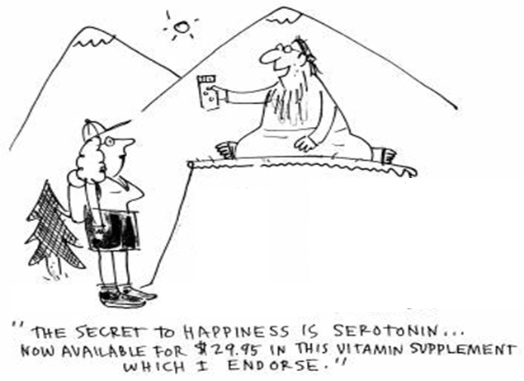
36
5-ht actions
WINTER
serotonin
Template

Slide 39
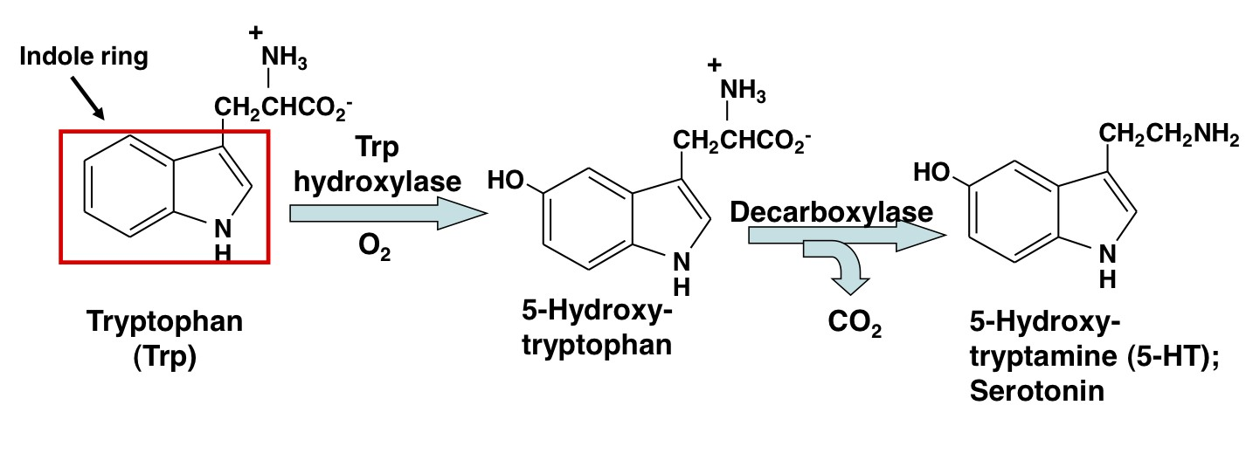
32
Serotonin [5ht]
Serotonin is synthesized from the amino acid L-tryptophan

Slide 40
33
Serotonin [5-ht]
distribution
1] Intestinal wall ,in chromaffin cells, in neuronal cells in the myenteric plexus
2]Blood ,in platelets , released when aggregated, in sites of tissue damage
3]CNS:-a neurotransmitter, in midbrain

Slide 41
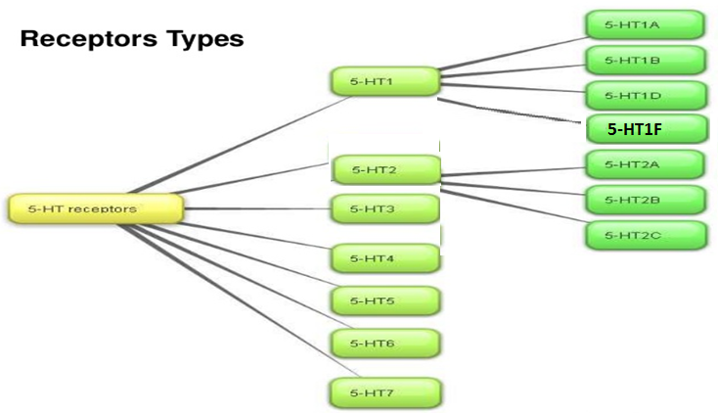
34
Serotonin [5-ht]
receptors

Slide 42
35
Actions of 5-ht
GIT:-5-HT increases motility
Contracts uterus, bronchiole, other smooth muscles
Blood vessels:-
Contracts large vessels by a direct action & relaxes other vessels by releasing NO
Increases capillary pressure & permeability

Slide 43
36
5-ht actions
WINTER
Platelets:- causes aggregation, aggregated platelets release 5-HT
Template
Neuronal terminals:- 5-HT stimulates nociceptive neuron endings → pain
CNS;-stimulates some neurons & inhibits others, inhibits release of other neurotransmitters

Slide 44

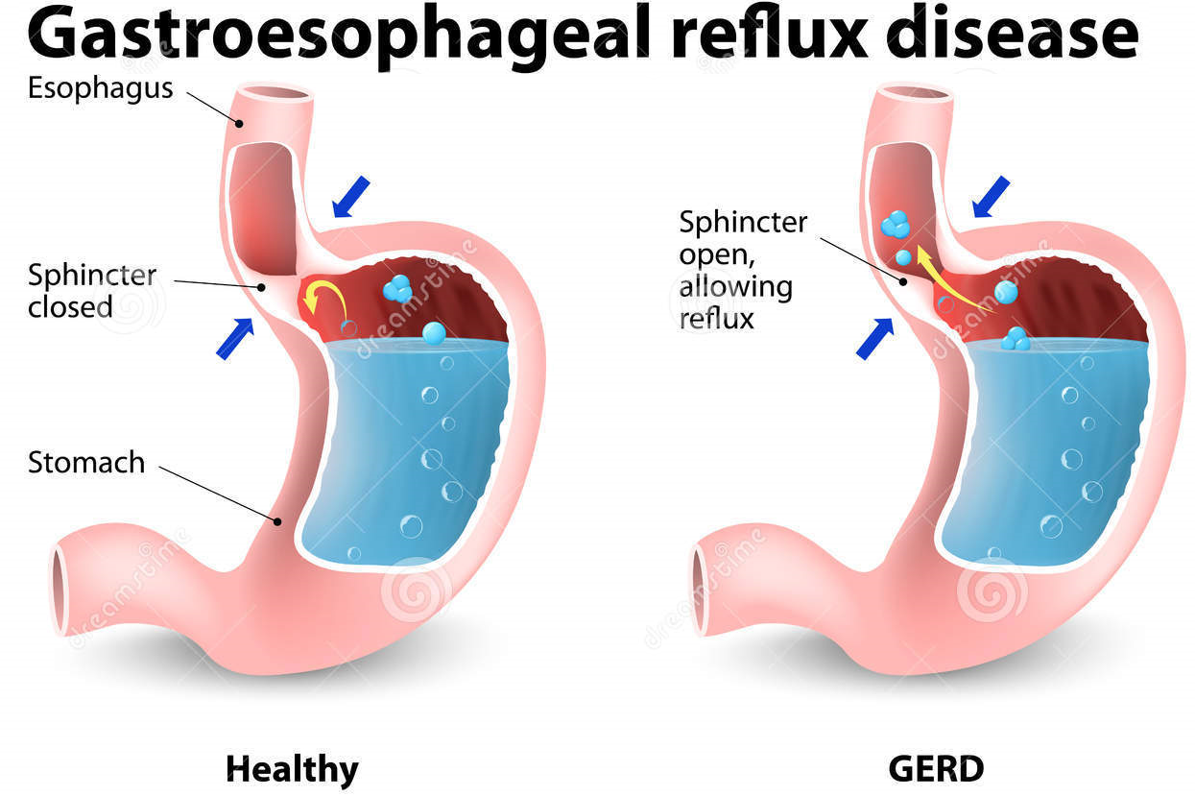
37
5-ht receptor agonists
Buspirone :-5-HT1A agonist , effective anxiolytic
Cisapride:-5-HT4 -receptor agonist, used in gastroesophageal reflux & motility disorders.

Slide 45


38
5-ht receptor antagonists
Selective 5-HT3 antagonist, Ondansetron, antiemetic action for cancer chemotherapy

Slide 46





Clinical conditions in which 5-ht is implicated
39
1-migraine
Activation of trigeminal system leads to peptides release promoting an inflammatory reaction.
This increases flow of sensory traffic through the brain stem, the thalamus & the cortex

Slide 47

40
sumatriptan
5-HT1B,1D &1F-receptor agonist , effective in acute migraine attack
It binds to 5HT1B , in cranial blood vessels causing vasoconstriction & 1D & 1F in presynaptic trigeminal nerve causing inhibition of pro inflammatory neuropeptide release

Slide 48

41
2- Carcinoid syndrome
A malignant tumor of intestinal chromaffin cells
The tumor releases 5-HT, SP, PGs, kinins & histamine causing flushing ,diarrhea, bronchoconstriction & hypotension
Serotonin antagonists (cyproheptadine, 5HT2 antagonist) could be administered to control diarrhea ,flushing & malabsorption.

