Slide 1
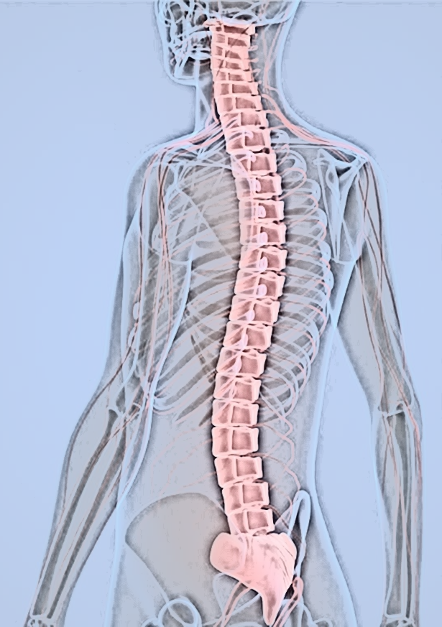
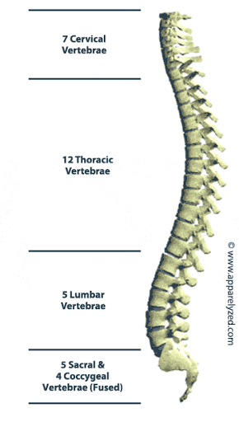
ANATOMY
OF
THE SPINE
Dr. Zahid Kaimkhani

Slide 2
ANATOMY OF THE SPINE
OBJECTIVES
By the end of this session we should be able to:
Differentiate between the cervical, thoracic, lumbar, sacral and coccygeal vertebrae.
Identify the cervical, thoracic, lumbar, sacral and coccygeal vertebrae in a figure, plastic model and prosection.
Describe the vertebral curvatures.
Describe the movements occurring in each region of the vertebral column.
List the structures connecting adjacent vertebrae.
List and identify the ligaments of the intervertebral joints.
Dr. Zahid Kaimkhani

Slide 3
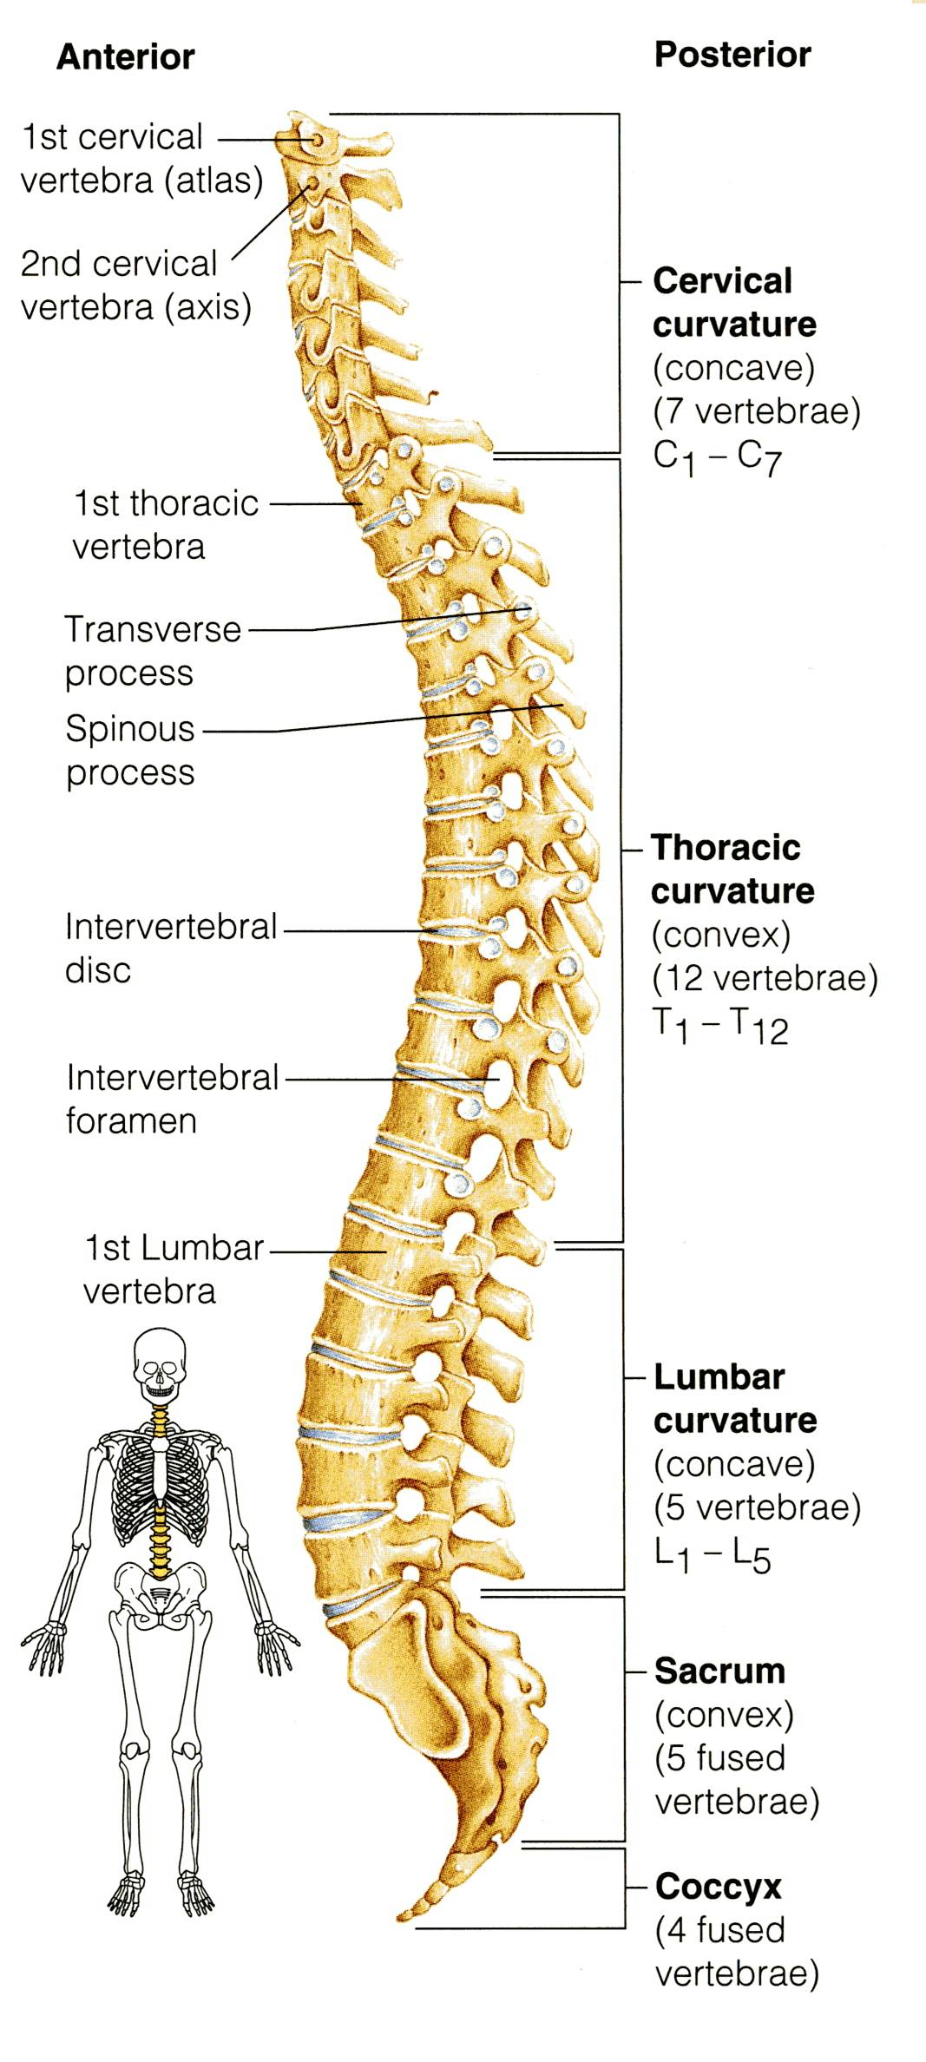
ANATOMY OF THE SPINE
The vertebral column (SPINE):
extends from the skull to the pelvis.
surrounds and protects the spinal cord and supports the whole body.
formed from 33 irregular vertebrae.
consists of 24 single vertebrae and 2 bones:
Sacrum (5 fused vertebrae)
Coccyx (4 fused vertebrae)
Of the 24 single bones,
7 Cervical vertebrae,
12 Thoracic vertebrae, &
5 Lumbar vertebrae.
Dr. Zahid Kaimkhani

Slide 4
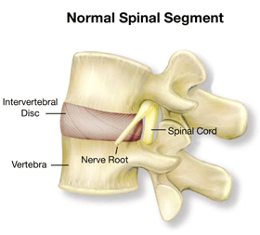
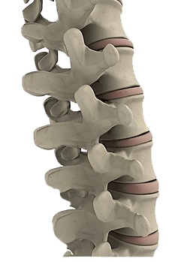
ANATOMY OF THE SPINE
The vertebral column
Vertebrae are separated by pads of flexible fibrocartilage called the intervertebral disc (I/V disc).
The intervertebral discs:
Cushion the vertebrae
Absorb shocks.
Along with S-shaped curvatures of the VC prevent shock to the head during walk or run.
Also make the body trunk flexible.
Dr. Zahid Kaimkhani

Slide 5
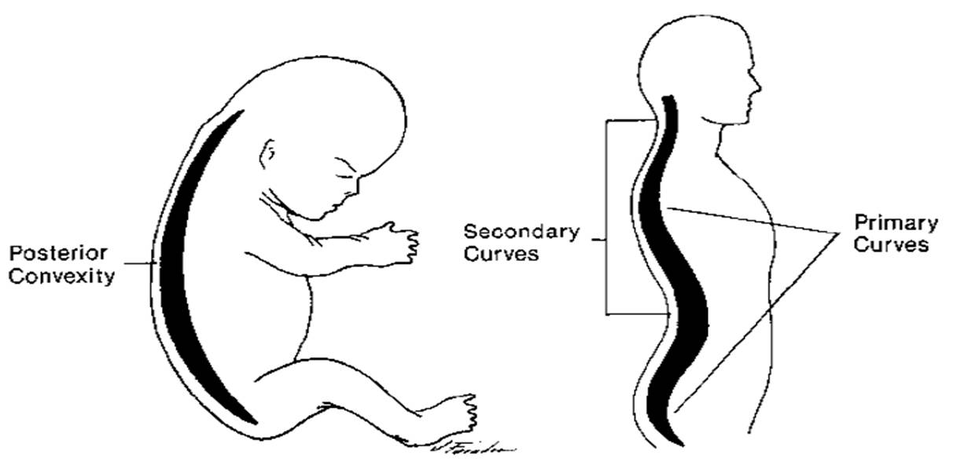
ANATOMY OF THE SPINE
The spinal Curvatures
The primary curvatures
Present in the thoracic and sacral regions
Y primary
because they are present when we are born.
The secondary curvatures
The cervical curvature appears when a baby begins to hold his head (6th month), &
The lumbar curvature develops when the baby begins to walk (around the end of the 1st year).
Dr. Zahid Kaimkhani

Slide 6
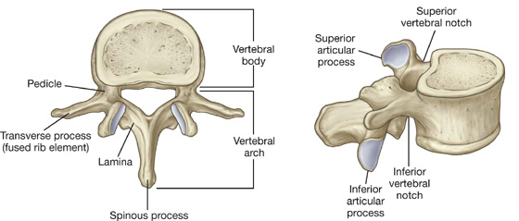
ANATOMY OF THE SPINE
TYPICAL VERTEBRA
Body or Centrum
Vertebral arch
Each vertebral arch
formed of
2 Pedicles,
2 Laminae
Vertebral foramen
Carries 7 process:
2 Transverse processes:
One spinous process:
4 articular processes:
2 Superior &
2 inferior
Dr. Zahid Kaimkhani

Slide 7
ANATOMY OF THE SPINE
TYPICAL VERTEBRA
Body or Centrum
Vertebral arch
Each vertebral arch
formed of
2 Pedicles,
2 Laminae
Vertebral foramen
carries 7 process:
2 Transverse processes:
One spinous process:
4 articular processes:
2 Superior &
2 inferior
Disc like, weight-bearing part of the vertebra that lies anteriorly.
Lies between the body and the arch, through which the spinal cord passes.
Lateral projections from the vertebral arch.
single projection arising from the posterior aspect of the vertebral arch.
Paired projections lateral to the vertebral foramen, allowing a vertebra to form joints with adjacent vertebrae.
Dr. Zahid Kaimkhani

Slide 8
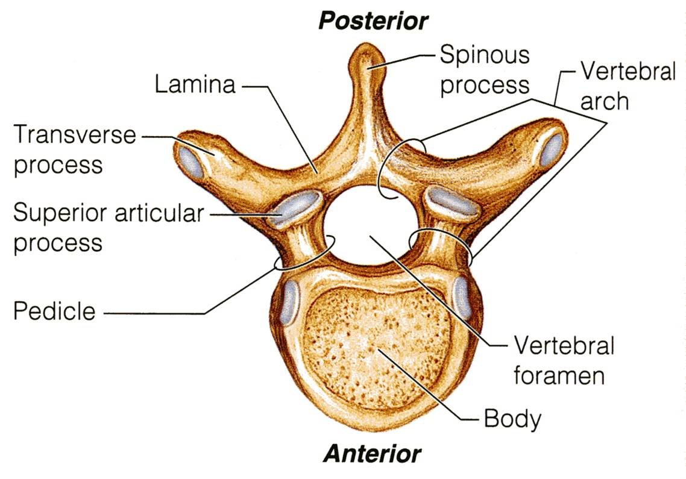
ANATOMY OF THE SPINE
Q
K
R
L
M
P
N
Dr. Zahid Kaimkhani

Slide 9
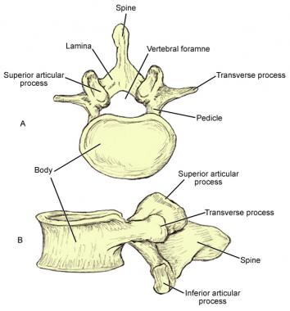
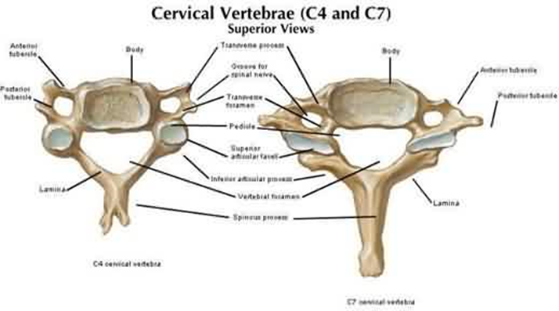
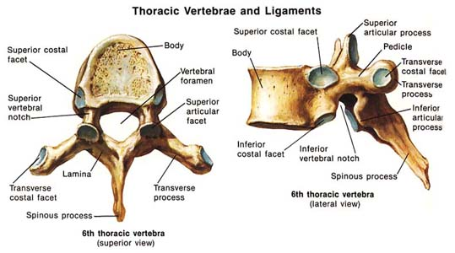
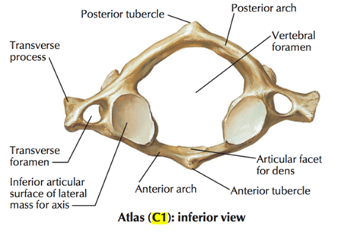
ANATOMY OF THE SPINE
REMEMBER 2 POINTS TO DIFFERENTIATE BETWEEN CERVICAL, THORACIC AND LUMBER VERTEBRA
FORAMEN IN TRANSVERSE PROCESS CERVICAL
FACET ON THE BODY THORACIC
NO FORAMEN IN TRANSVERSE PROCESS & NO FACET ON THE BODY LUMBER
Dr. Zahid Kaimkhani

Slide 10
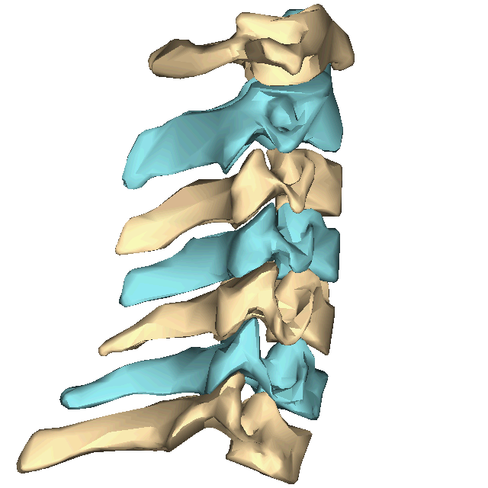
ANATOMY OF THE SPINE
CERVICAL VERTEBRAE
Dr. Zahid Kaimkhani

Slide 11
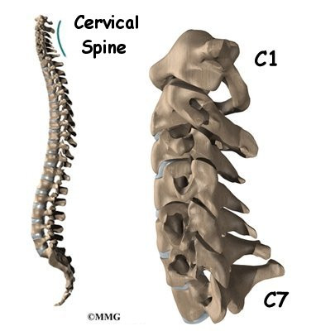
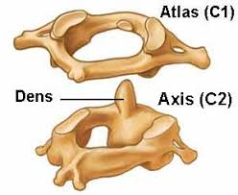
ANATOMY OF THE SPINE
CERVICAL VERTEBRAE
Salient Features:
7 in number
Identified by
the foramen transversarium .
small and bifid spine (exception C1 and C7).
Atypical
1st ATLAS and 2nd AXIS are different because they perform functions not shared by the other cervical vertebrae.
7th is also Atypical
Dr. Zahid Kaimkhani

Slide 12
ANATOMY OF THE SPINE
TYPICAL CERVICAL VERTEBRAE
C3 to C4
the 3 smallest,
lightest vertebrae,
spinous processes are short and bifid.
The transverse processes
foramina
“foramen transversarium”
transmits
Vertebral vessels and sympathetic nerve fibers.
Dr. Zahid Kaimkhani

Slide 13
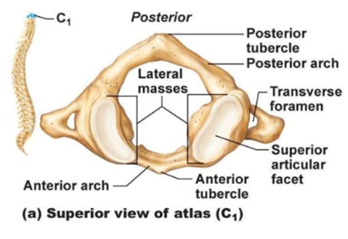
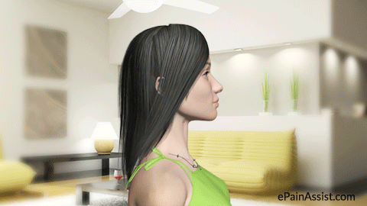
ANATOMY OF THE SPINE
A-TYPICAL CERVICAL VERTEBRAE
C1 ATLAS
C2 AXIS &
C7
The Atlas (C1)
NO BODY,
2 lateral masses.
The superior receive the occipital condyles of the skull.
This joint ATLANTO-OCCIPITAL allows us to nod i.e yes
Dr. Zahid Kaimkhani

Slide 14
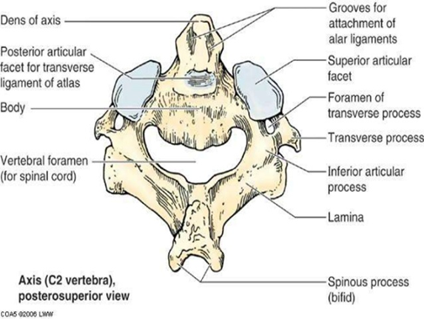
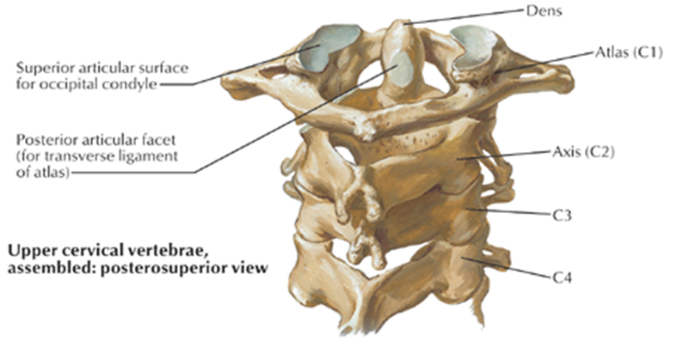
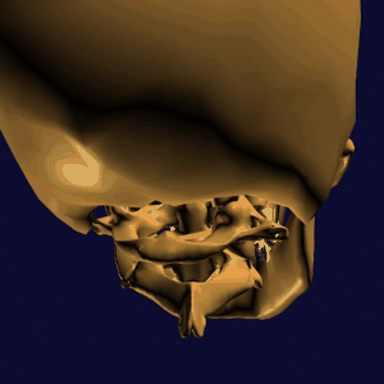
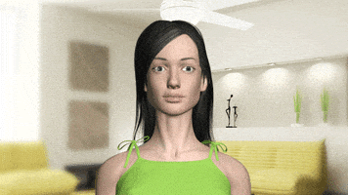
ANATOMY OF THE SPINE
A-TYPICAL CERVICAL VERTEBRAE
The axis (C2)
acts as a pivot for the rotation of the atlas (and the skull) above.
has a large upright process, the odontoid process, or dens, which acts as a pivot .
The joint between C1 & C2 ATLANTO-AXIAL allows to rotate the head from side to side to say "nooooo”
Dr. Zahid Kaimkhani

Slide 15
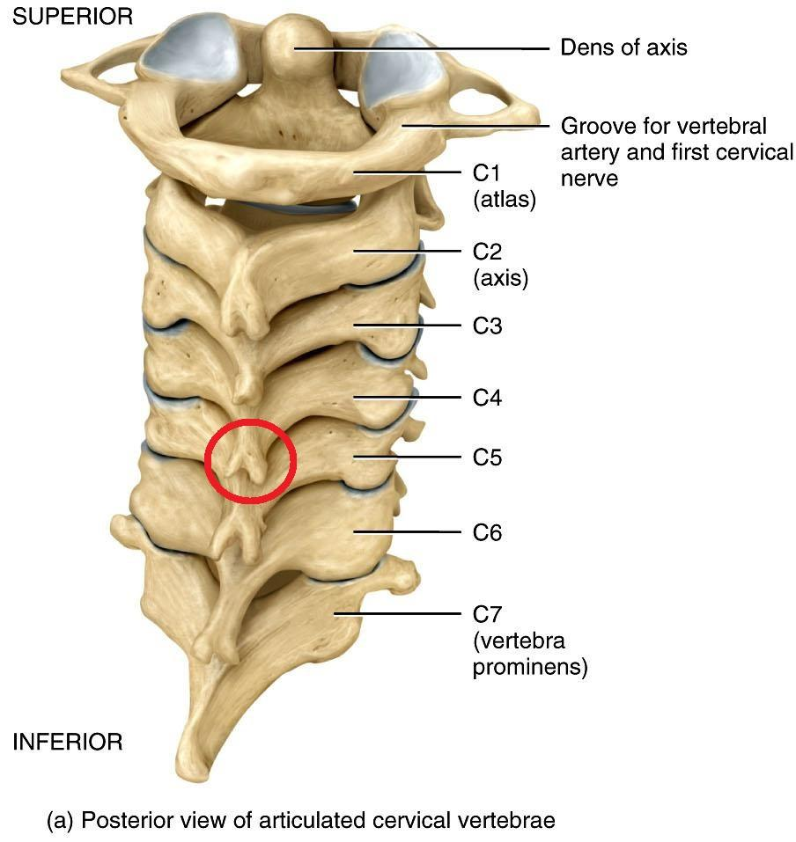
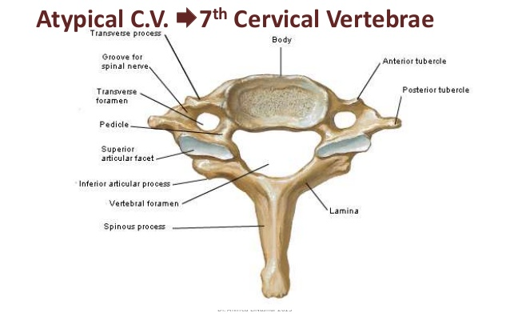
ANATOMY OF THE SPINE
A-TYPICAL CERVICAL VERTEBRAE
The 7th cervical Vertebra Also called Cervica Prominens
has the LONGEST SPINOUS process which is NOT BIFID.
is the first spine to be felt subcutaneously in the root of the back of the neck.
Dr. Zahid Kaimkhani

Slide 16
ANATOMY OF THE SPINE
THE ATLANTO-OCCIPITAL JOINT
MOVEMENTS
Flexion,
Extension, and
Lateral flexion;
Allows us NODDING i.e YES
NOT ROTATATION
THE ATLANTO-AXIAL JOINT
MOVEMENTS
Extensive ROTATION of the atlas and the skull (and thus of the head on the axis).
That is to say “NO”
Dr. Zahid Kaimkhani

Slide 17
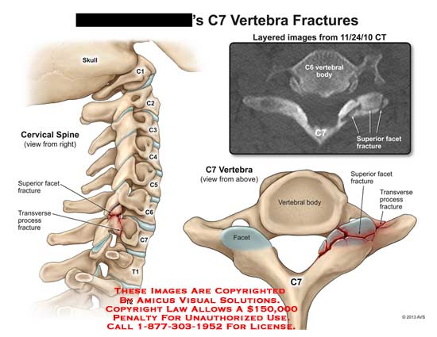
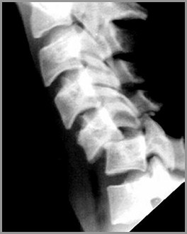
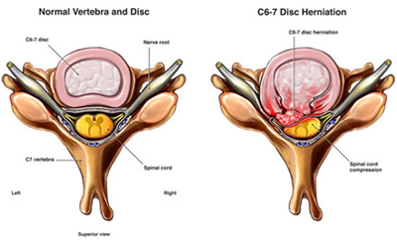
ANATOMY OF THE SPINE
The Cervical Spine
APPLIED ANATOMY:
The cervical vertebrae (particularly C7), may be FRACTURED or, more commonly, dislocated by a fall on the head with acute flexion of the neck e.g. diving into shallow water.
Dislocation may even result from the sudden forward jerk (during car or aeroplane crash).
WHY NOT FRACTURE-
the relatively horizontal intervertebral facets of the cervical vertebrae allow dislocation to take place without their being fractured.
Cervical disc prolapse- This may sometimes occur at the lower cervical intervertebral discs C5/6 and C6/7.

Slide 18
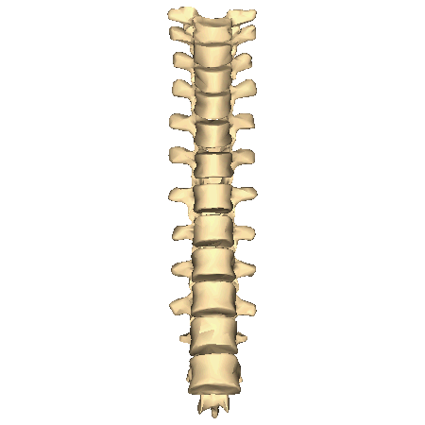
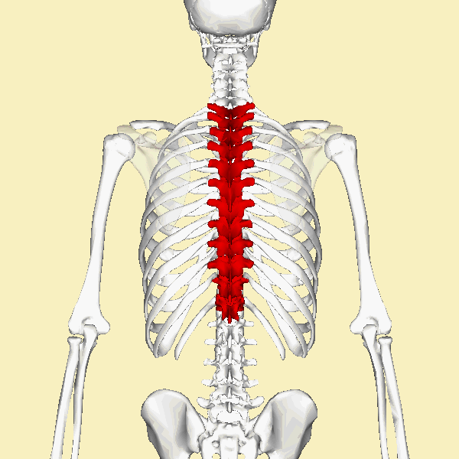
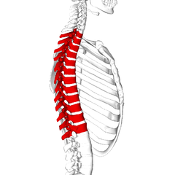
ANATOMY OF THE SPINE
THORACIC VERTEBRAE
Dr. Zahid Kaimkhani

Slide 19
ANATOMY OF THE SPINE
THORACIC VERTEBRAE
12 (T₁-T₁₂).
The body
somewhat heart-shaped
has two costal demifacets
The spinous process
long and hooks sharply downward
Dr. Zahid Kaimkhani

Slide 20
ANATOMY OF THE SPINE
THORACIC VERTEBRAE
The 12 thoracic vertebrae (T₁-T₁₂) are almost typical.
They are larger than the cervical vertebrae.
The body is somewhat heart-shaped and has two costal demifacets (articulating surfaces) on each side, which receive the heads of the ribs.
The spinous process is long and hooks sharply downward
Dr. Zahid Kaimkhani

Slide 21
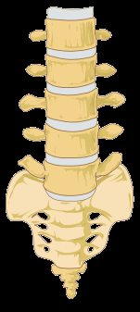
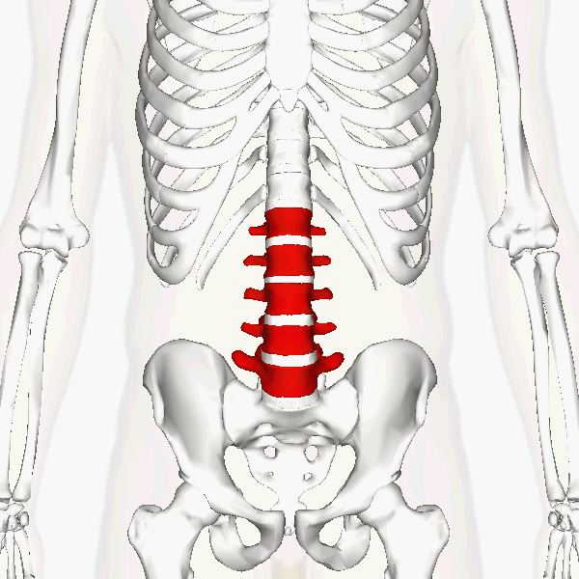
ANATOMY OF THE SPINE
LUMBER VERTEBRAE
Dr. Zahid Kaimkhani

Slide 22
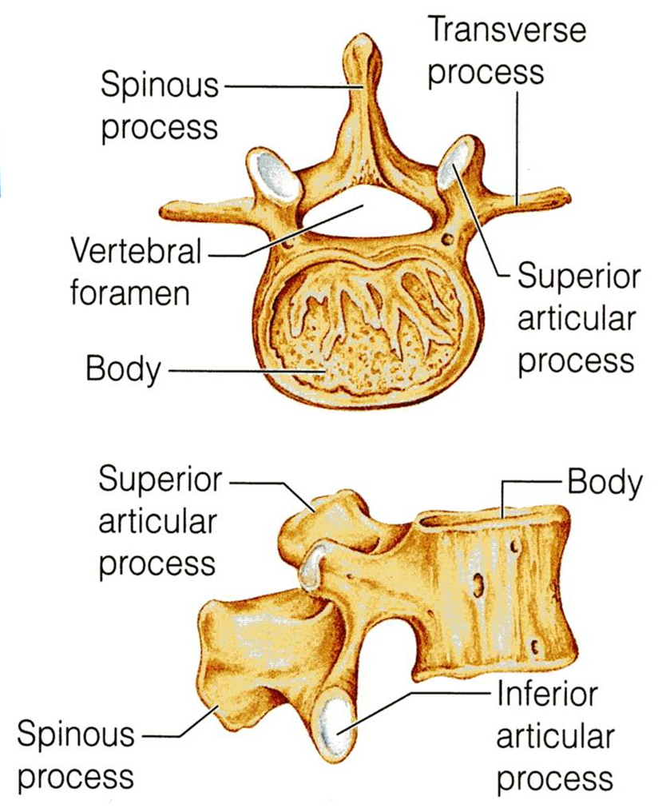
ANATOMY OF THE SPINE
LUMBER VERTEBRAE
5 lumbar vertebrae (L₁-L₅)
the most solid of all vertebrae
BODY
Massive & block like.
SPINOUS PROCESSES
Short & hatchet-shaped.
Dr. Zahid Kaimkhani

Slide 23
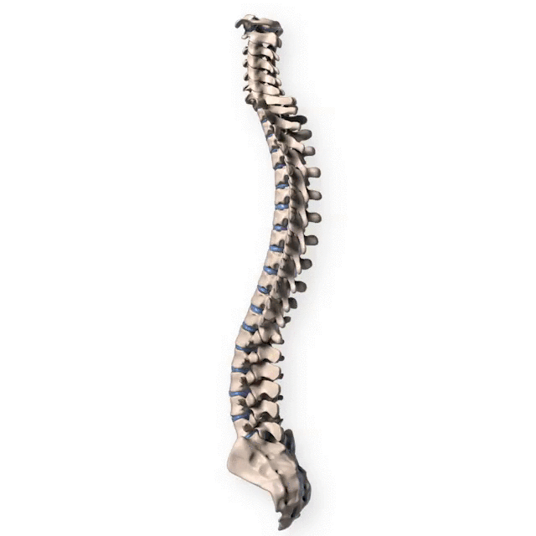
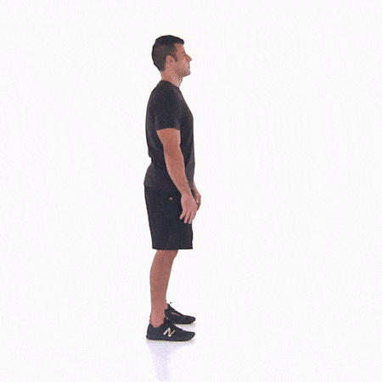
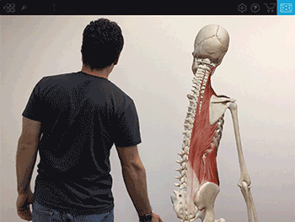
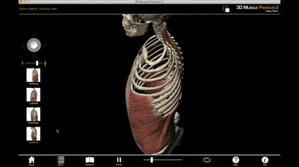
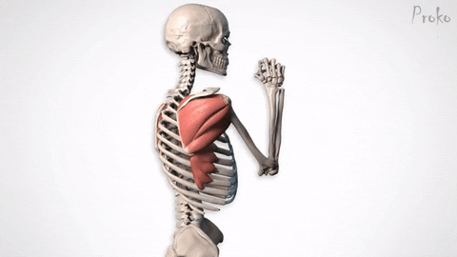
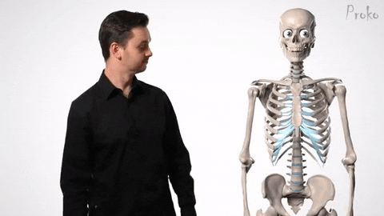
ANATOMY OF THE SPINE
MOVEMENTS OF THE THORACOLUMBAR SPINE
Lateral Flexion
Rotation
Flexion & extension
Dr. Zahid Kaimkhani

Slide 24
ANATOMY OF THE SPINE
MOVEMENTS OF THE THORACOLUMBAR SPINE
The following movements are possible on the spine:
Flexion, extension,
lateral flexion and
rotation.
In the thoracic region,
the ribs, the costal cartilages, and the sternum severely RESTRICT the range of movement.
Flexion, extension and lateral flexion: are extensive in the lumbar regions but restricted in the thoracic region.
Rotation:
It is extensive in thoracic spine and least extensive in the lumbar region.
Dr. Zahid Kaimkhani

Slide 25
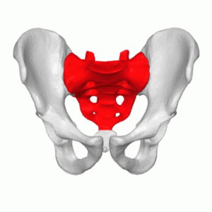
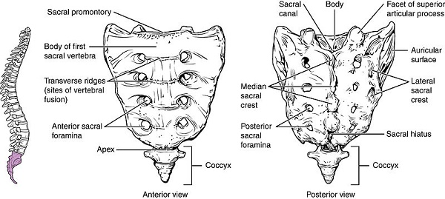
ANATOMY OF THE SPINE
SACRUM
formed by fusion of 5 vertebrae.
forms the posterior wall of the pelvic cavity.
Articulation
Superiorly with L5, &
Inferiorly with the coccyx.
Sacral Promontory:
The anterior and upper margin of the first sacral vertebra.
The wing like ala articulate laterally with the hip bones, forming the sacroiliac joints.
Dr. Zahid Kaimkhani

Slide 26
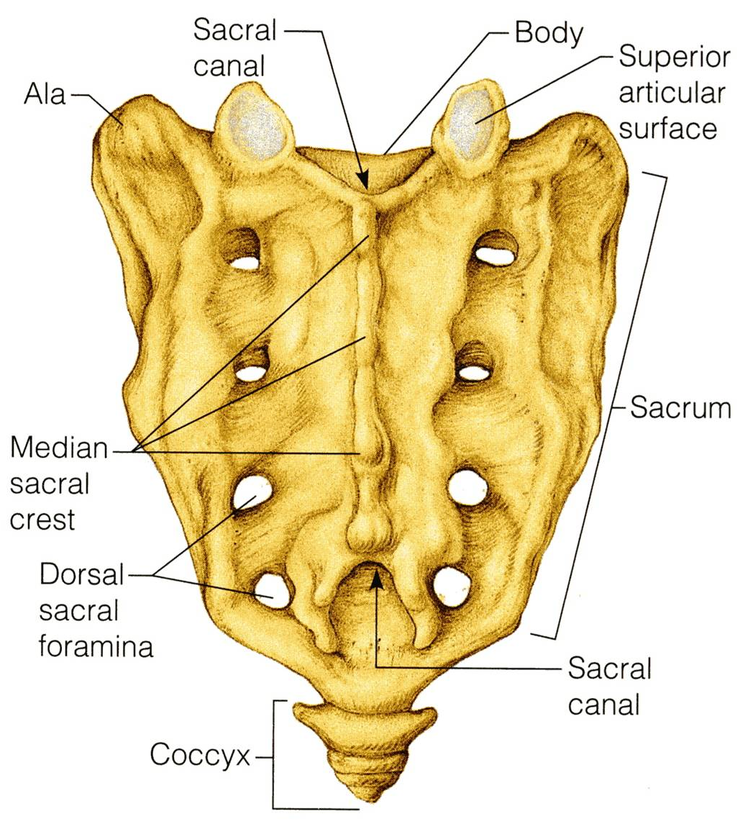
ANATOMY OF THE SPINE
SACRUM
DORSAL SURFACE
Median Sacral Crest, (the fused spinous processes of the sacral vertebrae).
Dorsal Sacral Foramina laterally
The vertebral canal continues inside the sacrum as the Sacral Canal.
The sacral canal opens inferiorly in what is called Sacral Hiatus.
Dr. Zahid Kaimkhani

Slide 27
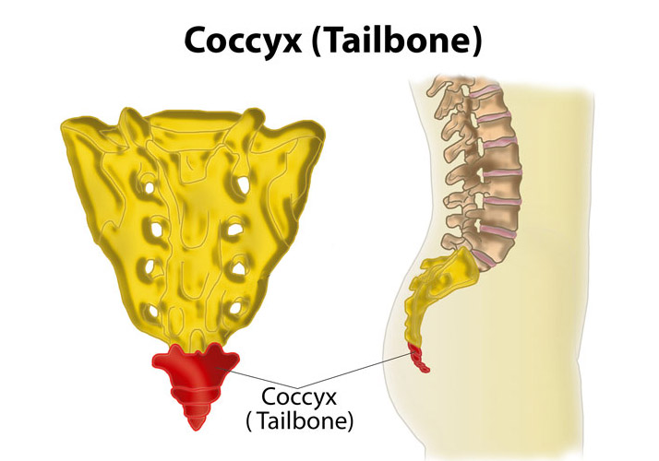
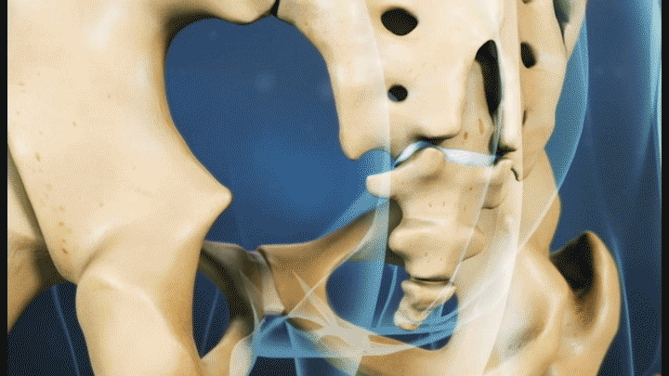
ANATOMY OF THE SPINE
COCCYX
is formed of fusion of tiny, irregularly shaped vertebrae.
Dr. Zahid Kaimkhani

Slide 28
ANATOMY OF THE SPINE
VERTEBRAL JOINTS
Adjacent vertebrae are held together by
Strong ligaments
Small joints
Joints b/w bodies
Joints b/w neural arches
Note: joints b/w neural arches allows greater range of movements than b/w bodies
,
Dr. Zahid Kaimkhani

Slide 29
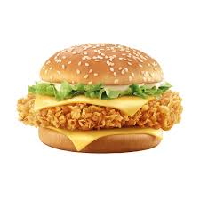
ANATOMY OF THE SPINE
VERTEBRAL JOINTS
Joint b/w bodies –Intervertebral disc
JOINTS b/w BODIES
It is a secondary cartilaginous joint (Symphasis).
The upper and lower surfaces of the bodies of 2 adjacent vertebrae are covered by thin plates of hyaline cartilage.
Sandwiched between the plates of hyaline cartilage is an intervertebral disc of fibrocartilage.
Joint b/w facets –facets Joint
Dr. Zahid Kaimkhani

Slide 30
ANATOMY OF THE SPINE
VERTEBRAL JOINTS
INTERVERTEBRAL DISCS
one fourth of the whole length of the VC.
thickest in the cervical and lumbar regions.
consists ofa:
ANNULUS FIBROSUS,.
NUCLEUS PULPOSUS
The nucleus pulposus contains
water, collagen fibers & few cartilage cells.
NOTE:
NO DISCS
WHERE
between the first & second cervical vertebrae in the sacrum
& coccyx.
Dr. Zahid Kaimkhani

Slide 31
ANATOMY OF THE SPINE
VERTEBRAL JOINTS
INTERVERTEBRAL DISCS
forms about one fourth of the whole length of the vertebral column.
thickest in the cervical and lumbar regions, where the movements of the vertebral column are greatest.
Each disc consists of a:
Peripheral part, called the ANNULUS FIBROSUS, composed of fibrocartilage.
Central part, called the NUCLEUS PULPOSUS, a mass of gelatinous material.
The nucleus pulposus
15% of the whole disc
formed of:
Water (90% at birth, and 70% in old age.
OVER NIGHT Increase in height, Astronaut ?? ),
Small number of collagen fibers,
Few cartilage cells.
No discs are found between the first & second cervical vertebrae or in the sacrum or coccyx.
Dr. Zahid Kaimkhani

Slide 32
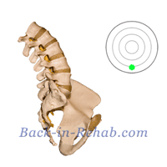
ANATOMY OF THE SPINE
VERTEBRAL JOINTS
FUNCTION OF INTERVERTEBRAL DISCS
Allow one vertebra to rock forward or backward on another, as in flexion and extension of vertebral column.
Serve as shock absorbers when the load on the vertebral column is suddenly increased, as when one is jumping.
Dr. Zahid Kaimkhani

Slide 33
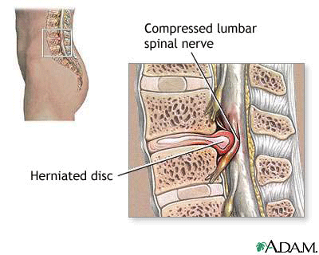
ANATOMY OF THE SPINE
VERTEBRAL JOINTS
Applied Anatomy
Disc prolapse / Herniated/Slipped disc
Sometimes, the annulus fibrosus ruptures, allowing the nucleus pulposus to herniate and protrude into the vertebral canal, where it may press on the spinal nerve roots, or the spinal nerve, or even spinal cord itself
Dr. Zahid Kaimkhani

Slide 34
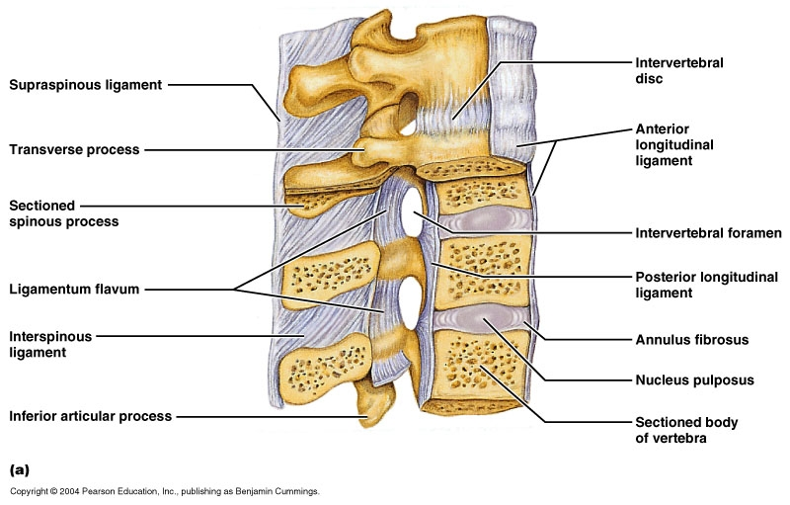
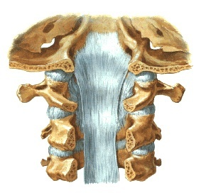
ANATOMY OF THE SPINE
VERTEBRAL JOINTS
LIGAMENTS - JOINTS b/w BODIES
P
O
S
T
E
R
I
O
R
A
N
T
E
R
I
O
R
Anterior
The anterior and posterior longitudinal ligaments run as continuous bands along the anterior & posterior surfaces of the vertebral bodies.
These ligaments hold the vertebrae firmly together but at the same time permit a small amount of movement to take place.

Slide 35
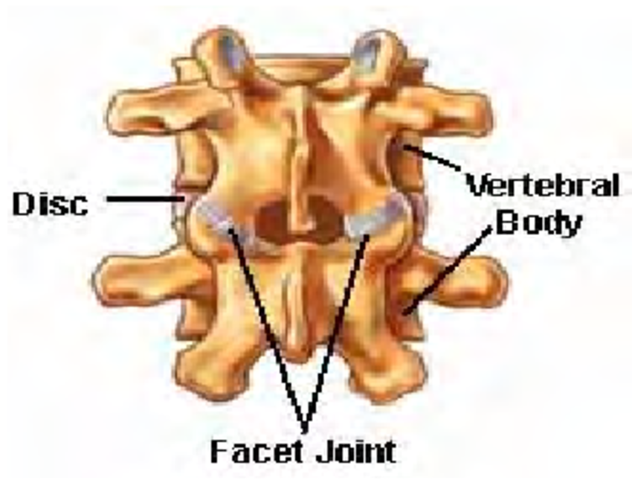
ANATOMY OF THE SPINE
VERTEBRAL JOINTS
JOINTS BETWEEN THE NEURAL ARCHES
Between Pedicels – intervertebral foramen
Adjacent articular process –synovial joints (Facet joints or Zygapophyseal joints
Remanning arch by ligaments ; the most important are
SUPRASPINOUS
LIGAMENT FLAVA
The joints between two vertebral arches consist of synovial joints between the superior and inferior articular processes of 2 adjacent vertebrae.
Anterior
The articular facets are covered with hyaline cartilage, and the joints are surrounded by a fibrous capsule.

Slide 36
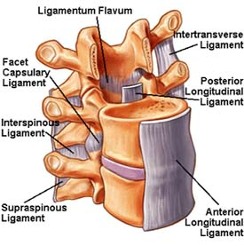
ANATOMY OF THE SPINE
VERTEBRAL JOINTS
LIGAMENTS - JOINTS b/w ARCHES
1
4
Ligamentum flavum
(Connects Lamina)
Interspinous ligament
Supraspinous ligament
Intertransverse ligament
2
Anterior
3

Slide 37
ANATOMY OF THE SPINE
VERTEBRAL JOINTS
LIGAMENTS - JOINTS b/w ARCHES
The Ligamentum Flava: yellow, high elastic fibers, join the adjacent LAMINA , stretch by the flexion of spine ( in leaning forward –ANTI-GRAVITY support
1
The Supraspinous ligament: strong , white, join the tips of spinous process, lax in extended spine, taut by full flexion & support spine ( touching the toes)
4
Interspinous& Intertransverse ligaments
weak ligaments
Anterior
2
3

Slide 38
ANATOMY OF THE SPINE
VERTEBRAL JOINTS
LIGAMENTUM NUCHAE
In the cervical region, the Supraspinous and Interspinous ligaments are thickened to form the strong ligamentum nuchae.
It extends from the external occipital protuberance of the skull to the spine of the seventh cervical vertebra.
Its anterior border is strongly attached to the cervical spines in between.
Anterior

Slide 39
ANATOMY OF THE SPINE
BLOOD SUPPLY OF THE VERTEBRAE
Drain s by
Basivertebral veins
Internal vertebral venous plexus
External vertebral venous plexus Into
Regional segmental veins [vertebral, post intercostal, lumber & lateral sacral veins]
Venous communication – reflux blood along valveless vein --- malignant disease from prostate, kidney , breast ,bronchus ,thyroid can spread to spine
Segmentally by
The vertebral artery
Ascending & deep cervical arteries
Intercostal artery
Lumber & lateral sacral arteries
Anterior

Slide 40
Thank You for listening
STAY BLESSED
Dr. Zahid Kaimkhani

