Slide 1
Contraction of Skeletal Muscle and Neuromuscular Transmission
Textbook of medical physiology Guyton & Hall (13th edition)
UNIT II CHAPTER 6 & 7
Pages 75-95
Dr. Mohammed Alotaibi

Slide 2
Objectives of the lecture
At the end of the lecture the student should be able to:
Know and describe the followings:
The physiologic anatomy of the skeletal muscle and NM junction.
Motor End Plate potential and how action potential and excitation-contraction coupling are generated in skeletal muscle.
The molecular mechanism of skeletal muscle contraction & relaxation.
Sliding filament mechanism.
Drugs/ diseases affecting the neuromuscular transmission.

Slide 3
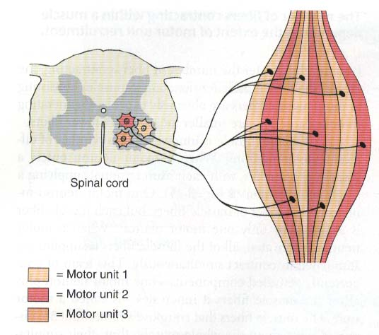
Motor Unit
What is a Motor Unit?
It is the Motor Neuron (Anterior Horn Cell , Axon) and all the muscle fibers it innervates.

Slide 4
40% of the body are skeletal muscles
Sarcolemma

Slide 5
Physiological Anatomy of Skeletal Muscle fiber
Z band
Sarcomere
Z band

Slide 6
Myosin
Actin
M line
Myofibril
The light and dark bands give skeletal and cardiac muscle their striated appearance.

Slide 7
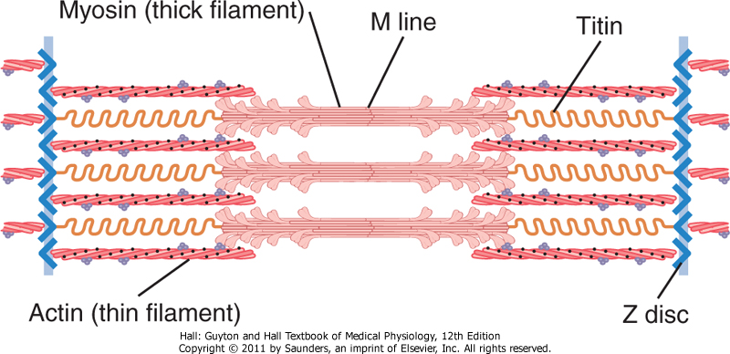
Fig. 6.3 Organization of proteins in a sarcomere

Slide 8
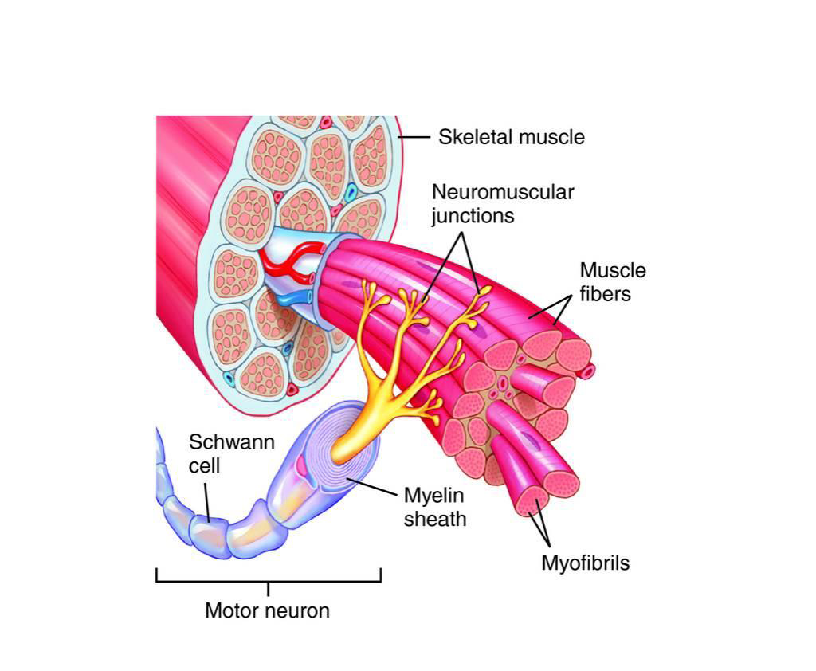

Slide 10
Transmission of impulses from nerve endings to skeletal muscle fibers occurs via:
THE NEUROMUSCULAR JUNCTION (NMJ)

Slide 11
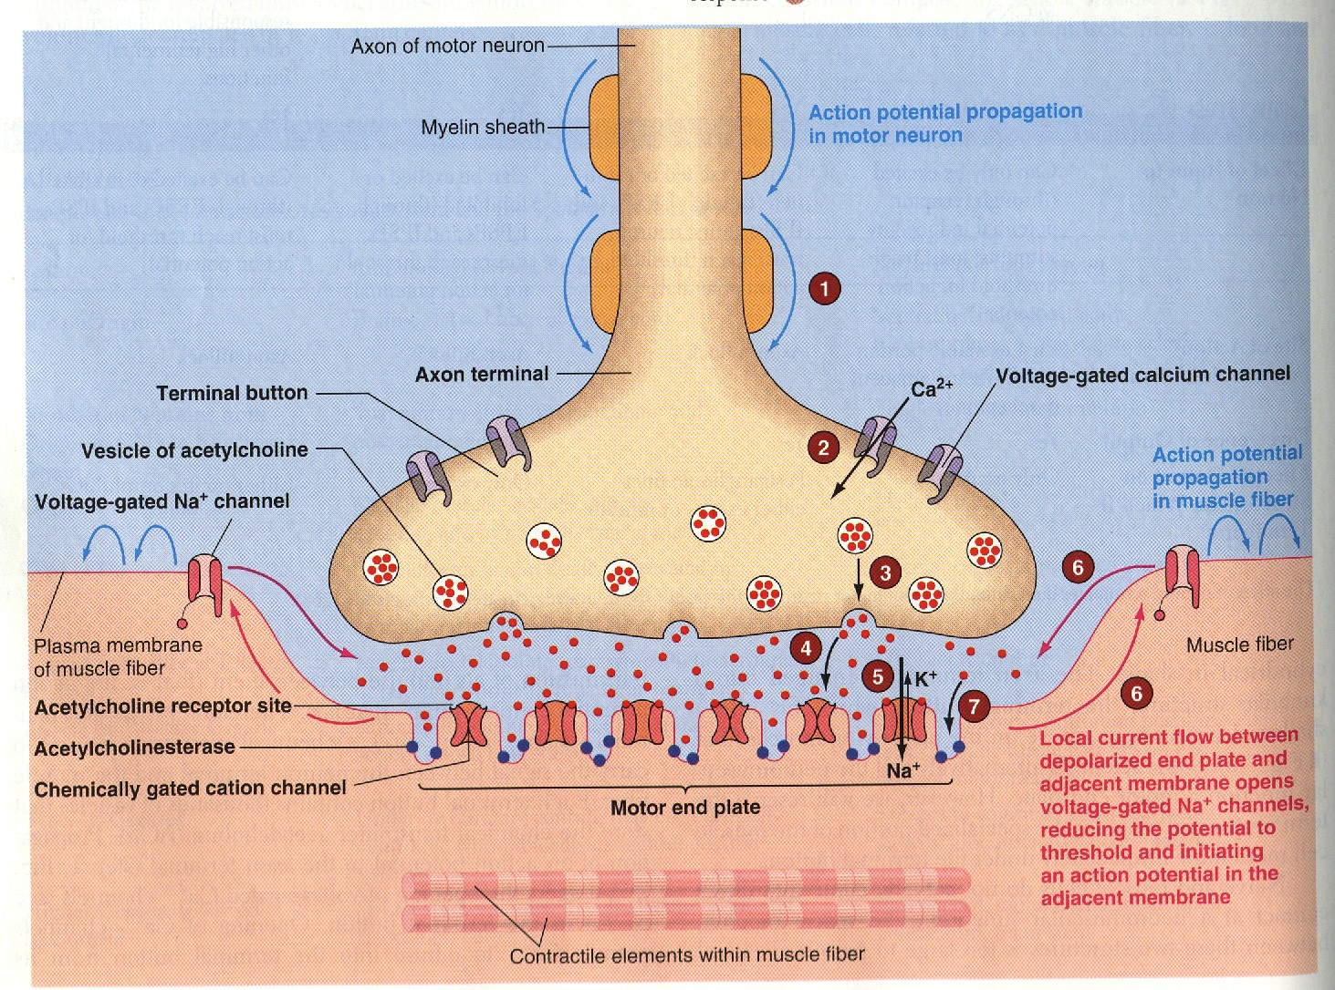
Physiologic Anatomy of the Neuromuscular Junction
Motor End Plate (MEP)
Synaptic trough/ gutter
Presynaptic terminal
Postsynaptic terminal
Synaptic space/cleft
Acetylcholine (Ach)
Synaptic vesicles
Acetylcholinesterase
125
(Nicotinic Ach receptor)

Slide 12
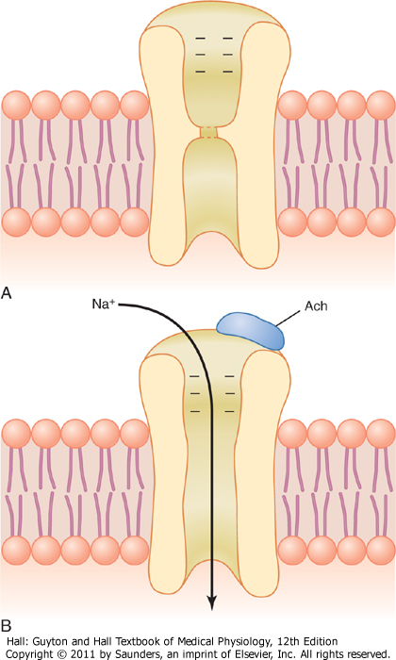
Effect of Ach on the Postsynaptic Muscle Membrane
Two molecules of Ach must attach to the receptor.
Ach-channels open and allow Na⁺, Ca⁺, or K⁺ ions to move through easily; but not negative ions such as Cl⁻
More Na⁺ ions will pass through which creates a local positive potential change inside the muscle fiber membrane, called the end plate potential (EPP).
EPP spreads along the muscle fiber membrane
Fig. 7.3 Acetylcholine gated channels
A. Closed B. After Ach attaches

Slide 13
Na⁺
Na⁺
Na⁺
Na⁺
Cytoskeleton
Synapsin
P
Ca²⁺- Cal-PK
AP spreads along the T tubules
+
Na⁺
Na⁺
When Ach-gated channels open, sudden influx of Na⁺ will increase electrical potential in the positive direction as much as 50-75 mV and creates a local EPP. This will open voltage gated Na+ channels.

Slide 14
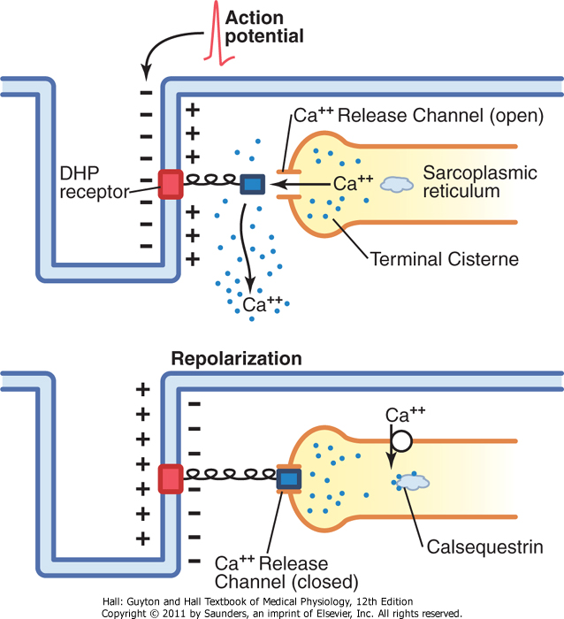
Release of Calcium Ions by the Sarcoplasmic Reticulum
As AP reaches the T-tubule, the voltage change is sensed by [voltage-gated calcium channel dihydropyridine receptors (DHP)] linked to calcium release channels (Ryanodine receptors) which triggers the release of Ca⁺⁺ initiating contraction.
Calcium pump removes calcium ions after contraction occurs.
Calcium binds to calsequestrin.
At rest
Sarcolemma
Fig. 7.6 Excitation-contraction coupling in skeletal muscle.

Slide 15
EXCITATION-CONTRACTION COUPLING IN SKELETAL MUSCLE

Slide 16
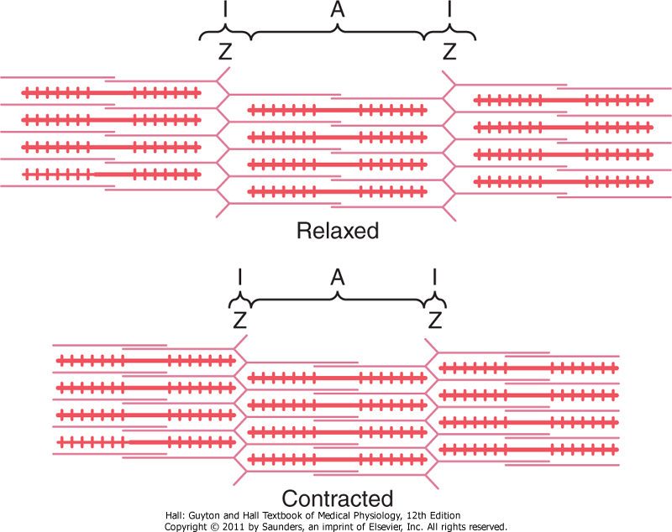
Molecular Mechanism of Muscle Contraction
Muscle Contraction Occurs by a Sliding Filament Mechanism
Figure 6-5. Relaxed and contracted states of a myofibril.

Slide 17
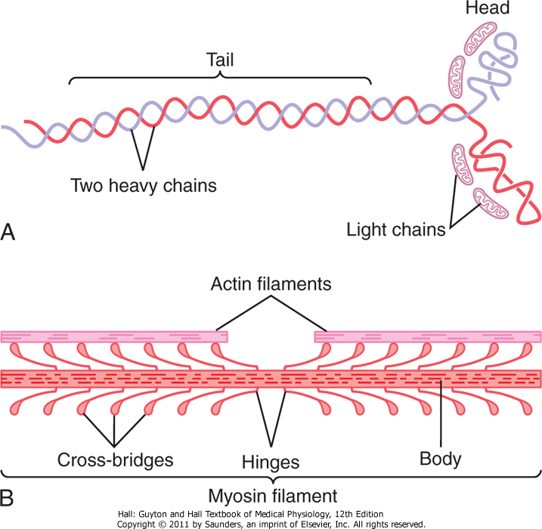
Molecular Characteristics of the Contractile Filaments
Myosin filaments are composed of multiple myosin molecules.
Each Myosin molecule has:
(1) Head
( 2 ) Tail
(3) Hinge (joint )
Each myosin head contains:
(1) Actin binding site
(2) Myosin ATPase site

Slide 18
Molecular Characteristics of the Contractile Filaments
Actin filaments are composed of actin, tropomyosin and troponin
(I, T, C)
Double-Stranded: backbone of the actin filament
Fig. 6.7 Actin filament

Slide 19
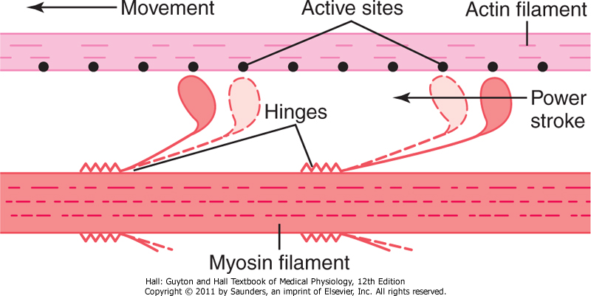
Molecular Mechanism
Fig. 6.8 “Walk-along” mechanism for muscle contraction.
The heads of the cross-bridges bend back and forth and step by step walk along the actin filament, pulling the ends of two actin filaments toward the center of the myosin filament.

Slide 20
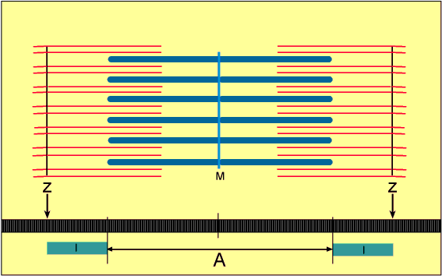
Sliding Filament Mechanism
But what causes the actin filaments to slide inward among the myosin filaments?
Forces generated by interaction of the cross-bridges from the myosin filaments with the actin filaments

Slide 21
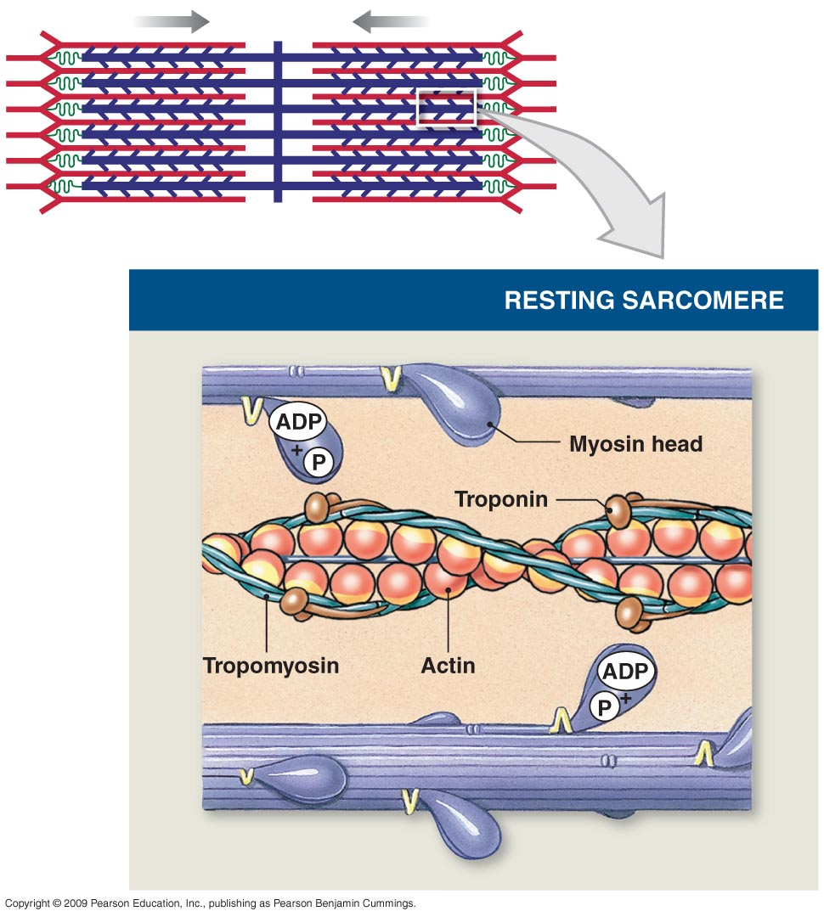
Forces are inactive
The heads of the cross bridges bind with ATP. The ATPase activity of the myosin head immediately cleaves the ATP but leaves the cleavage products, ADP plus phosphate ion, bound to the head.

Slide 22
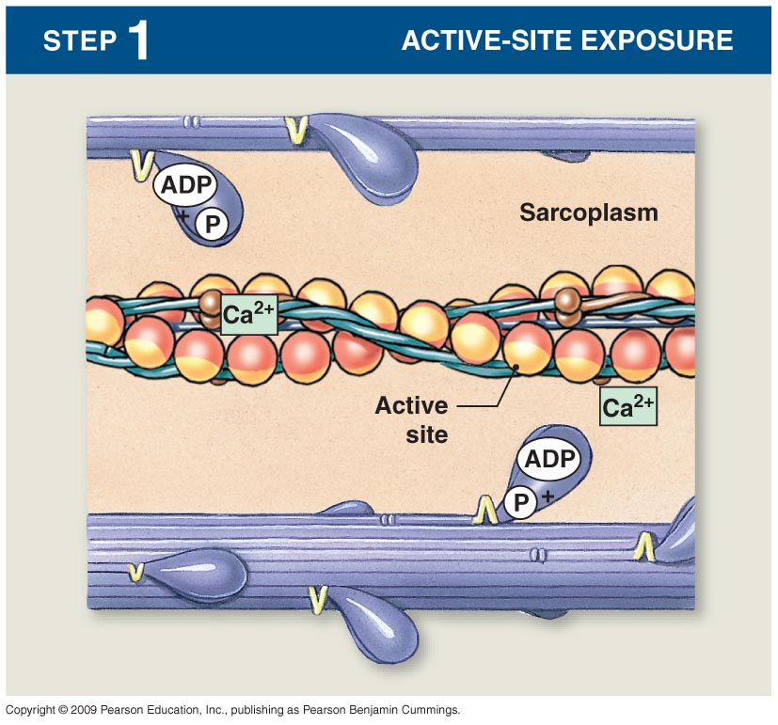
When the troponin-tropomyosin complex binds with calcium ions, active sites on the actin filament are uncovered and the myosin heads then bind with these sites.

Slide 23
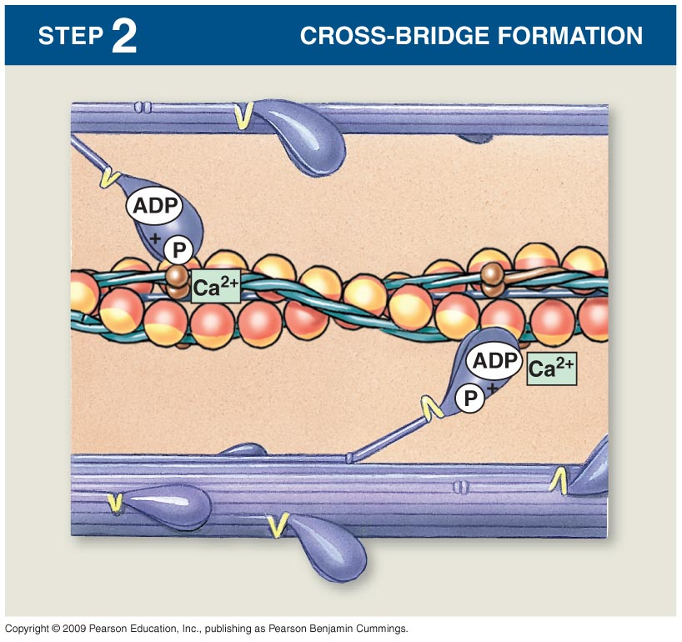
With the active sites on the actin exposed, the myosin heads bind to the actin, forming cross-bridges.

Slide 24
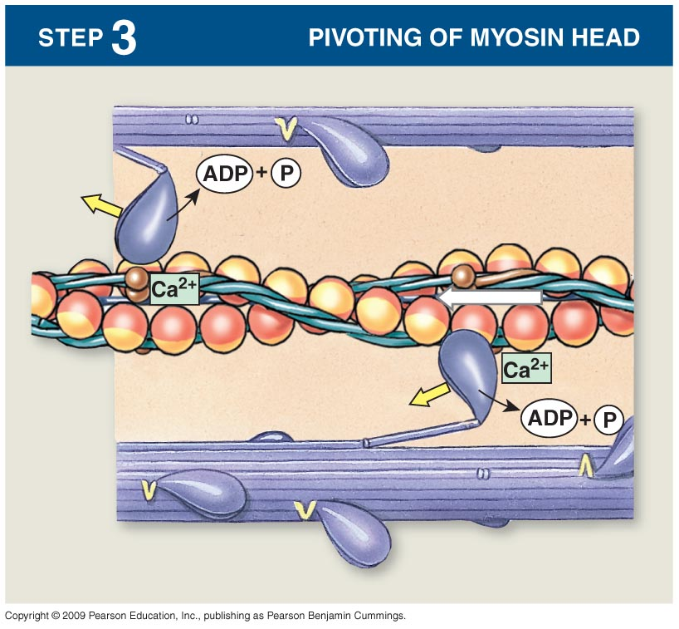
Binding the head of the cross-bridge with the active site causes a conformational change in the head, prompting the head to tilt toward the arm of the cross-bridge and providing the power stroke for pulling the actin filament.
Notes:
After cross-bridge formation, the ATP present in the myosin is used to “cock” (the opposite direction from its resting state). As the ATP is used and the ADP + P is released, the “power stroke” occurs as the myosin pivots toward the M line.

Slide 25
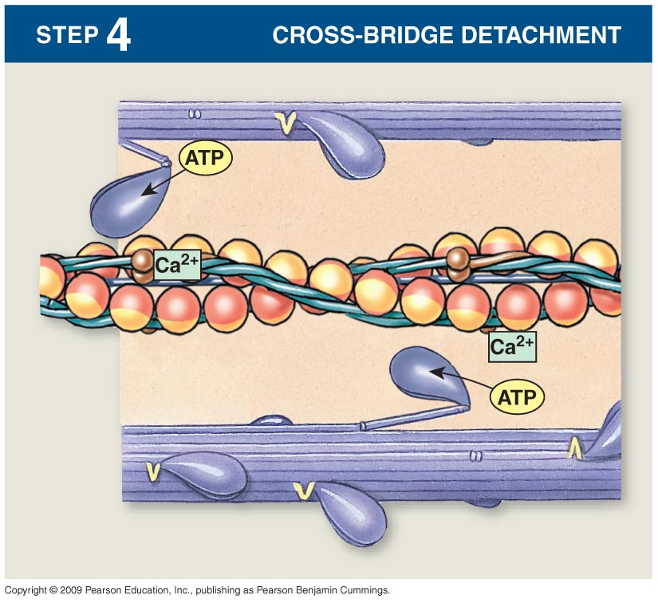
Once the head of the cross-bridge tilts, ADP and phosphate ion are released and new molecule of ATP binds. This binding of new ATP causes detachment of the head from the actin.

Slide 26
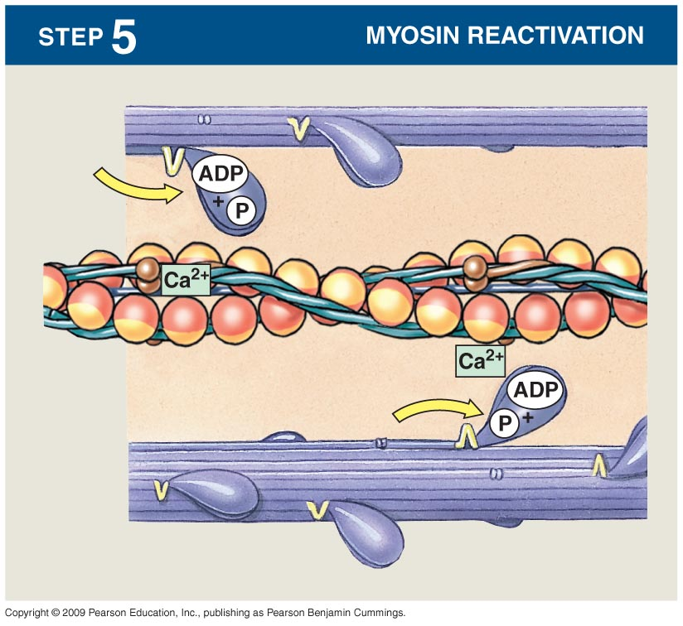
The new ATP is cleaved to begin the next cycle which “cocks” the head back to its perpendicular condition, ready to begin the new power stroke cycle.

Slide 27
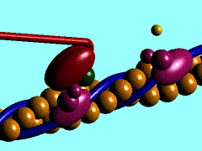
What is Rigor Mortis ?
The contracture of skeletal muscles that begins several hours after death due to the loss of ATP.

Slide 28
Muscle Action Potential (AP)
 | Skeletal Muscle | Large Nerves
Resting Membrane Potential | -80 to -90 mV | -80 to -90 mV
Duration of the Action Potential | Lasts 1- 5 msec | Lasts 0.2- 1 msec
Velocity of Conduction | 3-5 m/sec | 39-65 m/sec

Slide 29
Drugs That Enhance Transmission at the
Neuromuscular Junction
Methacholine, Carbachol, and Nicotine.
They act for minutes or hours—are not destructed by cholinesterase.
Neostigmine, Physostigmine [inactivate acetylcholinesterase for several hours]
Diisopropyl fluorophosphate (nerve gas poison) [inactivates acetylcholinesterase for weeks -------can cause death because of respiratory muscle spasm]
Drugs That Stimulate the Muscle Fiber by Ach-Like Action:
Drugs That Stimulate the NMJ by Inactivating Acetylcholinesterase:

Slide 30
Drugs That Block Transmission at the
Neuromuscular Junction
Curare & Curariform like-drugs.
Prevent passage of impulses from the nerve ending into the muscle by blocking the action of Ach on its receptors on MEP.
Botulinum Toxin.
Bacterial poison that decreases the quantity of Ach release by the nerve presynaptic terminals.
Drugs That Block Transmission at the NMJ

Slide 31
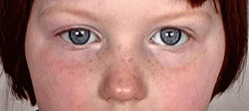
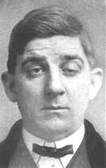
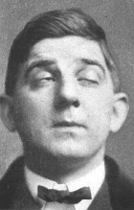
Myasthenia Gravis
Disease of adult females affects eyelid, extra ocular bulbar and proximal limb muscles.
Presents with ptosis, dysarthria, dysphagia, and proximal limb weakness in hands& feet.

Slide 32
Myasthenia Gravis
Autoimmune disorder [patients develop antibodies which block or destroy their own Ach receptors].
Occurs in about 1 in every 20,000 persons.
Causes muscle weakness because of the inability of the NMJ to transmit enough signals from the nerve fibers to the muscle fibers.
The EPP that occur in the muscle fibers is mostly too weak to initiate opening of the voltage-gated sodium channels.
Patient may die of respiratory failure.

Slide 33
Myasthenia Gravis
Treatment:
Administration of anticholinesterase drugs such as Neostigmine which allows larger than normal amounts of Ach to accumulate in the synaptic space.
Corticosteroids and Immunosuppressant drugs to inhibit the immune system, limiting antibody production.

Slide 34
The End

