Slide 1
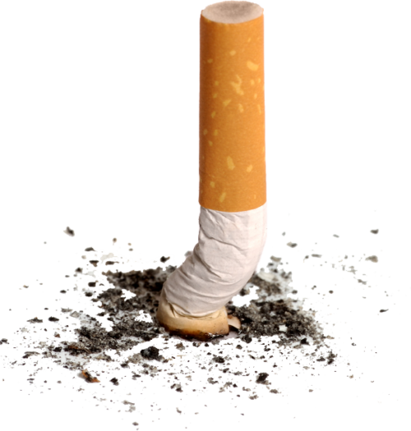
Tobacco Consumption
Problems and solutions
Dr. Nada A. AlYousefi Associate Professor, Postgraduate Trainer and Consultant of Family Medicine International Board Certified Lactation Consultant Department of Family and Community Medicine College of Medicine, King Saud University (KSU)
nalyousefi@ksu.edu.sa
January 2021

Slide 2
Objectives
Epidemiology of smoking in Saudi Arabia.
Risks of smoking (Morbidity and Mortality).
Effect of passive smoking on pregnancy, children …
How are you going to help the smoker to quit and how to overcome withdrawal symptoms.
Update in pharmacological management, smoking cessation medication.
Nicotine preparations, varniciline, bupropion …

Slide 3
Content of Cigarette

Slide 4
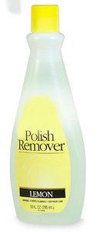
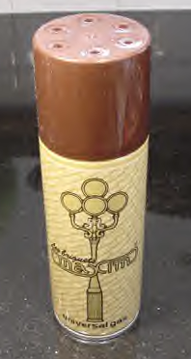
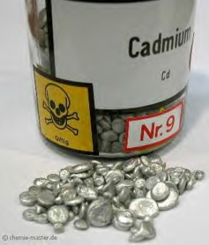
What is in tobacco
More than 4,000 substances, including:
Tar: black sticky substance used to pave roads
Nicotine: Insecticide
Carbon Monoxide: Car exhaust
²¹⁰ Polonium: radio-active substance
Acetone: Finger nail polish remover
Ammonia: Toilet Cleaner
Cadmium: used batteries
Ethanol: Alcohol
Arsenic: Rat poison
Butane: Lighter Fluid
Notes:
There are over 4,000 chemicals in cigarette smoke. These chemicals irritate the throat and cause cancer, lung and heart disease. Chemicals are added to: Make tobacco burn smoothly; Make the paper burn evenly Enhance the flavor; Boost the nicotine (ammonia); Kill the tobacco slugs Make sure the cigarette doesn’t go out in the ashtray when not puffing on it. Other chemicals found in tobacco include:
Benzene: found in moth balls
Denatured alcohol: used to keep cigarettes burning
Toluene: now illegal to put in top coat solution for polishing your nails.
DDT: Insecticides
Arsenic: found in rat poison
Formaldehyde: dead body preserver
Tar: a pack a day smoker would accumulate 1 quart of tar a year In their lungs. Contains most of the cancer-causing agents of tobacco smoke.
“Activity”:
Show each chemical & read warning label of each (benzene, denatured alcohol, toluene, acetone)

Slide 5
Prevalence of Tobacco smoking among persons aged 15 years and above % (Male) – 2015 WHO “SA 27.9%”

Slide 6
Prevalence of Tobacco Product Consumption and Exposure among Healthcare Students in King Saud University in Riyadh, Saudi Arabia (2017)
A total of 1207 healthcare students, (College of Medicine, College of Dentistry, College of Pharmacy, College of Nursing and College of Medical Applied Science)
The prevalence of tobacco product smoking was 13.5%.
The highest in the college of nursery 19.23%, and lowest in the college of pharmacy 10.11%.
The age group of 18-21 years old, the prevalence was only 9.54%, while the age group of 22-25 was 19.25%, and for 26 years old students or more was 33.33%.
The prevalence of smoking water pipe came to be 12.1% and of small-pipe (Midwakh) 5.6%.
The prevalence of students with direct home exposure was 31.48% and environment exposure such as hanging out with friends was 40.93%.
Amin HS, Alomair ANA, Alhammad AHA, Altwijri FAA, Altaweel AAA, et al. (2017) Prevalence of Tobacco Product Consumption and Exposure among Healthcare Students in King Saud University in Riyadh, Saudi Arabia. J Community Med Health Educ 7: 567

Slide 7
Risks of Smoking (Morbidity and Mortality)
Cigarette smoking causes more than 480,000 deaths each year in the United States.
This is about one in five deaths.
Smoking causes more deaths each year than all of these combined:
Human immunodeficiency virus (HIV)
Illegal drug use
Alcohol use
Motor vehicle injuries
Firearm-related incidents

Slide 8
Risks of smoking (Morbidity and Mortality)
Smokers are more likely than nonsmokers to develop:
Heart disease, Stroke, and Lung cancer.
Smoking is estimated to increase the risk of:
Coronary heart disease by 2 to 4 times
Stroke by 2 to 4 times
Lung cancer by 25 times

Slide 9
Smoking and Cardiovascular System
Smoking causes stroke and coronary heart disease —the leading causes of death in the United States.
Smoking damages blood vessels.
Walls of Arteries are thicken and lumen grow narrower (Atherosclerosis)
The heart beat faster and blood pressure goes up.
Thrombosis can also form and lead to; IHD, Peripheral Vascular Disease and Stroke.
Even people who smoke fewer than five cigarettes a day can have early signs of cardiovascular disease.

Slide 10
Smoking and Respiratory System
Lung diseases caused by smoking include:
COPD, which includes emphysema and chronic bronchitis.
Smoking can cause lung disease by damaging the airways and the alveoli.
In presence of asthma, tobacco smoke can trigger an attack or make an attack worse.
Smokers are 12 to 13 times more likely to die from COPD than nonsmokers.
Cigarette smoking causes most cases of lung cancer.

Slide 11
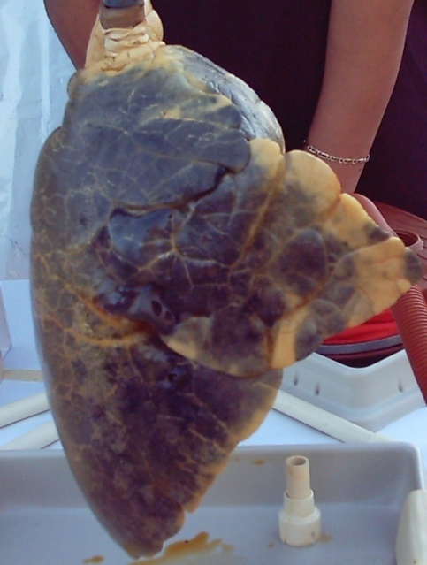
Smoking and Cancer
Smoking can cause cancer almost anywhere in your body:
Trachea, bronchus, and lung
Bladder
Esophagus
Larynx
Oropharynx (includes parts of the throat, tongue, soft palate, and the tonsils)
If nobody smoked, one of every three cancer deaths in the United States would not happen.

Slide 13
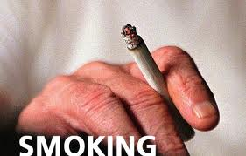
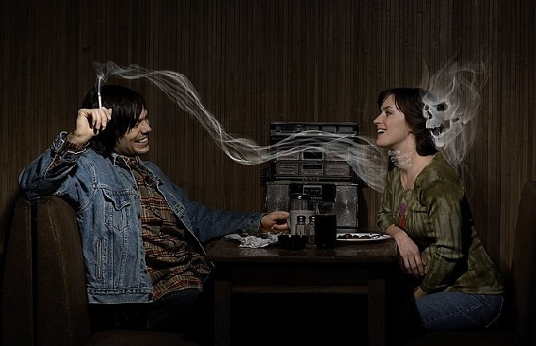
Types of Smoking
Conventional smoking
Passive ( secondhand) smoking

Slide 14
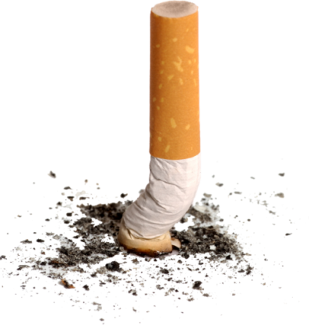
Third-hand smoke exposure — Third hand
smoke exposure refers to exposure to smoke components and their metabolic by-products from contact with surfaces that have adsorbed smoke. The smoke leaves a residue of nicotine and other toxic substances in household dust and on surfaces. Although not yet well studied, there is concern that contact with third hand smoke will result in absorption of toxins through the skin or ingestion from contamination of the hands.

Slide 15
Effect of Passive Smoking
What is passive smoking?
Passive smoking means breathing in other people’s tobacco smoke.
Exhaled smoke is called exhaled mainstream smoke.
The smoke drifting from a lit cigarette is called sidestream smoke.
The combination of mainstream and sidestream smoke is called second-hand smoke (SHS).

Slide 16
Effect of passive smoking on pregnancy and children

Slide 17
Effect of Passive Smoking on Pregnancy and Children
Kids are particularly at risk for the effects of secondhand smoke because their bodies are still growing and they breathe at a faster rate than adults.
Conditions have been linked to secondhand smoke exposure in children:
Sudden infant death syndrome (SIDS)
More respiratory infections (such as bronchitis and pneumonia)
More severe and frequent Asthma attacks
Ear infections
Chronic cough

Slide 18
Children & Secondhand Smoke
38% of children aged 2 months to 5 years are exposed to SHS in the home.
Up to 2,000,000 ear infections each year
Nearly 530,000 doctor visits for asthma
Up to 436,000 episodes of bronchitis in children under five
Up to 190,000 cases of pneumonia in children under five
Notes:
More upper respiratory infections
More bronchitis and pneumonia
More ear infections and hearing problems
Higher rate of SIDS
More cases of asthma
More severe symptoms in children who already have asthma

Slide 19
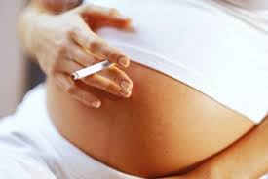
Effect of Passive Smoking on Pregnancy and Children
Smoking during pregnancy can lead to:
Premature delivery,
Low birth weight,
Sudden Infant Death Syndrome (SIDS),
Limited mental ability, trouble with learning.
The more cigarettes a mother-to-be smokes, the greater the danger to her baby causing 5 % of infant deaths and 10 % of preterm births.

Slide 20
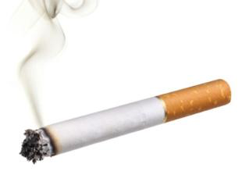
Types of smoking
Cigarettes: Cigarettes are uniform in size and contain less than 1g of tobacco each. They are made from different blends of tobaccos, and wrapped with paper.
Cigars
Most cigars are composed primarily of a single type of tobacco (air-cured and fermented), and they have a tobacco wrapper.
They can vary in size and shape and contain between 1 gram and 20 grams of tobacco.

Slide 21
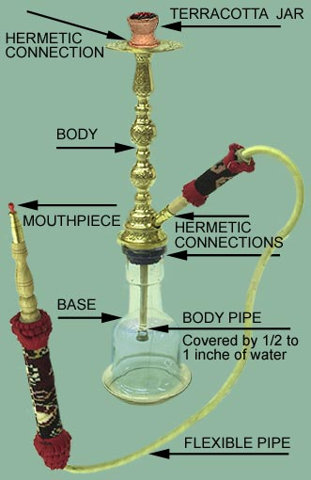
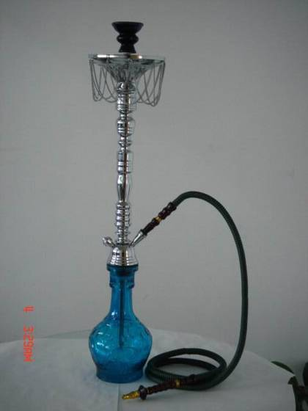
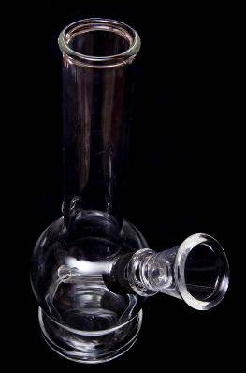
Water-Pipe: Sheesha
- Not safer than regular tobacco smoke.
- Causes the same diseases but more Polycythemia ( RBCs and Haemoglobin).
- Raises the risk of lip cancer, spreading infections like Tuberculosis.
- Users ingest about 100 times more lead from hookah (نرجيلة) smoke than from a cigarette.

Slide 23
How are you going to help the smoker to Quit and how to overcome withdrawal symptoms?

Slide 24
Management of smoking cessation

Slide 25
Control Measures
Surveillance is the key
Taxes
Health education
Picture warnings
Tobacco users need help to quit
Assess the Dependence first:
The time of the first cigarette at morning.
The number of cigarettes per day.

Slide 26
Why is it so hard to quit smoking?
Nicotine
Found naturally in tobacco, which is as addictive as heroin or cocaine.
Over time, a person becomes physically dependent on and emotionally addicted to nicotine.
◙ The physical dependence causes unpleasant withdrawal symptoms when you try
to quit.
◙ The mental dependence (addiction) make it hard to stay away from nicotine after
quit.

Slide 27
Why quit smoking now?
No matter how old or how long a person’s smoked, quitting can help live longer and be healthier.
People who stop smoking before age 50 cut their risk of dying in the next 15 years in half compared with those who keep smoking.
Ex-smokers enjoy a higher quality of life – they have fewer illnesses.

Slide 28
Why quit smoking now?
Immediate rewards of quitting smoking:
Breath smells better
Stained teeth get whiter
Bad smell in clothes and hair go away
Yellow fingers and fingernails disappear
Food tastes better
Sense of smell returns to normal
Everyday activities (such as climbing stairs or light housework) no longer leave them out of breath
They can be in smoke-free buildings without having to go outside to smoke.
Reduce the Cost
Social acceptance

Slide 29
Getting help with the Mental and Physical Addiction
Some people are able to quit on their own, without the help of others or the use of medicines. But for many smokers, it can be hard to break the social and emotional ties to smoking while getting over nicotine withdrawal symptoms at the same time.
Quit-smoking programs:
Tobacco Control Program; Ministry of Health (http://www.sa-tcp.com)
Purity Organization; Ministry of Social Affairs (http://naqa.org.sa/)
Support of family and friends:
Increase rate of quitting

Slide 30
KSA Tobacco Control Program937 http://www.tcpmoh.gov.sa/

Slide 32
Smoking Cessation Clinic in KSU

Slide 33
Withdrawal symptoms can include any of the following: Peak: first to second week where the relapse rate is high))
Dizziness (which may last 1 to 2 days after quitting)
Feelings of frustration, impatience, and anger
Depression, Anxiety, Tiredness and Irritability
Sleep disturbances
Trouble concentrating
Restlessness or boredom
Headaches
Increased appetite and Weight gain
Constipation and gas
Cough, dry mouth, sore throat, and nasal drip
Chest tightness

Slide 34
Dealing with smoking withdrawal
If someone’s been smoking for any length of time, smoking has become linked with a lot of the things in daily life – waking up in the morning, eating, reading, watching TV, and drinking coffee, for example.

Slide 35
Tips to overcome withdrawal symptoms
Avoid temptation. Stay away from people and places that tempt you to smoke.
Change your habits. Switch to juices instead of coffee. Take a brisk walk instead.
Choose other things for your mouth: such as sugarless gum or hard candy, raw vegetables such as carrot.
Get active with your hands: Do something to reduce your stress like Exercise or keeps your hands busy.

Slide 36
Tips to overcome withdrawal symptoms
Breathe deeply: as you inhaled the smoke.
Delay: If you feel that you’re about to light up, hold off. Tell yourself you must wait at least 10 minutes.
Reward yourself. Put the money you would have spent on tobacco in a jar every day and then buy yourself a gift.

Slide 37
Five Major Steps to Quit (The "5 A's")
Ask - about tobacco use for every patient at every visit.
Advise - every tobacco user to quit.
Assess - are you willing to quit smoking.
Assist - use counseling and pharmacotherapy to help him or her quit.
Arrange - Schedule follow up contact after the quit date.

Slide 38
Electronic Cigarette
An electronic cigarette or electronic Nicotine delivery system (ENDS) is a battery-powered vaporizer which has a similar feel to tobacco smoking.
Electronic cigarettes do not contain tobacco, although they do use nicotine from tobacco plants. They do not produce cigarette smoke but rather an aerosol, which is frequently but inaccurately referred to as vapor.

Slide 39
E-cig in Smoking Cessation
As of 2014, research on the safety and efficacy of e-cigarette use for smoking cessation is limited.
Their benefit in helping people quit smoking is uncertain.
A 2014 Cochrane review found that e-cigarettes can help people quit, but was based on a small number of studies.
Two 2014 reviews found no evidence that e-cigarettes are more effective than existing nicotine replacement treatments for smoking cessation.

Slide 41
Bahammam AS. Electronic vaping: Is it harmless or a snake in the grass? J Nat Sci Med 2019;2:183-5.

Slide 42
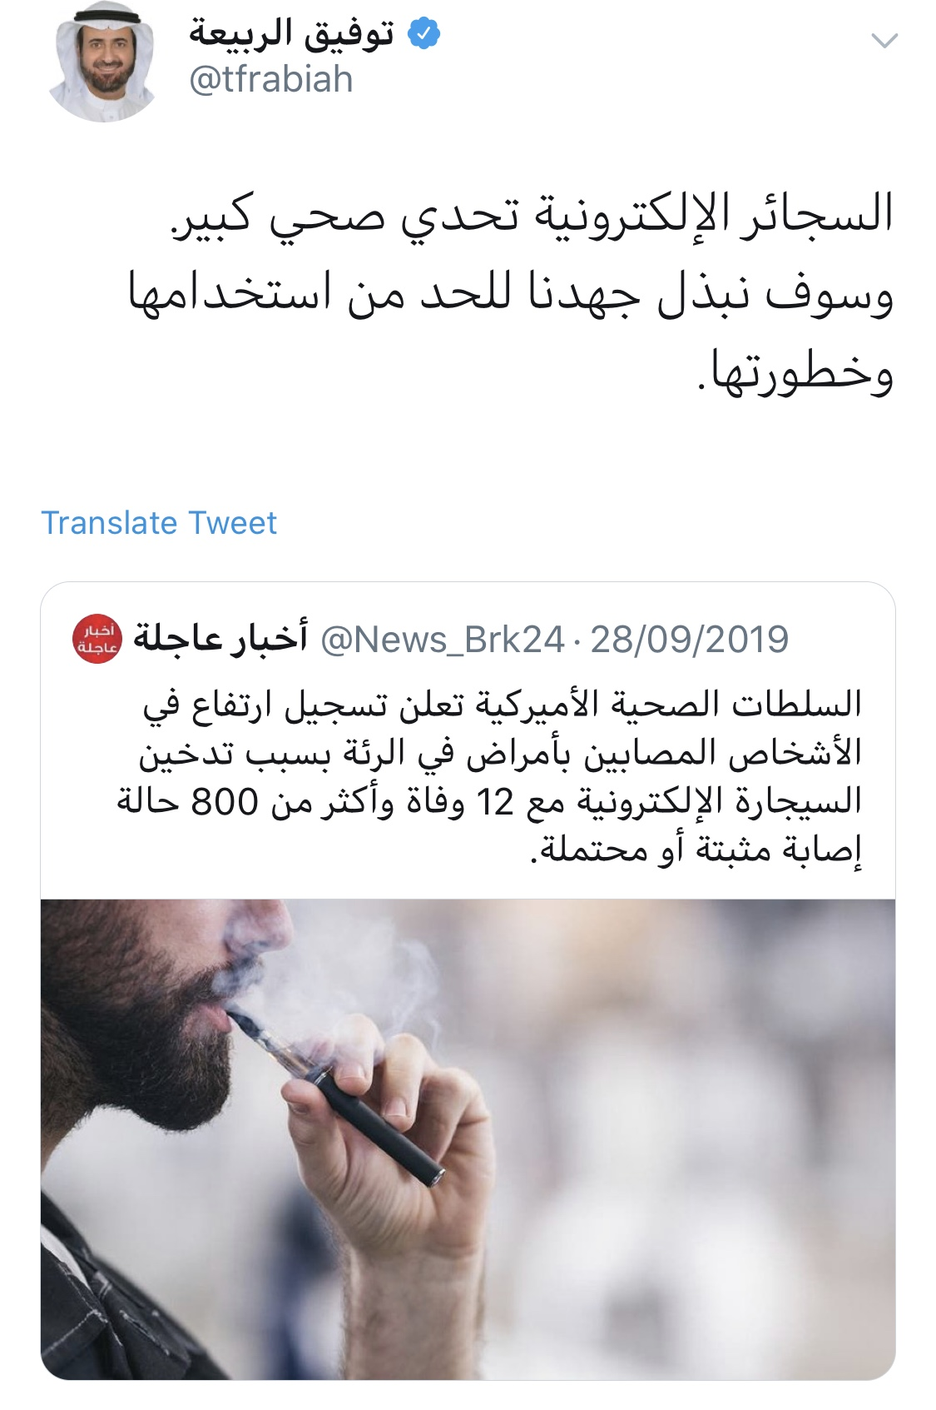

Slide 43
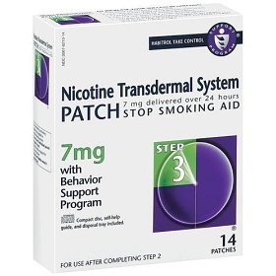
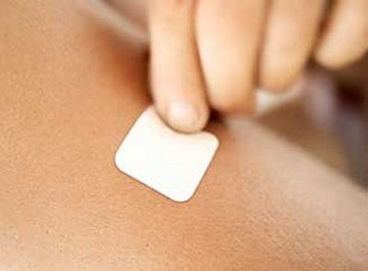
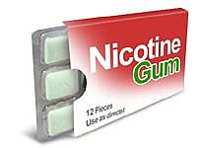
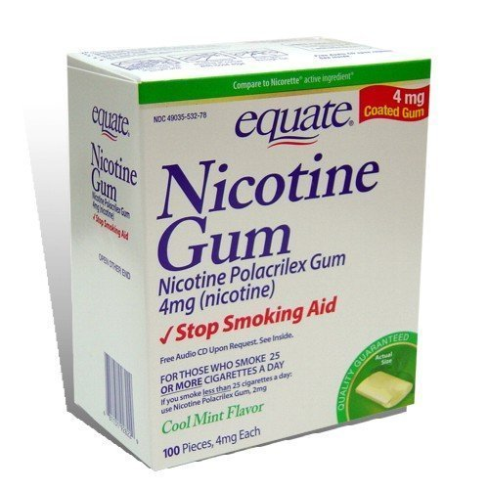
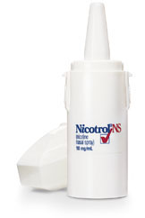
Nicotine Replacement Therapy (NRT)
Nicotine Patch
Nicotine Gum
Nicotine Inhaler
(Deliver Nicotine Fast)
Nicotine Nasal Spray

Slide 44
Nicotine Replacement Therapy (NRT)
The goal of nicotine replacement therapy (NRT) is to provide nicotine to a smoker without using tobacco, thereby relieving nicotine withdrawal symptoms as the smoker breaks the behavior of cigarette smoking.
The initial dosing of most NRT products is based on the number of cigarettes smoked daily.

Slide 45
Nicotine Replacement Therapy (NRT)
Transdermal Nicotine Patch:
The nicotine patch is the simplest NRT product for a smoker to use and provides the most continuous nicotine delivery of all NRT products.
The patch has a long-acting, slow-onset pattern of nicotine delivery, producing relatively constant withdrawal relief over 24 hours.
Compliance with the patch is high.
The patch is available over the counter.

Slide 46
Nicotine Replacement Therapy (NRT)
Starting on the quit day, patients who smoke >10 cigarettes/day
use the highest dose of the nicotine patch (21 mg/day) for 4 to 6 weeks,
followed by 14 mg/day for two weeks,
and finish with 7 mg/day for two weeks.
Smokers who weigh less than 45 kg or smoke ≤10 cigarettes per day are advised to begin with the 14 mg/day strength for six weeks, followed by 7 mg/day for two weeks.
To use the nicotine patch, the smoker applies one patch each morning to any non-hairy skin site. It is removed and replaced with a new patch the next morning.

Slide 47
Nicotine Replacement Therapy (NRT)
Nicotine gum:
Nicotine gum is one of the most commonly used short-acting NRT.
Chewing the gum releases nicotine that is absorbed through the oral mucosa, resulting in a peak of blood nicotine levels 20 minutes after starting to chew.
The 4 mg dose of gum is recommended for smokers who smoke ≥ 20 cigarettes per day, whereas the 2 mg dose is recommended for lighter smokers.
They can chew one piece of gum every 1 to 2 hours for six weeks, with a gradual reduction over a second six weeks, for a total duration of three months.
Acidic beverages (e.g, coffee) should be avoided before and during gum use, as acidic beverages lowers oral pH, causing reducing nicotine absorption.

Slide 48
Bupropion
Bupropion inhibits the uptake of norepinephrine, serotonin, and dopamine → reduce the urge of smoking and improve the mood so good in cases of depression.
The quit date should be set for one to two weeks after bupropion therapy is initiated.
Bupropion therapy is usually continued for eight to 12 weeks after the patient has quit smoking.
Contraindications:
A history of seizure disorder
The presence of eating disorders.
Uncontrolled hypertension

Slide 49
Varenicline (Champix / Chantix)
Varenicline:
It blocks the nicotine in tobacco smoke from binding to the receptor, thereby reducing the rewarding aspects of cigarette smoking.
It results in moderate levels of dopamine in the terminal synapse.
It reduces the withdrawal symptoms.
It increases the chances of a successful quit attempt two- to three fold compared with non pharmacologic assistance.
Varenicline is superior to bupropion in promoting abstinence.
There is increased risk of coronary events with varenicline

Slide 51
References
1-http://who.int/tobacco/surveillance/policy/country_profile/sau.pdf?ua=1
2-http://www.cdc.gov/tobacco/data_statistics/fact_sheets/health_effects/effects_cig_smoking/
3- http://www.betterhealth.vic.gov.au/bhcv2/bhcarticles.nsf/pages/Passive_smoking
4-http://www.cancer.org/%20healthy/stayawayfromtobacco/guidetoquittingsmoking/index
5- http://www.uptodate.com/contents/image?imageKey=PC%2F74402&topicKey=PC%2F6920&source=see_link&utdPopup=true
6-http://www.uptodate.com/contents/behavioral-approaches-to-smoking-cessation#H335652334
7-http://www.aafp.org/dam/AAFP/documents/patient_care/tobacco/AAFPStopSmokeGuide2012.pdf
8-http://www.medscape.com/viewarticle/559955_3

Slide 52
THANK YOU

