Slide 1
Oxygen and Carbon dioxide Transport
Dr.Aida Korish
Associate Prof.PHysiology

Slide 2
Objectives
Understand the forms of oxygen transport in the blood, the importance of each.
Differentiate between O2 capacity, O2 content and O2 saturation.
Describe (Oxygen- hemoglobin dissociation curve)
Define the P50 and its significance.
Explain how DPG, temperature, H⁺ ions and PCO₂ affect affinity of O₂ for Hemoglobin and the physiological importance of these effects.
Describe the three forms of carbon dioxide that are transported in the blood, and the chloride shift.

Slide 3
Forms of O2 transport
The presence of hemoglobin ( Hb) in the red blood cells allows the blood to transport 30 to 100 times as much oxygen as could be transported in the form of dissolved oxygen in the water of the blood.

Slide 4
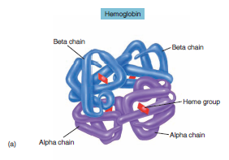
Transport of O2 and CO2 in the blood and body fluids
O₂ is mostly transported in the blood bound to hemoglobin
If the PO2 increases Hb binds O₂
If PO₂ decreases Hb releases O₂
O2 binds to the heme group on hemoglobin, with 4 oxygens per /Hb molecule.

Slide 5
Terminology
O₂ content: The amount of O₂ in blood (ml O₂/100 ml blood)
O₂-binding capacity: The maximum amount of O₂ that can bind to hemoglobin (ml O₂/100 ml blood) measured at 100% saturation.
The Percentage saturation of Hb: % of heme groups bound to O₂
% saturation of Hb = oxygen content x 100
oxygen capacity
The dissolved O_{2:} The O2 not bound to Hb in blood (ml O₂/100 ml blood) e.g the O2 dissolved in the plasma.

Slide 6
Cont…transport of oxygen in arterial blood
When the Hb of the blood is 100% saturated with O2: each gram of Hb carries 1.34 ml O2
So if an adult has 15 g Hb/100 ml (dl) blood.
His O2 content = 15 g of Hb x 1.34 O2 = 20 ml/ 100 ml blood (dl).
But when the blood is only 97% saturated with O2:each 100 ml blood contain 19.4 ml O2).
Amount of oxygen released from the hemoglobin to the tissues is 5 ml O2 per each 100 ml blood.
So O2 content in venous blood at rest =19.4 ml - 5 ml = 14.4 ml.
During strenuous exercise the oxygen uptake by the tissues increases 3 folds so 15 ml O2 is taken by the tissues from each dl of blood. So O2 content in venous blood =19.4-15 = 4.4 ml O2/dl
At rest the tissues consume 250 ml O2 /min and produce 200 ml CO2

Slide 7
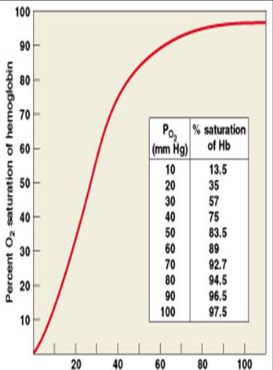
Forms of Oxygen transported in Blood
3% is dissolved in plasma
97% is bound to hemoglobin (oxyhemoglobin)
The higher PO2₂ results in greater Hb saturation with O2.
The relationship between PO2 and % Hb-O2 is not linear .
The curve is called Oxyhemoglobin Saturation Curve or (O2-Hb- dissociation curve)
Which is S- shaped or sigmoid

Slide 8
Oxygen-hemoglobin Dissociation Curve

Slide 9
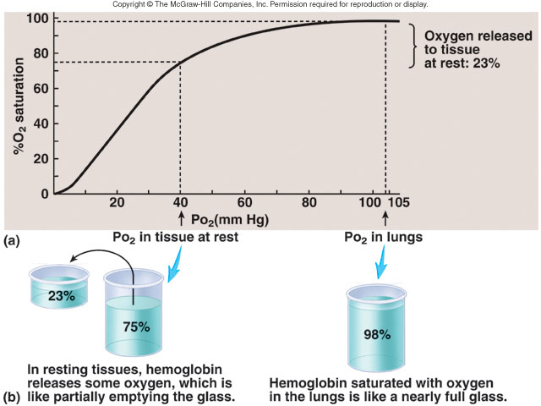

Slide 10
Factors that shift the O2-Hb dissociation curve
The position of the dissociation curve can be determined by measuring the P50
P50:The arterial PO2 at which 50% of the Hb is saturated with O2,
normally P50 = 26.5 mmHg
Decreased P50 means increased affinity of Hb to O2 or shift of the curve to left.
Increased P50 means decreased affinity or shift of the curve to right.

Slide 11
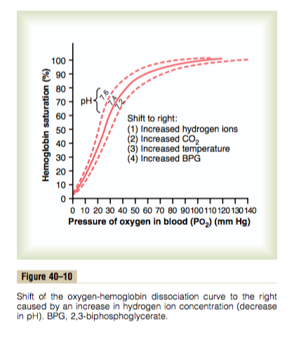
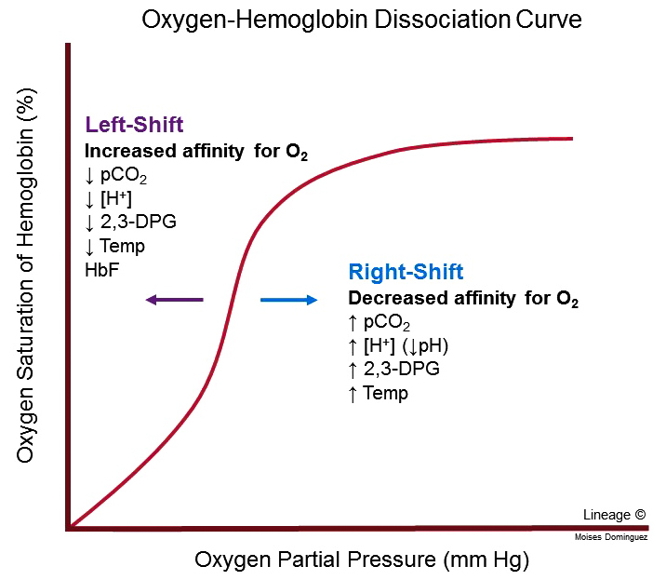
Shift of the Oxygen–Hb Dissociation Curve

Slide 12
Rt and Lt shifts: of the O2-Hb dissociation curve
Rt shift means the oxygen is unloaded (released) to the tissues from Hb, while Lt shift means loading or attachment of oxygen to Hb.
Increased 2,3DPG, H+, Temperature , PCO2 shift the curve to right.
2,3DPG is synthesized in RBCs from the glycolytic pathway , it binds tightly to reduced Hb. increased 2,3 DPG facilitate the oxygen release and shifts the dissociation curve to Rt.
2,3 DPG increases in the RBCs in anemia and hypoxemia, and thus serves as an important adaptive response in maintaining tissue oxygenation
Fetal Hb: has a P50 of 20 mmHg in comparison to 27 mmHg of adult Hb.

Slide 13
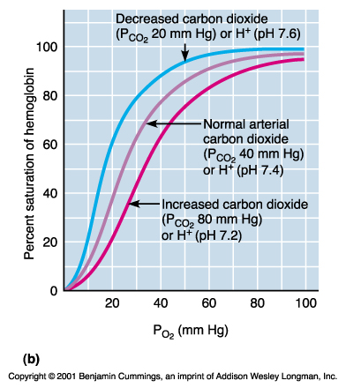
Bohr Effect
Effect of carbon dioxide and hydrogen ions on the curve ( Bohr effect) At tissues: Increased CO2 and H+ ions produced by the tissues during metabolism will shift the curve to the RT and helps release ( unloading) of O2 from Hb to the tissues.
At lung the reverse will occur : diffusion of CO2 from blood to alveoli will decrease blood CO2 &H+ →shift the curve to left and increases O2 affinity to Hb allowing more O2 transport to tissues

Slide 14
Shift of dissociation curve during exercise
Exercise increases Temp, H+, 2,3 DPG and shifts the curve to Rt.
Utilization Coefficient The percentage of the blood that gives up its oxygen as it passes through the tissues capillaries is called utilization coefficient.
= O2 delivered to the tissues
O2 content of arterial blood
Normally at rest = 5ml/20 ml= 25% ,
during exercise it = 15 ml/20 ml= 75 % - 85%

Slide 15
Transport of oxygen in the dissolved state.
Only 3% of O2 is transported in the dissolved state,
At normal arterial PO2 of 95 mmHg , about 0.29 ml of oxygen is dissolved in each 100ml of blood.
When the PO2 of the blood falls to 40 mmHg in tissue capillaries, only 0.12 of oxygen remains dissolved.
Therefore 0.17 ml of oxygen is normally transported in the dissolved state to the tissues per each 100 ml of blood.
Importance of dissolved O2 :
The dissolved O2 determines the PO2 in the blood
It s the form of oxygen used directly by the tissues.

Slide 16
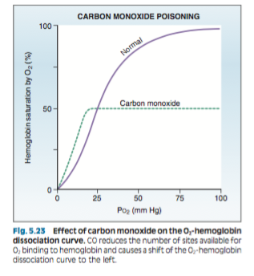
Combination of Hb with carbon monoxide (CO) - displacement of oxygen
CO combines with Hb at the same point on the Hb molecule as does oxygen,
It binds with Hb about 250 times as much as O2 (affinity of Hb to CO is very high (250 times) that to O2.It causes Lt shift of the O2-Hb curve.

Slide 17
Pulse Oximetry
Measures % saturation of arterial blood (e.g., of the finger) using dual-wavelength spectrophotometry.
Because oxyhemoglobin and deoxyhemoglobin have different absorbance characteristics, the machine calculates % saturation from absorbance at two different wavelengths.
Pulse oximetry does not directly measure PaO2. However, knowing % saturation, one can estimate PaO2 from the O2-hemoglobin dissociation curve.

Slide 18
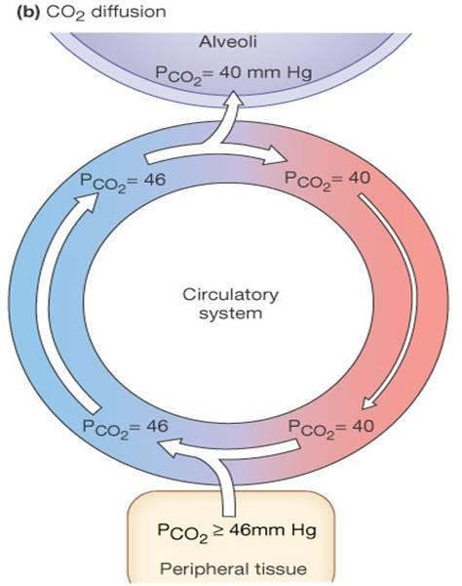
Transport of carbon dioxide in the blood
Carbon dioxide is transported in three forms.
Dissolved CO2 7% ( this determines the PCO2 in blood)
Bicarbonate ions (HCO3)70 %
Carbaminohemoglobin ( CO2 combined with Hb) 23%.
Each 100 ml of blood carry 4 ml of CO2 from the tissues.

Slide 19
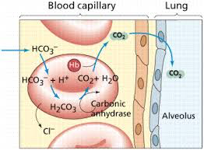
Formation of HCO3_ & Chloride shift
In Tissues
In Pulmonary capillaries

Slide 20
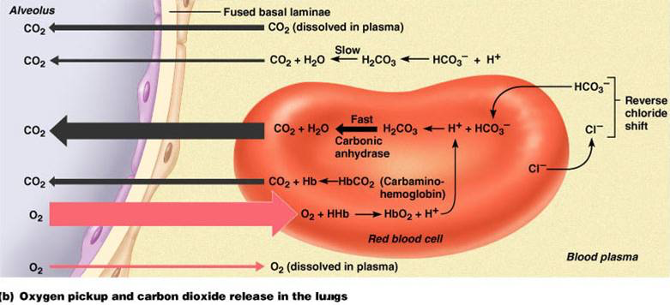
The Haldane effect
When oxygen binds with hemoglobin at the lungs , CO2 is released into the alveoli- to increase CO2 transport
Binding of Hb with O2 at the lung causes the Hb to become a stronger acid and , this in turn displaces CO2 from the blood and into the alveoli
Change in blood acidity during CO2 transport.
Arterial blood has a PH of 7.41 that of the venous blood with higher PCO2 falls to 7.37 ( i.e change of 0.04 unit takes place)

Slide 21
Respiratory Exchange ratio (Respiratory Quotient)
R= Rate of carbon dioxide output
Rate of oxygen uptake
Normally it is 4/5= 82%
When Carbohydrate diet is used R = 1
When fats only is used R = 0.7
A person on normal diet R = 0.825
The reason for this difference is that when O2 is metabolized with carbohydrates, one molecule of CO2 is formed for each molecule of O2 consumed; when O2 reacts with fats, a large share of the O2 combines with hydrogen atoms from the fats to form water instead of CO2.

