Slide 1
MUSCLES INVOLVED IN RESPIRATION
Prof. Ahmed Fathalla Ibrahim
Professor of Anatomy
College of Medicine
King Saud University
E-mail: ahmedfathala@gmail.com

Slide 2
OBJECTIVES
At the end of the lecture, students should:
Describe the components of the thoracic cage and their articulations.
Describe in brief the respiratory movements.
List the muscles involved in inspiration and in expiration.
Describe the attachments of each muscle to the thoracic cage and its nerve supply.
Describe the origin, insertion, nerve supply of diaphragm.

Slide 3
THORACIC CAGE
Vertebra
Rib

Slide 4
THORACIC CAGE
Conical in shape
Has 2 apertures (openings):
Superior (thoracic outlet): narrow, open, continuous with neck
Inferior: wide, closed by diaphragm
Formed of:
Sternum & costal cartilages: anteriorly
Twelve pairs of ribs: laterally
Twelve thoracic vertebrae: posteriorly

Slide 5
ARTICULATIONS
Costovertebral
Manubriosternal
Intervertebral
disc
Costochondral
Sternocostal
Xiphisternal

Slide 6
ARTICULATIONS
Costovertebral
Sternocostal
Costochondral
Interchondral

Slide 7
ARTICULATIONS
Secondary cartilaginous: Manubriosternal joint, Xiphisternal joint and Intervertebral discs.
Primary cartilaginous: 1st Sternocostal joint, Costochondral joints and Interchondral joints.
Plane synovial joints: Costovertebral joints and the rest of Sternocostal joints.

Slide 9
RESPIRATORY MOVEMENTS A- MOVEMENTS OF DIAPHRAGM
Inspiration
Contraction (descent) of diaphragm
Increase of vertical diameter
of thoracic cavity
Relaxation (ascent)
of diaphragm)
Expiration

Slide 10
RESPIRATORY MOVEMENTS B- MOVEMENTS OF RIBS
PUMP HANDLE MOVEMENT
Elevation of ribs
Increase in antero-posterior diameter of thoracic cavity
BUCKET HANDLE MOVEMENT
Elevation of ribs
Increase in lateral diameter of thoracic cavity

Slide 11
INSPIRATORY MUSCLES
Diaphragm (most important muscle)
Rib elevators: external intercostal muscles
Accessory muscles (only during forced inspiration), such as:
Muscles attaching cervical vertebrae to first & second rib: scalene muscles
Muscles attaching thoracic cage to upper limb: pectoralis major, pectoralis minor, serratus anterior.
Muscles attaching thoracic cage to skull: sternocleidomastoid.

Slide 12
ORIGIN OF DIAPHRAGM
1) Costal: lower 6 costal cartilages
3) Sternal: xiphoid process of sternum
2) Vertebral: upper 3 lumbar vertebrae
(right & left crus + arcuate ligaments)
Lateral arcuate ligament:
connects 1st lumbar
vertebra to last rib
Medial arcuate
ligament:
connects each crus
to 1st lumbar vertebra
Lateral arcuate ligament
Medial arcuate ligament
Lateral arcuate ligament
Median arcuate ligament:
connects right & left crus
Posterior view
B. Posterior view

Slide 13
INSERTION OF DIAPHRAGM (CENTRAL TENDON)

Slide 14
DIAPHRAGM
A musculotendinous partition between thoracic & abdominal cavity.
Convex toward thoracic & concave toward abdominal cavity.
Attached to: sternum, costal cartilages,12th rib & lumbar vertebrae.
Fibers converge to join the central tendon.
Nerve supply: phrenic nerve (C3,4,5), penetrates diaphragm & innervates it from abdominal surface
Action: contraction (descent) of diaphragm increase vertical diameter of thoracic cavity (essential for normal breathing).

Slide 15
MAJOR OPENINGS OF DIAPHRAGM
Aortic opening (hiatus):
Level: T12.
Site: between right & left crus.
Structures passing through it: Aorta, azygos vein & thoracic duct.
Esophageal opening (hiatus):
Level: T10.
Site: in the right crus.
Structures passing through it: Esophagus, right & left vagus nerves, esophageal branches of left gastric artery and corresponding veins.
Inferior vena caval opening (hiatus):
Level: T8.
Site: in the central tendon.
Structures passing through it: IVC, right phrenic nerve, lymphatics.

Slide 16
EXTERNAL INTERCOSTAL
Attachments: from lower border of rib above to upper border of rib below
Direction of fibers: downward & medially
Nerve supply: intercostal nerves
Action: rib elevators (inspiratory)

Slide 17
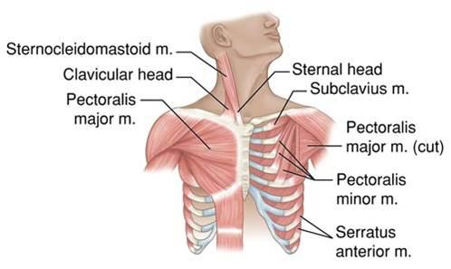
ACCESSORY MUSCLES OF INSPIRATION

Slide 18
SCALENE MUSCLES
5- Scalenus anterior
6. Scalenus medius
7. Scalenus posterior
Origins: cervical vertebrae
Insertions: 1st rib (scalenus anterior and medius) & 2nd rib (scalenus posterior)
Action: elevate 1st & 2nd ribs (inspiratory)
Cervical vertebrae
1st rib
2nd rib

Slide 19
STERNOCLEIDOMASTOID
Origin:
Sternal head: front of manubrium sterni.
Clavicular head: medial 1/3 of clavicle.
Insertion: mastoid process.
Action: elevates the manubrium.

Slide 20
PECTORALIS MAJOR
Action: increases antero-posterior diameter of thoracic cavity, when arm is fixed (inspiratory)
Origin: clavicle + sternum + costal cartilages
Insertion: humerus

Slide 21
EXPIRATORY MUSCLES
Act only during forced expiration
Rib depressors:
Internal intercostal
Innermost intercostal
Subcostals
Transversus thoracis
Anterior abdominal wall muscles:
External oblique
Internal oblique
Transversus abdominis
Rectus abdominis

Slide 22
RIB DEPRESSORS: REST OF INTERCOSTAL MUSCLES
1. Internal intercostal
2. Innermost intercostal
Direction: backward & laterally
3. Subcostal
4. Transversus thoracis (sternocostalis)
Nerve supply: intercostal nerves (ventral rami of T1-T11)

Slide 23
ANTERIOR ABDOMINAL WALL
External oblique (outer layer)
Direction: downward & medially
Internal oblique (middle layer)
Direction: upward & medially
Linea
alba

Slide 24
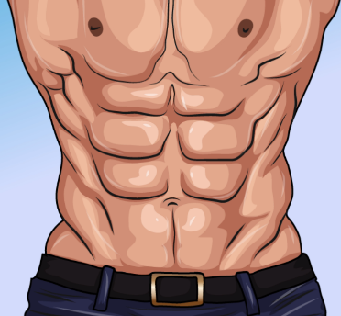
ANTERIOR ABDOMINAL WALL
Transversus abdominis (inner layer)
Direction: transverse
Rectus abdominis
Direction: vertical
Rectus abdominis
Transversus abdominis

Slide 25
Anterior abdominal wall
Is formed of 3 layers of muscles of fibers running in different directions (to increase strength of anterior abdominal wall)
The 3 muscles form a sheath in which a fourth muscles lies (rectus abdominis)
Muscles are attached to: sternum, costal cartilages and ribs + hip bones
The aponeurosis of the 3 muscles on both sides fuse in the midline to form linea alba
Action (during forced expiration): Compression of abdominal viscera to help in ascent of diaphragm (during forced expiration)
Nerve supply: lower 5 intercostal nerves (T7 – T11), subcostal nerve (T12) and first lumbar nerve.

Slide 26
SUMMARY OF RESPIRATORY MOVEMENTS
Inspiration
Expiration
Quiet Inspiration (active)
Quiet Expiration (passive)
Elastic recoil of lung
Relaxation of diaphragm & external intercostal
Forced Expiration (active):
Contraction of anterior Depression of ribs
abdominal wall muscles (rest of intercostal
muscles)
Compression of abdominal
viscera
Ascent of diaphragm
Contraction (Descent) Elevation of ribs
of diaphragm (external intercostal)
Increase in vertical Increase in:
diameter - anteroposterior
diameter
- lateral diameter
Forced Inspiration (active)
Accessory muscles of inspiration:
Pectoralis major
Scalene muscles

Slide 27
QUESTIONS
Are the following muscles have a respiratory role? If yes, what is it?
Levatores costarum.
Serratus posterior superior.
Serratus posterior inferior.
Pectoralis minor.
Serratus anterior.
Latissimus dorsi.
Quadratus lumborum.
Why diaphragm is supplied by cervical nerves?
Why right crus of diaphragm is larger than left crus?

Slide 28
THANK YOU

